Slide 1
Lossy Image Compression
DCT and Scalar Quantization
Marcus Windmark, Dec 25 -14
Data Compression, NTNU

Slide 2
Outline of the Project
Lossy image compression
8 bit grayscale images

Slide 3
Choice of Algorithms
Adaptive Huffman Coding
Discrete Cosine Transform
Scalar Quantization

Slide 4
General Encoding Algorithm
Convert image into N * N tiles
Perform forward DCT on all tiles
Scalar Quantize all tiles
Encode using Adaptive Huffman

Slide 5
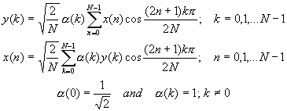
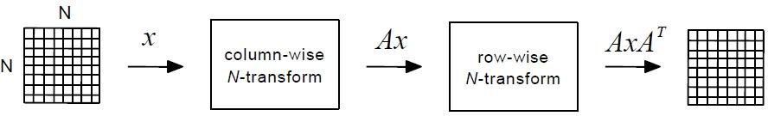
Implementation - DCT(1)

Slide 6
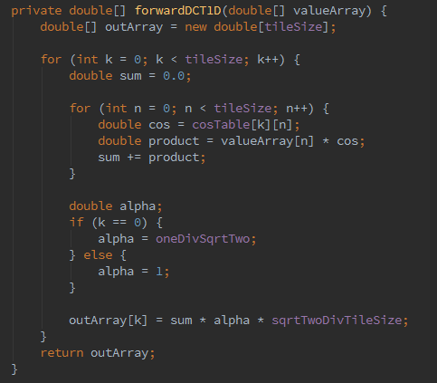
Implementation - DCT(2)

Slide 7
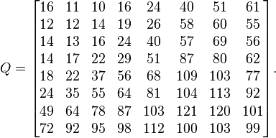
Implementation
- Scalar Quantization(1)
Sample JPEG Quantization Table (show)

Slide 8
Implementation
- Scalar Quantization(2)
Sample JPEG Quantization Table (show)
Zig-zag scanning
Encoding removes trailing zeroes

Slide 9
Obstacles and Solutions
Negative values with Huffman coding
Solution: Extend bit size from 0-256 to 0-253 and convert
Too large value interval by Inverse DCT
Solution: Normalize to 0 and 255 respectively

Slide 10
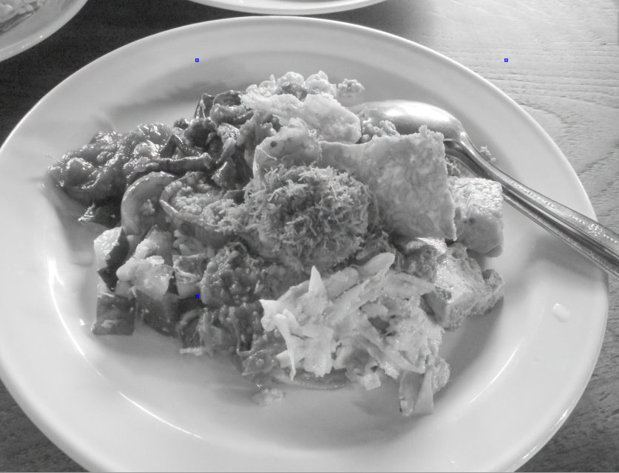
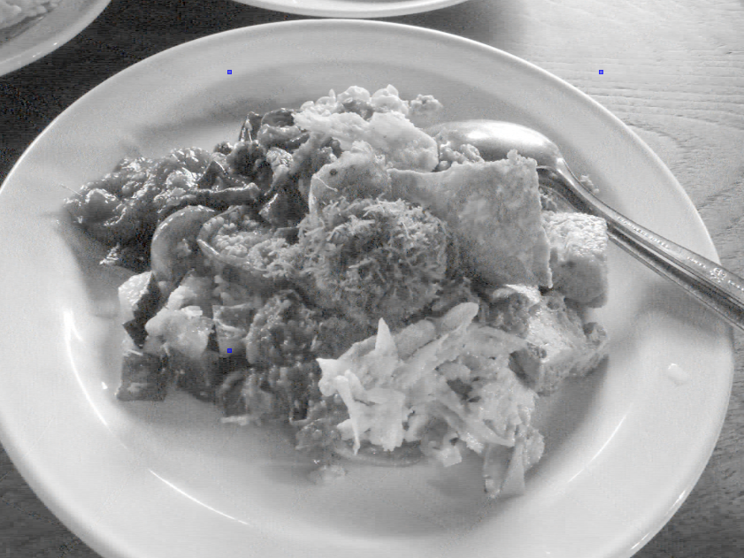
Result
Original image
Coded image

Slide 11
Result - Measurements
Image | Raw Size | Lossy Size | Compression Ratio | Space Saving | SNR | Encoding time | Decoding time
1 | 1920000 | 383654 | 5.00 | 80.02% | 26.84 | 836 | 825
2 | 1920000 | 266754 | 7.20 | 86.11% | 17.73 | 848 | 780
3 | 1920000 | 317213 | 6.05 | 83.48% | 27.88 | 785 | 777
4 | 1920000 | 310056 | 6.19 | 83.85% | 26.27 | 807 | 773
5 | 1920000 | 867319 | 2.21 | 54.83% | 18.00 | 973 | 859

Slide 12
Result - Compared to Lossless
Image | Raw Size | Lossy Size | CR | Lossless Size | CR | Space Saving
1 | 1920000 | 383654 | 5.00 | 1802687 | 1.065 | 6.11%
2 | 1920000 | 266754 | 7.20 | 1272218 | 1.509 | 33.74%
3 | 1920000 | 317213 | 6.05 | 1566242 | 1.226 | 18.42%
4 | 1920000 | 310056 | 6.19 | 1488520 | 1.290 | 22.47%
5 | 1920000 | 867319 | 2.21 | 1921055 | 0.999 | -0.05%

Slide 13
Questions?

