Slide 1
Project 1 Lossless Compression

Slide 2

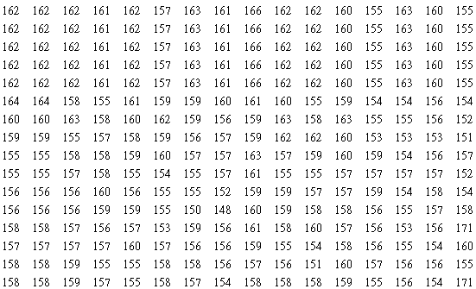
Project #1: Lossless compression for gray-scale images
16
512
16
A raw gray-scale image
512*512 uint8 (0 - 255)
512
Stored in a file row by row, no header information

Slide 3
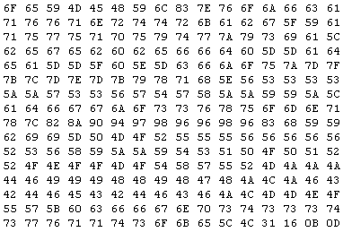
Input
Example: test1.raw
Notes:
6F -> 111
4D -> 77

Slide 4
Project #1
Goal: Design a lossless codec for gray-scale images
Five raw images, and each has a resolution of 1600 (width) and 1200 (height)
http://www.csie.ntnu.edu.tw/~myeh/courses/dc/Assignments/project1_data.zip

Slide 5
Project#1
Design choices
Algorithms introduced in class
Huffman code, arithmetic code, dictionary-based approaches and etc.
Your own design

Slide 6
Project #1
Please perform comparisons on methods!
Your codec
Commercial tools (e.g. 7-Zip, WinZip, WinRAR)

Slide 7
Project #1
Upload your package on moodle by October 23 that includes
presentation slides
programs
table statistics (if any)
Example: Huffman_Table.txt
Symbol Probability Codeword
Be prepared to talk to us in English about:
your implementation of the compression program
experimental results

Slide 8
Example
Usage: program [model file] input_file_name output_file_name
>> Encode.exe huff.txt test1.raw test1.enc
>> Decode.exe huff.txt test1.enc test1_reconstruction.raw
Please report
Compression rate (raw file vs. compressed file)
Speed of your encoder / decoder

Slide 9
Questions?
Start Early!

