Slide 1
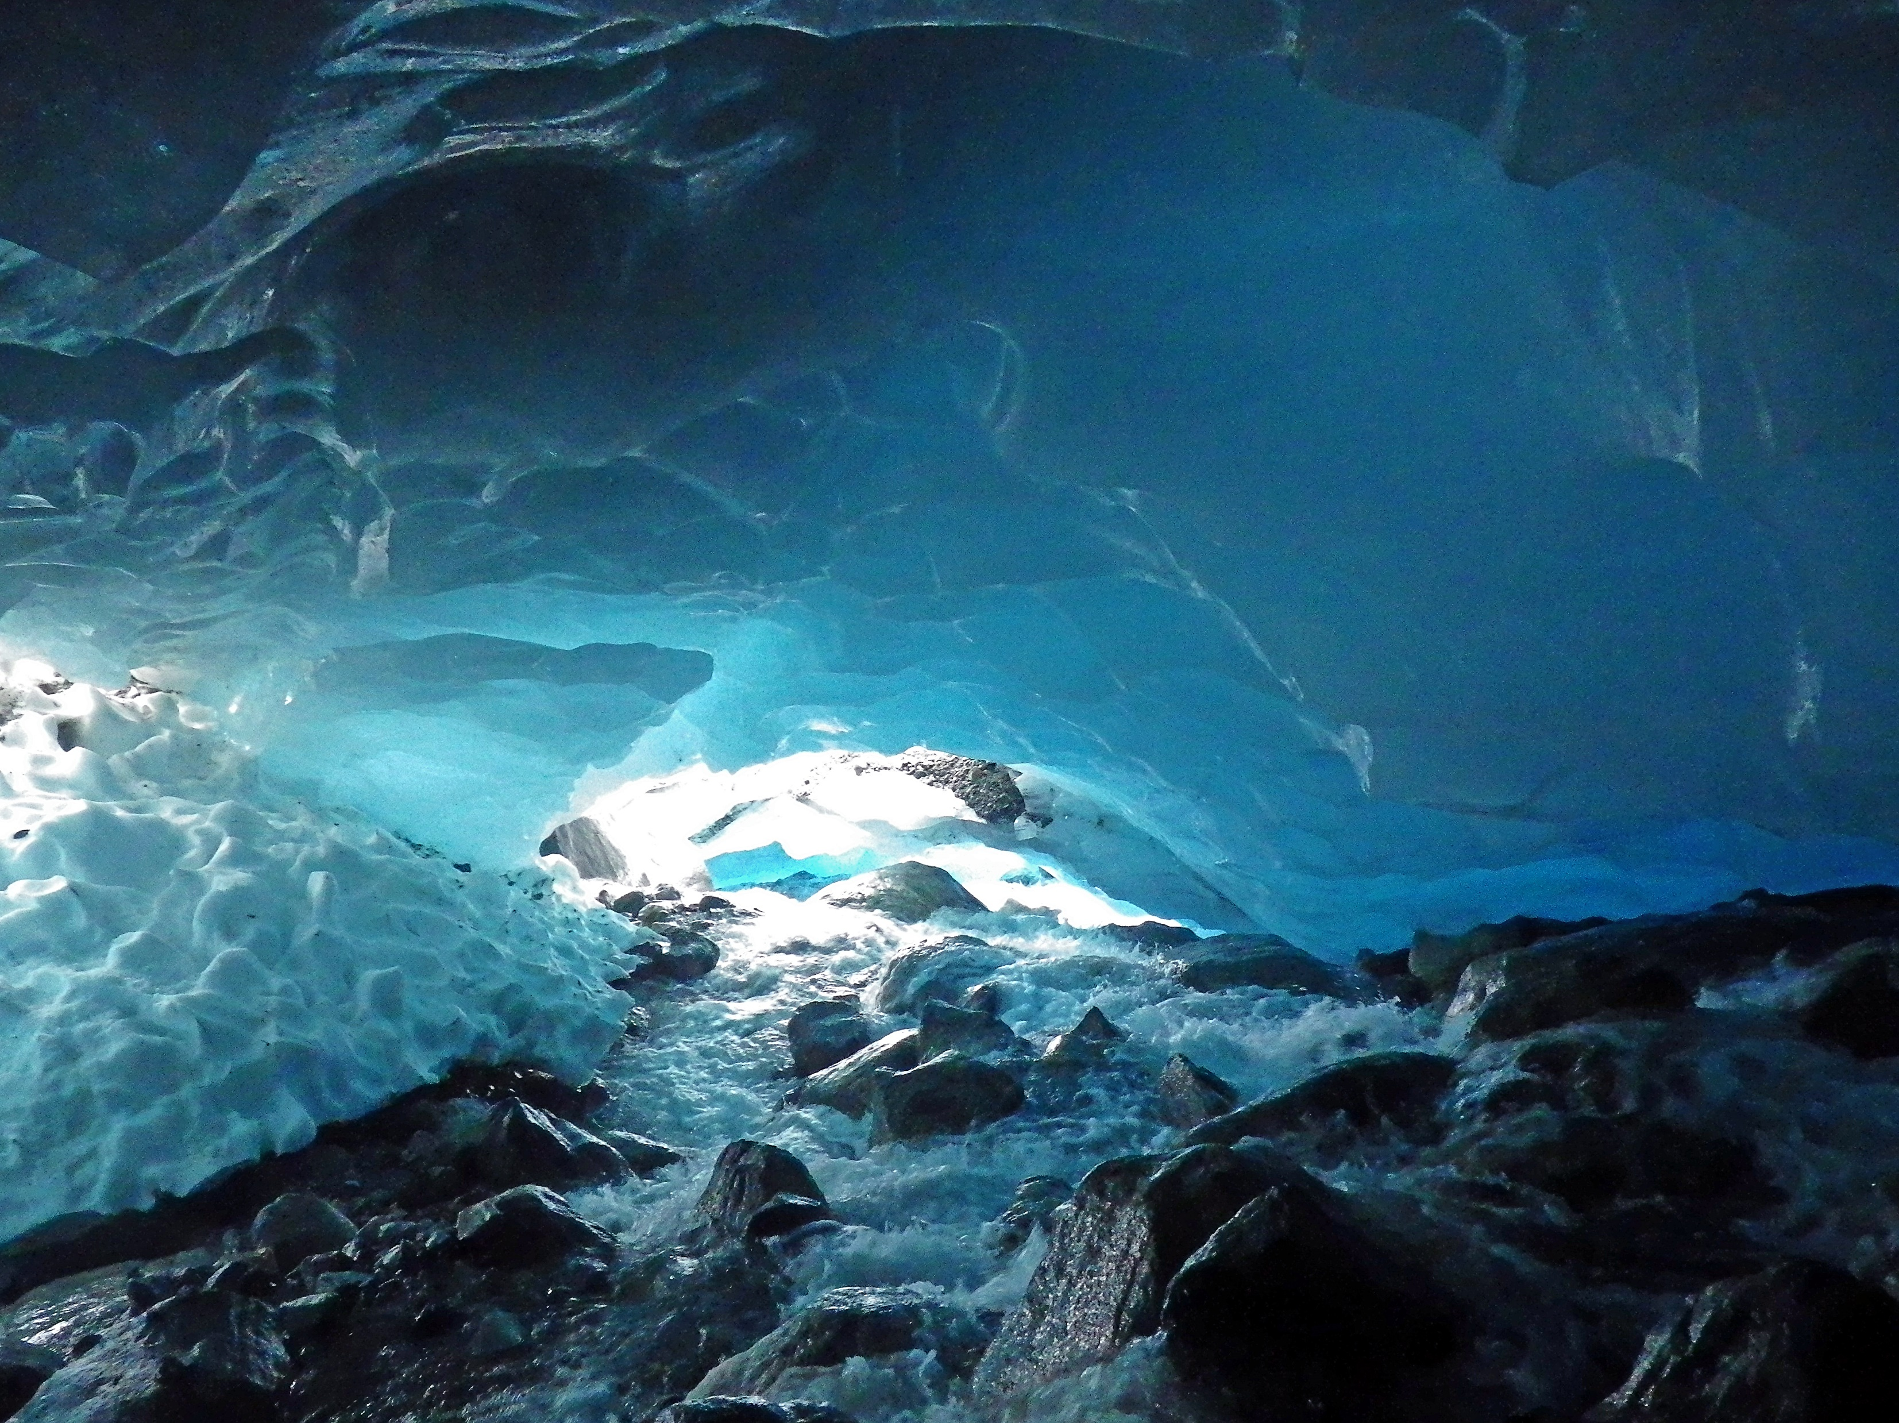
Global analysis of glaciers
Ann Windnagel
Geog 5663, spring 2019

