Slide 1
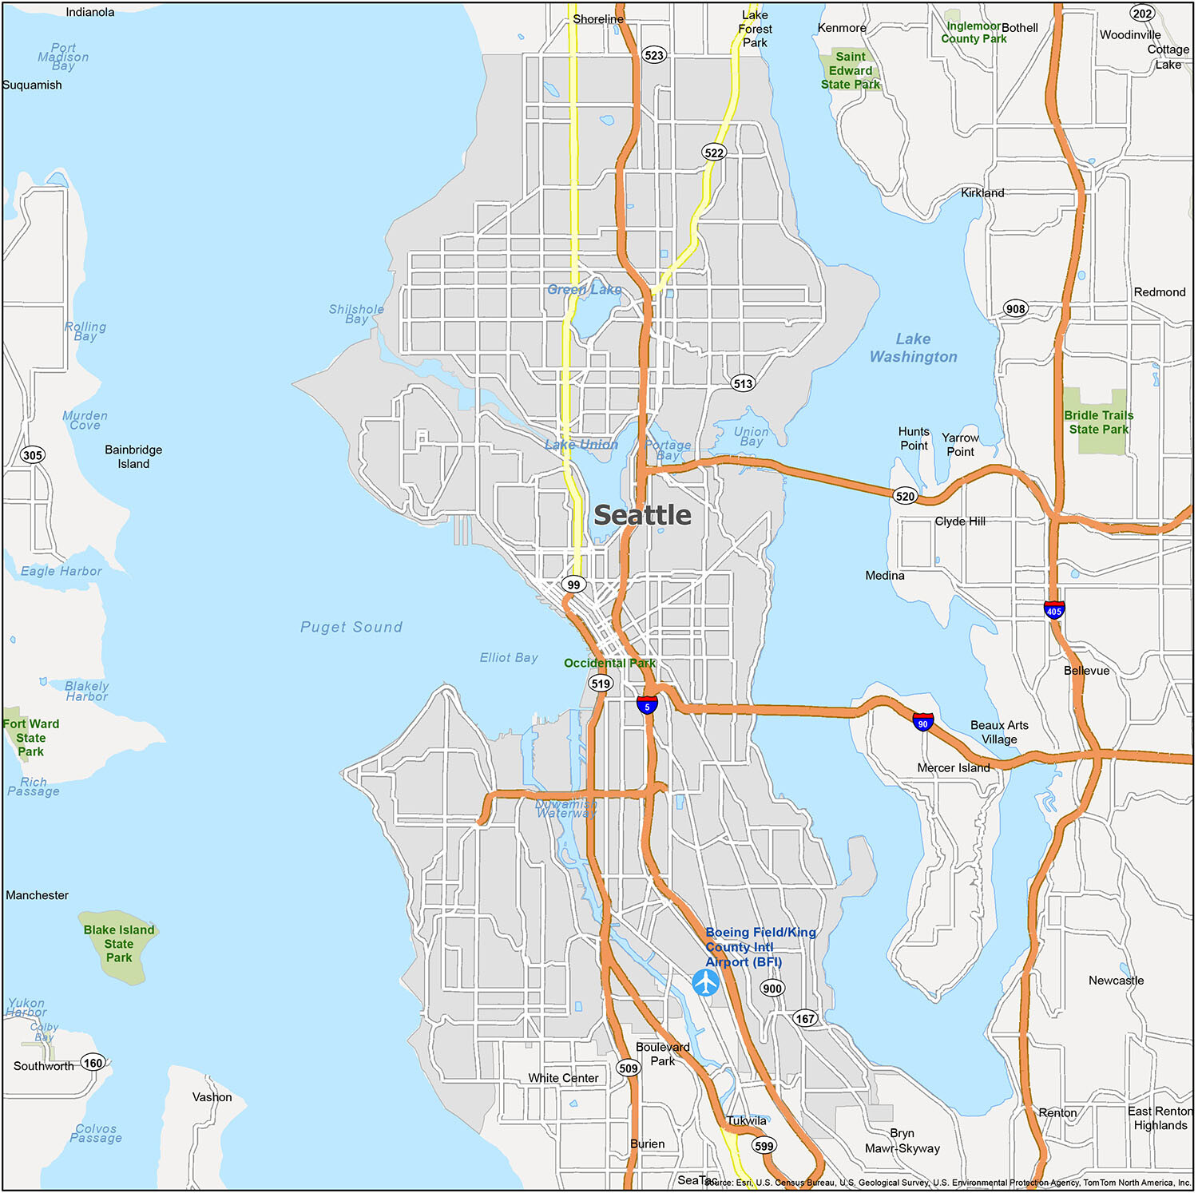
House Price Prediction
Collaborators:
Victor
Jenifar
Octavian
Yoan

Slide 2
OVERVIEW
Project Goal & Roadmap
Build a machine learning model that accurately predicts house sale prices from structured real-estate data, then explain which factors drive price the most.
01
02
03
Data Cleaning
Exploratory Analysis
Baseline Models
Duplicates, missing values, date parsing
Correlations, distributions, multicollinearity
Linear Regression → XGBoost, raw features
04
05
06
Feature Engineering
Improved Models
Tuning & Insights
Age of house, target-encoded zipcode
Same six models, cleaned feature set
n_estimators sweep, feature importance
House Price Prediction — ML Regression Project
2

Slide 3
PREPARATION
Data Cleaning Steps
✓
Sanity check
Identified zero duplicate rows and zero missing values across all 21 raw columns, ensuring a completely solid modeling baseline
✓
Noise Reduction
Removed redundant indicators: database primary keys (id) and highly dimensional location classes (zipcode) that confuse KNN distance evaluations.
✓
Time transformed
Converted text-based date timestamps into timeline_days, preserving chronological sale progressions as numeric trends.
House Price Prediction — ML Regression Project
4

Slide 4
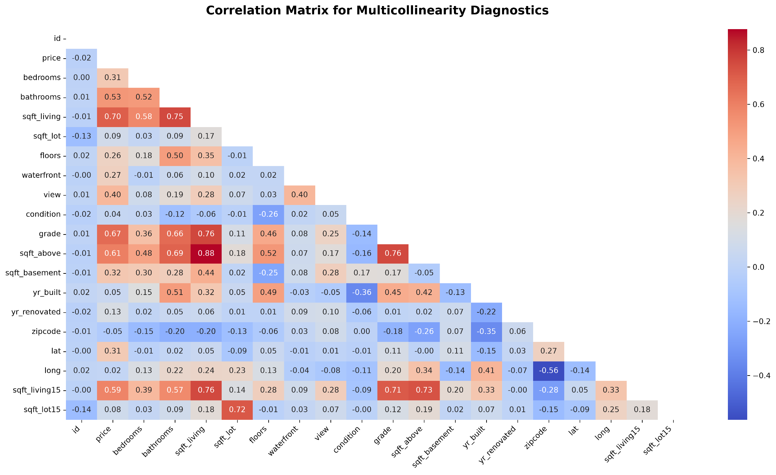

Slide 5
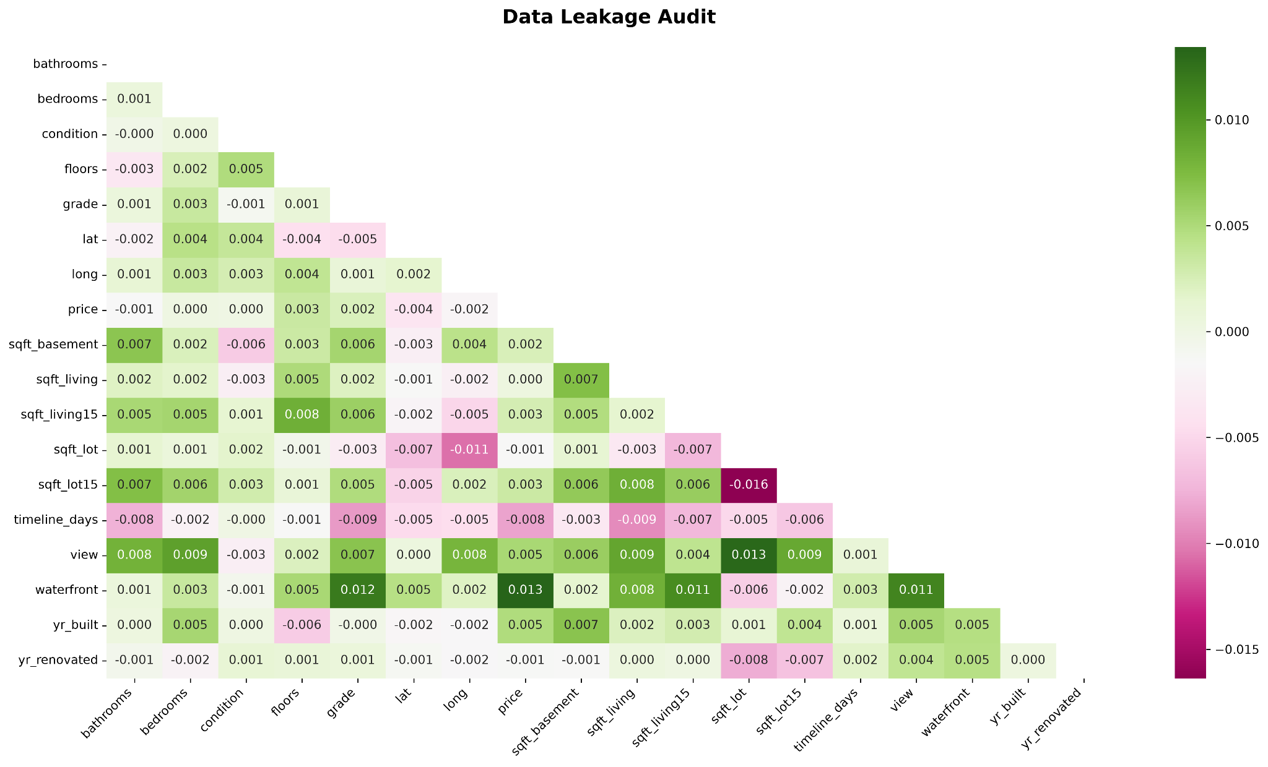

Slide 6
PREPARATION
Encoding
✓
No explicit categorical columns
Our features contain zero string/text data types (object or category).
✓
Naturally encoded binary features
The waterfront column is already represented as binary integers (0 and 1). The column is already in the absolute perfect format for machine learning.
✓
Naturally encoded ordinal features
Converted text-based date timestamps into timeline_days, preserving chronological sale progressions as numeric trends.
✓
Preserving mathematical "closeness" (using grade as an example)
Keeping these numeric is crucial for our distance-based models. If we one-hot encoded them, the model would completely lose its ability to recognize that a grade 8 house is highly similar to a grade 9 house. Instead, the mathematical distance between grade 8 and 9 would look exactly the same as the distance between grade 2 and grade 11.
House Price Prediction — ML Regression Project
4

Slide 7
METHODOLOGY
Modeling Approach
Six regression models were trained and compared across three progressive experiments, always on an 80 / 20 train-test split (random_state = 42).
Linear Regression
KNN Regressor
Decision Tree
Random Forest
Gradient Boosting
XGBoost
Experiment 1
Experiment 2
Experiment 3
Raw features
Redundant columns dropped
Full feature engineering
Only the date column engineered (→ year, month). Everything else used as-is, including standardized re-runs for LR and KNN.
id, sqft_above, month and sqft_basement removed before re-testing all six models.
Adds age_of_house and target-encoded zipcode; also drops the two most collinear columns, sqft_living15 and sqft_lot.
House Price Prediction — ML Regression Project
7

Slide 8
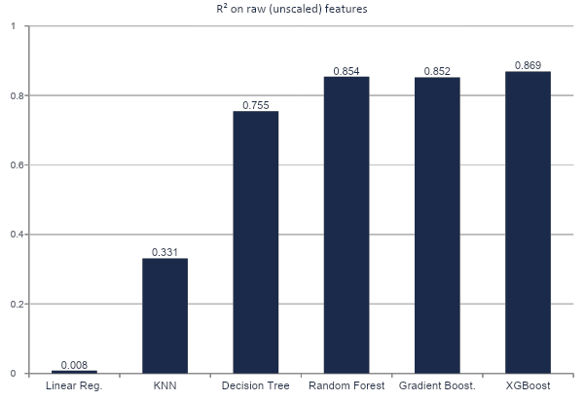
EXPERIMENT 1
Baseline Results — Raw Features
An unscaled surprise
R² = 0.008
Linear Regression on raw, unscaled features
Large-magnitude columns (sqft_lot, price-scale features) and multicollinearity destabilised the raw linear fit — essentially a coefficient-scaling issue, not a real signal problem.
Tree-based models were unaffected by scale: Decision Tree, Random Forest, Gradient Boosting and XGBoost all cleared R² = 0.75–0.87, confirming the dataset holds strong nonlinear signal even before any feature engineering.
House Price Prediction — ML Regression Project
8

Slide 9
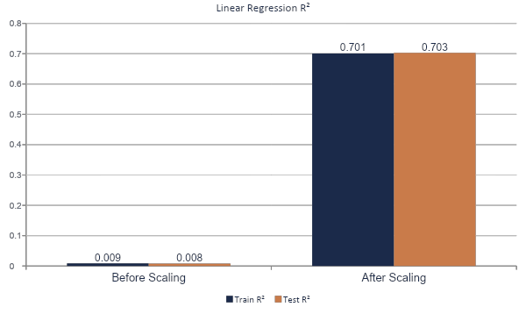
FOCUS: LINEAR REGRESSION
Train vs Test, Before and After Scaling
Same model, same split — only the feature scale changes. Train and test move together in both cases, which is the real signature of a numerical fix, not overfitting correction.
Reading the two bars together
Before scaling
Train 0.009 · Test 0.008
R² ≈ 0.008 — not a sign of a well-fit model. Both scores are bad, meaning the solver failed to fit anything at all, on either set.
After scaling
Train 0.701 · Test 0.703
R² ≈ 0.7 — both scores are acceptable. The model is fitting real signal on both sets.
House Price Prediction — ML Regression Project
11

Slide 10
DIAGNOSIS
Correcting the 0.008 Result
Initially read as a genuine model failure, fixed by scaling. Further investigation found a version-specific bug behind both.
1
1 · OBSERVED
VERSION IMPACT
Raw Linear Regression scored R² = 0.008
Looked like a complete model failure — most coefficients collapsed near zero and the intercept ($527,691) did almost all the predicting.
numpy 2.5.1 + scikit-learn 1.7.2
R² = 0.703 (id included, unscaled)
2
2 · LOOKED LIKE THE FIX
StandardScaler pushed R² to 0.703
numpy 2.5.1 + scikit-learn 1.9.0 (project env)
Matched the textbook story — “linear models need scaled features.” Result looked correct, so it wasn't questioned further at first.
R² = 0.008 (id included, unscaled)
3
3 · REAL ROOT CAUSE
COEFFICIENT EVIDENCE
The id column, not scaling in general
id is a 10-digit identifier (up to 9.9B) beside features like bedrooms (0–33). That scale gap, combined with numpy 2.5.1 / scikit-learn 1.9.0, made the least-squares solve ill-conditioned.
20 of 21 raw coefficients shrank to between 1e-6 and 1e-8; only sqft_lot (0.66) and year (0.35) stayed meaningful. Near-total coefficient collapse plus one runaway intercept is the signature of a numerically unstable solve — not genuinely weak predictors.
4
4 · CONFIRMED & RESOLVED
Dropping id alone → R² = 0.703, no scaling needed
Proves the fix was never about scaling broadly — it was one meaningless identifier column exposing a version-specific numerical bug.
Takeaway: the “scaling fixes linear regression” story was half right for the wrong reason — the real fix was removing one meaningless identifier column that exposed a version-specific numerical bug, not a general scaling lesson.
House Price Prediction — ML Regression Project
9

Slide 11
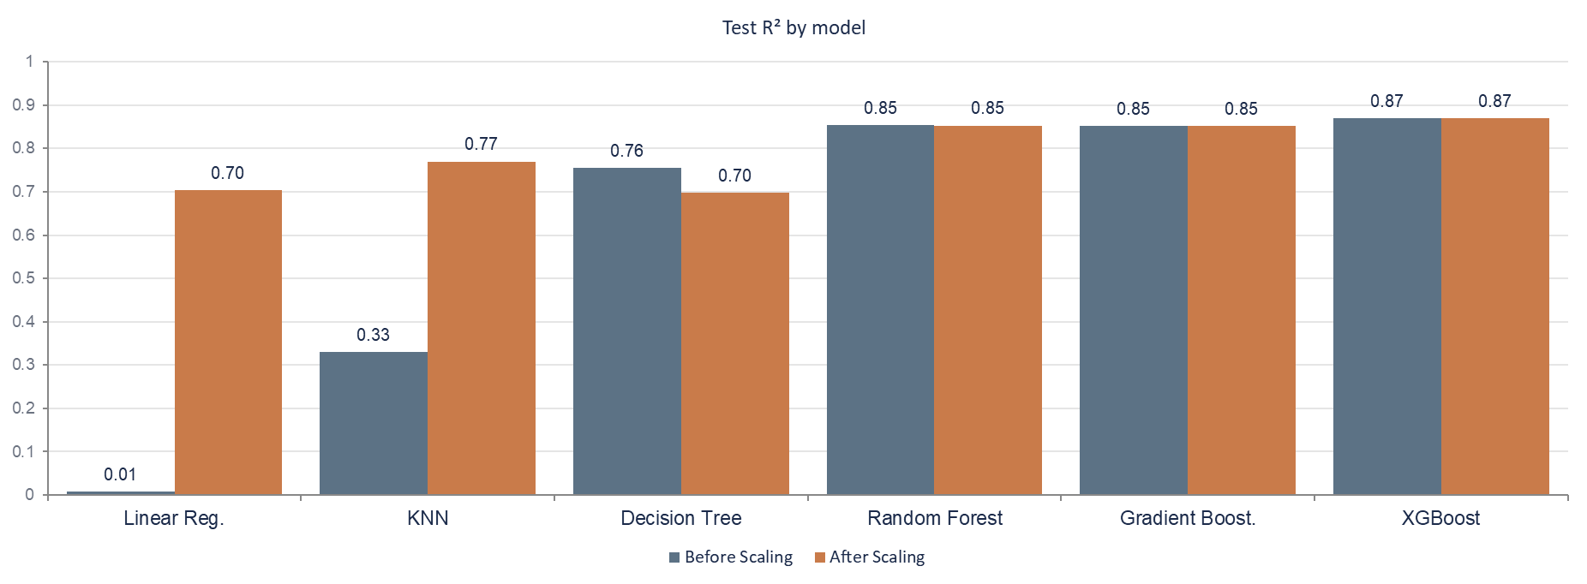
ALL SIX MODELS
Test R² — Before vs After Scaling
Scaling is a Linear Regression / KNN story. Tree-based ensembles are mathematically invariant to it — the small moves here are floating-point noise, not a real effect.
Only Linear Regression (+0.695) and KNN (+0.439) improve. Random Forest, Gradient Boosting and XGBoost are flat (± 0.001). Decision Tree drops slightly (−0.057) — floating-point tie-breaking in an unconstrained, unstable tree, not a scaling effect.
House Price Prediction — ML Regression Project
12

Slide 12
EXPERIMENT 3
Feature Engineering
All engineering was applied after the train/test split, fit on training data only, to avoid leakage.
Created
Encoded
age_of_house
zipcode → zipcode_encoded
= sale year − yr_built. Turns a weak raw signal (yr_built, corr 0.05) into a directly usable age feature.
Target-mean encoding: each zipcode replaced by the average training-set price for that area. Captures location value that raw zipcode numbers cannot.
Dropped (redundant)
Dropped (collinear)
id, sqft_above, month, sqft_basement
sqft_living15, sqft_lot
Identifiers and columns largely reconstructable from other features.
Highly correlated with sqft_living / sqft_lot15, adding noise without new information.
House Price Prediction — ML Regression Project
13

Slide 13
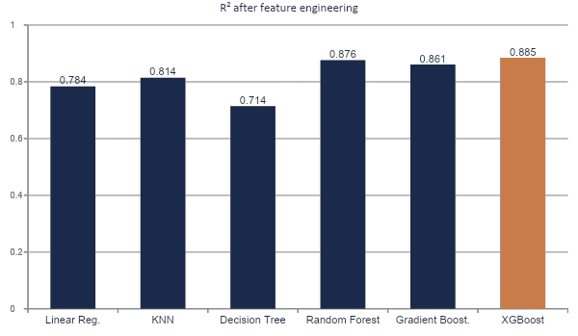
EXPERIMENT 3 RESULTS
Improved Model Comparison
Model | MAE ($)
Linear Regression | 104,609
KNN | 88,436
Decision Tree | 102,415
Random Forest | 71,125
Gradient Boosting | 78,750
XGBoost | 72,098
XGBoost leads
R² 0.885 · MAE $72,098
Highest R² and among the lowest error, ahead of Random Forest and Gradient Boosting; captures nonlinear patterns and benefits most from the engineered features.
House Price Prediction — ML Regression Project
14

Slide 14
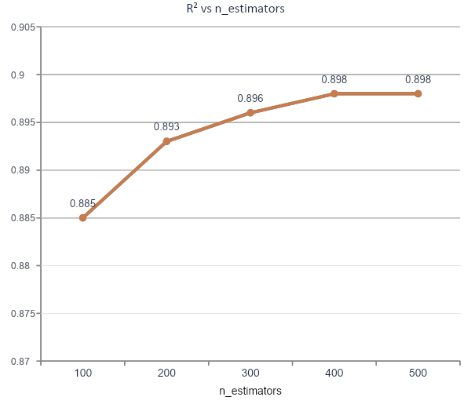
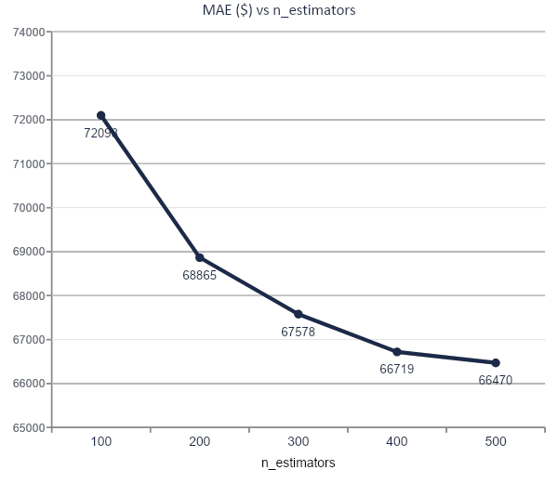
OPTIMIZATION
Hyperparameter Tuning — n_estimators
R² improved 0.885 → 0.898 (+1.3%) and MAE fell $72,098 → $66,470 (−7.8%) as trees increased from 100 to 500 — more boosting rounds let XGBoost learn deeper patterns, with gains flattening after 400.
House Price Prediction — ML Regression Project
15

Slide 15
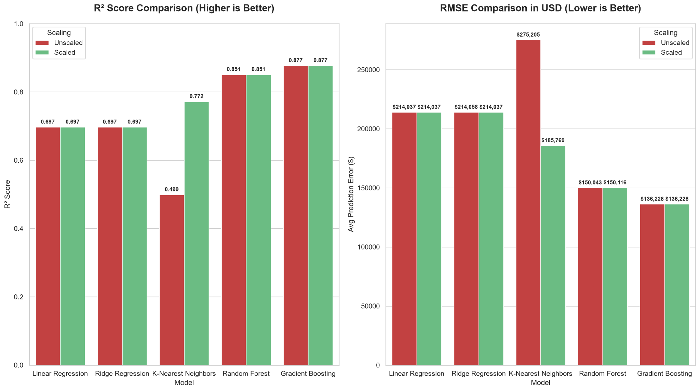

Slide 16
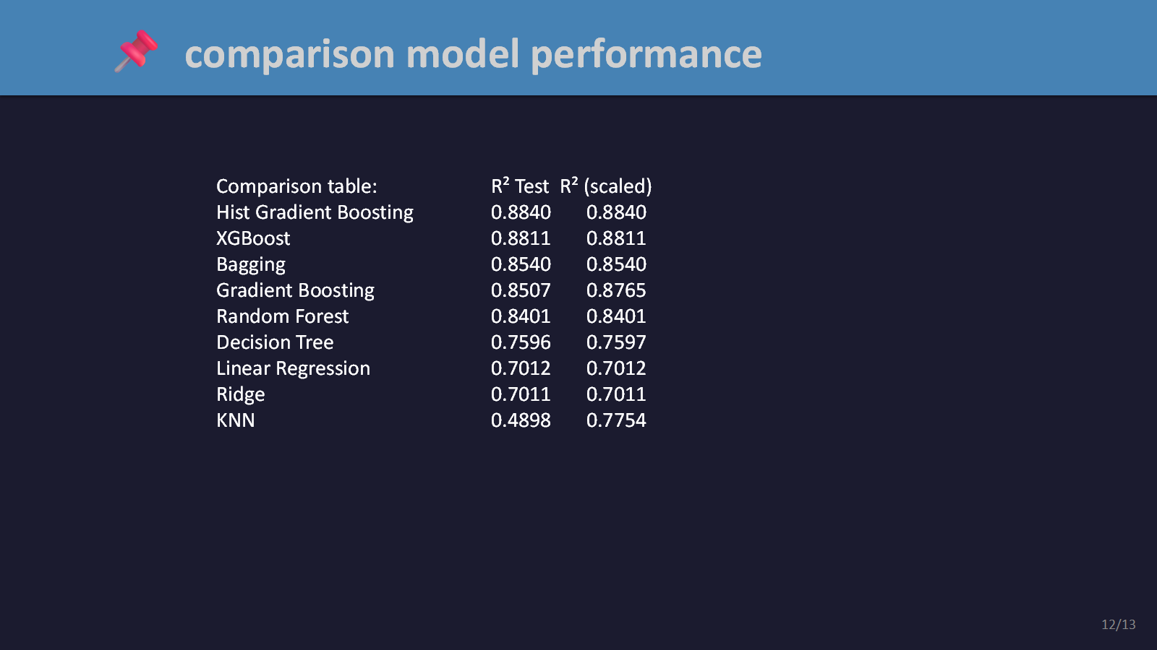

Slide 17
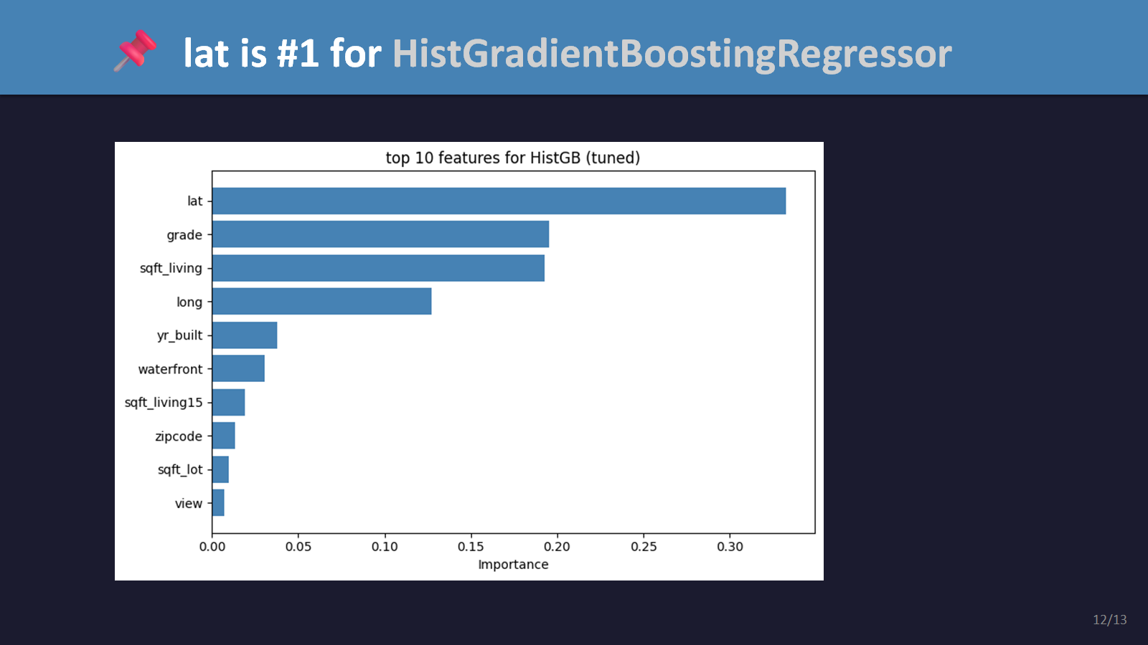

Slide 18
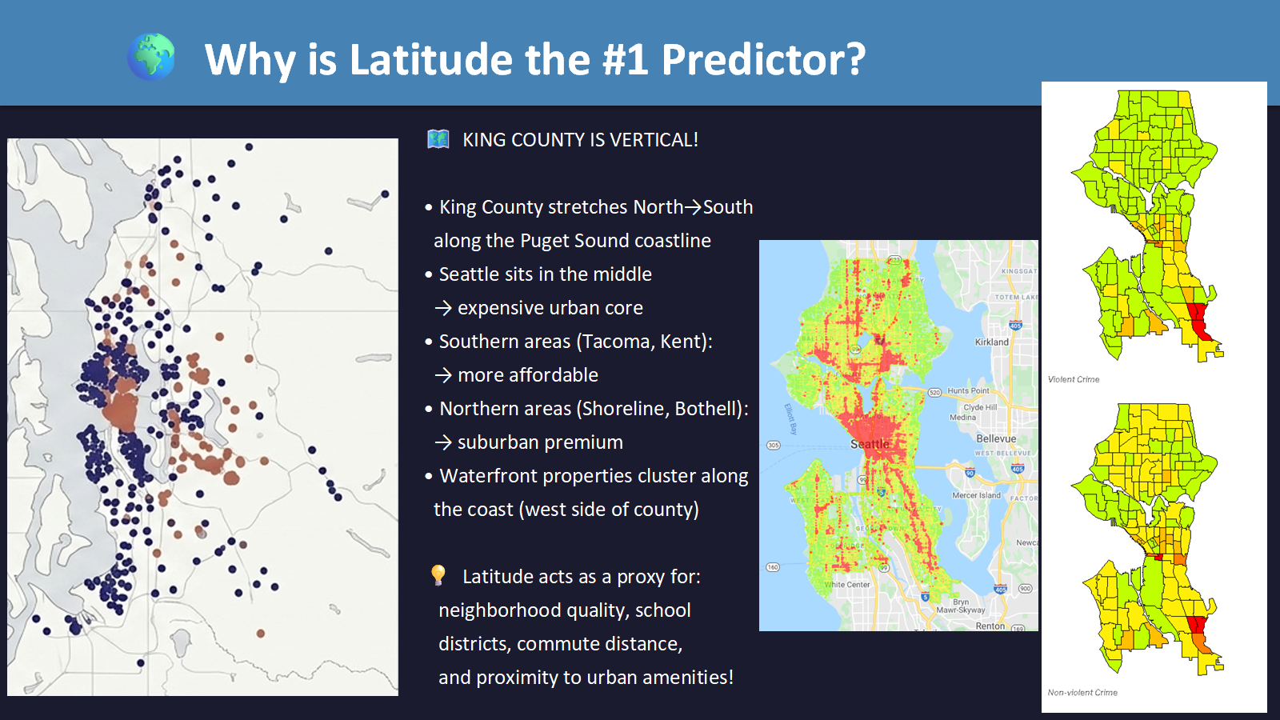

Slide 19
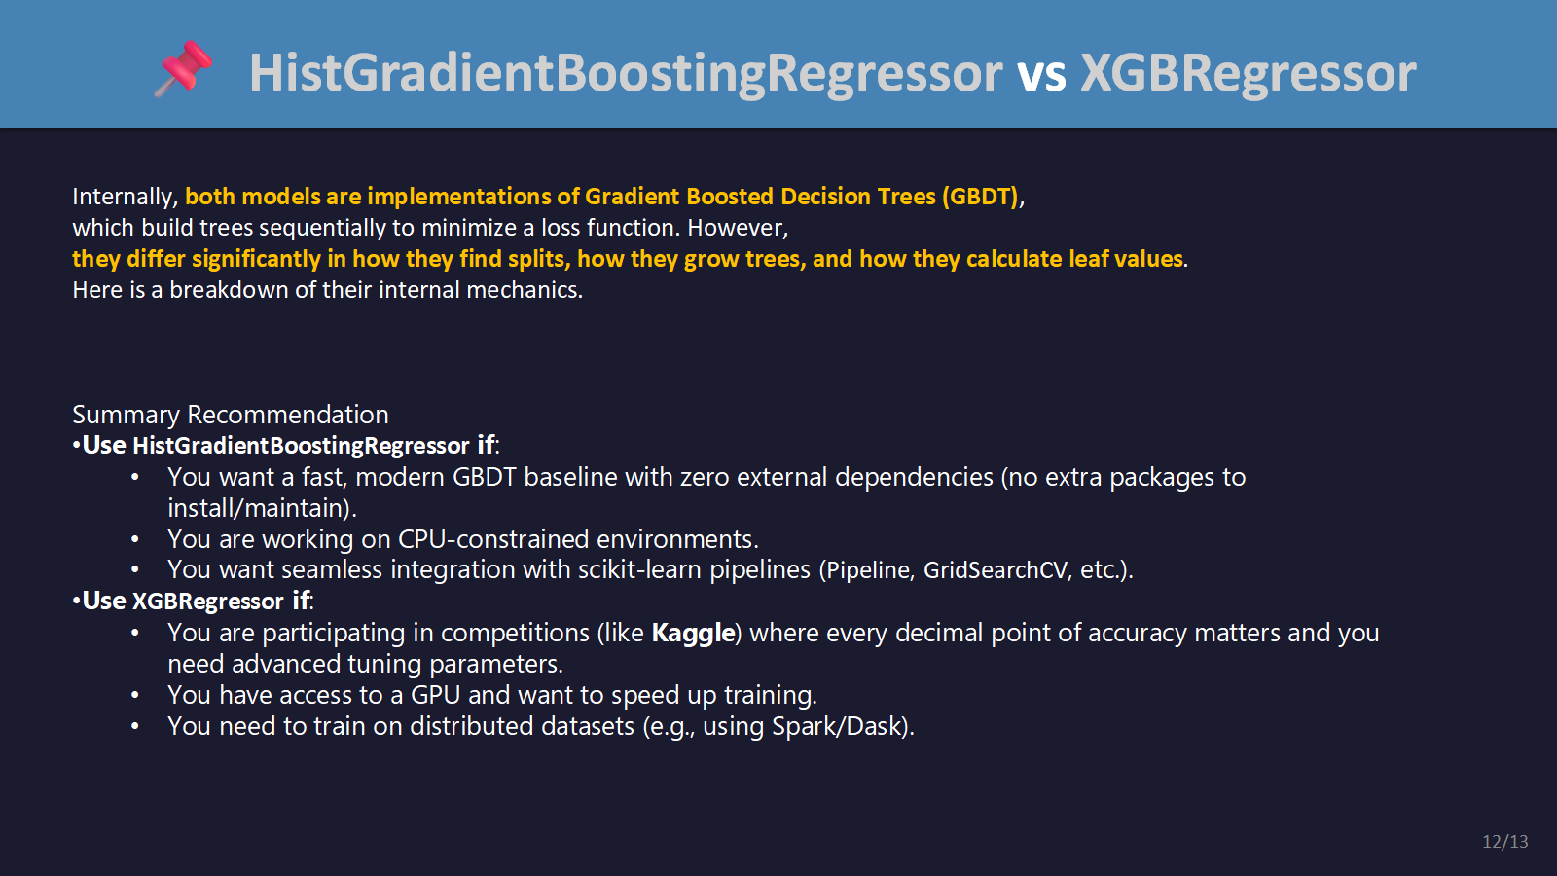

Slide 20


Slide 21
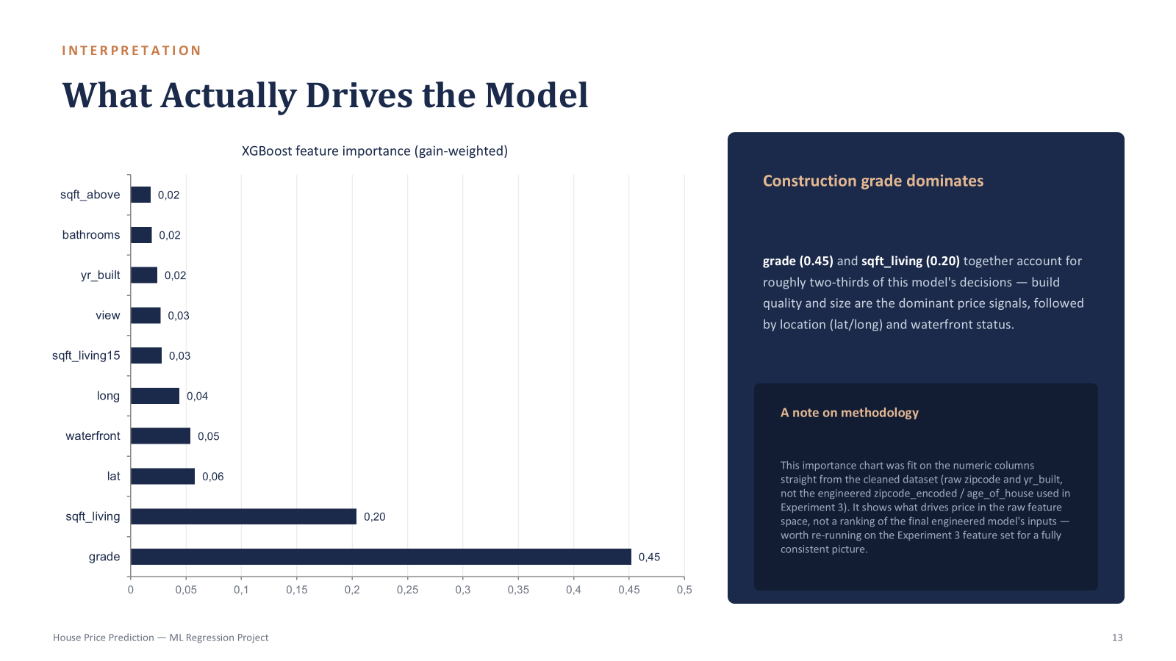

Slide 22
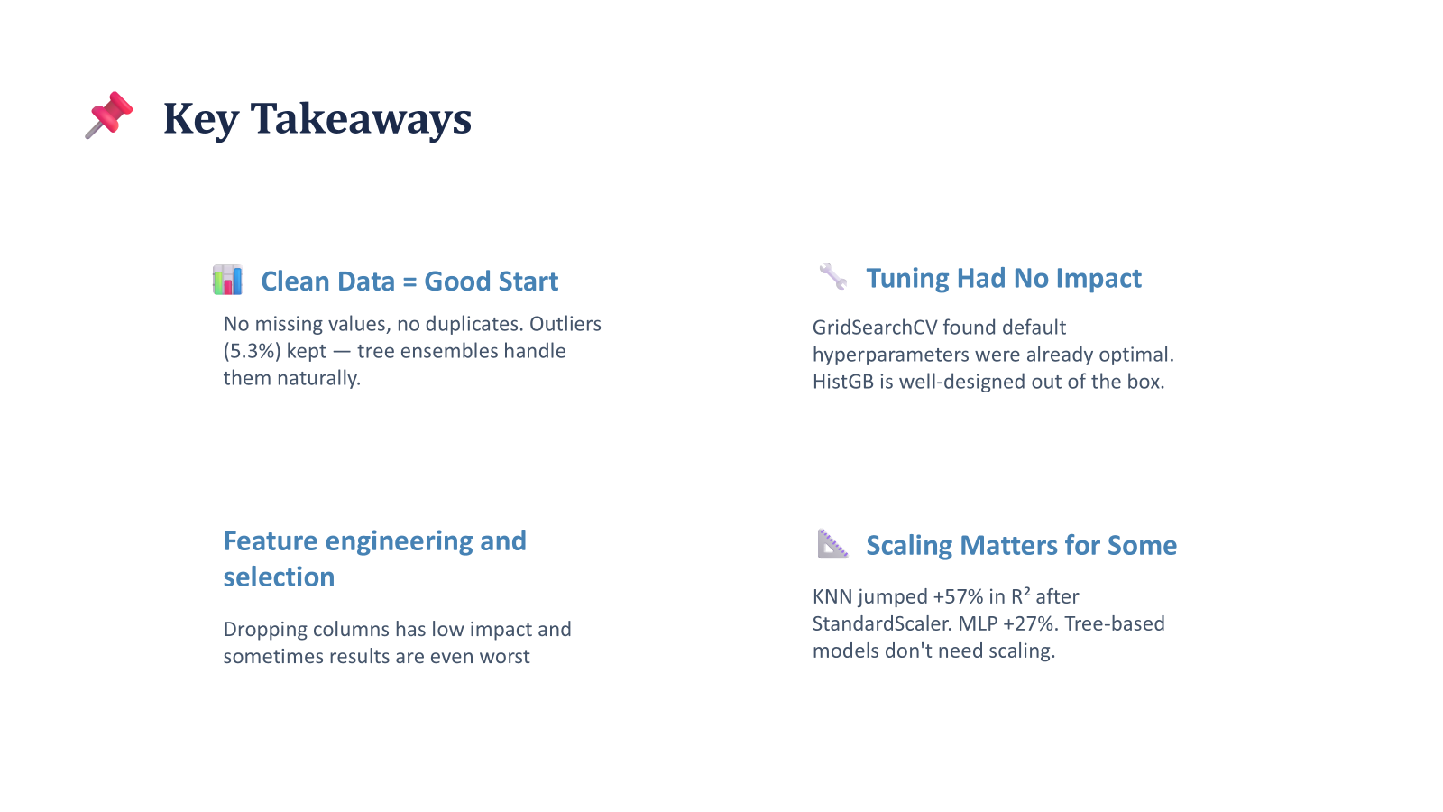

Slide 23
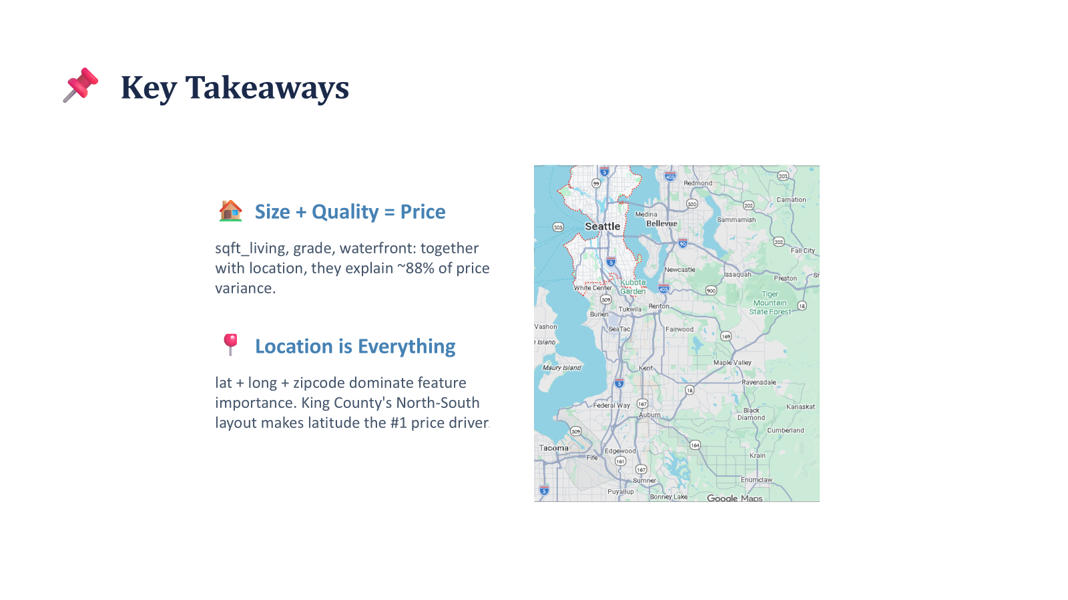

Slide 24
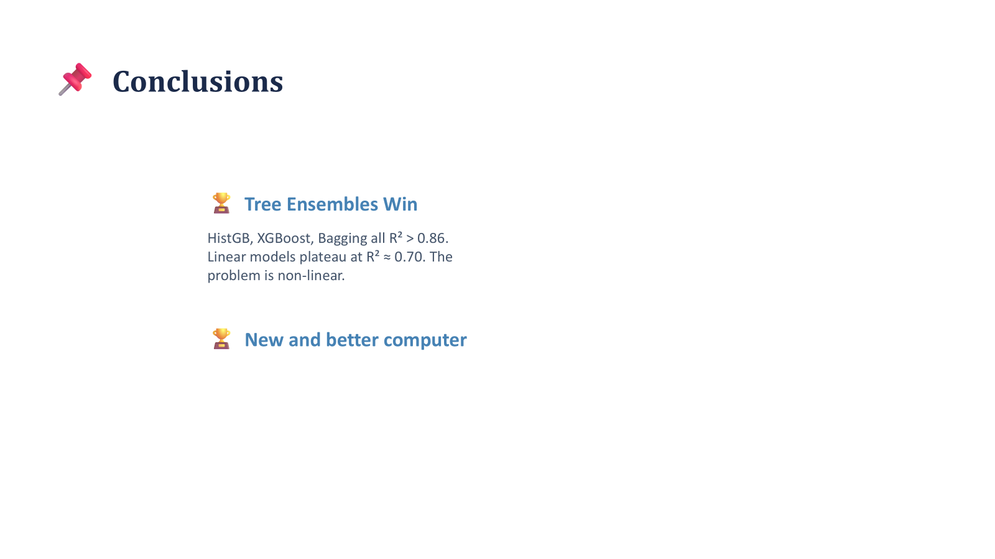

Slide 25
THANK YOU!

