Slide 1

Python OOP Homework Presentation
Vikings OOP
Mini Project
Agenda
Historical background
Class relationships
A short presentation about the historical background, the class design, and what I learned from the project.
OOP concepts learned
Challenges and results
Vikings OOP Mini Project

Slide 2
02
Historical Background: Vikings vs. Saxons
The project is fictional, but it is inspired by a real historical conflict in early medieval England.
Late 700s
Viking raids began along the coasts of Britain and Ireland.
865
A large Viking force, often called the Great Heathen Army, landed in East Anglia.
867
Vikings captured York, an important city in Northumbria.
878
Alfred of Wessex defeated Guthrum at Edington, leading toward peace terms.
Danelaw
Northern and eastern England came under strong Scandinavian legal and political influence.
Why it matters here
The code turns a large historical conflict into small objects and methods.
Sources: Great Heathen Army, Danelaw, Treaty of Alfred and Guthrum

Slide 3
03
From History to Python Objects
The assignment simplifies the historical setting into a small battle simulation. Each real-world idea becomes a class, an attribute, or a method.
Historical idea
Python design
Individual warrior
Soldier object with attributes health and strength
Viking fighter
Viking subclass with name and battleCry()
Saxon fighter
Saxon subclass with its own damage message
Battle between two groups
War object with two army lists and attack methods
Vikings OOP Mini Project · about 10 minutes

Slide 4
04
Class Relationships
There are two different relationships in the project: inheritance and composition.
Inheritance
Composition
Soldier
War
health
strength
attack()
receiveDamage()
vikingArmy list
saxonArmy list
vikingAttack()
saxonAttack()
showStatus()
Viking
Saxon
inherits Soldier
adds name
adds battleCry()
overrides damage
inherits Soldier
no name
inherits attack()
overrides damage
Army lists
War does not inherit from Soldier.
It contains objects and controls battle flow.
Vikings OOP Mini Project · about 10 minutes

Slide 5
05
What We Learned
class Viking(Soldier):
def __init__(self, name, health, strength):
self.name = name
super().__init__(health, strength)
def receiveDamage(self, damage):
self.health -= damage
return message
class
Defines a new type of object and groups related data and behavior.
__init__
Runs when an object is created and sets initial attributes.
super()
Calls the parent constructor so inherited setup is reused.
inheritance
Lets Viking and Saxon reuse Soldier.attack().
overriding
Lets each subclass customize receiveDamage().
Vikings OOP Mini Project · about 10 minutes

Slide 6
05
What We Learned
#Viking
class Viking(Soldier):
…
def battleCry(self):
# your code here
return("Odin Owns You All!")
class
Viking inherits from Soldier
battleCry()
Returns the battle cry.
super()
attack() recieveDamage() health strength
------------
inheritance
Lets Viking and Saxon reuse super() methods.
overriding
Lets each subclass customize receiveDamage().
Vikings OOP Mini Project · about 10 minutes

Slide 7
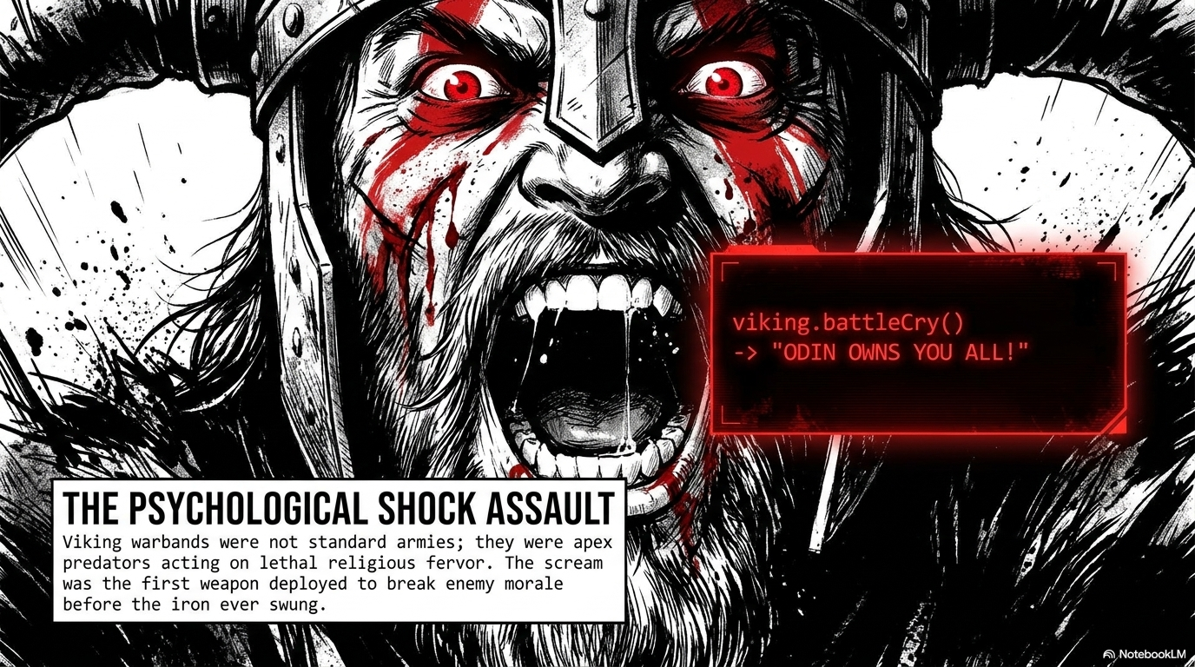

Slide 8

06
Challenges and Final Result
Main challenges
Final result
Choosing what belongs in the parent class versus the subclasses
Soldier tests passed
Viking tests passed
Making return strings match the unit tests exactly
Saxon tests passed
Removing defeated soldiers from the correct army list
War tests passed
Big takeaway: OOP helps separate shared logic from special behavior, which makes the code easier to test and extend.
Vikings OOP Mini Project · about 10 minutes

Slide 9

Dankeschön
Muchas Gracias
谢谢 (xiexie)
Thank you
Dankeschön
Muchas Gracias
谢谢 (xiexie)
Thank you

