Slide 1
How do Team Player Ratings and Team Formations Influence Match Performance?
Key Variables:
• rating_difference = Home team avg rating − Away team avg rating
• home_formation / away_formation = Tactical setup (encoded 0–4)
Formation Encoding Key (from the dataset documentation):
- **0** → 2 defenders, 1 forward (e.g., 4-2-3-1, 4-3-3, 4-5-1)
- **1** → 3 defenders, 1 forward (e.g., 3-4-2-1, 3-5-1-1, 5-2-2-1)
- **2** → 2 defenders, 2 forwards (e.g., 4-4-2, 4-2-2-2)
- **3** → 3 defenders, 2 forwards (e.g., 3-5-2, 3-4-1-2, 5-3-2)
- **4** → Other / unusual formations (anything not fitting the above patterns)
1 / 6
Notes:
Good morning everyone. In this section I'll answer our fourth research question: How do team player ratings and team formations influence match performance?
We worked with over 16,000 matches from top European leagues. The two key variables are rating difference — that's the home team's average player rating minus the away team's, covering defense, midfield, and attack — and team formation, which is the tactical setup encoded from 0 to 4 in our dataset.

Slide 2
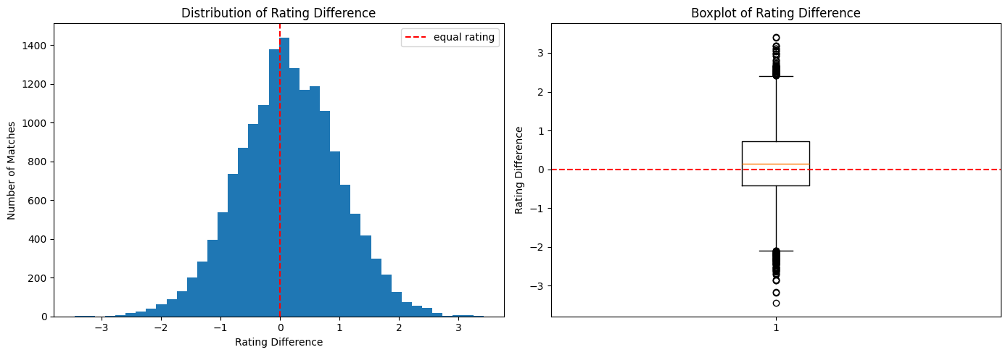
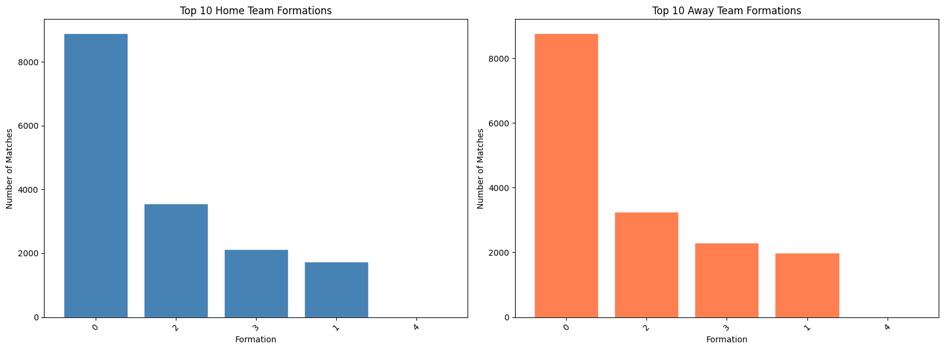
1. Univariate Analysis — What Does the Data Look Like?
Rating Difference Distribution
Formation Distribution
[INSERT CHART] Rating Difference Histogram + Boxplot
[INSERT CHART] Formation Bar Charts (Home vs Away)
Key Numbers:
• Formation 0 (4-2-3-1 / 4-3-3) = ~40%+ of all matches
• Formation 2 (4-4-2) = ~25%+
• Home & away distributions nearly identical
Key Numbers:
• Mean rating difference ≈ 0.00 — evenly matched
• Range: −5 to +5
• Symmetric, bell-shaped distribution
Formation Key: 0 = 2 def, 1 fwd (4-3-3) | 1 = 3 def, 1 fwd (3-4-2-1) | 2 = 2 def, 2 fwd (4-4-2) | 3 = 3 def, 2 fwd (3-5-2) | 4 = Other
2 / 6
Notes:
Let's start with what the data looks like.
First, the rating difference distribution: it's a beautiful bell shape centered at zero. This makes sense — in most matches, both teams have very similar average player ratings. The spread goes from roughly minus 5 to plus 5, and there are hardly any extreme outliers.
Second, the formation distribution: this is where it gets interesting. Formation 0 — which corresponds to setups like 4-2-3-1 or 4-3-3 — is by far the most popular, appearing in over 40% of matches. Formation 2, the classic 4-4-2, is second. What's really striking is that home and away teams use almost exactly the same formations. Home teams don't suddenly switch to a more attacking shape just because they're at home — the distributions are virtually identical. So formation alone probably won't explain home advantage.

Slide 3
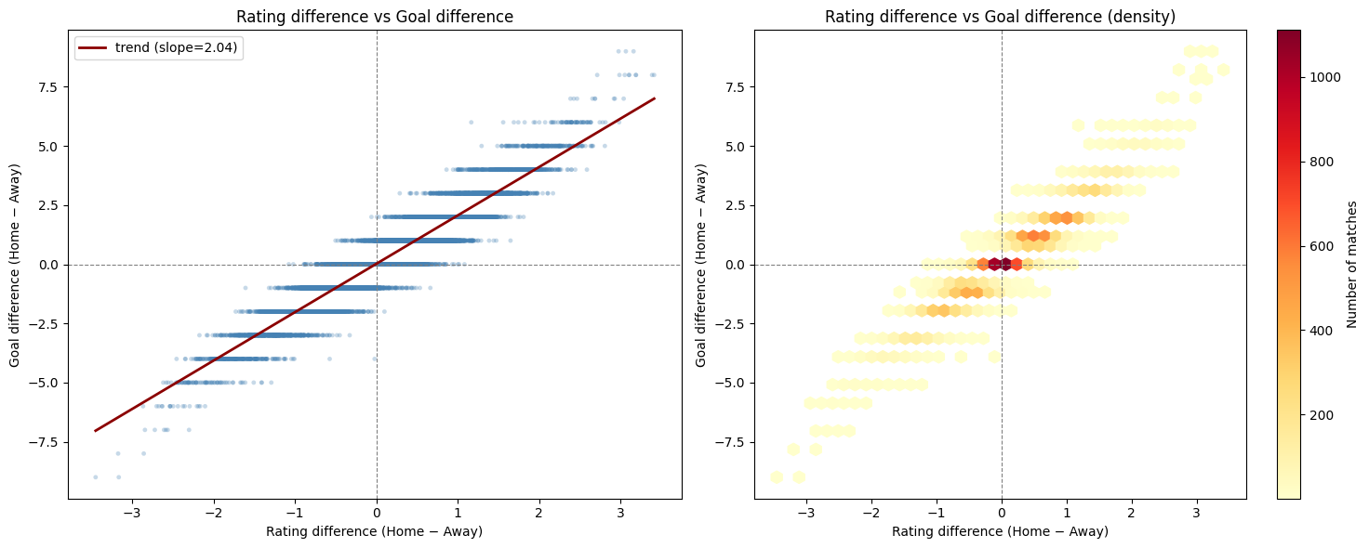
2. Do Higher Ratings = More Goals?
Rating Difference vs Goal Difference
KEY STATISTICS
Correlation:
r ≈ 0.50
Trend line slope:
+0.44 goals per
+1 rating point
Highest density:
near (0, 0)
→ close matches
dominate
[INSERT CHART] Scatter Plot + Hexbin Density
💡 In football analytics, r = 0.50 is actually quite strong — football is a low-scoring, high-variance sport.
3 / 6
Notes:
Now, the big question: do higher-rated teams actually score more goals? The answer is clearly yes.
This scatter plot shows rating difference on the x-axis and goal difference on the y-axis. The red trend line is unmistakably upward. The correlation is around 0.50, which in football analytics is actually quite strong — football is a low-scoring, high-variance sport.
The hexbin density map on the right confirms that the vast majority of matches cluster around zero-zero: when ratings are similar, goal differences are small. But as rating advantage grows, so does the expected goal margin. Concretely, a one-point rating advantage translates to roughly half a goal in the final margin.

Slide 4
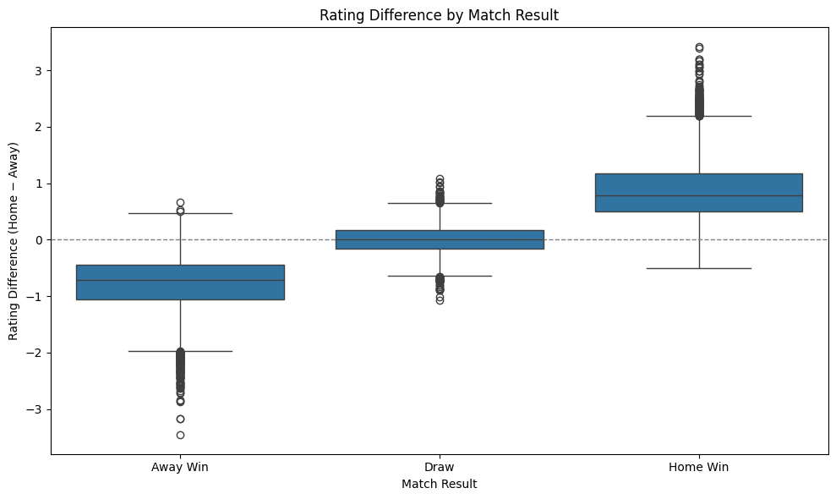
3. Player Ratings Predict Match Outcomes
Rating Difference by Match Result
[INSERT CHART] Boxplot: Rating Difference grouped by Match Result
Match Result Avg Rating Diff
─────────────────────────────────
🏠 Home Win +0.75
🤝 Draw −0.05
✈️ Away Win −0.69
💡 A perfect gradient:
Home rated higher → Home wins | Ratings equal → Draw | Away rated higher → Away wins
4 / 6
Notes:
Let's make this even more concrete. Here's a boxplot of rating difference grouped by the final match result.
Look at the pattern: Home wins have a positive median rating difference of about +0.75. Away wins show the exact opposite: a negative median of −0.69. And draws? They're dead centered at zero — both teams equally matched.
This is a really clean result. The gradient is perfect: when the home team is rated higher, they tend to win. When the away team is rated higher, they tend to win. When they're equal, they tend to draw. Player ratings are a genuinely strong predictor of match outcomes.

Slide 5
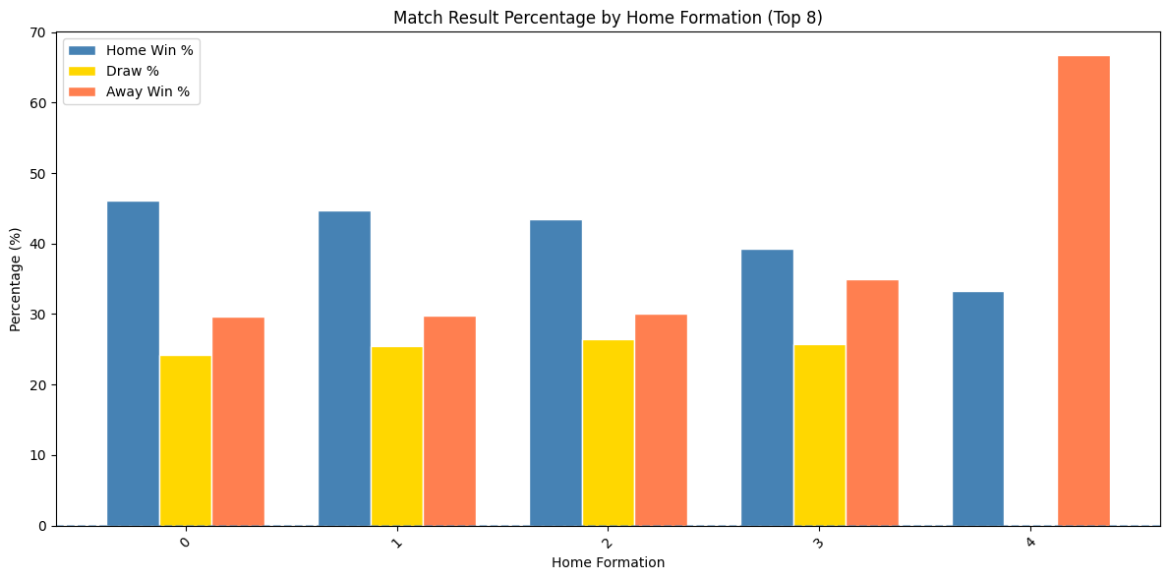
4. Do Formations Matter? — Barely
Match Result % by Home Formation (Top 8)
[INSERT CHART] Grouped Bar Chart: Win % by Formation
Key Numbers:
• Home win % across top 8 formations: 44–47%
• Variation between formations: ≤ 3 pct points
• Draw %: 25–28% across all formations
• Away win %: 27–29% across all formations
→ No formation is a magic bullet!
💡 Manchester City playing 4-4-2 beats a relegation side playing 4-3-3 every time.
Quality of the players matters far more than how you arrange them.
5 / 6
Notes:
So, ratings clearly matter. What about formations?
This chart shows the percentage of home wins, draws, and away wins for each of the top 8 formations. And the takeaway is: formations barely move the needle.
Whether you play 4-3-3, 4-4-2, or 3-5-2, your home win percentage hovers between 44% and 47%. The differences are just 2 to 3 percentage points — nowhere near statistically meaningful. No formation is a magic bullet.
This makes intuitive sense: Manchester City playing a 4-4-2 will beat a relegation side playing 4-3-3 every time. The quality of the players matters far more than how you arrange them on paper. Formations are a secondary factor at best.

Slide 6
Final Answer
"Team player ratings are a strong predictor of match performance.
Team formations, by contrast, show only a weak association with results."
Three Key Takeaways
🎯 Ratings → Goals
r = 0.50 correlation
with goal difference
Each +1 rating ≈
+0.44 goals
🎯 Formations
Minor Impact
All formations produce
~45% home win rate
Quality > Shape
🎯 Ratings → Wins
Clear gradient:
Away Win (−0.69)
→ Draw (0.00)
→ Home Win (+0.75)
Combined with xG & recent form: Ratings = structural quality measure | xG & form = situational measures
6 / 6
Notes:
So, to answer our question: how do player ratings and formations influence match performance?
Player ratings influence it a lot. We see a strong correlation with goals, a perfect gradient across match results, and consistency across leagues. Ratings capture the underlying quality of a team.
Formations, on the other hand, influence match performance very little. Every common formation produces roughly the same win rate. The lesson is clear: it's the players, not the system.
Combined with our earlier findings on xG and recent form, ratings complete the picture: they are the structural measure of quality, while xG and form are situational measures. Together, they give us a powerful framework for predicting football match outcomes. Thank you.

