Slide 1
Job Market Intelligence & Career Advisor
Data Science & Machine Learning - Ironhack Final Project

Slide 2
What is this project?
🔹 A Streamlit dashboard for exploring the job market
🔹 Combines real salary data with AI-powered insights
🔹 4 interactive tabs — explore, predict, chat, and search
🔹 Data source: Data Science Job Salaries (Hugging Face → 607 rows)
🔹 Live job search across 7 global regions via Tavily API
🔹 AI Career Coach powered by DeepSeek + RAG (LangChain + ChromaDB)
Job Market Intelligence | Ironhack Final Project

Slide 3
4 Interactive Tabs
1 - Market Explorer
Charts & metrics — salary by experience, company size, DS/ML field
Toggle between "All Data Jobs" and "DS / ML / DL Only"
2 - Salary Predictor
Select role + experience + location → instant salary estimate
3 - AI Career Coach
Chat with DeepSeek RAG — answers backed by real data
4 - Live Job Finder
Tavily searches 7 regions for DS/ML/DL & Aerospace jobs
Filter by field type & geographic region
Job Market Intelligence | Ironhack Final Project

Slide 4
Market Explorer
• Interactive Plotly charts embedded in Streamlit
• Radio toggle: "All Data Jobs" vs "DS / ML / DL Only"
• Filter by experience level with a dropdown
• 4 KPI cards: Median Salary, Mean Salary, Unique Roles, Countries
• Charts include:
→ Salary by Experience Level (horizontal bar)
→ Salary by Company Size (bar)
→ Salary by DS/ML Field (in DS/ML mode)
→ Top 15 Job Titles (bar)
Job Market Intelligence | Ironhack Final Project

Slide 5
Salary Predictor
• Uses the DS/ML/DL dataset for richer predictions
• 3 dropdowns: Job Role → Experience Level → Location
• Click "Predict Salary" → shows median salary for that exact combination
• Falls back to overall median if no exact match exists
• ML pipeline behind the scenes:
→ Regression models: Linear, Random Forest, XGBoost, LightGBM
→ Trained in notebook 02_ml_modeling.ipynb
Job Market Intelligence | Ironhack Final Project

Slide 6
AI Career Coach (RAG)
• Chat interface powered by DeepSeek (OpenAI-compatible)
• Retrieval-Augmented Generation (RAG) pipeline:
→ Documents built from salary data rows
→ Embeddings: sentence-transformers/all-MiniLM-L6-v2
→ Vector store: ChromaDB
→ LLM: DeepSeek Chat
• Answers career questions backed by real market data
• Built in notebook 03_rag_build.ipynb
Job Market Intelligence | Ironhack Final Project

Slide 7
Live Job Finder — 7 Regions
• Searches the web in real-time via Tavily API
• 6 geographic regions + 1 field category:
Europe | Middle East | China | Russia | South America | East Asia
• 🛩️ Aerospace — aircraft structural designer, airframe, composites, maintenance
• Two filter dropdowns: Field (DS/ML/DL or Aerospace) + Region
• Stacked bar chart: shows DS/ML/DL vs Aerospace split per region
• Browse results in expandable cards with direct links
• Export all jobs as CSV
Job Market Intelligence | Ironhack Final Project

Slide 8
Tech Stack
Data & EDA Pandas, NumPy, Matplotlib, Seaborn, Plotly
Machine Learning Scikit-learn (Linear, Random Forest), XGBoost, LightGBM
Gen AI / RAG DeepSeek (OpenAI-compatible), LangChain, ChromaDB
HuggingFace embeddings (all-MiniLM-L6-v2)
App Streamlit — 4-tab dashboard, @st.cache_data, Plotly charts
Live Search Tavily API — 7 regions, real-time web scraping
Datasets Hugging Face (no Kaggle account needed)
ds_salaries.csv — 607 rows, 12 columns
Job Market Intelligence | Ironhack Final Project

Slide 9
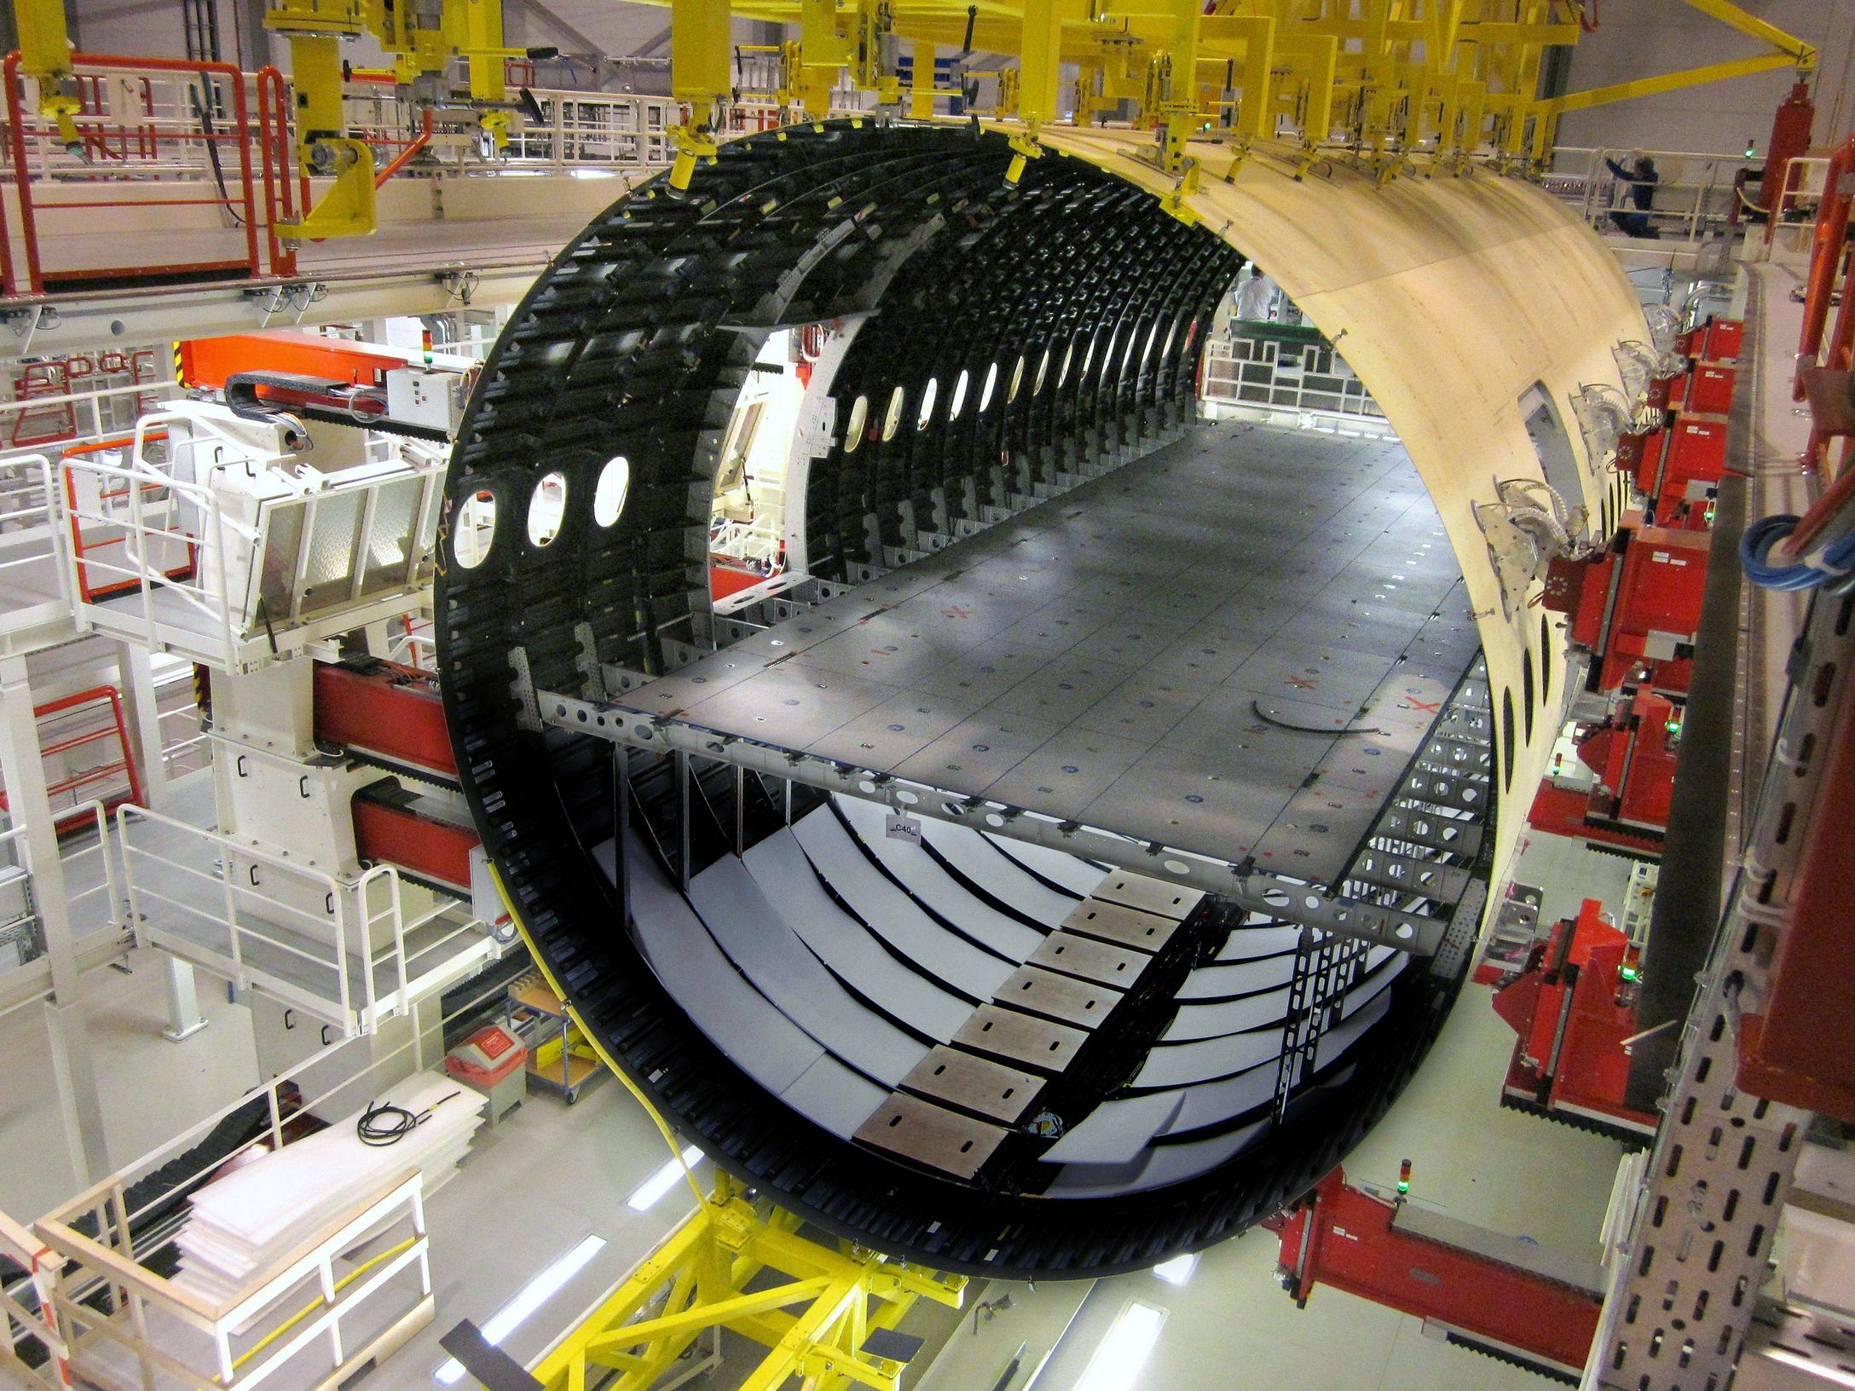
Live Demo
☺

