Slide 1


Slide 2
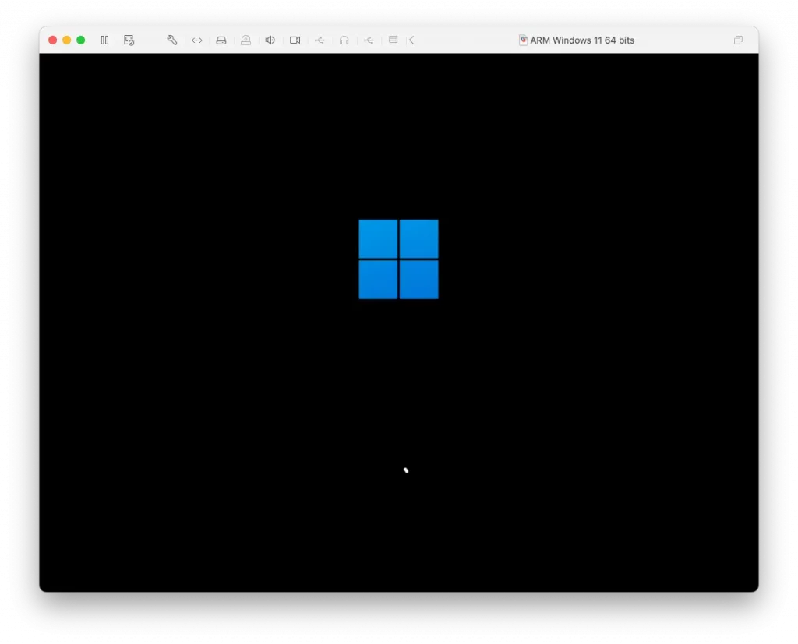
This Photo by Unknown Author is licensed under CC BY-NC-ND

Slide 3
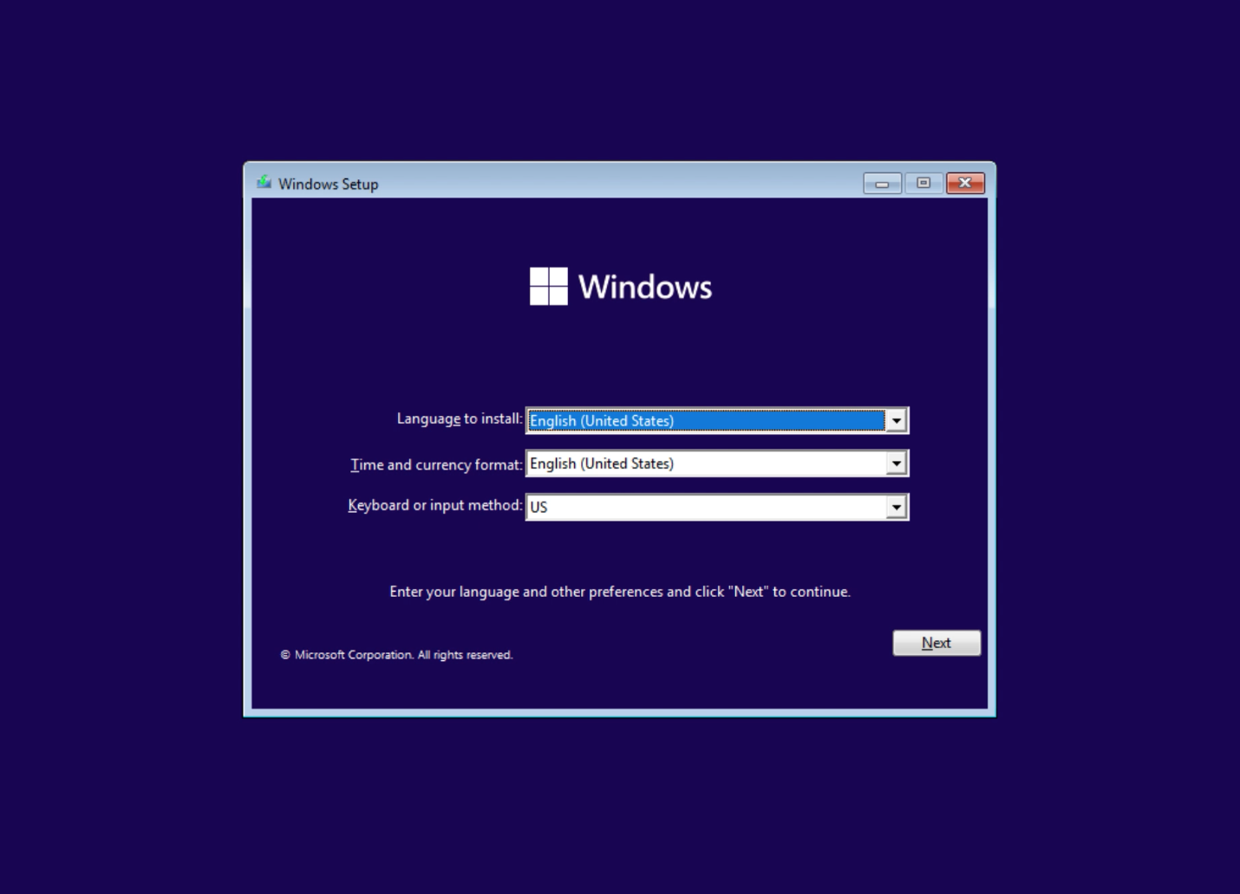

Slide 4
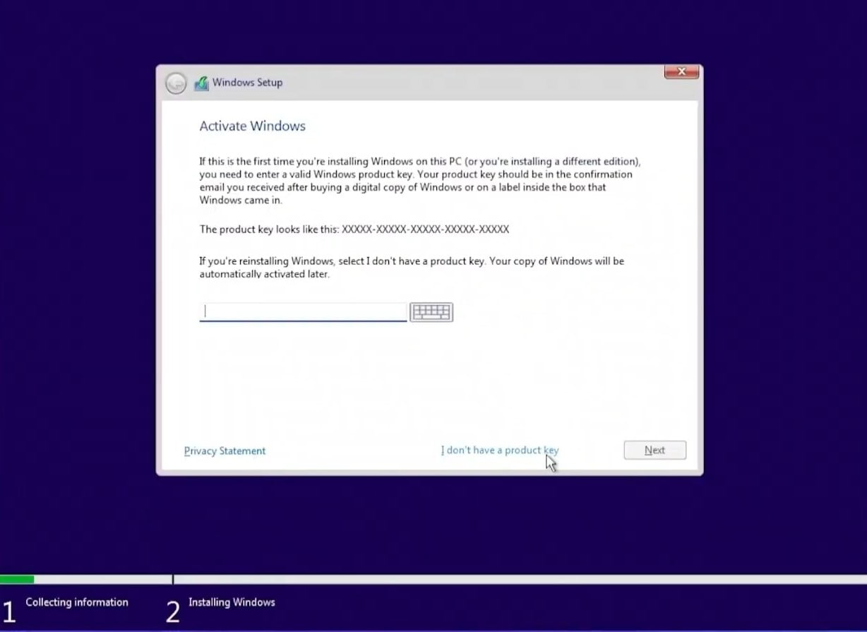

Slide 5
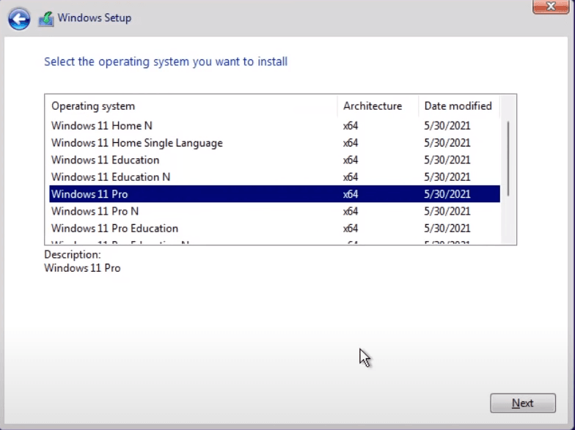

Slide 6
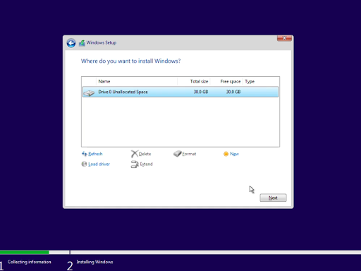

Slide 7
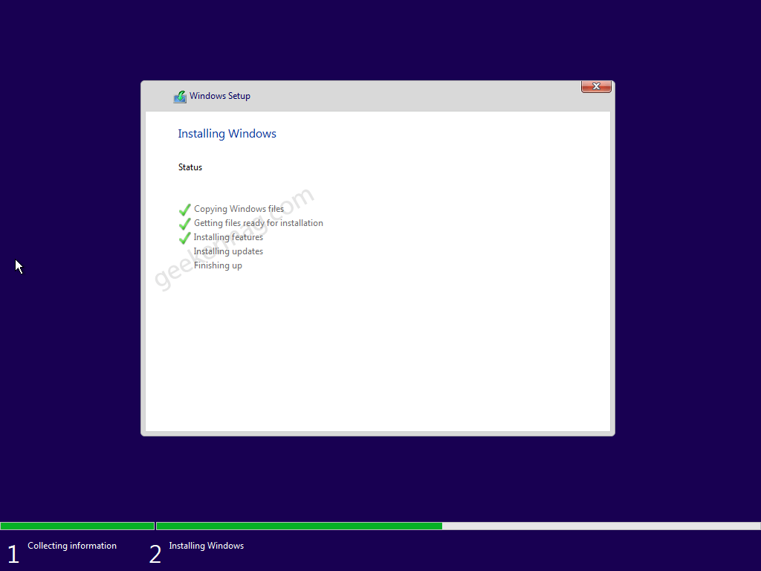
1%

Slide 8
2%

Slide 9
3%

Slide 10
6%

Slide 11
11%

Slide 12
15%

Slide 13
15%

Slide 14
20%

Slide 15
30%

Slide 16
40%

Slide 17
50%

Slide 18
60%

Slide 19
70%

Slide 20
80%

Slide 21
80%

Slide 22
90%

Slide 23
100%

Slide 24

100%

Slide 25
.

Slide 26
..

Slide 27
...

Slide 28



Slide 29
Getting things ready

Slide 30
Setting up devices

Slide 31
Setting up devices 10%

Slide 32
Setting up devices 20%

Slide 33
Setting up devices 30%

Slide 34
Setting up devices 40%

Slide 35
Setting up devices 50%

Slide 36
Setting up devices 60%

Slide 37
Setting up devices 70%

Slide 38
Setting up devices 80%

Slide 39
Setting up devices 90%

Slide 40
Setting up devices 100%

Slide 41
Restrating….

Slide 42
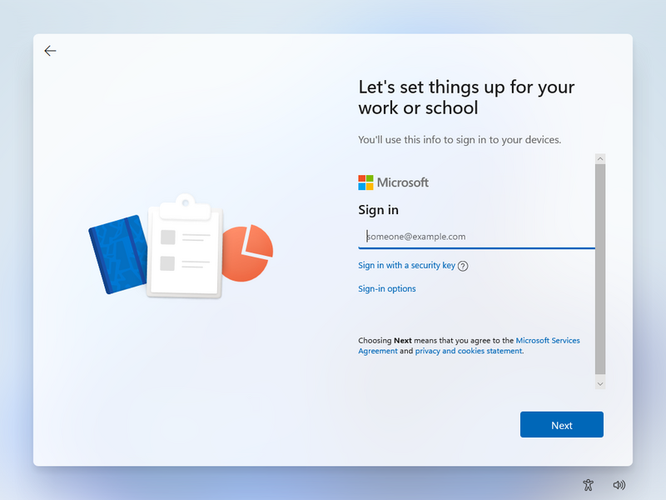
This Photo by Unknown Author is licensed under CC BY-SA

Slide 43
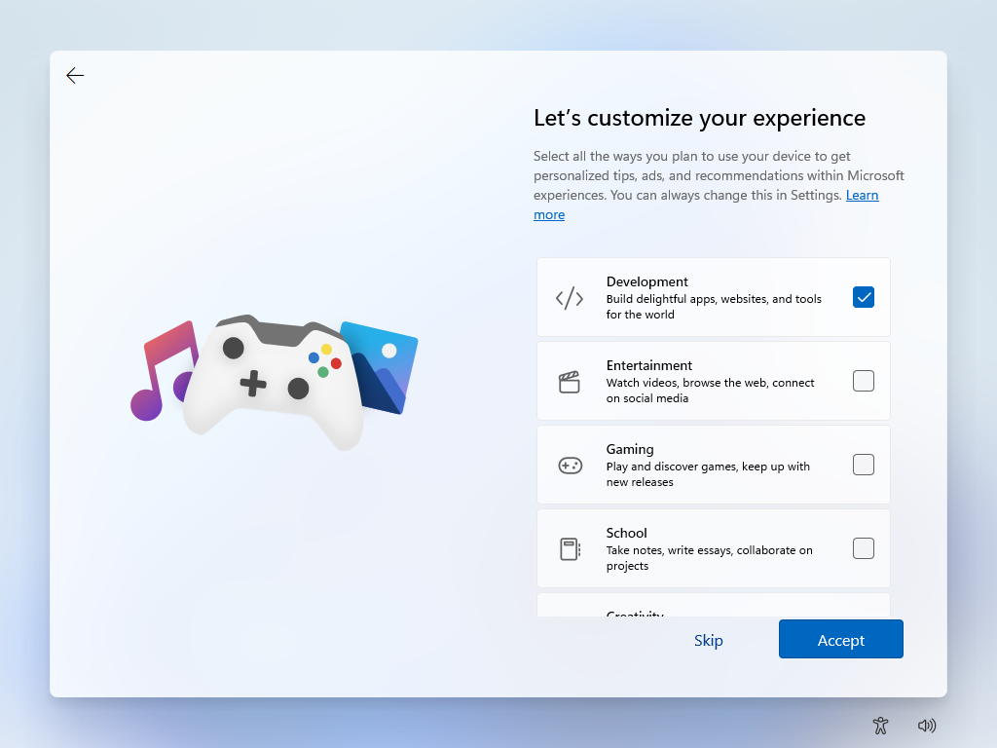
This Photo by Unknown Author is licensed under CC BY-SA

Slide 44
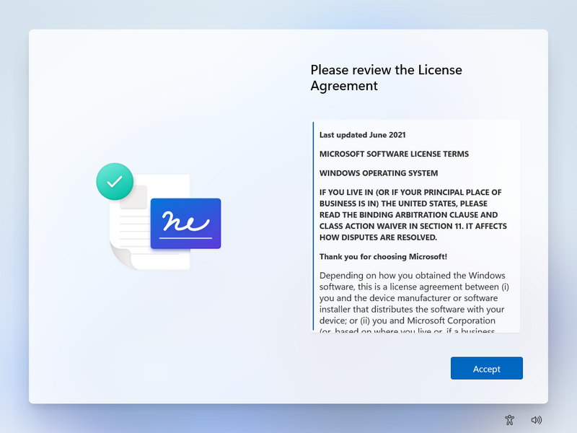
This Photo by Unknown Author is licensed under CC BY-SA

Slide 45
hi

Slide 46
This wont take long
Setting up your apps

Slide 47
This might take a while
Installing the apps

Slide 48
Alomost thre

Slide 49
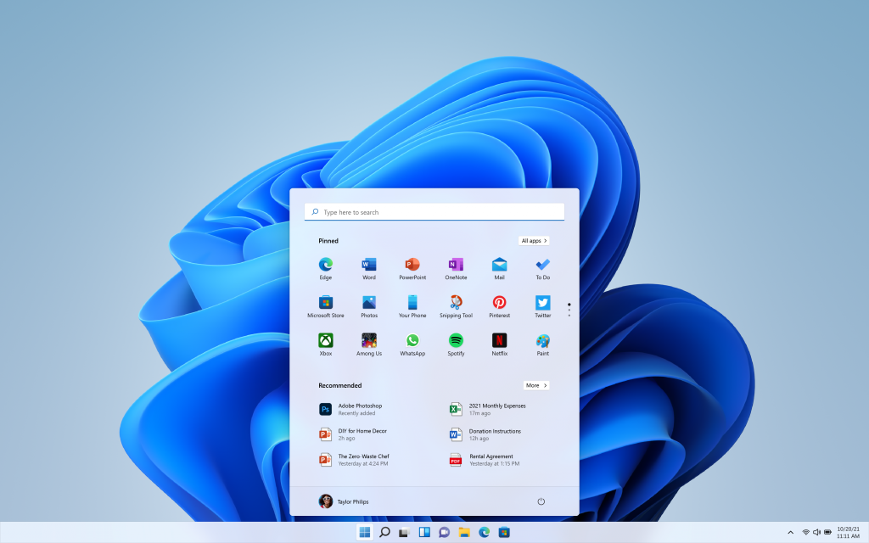
This Photo by Unknown Author is licensed under CC BY-SA

Slide 50
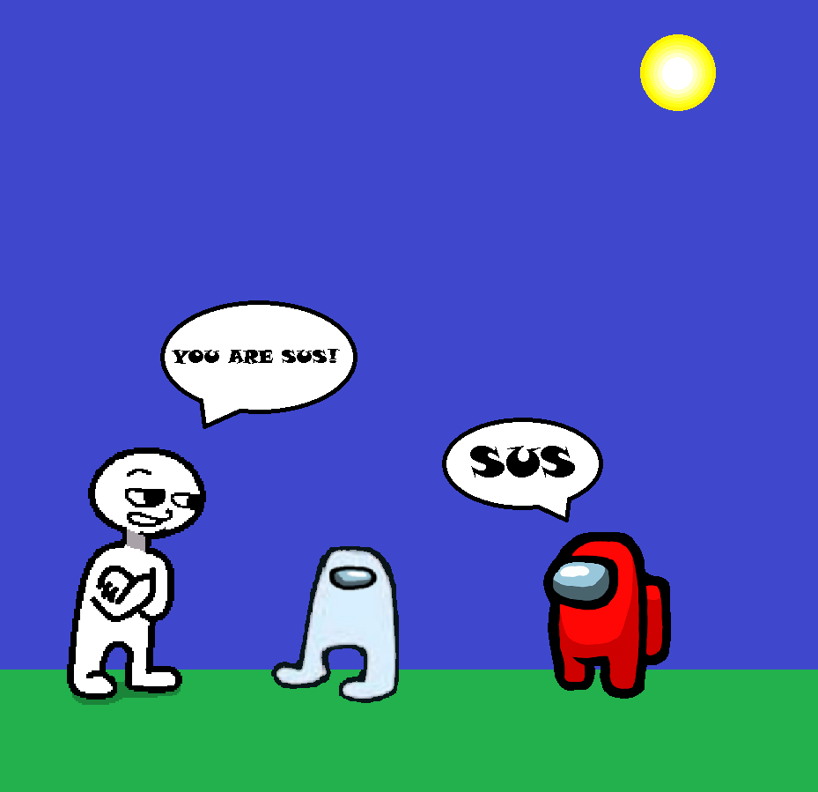

Slide 51


Slide 52

This Photo by Unknown Author is licensed under CC BY

Slide 53

This Photo by Unknown Author is licensed under CC BY-SA

Slide 54
You win!

Slide 55
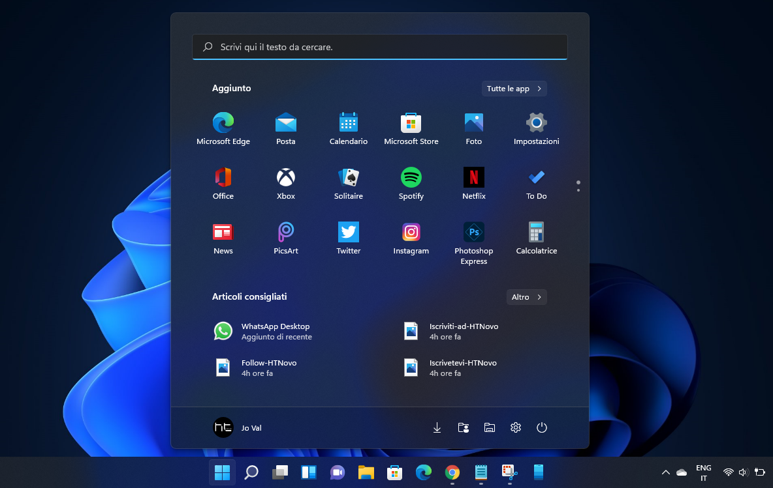
This Photo by Unknown Author is licensed under CC BY-SA

Slide 56
h

Slide 57
hi

Slide 58
hi
t

Slide 59
hi
th

Slide 60
hi
thi

Slide 61
hi
this

Slide 62
hi
This i

Slide 63
hi
This is

Slide 64
hi
This is w

Slide 65
hi
This is wi

Slide 66
hi
This is win

Slide 67
hi
This is wind

Slide 68
hi
This is windo

Slide 69
hi
This is window

Slide 70
hi
This is windows

Slide 71
hi
This is windows1

Slide 72
hi
This is windows11

Slide 73
This Photo by Unknown Author is licensed under CC BY-SA

Slide 74
Shutingg down

Slide 75
Shutingg down

Slide 76
Shutingg down

