Slide 1
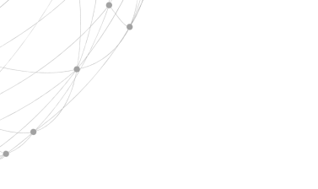

Claude Elwood Shannon
汇报人:王杰

Slide 2
01
Biography
CONTENT
02
Achievement
content
03
Conclusion

Slide 3
1
Biography

Slide 4
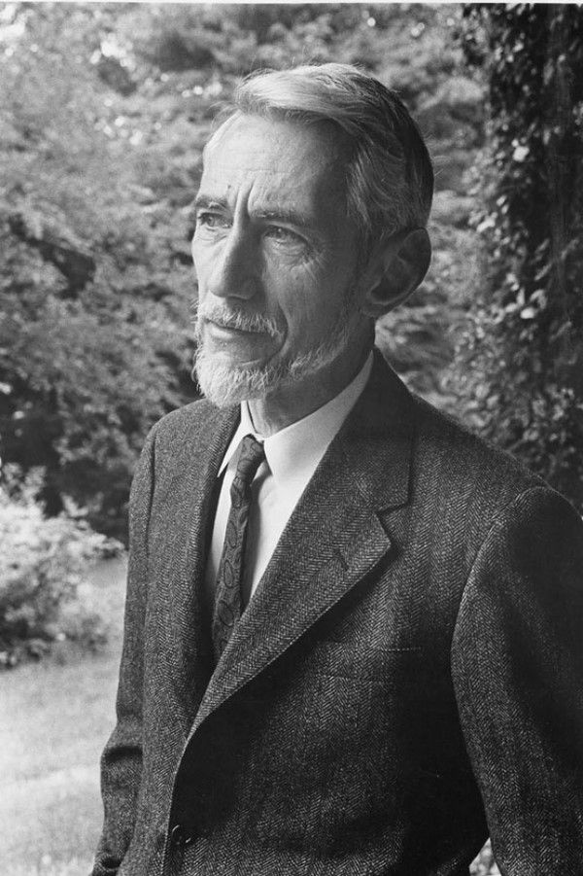
Biography
Claude Elwood Shannon
(1916--2001)
American mathematician
electrical engineer
Cryptographer
the father of information theory
,,
Born in Petoskey, Michigan Grew up in Gaylord, Michigan
Aged 84

Slide 5


Biography
1936
began his graduate studies
in electrical engineering
1936
electrical engineering
mathematics
1938
A Symbolic Analysis of Relay and Switching Circuits
1932
,,
1940
introduced to the work of George Boole
received his Ph.D. degree
1916

Slide 6
Biography
1945
Data Smoothing and Prediction in Fire-Control Systems
1942
invented of signal-flow graphs
discovered the topological gain formula
1948
A Mathematical Theory of Communication
During World War II
,,
joined Bell Labs to work on fire-control systems and cryptography
1949
Communication Theory of Secrecy Systems

Slide 7
2
Achievement

Slide 8
Achievement
2
Logic circuits
Information theory

Slide 9
Logic circuits
A Symbolic Analysis of Relay and Switching Circuits
proving that these circuits could solve all problems that Boolean algebra could solve
Using this property of electrical switches to implement logic is the fundamental concept
that underlies all electronic digital computers
Shannon's work became the foundation of digital circuit design

Slide 10
Information theory
A Mathematical Theory of Communication
Using math to explain information
Come up with Information entropy to measure information
Became the beginning of modern information theory research
One of the foundations of information age

Slide 11
3
Conclusion

Slide 12
Conclusion
He is a genius.In his whole life,he developed two most importance theory in 20st century.One developed logic circuits. And another one developed information theory.
You can’t really overstate the impact that Shannon’s work has had,it does begin to open up a possibility to understand ourselves and our society,because pretty much anything and everything can be measured and encoded as data.

Slide 13
Thanks for Listening
王杰

