Slide 1
H-index of Nodes

Slide 2
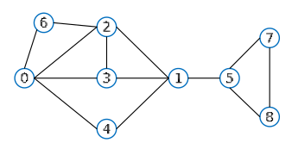
H-index 介绍
H-index 最初用于度量学者或期刊的影响。
For a scholar or journal, the H-index is defined as the maximum value h such that there exists at least h papers, each with citation count >= h.
在网络中，扩展了 H-index 的概念，用于度量节点的重要性。
The H-index of a node is defined to be the maximum value h such that there exists at least h neighbours of degree no less than h.

Slide 3
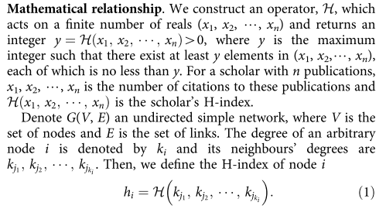

Slide 4
