Slide 1
Data Mining:
Concepts and Techniques
(3rd ed.)
— Chapter 4 —
Jianjun Cheng
School of Information Science & Engineering
Lanzhou University
©2011 Han, Kamber & Pei. All rights reserved.

Slide 2
Chapter 4: Data Warehousing and On-line Analytical Processing
Data Warehouse: Basic Concepts
Data Warehouse Modeling: Data Cube and OLAP
Data Warehouse Design and Usage
Data Warehouse Implementation
Data Generalization by Attribute-Oriented Induction
Summary


Slide 3
What is a Data Warehouse?
Defined in many different ways, but not rigorously.
  A decision support database that is maintained separately from the organization’s operational database
  Support information processing by providing a solid platform of consolidated, historical data for analysis.
"A data warehouse is a subject-oriented, integrated, time-variant, and nonvolatile collection of data in support of management’s decision-making process."—W. H. Inmon
Data warehousing:
  The process of constructing and using data warehouses

Slide 4
Data Warehouse—Subject-Oriented
Organized around major subjects, such as customer, product, sales
Focusing on the modeling and analysis of data for decision makers, not on daily operations or transaction processing
Provide a simple and concise view around particular subject issues by excluding data that are not useful in the decision support process

Slide 5
Data Warehouse—Integrated
Constructed by integrating multiple, heterogeneous data sources
  relational databases, flat files, on-line transaction records
Data cleaning and data integration techniques are applied.
  Ensure consistency in naming conventions, encoding structures, attribute measures, etc. among different data sources
    E.g., Hotel price: currency, tax, breakfast covered, etc.
  When data is moved to the warehouse, it is converted.

Slide 6
Data Warehouse—Time Variant
The time horizon for the data warehouse is significantly longer than that of operational systems
  Operational database: current value data
  Data warehouse data: provide information from a historical perspective (e.g., past 5-10 years)
Every key structure in the data warehouse
  Contains an element of time, explicitly or implicitly
  But the key of operational data may or may not contain "time element"

Slide 7
Data Warehouse—Nonvolatile
A physically separate store of data transformed from the operational environment
Operational update of data does not occur in the data warehouse environment
  Does not require transaction processing, recovery, and concurrency control mechanisms
  Requires only two operations in data accessing:
    initial loading of data and access of data

Slide 8
Data Warehouse vs. Heterogeneous DBMS
Traditional heterogeneous DB integration: A query driven approach
  Build wrappers/mediators on top of heterogeneous databases
  When a query is posed to a client site, a meta-dictionary is used to translate the query into queries appropriate for individual heterogeneous sites involved, and the results are integrated into a global answer set
  Complex information filtering, compete for resources
Data warehouse: update-driven, high performance
  Information from heterogeneous sources is integrated in advance and stored in warehouses for direct query and analysis
Data Mining: Concepts and Techniques

Slide 9
Data Warehouse vs. Operational DBMS
OLTP (on-line transaction processing)
  Major task of traditional relational DBMS
  Day-to-day operations: purchasing, inventory, banking, manufacturing, payroll, registration, accounting, etc.
OLAP (on-line analytical processing)
  Major task of data warehouse system
  Data analysis and decision making
Distinct features (OLTP vs. OLAP):
  User and system orientation: customer vs. market
  Data contents: current, detailed vs. historical, consolidated
  Database design: ER + application vs. star + subject
  View: current, local vs. evolutionary, integrated
  Access patterns: update vs. read-only but complex queries
Data Mining: Concepts and Techniques

Slide 10

OLTP vs. OLAP

Slide 11
Why a Separate Data Warehouse?
High performance for both systems
  DBMS— tuned for OLTP: access methods, indexing, concurrency control, recovery
  Warehouse—tuned for OLAP: complex OLAP queries, multidimensional view, consolidation
Different functions and different data:
  missing data: Decision support requires historical data which operational DBs do not typically maintain
  data consolidation: DS requires consolidation (aggregation, summarization) of data from heterogeneous sources
  data quality: different sources typically use inconsistent data representations, codes and formats which have to be reconciled
Note: There are more and more systems which perform OLAP analysis directly on relational databases

Slide 12
Data Warehouse: A Multi-Tiered Architecture
Monitor
&
Integrator
OLAP Server
Other
sources
Metadata
Analysis
Query
Reports
Data mining
Operational
DBs
Extract
clean
Transform
Load
Refresh
Data
Warehouse
Serve
Data Marts
Data Sources
Data Storage
OLAP Engine
Front-End Tools

Slide 13
Three Data Warehouse Models
Enterprise warehouse
  collects all of the information about subjects spanning the entire organization
Data Mart
  a subset of corporate-wide data that is of value to a specific groups of users. Its scope is confined to specific, selected groups, such as marketing data mart
    Independent vs. dependent (directly from warehouse) data mart
Virtual warehouse
  A set of views over operational databases
  Only some of the possible summary views may be materialized

Slide 14
Data Warehouse: A recommended approach
Multi-Tier Data Warehouse
Distributed Data Marts
incremental
and
evolutionary
Enterprise Data Warehouse
Data Mart
Data Mart
Model refinement
Model refinement
Define a high-level corporate data model

Slide 15
Extraction, Transformation, and Loading (ETL)
Data extraction
  get data from multiple, heterogeneous, and external sources
Data cleaning
  detect errors in the data and rectify them when possible
Data transformation
  convert data from legacy or host format to warehouse format
Load
  sort, summarize, consolidate, compute views, check integrity, and build indicies and partitions
Refresh
  propagate the updates from the data sources to the warehouse

Slide 16
Metadata Repository
Meta data is the data defining warehouse objects. It stores:
  Description of the structure of the data warehouse
    schema, view, dimensions, hierarchies, derived data defnition, data mart locations and contents
  Operational meta-data
    data lineage (history of migrated data and transformation path), currency of data (active, archived, or purged), monitoring information (warehouse usage statistics, error reports, audit trails)
  The algorithms used for summarization
    measure, dimension definition algorithm, data on granularity, partitions, subject areas, aggregation, summary, predefined queries and reports
  The mapping from operational environment to the data warehouse
    src. db. and contents, gw. des., data parti., data extract., cleaning, transformation rules and defaults, data refresh and purging rules, security
  Data related to system performance
    warehouse schema, view and derived data definitions
  Business data
    business terms and definitions, ownership of data, charging policies

Slide 17
Chapter 4: Data Warehousing and On-line Analytical Processing
Data Warehouse: Basic Concepts
Data Warehouse Modeling: Data Cube and OLAP
Data Warehouse Design and Usage
Data Warehouse Implementation
Data Generalization by Attribute-Oriented Induction
Summary


Slide 18
From Tables and Spreadsheets to
Data Cubes
A data warehouse is based on a multidimensional data model which views data in the form of a data cube
A data cube, such as sales, allows data to be modeled and viewed in multiple dimensions
  Dimension tables, such as item(item_name, brand, type), or time(day, week, month, quarter, year)
  Fact table contains measures (such as dollars_sold) and keys to each of the related dimension tables
In data warehousing literature, an n-D base cube is called a base cuboid. The top most 0-D cuboid, which holds the highest-level of summarization, is called the apex cuboid. The lattice of cuboids forms a data cube.

Slide 19
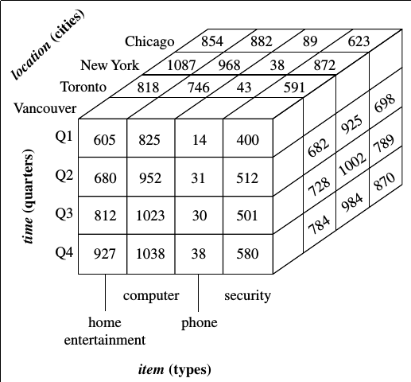
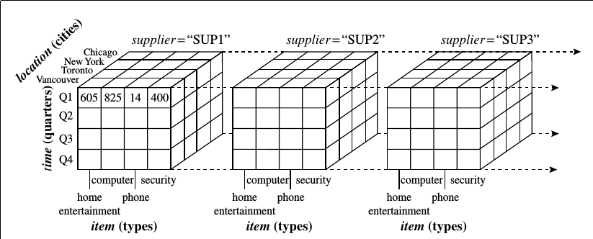
Data Cube: an example

Slide 20
Cube: A Lattice of Cuboids
all
0-D (apex) cuboid
time
item
location
supplier
1-D cuboids
time,location
item,location
location,supplier
time,item
2-D cuboids
time,supplier
item,supplier
time,location,supplier
3-D cuboids
time,item,location
time,item,supplier
item,location,supplier
4-D (base) cuboid
time, item, location, supplier

Slide 21

A Sample Data Cube
Date
Total annual sales
of TVs in U.S.A.
1Qtr
2Qtr
3Qtr
4Qtr
sum
Product
TV
PC
U.S.A
VCR
sum
Canada
Country
Mexico
sum
All, All, All

Slide 22
Cuboids Corresponding to the Cube
all
0-D (apex) cuboid
product
date
country
1-D cuboids
product,date
product,country
date, country
2-D cuboids
product, date, country
3-D (base) cuboid

Slide 23
Conceptual Modeling of Data Warehouses
Modeling data warehouses: dimensions & measures
  Star schema: A fact table in the middle connected to a set of dimension tables
  Snowflake schema: A refinement of star schema where some dimensional hierarchy is normalized into a set of smaller dimension tables, forming a shape similar to snowflake
  Fact constellations: Multiple fact tables share dimension tables, viewed as a collection of stars, therefore called galaxy schema or fact constellation

Slide 24
Example of Star Schema
time
time_key
day
day_of_the_week
month
quarter
year
item
item_key
item_name
brand
type
supplier_type
Sales Fact Table
time_key
item_key
branch_key
branch
location
location_key
branch_key
branch_name
branch_type
location_key
street
city
state_or_province
country
units_sold
dollars_sold
avg_sales
Measures

Slide 25
Example of Snowflake Schema
time
item
time_key
day
day_of_the_week
month
quarter
year
item_key
item_name
brand
type
supplier_key
supplier
Sales Fact Table
supplier_key
supplier_type
time_key
item_key
branch_key
branch
location
location_key
location_key
street
city_key
branch_key
branch_name
branch_type
units_sold
dollars_sold
city
avg_sales
city_key
city
state_or_province
country
Measures

Slide 26
Example of Fact Constellation
time
time_key
day
day_of_the_week
month
quarter
year
item
Shipping Fact Table
item_key
item_name
brand
type
supplier_type
time_key
Sales Fact Table
item_key
time_key
shipper_key
item_key
from_location
branch_key
to_location
branch
location_key
location
dollars_cost
branch_key
branch_name
branch_type
units_sold
location_key
street
city
province_or_state
country
units_shipped
dollars_sold
shipper
avg_sales
Measures
shipper_key
shipper_name
location_key
shipper_type

Slide 27
A Concept Hierarchy: Dimension (location)
all
all
region
Europe
...
North_America
country
Germany
...
Spain
Canada
...
Mexico
city
Frankfurt
...
Vancouver
...
Toronto
office
L. Chan
...
M. Wind

Slide 28


View of Warehouses and Hierarchies
Specification of hierarchies
Schema hierarchy
  day < {month < quarter; week} < year
Set_grouping hierarchy
  {1..10} < inexpensive

Slide 29
Multidimensional Data
Sales volume as a function of product, month, and region
Dimensions: Product, Location, Time
Hierarchical summarization paths
Region
Industry Region Year
Category Country Quarter
Product City Month Week
Office Day
Product
Month

Slide 30
Data Cube Measures: Three Categories
Distributive: if the result derived by applying the function to n aggregate values is the same as that derived by applying the function on all the data without partitioning
    E.g., count(), sum(), min(), max()
Algebraic: if it can be computed by an algebraic function with M arguments (where M is a bounded integer), each of which is obtained by applying a distributive aggregate function
    E.g., avg(), min_N(), standard_deviation()
Holistic: if there is no constant bound on the storage size needed to describe a subaggregate.
    E.g., median(), mode(), rank()

Slide 31
Typical OLAP Operations
Roll up (drill-up): summarize data
  by climbing up hierarchy or by dimension reduction
Drill down (roll down): reverse of roll-up
  from higher level summary to lower level summary or detailed data, or introducing new dimensions
Slice and dice: project and select
Pivot (rotate):
  reorient the cube, visualization, 3D to series of 2D planes
Other operations
  drill across: involving (across) more than one fact table
  drill through: through the bottom level of the cube to its back-end relational tables (using SQL)

Slide 32
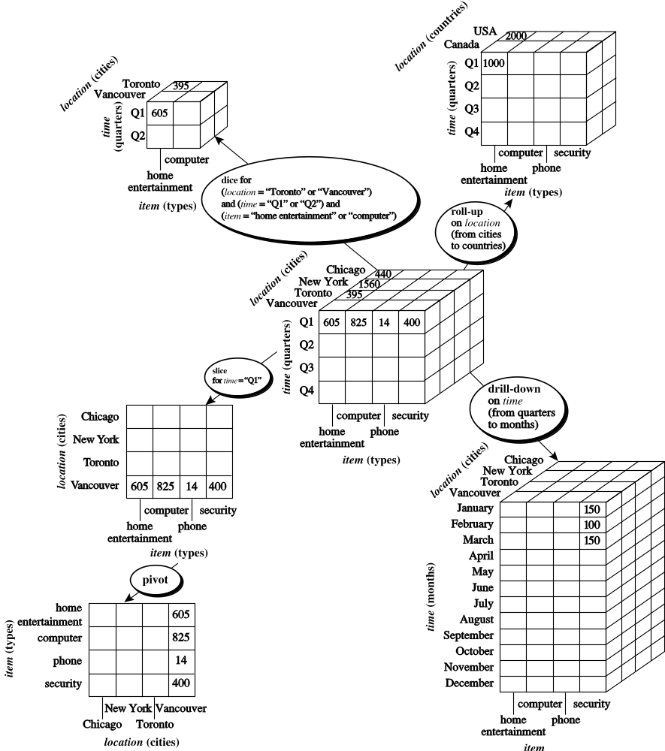
Fig. 3.10 Typical OLAP Operations

Slide 33
A Star-Net Query Model
Customer Orders
Shipping Method
Customer
CONTRACTS
AIR-EXPRESS
ORDER
TRUCK
PRODUCT LINE
Time
Product
ANNUALY
QTRLY
DAILY
PRODUCT ITEM
PRODUCT GROUP
CITY
SALES PERSON
COUNTRY
DISTRICT
REGION
DIVISION
Location
Each circle is called a footprint
Promotion
Organization

Slide 34
Chapter 4: Data Warehousing and On-line Analytical Processing
Data Warehouse: Basic Concepts
Data Warehouse Modeling: Data Cube and OLAP
Data Warehouse Design and Usage
Data Warehouse Implementation
Data Generalization by Attribute-Oriented Induction
Summary


Slide 35
Design of Data Warehouse: A Business Analysis Framework
Business analysts gain much from having a data warehouse
  competitive advantage
    presenting relevant information from which to measure performance and make critical adjustment to help win over competitors
  business productivity
    abel to quickly and efficiently gather information that accurately describe the orgniazation
  CRM
    provides a consistent view of customer and items across all lines of business, all departments and all markets
  cost reduction
    by tracking trends, patterns, and exceptions over long periods in a consistent and reliable manner

Slide 36
Design of Data Warehouse: A Business Analysis Framework
Four views regarding the design of a data warehouse
  Top-down view
    allows selection of the relevant information necessary for the data warehouse
  Data source view
    exposes the information being captured, stored, and managed by operational systems
  Data warehouse view
    consists of fact tables and dimension tables
  Business query view
    sees the perspectives of data in the warehouse from the view of end-user

Slide 37
Design of Data Warehouse: A Business Analysis Framework
Three skills needed
  Business skills, involves understanding
    how system store and manage their data
    how to build extractors that transfer data from operational systems to data warehouse
    how to build warehouse refresh software that keeps data warehouse up-to-date with the operational system's data
  Using a data warehouse involves understanding the significance of the data it contains, as well as understanding and translating the business requirements into queries that can be satisfied by the data warehouse

Slide 38
Design of Data Warehouse: A Business Analysis Framework
Three skills needed
  technology skills, data analysts are required to understand
    how to make assessments from quantitative information and derive facts based on conclusions from historic information
    include abilities to discover patters and trends, to extrapolate trends based on history and look for anomalies or paradigm shifts, to present coherent managerial recommendations based on such analysis
  program management skills, involve
    the need to interface with many technologies, vendors, and end-user in order to deliver results in a timely and cost-effective manner

Slide 39
Data Warehouse Design Process
Top-down, bottom-up approaches or a combination of both
  Top-down: Starts with overall design and planning (mature)
  Bottom-up: Starts with experiments and prototypes (rapid)
From software engineering point of view
  Waterfall: structured and systematic analysis at each step before proceeding to the next
  Spiral: rapid generation of increasingly functional systems, short turn around time, quick turn around

Slide 40
Data Warehouse Design Process
Typical data warehouse design process
  Choose a business process to model, e.g., orders, invoices, etc.
    orgnizational, involves multiple complex object collections ---- data warehouse model
    departmental, focuses on the analysis of one kind of business process
    ---- data mart
  Choose the grain (atomic level of data) of the business process
    individual transactions, individual daily snapshots, ...
  Choose the dimensions that will apply to each fact table record
    time, item, customer, supplier, warehouse, transaction type, status,...
  Choose the measure that will populate each fact table record
    numeric additive quantities: dollars_sold, unit_sold
dw construction is a difficult and long-term task, its implementation scope should be clearly defined
The goals of an initial dw implementation should be specific, achievable, and measurable, involve determining
  time and budget allocations
  the subset of the organization that is to be modeled
  the number of data sources selected
  the number and types of departments to be served

Slide 41
Data Warehouse Development: A Recommended Approach
Multi-Tier Data Warehouse
Distributed Data Marts
Enterprise Data Warehouse
Data Mart
Data Mart
Model refinement
Model refinement
Define a high-level corporate data model

Slide 42
Data Warehouse Usage
data warehouse evolves along with its application
  generate reports and answer predefined queries
  anlyze summarized and detailed data, the results are represented in the form of reports and charts
  is used for strategic purposes, performing multidimensional analysis and sophisticated slice-and-dice operations
  is employed for knowledge discovery and strategic decision making using data mining tools

Slide 43
Data Warehouse Usage
Three kinds of data warehouse applications
  Information processing
    supports querying, basic statistical analysis, and reporting using crosstabs, tables, charts and graphs
    construct low-cost web-based accessing tools that are then integrated with web browsers
  Analytical processing
    multidimensional analysis of data warehouse data
    supports basic OLAP operations, slice-dice, drilling, pivoting
  Data mining
    knowledge discovery from hidden patterns
    supports associations, constructing analytical models, performing classification and prediction, and presenting the mining results using visualization tools

Slide 44
From On-Line Analytical Processing (OLAP) to On Line Analytical Mining (OLAM)
Why online analytical mining?
  High quality of data in data warehouses
    DW contains integrated, consistent, cleaned data
  Available information processing structure surrounding data warehouses
    ODBC, OLEDB, Web accessing, service facilities, reporting and OLAP tools
  OLAP-based exploratory data analysis
    Mining with drilling, dicing, pivoting, etc.
  On-line selection of data mining functions
    Integration and swapping of multiple mining functions, algorithms, and tasks

Slide 45
Chapter 4: Data Warehousing and On-line Analytical Processing
Data Warehouse: Basic Concepts
Data Warehouse Modeling: Data Cube and OLAP
Data Warehouse Design and Usage
Data Warehouse Implementation
Data Generalization by Attribute-Oriented Induction
Summary


Slide 46

Efficient Data Cube Computation
Data cube can be viewed as a lattice of cuboids
  The bottom-most cuboid is the base cuboid
  The top-most cuboid (apex) contains only one cell
  How many cuboids in an n-dimensional cube with L levels?
Materialization of data cube
  Materialize every (cuboid) (full materialization), none (no materialization), or some (partial materialization)
  Selection of which cuboids to materialize
    Based on size, sharing, access frequency, etc.

Slide 47



Indexing OLAP Data: Bitmap Index
Index on a particular column
Each value in the column has a bit vector: bit-op is fast
The length of the bit vector: # of records in the base table
The i-th bit is set if the i-th row of the base table has the value for the indexed column
not suitable for high cardinality domains
  A recent bit compression technique, Word-Aligned Hybrid (WAH), makes it work for high cardinality domain as well [Wu, et al. TODS’06]
Base table
Index on Region
Index on Type

Slide 48

Indexing OLAP Data: Join Indices
Join index: JI(R-id, S-id) where R (R-id, …) ⋈ S (S-id, …)
Traditional indices map the values to a list of record ids
  It materializes relational join in JI file and speeds up relational join
In data warehouses, join index relates the values of the dimensions of a star schema to rows in the fact table.
  E.g. fact table: Sales and two dimensions city and product
    A join index on city maintains for each distinct city a list of R-IDs of the tuples recording the Sales in the city
  Join indices can span multiple dimensions

Slide 49
Efficient Processing OLAP Queries
Determine which operations should be performed on the available cuboids
  Transform drill, roll, etc. into corresponding SQL and/or OLAP operations, e.g., dice = selection + projection
Determine which materialized cuboid(s) should be selected for OLAP op.
  Let the query to be processed be on {brand, province_or_state} with the condition "year = 2004 ", and there are 4 materialized cuboids available:
    1) {year, item_name, city}
    2) {year, brand, country}
    3) {year, brand, province_or_state}
    4) {item_name, province_or_state} where year = 2004
    Which should be selected to process the query?
Explore indexing structures and compressed vs. dense array structs in MOLAP

Slide 50
OLAP Server Architectures
Relational OLAP (ROLAP)
  Use relational or extended-relational DBMS to store and manage warehouse data and OLAP middle ware
  Include optimization of DBMS backend, implementation of aggregation navigation logic, and additional tools and services
  Greater scalability
Multidimensional OLAP (MOLAP)
  Sparse array-based multidimensional storage engine
  Fast indexing to pre-computed summarized data
Hybrid OLAP (HOLAP) (e.g., Microsoft SQLServer)
  Flexibility, e.g., low level: relational, high-level: array
Specialized SQL servers (e.g., Redbricks)
  Specialized support for SQL queries over star/snowflake schemas

Slide 51
Chapter 4: Data Warehousing and On-line Analytical Processing
Data Warehouse: Basic Concepts
Data Warehouse Modeling: Data Cube and OLAP
Data Warehouse Design and Usage
Data Warehouse Implementation
Data Generalization by Attribute-Oriented Induction
Summary


Slide 52
Data Generalization
Data generalization summarizes data by replacing relatively low-level values with high-level concepts, or by reducing the number of dimensions to summarize data in concept space involving fewer dimensions.
Facilitating users to examine the general behavior of the data at multiple levels of abstraction
  e.g., instead of examing individual custormer transactions, sales managers prefer to view data generalized to a higher level, such as summarized by customer groups according to geographic regions, frequency of purchases per group, customer income

Slide 53
Data Generalization: Concept Description
Concept description is a form of data generalization
A concept typically refers to a data collection, but is not a simple enumeration of data
Concept description generates description for data generalization and comparsion
  Characterization: provides a concise and succinct summarization of the given data collection
  Discrimination: provides description comparing two or more data collection
Complex data types, automation: AOI

Slide 54
Attribute-Oriented Induction
Proposed in 1989 (KDD'89 workshop)
Not confined to categorical data nor particular measures
How it is done?
  Collect the task-relevant data (initial relation) using a relational database query
  Perform generalization by attribute removal or attribute generalization
  Apply aggregation by merging identical, generalized tuples and accumulating their respective counts
  Interaction with users for knowledge presentation

Slide 55
Attribute-Oriented Induction: An Example
Example: Describe general characteristics of graduate students in the Big University database
  use Big_University_DB
  mine characteristics as "Science Students"
  in relevance to name, gender, major, birth_place,
  birth_date, residence, phone#, gpa
  from student
  where status in "graduate"

Slide 56
Attribute-Oriented Induction: An Example
Example: Describe general characteristics of graduate students in the Big University database
Step 1. Fetch relevant set of data using an SQL statement, e.g.,
use Big_University_DB
    Select * (i.e., name, gender, major, birth_place, birth_date, residence, phone#, gpa)
    from student
    where student_status in {“Msc”, “MBA”, “PhD” }
Step 2. Perform attribute-oriented induction
Step 3. Present results in generalized relation, cross-tab, or rule forms

Slide 57
Basic Principles of Attribute-Oriented Induction
Data focusing: task-relevant data, including dimensions, and the result is the initial working relation -- Cor. Ana.
Data Generalization
  Attribute-removal: remove attribute A if there is a large set of distinct values for A but (1) there is no generalization operator on A, or (2) A’s higher level concepts are expressed in terms of other attributes
  Attribute-generalization: If there is a large set of distinct values for A, and there exists a set of generalization operators on A, then select an operator and generalize A
Attribute Generalization Control
  Attribute-threshold control: typical 2-8, specified/default
  Generalized relation threshold control: control the final relation/rule size

Slide 58
Attribute-Oriented Induction: Basic Algorithm
InitialRel: Query processing of task-relevant data, deriving the initial working relation.
PreGen: Based on the analysis of the number of distinct values in each attribute, determine generalization plan for each attribute: removal? or how high to generalize?
PrimeGen: Based on the PreGen plan, perform generalization to the right level to derive a "prime generalized relation", accumulating the counts.
Presentation: User interaction: (1) adjust levels by drilling, (2) pivoting, (3) mapping into rules, cross tabs, visualization presentations.

Slide 59
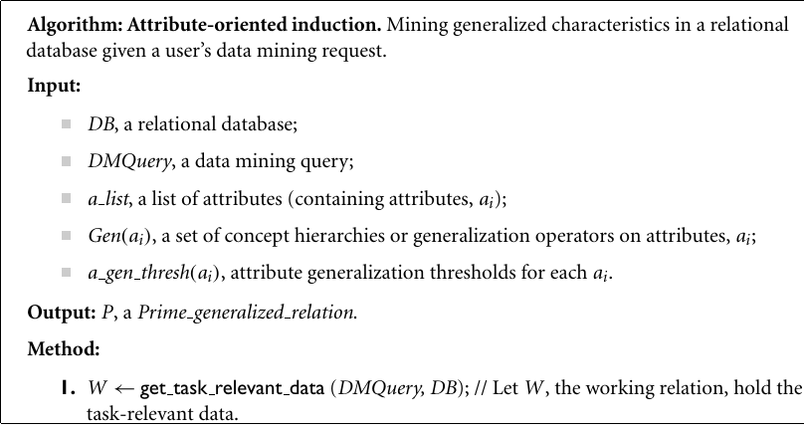
Attribute-Oriented Induction: Basic Algorithm

Slide 60
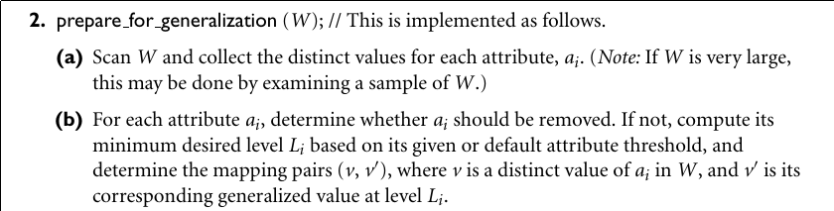
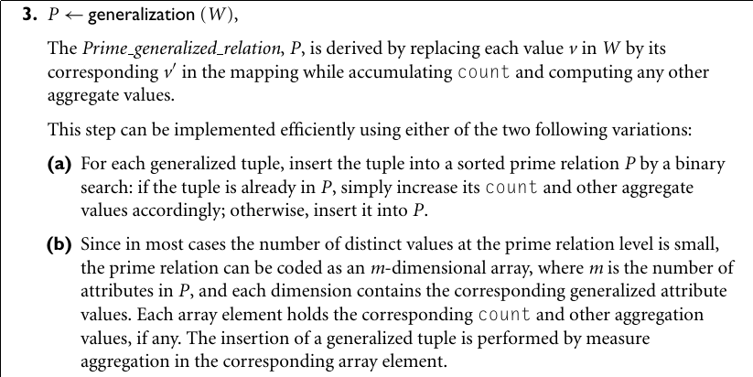

Slide 61



Class Characterization: An Example
Initial Relation
Prime Generalized Relation

Slide 62
Presentation of Generalized Results
Generalized relation:
  Relations where some or all attributes are generalized, with counts or other aggregation values accumulated.
Cross tabulation:
  Mapping results into cross tabulation form (similar to contingency tables).
  Visualization techniques:
  Pie charts, bar charts, curves, cubes, and other visual forms.
Quantitative characteristic rules:
  Mapping generalized result into characteristic rules with quantitative information associated with it, e.g.,

Slide 63
Mining Class Comparisons
Comparison: Comparing two or more classes
Method:
  Partition the set of relevant data into the target class and the contrasting class(es)
  Generalize both classes to the same high level concepts
  Compare tuples with the same high level descriptions
  Present for every tuple its description and two measures
    support - distribution within single class
    comparison - distribution between classes
  Highlight the tuples with strong discriminant features
Relevance Analysis:
  Find attributes (features) which best distinguish different classes

Slide 64
Mining Class Comparisons
Example: comparison of the general properties of the graduate and undergraduate students at Big University
use Big University DB
  mine comparison as "grad vs undergrad students"
  in relevance to name, gender, major, birth place,
  birth date, residence, phone#, gpa
  for "graduate students"
  where status in "graduate"
  versus "undergraduate students"
  where status in "undergraduate"
  analyze count%
  from student

Slide 65
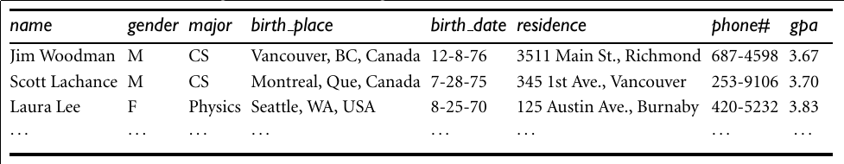
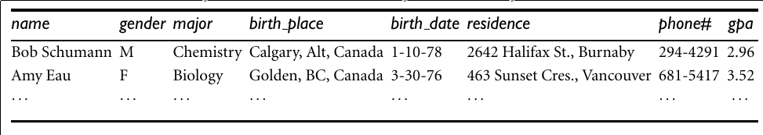
Class Comparison: An Example
Initial Target Relation
Initial Contrasting Relation

Slide 66
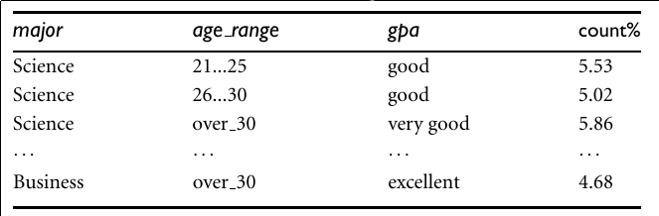
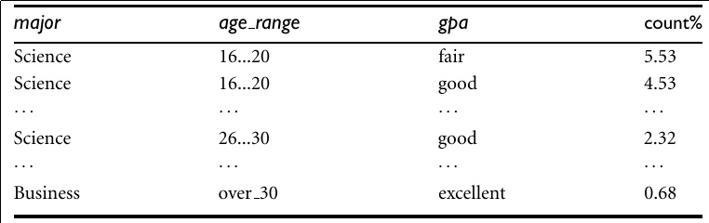
Class Comparison: An Example
Prime Generalized Relation
Prime Generalized Contrasting Relation

Slide 67
Concept Description vs. Cube-Based OLAP
Similarity:
  Data generalization
  Presentation of data summarization at multiple levels of abstraction
  Interactive drilling, pivoting, slicing and dicing
Differences:
  OLAP has systematic preprocessing, query independent, and can drill down to rather low level
  AOI has automated desired level allocation, and may perform dimension relevance analysis/ranking when there are many relevant dimensions
  AOI works on the data which are not in relational forms

Slide 68
Chapter 4: Data Warehousing and On-line Analytical Processing
Data Warehouse: Basic Concepts
Data Warehouse Modeling: Data Cube and OLAP
Data Warehouse Design and Usage
Data Warehouse Implementation
Data Generalization by Attribute-Oriented Induction
Summary


Slide 69
Summary
Data warehousing: A multi-dimensional model of a data warehouse
  A data cube consists of dimensions & measures
  Star schema, snowflake schema, fact constellations
  OLAP operations: drilling, rolling, slicing, dicing and pivoting
Data Warehouse Architecture, Design, and Usage
  Multi-tiered architecture
  Business analysis design framework
  Information processing, analytical processing, data mining, OLAM (Online Analytical Mining)
Implementation: Efficient computation of data cubes
  Partial vs. full vs. no materialization
  Indexing OALP data: Bitmap index and join index
  OLAP query processing
  OLAP servers: ROLAP, MOLAP, HOLAP
Data generalization: Attribute-oriented induction

Slide 70
References (I)
S. Agarwal, R. Agrawal, P. M. Deshpande, A. Gupta, J. F. Naughton, R. Ramakrishnan, and S. Sarawagi. On the computation of multidimensional aggregates. VLDB’96
D. Agrawal, A. E. Abbadi, A. Singh, and T. Yurek. Efficient view maintenance in data warehouses. SIGMOD’97
R. Agrawal, A. Gupta, and S. Sarawagi. Modeling multidimensional databases. ICDE’97
S. Chaudhuri and U. Dayal. An overview of data warehousing and OLAP technology. ACM SIGMOD Record, 26:65-74, 1997
E. F. Codd, S. B. Codd, and C. T. Salley. Beyond decision support. Computer World, 27, July 1993.
J. Gray, et al. Data cube: A relational aggregation operator generalizing group-by, cross-tab and sub-totals. Data Mining and Knowledge Discovery, 1:29-54, 1997.
A. Gupta and I. S. Mumick. Materialized Views: Techniques, Implementations, and Applications. MIT Press, 1999.
J. Han. Towards on-line analytical mining in large databases. ACM SIGMOD Record, 27:97-107, 1998.
V. Harinarayan, A. Rajaraman, and J. D. Ullman. Implementing data cubes efficiently. SIGMOD’96
J. Hellerstein, P. Haas, and H. Wang. Online aggregation. SIGMOD'97

Slide 71
References (II)
C. Imhoff, N. Galemmo, and J. G. Geiger. Mastering Data Warehouse Design: Relational and Dimensional Techniques. John Wiley, 2003
W. H. Inmon. Building the Data Warehouse. John Wiley, 1996
R. Kimball and M. Ross. The Data Warehouse Toolkit: The Complete Guide to Dimensional Modeling. 2ed. John Wiley, 2002
P. O’Neil and G. Graefe. Multi-table joins through bitmapped join indices. SIGMOD Record, 24:8–11, Sept. 1995.
P. O'Neil and D. Quass. Improved query performance with variant indexes. SIGMOD'97
Microsoft. OLEDB for OLAP programmer's reference version 1.0. In http://www.microsoft.com/data/oledb/olap, 1998
S. Sarawagi and M. Stonebraker. Efficient organization of large multidimensional arrays. ICDE'94
A. Shoshani. OLAP and statistical databases: Similarities and differences. PODS’00.
D. Srivastava, S. Dar, H. V. Jagadish, and A. V. Levy. Answering queries with aggregation using views. VLDB'96
P. Valduriez. Join indices. ACM Trans. Database Systems, 12:218-246, 1987.
J. Widom. Research problems in data warehousing. CIKM’95
K. Wu, E. Otoo, and A. Shoshani, Optimal Bitmap Indices with Efficient Compression, ACM Trans. on Database Systems (TODS), 31(1): 1-38, 2006

Slide 72
Surplus Slides

Slide 73
Compression of Bitmap Indices
Bitmap indexes must be compressed to reduce I/O costs and minimize CPU usage—majority of the bits are 0’s
Two compression schemes:
  Byte-aligned Bitmap Code (BBC)
  Word-Aligned Hybrid (WAH) code
Time and space required to operate on compressed bitmap is proportional to the total size of the bitmap
Optimal on attributes of low cardinality as well as those of high cardinality.
WAH out performs BBC by about a factor of two

