Slide 1
Data Mining:
Concepts and Techniques
(3rd ed.)
— Chapter 5 —
Jianjun Cheng
School of Information Science & Engineering
Lanzhou University
©2010 Han, Kamber & Pei. All rights reserved.

Slide 2
Chapter 5: Data Cube Technology

Data Cube Computation: Preliminary Concepts
Data Cube Computation Methods
Processing Advanced Queries by Exploring Data Cube Technology
Multidimensional Data Analysis in Cube Space
Summary

Slide 3
Data Cube: A Lattice of Cuboids
all
0-D(apex) cuboid
time
item
location
supplier
1-D cuboids
time,location
item,location
location,supplier
2-D cuboids
time,item
time,supplier
item,supplier
time,location,supplier
3-D cuboids
time,item,location
time,item,supplier
item,location,supplier
4-D(base) cuboid
time, item, location, supplierc

Slide 4
Data Cube: A Lattice of Cuboids
all
0-D(apex) cuboid
time
item
location
supplier
1-D cuboids
time,item
time,location
item,location
location,supplier
time,supplier
item,supplier
2-D cuboids
time,location,supplier
3-D cuboids
time,item,location
time,item,supplier
item,location,supplier
time, item, location, supplier
4-D(base) cuboid
Base vs. aggregate cells; ancestor vs. descendant cells; parent vs. child cells
  (9/15, milk, Urbana, Dairy_land)
  (9/15, milk, Urbana, *)
  (*, milk, Urbana, *)
  (*, milk, Urbana, *)
  (*, milk, Chicago, *)
  (*, milk, *, *)

Slide 5
Cube Materialization
Cube、Cuboid、basic cuboid、apex cuboid
Basic cell、aggregate cell
A cell in the base cuboid is a base cell, a cell from a nonbase cuboid is an aggregate cell.
An aggregate cell aggregates over one or more dimensions, where each aggregated dimension is indicated by a "*" in the cell notation.
Let a = (a₁ , a₂ , . . . , a_{n} , measures) be a cell from one of the cuboids making up the data cube. We say that a is an m-dimensional cell if exactly m (m ≤ n) values among {a₁ , a₂ , . . . , a_{n} } are not "*".
If m = n, then a is a base cell; otherwise, it is an aggregated cell (i.e., where m < n).
Data Mining: Concepts and Techniques

Slide 6
Cube Materialization
An ancestor-descendant relationship may exist between cells.
In an n-dimensional data cube, an i-D cell a = (a₁, a₂, …, a_{n}, measures_{a}) is an ancestor of a j-D cell b = (b₁, b₂, …, b_{n}, measures_{b}), and b is a descendant of a, if and only if
(1) i < j
(2) for 1≤m≤n, a_{m} = b_{m} whenever a_{m} ≠ “*”.
In particular, cell a is called a parent of cell b, and b is a child of a, if and only if j = i+1 and b is a descendant of a.
Data Mining: Concepts and Techniques

Slide 7

Cube Materialization:
Full Cube vs. Iceberg Cube
Full cube vs. iceberg cube
    compute cube sales iceberg as
    select month, city, customer group, count(*)
    from salesInfo
    cube by month, city, customer group
    having count(*) >= min_support
iceberg condition
Computing only the cuboid cells whose measure satisfies the iceberg condition
Only a small portion of cells may be “above the water’’ in a sparse cube
Avoid explosive growth: A cube with 100 dimensions
  2 base cells: (a1, a2, …., a100), (b1, b2, …, b100)
  How many aggregate cells if “having count >= 1”?
  What about “having count >= 2”?

Slide 8
Iceberg Cube, Closed Cube & Cube Shell
Is iceberg cube good enough?
  2 base cells: {(a₁, a₂, a₃ . . . , a₁₀₀):10, (a₁, a₂, b₃, . . . , b₁₀₀):10}
  How many cells will the iceberg cube have if having count(*) >= 10? Hint: A huge but tricky number!
Close cube:
  Closed cell c: if there exists no cell d, s.t. d is a descendant of c, and d has the same measure value as c.
  Closed cube: a cube consisting of only closed cells
  What is the closed cube of the above base cuboid? Hint: only 3 cells
Cube Shell
  Precompute only the cuboids involving a small # of dimensions, e.g., 3
  More dimension combinations will need to be computed on the fly
For (A₁, A₂, … A₁₀), how many combinations to compute?

Slide 9
Roadmap for Efficient Computation
General cube computation heuristics (Agarwal et al.’96)
Computing full/iceberg cubes: 3 methodologies
  Bottom-Up: Multi-Way array aggregation (Zhao, Deshpande & Naughton, SIGMOD’97)
  Top-down:
    BUC (Beyer & Ramarkrishnan, SIGMOD’99)
    H-cubing technique (Han, Pei, Dong & Wang: SIGMOD’01)
  Integrating Top-Down and Bottom-Up:
    Star-cubing algorithm (Xin, Han, Li & Wah: VLDB’03)
High-dimensional OLAP: A Minimal Cubing Approach (Li, et al. VLDB’04)
Computing alternative kinds of cubes:
  Partial cube, closed cube, approximate cube, etc.

Slide 10
Preliminary Tricks (Agarwal et al. VLDB’96)
Sorting, hashing, and grouping operations are applied to the dimension attributes in order to reorder and cluster related tuples
  Share-sorts: sharing sorting costs cross multiple cuboids when sort-based method is used
  Share-partitions: sharing the partitioning cost across multiple cuboids when hash-based algorithms are used
Aggregates may be computed from previously computed aggregates, rather than from the base fact table
  Cache-results: caching results of a cuboid from which other cuboids are computed to reduce disk I/Os
  Amortize-scans: computing as many as possible cuboids at the same time to amortize disk reads
  Smallest-child: computing a cuboid from the smallest, previously computed cuboid
  Apriori pruning method: If a given cell does not satisfy minimum support, then no descendant of the cell will satisfy minimum support either.
Data Mining: Concepts and Techniques

Slide 11
Chapter 5: Data Cube Technology
Data Cube Computation: Preliminary Concepts
Data Cube Computation Methods
Processing Advanced Queries by Exploring Data Cube Technology
Multidimensional Data Analysis in Cube Space
Summary


Slide 12
Data Cube Computation Methods
Multi-Way Array Aggregation
BUC
Star-Cubing
High-Dimensional OLAP

Slide 13
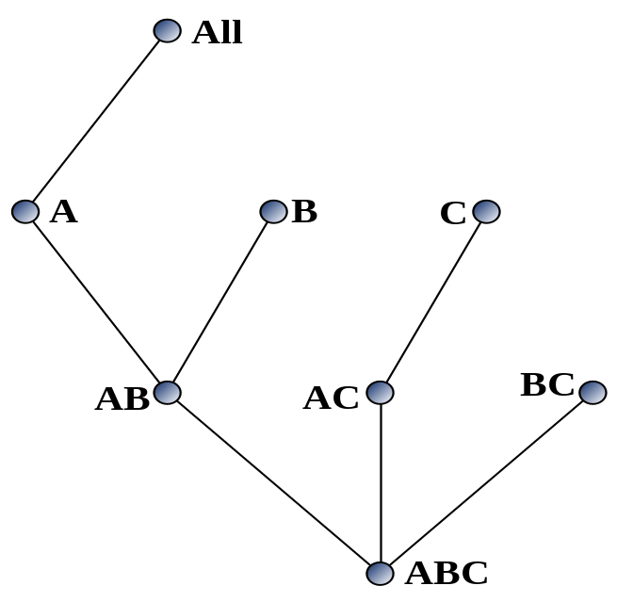
Multi-Way Array Aggregation
Array-based "bottom-up" algorithm
Using multi-dimensional chunks
No direct tuple comparisons
Simultaneous aggregation on multiple dimensions
Intermediate aggregate values are re-used for computing ancestor cuboids
Cannot do Apriori pruning: No iceberg optimization

Slide 14
Multi-way Array Aggregation for Cube Computation (MOLAP)
Partition arrays into chunks (a small subcube which fits in memory).
Compressed sparse array addressing: (chunk_id, offset)
Compute aggregates in "multiway" by visiting cube cells in the order which minimizes the # of times to visit each cell, and reduces memory access and storage cost.
C
c3
61
62
63
64
c2
45
46
47
48
c1
29
30
31
32
What is the best traversing order to do multi-way aggregation?
c 0
B
60
b3
13
14
15
16
44
9
28
56
b2
B
40
24
52
b1
5
36
20
b0
1
2
3
4
a0
a1
a2
a3
A

Slide 15
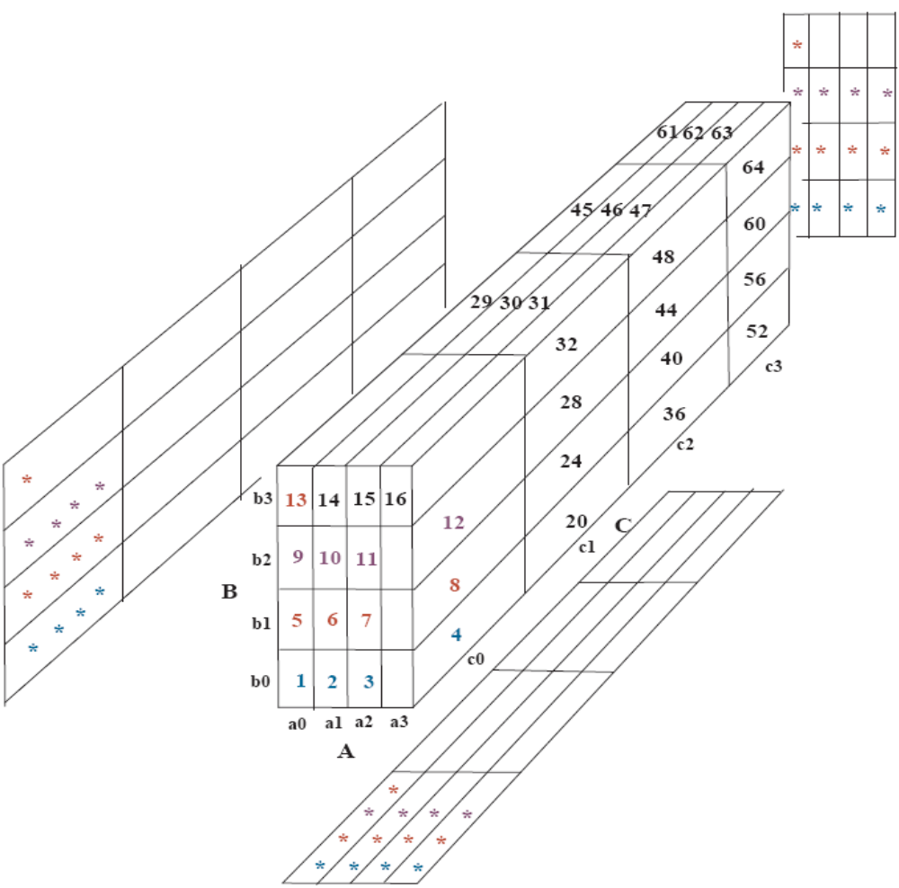
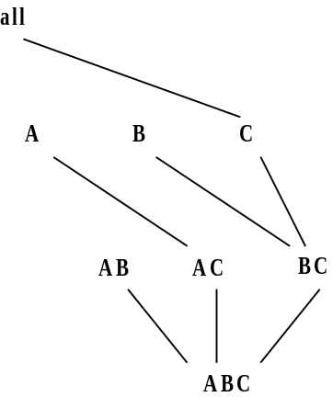
Multi-way Array Aggregation for Cube Computation (3-D to 2-D)
The best order is the one that minimizes the memory requirement and reduced I/Os

Slide 16
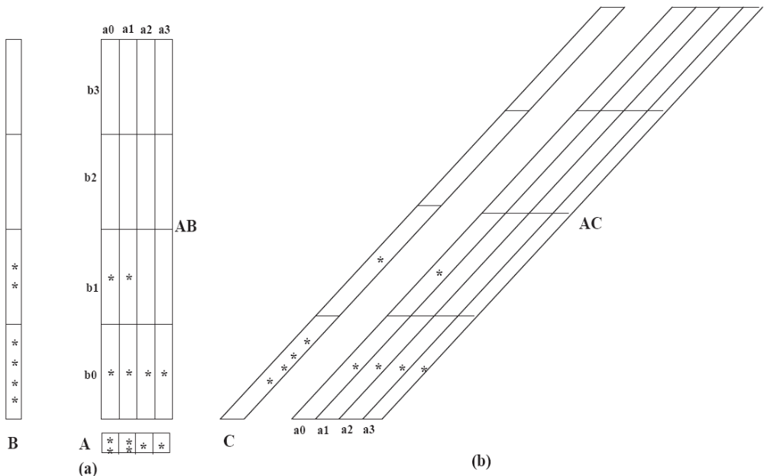
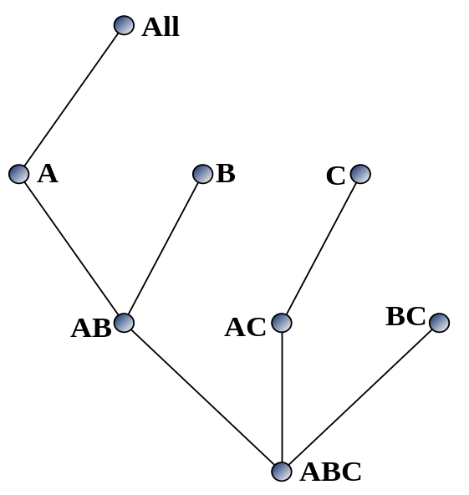
Multi-way Array Aggregation for Cube Computation (2-D to 1-D)

Slide 17
Multi-way Array Aggregation for Cube Computation
C
c3
61
62
63
64
c2
45
46
47
48
c1
29
30
31
32
c 0
B
60
b3
13
14
15
16
44
B
9
28
56
b2
40
5
24
52
b1
36
20
b0
1
2
3
4
a0
a1
a2
a3
A
Data Mining: Concepts and Techniques

Slide 18
Multi-way Array Aggregation for Cube Computation
C
c3
61
62
63
64
c2
45
46
47
48
c1
29
30
31
32
c 0
B
60
b3
13
14
15
16
44
B
9
28
56
b2
40
5
24
52
b1
36
20
b0
1
2
3
4
a0
a1
a2
a3
A
Data Mining: Concepts and Techniques

Slide 19
Multi-Way Array Aggregation for Cube Computation (Method Summary)
Method: the planes should be sorted and computed according to their size in ascending order
  Idea: keep the smallest plane in the main memory, fetch and compute only one chunk at a time for the largest plane
Limitation of the method: computing well only for a small number of dimensions
  If there are a large number of dimensions, "top-down" computation and iceberg cube computation methods can be explored

Slide 20
Data Cube Computation Methods
Multi-Way Array Aggregation
BUC
Star-Cubing
High-Dimensional OLAP

Slide 21
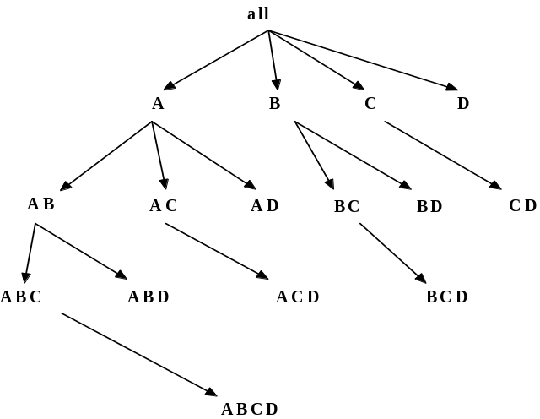
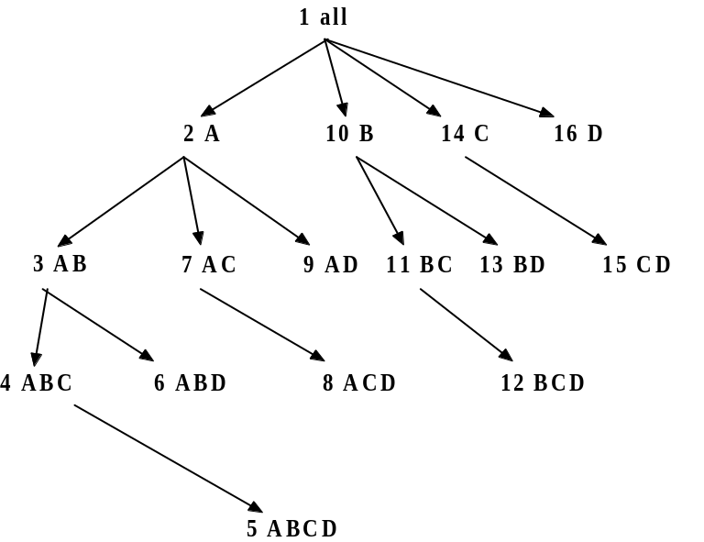
Bottom-Up Computation (BUC)
BUC (Beyer & Ramakrishnan, SIGMOD’99)
Bottom-up cube computation
  (Note: top-down in our view!)
Divides dimensions into partitions and facilitates iceberg pruning
  If a partition does not satisfy min_sup, its descendants can be pruned
  If minsup = 1  compute full CUBE!
No simultaneous aggregation

Slide 22
BUC: Partitioning
Usually, entire data set can’t fit in main memory
Sort distinct values
  partition into blocks that can fit in main memory
Continue processing
Optimizations
  Partitioning
    External Sorting, Hashing, Counting Sort
  Ordering dimensions to encourage pruning
    Cardinality, Skew, Correlation
  Collapsing duplicates
    Can’t do holistic aggregates anymore!

Slide 23
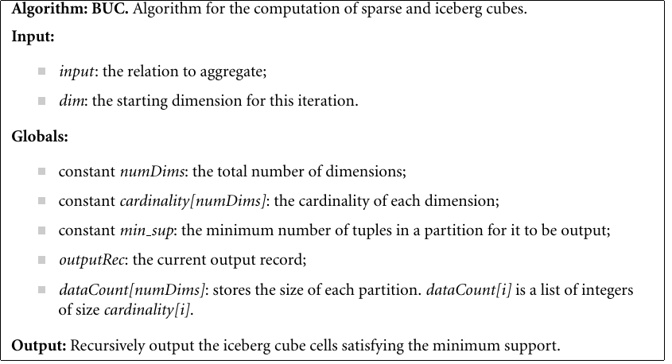
BUC: Partitioning

Slide 24
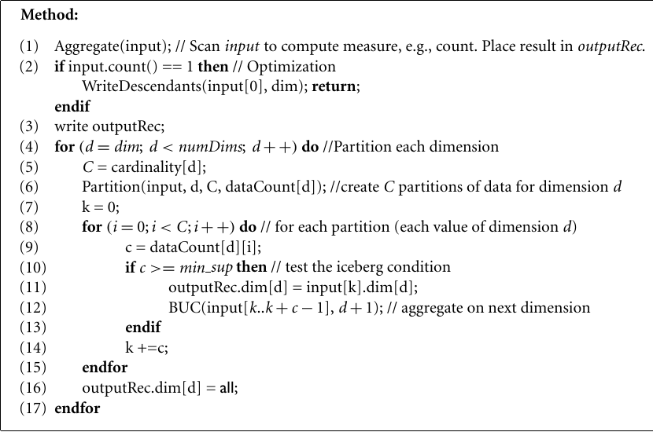
BUC: Partitioning

Slide 25

BUC: Example
compute cube iceberg cube as
select A, B, C, D, count(*)
from R
cube by A, B, C, D
having count(*) >= 3

Slide 26
Data Cube Computation Methods
Multi-Way Array Aggregation
BUC
Star-Cubing
High-Dimensional OLAP

Slide 27
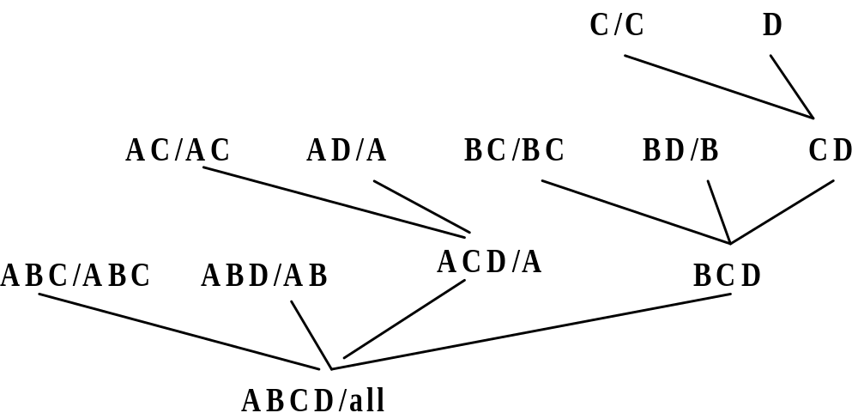
Star-Cubing: An Integrating Method
D. Xin, J. Han, X. Li, B. W. Wah, Star-Cubing: Computing Iceberg Cubes by Top-Down and Bottom-Up Integration, VLDB'03
Explore shared dimensions
  E.g., dimension A is the shared dimension of ACD and AD
  ABD/AB means cuboid ABD has shared dimensions AB
Allows for shared computations
  e.g., cuboid AB is computed simultaneously as ABD
Aggregate in a top-down manner but with the bottom-up sub-layer underneath which will allow Apriori pruning
Shared dimensions grow in bottom-up fashion

Slide 28
Iceberg Pruning in Shared Dimensions
Anti-monotonic property of shared dimensions
  If the measure is anti-monotonic, and if the aggregate value on a shared dimension does not satisfy the iceberg condition, then all the cells extended from this shared dimension cannot satisfy the condition either
Intuition: if we can compute the shared dimensions before the actual cuboid, we can use them to do Apriori pruning
Problem: how to prune while still aggregate simultaneously on multiple dimensions?

Slide 29
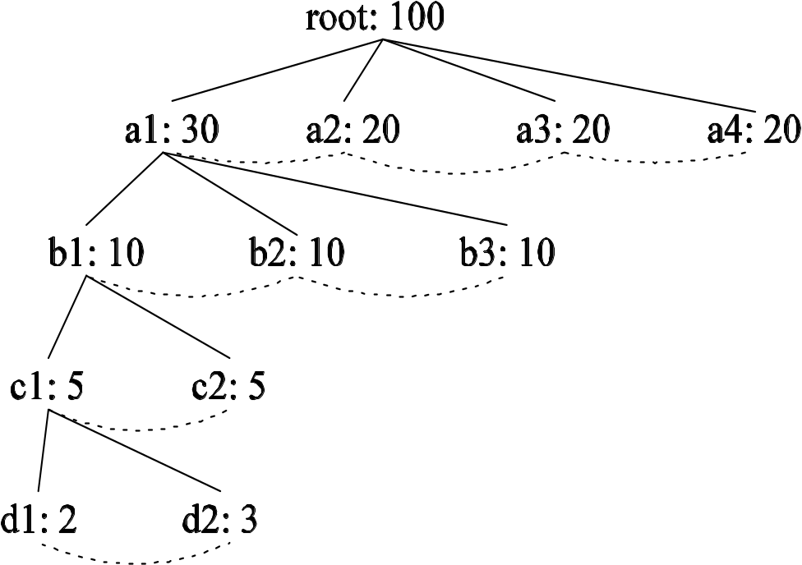
Cell Trees
Use a tree structure similar to H-tree to represent cuboids
Collapses common prefixes to save memory
Keep count at node
Traverse the tree to retrieve a particular tuple

Slide 30
Star Attributes and Star Nodes
Intuition: If a single-dimensional aggregate on an attribute value p does not satisfy the iceberg condition, it is useless to distinguish them during the iceberg computation
  E.g., b₂, b₃, b₄, c₁, c₂, c₄, d₁, d₂, d₃
Solution: Replace such attributes by a *. Such attributes are star attributes, and the corresponding nodes in the cell tree are star nodes
A | B | C | D | Count
a1 | b1 | c1 | d1 | 1
a1 | b1 | c4 | d3 | 1
a1 | b2 | c2 | d2 | 1
a2 | b3 | c3 | d4 | 1
a2 | b4 | c3 | d4 | 1

Slide 31
Example: Star Reduction
Suppose minsup = 2
Perform one-dimensional aggregation. Replace attribute values whose count < 2 with *. And collapse all *’s together
Resulting table has all such attributes replaced with the star-attribute
With regards to the iceberg computation, this new table is a lossless compression of the original table
A | B | C | D | Count
a1 | b1 | * | * | 1
a1 | b1 | * | * | 1
a1 | * | * | * | 1
a2 | * | c3 | d4 | 1
a2 | * | c3 | d4 | 1
A | B | C | D | Count
a1 | b1 | * | * | 2
a1 | * | * | * | 1
a2 | * | c3 | d4 | 2

Slide 32
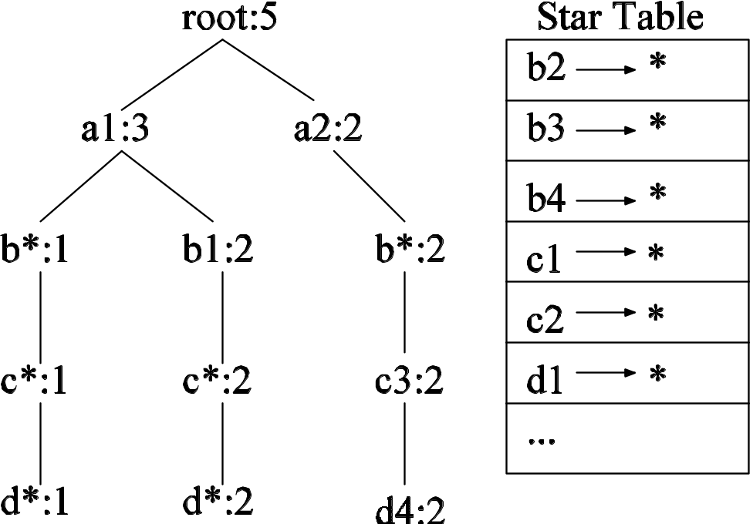
Star Tree
Given the new compressed table, it is possible to construct the corresponding cell tree—called star tree
Keep a star table at the side for easy lookup of star attributes
The star tree is a lossless compression of the original cell tree
A | B | C | D | Count
a1 | b1 | * | * | 2
a1 | * | * | * | 1
a2 | * | c3 | d4 | 2

Slide 33
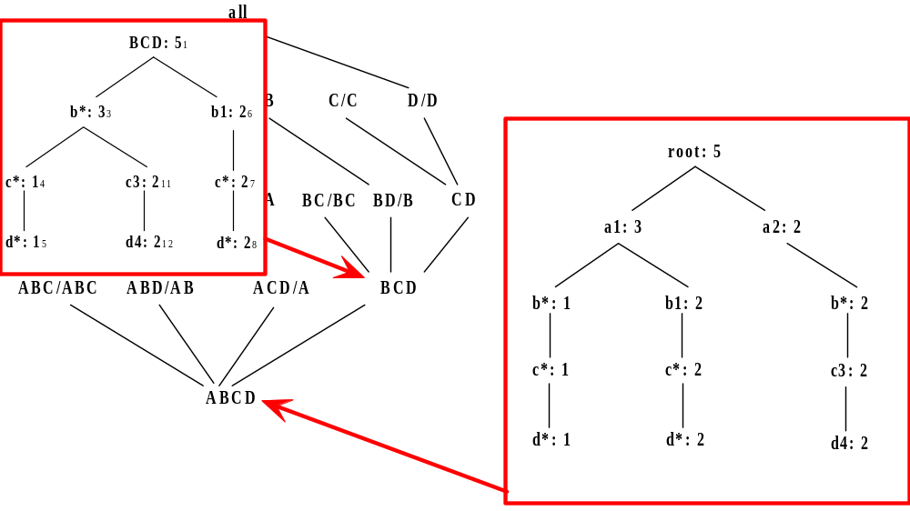
Star-Cubing Algorithm—DFS on Lattice Tree

Slide 34
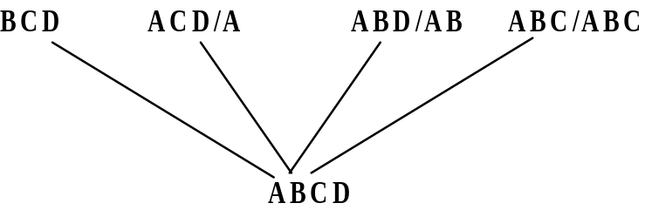
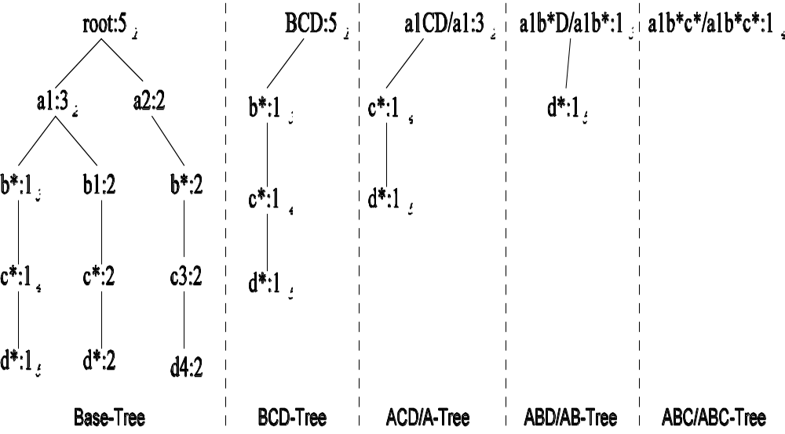
Multi-Way Aggregation

Slide 35
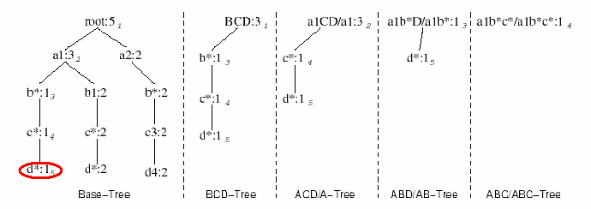
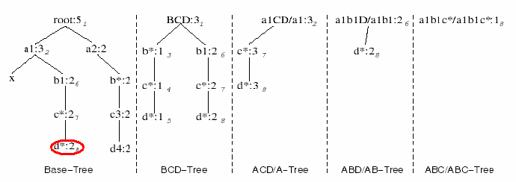
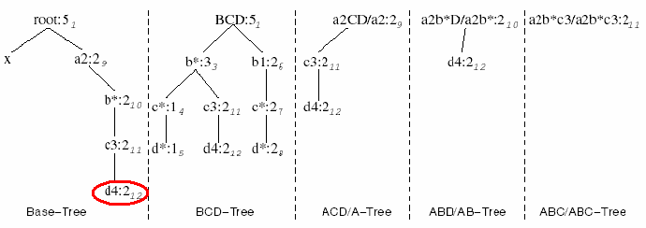
Star-Cubing Algorithm—DFS on Star-Tree

Slide 36
Multi-Way Star-Tree Aggregation
Start depth-first search at the root of the base star tree
At each new node in the DFS, create corresponding star tree that are descendants of the current tree according to the integrated traversal ordering
  E.g., in the base tree, when DFS reaches a1, the ACD/A tree is created
  When DFS reaches b*, the ABD/AD tree is created
The counts in the base tree are carried over to the new trees
When DFS reaches a leaf node (e.g., d*), start backtracking
On every backtracking branch, the count in the corresponding trees are output, the tree is destroyed, and the node in the base tree is destroyed
Example
  When traversing from d* back to c*, the a1b*c*/a1b*c* tree is output and destroyed
  When traversing from c* back to b*, the a1b*D/a1b* tree is output and destroyed
  When at b*, jump to b1 and repeat similar process

Slide 37
Data Cube Computation Methods
Multi-Way Array Aggregation
BUC
Star-Cubing
High-Dimensional OLAP

Slide 38
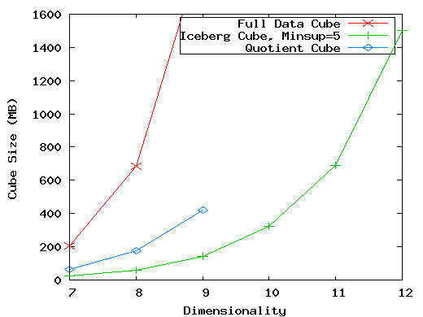
The Curse of Dimensionality
None of the previous cubing method can handle high dimensionality!
A database of 600k tuples. Each dimension has cardinality of 100 and zipf of 2.

Slide 39
Motivation of High-D OLAP
X. Li, J. Han, and H. Gonzalez, High-Dimensional OLAP: A Minimal Cubing Approach, VLDB'04
Challenge to current cubing methods:
  The "curse of dimensionality" problem
  Iceberg cube and compressed cubes: only delay the inevitable explosion
  Full materialization: still significant overhead in accessing results on disk
High-D OLAP is needed in applications
  Science and engineering analysis
  Bio-data analysis: thousands of genes
  Statistical surveys: hundreds of variables

Slide 40
Fast High-D OLAP with Minimal Cubing
Observation: OLAP occurs only on a small subset of dimensions at a time
Semi-Online Computational Model
  Partition the set of dimensions into shell fragments
  Compute data cubes for each shell fragment while retaining inverted indices or value-list indices
  Given the pre-computed fragment cubes, dynamically compute cube cells of the high-dimensional data cube online

Slide 41
Properties of Proposed Method
Partitions the data vertically
Reduces high-dimensional cube into a set of lower dimensional cubes
Online re-construction of original high-dimensional space
Lossless reduction
Offers tradeoffs between the amount of pre-processing and the speed of online computation

Slide 42
Example Computation
Let the cube aggregation function be count
Divide the 5 dimensions into 2 shell fragments:
  (A, B, C) and (D, E)
tid | A | B | C | D | E
1 | a1 | b1 | c1 | d1 | e1
2 | a1 | b2 | c1 | d2 | e1
3 | a1 | b2 | c1 | d1 | e2
4 | a2 | b1 | c1 | d1 | e2
5 | a2 | b1 | c1 | d1 | e3

Slide 43
1-D Inverted Indices
Build traditional invert index or RID list
Attribute Value | TID List | List Size
a1 | 1 2 3 | 3
a2 | 4 5 | 2
b1 | 1 4 5 | 3
b2 | 2 3 | 2
c1 | 1 2 3 4 5 | 5
d1 | 1 3 4 5 | 4
d2 | 2 | 1
e1 | 1 2 | 2
e2 | 3 4 | 2
e3 | 5 | 1

Slide 44


Shell Fragment Cubes: Ideas
Generalize the 1-D inverted indices to multi-dimensional ones in the data cube sense
Compute all cuboids for data cubes ABC and DE while retaining the inverted indices
For example, shell fragment cube ABC contains 7 cuboids:
  A, B, C
  AB, AC, BC
  ABC
This completes the offline computation stage
Cell
Intersection
TID List
List Size
a1 b1
1 2 3 1 4 5
1
1
a1 b2
1 2 3 2 3
2 3
2
a2 b1
4 5 1 4 5
4 5
2
a2 b2
4 5 2 3
0

Slide 45
Shell Fragment Cubes: Ideas
Cuboid A、B、C、D、E
Cell | TID List | |*|
a1 | {1,2,3} | 3
a2 | {4,5} | 2
b1 | {1,4,5} | 3
b2 | {2,3} | 2
c1 | {1,2,3,4,5} | 5
d1 | {1,3,4,5} | 4
d2 | {2} | 1
e1 | {1,2} | 2
e2 | {3,4} | 2
e3 | {5} | 1

Slide 46
Shell Fragment Cubes: Ideas
Cuboid AC
Cell | Intersection | T List | |AC|
a₁ c₁ | {1,2,3}⋂{1,2,3,4,5} | {1,2,3} | 3
a₂ c₁ | {4,5}⋂{1,2,3,4,5} | {4,5} | 2
Cuboid AB
Cell | Intersection | T List | |AB|
a₁ b₁ | {1,2,3}⋂{1,4,5} | {1} | 1
a₁ b₂ | {1,2,3}⋂{2,3} | {2,3} | 2
a₂ b₁ | {4,5}⋂{1,4,5} | {4,5} | 2
a₂ b₂ | {4,5}⋂{{2,3} | {} | 0
Cuboid BC
Cell | Intersection | T List | |BC|
b₁ c₁ | {1,4,5}⋂{1,2,3,4,5} | {1,4,5} | 3
b₂ c₁ | {2,3}⋂{1,2,3,4,5} | {2,3} | 2
Cuboid ABC
Cell | intersection | T List | |ABC|
a₁ b₁ c₁ | {1}⋂{1,2,3,4,5} | {1} | 1
a₁ b₂ c₁ | {2,3}⋂{1,2,3,4,5} | {2,3} | 2
a₂ b₁ c₁ | {4,5}⋂{1,2,3,4,5} | {4,5} | 2
a₂ b₂ c₁ | {}⋂{1,2,3,4,5} | {} | 0
Cuboid DE
Cell | Intersection | T List | |DE|
d₁ e₁ | {1,3,4,5}⋂{1,2} | {1} | 1
d₁ e₂ | {1,3,4,5}⋂{3,4} | {3,4} | 2
d₁ e₃ | {1,3,4,5}⋂{5} | {5} | 1
d₂ e₁ | {2}⋂{1,2} | {2} | 1

Slide 47
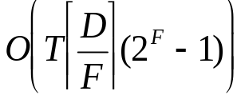
Shell Fragment Cubes: Size and Design
Given a database of T tuples, D dimensions, and shell fragment size F, the fragment cubes’ space requirement is
  For F < 5, the growth is sub-linear
Shell fragments do not have to be disjoint
Fragment groupings can be arbitrary to allow for maximum online performance
  Known common combinations (e.g.,<city, state>) should be grouped together.
Shell fragment sizes can be adjusted for optimal balance between offline and online computation

Slide 48
ID_Measure Table
If measures other than count are present, store in ID_measure table separate from the shell fragments
tid | count | sum
1 | 5 | 70
2 | 3 | 10
3 | 8 | 20
4 | 5 | 40
5 | 2 | 30

Slide 49
The Frag-Shells Algorithm
Partition set of dimension (A₁,…,A_{n}) into a set of k fragments (P₁,…,P_{k}).
Scan base table once and do the following
insert <tid, measure> into ID_measure table.
for each attribute value a_{i} of each dimension A_{i}
build inverted index entry <a_{i}, tidlist>
For each fragment partition P_{i}
build local fragment cube S_{i} by intersecting tid-lists in bottom- up fashion.

Slide 50
Frag-Shells (2)
Dimensions
D Cuboid
EF Cuboid
A | B | C | D | E | F | …
DE Cuboid
Cell | Tuple-ID List
d1 e1 | {1, 3, 8, 9}
d1 e2 | {2, 4, 6, 7}
d2 e1 | {5, 10}
… | …
ABC
Cube
DEF
Cube

Slide 51
Online Query Computation: Query
A query has the general form <a₁,a₂,...,a_{n}:M?>
Each a_{i} has 3 possible values
  Instantiated value
  Aggregate * function
  Inquire ? function
For example, <3,?,?,*,1:count?> returns a 2-D data cube.

Slide 52
Online Query Computation: Method
Given the fragment cubes, process a query as follows
  Divide the query into fragment, same as the shell
  Fetch the corresponding TID list for each fragment from the fragment cube
  Intersect the TID lists from each fragment to construct instantiated base table
  Compute the data cube using the base table with any cubing algorithm

Slide 53
Online Query Computation: Sketch
A | B | C | D | E | F | G | H | I | J | K | L | M | N | …
Instantiated
Base Table
Online
Cube

Slide 54
Point Query
Query <a₂, b₁, c₁, d₁, *: count()?>
Query is broken down into two subqueries based on the precomputed fragments:
<a₂, b₁, c₁, *, *>, <*, *, *, d₁, *>
The best-fit precomputed fragment for <a₂, b₁, c₁, *, *>: ABC
The best-fit precomputed fragment for <*, *, *, d₁, *>: D
The TID lists for the two subqueries: {4,5} {1,3,4,5}
The intersection is: {4,5}, so the answer is: count()=2
Data Mining: Concepts and Techniques

Slide 55
Subcube Query
Query <a₂, b₁, ?, *, ?: count()?>
Query is broken down into 3 best-fit fragments:
AB, C, E
The TID lists for them:
(a₂, b₂): {4,5}、 (c₁): {1,2,3,4,5}、
{(e₁: {1,2}), (e₂: {3,4}), (e₃: {5})}
The intersections of them get a cuboid with two tuples
{(c₁, e₂): {4}, (c₁, e₃): {5}}
Data Mining: Concepts and Techniques

Slide 56
Computing Cubes with Non-Antimonotonic Iceberg Conditions
J. Han, J. Pei, G. Dong, K. Wang. Efficient Computation of Iceberg Cubes With Complex Measures. SIGMOD’01
Most cubing algorithms cannot compute cubes with non-antimonotonic iceberg conditions efficiently
Example
    CREATE CUBE Sales_Iceberg AS
    SELECT month, city, cust_grp, AVG(price), COUNT(*)
    FROM Sales_Infor
    CUBEBY month, city, cust_grp
    HAVING AVG(price) >= 800 AND COUNT(*) >= 50
How to push constraint into the iceberg cube computation?
Data Mining: Concepts and Techniques

Slide 57
Non-Anti-Monotonic Iceberg Condition
Anti-monotonic: if a process fails a condition, continue processing will still fail
The cubing query with avg is non-anti-monotonic!
  (Mar, *, *, 600, 1800) fails the HAVING clause
  (Mar, *, Bus, 1300, 360) passes the clause
CREATE CUBE Sales_Iceberg AS
SELECT month, city, cust_grp,
AVG(price), COUNT(*)
FROM Sales_Infor
CUBEBY month, city, cust_grp
HAVING AVG(price) >= 800 AND
COUNT(*) >= 50
Month | City | Cust_grp | Prod | Cost | Price
Jan | Tor | Edu | Printer | 500 | 485
Jan | Tor | Hld | TV | 800 | 1200
Jan | Tor | Edu | Camera | 1160 | 1280
Feb | Mon | Bus | Laptop | 1500 | 2500
Mar | Van | Edu | HD | 540 | 520
… | … | … | … | … | …
Data Mining: Concepts and Techniques

Slide 58
From Average to Top-k Average
Let (*, Van, *) cover 1,000 records
  Avg(price) is the average price of those 1000 sales
  Avg⁵⁰(price) is the average price of the top-50 sales (top-50 according to the sales price)
Top-k average is anti-monotonic
  The top 50 sales in Van. is with avg(price) <= 800 → the top 50 deals in Van. during Feb. must be with avg(price) <= 800
Month | City | Cust_grp | Prod | Cost | Price
… | … | … | … | … | …
Data Mining: Concepts and Techniques

Slide 59
Computing Iceberg Cubes with Other Complex Measures
Computing other complex measures
  Key point: find a function which is weaker but ensures certain anti-monotonicity
Examples
  Avg() ≤ v: avg^{k}(c) ≤ v (bottom-k avg)
  Avg() ≥ v only (no count): max(price) ≥ v
  Sum(profit) (profit can be negative):
    p_sum(c) ≥ v if p_count(c) ≥ k; or otherwise, sum^{k}(c) ≥ v
Data Mining: Concepts and Techniques

Slide 60
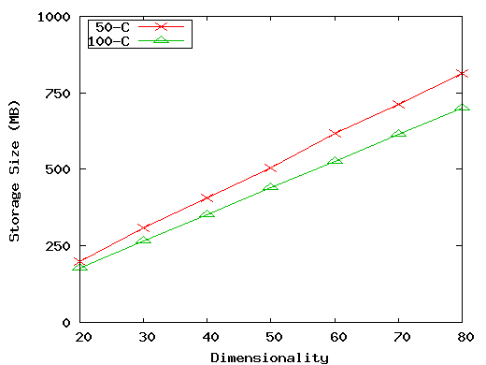
Experiment: Size vs. Dimensionality (50 and 100 cardinality)
(50-C): 10⁶ tuples, 0 skew, 50 cardinality, fragment size 3.
(100-C): 10⁶ tuples, 2 skew, 100 cardinality, fragment size 2.

Slide 61
Experiments on Real World Data
UCI Forest CoverType data set
  54 dimensions, 581K tuples
  Shell fragments of size 2 took 33 seconds and 325MB to compute
  3-D subquery with 1 instantiated D: 85ms~1.4 sec.
Longitudinal Study of Vocational Rehab. Data
  24 dimensions, 8818 tuples
  Shell fragments of size 3 took 0.9 seconds and 60MB to compute
  5-D query with 0 instantiated D: 227ms~2.6 sec.

Slide 62
Chapter 5: Data Cube Technology
Data Cube Computation: Preliminary Concepts
Data Cube Computation Methods
Processing Advanced Queries by Exploring Data Cube Technology
Multidimensional Data Analysis in Cube Space
Summary


Slide 63
Processing Advanced Queries by Exploring Data Cube Technology
Sampling Cube
  X. Li, J. Han, Z. Yin, J.-G. Lee, Y. Sun, “Sampling Cube: A Framework for Statistical OLAP over Sampling Data”, SIGMOD’08
Ranking Cube
  D. Xin, J. Han, H. Cheng, and X. Li. Answering top-k queries with multi-dimensional selections: The ranking cube approach. VLDB’06
Other advanced cubes for processing data and queries
  Stream cube, spatial cube, multimedia cube, text cube, RFID cube, etc. — to be studied in volume 2

Slide 64
Statistical Surveys and OLAP
Statistical survey: A popular tool to collect information about a population based on a sample
  Ex.: TV ratings, US Census, election polls
A common tool in politics, health, market research, science, and many more
An efficient way of collecting information (Data collection is expensive)
Many statistical tools available, to determine validity
  Confidence intervals
  Hypothesis tests
OLAP (multidimensional analysis) on survey data
  highly desirable but can it be done well?

Slide 65

Surveys: Sample vs. Whole Population
Data is only a sample of population
Age\Education | High-school | College | Graduate
18
19
20
…

Slide 66

Problems for Drilling in Multidim. Space
Data is only a sample of population but samples could be small when drilling to certain multidimensional space
Age\Education | High-school | College | Graduate
18
19
20
…

Slide 67
OLAP on Survey (i.e., Sampling) Data
Semantics of query is unchanged
Input data has changed
Age/Education | High-school | College | Graduate
18
19
20
…

Slide 68
Challenges for OLAP on Sampling Data
Computing confidence intervals in OLAP context
No data?
  Not exactly. No data in subspaces in cube
  Sparse data
  Causes include sampling bias and query selection bias
Curse of dimensionality
  Survey data can be high dimensional
  Over 600 dimensions in real world example
  Impossible to fully materialize

Slide 69
Example 1: Confidence Interval
What is the average income of 19-year-old high-school students?
  Return not only query result but also confidence interval
Age/Education | High-school | College | Graduate
18
19
20
…

Slide 70



Confidence Interval
  Confidence interval at :
    x is a sample of data set; is the mean of sample
    t_{c} is the critical t-value, calculated by a look-up
    is the estimated standard error of the mean
  Example: $50,000 ± $3,000 with 95% confidence
    Treat points in cube cell as samples
    Compute confidence interval as traditional sample set
Return answer in the form of confidence interval
    Indicates quality of query answer
    User selects desired confidence interval

Slide 71
Efficient Computing Confidence Interval Measures
Efficient computation in all cells in data cube
    Both mean and confidence interval are algebraic
    Why confidence interval measure is algebraic?
    is algebraic
    where both s and l (count) are algebraic
Thus one can calculate cells efficiently at more general cuboids without having to start at the base cuboid each time

Slide 72
Example 2: Query Expansion
What is the average income of 19-year-old college students?
Age/Education | High-school | College | Graduate
18
19
20
…

Slide 73
Boosting Confidence by Query Expansion
From the example: The queried cell "19-year-old college students" contains only 2 samples
Confidence interval is large (i.e., low confidence). why?
  Small sample size
  High standard deviation with samples
Small sample sizes can occur at relatively low dimensional selections
  Collect more data?― expensive!
  Use data in other cells? Maybe, but have to be careful

Slide 74
Intra-Cuboid Expansion: Choice 1
Expand query to include 18 and 20 year olds?
Age/Education | High-school | College | Graduate
18
19
20
…

Slide 75
Intra-Cuboid Expansion: Choice 2
Expand query to include high-school and graduate students?
Age/Education | High-school | College | Graduate
18
19
20
…

Slide 76
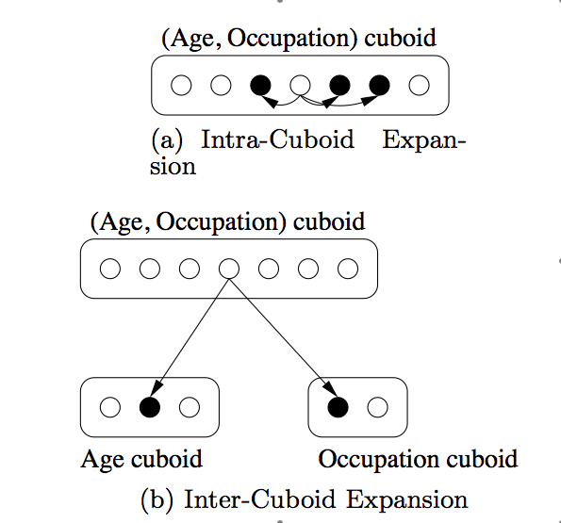
Query Expansion

Slide 77
Intra-Cuboid Expansion
Combine other cells’ data into own to "boost" confidence
  If share semantic and cube similarity
  Use only if necessary
  Bigger sample size will decrease confidence interval
Cell segment similarity
  Some dimensions are clear: Age
  Some are fuzzy: Occupation
  May need domain knowledge
Cell value similarity
  How to determine if two cells’ samples come from the same population?
  Two-sample t-test (confidence-based)

Slide 78
Inter-Cuboid Expansion
If a query dimension is
    Not correlated with cube value
    But is causing small sample size by drilling down too much
Remove dimension (i.e., generalize to *) and move to a more general cuboid
Can use two-sample t-test to determine similarity between two cells across cuboids
Can also use a different method to be shown later

Slide 79
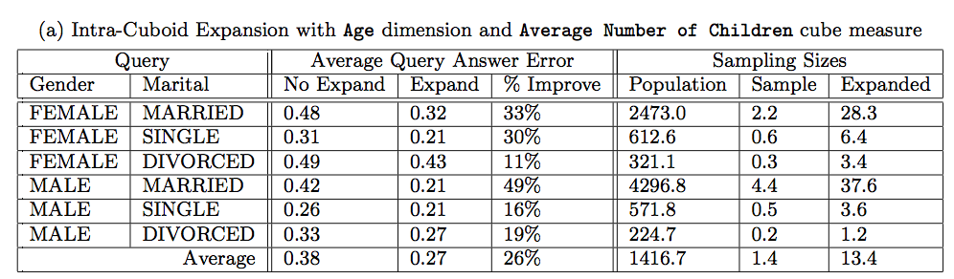
Query Expansion Experiments
Real world sample data: 600 dimensions and 750,000 tuples
0.05% to simulate "sample" (allows error checking)

Slide 80
Ranking Cubes – Efficient Computation of Ranking queries
Data cube helps not only OLAP but also ranked search
(top-k) ranking query: only returns the best k results according to a user-specified preference, consisting of (1) a selection condition and (2) a ranking function
Ex.: Search for apartments with expected price 1000 and expected square feet 800
    Select top 1 from Apartment
    where City = "LA" and Num_Bedroom = 2
    order by [price – 1000]^2 + [sq feet - 800]^2 asc
Efficiency question: Can we only search what we need?
  Build a ranking cube on both selection dimensions and ranking dimensions

Slide 81
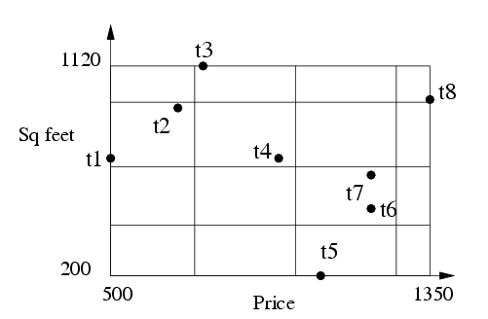
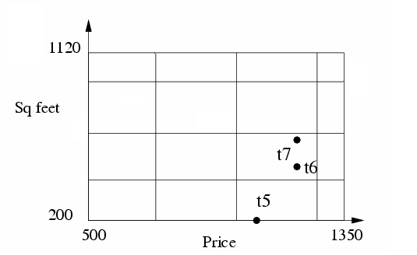
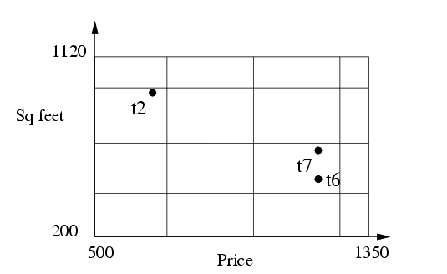
Ranking Cube: Partition Data on Both Selection and Ranking Dimensions
One single data partition as the template
Slice the data partition by selection conditions
Partition for
all data
Sliced Partition
for city=“LA”
Sliced Partition
for BR=2

Slide 82
Materialize Ranking-Cube
Step 1: Partition Data on Ranking Dimensions
tid | City | BR | Price | Sq feet | Block ID
t1 | SEA | 1 | 500 | 600 | 5
t2 | CLE | 2 | 700 | 800 | 5
t3 | SEA | 1 | 800 | 900 | 2
t4 | CLE | 3 | 1000 | 1000 | 6
t5 | LA | 1 | 1100 | 200 | 15
t6 | LA | 2 | 1200 | 500 | 11
t7 | LA | 2 | 1200 | 560 | 11
t8 | CLE | 3 | 1350 | 1120 | 4
1 2 3 4
5 6 7 8
9 10 11 12
13 14 15 16
Step 2: Group data by
Selection Dimensions
Step 3: Compute Measures for each group
For the cell (LA)
City
Block-level: {11, 15}
Data-level: {11: t6, t7; 15: t5}
SEA
LA
CLE
City & BR
BR
1
2
3
4

Slide 83
Search with Ranking-Cube:
Simultaneously Push Selection and Ranking
Select top 1 from Apartment
where city = “LA”
order by [price – 1000]^2 + [sq feet - 800]^2 asc
Bin boundary for price | [500, 600, 800, 1100,1350]
Bin boundary for sq feet | [200, 400, 600, 800, 1120]
Given the bin boundaries, locate the block with top score
800
11
15
1000
Without ranking-cube: start search from here
With ranking-cube: start search from here
Measure for LA: {11, 15}
{11: t6,t7; 15:t5}

Slide 84
Processing Ranking Query: Execution Trace
Select top 1 from Apartment
where city = “LA”
order by [price – 1000]^2 + [sq feet - 800]^2 asc
Bin boundary for price | [500, 600, 800, 1100,1350]
Bin boundary for sq feet | [200, 400, 600, 800, 1120]
f=[price-1000]^2 + [sq feet – 800]^2
Execution Trace:
800
1. Retrieve High-level measure for LA {11, 15}
2. Estimate lower bound score for block 11, 15
f(block 11) = 40,000, f(block 15) = 160,000
11
15
3. Retrieve block 11
1000
4. Retrieve low-level measure for block 11
5. f(t6) = 130,000, f(t7) = 97,600
With ranking-cube: start search from here
Measure for LA: {11, 15}
{11: t6,t7; 15:t5}
Output t7, done!

Slide 85
Ranking Cube: Methodology and Extension
Ranking cube methodology
  Push selection and ranking simultaneously
  It works for many sophisticated ranking functions
How to support high-dimensional data?
  Materialize only those atomic cuboids that contain single selection dimensions
    Uses the idea similar to high-dimensional OLAP
    Achieves low space overhead and high performance in answering ranking queries with a high number of selection dimensions

Slide 86
Chapter 5: Data Cube Technology
Data Cube Computation: Preliminary Concepts
Data Cube Computation Methods
Processing Advanced Queries by Exploring Data Cube Technology
Multidimensional Data Analysis in Cube Space
Summary


Slide 87
Multidimensional Data Analysis in Cube Space
Prediction Cubes: Data Mining in Multi-Dimensional Cube Space
Multi-Feature Cubes: Complex Aggregation at Multiple Granularities
Discovery-Driven Exploration of Data Cubes

Slide 88
Data Mining in Cube Space
Data cube greatly increases the analysis bandwidth
Four ways to interact OLAP-styled analysis and data mining
  Using cube space to define data space for mining
  Using OLAP queries to generate features and targets for mining, e.g., multi-feature cube
  Using data-mining models as building blocks in a multi-step mining process, e.g., prediction cube
  Using data-cube computation techniques to speed up repeated model construction
    Cube-space data mining may require building a model for each candidate data space
    Sharing computation across model-construction for different candidates may lead to efficient mining

Slide 89
Prediction Cubes
Prediction cube: A cube structure that stores prediction models in multidimensional data space and supports prediction in OLAP manner
Prediction models are used as building blocks to define the interestingness of subsets of data, i.e., to answer which subsets of data indicate better prediction

Slide 90
How to Determine the Prediction Power of an Attribute?
Ex. A customer table D:
  Two dimensions Z: Time (Month, Year ) and Location (State, Country)
  Two features X: Gender and Salary
  One class-label attribute Y: Valued Customer
Q: “Are there times and locations in which the value of a customer depended greatly on the customers gender (i.e., Gender: predictiveness attribute V)?”
Idea:
  Compute the difference between the model built on that using X to predict Y and that built on using X – V to predict Y
  If the difference is large, V must play an important role at predicting Y

Slide 91
Efficient Computation of Prediction Cubes
Naïve method: Fully materialize the prediction cube, i.e., exhaustively build models and evaluate them for each cell and for each granularity
Better approach: Explore score function decomposition that reduces prediction cube computation to data cube computation

Slide 92
Multidimensional Data Analysis in Cube Space
Prediction Cubes: Data Mining in Multi-Dimensional Cube Space
Multi-Feature Cubes: Complex Aggregation at Multiple Granularities
Discovery-Driven Exploration of Data Cubes

Slide 93
Complex Aggregation at Multiple Granularities: Multi-Feature Cubes
Multi-feature cubes (Ross, et al. 1998): Compute complex queries involving multiple dependent aggregates at multiple granularities
Ex. Grouping by all subsets of {item, region, month}, find the maximum price in 2010 for each group, and the total sales among all maximum price tuples
        select item, region, month, max(price), sum(R.sales)
        from purchases
        where year = 2010
        cube by item, region, month: R
        such that R.price = max(price)
Continuing the last example, among the max price tuples, find the min and max shelf live, and find the fraction of the total sales due to tuple that have min shelf life within the set of all max price tuples

Slide 94
Multidimensional Data Analysis in Cube Space
Prediction Cubes: Data Mining in Multi-Dimensional Cube Space
Multi-Feature Cubes: Complex Aggregation at Multiple Granularities
Discovery-Driven Exploration of Data Cubes

Slide 95
Discovery-Driven Exploration of Data Cubes
Hypothesis-driven
  exploration by user, huge search space
Discovery-driven (Sarawagi, et al.’98)
  Effective navigation of large OLAP data cubes
  pre-compute measures indicating exceptions, guide user in the data analysis, at all levels of aggregation
  Exception: significantly different from the value anticipated, based on a statistical model
  Visual cues such as background color are used to reflect the degree of exception of each cell

Slide 96
Kinds of Exceptions and their Computation
Parameters
  SelfExp: surprise of cell relative to other cells at same level of aggregation
  InExp: surprise beneath the cell
  PathExp: surprise beneath cell for each drill-down path
Computation of exception indicator (modeling fitting and computing SelfExp, InExp, and PathExp values) can be overlapped with cube construction
Exception themselves can be stored, indexed and retrieved like precomputed aggregates

Slide 97



Examples: Discovery-Driven Data Cubes

Slide 98
Chapter 5: Data Cube Technology
Data Cube Computation: Preliminary Concepts
Data Cube Computation Methods
Processing Advanced Queries by Exploring Data Cube Technology
Multidimensional Data Analysis in Cube Space
Summary


Slide 99
Data Cube Technology: Summary
Data Cube Computation: Preliminary Concepts
Data Cube Computation Methods
  MultiWay Array Aggregation
  BUC
  Star-Cubing
  High-Dimensional OLAP with Shell-Fragments
Processing Advanced Queries by Exploring Data Cube Technology
  Sampling Cubes
  Ranking Cubes
Multidimensional Data Analysis in Cube Space
  Discovery-Driven Exploration of Data Cubes
  Multi-feature Cubes
  Prediction Cubes

Slide 100
Ref.(I) Data Cube Computation Methods
S. Agarwal, R. Agrawal, P. M. Deshpande, A. Gupta, J. F. Naughton, R. Ramakrishnan, and S. Sarawagi. On the computation of multidimensional aggregates. VLDB’96
D. Agrawal, A. E. Abbadi, A. Singh, and T. Yurek. Efficient view maintenance in data warehouses. SIGMOD’97
K. Beyer and R. Ramakrishnan. Bottom-Up Computation of Sparse and Iceberg CUBEs.. SIGMOD’99
M. Fang, N. Shivakumar, H. Garcia-Molina, R. Motwani, and J. D. Ullman. Computing iceberg queries efficiently. VLDB’98
J. Gray, S. Chaudhuri, A. Bosworth, A. Layman, D. Reichart, M. Venkatrao, F. Pellow, and H. Pirahesh. Data cube: A relational aggregation operator generalizing group-by, cross-tab and sub-totals. Data Mining and Knowledge Discovery, 1:29–54, 1997.
J. Han, J. Pei, G. Dong, K. Wang. Efficient Computation of Iceberg Cubes With Complex Measures. SIGMOD’01
L. V. S. Lakshmanan, J. Pei, and J. Han, Quotient Cube: How to Summarize the Semantics of a Data Cube, VLDB'02
X. Li, J. Han, and H. Gonzalez, High-Dimensional OLAP: A Minimal Cubing Approach, VLDB'04
Y. Zhao, P. M. Deshpande, and J. F. Naughton. An array-based algorithm for simultaneous multidimensional aggregates. SIGMOD’97
K. Ross and D. Srivastava. Fast computation of sparse datacubes. VLDB’97
D. Xin, J. Han, X. Li, B. W. Wah, Star-Cubing: Computing Iceberg Cubes by Top-Down and Bottom-Up Integration, VLDB'03
D. Xin, J. Han, Z. Shao, H. Liu, C-Cubing: Efficient Computation of Closed Cubes by Aggregation-Based Checking, ICDE'06

Slide 101
Ref. (II) Advanced Applications with Data Cubes
D. Burdick, P. Deshpande, T. S. Jayram, R. Ramakrishnan, and S. Vaithyanathan. OLAP over uncertain and imprecise data. VLDB’05
X. Li, J. Han, Z. Yin, J.-G. Lee, Y. Sun, “Sampling Cube: A Framework for Statistical OLAP over Sampling Data”, SIGMOD’08
C. X. Lin, B. Ding, J. Han, F. Zhu, and B. Zhao. Text Cube: Computing IR measures for multidimensional text database analysis. ICDM’08
D. Papadias, P. Kalnis, J. Zhang, and Y. Tao. Efficient OLAP operations in spatial data warehouses. SSTD’01
N. Stefanovic, J. Han, and K. Koperski. Object-based selective materialization for efficient implementation of spatial data cubes. IEEE Trans. Knowledge and Data Engineering, 12:938–958, 2000.
T. Wu, D. Xin, Q. Mei, and J. Han. Promotion analysis in multidimensional space. VLDB’09
T. Wu, D. Xin, and J. Han. ARCube: Supporting ranking aggregate queries in partially materialized data cubes. SIGMOD’08
D. Xin, J. Han, H. Cheng, and X. Li. Answering top-k queries with multi-dimensional selections: The ranking cube approach. VLDB’06
J. S. Vitter, M. Wang, and B. R. Iyer. Data cube approximation and histograms via wavelets. CIKM’98
D. Zhang, C. Zhai, and J. Han. Topic cube: Topic modeling for OLAP on multi-dimensional text databases. SDM’09

Slide 102
Ref. (III) Knowledge Discovery with Data Cubes
R. Agrawal, A. Gupta, and S. Sarawagi. Modeling multidimensional databases. ICDE’97
B.-C. Chen, L. Chen, Y. Lin, and R. Ramakrishnan. Prediction cubes. VLDB’05
B.-C. Chen, R. Ramakrishnan, J.W. Shavlik, and P. Tamma. Bellwether analysis: Predicting global aggregates from local regions. VLDB’06
Y. Chen, G. Dong, J. Han, B. W. Wah, and J. Wang, Multi-Dimensional Regression Analysis of Time-Series Data Streams, VLDB'02
G. Dong, J. Han, J. Lam, J. Pei, K. Wang. Mining Multi-dimensional Constrained Gradients in Data Cubes. VLDB’ 01
R. Fagin, R. V. Guha, R. Kumar, J. Novak, D. Sivakumar, and A. Tomkins. Multi-structural databases. PODS’05
J. Han. Towards on-line analytical mining in large databases. SIGMOD Record, 27:97–107, 1998
T. Imielinski, L. Khachiyan, and A. Abdulghani. Cubegrades: Generalizing association rules. Data Mining & Knowledge Discovery, 6:219–258, 2002.
R. Ramakrishnan and B.-C. Chen. Exploratory mining in cube space. Data Mining and Knowledge Discovery, 15:29–54, 2007.
K. A. Ross, D. Srivastava, and D. Chatziantoniou. Complex aggregation at multiple granularities. EDBT'98
S. Sarawagi, R. Agrawal, and N. Megiddo. Discovery-driven exploration of OLAP data cubes. EDBT'98
G. Sathe and S. Sarawagi. Intelligent Rollups in Multidimensional OLAP Data. VLDB'01

Slide 103
Surplus Slides

Slide 104
Chapter 5: Data Cube Technology
Efficient Methods for Data Cube Computation
  Preliminary Concepts and General Strategies for Cube Computation
  Multiway Array Aggregation for Full Cube Computation
  BUC: Computing Iceberg Cubes from the Apex Cuboid Downward
  H-Cubing: Exploring an H-Tree Structure
  Star-cubing: Computing Iceberg Cubes Using a Dynamic Star-tree Structure
  Precomputing Shell Fragments for Fast High-Dimensional OLAP
Data Cubes for Advanced Applications
  Sampling Cubes: OLAP on Sampling Data
  Ranking Cubes: Efficient Computation of Ranking Queries
Knowledge Discovery with Data Cubes
  Discovery-Driven Exploration of Data Cubes
  Complex Aggregation at Multiple Granularity: Multi-feature Cubes
  Prediction Cubes: Data Mining in Multi-Dimensional Cube Space
Summary

Slide 105
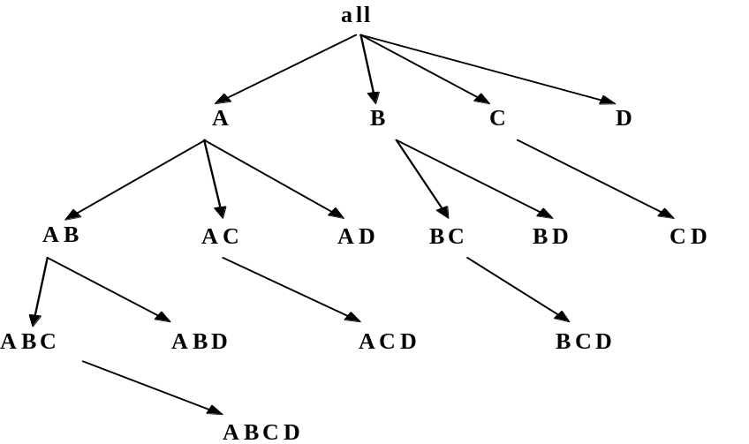
H-Cubing: Using H-Tree Structure
Bottom-up computation
Exploring an H-tree structure
If the current computation of an H-tree cannot pass min_sup, do not proceed further (pruning)
No simultaneous aggregation

Slide 106
H-tree: A Prefix Hyper-tree
Attr. Val. | Quant-Info | Side-link
Edu | Sum:2285 …
Hhd | …
Bus | …
… | …
Jan | …
Feb | …
… | …
Tor | …
Van | …
Mon | …
… | …
root
Header
table
hhd
bus
edu
Jan
Mar
Jan
Feb
Tor
Van
Tor
Mon
Month | City | Cust_grp | Prod | Cost | Price
Jan | Tor | Edu | Printer | 500 | 485
Jan | Tor | Hhd | TV | 800 | 1200
Jan | Tor | Edu | Camera | 1160 | 1280
Feb | Mon | Bus | Laptop | 1500 | 2500
Mar | Van | Edu | HD | 540 | 520
… | … | … | … | … | …
Quant-Info
Sum: 1765 Cnt: 2
bins
Q.I.
Q.I.
Q.I.

Slide 107
Computing Cells Involving “City”
Attr. Val. | Q.I. | Side-link
Edu | …
Hhd | …
Bus | …
… | …
Jan | …
Feb | …
… | …
From (*, *, Tor) to (*, Jan, Tor)
Header
Table
H_{Tor}
root
Edu.
Hhd.
Bus.
Attr. Val. | Quant-Info | Side-link
Edu | Sum:2285 …
Hhd | …
Bus | …
… | …
Jan | …
Feb | …
… | …
Tor | …
Van | …
Mon | …
… | …
Jan.
Mar.
Jan.
Feb.
Tor.
Van.
Tor.
Mon.
Quant-Info
Sum: 1765 Cnt: 2
bins
Q.I.
Q.I.
Q.I.

Slide 108
Computing Cells Involving Month But No City
Roll up quant-info
Compute cells involving month but no city
root
Edu.
Hhd.
Bus.
Attr. Val. | Quant-Info | Side-link
Edu. | Sum:2285 …
Hhd. | …
Bus. | …
… | …
Jan. | …
Feb. | …
Mar. | …
… | …
Tor. | …
Van. | …
Mont. | …
… | …
Jan.
Mar.
Jan.
Feb.
Q.I.
Q.I.
Q.I.
Q.I.
Tor.
Van.
Tor.
Mont.
Top-k OK mark: if Q.I. in a child passes top-k avg threshold, so does its parents. No binning is needed!

Slide 109
Computing Cells Involving Only Cust_grp
root
Check header table directly
hhd
bus
edu
Attr. Val. | Quant-Info | Side-link
Edu | Sum:2285 …
Hhd | …
Bus | …
… | …
Jan | …
Feb | …
Mar | …
… | …
Tor | …
Van | …
Mon | …
… | …
Jan
Mar
Jan
Feb
Q.I.
Q.I.
Q.I.
Q.I.
Tor
Van
Tor
Mon

