Slide 1
Data Mining:
Concepts and Techniques
(3rd ed.)
— Chapter 8 —
Jianjun Cheng
School of Information Science & Engineering
Lanzhou University
©2011 Han, Kamber & Pei. All rights reserved.

Slide 2
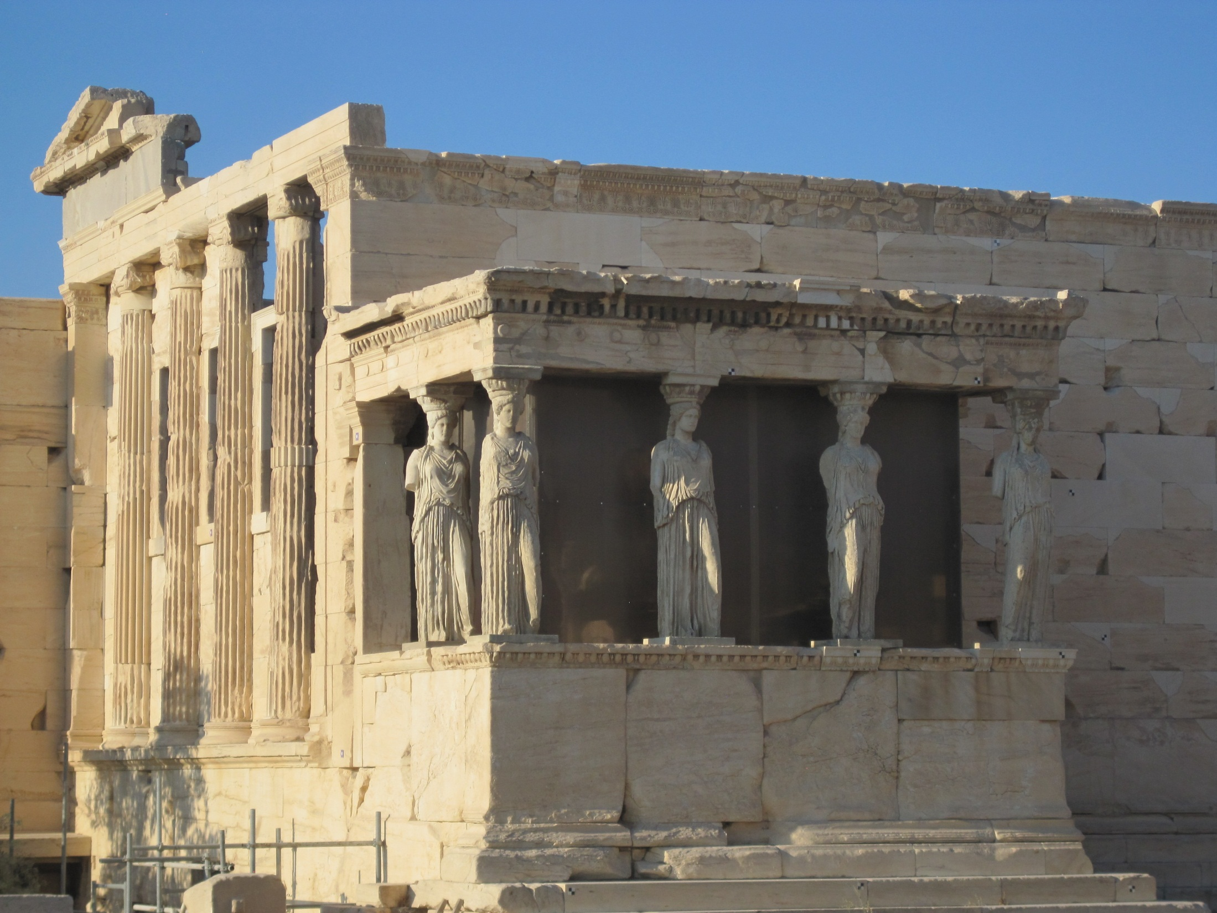

Slide 3
Chapter 8. Classification: Basic Concepts

Classification: Basic Concepts
Decision Tree Induction
Bayes Classification Methods
Rule-Based Classification
Model Evaluation and Selection
Techniques to Improve Classification Accuracy: Ensemble Methods
Summary

Slide 4
Machine Learming
Supervised learning (classification)
  the task of inferring a function from labeled training data
  each example in training data is a pair consisting of an input object and a desired output value
  a supervised learning algorithm analyzes the traning data and produces an inferred function, which can be used for mapping new examples
Data Mining: Concepts and Techniques

Slide 5
Machine Learming
Supervised learning (classification)
  Given a set of N training examples of the form {(x₁,y₁), ..., ( x_{N}, y_{N})} such that x_{i} is the feature vector of the i-th example and y_{i} is its label.
  A learning algorithm seeks a function f: X→Y, where X is the input space and Y is the output space.
  The function f is an element of some space of possible functions F, usually called the hypothesis space.
  Define a scoring function g: X×Y→R, then
  f(x)=argmax_{y}g(x, y).
Data Mining: Concepts and Techniques

Slide 6
Machine Learming
Supervised learning (classification)
  an optimal scenario will allow for the algorithm to correctly determine the class labels for unseen instances
  requires the algorithm to generalize from the training data to unseen situations in a "reasonalbe" way
  Supervision: The training data (observations, measurements, etc.) are accompanied by labels indicating the class of the observations
Data Mining: Concepts and Techniques

Slide 7
Machine Learming
Unsupervised learning (clustering)
  The task of inferring a function to describe hidden structure from unlabeled data
  The class labels of training data is unknown
  Given a set of measurements, observations, etc. with the aim of establishing the existence of classes or clusters in the data
  Partition the dataset into some groups, data points within the same group are more similar than those inter groups
Data Mining: Concepts and Techniques

Slide 8
Machine Learming
Semi-supervised learning
  a class of supervised learning tasks and techniques that also make use of unlabeled data for training ---- typically a small amount of labeled data with a large amount of unlabeled data
  falls between unsupervised learning and supervised learning
  inspired by observations by many machine-learning researchers: when used in conjuction with a small amount of labeled data, the learner can produce considerable improvement in learning accuracy
Data Mining: Concepts and Techniques

Slide 9
Machine Learming
Semi-supervised learning
  the acquisition of labeled data for a learning problem often requires a skilled human agent or a physical experiment
  the cost associated with the labeling process thus may render a fully labeled training set infeasible, whereas acquisition of unlabeled data is relatively inexpensive
  in situations mentioned above, semi-supervised learning can be of great practical value.
Data Mining: Concepts and Techniques

Slide 10
Machine Learming
Semi-supervised learning
  given a set of l examples x₁, x₂, ..., x_{l}∈X with corresponding labels y₁, y₂,...,y_{l}∈Y, and u unlabeled examples x_{l+1}, x_{l+2},...,x_{l+u}∈X .
  make use of this combined information to surpass the classification performance that could be obtained either by discarding the unlabeled data and doing supervised learning or by discarding the labels and doing unsupervised learning.
  transductive learning: infer the correct labels for the given unlabeled data x_{l+1},...,x_{l+u} only ---- homework
  inductive learning: infer the correct mapping from X to Y ---- class examination
Data Mining: Concepts and Techniques

Slide 11
Machine Learming
Semi-supervised learning
  two types of semi-supervised components: labeled data, pair-wise constraints
  labeled data
  pair-wise constraints: Must-Link and Cannot-Link
  Must-Link: (a,b)∈C_{m}  a and b must be classified into the same class
  Cannot-Link: (a,b)∈C_{c}  a and b cannot be classifed into the same class, and they must be allocated into different classes
Data Mining: Concepts and Techniques

Slide 12
Machine Learming
Active learning
  a special case of semi-supervised learning, in which a learning algorithm is able to interactively query an oracle to obtain the desired outputs at new data points
  in many situations, unlabeled data is aboundant, but manually labeling is expensive
  the learner can choose some examples actively to query the oracle for their labels
  its goal is to maximize the leaner's performance with the least cost
  the number of selected examples are often much lower than the number required in normal supervised learning
Data Mining: Concepts and Techniques

Slide 13
Machine Learming
Active learning
  Query strategies: select the most informative data points or the data points with least certainty
    Uncertainty sampling: label those points for which the current model is least certain as to what the correct output should be
    Query by committee: a variety of models are trained on the current labeled data, and vote on the output for unlabeled data; label those points for which the "committee" disagrees the most
    Expected model change: label those points that would most change the current model
Data Mining: Concepts and Techniques

Slide 14
Machine Learming
Active learning
  Query strategies: select the most informative data points or the data points with least certainty
    Expected error reduction: label those points that would most reduce the model's generalization error
    Variance reduction: label those points that would minimize output variance, which is one of the components of error
Data Mining: Concepts and Techniques

Slide 15
Prediction Problems: Classification vs. Numeric Prediction
Classification
  predicts categorical class labels (discrete or nominal)
  classifies data (constructs a model) based on the training set and the values (class labels) in a classifying attribute and uses it in classifying new data
Numeric Prediction
  models continuous-valued functions, i.e., predicts unknown or missing values
Typical applications
  Credit/loan approval:
  Medical diagnosis: if a tumor is cancerous or benign
  Fraud detection: if a transaction is fraudulent
  Web page categorization: which category it is

Slide 16
Classification—A Two-Step Process
Model construction: describing a set of predetermined classes
  Each tuple/sample is assumed to belong to a predefined class, as determined by the class label attribute
  The set of tuples used for model construction is training set
  The model is represented as classification rules, decision trees, or mathematical formulae
Model usage: for classifying future or unknown objects
  Estimate accuracy of the model
    The known label of test sample is compared with the classified result from the model
    Accuracy rate is the percentage of test set samples that are correctly classified by the model
    Test set is independent of training set (otherwise overfitting)
  If the accuracy is acceptable, use the model to classify new data
Note: If the test set is used to select models, it is called validation (test) set

Slide 17



Process (1): Model Construction
Classification
Algorithms
Training
Data
Classifier
(Model)
IF rank = ‘professor’
OR years > 6
THEN tenured = ‘yes’

Slide 18




Process (2): Using the Model in Prediction
Classifier
Testing
Data
Unseen Data
(Jeff, Professor, 4)
Tenured?

Slide 19
Chapter 8. Classification: Basic Concepts
Classification: Basic Concepts
Decision Tree Induction
Bayes Classification Methods
Rule-Based Classification
Model Evaluation and Selection
Techniques to Improve Classification Accuracy: Ensemble Methods
Summary


Slide 20
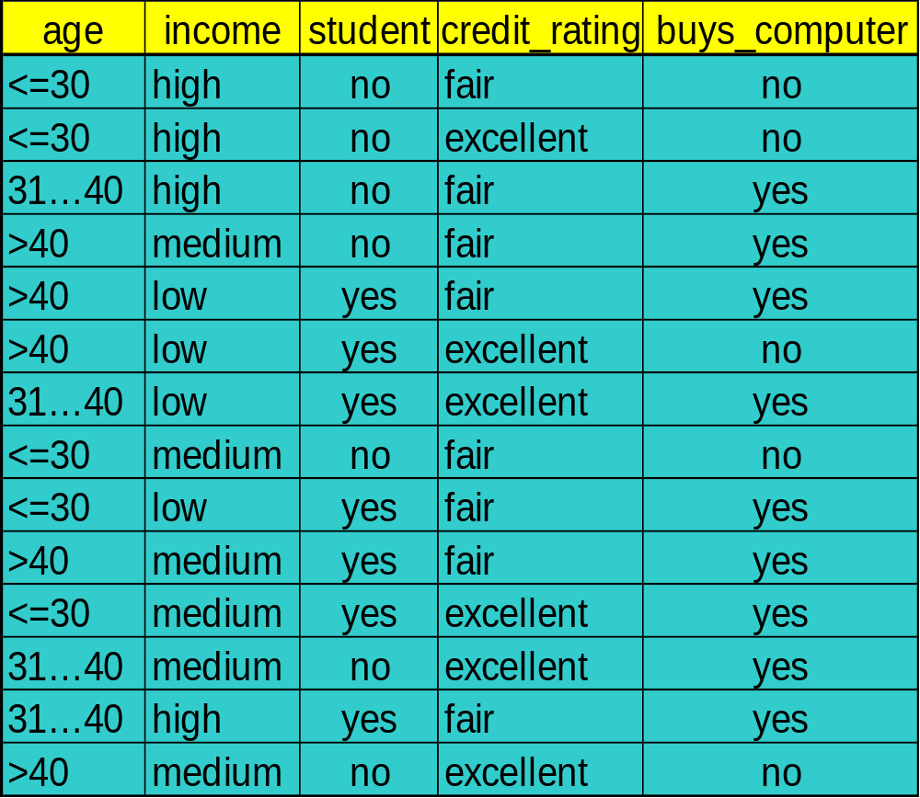
Decision Tree Induction: An Example
Training data set: Buys_computer

Slide 21
Decision Tree Induction: An Example
Resulting tree:
age?
<=30
overcast
>40
31..40
student?
yes
credit rating?
no
yes
excellent
fair
no
yes
no
yes

Slide 22
Algorithm for Decision Tree Induction
Basic algorithm (a greedy algorithm)
  Tree is constructed in a top-down recursive divide-and-conquer manner
  At start, all the training examples are at the root
  Attributes are categorical (if continuous-valued, they are discretized in advance)
  Examples are partitioned recursively based on selected attributes
  Test attributes are selected on the basis of a heuristic or statistical measure (e.g., information gain)
Conditions for stopping partitioning
  All samples for a given node belong to the same class
  There are no remaining attributes for further partitioning – majority voting is employed for classifying the leaf
  There are no samples left

Slide 23
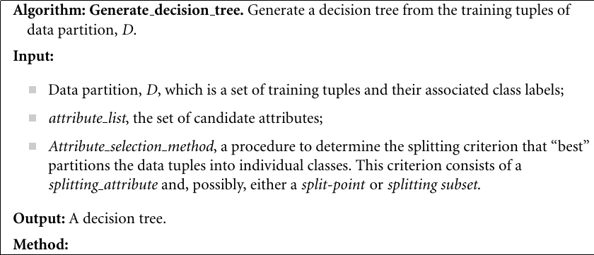
Algorithm

Slide 24
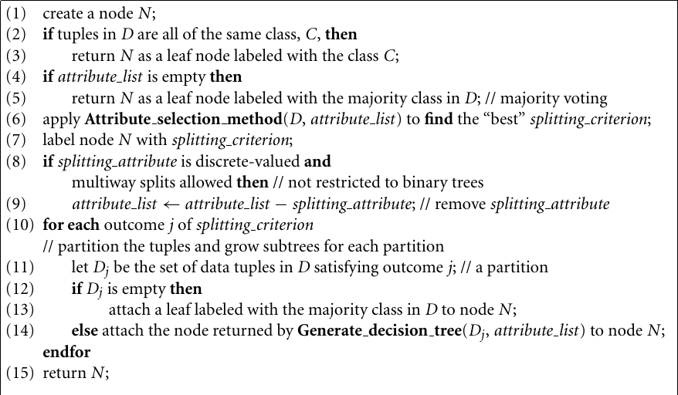
Algorithm

Slide 25
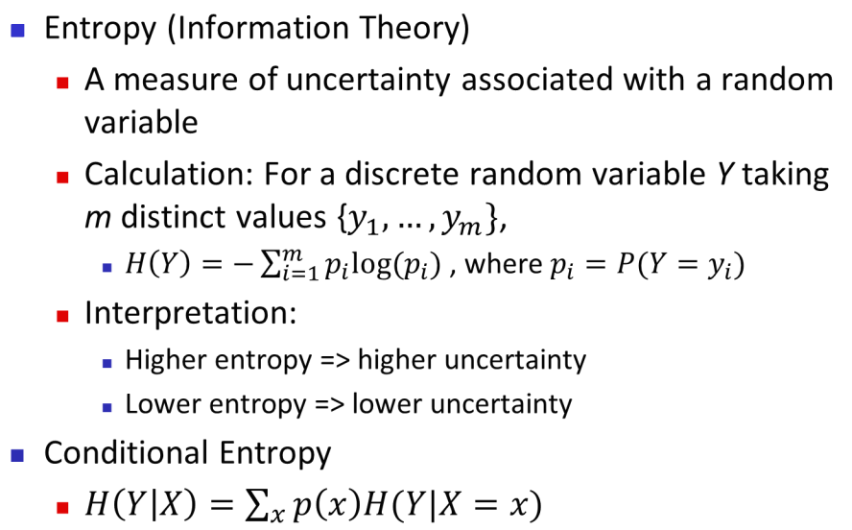

Brief Review of Entropy
m = 2

Slide 26
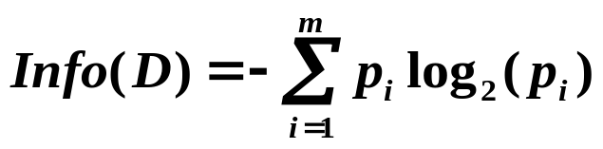
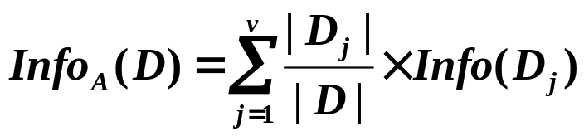

Attribute Selection Measure: Information Gain (ID3)
Select the attribute with the highest information gain
Let p_{i} be the probability that an arbitrary tuple in D belongs to class C_{i}, estimated by |C_{i, D}|/|D|
Expected information (entropy) needed to classify a tuple in D:
Information needed (after using A to split D into v partitions) to classify D:
Information gained by branching on attribute A

Slide 27






Attribute Selection: Information Gain
Class P: buys_computer = “yes”
Class N: buys_computer = “no”
means “age <=30” has 5 out of 14 samples, with 2 yes’es and 3 no’s. Hence
Similarly,

Slide 28
Computing Information-Gain for Continuous-Valued Attributes
Let attribute A be a continuous-valued attribute
Must determine the best split point for A
  Sort the value A in increasing order
  Typically, the midpoint between each pair of adjacent values is considered as a possible split point
    (a_{i}+a_{i+1})/2 is the midpoint between the values of a_{i} and a_{i+1}
  The point with the minimum expected information requirement for A, Info_{A}(D) is selected as the split-point for A
Split:
  D1 is the set of tuples in D satisfying A ≤ split-point, and D2 is the set of tuples in D satisfying A > split-point

Slide 29
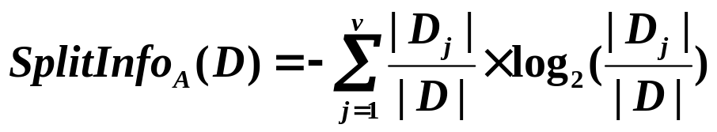
Gain Ratio for Attribute Selection (C4.5)
Information gain measure is biased towards attributes with a large number of values
C4.5 (a successor of ID3) uses gain ratio to overcome the problem (normalization to information gain)
  GainRatio(A) = Gain(A)/SplitInfo(A)
Ex.
  gain_ratio(income) = 0.029/1.557 = 0.019
The attribute with the maximum gain ratio is selected as the splitting attribute

Slide 30
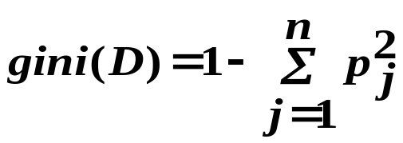


Gini Index (CART, IBM IntelligentMiner)
If a data set D contains examples from n classes, gini(D) is defined as
where p_{j} is the relative frequency of class j in D
If a data set D is split on A into two subsets D₁ and D₂, the gini index gini(D) is defined as
Reduction in Impurity:
The attribute provides the smallest gini_{split}(D) (or the largest reduction in impurity, Δgini(A)) is chosen to split the node (need to enumerate all the possible splitting points for each attribute)

Slide 31
Gini index (CART, IBM IntelligentMiner)
Split criterion for attribute A for Gini index: binary split
For discrete-valued attributes:
  A have v distinct values, {a₁, a₂, ..., a_{v}}, occuring in D
  examine all of the possible subsets that can be formed using known values of A: each subset, S_{A}, can be considered as a binary test for attribute A of the form "A∈S_{A}"
  give a tuple, this test is satisfied if the value of A for the tuple is among the values listed in S_{A}
  empty set and the power set are excluded, therefore, there are 2^{v}-2 possible ways to form two partitions of the data, D, based on a binary split on A
For continuous-valued attributes:
  each possible split-point must be considered
  strategy is similar to that used for information gain
Data Mining: Concepts and Techniques

Slide 32
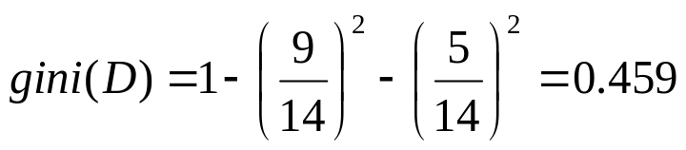


Computation of Gini Index
Ex. D has 9 tuples in buys_computer = “yes” and 5 in “no”
Suppose the attribute income partitions D into 10 in D₁: {low, medium} and 4 in D₂: {high}
  Gini_{{low,high}} is 0.458; Gini_{{medium,high}} is 0.450. Thus, split on the {low,medium} (and {high}) since it has the lowest Gini index
All attributes are assumed continuous-valued
May need other tools, e.g., clustering, to get the possible split values
Can be modified for categorical attributes

Slide 33
Comparing Attribute Selection Measures
The three measures, in general, return good results but
  Information gain:
    biased towards multivalued attributes
  Gain ratio:
    tends to prefer unbalanced splits in which one partition is much smaller than the others
  Gini index:
    biased to multivalued attributes
    has difficulty when # of classes is large
    tends to favor tests that result in equal-sized partitions and purity in both partitions

Slide 34
Other Attribute Selection Measures
CHAID: a popular decision tree algorithm, measure based on χ² test for independence
C-SEP: performs better than info. gain and gini index in certain cases
G-statistic: has a close approximation to χ² distribution
MDL (Minimal Description Length) principle (i.e., the simplest solution is preferred):
  The best tree as the one that requires the fewest # of bits to both (1) encode the tree, and (2) encode the exceptions to the tree
Multivariate splits (partition based on multiple variable combinations)
  CART: finds multivariate splits based on a linear comb. of attrs.
Which attribute selection measure is the best?
  Most give good results, none is significantly superior than others

Slide 35
Overfitting and Tree Pruning
Overfitting: An induced tree may overfit the training data
  Too many branches, some may reflect anomalies due to noise or outliers
  Poor accuracy for unseen samples
Two approaches to avoid overfitting
  Prepruning: Halt tree construction early ̵ do not split a node if this would result in the goodness measure falling below a threshold
    Difficult to choose an appropriate threshold
  Postpruning: Remove branches from a “fully grown” tree—get a sequence of progressively pruned trees
    Use a set of data different from the training data to decide which is the “best pruned tree”

Slide 36
Enhancements to Basic Decision Tree Induction
Allow for continuous-valued attributes
  Dynamically define new discrete-valued attributes that partition the continuous attribute value into a discrete set of intervals
Handle missing attribute values
  Assign the most common value of the attribute
  Assign probability to each of the possible values
Attribute construction
  Create new attributes based on existing ones that are sparsely represented
  This reduces fragmentation, repetition, and replication

Slide 37
Classification in Large Databases
Classification—a classical problem extensively studied by statisticians and machine learning researchers
Scalability: Classifying data sets with millions of examples and hundreds of attributes with reasonable speed
Why is decision tree induction popular?
  relatively faster learning speed (than other classification methods)
  convertible to simple and easy to understand classification rules
  can use SQL queries for accessing databases
  comparable classification accuracy with other methods
RainForest (VLDB’98 — Gehrke, Ramakrishnan & Ganti)
  Builds an AVC-list (attribute, value, class label)

Slide 38
Scalability Framework for RainForest
Separates the scalability aspects from the criteria that determine the quality of the tree
Builds an AVC-list: AVC (Attribute, Value, Class_label)
AVC-set (of an attribute X )
  Projection of training dataset onto the attribute X and class label where counts of individual class label are aggregated
AVC-group (of a node n )
  Set of AVC-sets of all predictor attributes at the node n

Slide 39

Rainforest: Training Set and Its AVC Sets
Training Examples
AVC-set on Age
AVC-set on income
Age | Buy_Computer
 | yes | no
<=30 | 2 | 3
31..40 | 4 | 0
>40 | 3 | 2
income | Buy_Computer
 | yes | no
high | 2 | 2
medium | 4 | 2
low | 3 | 1
AVC-set on
credit_rating
AVC-set on Student
student | Buy_Computer
 | yes | no
yes | 6 | 1
no | 3 | 4
Credit rating | Buy_Computer
 | yes | no
fair | 6 | 2
excellent | 3 | 3

Slide 40
BOAT (Bootstrapped Optimistic Algorithm for Tree Construction)
Use a statistical technique called bootstrapping to create several smaller samples (subsets), each fits in memory
Each subset is used to create a tree, resulting in several trees
These trees are examined and used to construct a new tree T’
  It turns out that T’ is very close to the tree that would be generated using the whole data set together
Adv: requires only two scans of DB, an incremental alg.

Slide 41

Presentation of Classification Results
Data Mining: Concepts and Techniques

Slide 42

Visualization of a Decision Tree in SGI/MineSet 3.0
Data Mining: Concepts and Techniques

Slide 43

Interactive Visual Mining by Perception-Based Classification (PBC)
Data Mining: Concepts and Techniques

Slide 44
Chapter 8. Classification: Basic Concepts
Classification: Basic Concepts
Decision Tree Induction
Bayes Classification Methods
Rule-Based Classification
Model Evaluation and Selection
Techniques to Improve Classification Accuracy: Ensemble Methods
Summary


Slide 45
Bayesian Classification: Why?
A statistical classifier: performs probabilistic prediction, i.e., predicts class membership probabilities
Foundation: Based on Bayes’ Theorem.
Performance: A simple Bayesian classifier, naïve Bayesian classifier, has comparable performance with decision tree and selected neural network classifiers
Incremental: Each training example can incrementally increase/decrease the probability that a hypothesis is correct — prior knowledge can be combined with observed data
Standard: Even when Bayesian methods are computationally intractable, they can provide a standard of optimal decision making against which other methods can be measured

Slide 46
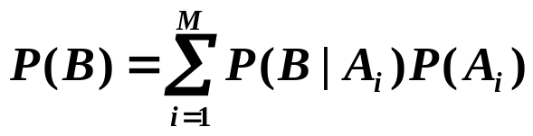
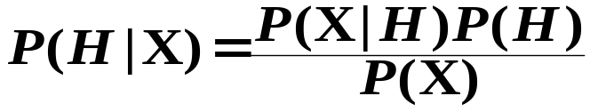
Bayes’ Theorem: Basics
Total probability Theorem:
Bayes’ Theorem:
  Let X be a data sample (“evidence”): class label is unknown
  Let H be a hypothesis that X belongs to class C
  Classification is to determine P(H|X), (i.e., posteriori probability): the probability that the hypothesis holds given the observed data sample X
  P(H) (prior probability): the initial probability
    E.g., X will buy computer, regardless of age, income, …
  P(X): probability that sample data is observed
  P(X|H) (likelihood): the probability of observing the sample X, given that the hypothesis holds
    E.g., Given that X will buy computer, the prob. that X is 31..40, medium income

Slide 47
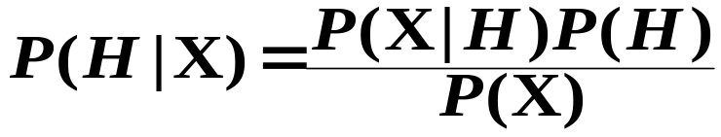
Prediction Based on Bayes’ Theorem
Given training data X, posteriori probability of a hypothesis H, P(H|X), follows the Bayes’ theorem
Informally, this can be viewed as
  posteriori = likelihood × prior/evidence
Predicts X belongs to C_{i} iff the probability P(C_{i}|X) is the highest among all the P(C_{k}|X) for all the k classes
Practical difficulty: It requires initial knowledge of many probabilities, involving significant computational cost

Slide 48
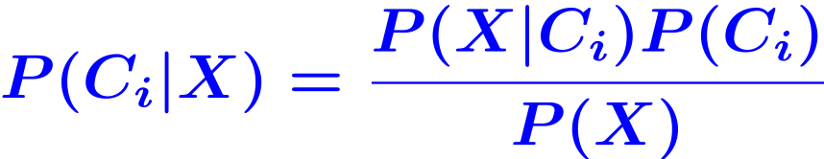
Classification Is to Derive the Maximum Posteriori
Let D be a training set of tuples and their associated class labels, and each tuple is represented by an n-D attribute vector X = (x₁, x₂, …, x_{n})
Suppose there are m classes C₁, C₂, …, C_{m}.
Classification is to derive the maximum posteriori, i.e., the maximal P(C_{i}|X)
This can be derived from Bayes’ theorem
Since P(X) is constant for all classes, only
  needs to be maximized

Slide 49
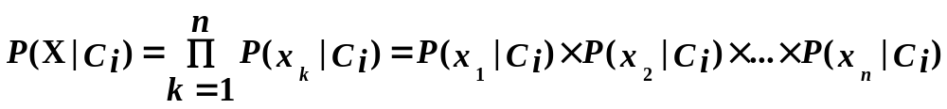
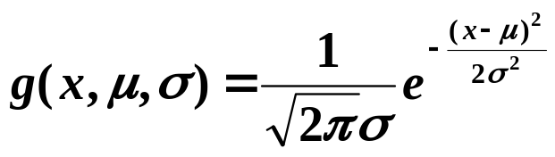

Naïve Bayes Classifier
A simplified assumption: attributes are conditionally independent (i.e., no dependence relation between attributes):
This greatly reduces the computation cost: only counts the class distribution
If A_{k} is categorical, P(x_{k}|C_{i}) is the # of tuples in C_{i} having value x_{k} for A_{k} divided by |C_{i, D}| (# of tuples of C_{i} in D)
If A_{k} is continous-valued, P(x_{k}|C_{i}) is usually computed based on Gaussian distribution with a mean μ and standard deviation σ
  and P(x_{k}|C_{i}) is

Slide 50

Naïve Bayes Classifier: Training Dataset
Class:
C1: buys_computer=‘yes’
C2: buys_computer=‘no’
Data to be classified:
X = (age <=30,
Income = medium,
Student = yes
Credit_rating = Fair)

Slide 51
Naïve Bayes Classifier: An Example
C₁: buys_computer="yes" P(C₁) = 9/14 = 0.643
C₂: buys_computer="no" P(C₂) = 5/14= 0.357
Compute P(X|C_{i}) for each class
  P(age = “<=30” | C₁) = 2/9 = 0.222
  P(age = “<= 30” | C₂) = 3/5 = 0.6
  P(income = “medium” | C₁) = 4/9 = 0.444
  P(income = “medium” | C₂) = 2/5 = 0.4
  P(student = “yes” | C₁) = 6/9 = 0.667
  P(student = “yes” | C₂) = 1/5 = 0.2
  P(credit_rating = “fair” | C₁) = 6/9 = 0.667
  P(credit_rating = “fair” | C₂) = 2/5 = 0.4
X=(age <= 30 , income = medium, student = yes, credit_rating = fair)
P(X|C_{i}) : P(X|C₁) = 0.222×0.444×0.667×0.667=0.044
P(X|C₂) = 0.6×0.4×0.2×0.4=0.019
P(X|C_{i})×P(C_{i}) : P(X|C₁)×P(C₁)=0.028
P(X|C₂)×P(C₂)=0.007
Therefore, X belongs to class C₁ (“buys_computer = yes”)

Slide 52
Naïve Bayesian Classifier: An Example
Build a Naïve Bayesian Classifier from the training data in the table, in whic x₁ and x₂ are attributes. The value of x₁∈{1, 2, 3}, x₂∈{S, M , L}, and Y is the label of the tubples, i.e., Y∈C=(1 , -1). To classify the tuple t=(2,S)^{T} using the classifier.
 | 1 | 2 | 3 | 4 | 5 | 6 | 7 | 8 | 9 | 10 | 11 | 12 | 13 | 14 | 15
x₁ | 1 | 1 | 1 | 1 | 1 | 2 | 2 | 2 | 2 | 2 | 3 | 3 | 3 | 3 | 3
x₂ | S | M | M | S | S | S | M | M | L | L | L | M | M | L | L
Y | -1 | -1 | 1 | 1 | -1 | -1 | -1 | 1 | 1 | 1 | 1 | 1 | 1 | 1 | -1
Data Mining: Concepts and Techniques

Slide 53
Naïve Bayesian Classifier: An Example
C₁: Y=1 C₂: Y=-1
P(C₁)=9/15 P(C₂)=6/15
P(x₁=1|C₁)=2/9 P(x₁=2|C₁)=3/9 P(x₁=3|C₁)=4/9
P(x₂=S|C₁)=1/9 P(x₂=M|C₁)=4/9 P(x₂=L|C₁)=4/9
P(x₁=1|C₂}=3/6 P(x₁=2|C₂)=2/6 P(x₁=3|C₂)=1/6
P(x₂=S|C₂)=3/6 P(x₂=M|C₂)=2/6 P(x₂=L|C₂)=1/6
For the tuple t=(2,S)^{T}:
P(C₁|t)∝P(C₁)P(x₁=2|C₁)P(x₂=S|C₁)=9/15*3/9*1/9=1/45
P(C₂|t)∝P(C₂)P(x₁=2|C₂)P(x₂=S|C₂)=6/15*2/6*3/6=1/15
so, the label of x=(2,S)^{T} is -1
Data Mining: Concepts and Techniques

Slide 54
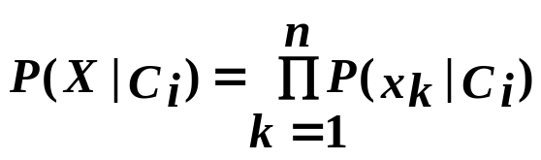
Avoiding the Zero-Probability Problem
Naïve Bayesian prediction requires each conditional prob. be non-zero. Otherwise, the predicted prob. will be zero
Ex. Suppose a dataset with 1000 tuples, income=low (0), income= medium (990), and income = high (10)
Use Laplacian correction (or Laplacian estimator)
  Adding 1 to each case
    P(income = low) = 1/1003
    P(income = medium) = 991/1003
    P(income = high) = 11/1003
  The “corrected” prob. estimates are close to their “uncorrected” counterparts

Slide 55
Naïve Bayes Classifier: Comments
Advantages
  Easy to implement
  Good results obtained in most of the cases
Disadvantages
  Assumption: class conditional independence, therefore loss of accuracy
  Practically, dependencies exist among variables
    E.g., hospitals: patients: Profile: age, family history, etc.
      Symptoms: fever, cough etc., Disease: lung cancer, diabetes, etc.
    Dependencies among these cannot be modeled by Naïve Bayes Classifier
How to deal with these dependencies? Bayesian Belief Networks (Chapter 9)

Slide 56
Chapter 8. Classification: Basic Concepts
Classification: Basic Concepts
Decision Tree Induction
Bayes Classification Methods
Rule-Based Classification
Model Evaluation and Selection
Techniques to Improve Classification Accuracy: Ensemble Methods
Summary


Slide 57
Using IF-THEN Rules for Classification
Represent the knowledge in the form of IF-THEN rules
  R: IF age = youth AND student = yes
  THEN buys_computer = yes
  Rule antecedent/precondition vs. rule consequent
If the condition in a rule antecedent holds true for a given tuple, it is said that the antecedent is satisfied, and the rule covers the tuple
Assessment of a rule: coverage and accuracy
  n_{covers} = # of tuples covered by R
  n_{correct} = # of tuples correctly classified by R
  coverage(R) = n_{covers} /|D|
  accuracy(R) = n_{correct} / n_{covers}
if a rule is satisfied by a tuple, the rule is said to be triggered

Slide 58
Using IF-THEN Rules for Classification
If more than one rule are triggered, need conflict resolution
  Size ordering: assign the highest priority to the triggering rules that has the “toughest” requirement (i.e., with the most attribute tests)
  Class-based ordering:
    classes are sorted in order of decreasing “importance” such as by decreasing order of prevalence
    classes are sorted based on the misclassification cost per class
  Rule-based ordering (decision list): rules are organized into one long priority list, according to some measure of rule quality or by experts
When there is no rule satisfied by a tuple, how to determine the class label of the tuple?
  A fallback or default rule can be set up to specify a default class, based on the training set.

Slide 59
Rule Extraction from a Decision Tree
Rules are easier to understand than large trees
One rule is created for each path from the root to a leaf
Each attribute-value pair along a path forms a conjunction: the leaf holds the class prediction
Rules are mutually exclusive and exhaustive
age?
<=30
31..40
>40
student?
yes
credit rating?
no
yes
excellent
fair
no
yes
no
yes
Example: Rule extraction from our buys_computer decision-tree
  IF age = young AND student = no THEN buys_computer = no
  IF age = young AND student = yes THEN buys_computer = yes
  IF age = mid-age THEN buys_computer = yes
  IF age = old AND credit_rating = excellent THEN buys_computer = no
  IF age = old AND credit_rating = fair THEN buys_computer = yes

Slide 60
Rule Induction: Sequential Covering Method
Sequential covering algorithm: Extracts rules directly from training data
Typical sequential covering algorithms: FOIL, AQ, CN2, RIPPER
Rules are learned sequentially, each for a given class C_{i} will cover many tuples of C_{i} but none (or few) of the tuples of other classes
Steps:
  Rules are learned one at a time
  Each time a rule is learned, the tuples covered by the rules are removed
  Repeat the process on the remaining tuples until termination condition, e.g., when no more training examples or when the quality of a rule returned is below a user-specified threshold
Comp. w. decision-tree induction: learning a set of rules simultaneously

Slide 61
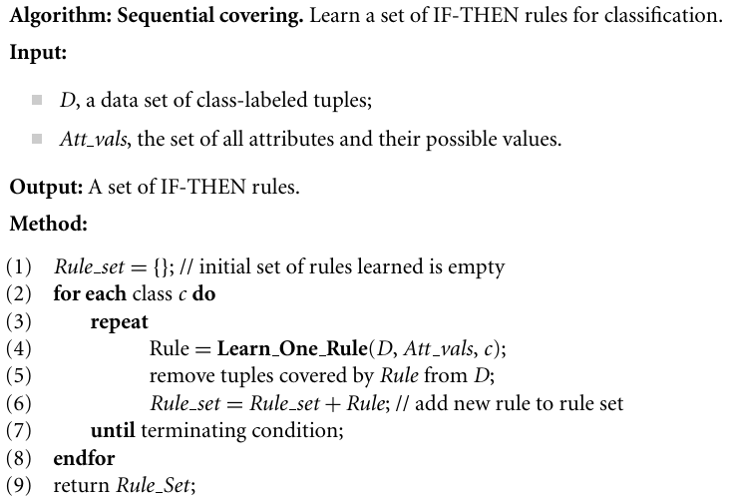
Sequential Covering Algorithm

Slide 62
Sequential Covering Algorithm
while (enough target tuples left)
  generate a rule
  remove positive target tuples satisfying this rule
Examples covered
by Rule 2
Examples covered
by Rule 1
Examples covered
by Rule 3
Positive examples

Slide 63
Rule Generation
To generate a rule
  while(true)
  find the best predicate p
  if foil-gain(p) > threshold then add p to current rule
  else break
A3=1
A3=1&&A1=2
A3=1&&A1=2
&&A8=5
Positive examples
Negative examples

Slide 64
How to Learn-One-Rule?
Rules are grown in a general-to-specific manner
Start with the most general rule possible: condition = empty
  E.g.: IF THEN loan_decision=accept
Then consider each possible attribute test that may be added to the rule
  can be derived from the param. Att_vals
  e.g.: for (att, val), consider attribute tests:
  att=val, att≤val, att>val
  Finding an optimal rule set becomes computationally explosive
Adding new attributes by adopting a greedy depth-first strategy
  Picks the one that most improves the rule quality
  e.g.: IF income=high THEN loan_decision=accept
  IF income=high AND credit_rating=excellent
  THEN load_decision=accept

Slide 65
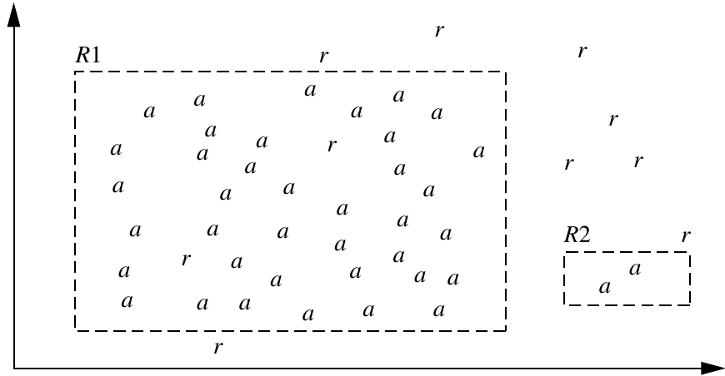
Rule Quality Measure
Rule-Quality measures: consider both accuracy and coverage
  accuracy: problematic (only accuracy)

Slide 66
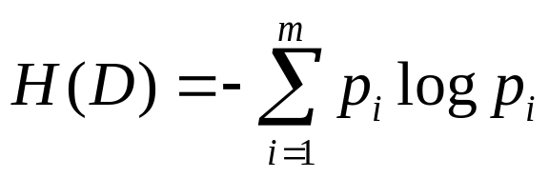
Rule Quality Measure
Rule-Quality measures: consider both accuracy and coverage
  Learing rules for the class c
  current rule is R: IF condition Then class=c
  new rule is R': IF condition' Then class=c
  condition' = condition And att_{i}
Entropy: information gain
  where D is the set of tuples covered by condition', p_{i} is the probability of class C_{i} in D
  The lower the entropy, the better condition' is

Slide 67

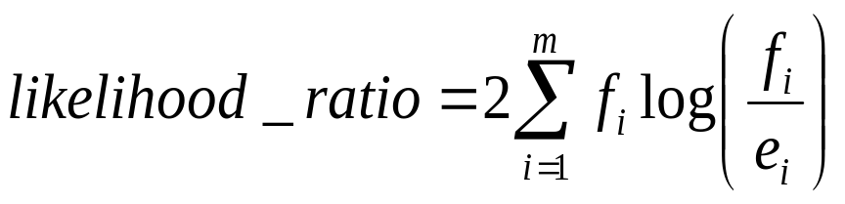
Rule Quality Measure
Rule-Quality measures: consider both accuracy and coverage
  Foil-gain (in FOIL & RIPPER): assesses info_gain by extending condition
    favors rules that have high accuracy and cover many positive tuples
likelihood ratio statistic
where m is # of classes, f_{i} is the observed freq. of class i among the tuples, e_{i} is the expected freq.
The higher the likelihood ratio, the performance of the rule is not due to chance.

Slide 68

Rule Pruning
Rule pruning based on an independent set of test tuples
pos/neg are # of positive/negative tuples covered by R.
If FOIL_Prune is higher for the pruned version of R, prune R

Slide 69
Chapter 8. Classification: Basic Concepts
Classification: Basic Concepts
Decision Tree Induction
Bayes Classification Methods
Rule-Based Classification
Model Evaluation and Selection
Techniques to Improve Classification Accuracy: Ensemble Methods
Summary


Slide 70
Model Evaluation and Selection
Evaluation metrics: How can we measure accuracy? Other metrics to consider?
Use validation test set of class-labeled tuples instead of training set when assessing accuracy
Methods for estimating a classifier’s accuracy:
  Holdout method, random subsampling
  Cross-validation
  Bootstrap
Comparing classifiers:
  Confidence intervals
  Cost-benefit analysis and ROC Curves

Slide 71
Classifier Evaluation Metrics
Terminology
  Poisitive tuples(P): tuples of the main class of interest
  Negative tuples(N): all other tuples
  True positives(TP): the positive tuples that were correctly labeled by the classifier
  True negative(TN): the negative tuples that were correctly labeled by the classifier
  False positive(FP): the negative tuples that were misclassfied as positive
  False negative(FN): the positive tuples that were misclassified as negative

Slide 72
Classifier Evaluation Metrics
Measure | Formula
accuracy, recognition rate | (TP+TN)/(P+N)
error rate, misclassification rate | (FP+FN)/(P+N)
sensitivity, true positive rate, recall | TP /P
specificity, true negative rate | TN / N
precision | TP /(TP+FP)
F, F₁, F-score harmonic mean of precision and recall | 2×precision×recall /(precision+recall)
F_{β}, where β is a non-negative number | (1+β²)×precision×recall /(β²×precision+recall)

Slide 73
Classifier Evaluation Metrics: Confusion Matrix
Confusion Matrix:
Actual class\Predicted class | C₁ | ¬ C₁
C₁ | True Positives (TP) | False Negatives (FN)
¬ C₁ | False Positives (FP) | True Negatives (TN)
Example of Confusion Matrix:
Actual class\Predicted class | buy_computer = yes | buy_computer = no | Total
buy_computer = yes | 6954 | 46 | 7000
buy_computer = no | 412 | 2588 | 3000
Total | 7366 | 2634 | 10000
Given m classes, an entry, CM_{i,j} in a confusion matrix indicates # of tuples in class i that were labeled by the classifier as class j
May have extra rows/columns to provide totals

Slide 74
Classifier Evaluation Metrics:
Accuracy, Error Rate
A\P | C | ¬C
C | TP | FN | P
¬C | FP | TN | N
 | P’ | N’ | All
Classifier Accuracy, or recognition rate: percentage of test set tuples that are correctly classified
  Accuracy = (TP + TN)/All
Error rate: 1 – accuracy, or
  Error rate = (FP + FN)/All

Slide 75
Classifier Evaluation Metrics:
Accuracy, Error Rate
Actual Class\Predicted class | cancer = yes | cancer = no | Total | Recognition(%)
cancer = yes | 90 | 210 | 300 | 30.00 (sensitivity
cancer = no | 140 | 9560 | 9700 | 98.56 (specificity)
Total | 230 | 9770 | 10000 | 96.40 (accuracy)
  Precision = 90/230 = 39.13%
  Recall = 90/300 = 30.00%

Slide 76
Classifier Evaluation Metrics:
Sensitivity and Specificity
Class Imbalance Problem:
  One class may be rare, e.g. fraud, or HIV-positive
  Significant majority of the negative class and minority of the positive class
  Sensitivity: True Positive recognition rate
    Sensitivity = TP /P
  Specificity: True Negative recognition rate
    Specificity = TN/N
accuracy=sensitivity×P /(P+N) + specificity×N /(P+N)

Slide 77
Classifier Evaluation Metrics:
Precision and Recall, and F-measures
Precision: exactness – what % of tuples that the classifier labeled as positive are actually positive
  precision=TP/(TP+FP)
Recall: completeness – what % of positive tuples did the classifier label as positive?
recall=TP/(TP+FN)
Perfect score is 1.0
Inverse relationship between precision & recall
F measure (F₁ or F-score): harmonic mean of precision and recall
2×precision×recall /(precision+recall)
F_{β}: weighted measure of precision and recall
  assigns β times as much weight to recall as to precision
  (1+β²)×precision×recall /(β²×precision+recall)

Slide 78
Classifier Evaluation Metrics: other measures
Speed: the compuational costs involved in generating and using the classifier
Robustness: the ability to make prediction given noisy data
Scalability: the ability to construct the classifier efficiently given large amounts of data
Interpretability: the level of understanding and insight that is provided by the classifier

Slide 79
Evaluating Classifier Accuracy:
Holdout & Cross-Validation Methods
Holdout method
  Given data is randomly partitioned into two independent sets
    Training set (e.g., 2/3) for model construction
    Test set (e.g., 1/3) for accuracy estimation
  Random subsampling: a variation of holdout
    Repeat holdout k times, accuracy = avg. of the accuracies obtained
Cross-validation (k-fold, where k=10 is most popular)
  Randomly partition the data into k mutually exclusive subsets, each approximately equal size
  At i-th iteration, use D_{i} as test set and others as training set
  Leave-one-out: k folds where k = # of tuples, for small sized data
  *Stratified cross-validation*: folds are stratified so that class dist. in each fold is approx. the same as that in the initial data

Slide 80
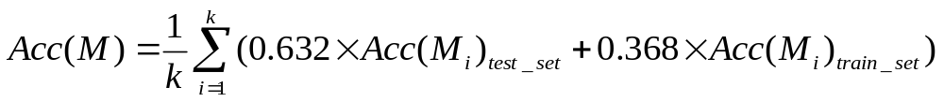
Evaluating Classifier Accuracy: Bootstrap
Bootstrap
  Works well with small data sets
  Samples the given training tuples uniformly with replacement
    i.e., each time a tuple is selected, it is equally likely to be selected again and re-added to the training set
Several bootstrap methods, and a common one is .632 boostrap
  A data set with d tuples is sampled d times, with replacement, resulting in a training set of d samples.
  The data tuples that did not make it into the training set end up forming the test set.
  About 63.2% of the original data end up in the bootstrap, and the remaining 36.8% form the test set (since (1 – 1/d)^{d} ≈ e⁻¹ = 0.368)
  Repeat the sampling procedure k times, overall accuracy of the model:

Slide 81


Estimating Confidence Intervals:
Classifier Models M₁ vs. M₂
Suppose we have 2 classifiers, M₁ and M₂, which one is better?
Use 10-fold cross-validation to obtain and
These mean error rates are just estimates of error on the true population of future data cases
What if the difference between the 2 error rates is just attributed to chance?
  Use a test of statistical significance
  Obtain confidence limits for our error estimates

Slide 82
Estimating Confidence Intervals:
Null Hypothesis
Perform 10-fold cross-validation
Assume samples follow a t distribution with k–1 degrees of freedom (here, k=10)
Use t-test (or Student’s t-test)
Null Hypothesis: M₁ & M₂ are the same
If we can reject null hypothesis, then
  we conclude that the difference between M₁ & M₂ is statistically significant
  Chose model with lower error rate

Slide 83


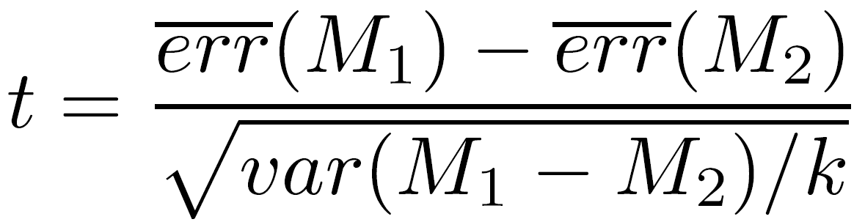

Estimating Confidence Intervals: t-test
If only 1 test set available: pairwise comparison
  For i^{th} round of 10-fold cross-validation, the same cross partitioning is used to obtain err(M₁)_{i} and err(M₂)_{i}
  Average over 10 rounds to get
  t-test computes t-statistic with k-1 degrees of freedom:
If two test sets available: use non-paired t-test
and
where
where
where k₁ & k₂ are # of cross-validation samples used for M₁ & M₂, resp.

Slide 84


Estimating Confidence Intervals:
Table for t-distribution
Symmetric
Significance level, e.g., sig = 0.05 or 5% means M₁ & M₂ are significantly different for 95% of population
Confidence limit, z = sig/2

Slide 85
Estimating Confidence Intervals:
Statistical Significance
Are M₁ & M₂ significantly different?
  Compute t. Select significance level (e.g. sig = 5%)
  Consult table for t-distribution: Find t value corresponding to k-1 degrees of freedom (here, 9)
  t-distribution is symmetric: typically upper % points of distribution shown → look up value for confidence limit z=sig/2 (here, 0.025)
  If t > z or t < -z, then t value lies in rejection region:
    Reject null hypothesis that mean error rates of M₁ & M₂ are same
    Conclude: statistically significant difference between M₁ & M₂
  Otherwise, conclude that any difference is chance

Slide 86
Model Selection: ROC Curves
ROC (Receiver Operating Characteristics) curves: for visual comparison of classification models
Originated from signal detection theory
Shows the trade-off between the true positive rate (TPR) and the false positive rate (FPR)
TPR is the proportion of positive tuples that are correctly labeled by the model
FPR is the proportion of negative tuples that are mislabeled as positive.
TP, FP, P, and N are the number of true positive, false positive, positive, and negative tuples
TPR = TP/P=sensitivity FPR = FP/N = 1 − specificity
The area under the ROC curve is a measure of the accuracy of the model

Slide 87
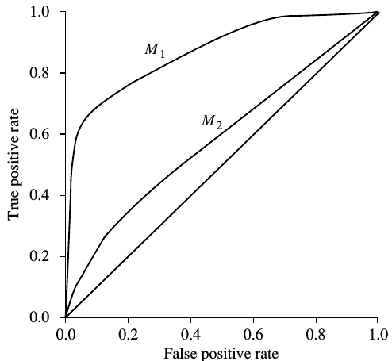
Model Selection: ROC Curves
Any increase in TPR occurs at the
cost of an increase in FPR
The area under the ROC curve is
a measure of the accuracy of the
model
To plot an ROC curve for a given
classification model, M, the model
must be able to return a probability of
the predicted class for each test tuple.

Slide 88
Model Selection: ROC Curves
For a tuple X, the probablistic
classifier returns f(X)→[0,1]
For a binary problem, a threshold
t is selected so that tuples where
f(X) ≥ t are considered positive
and all the other tuples are
considered negative
the number of true positives and the number of false positives are both functions of t, TP(t) and FP(t)

Slide 89
Model Selection: ROC Curves
Tuples are ranked and sorted so that the tuple with the most positive prob. appears at the top of the list, and the tuple with the least positive prob. lands at the bottom of the list
The vert. axis of an ROC curve represents TPR, the horiz. axis represents FPR
Starting at the bottom left corner: TPR = FPR = 0
if the tuple is true positive, then TP and TPR increase. On the graph, move up and plot a point.
If it is false positive, then both FP and FPR increase. On the graph, move right and plot a point.
This process is repeated for each of the test tuples in ranked order, each time moving up on the graph for a true positive or toward the right for a false positive

Slide 90
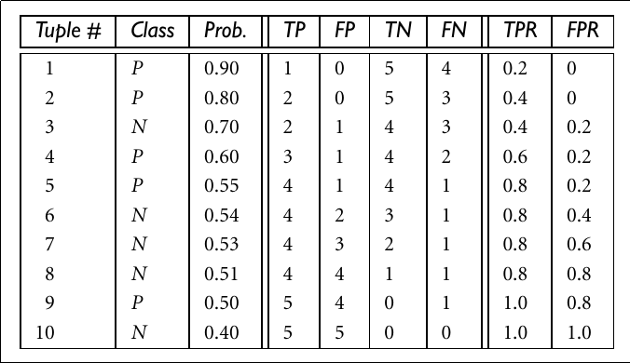
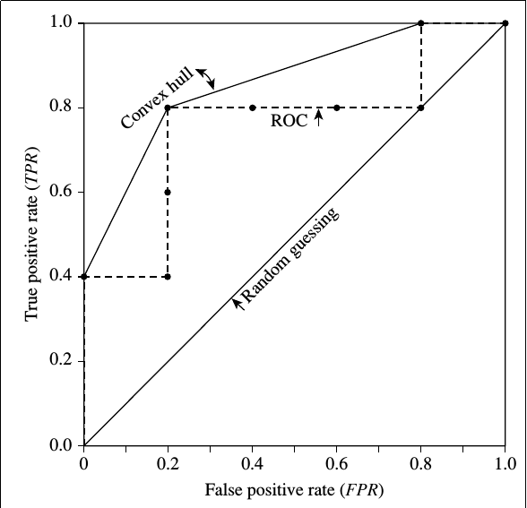
Model Selection: ROC Curves

Slide 91
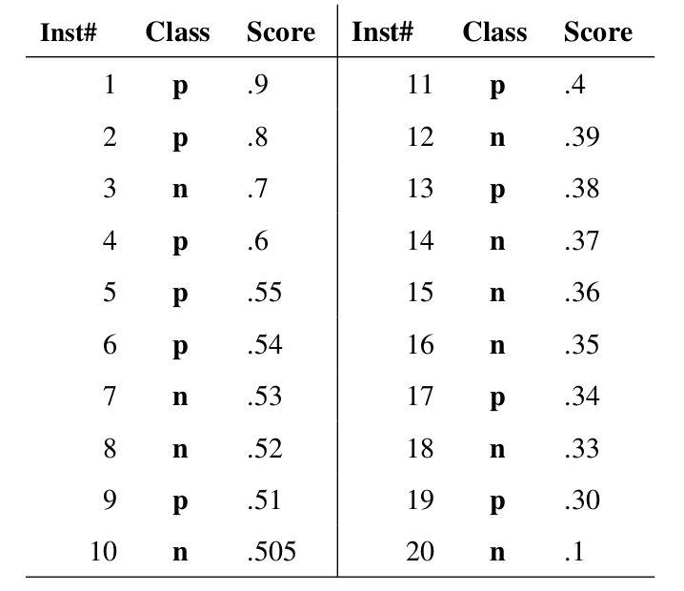
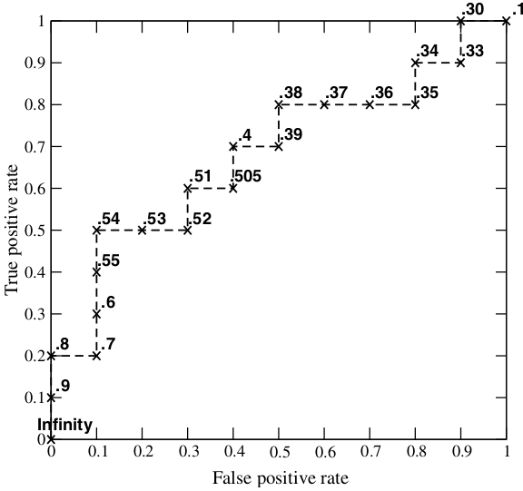
Model Selection: ROC Curves

Slide 92
Issues Affecting Model Selection
Accuracy
  classifier accuracy: predicting class label
Speed
  time to construct the model (training time)
  time to use the model (classification/prediction time)
Robustness: handling noise and missing values
Scalability: efficiency in disk-resident databases
Interpretability
  understanding and insight provided by the model
Other measures, e.g., goodness of rules, such as decision tree size or compactness of classification rules

Slide 93
Chapter 8. Classification: Basic Concepts
Classification: Basic Concepts
Decision Tree Induction
Bayes Classification Methods
Rule-Based Classification
Model Evaluation and Selection
Techniques to Improve Classification Accuracy: Ensemble Methods
Summary


Slide 94
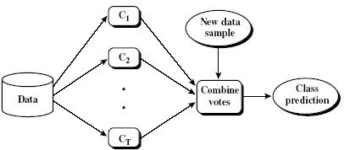
Ensemble Methods: Increasing the Accuracy
Ensemble methods
  Use a combination of
  models to increase
  accuracy
  Combine a series of k
  learned models, M₁, M₂, …, M_{k},
  with the aim of creating an improved model M*
Popular ensemble methods
  Bagging: averaging the prediction over a collection of classifiers
  Boosting: weighted vote with a collection of classifiers
  Ensemble: combining a set of heterogeneous classifiers

Slide 95
Bagging: Bootstrap Aggregation
Analogy: Diagnosis based on multiple doctors’ majority vote
Training
  Given a set D of d tuples, at each iteration i, a training set D_{i} of d tuples is sampled with replacement from D (i.e., bootstrap)
  A classifier model M_{i} is learned for each training set D_{i}
Classification: classify an unknown sample X
  Each classifier M_{i} returns its class prediction
  The bagged classifier M* counts the votes and assigns the class with the most votes to X

Slide 96
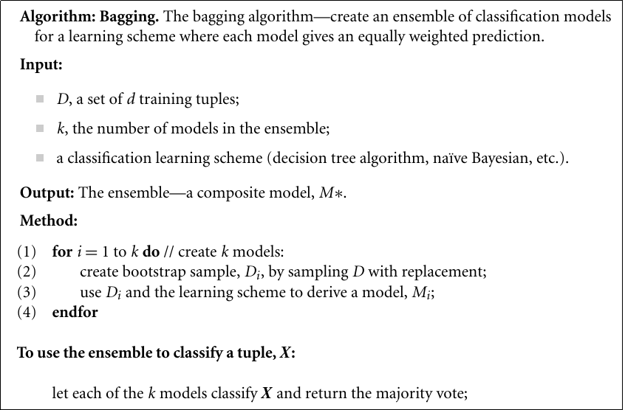
Bagging: Bootstrap Aggregation

Slide 97
Bagging: Bootstrap Aggregation
Prediction: can be applied to the prediction of continuous values by taking the average value of each prediction for a given test tuple
Accuracy
  Often significantly better than a single classifier derived from D
  For noise data: not considerably worse, more robust
  Proved improved accuracy in prediction

Slide 98
Boosting
Analogy: Consult several doctors, based on a combination of weighted diagnoses—weight assigned based on the previous diagnosis accuracy
How boosting works?
  Weights are assigned to each training tuple
  A series of k classifiers is iteratively learned
  After a classifier M_{i} is learned, the weights are updated to allow the subsequent classifier, M_{i+1}, to pay more attention to the training tuples that were misclassified by M_{i}
  The final M* combines the votes of each individual classifier, where the weight of each classifier's vote is a function of its accuracy

Slide 99
Boosting
Boosting algorithm can be extended for numeric prediction
Comparing with bagging:
  Boosting tends to have greater accuracy,
  it risks overfitting the model to misclassified data

Slide 100
Adaboost (Adaptive Boosting)
Given a set of d class-labeled tuples, (X₁, y₁), …, (X_{d}, y_{d})
Initially, all the weights of tuples are set the same (1/d)
Generate k classifiers in k rounds. At round i,
  Tuples from D are sampled (with replacement) to form a training set D_{i} of the same size
  Each tuple’s chance of being selected is based on its weight, w_{j}
  A classification model M_{i} is derived from D_{i}

Slide 101
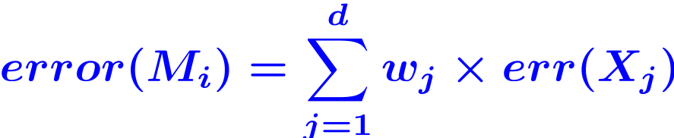
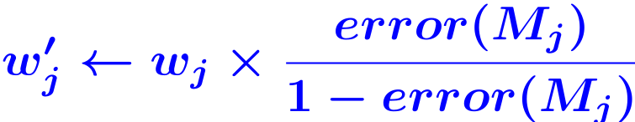
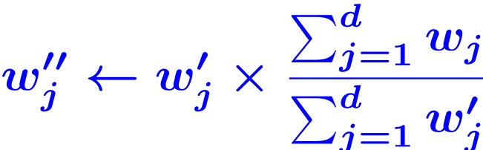
Adaboost (Adaptive Boosting)
Generate k classifiers in k rounds. At round i,
  ...
  Its error rate is calculated using D_{i} as a test set
  where err(X_{j})=1 if X_{j} is misclassified, o.w., err(X_{j})=0
  If tuple j is misclassified
  After the weights of all the correctly classified tuples are updated, the weights for all tuples are normalized

Slide 102
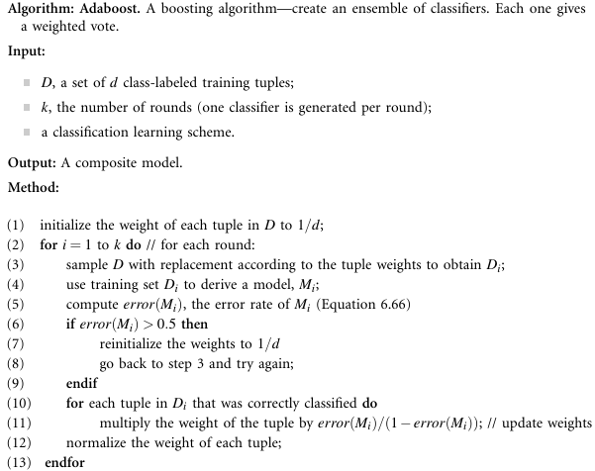

Slide 103
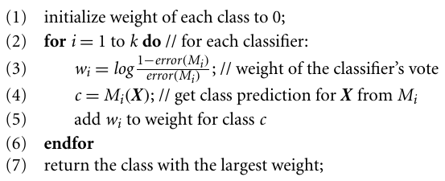
Adaboost
To use the ensemble to classify tuple, X:

Slide 104



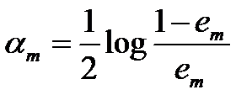
Binary version of Adaboost
Given a set of N class-labeled tuples, (X₁, y₁), …, (X_{d}, y_{d}), in which yi∈{+1,-1}
Initially, all the weights of tuples are set the same (1/N)
for m=1 to k
  Train a basic classifier using training data set with weight distribution, D_{m}:
  Caculate the error rate of G_{m}(x):
  Calculate the coefficient of G_{m}(x):

Slide 105
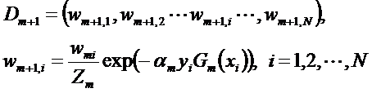

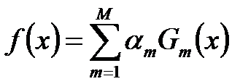
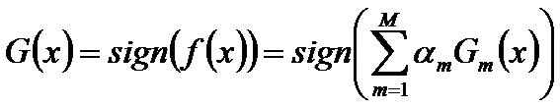
Binary version of Adaboost
for m=1 to k
  ...
  Update weight distribution of training data:
  where
Construct the linear combination of G_{m}(x)
The final classifier is:

Slide 106
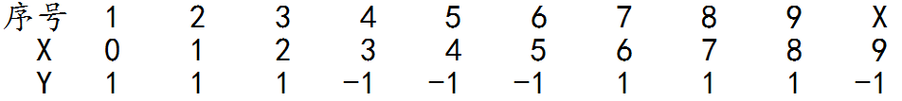
Example
Given the following data, to train a classifier using AdaBoost algorithm.
#

Slide 107
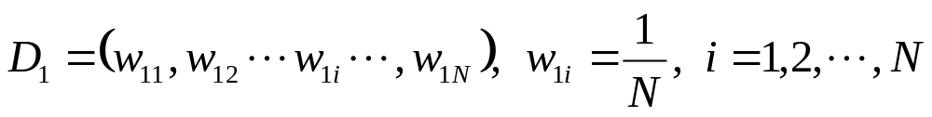
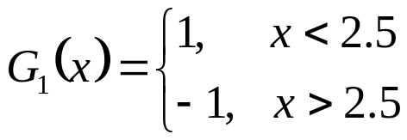
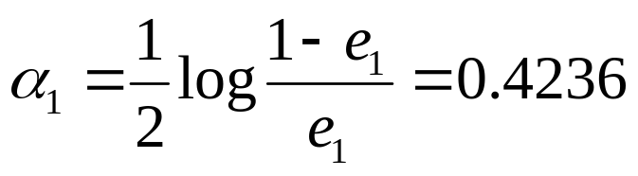
Example
Initialize the weight distribution of training data
i.e., W_{1i} = 0.1
For m=1
e₁=P(G₁(x_{i})≠y_{i}) = 0.3,
f₁(x)=0.4236G₁(x)
D₂=(0.0715, 0.0715, 0.0715,
0.0715, 0.0715, 0.0715,
0.1666, 0.1666, 0.1666,
0.0715)

Slide 108
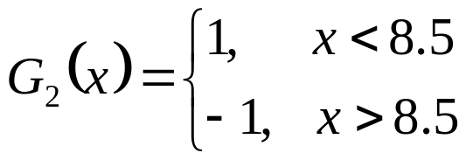
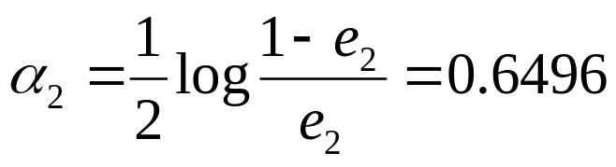
Example
For m=2
e₂=P(G₂(x_{i})≠y_{i}) = 0.2143
D₃=(0.0455, 0.0455, 0.0455, 0.1667, 0.1667,
0.01667, 0.1060, 0.1060, 0.1060, 0.0455)
f₂(x)=0.4236G₁(x) + 0.6496G₂(x)

Slide 109
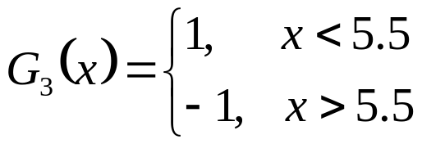
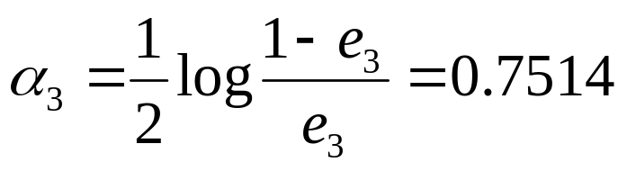
Example
For m=3
e₃=P(G₃(x_{i})≠y_{i}) = 0.1820
D₄=(0.125, 0.125, 0.125, 0.102, 0.102,
0.102, 0.065, 0.065, 0.065, 0.125)
f₃(x)=0.4236G₁(x) + 0.6496G₂(x)+0.7514G₃(x)
The final classifier is: G(x)=sign(f₃(x))

Slide 110
Random Forest (Breiman 2001)
Random Forest:
  Each classifier in the ensemble is a decision tree classifier and is generated using a random selection of attributes at each node to determine the split
  During classification, each tree votes and the most popular class is returned

Slide 111
Random Forest (Breiman 2001)
Two Methods to construct Random Forest:
  Forest-RI (random input selection): Randomly select, at each node, F attributes as candidates for the split at the node. The CART methodology is used to grow the trees to maximum size
  Forest-RC (random linear combinations): Creates new attributes (or features) that are a linear combination of the existing attributes (reduces the correlation between individual classifiers)
Comparable in accuracy to Adaboost, but more robust to errors and outliers
Insensitive to the number of attributes selected for consideration at each split, and faster than bagging or boosting

Slide 112
Classification of Class-Imbalanced Data Sets
Class-imbalance problem: Rare positive example but numerous negative ones, e.g., medical diagnosis, fraud, oil-spill, fault, etc.
Traditional methods assume a balanced distribution of classes and equal error costs: not suitable for class-imbalanced data
Typical methods for imbalance data in 2-class classification:
  Oversampling: re-sampling of data from positive class
  Under-sampling: randomly eliminate tuples from negative class
  Threshold-moving: moves the decision threshold, t, so that the rare class tuples are easier to classify, and hence, less chance of costly false negative errors
  Ensemble techniques: Ensemble multiple classifiers introduced above
Still difficult for class imbalance problem on multiclass tasks

Slide 113
Chapter 8. Classification: Basic Concepts
Classification: Basic Concepts
Decision Tree Induction
Bayes Classification Methods
Rule-Based Classification
Model Evaluation and Selection
Techniques to Improve Classification Accuracy: Ensemble Methods
Summary


Slide 114
Summary (I)
Classification is a form of data analysis that extracts models describing important data classes.
Effective and scalable methods have been developed for decision tree induction, Naive Bayesian classification, rule-based classification, and many other classification methods.
Evaluation metrics include: accuracy, sensitivity, specificity, precision, recall, F measure, and F_{ß} measure.
Stratified k-fold cross-validation is recommended for accuracy estimation. Bagging and boosting can be used to increase overall accuracy by learning and combining a series of individual models.

Slide 115
Summary (II)
Significance tests and ROC curves are useful for model selection.
There have been numerous comparisons of the different classification methods; the matter remains a research topic
No single method has been found to be superior over all others for all data sets
Issues such as accuracy, training time, robustness, scalability, and interpretability must be considered and can involve trade-offs, further complicating the quest for an overall superior method

Slide 116
References (1)
C. Apte and S. Weiss. Data mining with decision trees and decision rules. Future Generation Computer Systems, 13, 1997
C. M. Bishop, Neural Networks for Pattern Recognition. Oxford University Press, 1995
L. Breiman, J. Friedman, R. Olshen, and C. Stone. Classification and Regression Trees. Wadsworth International Group, 1984
C. J. C. Burges. A Tutorial on Support Vector Machines for Pattern Recognition. Data Mining and Knowledge Discovery, 2(2): 121-168, 1998
P. K. Chan and S. J. Stolfo. Learning arbiter and combiner trees from partitioned data for scaling machine learning. KDD'95
H. Cheng, X. Yan, J. Han, and C.-W. Hsu, Discriminative Frequent Pattern Analysis for Effective Classification, ICDE'07
H. Cheng, X. Yan, J. Han, and P. S. Yu, Direct Discriminative Pattern Mining for Effective Classification, ICDE'08
W. Cohen. Fast effective rule induction. ICML'95
G. Cong, K.-L. Tan, A. K. H. Tung, and X. Xu. Mining top-k covering rule groups for gene expression data. SIGMOD'05

Slide 117
References (2)
A. J. Dobson. An Introduction to Generalized Linear Models. Chapman & Hall, 1990.
G. Dong and J. Li. Efficient mining of emerging patterns: Discovering trends and differences. KDD'99.
R. O. Duda, P. E. Hart, and D. G. Stork. Pattern Classification, 2ed. John Wiley, 2001
U. M. Fayyad. Branching on attribute values in decision tree generation. AAAI’94.
Y. Freund and R. E. Schapire. A decision-theoretic generalization of on-line learning and an application to boosting. J. Computer and System Sciences, 1997.
J. Gehrke, R. Ramakrishnan, and V. Ganti. Rainforest: A framework for fast decision tree construction of large datasets. VLDB’98.
J. Gehrke, V. Gant, R. Ramakrishnan, and W.-Y. Loh, BOAT -- Optimistic Decision Tree Construction. SIGMOD'99.
T. Hastie, R. Tibshirani, and J. Friedman. The Elements of Statistical Learning: Data Mining, Inference, and Prediction. Springer-Verlag, 2001.
D. Heckerman, D. Geiger, and D. M. Chickering. Learning Bayesian networks: The combination of knowledge and statistical data. Machine Learning, 1995.
W. Li, J. Han, and J. Pei, CMAR: Accurate and Efficient Classification Based on Multiple Class-Association Rules, ICDM'01.

Slide 118
References (3)
T.-S. Lim, W.-Y. Loh, and Y.-S. Shih. A comparison of prediction accuracy, complexity, and training time of thirty-three old and new classification algorithms. Machine Learning, 2000.
J. Magidson. The Chaid approach to segmentation modeling: Chi-squared automatic interaction detection. In R. P. Bagozzi, editor, Advanced Methods of Marketing Research, Blackwell Business, 1994.
M. Mehta, R. Agrawal, and J. Rissanen. SLIQ : A fast scalable classifier for data mining. EDBT'96.
T. M. Mitchell. Machine Learning. McGraw Hill, 1997.
S. K. Murthy, Automatic Construction of Decision Trees from Data: A Multi-Disciplinary Survey, Data Mining and Knowledge Discovery 2(4): 345-389, 1998
J. R. Quinlan. Induction of decision trees. Machine Learning, 1:81-106, 1986.
J. R. Quinlan and R. M. Cameron-Jones. FOIL: A midterm report. ECML’93.
J. R. Quinlan. C4.5: Programs for Machine Learning. Morgan Kaufmann, 1993.
J. R. Quinlan. Bagging, boosting, and c4.5. AAAI'96.

Slide 119
References (4)
R. Rastogi and K. Shim. Public: A decision tree classifier that integrates building and pruning. VLDB’98.
J. Shafer, R. Agrawal, and M. Mehta. SPRINT : A scalable parallel classifier for data mining. VLDB’96.
J. W. Shavlik and T. G. Dietterich. Readings in Machine Learning. Morgan Kaufmann, 1990.
P. Tan, M. Steinbach, and V. Kumar. Introduction to Data Mining. Addison Wesley, 2005.
S. M. Weiss and C. A. Kulikowski. Computer Systems that Learn: Classification and Prediction Methods from Statistics, Neural Nets, Machine Learning, and Expert Systems. Morgan Kaufman, 1991.
S. M. Weiss and N. Indurkhya. Predictive Data Mining. Morgan Kaufmann, 1997.
I. H. Witten and E. Frank. Data Mining: Practical Machine Learning Tools and Techniques, 2ed. Morgan Kaufmann, 2005.
X. Yin and J. Han. CPAR: Classification based on predictive association rules. SDM'03
H. Yu, J. Yang, and J. Han. Classifying large data sets using SVM with hierarchical clusters. KDD'03.

Slide 120


Slide 121
CS412 Midterm Exam Statistics
Opinion Question Answering:
  Like the style: 70.83%, dislike: 29.16%
  Exam is hard: 55.75%, easy: 0.6%, just right: 43.63%
  Time: plenty:3.03%, enough: 36.96%, not: 60%
  Score distribution: # of students (Total: 180)
  >=90: 24
  80-89: 54
  70-79: 46
Final grading are based on overall score accumulation and relative class distributions
  <40: 2
  60-69: 37
  50-59: 15
  40-49: 2

Slide 122
Issues: Evaluating Classification Methods
Accuracy
  classifier accuracy: predicting class label
  predictor accuracy: guessing value of predicted attributes
Speed
  time to construct the model (training time)
  time to use the model (classification/prediction time)
Robustness: handling noise and missing values
Scalability: efficiency in disk-resident databases
Interpretability
  understanding and insight provided by the model
Other measures, e.g., goodness of rules, such as decision tree size or compactness of classification rules

Slide 123




Predictor Error Measures
Measure predictor accuracy: measure how far off the predicted value is from the actual known value
Loss function: measures the error betw. y_{i} and the predicted value y_{i}’
  Absolute error: | y_{i} – y_{i}’|
  Squared error: (y_{i} – y_{i}’)²
Test error (generalization error): the average loss over the test set
  Mean absolute error: Mean squared error:
  Relative absolute error: Relative squared error:
  The mean squared-error exaggerates the presence of outliers
  Popularly use (square) root mean-square error, similarly, root relative squared error

Slide 124
Scalable Decision Tree Induction Methods
SLIQ (EDBT’96 — Mehta et al.)
  Builds an index for each attribute and only class list and the current attribute list reside in memory
SPRINT (VLDB’96 — J. Shafer et al.)
  Constructs an attribute list data structure
PUBLIC (VLDB’98 — Rastogi & Shim)
  Integrates tree splitting and tree pruning: stop growing the tree earlier
RainForest (VLDB’98 — Gehrke, Ramakrishnan & Ganti)
  Builds an AVC-list (attribute, value, class label)
BOAT (PODS’99 — Gehrke, Ganti, Ramakrishnan & Loh)
  Uses bootstrapping to create several small samples

Slide 125
Data Cube-Based Decision-Tree Induction
Integration of generalization with decision-tree induction (Kamber et al.’97)
Classification at primitive concept levels
  E.g., precise temperature, humidity, outlook, etc.
  Low-level concepts, scattered classes, bushy classification-trees
  Semantic interpretation problems
Cube-based multi-level classification
  Relevance analysis at multi-levels
  Information-gain analysis with dimension + level

