Slide 1
Data Mining:
Concepts and Techniques
(3rd ed.)
— Chapter 9 —
Classification: Advanced Methods
Jianjun Cheng
School of Information Science & Engineering
Lanzhou University
©2011 Han, Kamber & Pei. All rights reserved.

Slide 2
Chapter 9. Classification: Advanced Methods

Bayesian Belief Networks
Classification by Backpropagation
Support Vector Machines
Classification by Using Frequent Patterns
Lazy Learners (or Learning from Your Neighbors)
Other Classification Methods
Additional Topics Regarding Classification
Summary

Slide 3
Bayesian Belief Networks
Bayesian belief networks (also known as Bayesian networks, probabilistic networks): allow class conditional independencies between subsets of variables
A (directed acyclic) graphical model of causal relationships
  Represents dependency among the variables
  Gives a specification of joint probability distribution
Nodes: random variables
Links: dependency
X and Y are the parents of Z, and Y is the parent of P
No dependency between Z and P
Has no loops/cycles
X
Y
Z
P

Slide 4
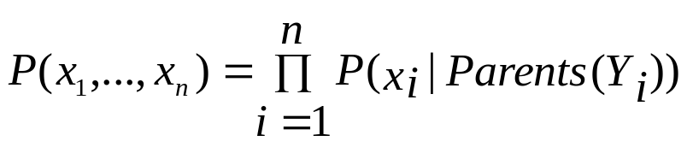
Bayesian Belief Network: An Example
Family
History (FH)
Smoker (S)
CPT: Conditional Probability Table for variable LungCancer:
(FH, S)
(FH, ~S)
(~FH, S)
(~FH, ~S)
LC
0.8
0.5
0.7
0.1
LungCancer
(LC)
Emphysema
~LC
0.2
0.5
0.3
0.9
shows the conditional probability for each possible combination of its parents
PositiveXRay
Dyspnea
Derivation of the probability of a particular combination of values of X(x₁,x₂,...,x_{n}), from CPT:
Bayesian Belief Network

Slide 5
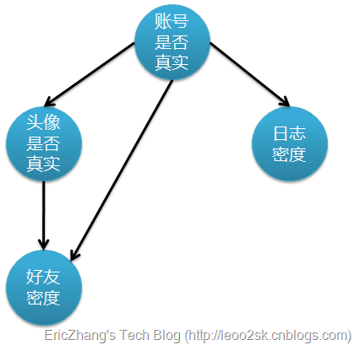
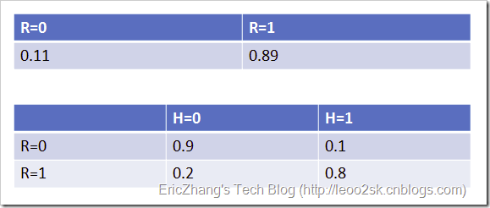
Bayesian network: an Example

Slide 6
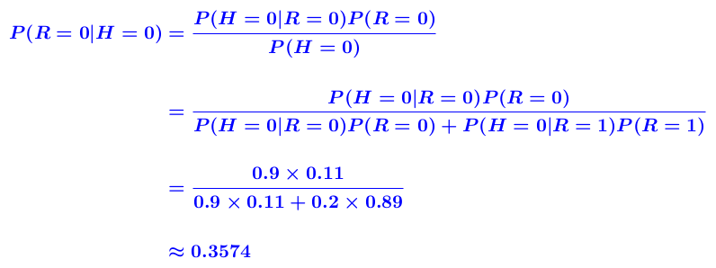
Bayesian network: an Example

Slide 7
Bayesian network: an Example
四个随机变量：账号真实性R，头像真实性H，
日志密度L，好友密度F。
其中H，L，F 可以观察到，而R无法直接观察得到
问题转换为通过H，L，F的观察值对R进行概率推理
推理过程可以如下表示：
  使用观察值实例化H,L和F，把随机值赋给R。
  计算P(R|H,L,F)∝P(R)P(H|R)P(L|R)P(F|R,H,L)
  =P(R)P(H|R)P(L|R)P(F|R,H)
  其中相应概率值可以查条件概率表

Slide 8
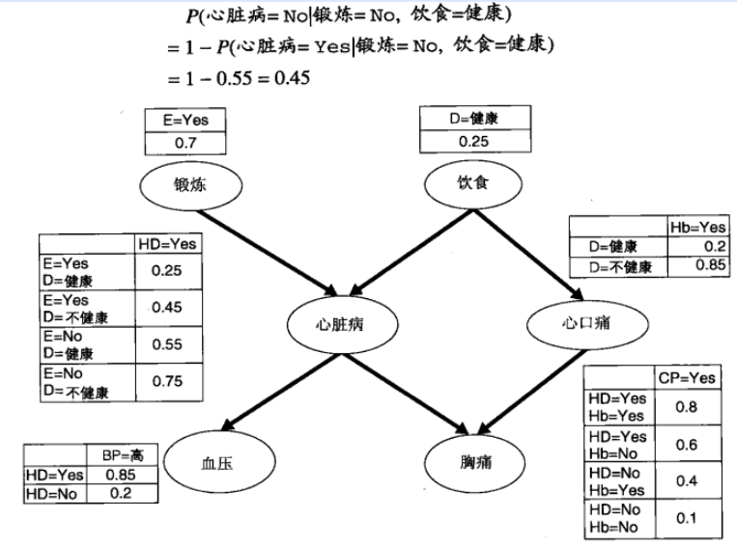
Bayesian network: an Example

Slide 9
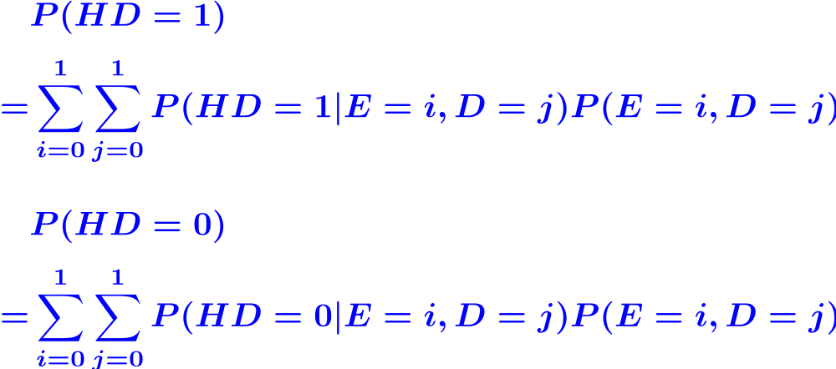
判断一个人是否患有心脏疾病
没有先验信息
  计算先验概率P(HD=1)和P(HD=0)
  其中i=0, 1表示锻炼的两个属
  性值，j=0, 1分别表示不健康
  和健康的饮食。

Slide 10
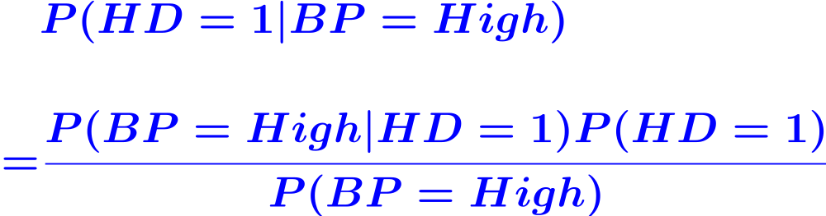
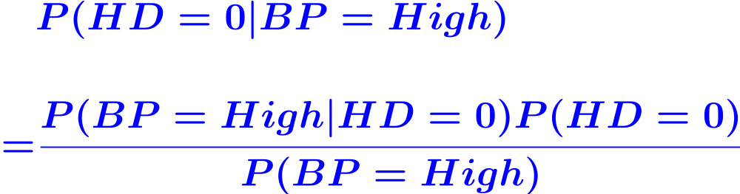
判断一个人是否患有心脏疾病
高血压
  比较后验概率P(HD=1|BP=High)
  和P(HD=0|BP=High)

Slide 11
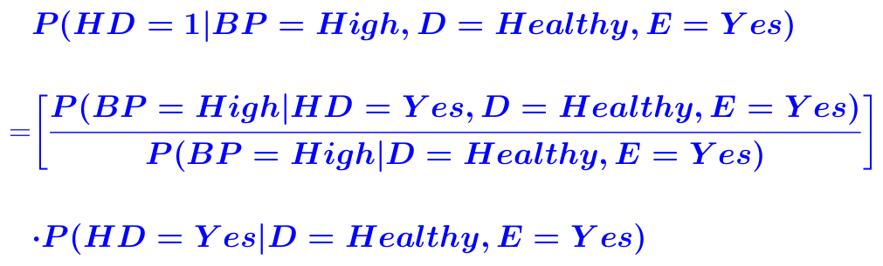
判断一个人是否患有心脏疾病
高血压，饮食健康，锻炼情况
很适合处理不完整的数据，
信息有缺失时，仍可分类
对模型过拟合有很好的鲁
棒性

Slide 12
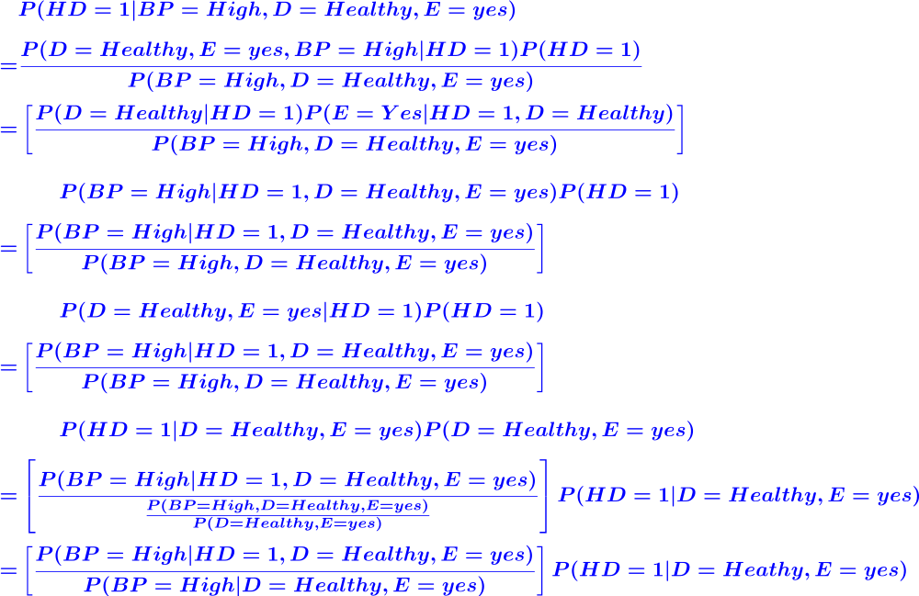

Slide 13
Training Bayesian Networks: Several Scenarios
Scenario 1: Given both the network structure and all variables observable: compute only the CPT entries
Scenario 2: Network structure known, some variables hidden: gradient descent (greedy hill-climbing) method, i.e., search for a solution along the steepest descent of a criterion function
  Weights are initialized to random probability values
  At each iteration, it moves towards what appears to be the best solution at the moment, w.o. backtracking
  Weights are updated at each iteration & converge to local optimum

Slide 14
Training Bayesian Networks: Several Scenarios
Scenario 3: Network structure unknown, all variables observable: search through the model space to reconstruct network topology
Scenario 4: Unknown structure, all hidden variables: No good algorithms known for this purpose
D. Heckerman. A Tutorial on Learning with Bayesian Networks. In Learning in Graphical Models, M. Jordan, ed.. MIT Press, 1999.

Slide 15
Training Bayesian Networks: Gradient Descent
Let D be a training set of data tuples, X₁, X₂, ..., X_{|D|}. Training the belief network means to learn the values of the CPT entries.
Let w_{ijk} be a CPT entry for the variable Y_{i}=y_{ij} having the parents U_{i}=u_{ik}, where w_{ijk}≡P(Y_{i}=y_{ij}|U_{i}=u_{ik}), which represents the probability of value of the ith variable, Y_{i}, to be its jth value, y_{ij}, given the value of its parents U_{i}, to be the kth combination, u_{ik}
E.g. w_{ijk}
Y_{i}=LungCancer y_{ij}=yes
U_{i}=FH, S u_{ik}=yes, yes
(FH, S)
(FH, ~S)
(~FH, S)
(~FH, ~S)
LC
0.8
0.5
0.7
0.1
~LC
0.2
0.5
0.3
0.9

Slide 16
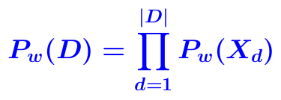
Training Bayesian Networks: Gradient Descent
The w_{ijk} are viewed as weights, the set of weights is collectively referred to as W.
The weights are initialized to random probability values.
A gradient descent strategy performs greedy hill-climbing, and the objective is to maximize the probability

Slide 17
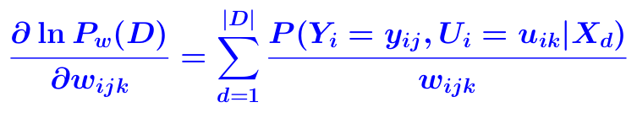
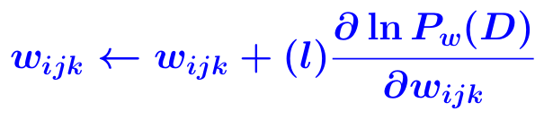

Training Bayesian Networks: Gradient Descent
Given the network topology and initialized w_{ijk} , the algorithm proceeds as follows
  Compute the gradients: For each i, j, k, compute
  Take a small step in the direction of the gradient
  Renormalize the weights, so that

Slide 18
Chapter 9. Classification: Advanced Methods
Bayesian Belief Networks
Classification by Backpropagation
Support Vector Machines
Classification by Using Frequent Patterns
Lazy Learners (or Learning from Your Neighbors)
Other Classification Methods
Additional Topics Regarding Classification
Summary


Slide 19
Classification by Backpropagation
Backpropagation: A neural network learning algorithm
Started by psychologists and neurobiologists to develop and test computational analogues of neurons
A neural network: A set of connected input/output units where each connection has a weight associated with it
During the learning phase, the network learns by adjusting the weights so as to be able to predict the correct class label of the input tuples
Also referred to as connectionist learning due to the connections between units

Slide 20
Neural Network as a Classifier
Weakness
  Long training time
  Require a number of parameters typically best determined empirically, e.g., the network topology or "structure".
  Poor interpretability: Difficult to interpret the symbolic meaning behind the learned weights and of "hidden units" in the network
Strength
  High tolerance to noisy data
  Ability to classify untrained patterns
  Well-suited for continuous-valued inputs and outputs
  Successful on an array of real-world data, e.g., hand-written letters
  Algorithms are inherently parallel
  Techniques have recently been developed for the extraction of rules from trained neural networks

Slide 21
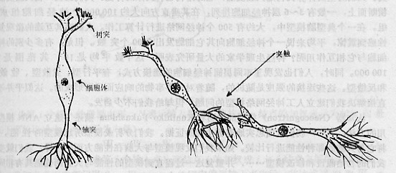
简单的神经元
电
脉
冲
输
树
形
成
突
输
细
胞
体
轴
突
入
突
触
出
信
息
处
理
传
输

Slide 22
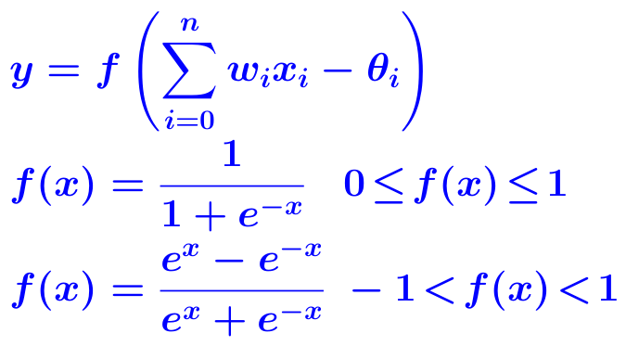
A Neuron (= a perceptron)
w₀
θ_{j}
x₀
w₁
output y
x₁
Σ
f
...
...
w_{n}
x_{n}
Input
vector x
weight
vector w
weighted
sum
Activation
function
The n-dimensional input vector x is mapped into variable y by means of the scalar product and a nonlinear function mapping
Data Mining: Concepts and Techniques

Slide 23
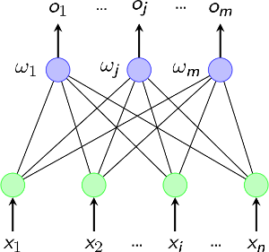
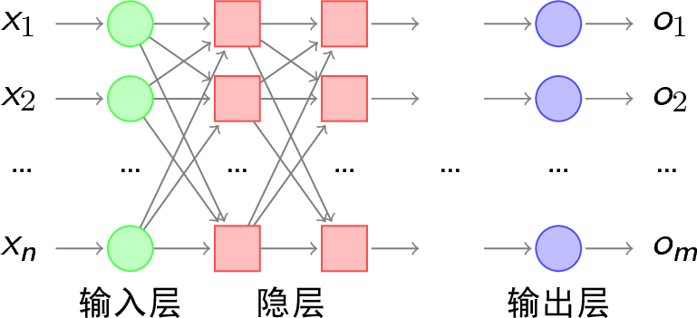
Neural Network: perceptron

Slide 24
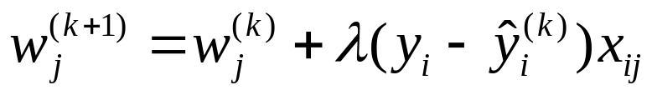
A Multi-Layer Feed-Forward Neural Network
Output vector
Output layer
Hidden layer
w_{ij}
Input layer
Input vector: X

Slide 25
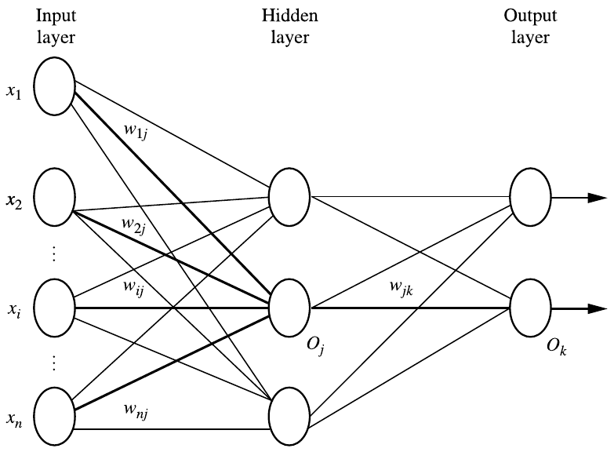
A Multi-Layer Feed-Forward Neural Network
Data Mining: Concepts and Techniques

Slide 26
How A Multi-Layer Neural Network Works
The inputs to the network correspond to the attributes measured for each training tuple
Inputs are fed simultaneously into the units making up the input layer
They are then weighted and fed simultaneously to a hidden layer
The number of hidden layers is arbitrary, usually only one
The weighted outputs of the last hidden layer are input to units making up the output layer, which emits the network's prediction
The network is feed-forward: None of the weights cycles back to an input unit or to an output unit of a previous layer
From a statistical point of view, networks perform nonlinear regression: Given enough hidden units and enough training samples, they can closely approximate any function

Slide 27
Defining a Network Topology
Decide the network topology: Specify # of units in the input layer, # of hidden layers (if > 1), # of units in each hidden layer, and # of units in the output layer
Normalize the input values for each attribute measured in the training tuples to [0.0—1.0]
One input unit per domain value, each initialized to 0
Output, if for classification and more than two classes, one output unit per class is used
Once a network has been trained and its accuracy is unacceptable, repeat the training process with a different network topology or a different set of initial weights

Slide 28
Backpropagation
Iteratively process a set of training tuples & compare the network's prediction with the actual known target value
For each training tuple, the weights are modified to minimize the mean squared error between the network's prediction and the actual target value
Modifications are made in the "backwards"
direction: from the output layer, through
each hidden layer down to the first hidden
layer, hence "backpropagation"
Steps
  Initialize weights to small random numbers, associated with biases
  Propagate the inputs forward (by applying activation function)
  Backpropagate the error (by updating weights and biases)
  Terminating condition (when error is very small, etc.)

Slide 29
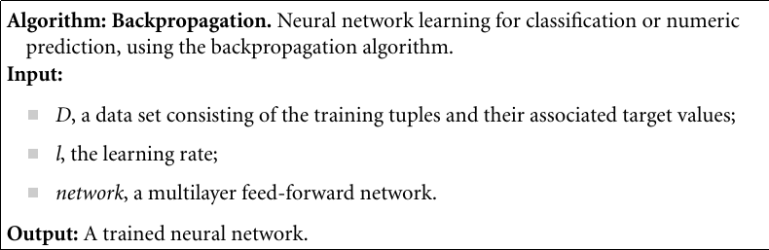
Algorithm: Backpropagation

Slide 30
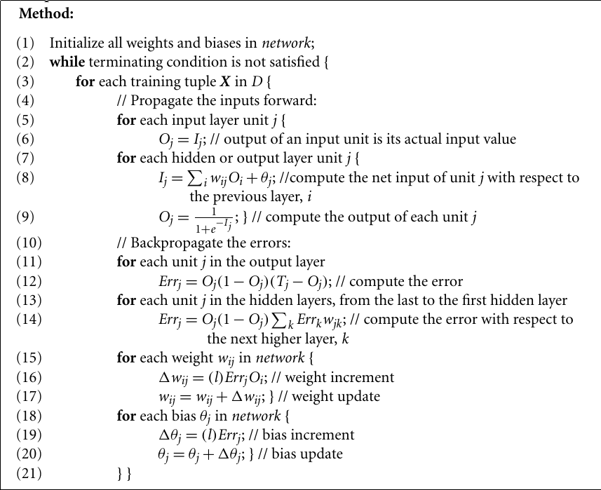

Slide 31
Backpropagation
Initialize weights (to small random #s) and biases in the network
  The weights in the network are initialized to small random numbers (e.g., ranging from −1.0 to 1.0, or −0.5 to 0.5).
  Each unit has a bias associated with it, it is also initialized to small random numbers
Propagate the inputs forward
  the training tuple is fed to the input layer of the network, the inputs pass through the input units, unchanged
  the net input and output of each unit in the hidden and output layers are computed: as a linear combination of its inputs
  each unit in the hidden and output layers takes its net input and then applies an activation function to it
Data Mining: Concepts and Techniques

Slide 32
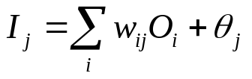
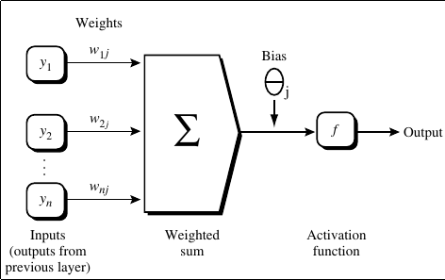
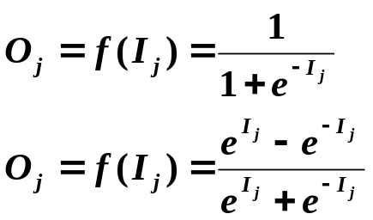
Backpropagation
Propagate the inputs forward
  for an input unit j, its output O_{j} is its input I_{j}
  for a unit j in a hidden or output layer, its net input is
  the output of unit j is
Data Mining: Concepts and Techniques

Slide 33

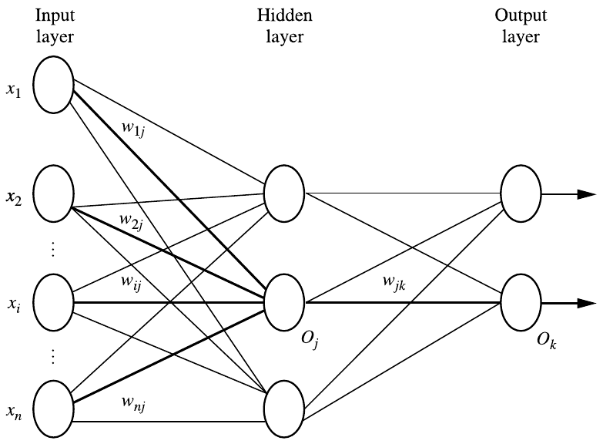
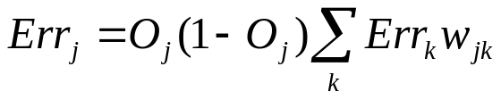
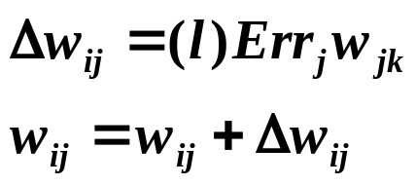
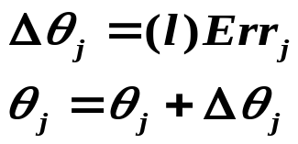
Backpropagation
Back Propagate the error
  the error is propagated backward by updating the weights and biases to reflect the error of the network's prediction
  for unit j in the output layer, the error Err_{j} is computed as
  for a hidden layer unit j, its error:
  weights are updated as
  biases are updated as
Data Mining: Concepts and Techniques

Slide 34
Backpropagation
Termination condition
  all Δw_{ij} in the previous epoch were so small as to be below some specific threshold
  the percentage of tuples misclassified in the previous epoch is below some threshold
  a prespecified number of epochs has expired
Data Mining: Concepts and Techniques

Slide 35
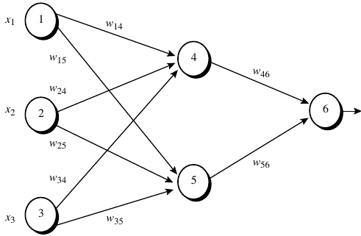
Example
In the neuro network following, let the learning rate be 0.9. The initial weight and bias values of the network are given in the table, along with the first training tuple, X = (1, 0, 1), whose class label is 1.
w₁₄ | 0.2 | w₁₅ | -0.3
w₂₄ | 0.4 | w₂₅ | 0.1
w₃₄ | -0.5 | w₃₅ | 0.2
w₄₆ | -0.3 | w₅₆ | -0.2
θ₄ | -0.4 | θ₅ | 0.2
θ₆ | 0.1
Data Mining: Concepts and Techniques

Slide 36
Example
the net input and output calculations
calculations of the error at each node
Unit j | Net input, I_{j} | Output, O_{j}
4 | 0.2+0-0.5-0.4=-0.7 | 1/(1+e^{0.7})=0.332
5 | -0.3+0+0.2+0.2=0.1 | 1/(1+e^{-0.1})=0.525
6 | (-0.3)(0.332)-(0.2)(0.525) +0.1 =-0.105 | 1/(1+e^{0.105})=0.474
Unit j | Err_{j}
6 | (0.474)(1 − 0.474)(1 − 0.474) = 0.1311
5 | (0.525)(1 − 0.525)(0.1311)(−0.2) = −0.0065
4 | (0.332)(1 − 0.332)(0.1311)(−0.3) = −0.0087
Data Mining: Concepts and Techniques

Slide 37
Calculations for weight and bias updating
weight/bias | New value
w₄₆ | −0.3 + (0.9)(0.1311)(0.332) = −0.261
w₅₆ | −0.2 + (0.9)(0.1311)(0.525) = −0.138
w₁₄ | 0.2 + (0.9)(−0.0087)(1) = 0.192
w₁₅ | −0.3 + (0.9)(−0.0065)(1) = −0.306
w₂₄ | 0.4 + (0.9)(−0.0087)(0) = 0.4
w₂₅ | 0.1 + (0.9)(−0.0065)(0) = 0.1
w₃₄ | −0.5 + (0.9)(−0.0087)(1) = −0.508
w₃₅ | 0.2 + (0.9)(−0.0065)(1) = 0.194
θ₆ | 0.1 + (0.9)(0.1311) = 0.218
θ₅ | 0.2 + (0.9)(−0.0065) = 0.194
θ₄ | −0.4 + (0.9)(−0.0087) = −0.408
Data Mining: Concepts and Techniques

Slide 38
Efficiency and Interpretability
Efficiency of backpropagation: Each epoch (one iteration through the training set) takes O(|D|×w), with |D| tuples and w weights, but # of epochs can be exponential to n, the number of inputs, in worst case
For easier comprehension: Rule extraction by network pruning
  Simplify the network structure by removing weighted links that have the least effect on the trained network
  Then perform link, unit, or activation value clustering
  The set of input and activation values are studied to derive rules describing the relationship between the input and hidden unit layers
Sensitivity analysis: assess the impact that a given input variable has on a network output. The knowledge gained from this analysis can be represented in rules

Slide 39
Chapter 9. Classification: Advanced Methods
Bayesian Belief Networks
Classification by Backpropagation
Support Vector Machines
Classification by Using Frequent Patterns
Lazy Learners (or Learning from Your Neighbors)
Other Classification Methods
Additional Topics Regarding Classification
Summary


Slide 40
Classification: A Mathematical Mapping
Classification: predicts categorical class labels
  E.g., Personal homepage classification
    x = (x₁, x₂, x₃, …), y_{i} = +1 or –1
    x₁ : # of word “homepage”
    x₂ : # of word “welcome”
Mathematically, x∈X=R^{n},
y∈Y={+1, –1}
  We want to derive a function
  f: X → Y
Linear Classification
  Binary Classification problem
  Data above the red line belongs to class ‘x’
  Data below red line belongs to class ‘o’
  Examples: SVM, Perceptron, Probabilistic Classifiers
x
x
x
x
x
x
x
x
x
o
o
x
o
o
o
o
o
o
o
o
o
o
o

Slide 41
SVM—Support Vector Machines
A relatively new classification method for both linear and nonlinear data
It uses a nonlinear mapping to transform the original training data into a higher dimension
With the new dimension, it searches for the linear optimal separating hyperplane (i.e., "decision boundary")
With an appropriate nonlinear mapping to a sufficiently high dimension, data from two classes can always be separated by a hyperplane
SVM finds this hyperplane using support vectors ("essential" training tuples) and margins (defined by the support vectors)

Slide 42
SVM—History and Applications
Vapnik and colleagues (1992)—groundwork from Vapnik & Chervonenkis’ statistical learning theory in 1960s
Features: training can be slow but accuracy is high owing to their ability to model complex nonlinear decision boundaries (margin maximization)
Used for: classification and numeric prediction
Applications:
  handwritten digit recognition, object recognition, speaker identification, benchmarking time-series prediction tests

Slide 43
SVM—General Philosophy
Small Margin
Large Margin
Support Vectors

Slide 44
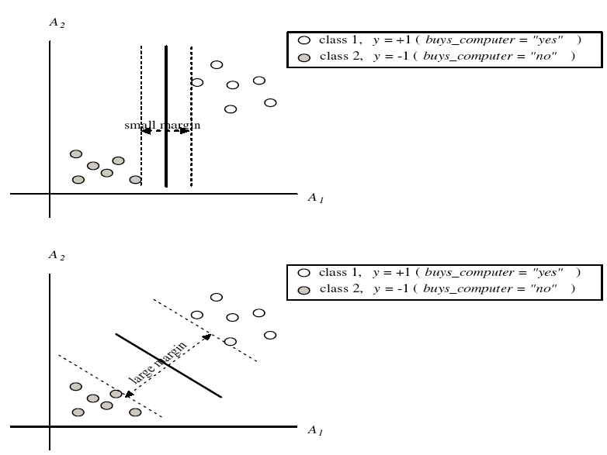

SVM—Margins and Support Vectors
Data Mining: Concepts and Techniques

Slide 45
SVM—When Data Is Linearly Separable
m
Let data D be (X₁, y₁), …, (X_{|D|}, y_{|D|}), where X_{i} is the set of training tuples associated with the class labels y_{i}
There are infinite lines (hyperplanes) separating the two classes but we want to find the best one (the one that minimizes classification error on unseen data)
SVM searches for the hyperplane with the largest margin, i.e., maximum marginal hyperplane (MMH)

Slide 46
SVM—Linearly Separable
A separating hyperplane can be written as
    w ･X + b = 0
  where w={w₁, w₂, …, w_{n}} is a weight vector and b a scalar (bias)
For 2-D it can be written as
    w₀ + w₁ x₁ + w₂ x₂ = 0
The hyperplane defining the sides of the margin:
    H₁: w₀ + w₁ x₁ + w₂ x₂ ≥ 1 for y_{i} = +1, and
    H₂: w₀ + w₁ x₁ + w₂ x₂ ≤ – 1 for y_{i} = –1
Any training tuples that fall on hyperplanes H₁ or H₂ (i.e., the sides defining the margin) are support vectors

Slide 47
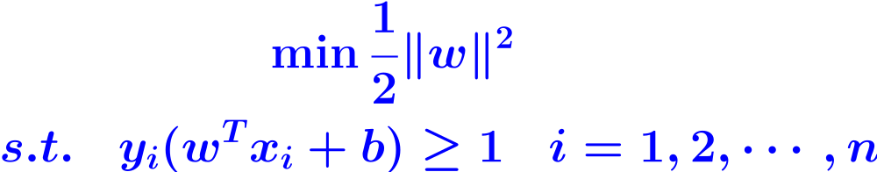
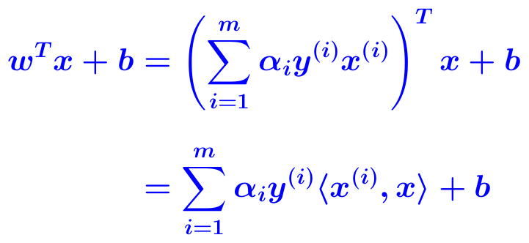
SVM—Linearly Separable
This becomes a constrained (convex) quadratic optimization problem: Quadratic objective function and linear constraints → Quadratic Programming (QP) → Lagrangian multipliers
The final model

Slide 48
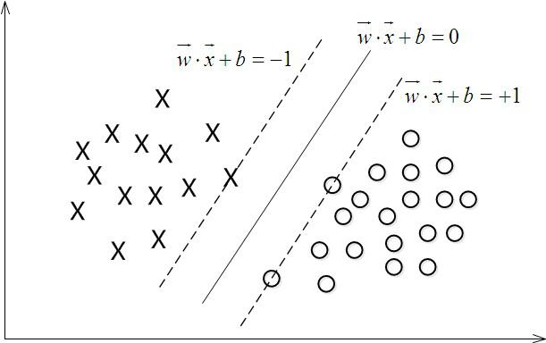
SVM的理论基础
线性可分的情况：寻找最大边界超平面
  f(x)=w^{T}x+b
  f(x)=0 x是超平面上的点
  f(x)>1 x是正类的点
  f(x)<1 x是负类的点

Slide 49
SVM的理论基础
在平面w^{T}x+b=0确定的情况下，|w^{T}x+b|即为点x到该平面的距离
记 为|w^{T}x+b|，该距离为函数间隔
训练集T中的样本点(x_{i},y_{i})的函数间隔的最小值定义为超平面f(x)关于训练集T的函数间隔
w^{T}和b的等比例放大时，对应还是同一个超平面，但函数间隔的值也会成比例增长，趋近于无穷大
几何间隔

Slide 50
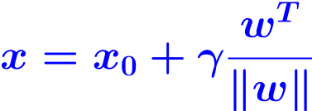

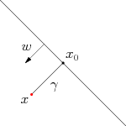
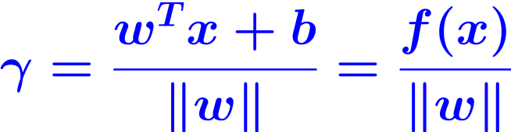
SVM的理论基础
假定对于一个点 x，令其垂直投影到超平面上的对应点为 x₀，w是垂直于超平面的一个向量，样本x到分类间隔的距离记为 ，根据平面几何知识，有关系
x₀为超平面上的点，满足超平面方程
f(x₀)=0
代入w^{T}x+b=0，即可得到

Slide 51
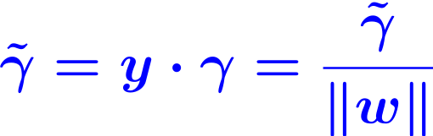
SVM的理论基础
考虑其绝对值
该间隔定义为几何间隔，代表点到超平面的距离
对数据点进行分类，当超平面离数据点的“间隔”越大，分类的确信度也越大
为了使得分类的确信度尽量高，需要让所选择的超平面能够最大化这个“间隔”值
函数间隔不适合用于最大化这个间隔值，而几何间隔适合

Slide 52
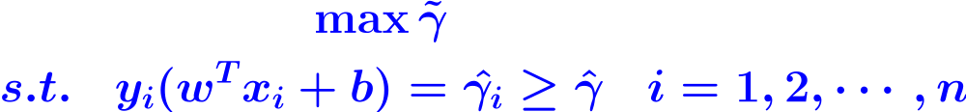
SVM的理论基础
最大间隔分类器的目标函数可定义为
右图中，实线表示的找到的
最优超平面，位于虚线表示
的平面上的点即为支持向量
两个虚线表示的超平面之间
的距离为2
对于支持向量： y_{i}(w^{T}x_{i}+b)=1
对于非支持向量： y_{i}(w^{T}x_{i}+b)>1

Slide 53

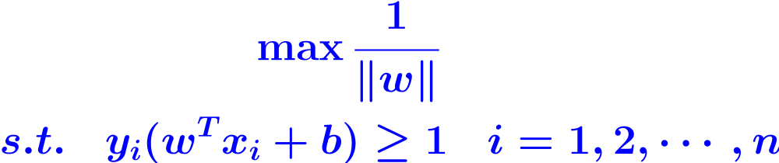
SVM的理论基础
最大间隔分类器的目标函数可定义为
可令目标函数约束条件中的
则目标函数为
为了优化方便，将其转换为等价的目标函数

Slide 54
Why Is SVM Effective on High Dimensional Data?
The complexity of trained classifier is characterized by the # of support vectors rather than the dimensionality of the data
The support vectors are the essential or critical training examples —they lie closest to the decision boundary (MMH)
If all other training examples are removed and the training is repeated, the same separating hyperplane would be found
The number of support vectors found can be used to compute an (upper) bound on the expected error rate of the SVM classifier, which is independent of the data dimensionality
Thus, an SVM with a small number of support vectors can have good generalization, even when the dimensionality of the data is high

Slide 55
SVM—Linearly Inseparable
Transform the original input data into a higher dimensional space
Nonlinear transformation of original input data into a higher dimensional space.
Example: Consider the following example. A 3-D input vector X=(x₁, x₂, x₃) is mapped into a 6-D space, Z, using the mappings φ₁(X)=x₁, φ₂(X)=x₂, φ₃(X)=x₃, φ₄(X)=(x₁)² , φ₅(X)=x₁x₂, and φ₆(X)=x₁x₃. A decision hyperplane in the new space is d(Z)=WZ + b, where W and Z are vectors.
d(Z)=w₁x₁ + w₂x₂ + w₃x₃ + w₄(x₁)² + w₅x₁x₂ + w₆x₁x₃ + b
= w₁z₁ + w₂z₂ + w₃z₃ + w₄z₄ + w₅z₅ + w₆z₆ + b
Search for a linear separating hyperplane in the new space

Slide 56
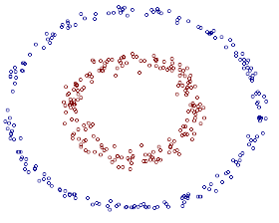
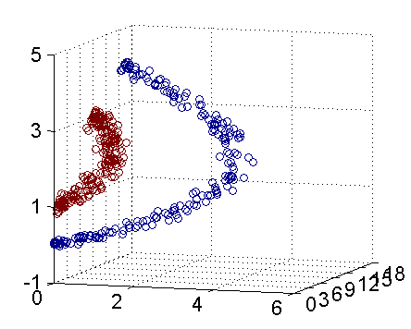
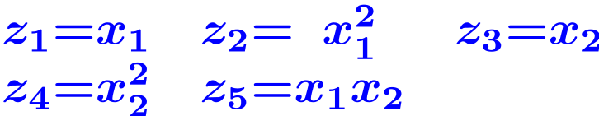
SVM—Linearly Inseparable
右图包含两类数据，分布形状分别为两个
圆圈——非线性可分
用x₁和x₂表示二维平面的坐标
可构造一个5-d空间，坐标分别为
右图为三维的情况

Slide 57

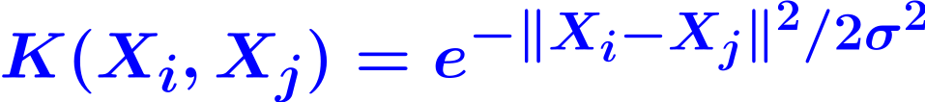
SVM: Different Kernel functions
Instead of computing the dot product on the transformed data, it is math. equivalent to applying a kernel function K(X_{i}, X_{j}) to the original data, i.e., K(X_{i}, X_{j}) = Φ(X_{i}) Φ(X_{j})
Typical Kernel Functions
  Polynomial kernel of degree h:
Gaussian radial basis function kernel:
Sigmoid kernel:
SVM can also be used for classifying multiple (>2) classes and for regression analysis (with additional parameters)

Slide 58
Scaling SVM by Hierarchical Micro-Clustering
SVM is not scalable to the number of data objects in terms of training time and memory usage
H. Yu, J. Yang, and J. Han, "Classifying Large Data Sets Using SVM with Hierarchical Clusters", KDD'03)
CB-SVM (Clustering-Based SVM)
  Given limited amount of system resources (e.g., memory), maximize the SVM performance in terms of accuracy and the training speed
  Use micro-clustering to effectively reduce the number of points to be considered
  At deriving support vectors, de-cluster micro-clusters near "candidate vector" to ensure high classification accuracy

Slide 59
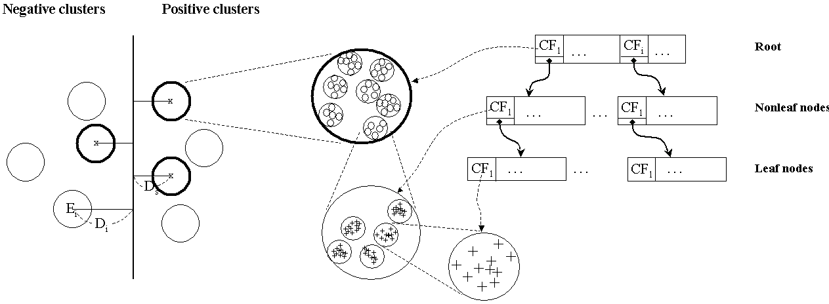
CF-Tree: Hierarchical Micro-cluster
Read the data set once, construct a statistical summary of the data (i.e., hierarchical clusters) given a limited amount of memory
Micro-clustering: Hierarchical indexing structure
  provide finer samples closer to the boundary and coarser samples farther from the boundary

Slide 60
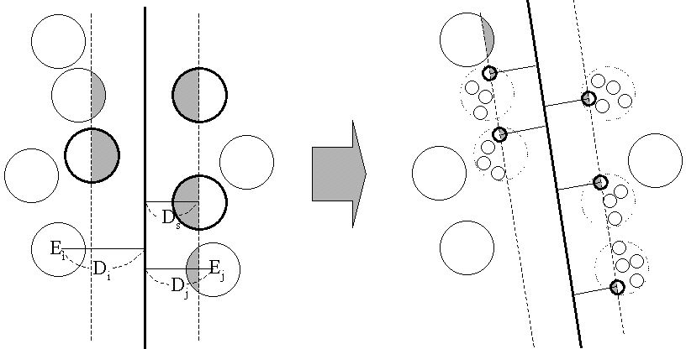
Selective Declustering: Ensure High Accuracy
CF tree is a suitable base structure for selective declustering
De-cluster only the cluster E_{i} such that
  D_{i}–R_{i}<D_{s}, where D_{i} is the distance from the boundary to the center point of E_{i} and R_{i} is the radius of E_{i}
  Decluster only the cluster whose subclusters have possibilities to be the support cluster of the boundary
    "Support cluster": The cluster whose centroid is a support vector

Slide 61
CB-SVM Algorithm: Outline
Construct two CF-trees from positive and negative data sets independently
  Need one scan of the data set
Train an SVM from the centroids of the root entries
De-cluster the entries near the boundary into the next level
  The children entries de-clustered from the parent entries are accumulated into the training set with the non-declustered parent entries
Train an SVM again from the centroids of the entries in the training set
Repeat until nothing is accumulated

Slide 62
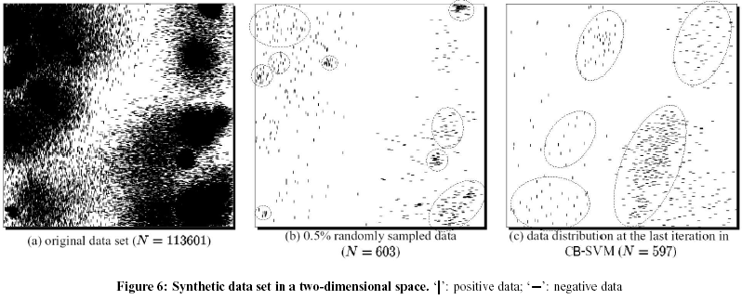
Accuracy and Scalability on Synthetic Dataset
Experiments on large synthetic data sets shows better accuracy than random sampling approaches and far more scalable than the original SVM algorithm

Slide 63
SVM vs. Neural Network
SVM
  Deterministic algorithm
  Nice generalization properties
  Hard to learn – learned in batch mode using quadratic programming techniques
  Using kernels can learn very complex functions
Neural Network
  Nondeterministic algorithm
  Generalizes well but doesn’t have strong mathematical foundation
  Can easily be learned in incremental fashion
  To learn complex functions—use multilayer perceptron (nontrivial)

Slide 64
SVM Related Links
SVM Website: http://www.kernel-machines.org/
Representative implementations
  LIBSVM: an efficient implementation of SVM, multi-class classifications, nu-SVM, one-class SVM, including also various interfaces with java, python, etc.
  SVM-light: simpler but performance is not better than LIBSVM, support only binary classification and only in C
  SVM-torch: another recent implementation also written in C

Slide 65
Chapter 9. Classification: Advanced Methods
Bayesian Belief Networks
Classification by Backpropagation
Support Vector Machines
Classification by Using Frequent Patterns
Lazy Learners (or Learning from Your Neighbors)
Other Classification Methods
Additional Topics Regarding Classification
Summary


Slide 66
Associative Classification
Associative classification: Major steps
  Mine data to find strong associations between frequent patterns (conjunctions of attribute-value pairs) and class labels
  Association rules are generated in the form of
      P₁ ^ P₂ … ^ P_{l} → "A_{class}=C " (conf, sup)
  Organize the rules to form a rule-based classifier
Why effective?
  It explores highly confident associations among multiple attributes and may overcome some constraints introduced by decision-tree induction, which considers only one attribute at a time
  Associative classification has been found to be often more accurate than some traditional classification methods, such as C4.5

Slide 67
Typical Associative Classification Methods
CBA (Classification Based on Associations: Liu, Hsu & Ma, KDD’98)
  Mine possible association rules in the form of
    Cond-set (a set of attribute-value pairs) → class label
  Build classifier: Organize rules according to decreasing precedence based on confidence and then support
CMAR (Classification based on Multiple Association Rules: Li, Han, Pei, ICDM’01)
  Classification: Statistical analysis on multiple rules
CPAR (Classification based on Predictive Association Rules: Yin & Han, SDM’03)
  Generation of predictive rules (FOIL-like analysis) but allow covered rules to retain with reduced weight
  Prediction using best k rules
  High efficiency, accuracy similar to CMAR

Slide 68
Frequent Pattern-Based Classification
H. Cheng, X. Yan, J. Han, and C.-W. Hsu, "Discriminative Frequent Pattern Analysis for Effective Classification", ICDE'07
Accuracy issue
  Increase the discriminative power
  Increase the expressive power of the feature space
Scalability issue
  It is computationally infeasible to generate all feature combinations and filter them with an information gain threshold
  Efficient method (DDPMine: FPtree pruning): H. Cheng, X. Yan, J. Han, and P. S. Yu, "Direct Discriminative Pattern Mining for Effective Classification", ICDE'08

Slide 69
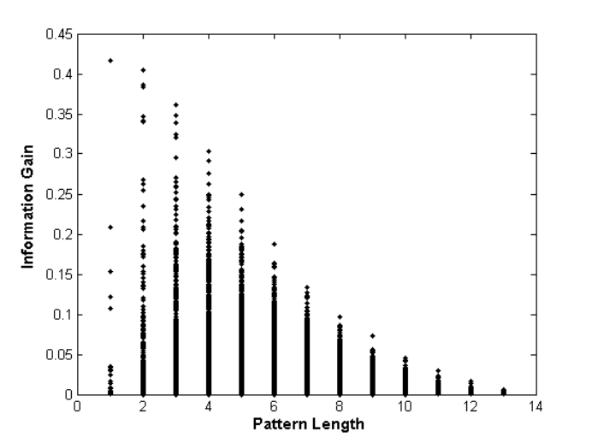
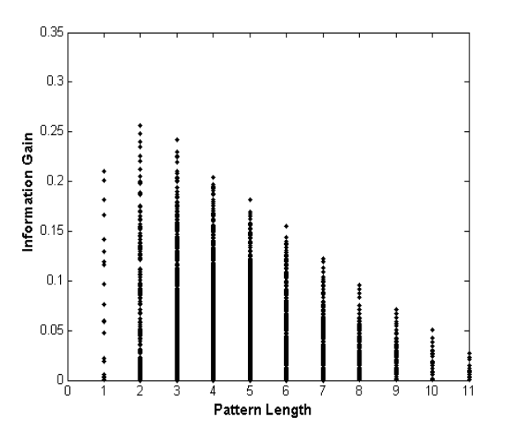
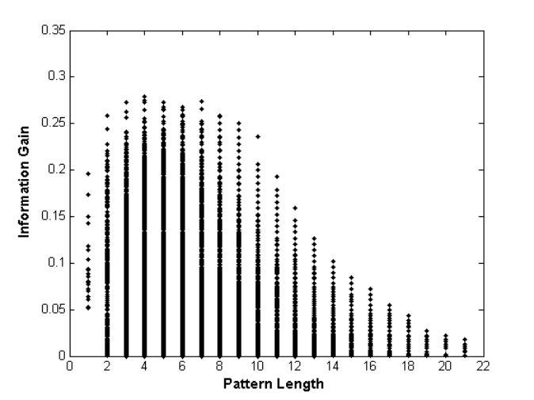
Frequent Pattern vs. Single Feature
  The discriminative power of some frequent patterns is higher than that of single features.
(a) Austral
(b) Cleve
(c) Sonar
Fig. 1. Information Gain vs. Pattern Length

Slide 70
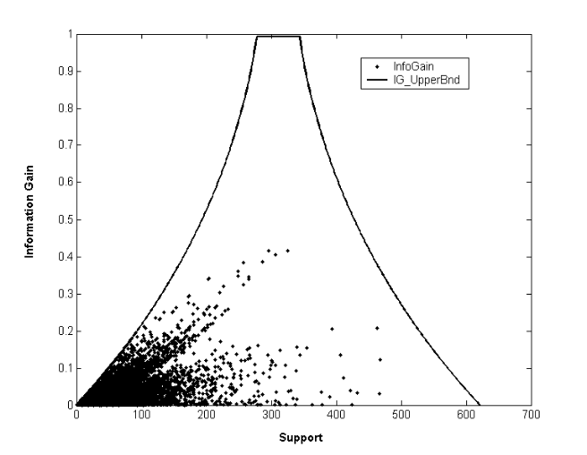


Empirical Results
(a) Austral
(b) Breast
(c) Sonar
Fig. 2. Information Gain vs. Pattern Frequency

Slide 71
Feature Selection
Given a set of frequent patterns, both non-discriminative and redundant patterns exist, which can cause overfitting
We want to single out the discriminative patterns and remove redundant ones
The notion of Maximal Marginal Relevance (MMR) is borrowed
  A document has high marginal relevance if it is both relevant to the query and contains minimal marginal similarity to previously selected documents

Slide 72

Experimental Results

Slide 73


Scalability Tests

Slide 74



DDPMine: Branch-and-Bound Search
a
b
a: constant, a parent node
b: variable, a descendent
Association between information gain and frequency

Slide 75

DDPMine Efficiency: Runtime
PatClass
Harmony
PatClass: ICDE’07 Pattern Classification Alg.
DDPMine

Slide 76
Chapter 9. Classification: Advanced Methods
Bayesian Belief Networks
Classification by Backpropagation
Support Vector Machines
Classification by Using Frequent Patterns
Lazy Learners (or Learning from Your Neighbors)
Other Classification Methods
Additional Topics Regarding Classification
Summary


Slide 77
Lazy vs. Eager Learning
Lazy vs. eager learning
  Lazy learning (e.g., instance-based learning): Simply stores training data (or only minor processing) and waits until it is given a test tuple
  Eager learning (the above discussed methods): Given a set of training tuples, constructs a classification model before receiving new (e.g., test) data to classify
Lazy: less time in training but more time in predicting
Accuracy
  Lazy method effectively uses a richer hypothesis space since it uses many local linear functions to form an implicit global approximation to the target function
  Eager: must commit to a single hypothesis that covers the entire instance space

Slide 78
Lazy Learner: Instance-Based Methods
Instance-based learning:
  Store training examples and delay the processing ("lazy evaluation") until a new instance must be classified
Typical approaches
  k-nearest neighbor approach
    Instances represented as points in a Euclidean space.
  Locally weighted regression
    Constructs local approximation
  Case-based reasoning
    Uses symbolic representations and knowledge-based inference

Slide 79

The k-Nearest Neighbor Algorithm
All instances correspond to points in the n-D space
The nearest neighbor are defined in terms of Euclidean distance,
Target function could be discrete- or real- valued
For discrete-valued, k-NN returns the most common value among the k training examples nearest to x_{q}
_
.
_
_
+
_
+
_
x_{q}
+
_
+

Slide 80

Discussion on the k-NN Algorithm
k-NN for real-valued prediction for a given unknown tuple
  Returns the mean values of the k nearest neighbors
Distance-weighted nearest neighbor algorithm
  Weight the contribution of each of the k neighbors according to their distance to the query x_{q}
    Give greater weight to closer neighbors
Robust to noisy data by averaging k-nearest neighbors
Curse of dimensionality: distance between neighbors could be dominated by irrelevant attributes
  To overcome it, axes stretch or elimination of the least relevant attributes

Slide 81
Case-Based Reasoning (CBR)
CBR: Uses a database of problem solutions to solve new problems
Store symbolic description (tuples or cases)—not points in a Euclidean space
Applications: Customer-service (product-related diagnosis), legal ruling
Methodology
  Instances represented by rich symbolic descriptions (e.g., function graphs)
  Search for similar cases, multiple retrieved cases may be combined
  Tight coupling between case retrieval, knowledge-based reasoning, and problem solving
Challenges
  Find a good similarity metric
  Indexing based on syntactic similarity measure, and when failure, backtracking, and adapting to additional cases

Slide 82
Chapter 9. Classification: Advanced Methods
Bayesian Belief Networks
Classification by Backpropagation
Support Vector Machines
Classification by Using Frequent Patterns
Lazy Learners (or Learning from Your Neighbors)
Other Classification Methods
Additional Topics Regarding Classification
Summary


Slide 83
Genetic Algorithms (GA)
Genetic Algorithm: based on an analogy to biological evolution
An initial population is created consisting of randomly generated rules
  Each rule is represented by a string of bits
  E.g., if A₁ and ¬A₂ then C₂ can be encoded as 100
  If an attribute has k>2 values, k bits can be used
Based on the notion of survival of the fittest, a new population is formed to consist of the fittest rules and their offspring
The fitness of a rule is represented by its classification accuracy on a set of training examples
Offspring are generated by crossover and mutation
The process continues until a population P evolves when each rule in P satisfies a prespecified threshold
Slow but easily parallelizable

Slide 84

Rough Set Approach
Rough sets are used to approximately or "roughly" define equivalent classes
A rough set for a given class C is approximated by two sets: a lower approximation (certain to be in C) and an upper approximation (cannot be described as not belonging to C)
Finding the minimal subsets (reducts) of attributes for feature reduction is NP-hard but a discernibility matrix (which stores the differences between attribute values for each pair of data tuples) is used to reduce the computation intensity

Slide 85

Fuzzy Set Approaches
Fuzzy logic uses truth values between 0.0 and 1.0 to represent the degree of membership (such as in a fuzzy membership graph)
Attribute values are converted to fuzzy values. Ex.:
  Income, x, is assigned a fuzzy membership value to each of the discrete categories {low, medium, high}, e.g. $49K belongs to "medium income" with fuzzy value 0.15 but belongs to "high income" with fuzzy value 0.96
  Fuzzy membership values do not have to sum to 1.
Each applicable rule contributes a vote for membership in the categories
Typically, the truth values for each predicted category are summed, and these sums are combined

Slide 86
Chapter 9. Classification: Advanced Methods
Bayesian Belief Networks
Classification by Backpropagation
Support Vector Machines
Classification by Using Frequent Patterns
Lazy Learners (or Learning from Your Neighbors)
Other Classification Methods
Additional Topics Regarding Classification
Summary


Slide 87
Multiclass Classification
Classification involving more than two classes (i.e., >2 Classes)
Method 1. One-vs.-all (OVA): Learn a classifier one at a time
  Given m classes, train m classifiers: one for each class
  Classifier j: treat tuples in class j as positive & all others as negative
  To classify a tuple X, the set of classifiers vote as an ensemble
Method 2. All-vs.-all (AVA): Learn a classifier for each pair of classes
  Given m classes, construct m(m-1)/2 binary classifiers
  A classifier is trained using tuples of the two classes
  To classify a tuple X, each classifier votes. X is assigned to the class with maximal vote
Comparison
  All-vs.-all tends to be superior to one-vs.-all
  Problem: Binary classifier is sensitive to errors, and errors affect vote count

Slide 88
Error-Correcting Codes for Multiclass Classification
Originally designed to correct errors during data transmission for communication tasks by exploring data redundancy
Example
  A 7-bit codeword associated with classes 1-4
Class | Error-Corr. Codeword
C₁ | 1 | 1 | 1 | 1 | 1 | 1 | 1
C₂ | 0 | 0 | 0 | 0 | 1 | 1 | 1
C₃ | 0 | 0 | 1 | 1 | 0 | 0 | 1
C₄ | 0 | 1 | 0 | 1 | 0 | 1 | 0
  Given a unknown tuple X, the 7-trained classifiers output: 0001010
  Hamming distance: # of different bits between two codewords
  H(X, C₁)=5, by checking # of bits between [1111111] & [0001010]
  H(X, C₂)=3, H(X, C₃)=3, H(X, C₄)=1, thus C₄ as the label for X
Error-correcting codes can correct up to (h-1)/h 1-bit error, where h is the minimum Hamming distance between any two codewords
If we use 1-bit per class, it is equiv. to one-vs.-all approach, the code are insufficient to self-correct
When selecting error-correcting codes, there should be good row-wise and col.-wise separation between the codewords

Slide 89
Semi-Supervised Classification
Semi-supervised: Uses labeled and unlabeled data to build a classifier
Self-training:
  Build a classifier using the labeled data
  Use it to label the unlabeled data, and those with the most confident label prediction are added to the set of labeled data
  Repeat the above process
  Adv: easy to understand; disadv: may reinforce errors
Co-training: Use two or more classifiers to teach each other
  Each learner uses a mutually independent set of features of each tuple to train a good classifier, say f₁
  Then f₁ and f₂ are used to predict the class label for unlabeled data X
  Teach each other: The tuple having the most confident prediction from f₁ is added to the set of labeled data for f₂, & vice versa
Other methods, e.g., joint probability distribution of features and labels

Slide 90
Active Learning
Class labels are expensive to obtain
Active learner: query human (oracle) for labels
Pool-based approach: Uses a pool of unlabeled data
  L: a small subset of D is labeled, U: a pool of unlabeled data in D
  Use a query function to carefully select one or more tuples from U and request labels from an oracle (a human annotator)
  The newly labeled samples are added to L, and learn a model
  Goal: Achieve high accuracy using as few labeled data as possible
Evaluated using learning curves: Accuracy as a function of the number of instances queried (# of tuples to be queried should be small)
Research issue: How to choose the data tuples to be queried?
  Uncertainty sampling: choose the least certain ones
  Reduce version space, the subset of hypotheses consistent w. the training data
  Reduce expected entropy over U: Find the greatest reduction in the total number of incorrect predictions

Slide 91


Transfer Learning: Conceptual Framework
Transfer learning: Extract knowledge from one or more source tasks and apply the knowledge to a target task
Traditional learning: Build a new classifier for each new task
Transfer learning: Build new classifier by applying existing knowledge learned from source tasks
Traditional Learning Framework
Transfer Learning Framework

Slide 92
Transfer Learning: Methods and Applications
Applications: Especially useful when data is outdated or distribution changes, e.g., Web document classification, e-mail spam filtering
Instance-based transfer learning: Reweight some of the data from source tasks and use it to learn the target task
TrAdaBoost (Transfer AdaBoost)
  Assume source and target data each described by the same set of attributes (features) & class labels, but rather diff. distributions
  Require only labeling a small amount of target data
  Use source data in training: When a source tuple is misclassified, reduce the weight of such tupels so that they will have less effect on the subsequent classifier
Research issues
  Negative transfer: When it performs worse than no transfer at all
  Heterogeneous transfer learning: Transfer knowledge from different feature space or multiple source domains
  Large-scale transfer learning

Slide 93
Chapter 9. Classification: Advanced Methods
Bayesian Belief Networks
Classification by Backpropagation
Support Vector Machines
Classification by Using Frequent Patterns
Lazy Learners (or Learning from Your Neighbors)
Other Classification Methods
Additional Topics Regarding Classification
Summary


Slide 94
Summary
Effective and advanced classification methods
  Bayesian belief network (probabilistic networks)
  Backpropagation (Neural networks)
  Support Vector Machine (SVM)
  Pattern-based classification
  Other classification methods: lazy learners (KNN, case-based reasoning), genetic algorithms, rough set and fuzzy set approaches
Additional Topics on Classification
  Multiclass classification
  Semi-supervised classification
  Active learning
  Transfer learning

Slide 95
Surplus Slides

Slide 96
What Is Prediction?
(Numerical) prediction is similar to classification
  construct a model
  use model to predict continuous or ordered value for a given input
Prediction is different from classification
  Classification refers to predict categorical class label
  Prediction models continuous-valued functions
Major method for prediction: regression
  model the relationship between one or more independent or predictor variables and a dependent or response variable
Regression analysis
  Linear and multiple regression
  Non-linear regression
  Other regression methods: generalized linear model, Poisson regression, log-linear models, regression trees

Slide 97


Linear Regression
Linear regression: involves a response variable y and a single predictor variable x
    y = w₀ + w₁x
  where w₀ (y-intercept) and w₁ (slope) are regression coefficients
Method of least squares: estimates the best-fitting straight line
Multiple linear regression: involves more than one predictor variable
  Training data is of the form (X₁, y₁), (X₂, y₂),…, (X_{|D|}, y_{|D|})
  Ex. For 2-D data, we may have: y= w₀ + w₁x₁+ w₂x₂
  Solvable by extension of least square method or using SAS, S-Plus
  Many nonlinear functions can be transformed into the above

Slide 98
Nonlinear Regression
Some nonlinear models can be modeled by a polynomial function
A polynomial regression model can be transformed into linear regression model. For example,
    y = w₀ + w₁ x + w₂ x² + w₃ x³
  convertible to linear with new variables: x₂ = x², x₃= x³
    y = w₀ + w₁ x + w₂ x₂ + w₃ x₃
Other functions, such as power function, can also be transformed to linear model
Some models are intractable nonlinear (e.g., sum of exponential terms)
  possible to obtain least square estimates through extensive calculation on more complex formulae

Slide 99
Other Regression-Based Models
Generalized linear model:
  Foundation on which linear regression can be applied to modeling categorical response variables
  Variance of y is a function of the mean value of y, not a constant
  Logistic regression: models the prob. of some event occurring as a linear function of a set of predictor variables
  Poisson regression: models the data that exhibit a Poisson distribution
Log-linear models: (for categorical data)
  Approximate discrete multidimensional prob. distributions
  Also useful for data compression and smoothing
Regression trees and model trees
  Trees to predict continuous values rather than class labels

Slide 100
Regression Trees and Model Trees
Regression tree: proposed in CART system (Breiman et al. 1984)
  CART: Classification And Regression Trees
  Each leaf stores a continuous-valued prediction
  It is the average value of the predicted attribute for the training tuples that reach the leaf
Model tree: proposed by Quinlan (1992)
  Each leaf holds a regression model—a multivariate linear equation for the predicted attribute
  A more general case than regression tree
Regression and model trees tend to be more accurate than linear regression when the data are not represented well by a simple linear model

Slide 101
Predictive Modeling in Multidimensional Databases
Predictive modeling: Predict data values or construct generalized linear models based on the database data
One can only predict value ranges or category distributions
Method outline:
  Minimal generalization
  Attribute relevance analysis
  Generalized linear model construction
  Prediction
Determine the major factors which influence the prediction
  Data relevance analysis: uncertainty measurement, entropy analysis, expert judgement, etc.
Multi-level prediction: drill-down and roll-up analysis

Slide 102

Prediction: Numerical Data

Slide 103

Prediction: Categorical Data

Slide 104
SVM—Introductory Literature
"Statistical Learning Theory" by Vapnik: extremely hard to understand, containing many errors too.
C. J. C. Burges. A Tutorial on Support Vector Machines for Pattern Recognition. Knowledge Discovery and Data Mining, 2(2), 1998.
  Better than the Vapnik’s book, but still written too hard for introduction, and the examples are so not-intuitive
The book "An Introduction to Support Vector Machines" by N. Cristianini and J. Shawe-Taylor
  Also written hard for introduction, but the explanation about the mercer’s theorem is better than above literatures
The neural network book by Haykins
  Contains one nice chapter of SVM introduction

Slide 105
Notes about SVM—
Introductory Literature
"Statistical Learning Theory" by Vapnik: difficult to understand, containing many errors.
C. J. C. Burges. A Tutorial on Support Vector Machines for Pattern Recognition. Knowledge Discovery and Data Mining, 2(2), 1998.
  Easier than Vapnik’s book, but still not introductory level; the examples are not so intuitive
The book An Introduction to Support Vector Machines by Cristianini and Shawe-Taylor
  Not introductory level, but the explanation about Mercer’s Theorem is better than above literatures
Neural Networks and Learning Machines by Haykin
  Contains a nice chapter on SVM introduction

Slide 106


Associative Classification Can Achieve High Accuracy and Efficiency (Cong et al. SIGMOD05)

Slide 107
A Closer Look at CMAR
CMAR (Classification based on Multiple Association Rules: Li, Han, Pei, ICDM’01)
Efficiency: Uses an enhanced FP-tree that maintains the distribution of class labels among tuples satisfying each frequent itemset
Rule pruning whenever a rule is inserted into the tree
  Given two rules, R₁ and R₂, if the antecedent of R₁ is more general than that of R₂ and conf(R₁) ≥ conf(R₂), then prune R₂
  Prunes rules for which the rule antecedent and class are not positively correlated, based on a χ² test of statistical significance
Classification based on generated/pruned rules
  If only one rule satisfies tuple X, assign the class label of the rule
  If a rule set S satisfies X, CMAR
    divides S into groups according to class labels
    uses a weighted χ² measure to find the strongest group of rules, based on the statistical correlation of rules within a group
    assigns X the class label of the strongest group

Slide 108
Perceptron & Winnow
Vector: x, w
Scalar: x, y, w
Input: {(x₁, y₁), …}
Output: classification function f(x)
f(x_{i}) > 0 for y_{i} = +1
f(x_{i}) < 0 for y_{i} = -1
f(x) => wx + b = 0
or w₁x₁+w₂x₂+b = 0
x₂
Perceptron: update W additively
Winnow: update W multiplicatively
x₁

