Slide 1
情感分析

Slide 2
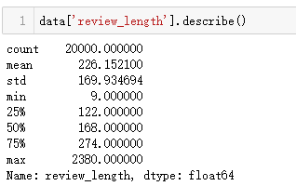
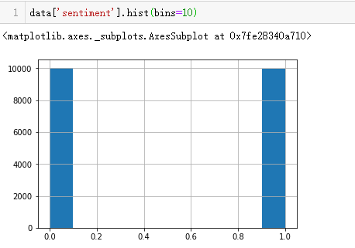
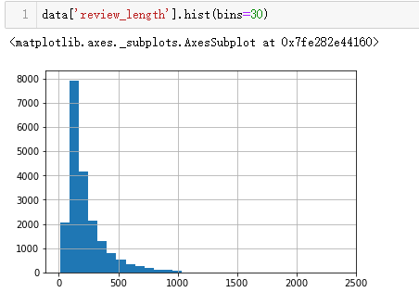
数据分析
20k train + 5k test + 50k unsup

Slide 3
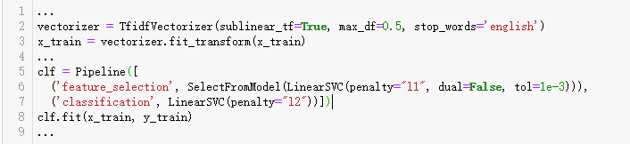
解决方案
TF-IDF
分类器可以用SVM, LogReg, MLP…
简单，速度快，效果好

Slide 4
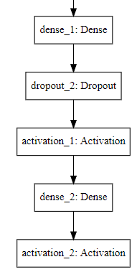
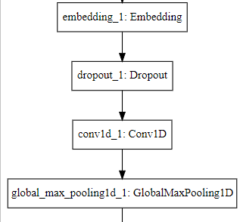
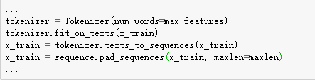
解决方案
Deep learning
Word embedding
texts_to_sequences…
Word2vec, Glove…
CNN, LSTM, CNN+LSTM, Bi_LSTM, Attention…

Slide 5
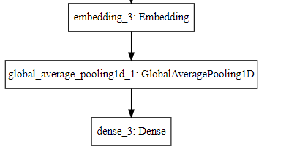

解决方案
Sentence embedding
词向量取平均
词向量+TF-IDF
Doc2vec…
N-gram

Slide 6
一些调研
Universal Language Model Fine-tuning for Text Classification | 18年，错误率只有4.6% | https://github.com/fastai/fastai/tree/master/courses/dl2/imdb_scripts
Adversarial Training Methods for Semi-Supervised Text Classification | 17年，提出了Adversarial模型，半监督，错误率5.91% | https://github.com/tensorflow/models/tree/master/research/adversarial_text
Supervised and semi-supervised text categorization using LSTM for region embeddings | 16年，作者发了一系列论文，提出了ConText模型 ，错误率5.94% | https://github.com/riejohnson/ConText
Learned in Translation: Contextualized Word Vectors | 17年，提出了CoVe模型，错误率8.2% | https://github.com/salesforce/cove
Distributed Representations of Sentences and Documents | 14年，作者是Mikolov，错误率在7.4% | https://github.com/RaRe-Technologies/gensim/blob/develop/docs/notebooks/doc2vec-IMDB.ipynb

