Slide 1
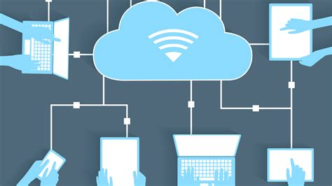
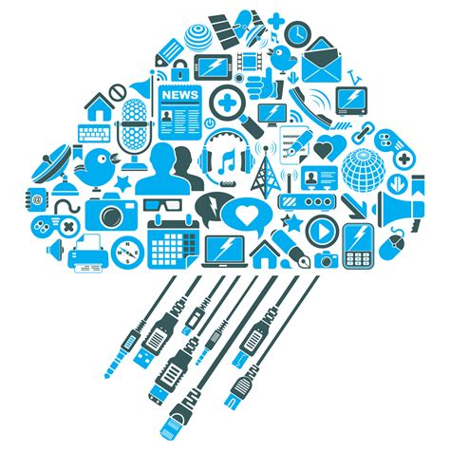
Cloud Computing

Slide 2

What is Cloud Computing?
Cloud computing is a model for enabling ubiquitous, convenient, on-demand network access to a shared pool of configurable computing resources (e.g., networks, servers, storage, applications, and services) that can be rapidly provisioned and released with minimal management effort or service provider interaction.(source: The NIST Definition of Cloud Computing)
Cloud computing:(noun)
Internet-based computing in which large groups of remote servers are networked so as to allow sharing of data-processing tasks, centralized data storage, and online access to computer services or resources.
Any computer related task that is done entirely on the Internet

Slide 3
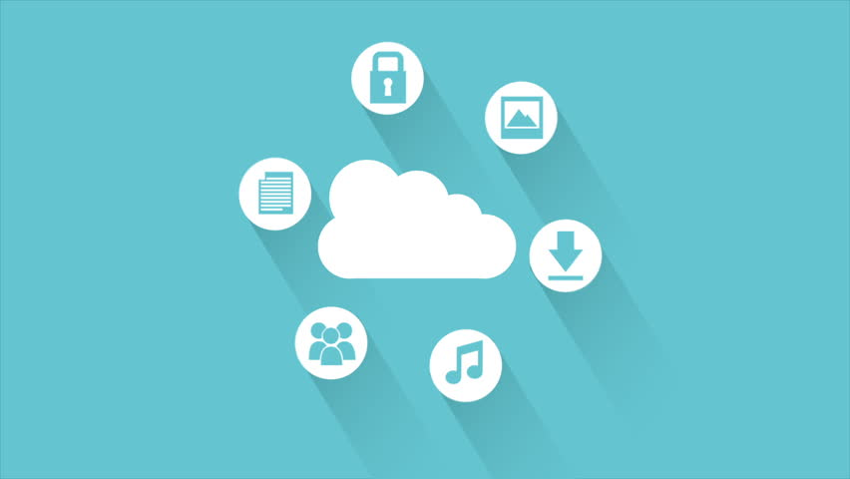
Essential Characteristics
On-demand self-service
Broad network access
Resource pooling
Rapid elasticity
Measured service

Slide 4
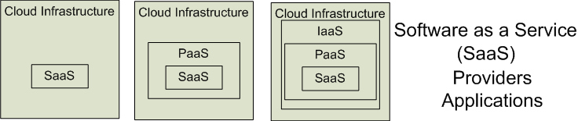
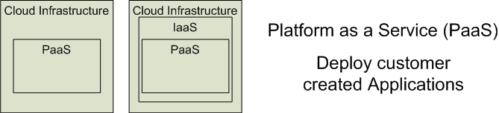
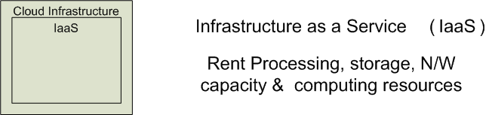
Cloud Service Models
Software as a Service (SaaS)
Platform as a Service (PaaS)
Infrastructure as a Service (IaaS)
Notes:
CSA, Security guidance for critical areas of focus in cloud computing
There are so many different cloud deployment options. This is a popular service model. It is called SPI service models.
SPI refers to Software as a Service, Platform as a Service, or Infrastructure as a Service, explained in depth in next slides
Higher layers are built on lower layers. Higher abstractions include lower ones.
IaaS:
Customer rent fundamental computing resources from service providers (for example: processing, storage, networks and so on).
And they are able to run their own operation system and applications. While they do not need manage and maintain hardware.
Example: Amazon EC2 provides resizable compute capacity in the cloud.
PaaS:
Customers deploy applications onto the provider’s infrastructure. These applications are created using programming languages and tools supported by the providers.
Beside the hardware, customers do not manage operation systems.
Example: Google App Engine supports two application environments: Java and Python
SaaS:
Customers use the provider’s application which is accessible over the Internet.
Customers only need control limited user-specific application configuration setting.
Example: Salesforce.Com offers CRM application. Customers use the CRM system as web application.

Slide 5
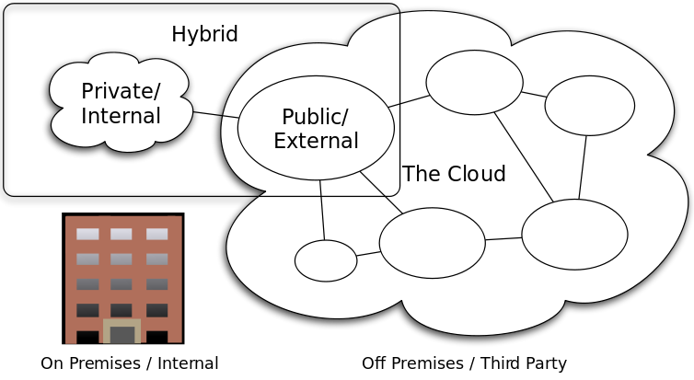
Deployment Models
Private Cloud
-Done by service providers
Community Cloud
-organizations from a specific community with common concerns
Public Cloud
-operated solely for a single organization
Hybrid Cloud
-composition of two or more clouds (private, community or public)

Slide 6
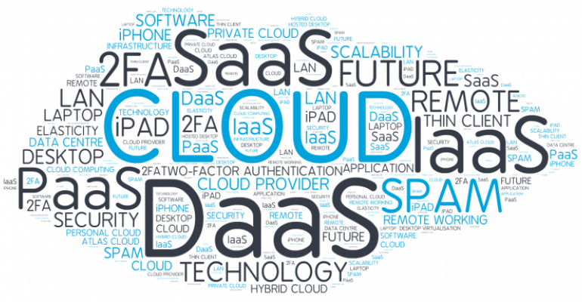
The impact of cloud computing on the applicability of information systems
Improve users' confidence in responding to unexpected changes
Grasp the effectiveness of new opportunities
Maintain consistency between IT strategy and business strategy
Reduce support and maintenance time and effort
Simplifying new branch integration

Slide 7
Thank you for your Attention!

