Slide 1
Innovative burning of waste oil
By Innovationfund & ONU

Slide 2
Problem
How to use waste oil, do it environmentally and efficiently?
How to make coal, gas and fuel oil plants more efficient, economical and environmentally friendly?
Solution is: Innovative, environmentally friendly combustion used oil burner to generate heat or electricity

Slide 3

Solution
Innovative, environmentally friendly combustion method to generate heat or electricity.
Waste oil and water are superheated by the residual heat from the combustion chamber. Under high pressure and at high temperatures, substances are simultaneously fed into the combustion chamber using a spark from a Tesla transformer. Thanks to this technology, we burn waste oil together with water in a ratio of 30% to 70%, the combustion process is more environmentally friendly, the combustion temperature is higher.
We receive heat energy from used oil for the needs of enterprises, for heating and heating, for generating electricity.

Slide 4
Clients
Enterprises that need heat or electricity.
Especially enterprises that use fuel oil, coal, gas for this.
Thermal power plants, boiler houses, metallurgy.

Slide 5
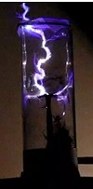


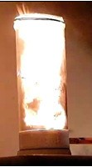
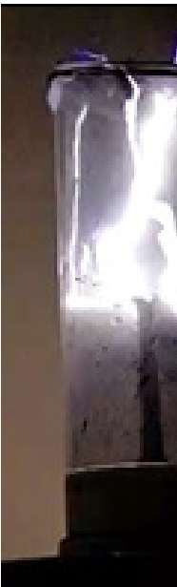


Demonstration of combustion of coal dust under normal conditions under the action of high-voltage high-frequency pulses (there is now same photos with combustion oil)
fuel supply to the reactor
ignition stage
combustion stage
Bulk burning under the action of streamers
afterburning
post-combustion

Slide 6
Solution / Competitive Advantages
Classical coal combustion methods
At the first start of the burners, preheating of the combustion chamber is required
The classical process of burning dust fuels (coal, coke)
When burned, more harmful substances are released into the atmosphere
Our technology
The chamber does not need premature heating with liquid or gaseous fuel
The combustion process is more efficient in electro kinetic mode
The process is more environmentally friendly by increasing the combustion efficiency

Slide 7
Solution / Competitive Advantages
Classical used oil and mazut (fuel oil) combustion methods
The burners using 100%-95% of mazut Combustion of used oil is forbidden in EU
Standard temperature of combustion (980 C)
When burned, more harmful substances are released into the atmosphere
Standard torch length
Our technology
The burners works by using 30% of mazut/used oil by combining it with water (70%)
Temperature of combustion higher (~1450 C)
The process is more environmentally friendly by increasing the combustion efficiency
Torch length is less

Slide 8
Strategy
Involve
Involve invests for making pilot model
Test
Test it
Make
Make small working burner for small business
Cooperate
Cooperate with factory, which can make industrial burner for business (Thermal power plants, boiler houses, metallurgy)
Sell and service
Sell and service it
Make
Make an own thermal power plant to sell electricity

Slide 9
Business model

Slide 10
Metrics and forecast
2020 – make and test pilot model, produce small used oil burners and get all government certificates
Model should: use only 30% of used oil and 70% of water
Be more effective, than standard burners
Be more be more environmentally friendly (less emissions)
2021 – produce and install industrial burners for two forges, one oil refinery, two metallurgical plants.
Attract investments, invest the earned money and build a power plant worth up to 6 million EUR with a payback period in less than 6 years

Slide 11
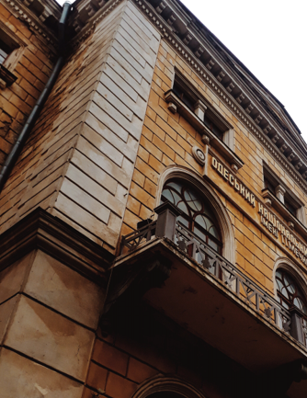
Team
Pavel Koyen – head of project
Shinagrev Grigory - Senior Researcher, Research Institute of Physics, Candidate of Physics and Mathematics
Shevchuk Vladimir - Professor of the Department of General Physics and Physics of Heat and Power and Chemical Processes, ONU. Mechnikov
Politaev Nikolay - Director of the Institute of Combustion and Unconventional Technologies of the ONU named after Mechnikov, Professor, Doctor of Physics and Mathematics
Chernenko Alexander - Candidate of Physics and Mathematics, Associate Professor of the Department of General Physics and Physics of Heat-Power and Chemical Processes, ONU Mechikova
Sidorov Aleksey - Candidate of Physics and Mathematics, Associate Professor of the Department of General Physics and Physics of Heat-Power and Chemical Processes, ONU

Slide 12

innovationfund@onu.edu.ua onu.edu.ua innovationfund.in +380-99-52-50-511

