Slide 1
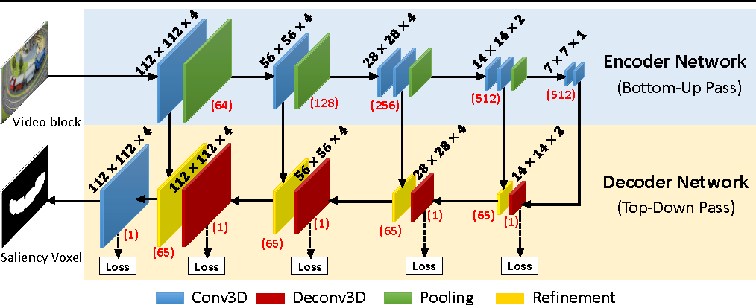
version: joint-v4
- this version implement deeply supervised network
[reference]
[1] "Deeply Supervised Salient Object Detection with Short Connections" - cvpr 2017
http://mmcheng.net/dss/
[2] "DSOD: Learning Deeply Supervised Object Detectors from Scratch" - iccv 2017
https://github.com/szq0214/DSOD
what is deeply supervised? - construct auxilary loss for back propagation intermediate features

Slide 2
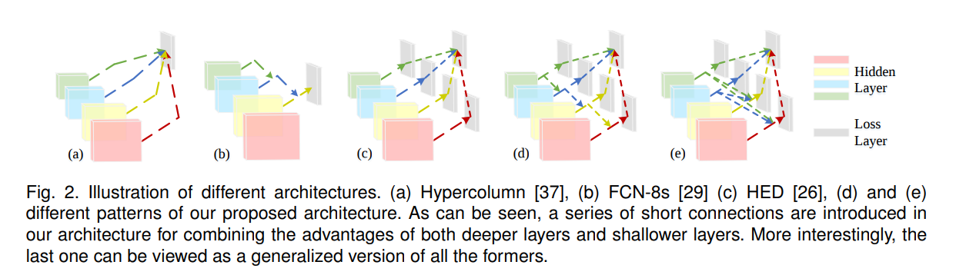
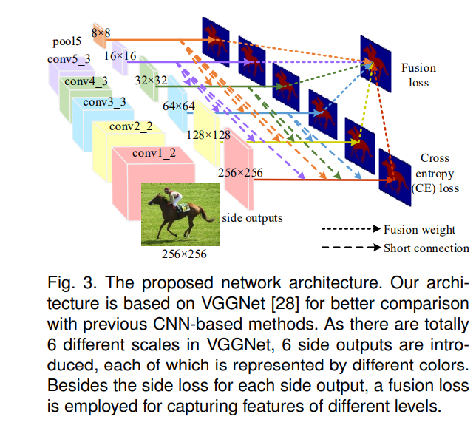
Hypercolumn
Deeply supervsied

Slide 3
- our implementation
weight=0.50
weight=0.05
segmentation loss
classification loss
non-empty images
all images
5*64x128x128
64x128x128
weight=1.00
x
Resnet34 encoder
decoder
image pool
segmentation loss
3x128x128
hyper-column
all images
(fusion)
global ave pool
512x1x1
64x1x1
image pool
upsize

Slide 4
- model file:
model128_resnet34_all.py
- trainer file:
train128_all_pad128.py
101 pad to 128 without resizing
train128_all_resize128.py
101 resize to 128 without padding
- submit file:
local_submit_pad128_joint_all.py
local LB
local_submit_resize128_joint_all.py
kaggle_submit_joint_all.py
submit to kaggle server

Slide 5
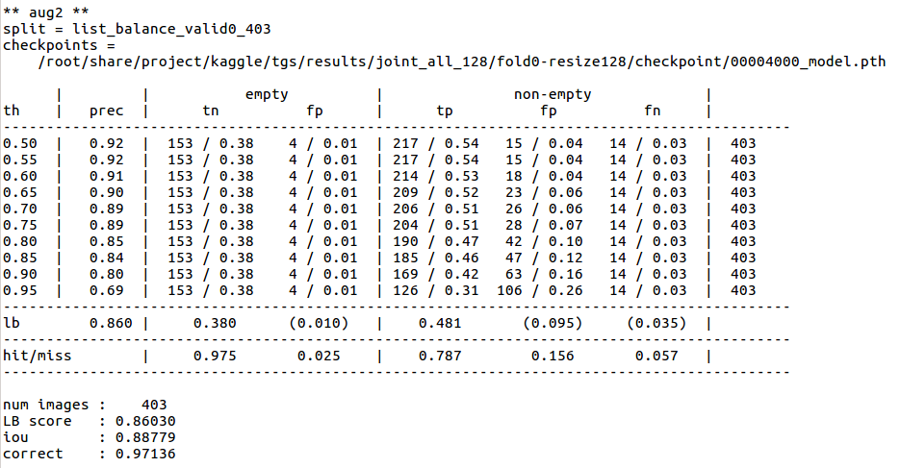
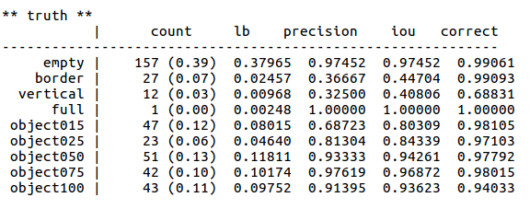
- sample results
fold0 : pad128 (null+flip) + resize128 (null+flip) = public LB 0.855
local validation

Slide 6
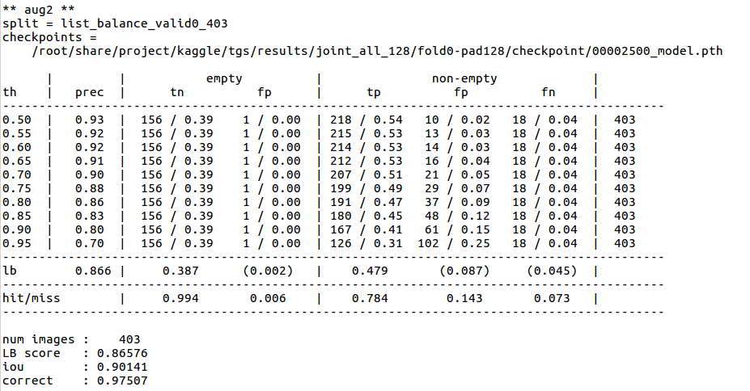
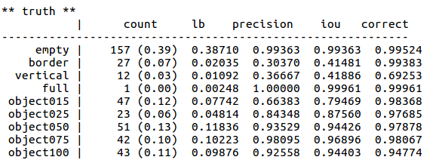

Slide 7
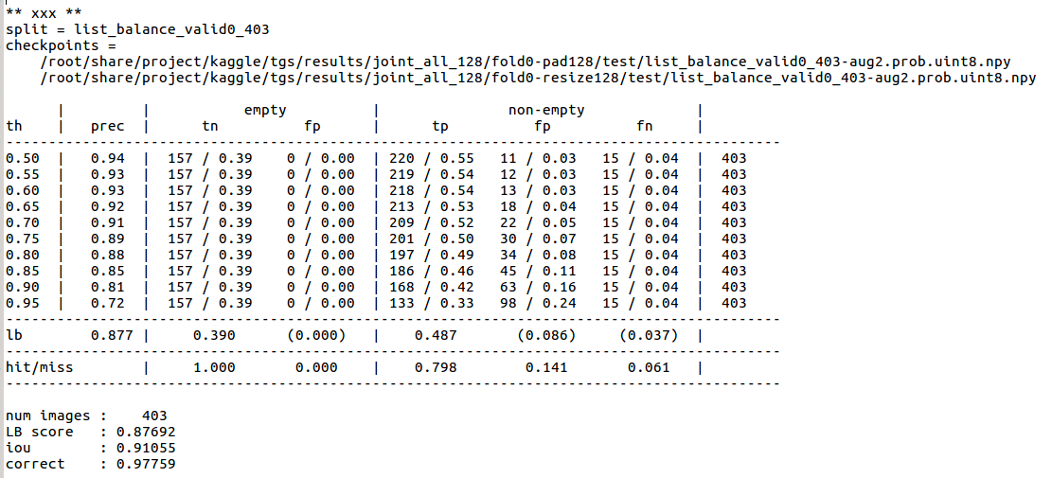
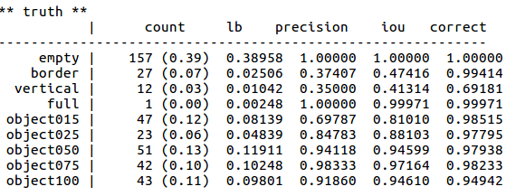
results/custom_ensemble/000/test
zero fp

Slide 8
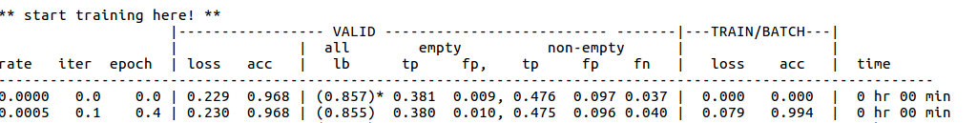
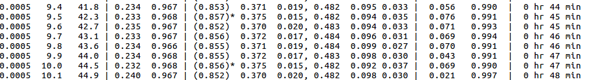
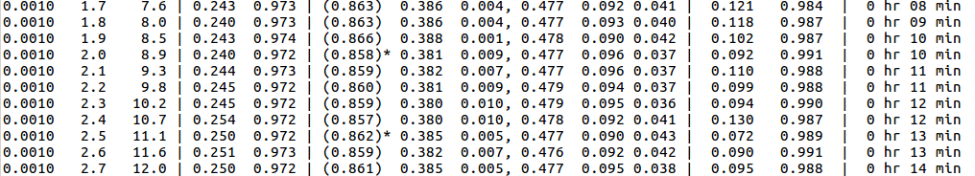
training log
resize128
pad128

