Slide 1

How to build an email filter and classifier
that runs locally using Java and Ollama

Slide 2
The Problem

Slide 3
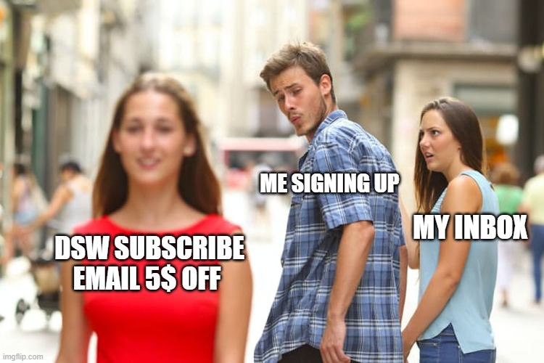
The Problem

Slide 4
The problem
Personal Inbox
> 100,000 Emails
10 years of sign-ups
Mixed with real emails
Like store receipts, emails from friends, etc

Slide 5

The Hero’s Journey

Slide 6
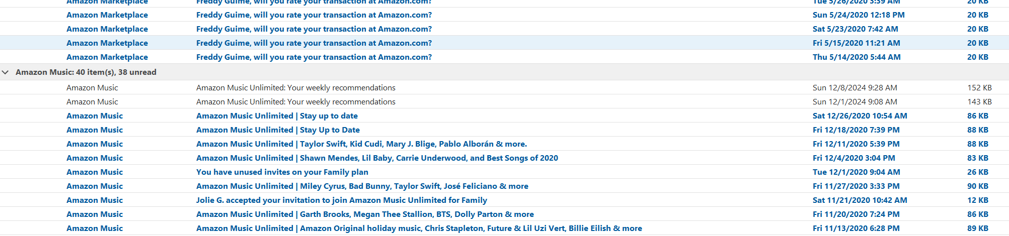
Tried all the Tricks
Trick #1 (Sort by Sender)

Slide 7
Tried all the Tricks
Trick #1 (Sort by Sender)
Too many Senders

Slide 8
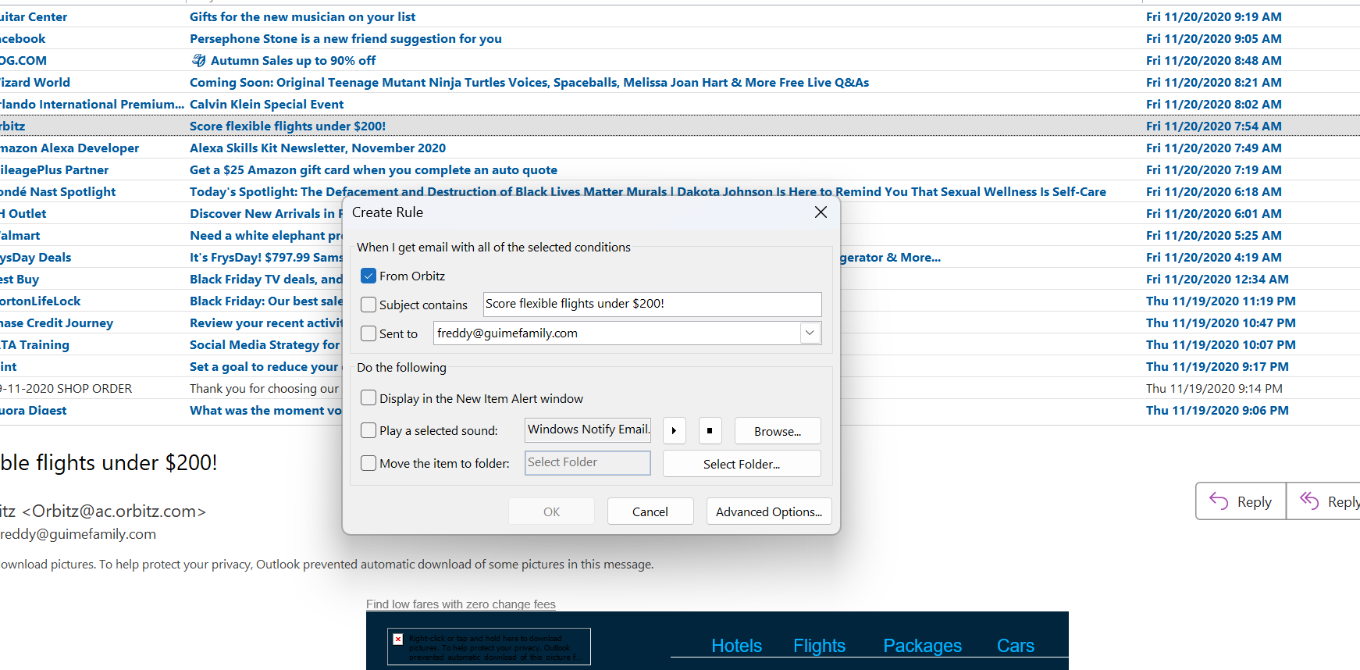
Trick #2 – Rules

Slide 9
Trick #2 – Rules
Too Many Rules

Slide 10
Trick #3 – Here’s my money
SpamTitan
SaneBox
Barracuda
Outlook Plugins?

Slide 11
Trick #3 – Here’s my money
SpamTitan
SaneBox
Barracuda
Outlook Plugins?
Got Expensive for 100,000 emails

Slide 12

Trick #2 – Rules
Too Many Rules

Slide 13

The Training

Slide 14
An Email Classifier using LLM
Should be Free(ish)
Run in my local computer
No shipping family emails to a third party
Make it work across all my email clients
Need to run once in a while
Or at least “once”

Slide 15
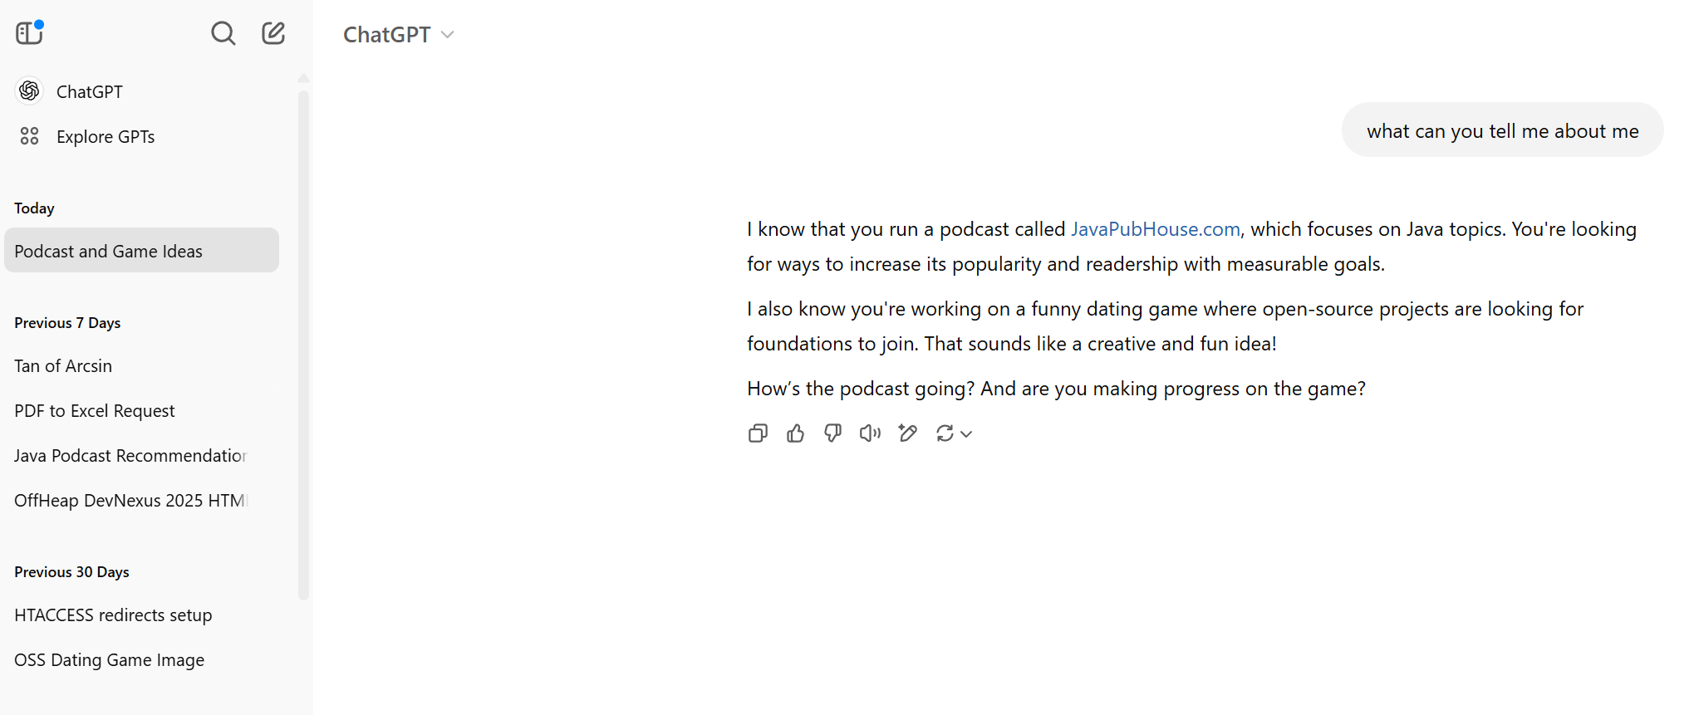
An Email Classifier using LLM
Should be Free(ish)
Run in my local computer
No shipping family emails to a third party
Make it work across all my email clients
Need to run once in a while
Or at least “once”

Slide 16
An Email Classifier using LLM
Should be Free(ish)
Run in my local computer
No shipping family emails to a third party
Make it work across all my email clients
Need to run once in a while
Or at least “once”

Slide 17
The design
Retrieve Email
Check if it’s spam
Move it to Spam
Profit!

Slide 18



The design
Retrieve Email
Check if it’s spam
Move it to Spam
Profit!

Slide 19
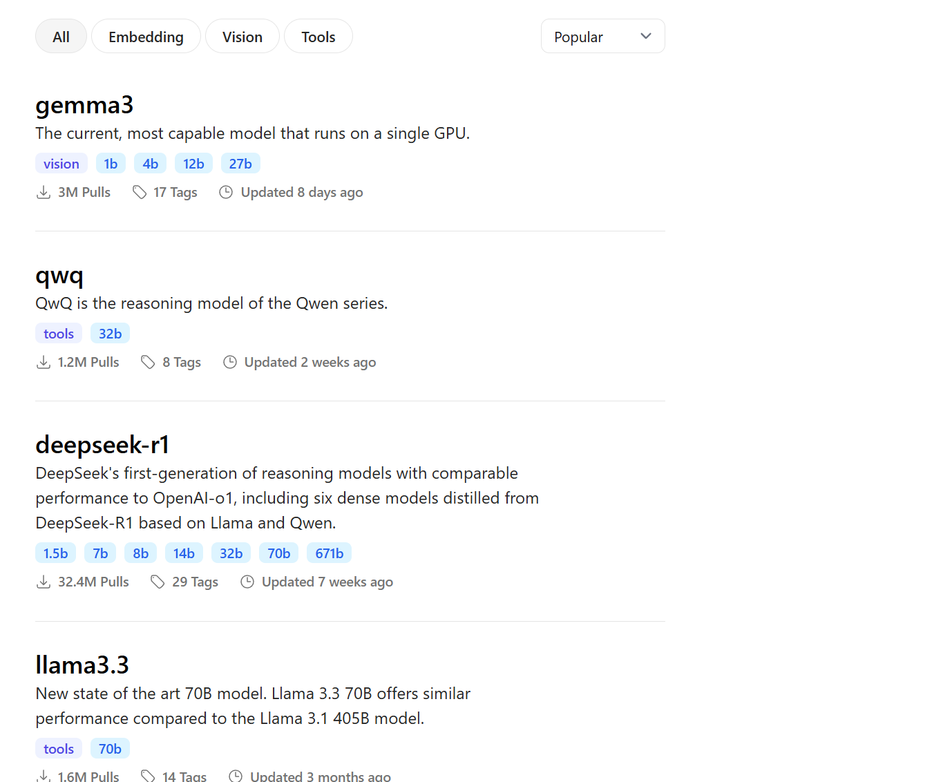
Open Weights Models
Published (usually)
HuggingFace
Ollama

Slide 20
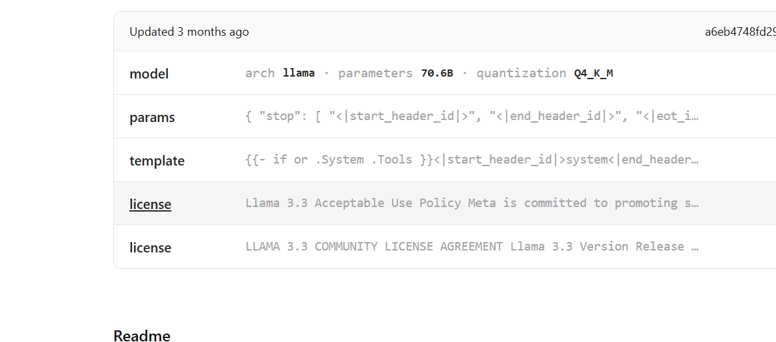
Open Weights Models
Published (usually)
HuggingFace
Ollama

Slide 21
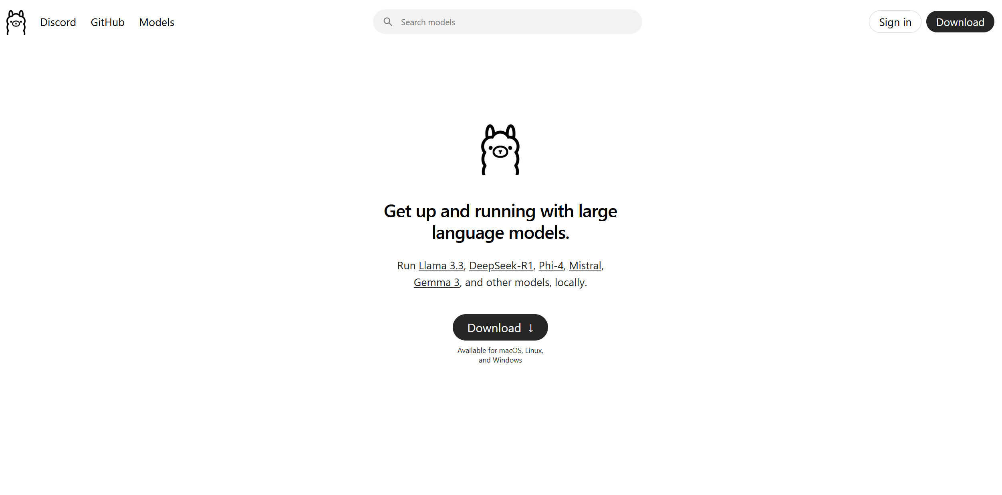
Ollama

Slide 22
Ollama Demo
/set parameter num_gpu 1

Slide 23
Ollama Demo
Runs Local
Will use GPU if you use it
A great way to ask for a “Gamer laptop”, because you really need that GPU
No costs (or info) send to OpenAI or Anthropic

Slide 24
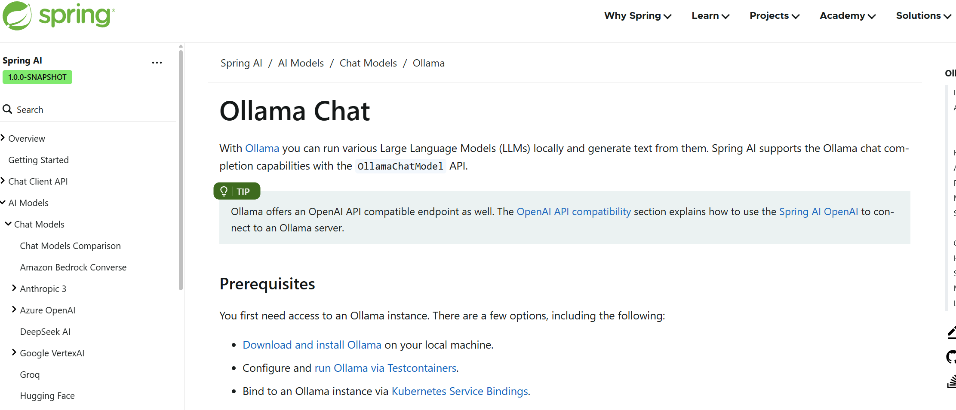
Spring AI
So many good talks

Slide 25
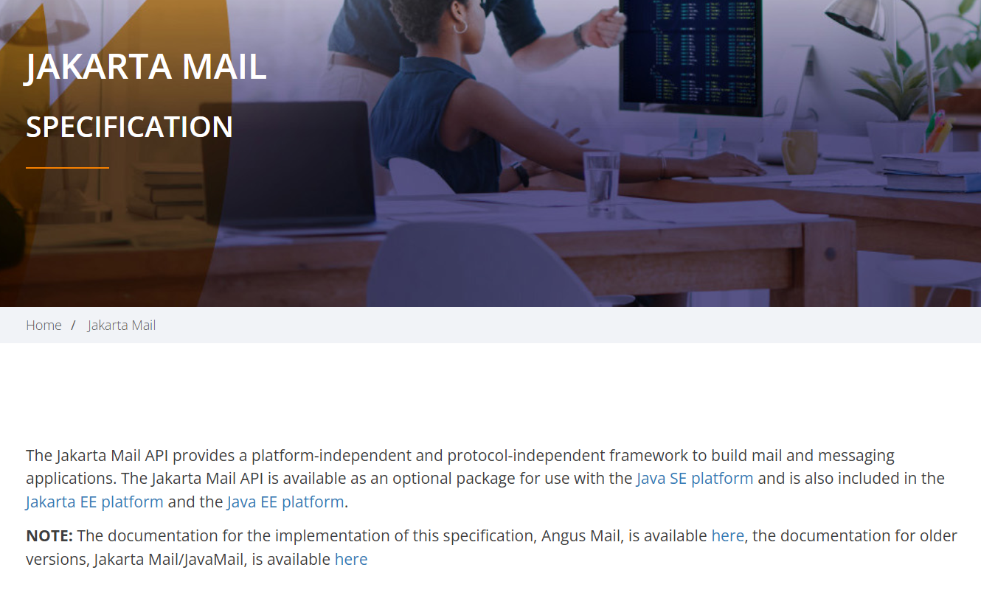
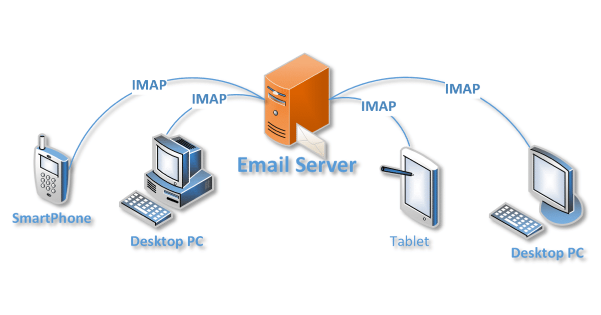
Jakarta Mail

Slide 26

Let’s get to Training!

Slide 27
OrganizerService
IMapService
Reads Emails
Classifier
Classify an Email
MessageIdProgressStore
Keeps Track of the “last Email done”
Email
Jsoup (to read body of email)

Slide 28
Let’s get to Training!
You are going to read an email and help me classify it
{email}
classify the above email. It can be from these different categories
{classifier}
Other: Any email that does not fall into any of the previous categories. This could include personal communications, or professional correspondence.
What kind of email is this? Give me just the category name as category:<category>

Slide 29
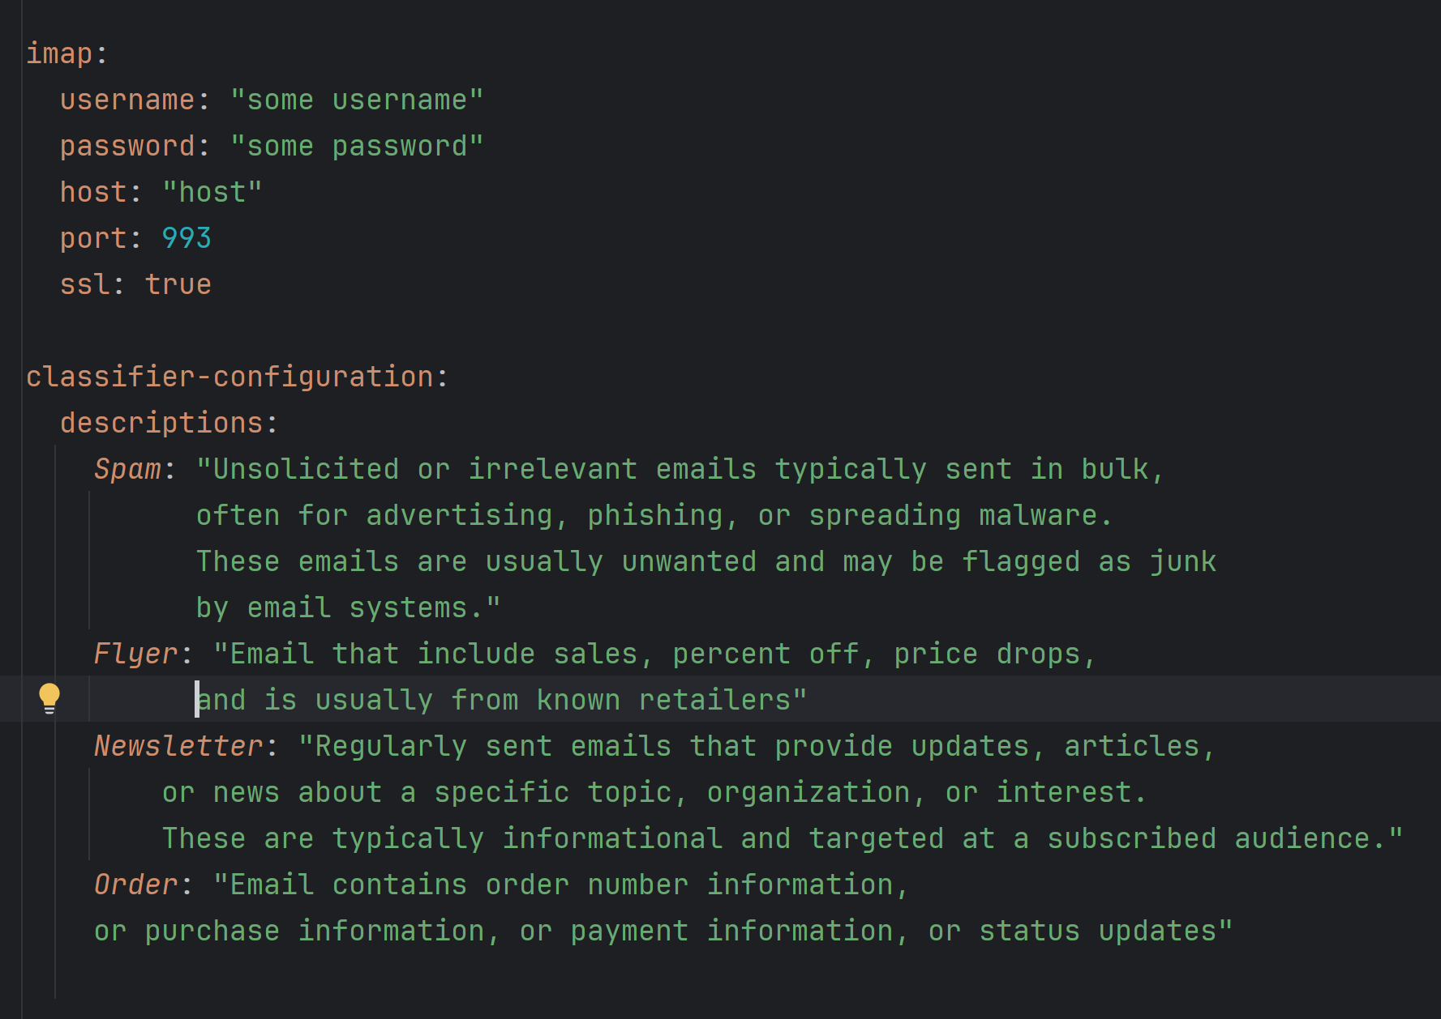
Let’s get to Training!

Slide 30


Slide 31

FIN

Slide 32

FIN?

Slide 33
Some Interesting Hacks
Use LLM to help you generate LLM Prompts
Write me a one sentence on how would you identify emails that are Spam, Flyer, Newsletter, Orders

Slide 34
IF YOU USE THIS IN YOUR INBOX
BACK IT UP
Back it up
back it up
Back all the email up
Export into something (that’s like backing it up)
Make sure that the email is backed up
Back it up
Seriously, do make a backup

Slide 35
IF YOU USE THIS IN YOUR INBOX
BACK IT UP
Back it up
back it up
Back all the email up
Export into something (that’s like backing it up)
Make sure that the email is backed up
Back it up
Seriously, do make a backup
DID WE MENTION TO BACKUP?

Slide 36
IF YOU USE THIS IN YOUR INBOX
LLMs do Make Mistakes
This helps you pre-sort tons of emails
You can choose to keep those
Syncing 100,000 Emails takes “A lot of time”
YOU WILL NEED TO SUBSCRIBE TO THE NEW FOLDERS
If you haven’t already done so.
YOU MAY NEED TO ENCOURAGE YOUR EMAIL CLIENT TO SYNC

Slide 37



Thank you!
https://github.com/windust/mail-organizer
PubHouse.net

