Slide 1
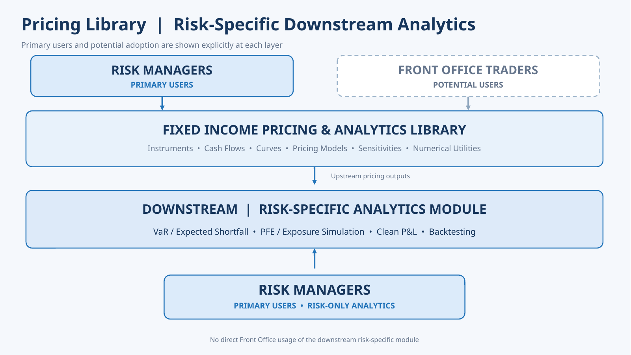
Bond Analytics Library - Proposed Architecture
Architecture Overview
FOCUS: SLIDES 2 & 3

Slide 2
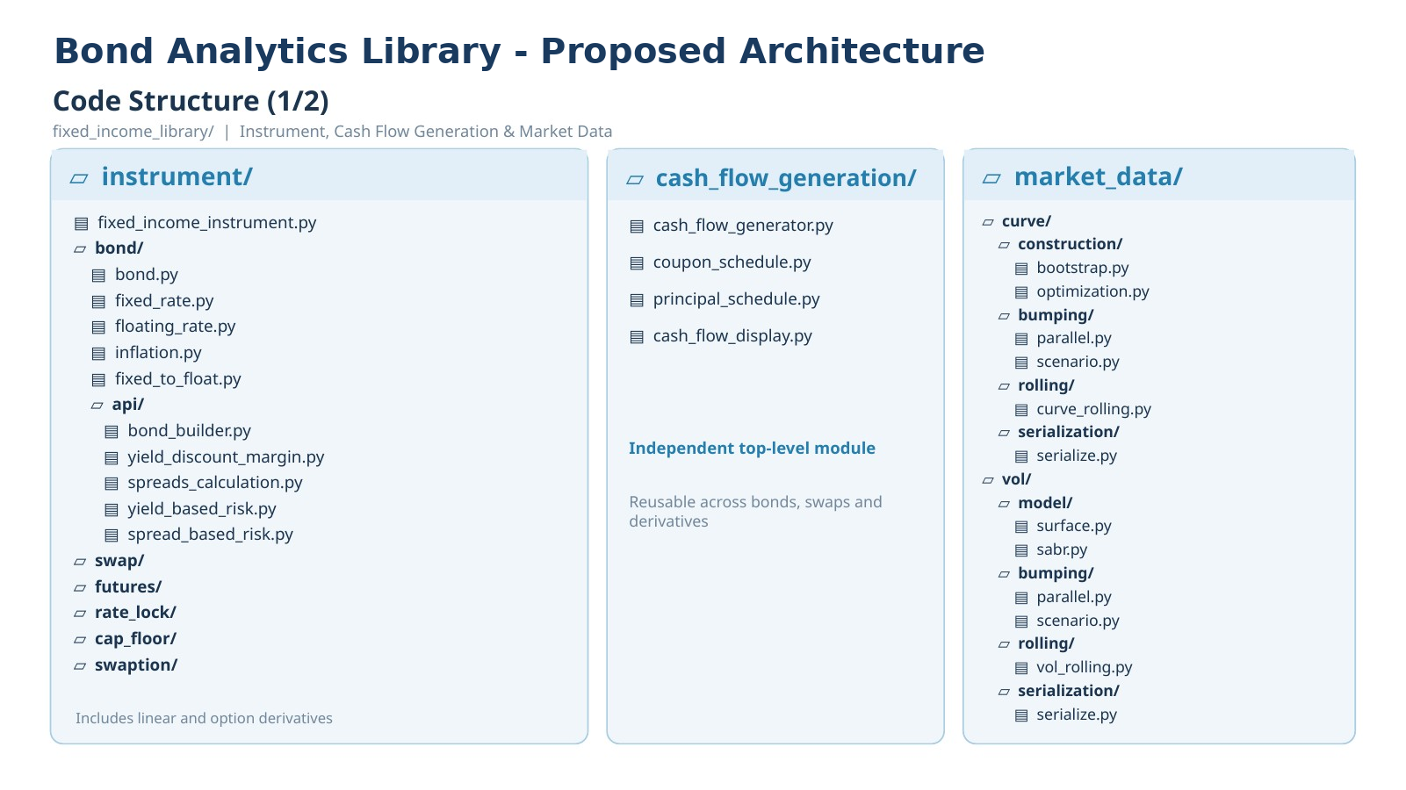
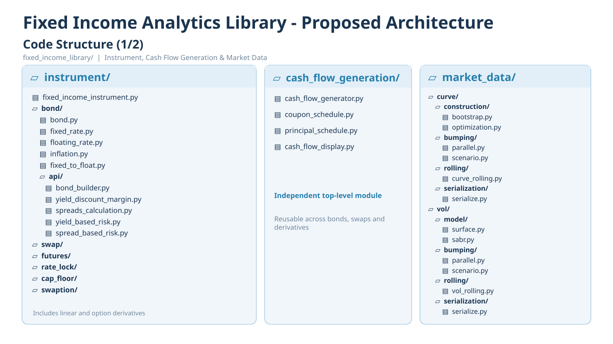

Slide 3
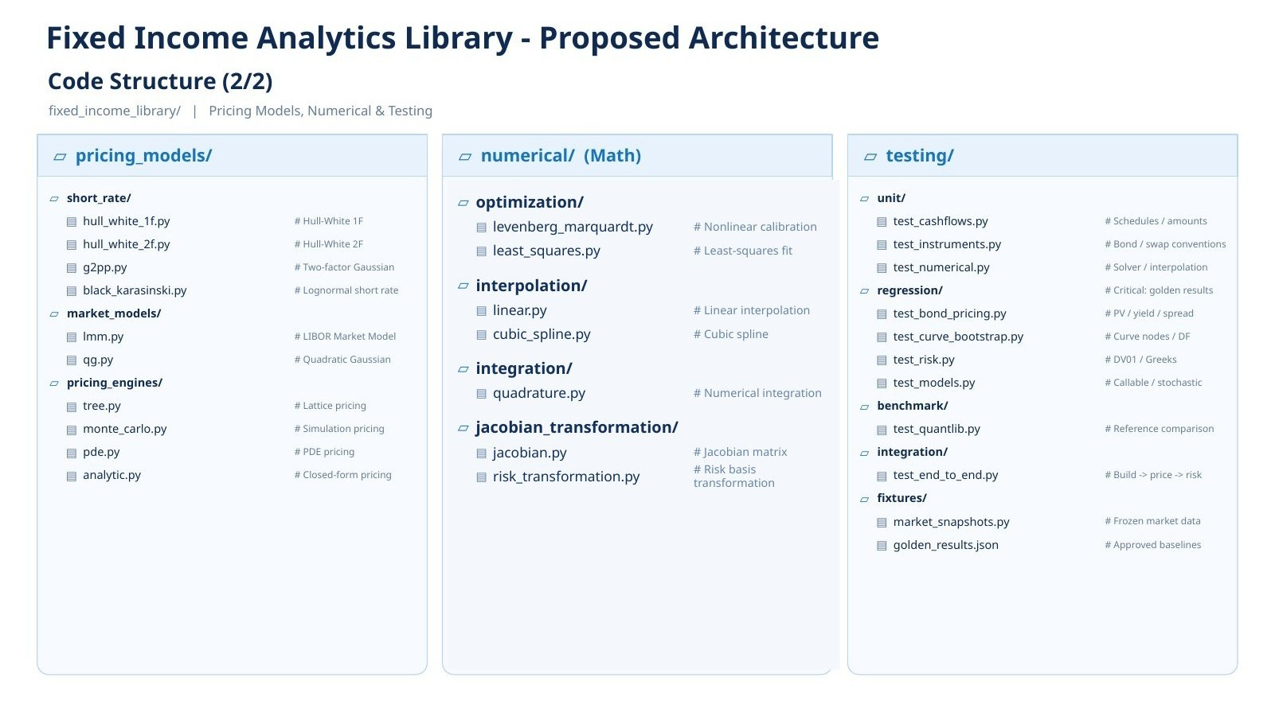
Bond Analytics Library - Proposed Architecture
Code Structure (2/2)

Slide 4


