Slide 1
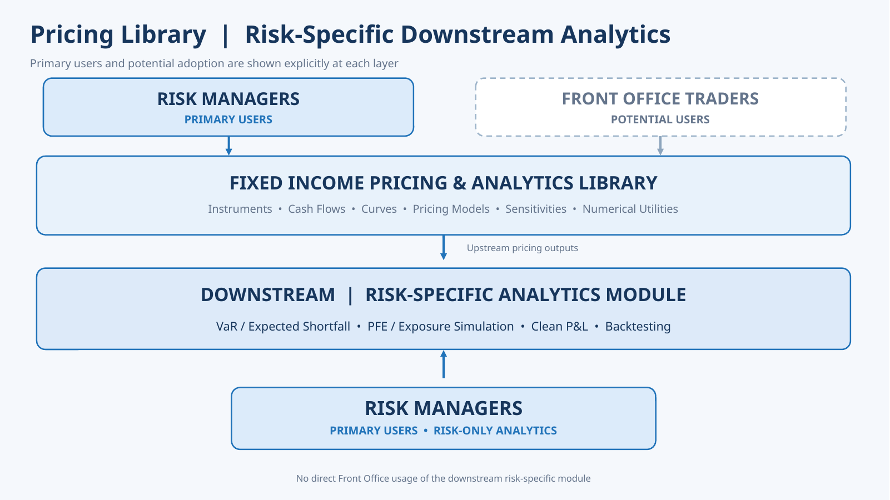
Fixed Income Analytics Library - Proposed Architecture
Architecture Overview
FOCUS: SLIDES 2 & 3

Slide 2
Fixed Income Analytics Library - Proposed Architecture
Fixed Income Analytics Library - Proposed Architecture
Code Structure (1/2)
Code Structure (1/2)
fixed_income_library/ | Instrument, Cash Flow Generation & Market Data
▱ instrument/
▱ cash_flow_generation/
▱ market_data/
▤ fixed_income_instrument.py
▤ cash_flow_generator.py
▱ curve/
▱ bond/
▤ coupon_schedule.py
▱ construction/
▤ bond.py
▤ bootstrap.py
▤ fixed_rate.py
▤ principal_schedule.py
▤ optimization.py
▤ floating_rate.py
▤ cash_flow_display.py
▱ bumping/
▤ inflation.py
▤ parallel.py
▤ fixed_to_float.py
▤ scenario.py
▱ api/
▱ serialization/
▤ bond_builder.py
Independent top-level module
▤ serialize.py
▤ yield_discount_margin.py
▤ deserialize.py
▤ spreads_calculation.py
Reusable across bonds, swaps and derivatives
▱ vol/
▤ yield_based_risk.py
▱ model/
▤ spread_based_risk.py
▤ surface.py
▱ swap/
▤ sabr.py
▱ futures/
▱ bumping/
▱ rate_lock/
▤ parallel.py
▱ cap_floor/
▤ scenario.py
▱ swaption/
▱ serialization/
▤ serialize.py
Includes linear and option derivatives
▤ deserialize.py

Slide 3
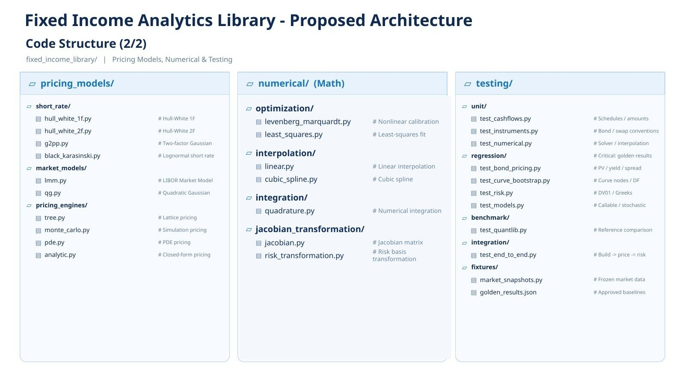
Fixed Income Analytics Library - Proposed Architecture
Code Structure (2/2)

