Slide 1
Lecture1 Introduction (III) Cost & Performance Metrics
Computer Organization and Architecture

Slide 2
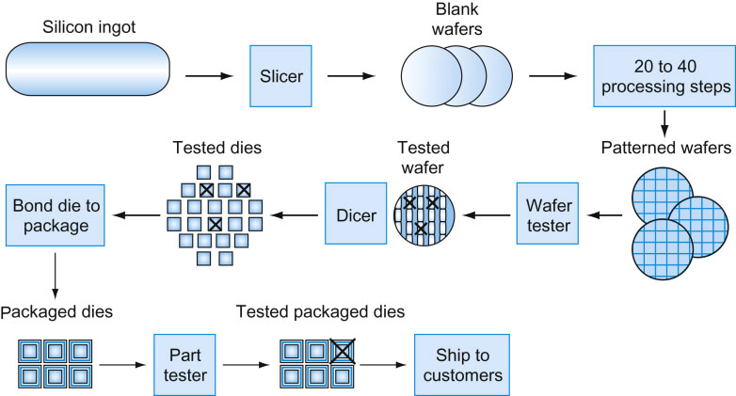
The chip manufacturing process
1.0
Yield: proportion of working dies per wafer

Slide 3
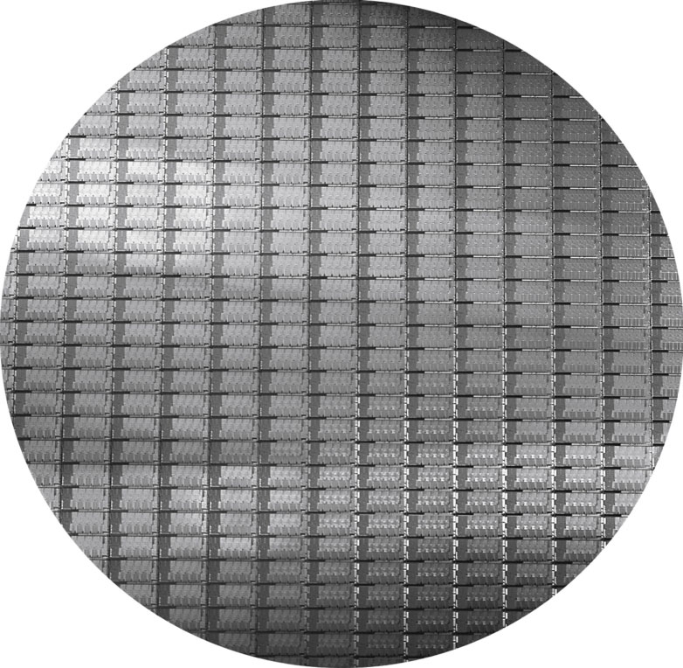
Intel Core i7 Wafer
300mm wafer, 280 chips, 32nm technology
Each chip is 20.7 x 10.5 mm

Slide 4

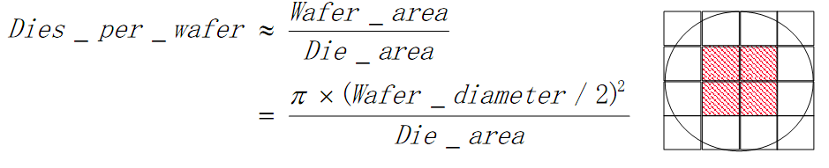
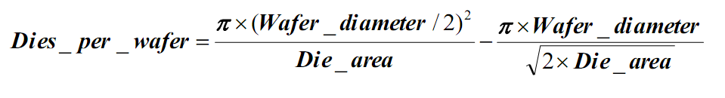
Cost of ICs

Slide 5
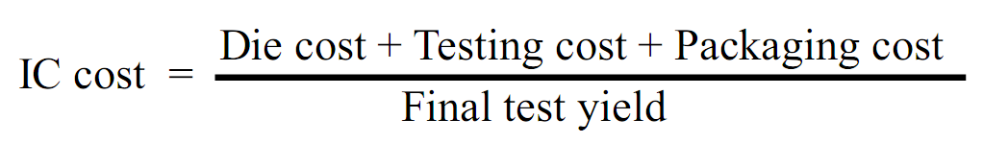
Other Costs
Packing Cost: Depends on the pin number and the requirement of heat dissipation

Slide 6
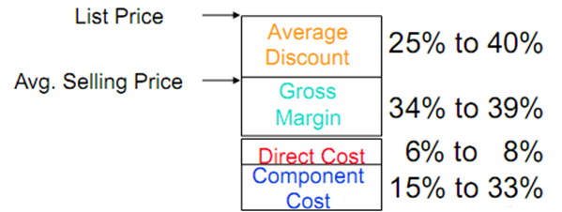
Cost / Performance
2.0
What is the relationship between Cost and Price?
Component Costs
Direct Costs (add 25% to 40%) recurring costs: labor, purchasing, scrap, warranty
Gross Margin(add 82% to 186%) nonrecurring costs: R&D, marketing, sales, equipment maintenance, rental, financing cost, pretex profits, taxes
Average Discount to get list Price (add 33% to 66%): volume discounts and/or retailer markup

Slide 7
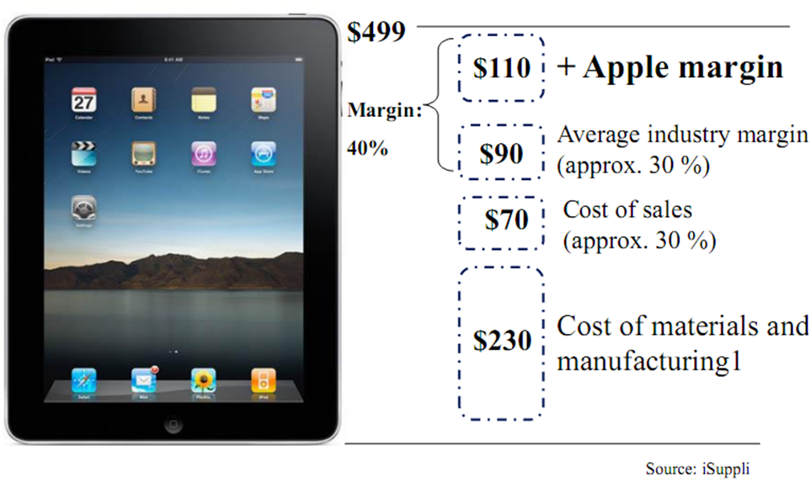
Profit from Margin in Hardware -- Apple

Slide 8
How to Define the Performance
The goal of performance evaluation in this chapter is to be able to compare, for example.
Different architectures
Different implementations of an architecture
Different compilers for a given architecture
General Sense:
How well the computer performs?

Slide 9
Defining Performance
Which airplane has the best performance?

Slide 10
Performance and cost
Airplane | Washington -Paris | Speed | Passengers | Through-put
Boeing 747 | 6.5 hours | 610 mph | 470 | 286,700
BAD/Sud Concodre | 3 hours | 1350 mph | 132 | 178,200
Time to execute a task (Execution Time)
Execution time, response time, latency
Tasks that executed in a unit time( per day, per hour, per week, per second,…) (Performance)
Throughput, bandwidth

Slide 11
Throughput and response time
How will the throughput and response time be influenced if :
Use a more faster processor?
Use more processors and assign different task to different processor?
Reducing response can always improve throughput!
Response time of a task can not be improved with more processors, if the task can not be parallelized!
In real systems, tasks usually need to wait in line for execution, execution time and throughput usually affect each other.

Slide 12
Defining (Speed) Performance
Normally interested in reducing
Response time (aka execution time) – the time between the start and the completion of a task
Important to individual users
Thus, to maximize performance, need to minimize execution time
performance_{X} = 1 / execution_time_{X}
If X is n times faster than Y, then
performance_{X} execution_time_{Y}
-------------------- = --------------------- = n
performance_{Y} execution_time_{X}
Throughput – the total amount of work done in a given time
Important to data center managers
Decreasing response time almost always improves throughput
Notes:
Increasing performance requires decreasing execution time

Slide 13
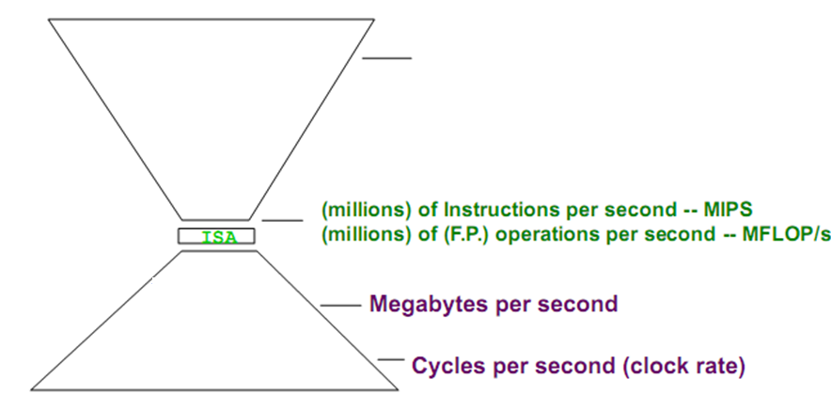
Metrics of performance
Application
Response per month
Operations per second
Program Language
Complier
Datapath
Control
Functional Units
Trans. Wire, Pin

Slide 14
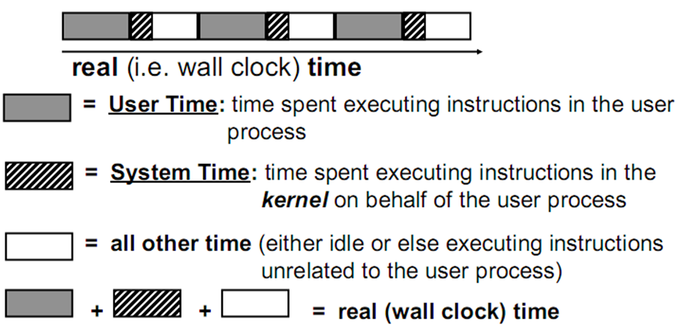
The Nature of Time
Unless otherwise specified, “time” often refers to “user time”

Slide 15
Executing Time
Elapsed Time
Counts everything (disk and memory accesses, I/O, etc.)
A useful parameter, but often not for comparing purposes
CPU Time
No counts I/O and time running other programs
Can be separated into System Time, and User Time
Our focus: user CPU time
Executing the lines of code that are “in” our program

Slide 16
Time
Wall-clock time, response time, or elapsed time: the total time to complete a task, including disk accesses, memory accesses, input/output activities, operating system overhead. — everything!
CPU execution time or CPU time: the time CPU spends computing for a specific task with no counting the waiting time of I/O or running other programs.

Slide 17
CPU Time
If we know # of CPU clock cycles for a program
CPU time for a program
= # of CPU cycles for a program X Clock cycle time
= # of CPU cycles for a program / Frequency
(period per cycle)

Slide 18
Performance Factors
Want to distinguish elapsed time and the time spent on our task
CPU execution time (CPU time) – time the CPU spends working on a task
Does not include time waiting for I/O or running other programs
Can improve performance by reducing either the length of the clock cycle or the number of clock cycles required for a program
# of CPU clock cycles for a program
= # of instructions of a program
X
average clock cycles for an instruction
Notes:
Many techniques that decrease the number of clock cycles also increase the clock cycle time

Slide 19
Clock Cycles per Instruction
Not all instructions take the same amount of time to execute
One way to think about execution time is that it equals the number of instructions executed multiplied by the average time per instruction
Clock cycles per instruction (CPI) – the average number of clock cycles each instruction takes to execute
A way to compare two different implementations of the same ISA

Slide 20
Quiz
A compiler writer needs to determinate from 2 code sequences
Hardware performance fact for 3 classes of Instruction:
Two code sequences below:
Cycle1=(2x1)+(1x2)+(2x3)=10 Cycle2=(4x1)+(1x2)+(1x3)=9
CPI1=10/5=2 CPI2=9/6=1.5
 | CPI for this instruction class
 | A | B | C
CPI | 1 | 2 | 3
Seq. # | Instruction count for each class
 | A | B | C
1 | 2 | 1 | 2
2 | 4 | 1 | 1

Slide 21
The Performance Equation
Our basic performance equation is then
CPU time = Instruction_count x CPI x clock_cycle
These equations separate the three key factors that affect performance
Can measure the CPU execution time by running the program
The clock rate is usually given
Can measure overall instruction count by using profilers/ simulators without knowing all of the implementation details
CPI varies by instruction type and ISA implementation for which we must know the implementation details
Notes:
Note that instruction count is dynamic – i.e., its not the number of lines in the code, but THE NUMBER OF INSTRUCTIONS EXECUTED

Slide 22
Determinates of CPU Performance
CPU time = Instruction_count x CPI x clock_cycle
 | Instruction_count | CPI | clock_cycle
Algorithm
Programming language
Compiler
ISA
Processor organization
Technology
X
X
X
X
X
X
X
X
X
X
X
X
Notes:
For lecture

Slide 23
Effective CPI
Computing the overall effective CPI is done by looking at the different types of instructions and their individual cycle counts and averaging
n
Overall effective CPI = Σ (CPI_{i} x IC_{i})
i = 1
Where IC_{i} is the count (percentage) of the number of instructions of class i executed
CPI_{i} is the (average) number of clock cycles per instruction for that instruction class
n is the number of instruction classes
The overall effective CPI varies by instruction mix – a measure of the dynamic frequency of instructions across one or many programs

Slide 24
A Simple Example
Op | Freq | CPI_{i} | Freq x CPI_{i}
ALU | 50% | 1
Load | 20% | 5
Store | 10% | 3
Branch | 20% | 2
 |  |  | Σ =
0.5
1.0
0.3
0.4
2.2
How much faster would the machine be if a better data cache reduced the average load time to 2 cycles?
How does this compare with using branch prediction to shave a cycle off the branch time?
What if two ALU instructions could be executed at once?

Slide 25
A Simple Example
Op | Freq | CPI_{i} | Freq x CPI_{i}
ALU | 50% | 1
Load | 20% | 5
Store | 10% | 3
Branch | 20% | 2
 |  |  | Σ =
.5
1.0
.3
.4
.5
.4
.3
.4
.5
1.0
.3
.2
.25
1.0
.3
.4
2.2
1.6
2.0
1.95
How much faster would the machine be if a better data cache reduced the average load time to 2 cycles?
How does this compare with using branch prediction to shave a cycle off the branch time?
What if two ALU instructions could be executed at once?
CPU time new = 1.6 x IC x CC so 2.2/1.6 means 37.5% faster
CPU time new = 2.0 x IC x CC so 2.2/2.0 means 10% faster
CPU time new = 1.95 x IC x CC so 2.2/1.95 means 12.8% faster
Notes:
For lecture

Slide 26
Benchmark Suites
Each vendor announces a SPEC rating for their system
a measure of execution time for a fixed collection of programs
is a function of a specific CPU, memory system, IO system, operating system, compiler
enables easy comparison of different systems
The key is coming up with a collection of relevant programs

Slide 27
Benchmarks
SPEC: System Performance Evaluation Corporation, an industry consortium that creates a collection of relevant programs (SPEC Series (http://www.spec.org)
The 2006 version includes 12 integer and 17 floating-point applications
The SPEC rating specifies how much faster a system is, compared to a baseline machine – a system with SPEC rating 600 is 1.5 times faster than a system with SPEC rating 400
Note that this rating incorporates the behavior of all 29 programs – this may not necessarily predict performance for your favorite program!
PARSEC (http://parsec.cs.princeton.edu/)
The Princeton Application Repository for Shared-Memory Computers (PARSEC) is a benchmark suite composed of multithreaded programs.
Others
SPLASH, BioPef, Biobench, TPC-C/H …

Slide 28
Comparing and Summarizing Performance
How do we summarize the performance for benchmark set with a single number?
The average of execution times that is directly proportional to total execution time is the arithmetic mean (AM) (What else?)
n
AM = 1/n Σ Time_{i}
i = 1
Where Time_{i} is the execution time for the i^{th} program of a total of n programs in the workload
A smaller mean indicates a smaller average execution time and thus improved performance
Guiding principle in reporting performance measurements is reproducibility – list everything another experimenter would need to duplicate the experiment (version of the operating system, compiler settings, input set used, specific computer configuration (clock rate, cache sizes and speed, memory size and speed, etc.))

Slide 29
Comparing and Summarizing Performance
How do we summarize the performance for benchmark set with a single number?
SPEC uses geometric mean (GM) – the execution time of each program is multiplied and the N^{th} root is derived
Weighted arithmetic mean – the execution times of some programs are weighted to balance priorities

Slide 30
不同平均值的对比
Notes:
参考资料：https://blog.csdn.net/ecnu18918079120/article/details/71307845

Slide 31
Evaluating ISAs
Design-time metrics:
Can it be implemented, in how long, at what cost?
Can it be programmed? Ease of compilation?
Static Metrics:
How many bytes does the program occupy in memory?
Dynamic Metrics:
How many instructions are executed? How many bytes does the processor fetch to execute the program?
How many clocks are required per instruction?
How "lean" a clock is practical?
Best Metric: Time to execute the program!
CPI
depends on the instructions set, the processor organization, and compilation techniques.
Inst. Count
Cycle Time

Slide 32
MIPS vs MIPS
MIPS: Originally for Microprocessor without Interlocked Pipeline Stages ( Arch Acronym)
MIPS: Million Instructions per Second (Performance Acronym)

Slide 33
Other Metrics: Power Consumption
Back to 70’s ~ 80’s, designers only cared about performance
Now, the story has changed…
Power consumption – especially in the embedded market where battery life is important (and passive cooling)
For power-limited applications, the most important metric is energy efficiency
Pentium |  | 200 MHz | 15.5 W
Pentium II 450 | Deschutes (250 nm) | 450 MHz | 27.1 W
Pentium III 1400S | Tualatin (130 nm) | 1.4 GHz | 32.2 W
Haswell High-End | Sandybridge-E (32 nm) | 3.3 GHz @ 6 Cores | 130 W

Slide 34
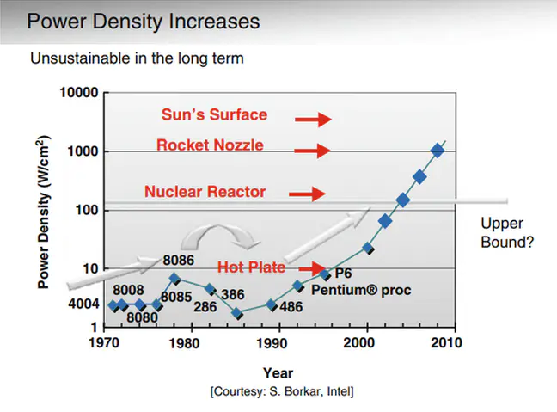
Notes:
参考资料：jianshu.com/p/243d0d9cd2fe

Slide 35
Two Types of Energy Consumption
Capacitors dominate dynamic energy (primary energy consumption)
Static energy consumes even if transistors are always off
Leakage is typical responsible for > 40% energy consumption.
Energy ∝ Capacitive load x Voltage²
Energy ∝ 1/2 x Capacitive load xVoltage²
Power ∝ 1/2 x Capacitive load x Voltage2 x Frequency switched
Notes:
参考资料：https://www.jianshu.com/p/2f6aa8adac7a
现在的设计普遍认为，功耗密度高于150W/c㎡是应该极力避免的，除非说你完全不在乎封装的成本。
根据估算，在20nm工艺下，以前的45nm处理器如果采用1.2V供电，不考虑散热的话，其实运行频率理论上可以达到30GHZ。但是带来的问题就是功耗密度达到惊人的20KW/c㎡，远高于太阳表面的功耗密度。即便运行频率达到10GHZ，功耗密度也达到5KW/c㎡，比火箭的尾焰还热。所以从散热考虑，实际的处理器运行频率都被限制在10GHZ以内，即便晶体管的速度允许其达到10GHZ。

Slide 36
Example Problem
A 1 GHz processor takes 100 seconds to execute a program, while consuming 70 W of dynamic power and 30 W of leakage power. Does the program consume less energy in Turbo boost mode when the frequency is increased to 1.2 GHz?

Slide 37

投票
最多可选1项
超频运行会使得该程序执行的总能耗如何改变？
A
增加
B
不变
C
降低
D
不一定
提交

Slide 38
Example Problem
A 1 GHz processor takes 100 seconds to execute a program, while consuming 70 W of dynamic power and 30 W of leakage power. Does the program consume less energy in Turbo boost mode when the frequency is increased to 1.2 GHz?
Normal mode energy = 100 W x 100 s = 10,000 J
Turbo mode energy = (70 x 1.2 + 30) x 100/1.2 = 9,500 J
Note:
Frequency only impacts dynamic power, not leakage power.
We assume that the program’s CPI is unchanged when
frequency is changed, i.e., exec time varies linearly
with cycle time.
Notes:
此处可以打开任务管理器，看基准频率与实时速度

Slide 39
DARK Silicon
We come to a utilization wall which says that with the progression of Moore's Law, the percentage of a chip that we can actively use within a chip's power budget is dropping exponentially! The remaining silicon that must be left unpowered is now referred to as Dark Silicon.
--UCSD Dark Silicon Team
Notes:
Tbyte = 2^40 bytes (or 10^12 bytes)
Note that Moore’s law is not about speed predictions but about chip complexity

Slide 40
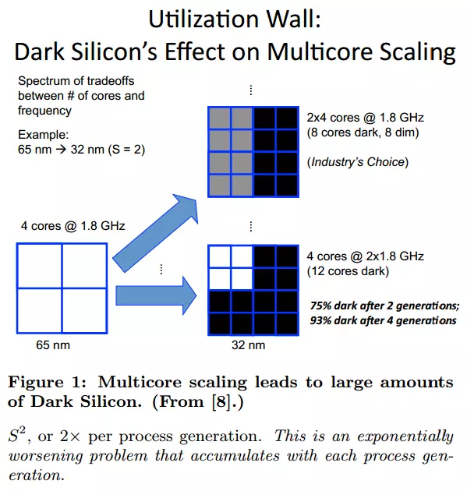
Notes:
参考资料：https://www.jianshu.com/p/2f6aa8adac7a

Slide 41
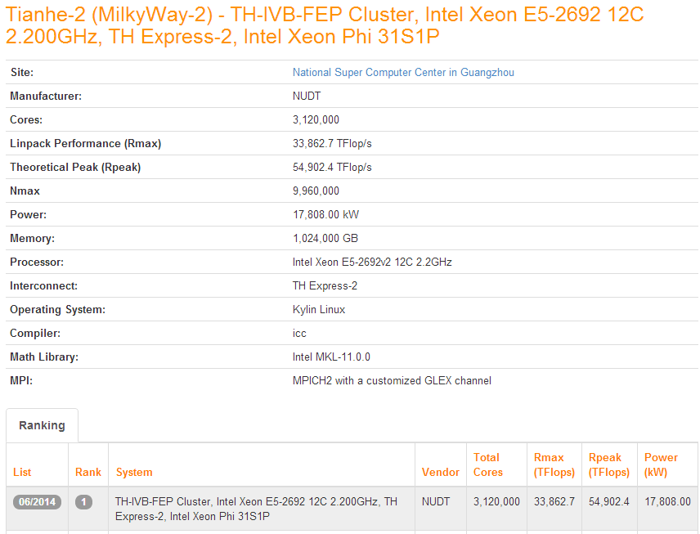

Power of Supercomputers
Notes:
参考网站：www.top500.org
播放视频：申威处理器简介

Slide 42
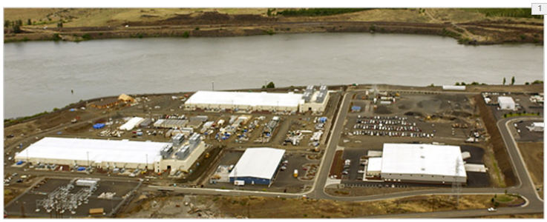

How about Data Centers?
“Data centers consumes up to 1.5% of all the world’s electricity”
“Google’s data centers draw almost 260 MW of power, which is more power than Salt Lake City uses.”

Slide 43
Other Metrics: Reliability
Sources of Errors
Particle-strike soft errors
Negative bias temperature instability (NBTI)
Electron-migration
Power failure
…
Protection mechanisms
Error correction codes
Redundant logic
Checkpoint, duplication …
Trade-off
Reliability ↑ → Design overhead (complex) ↑ → Performance ↓
Reliability ↑ → Design overhead / Function activity ↑ → Power ↑

Slide 44
Typical Server System Reliability Goals
Error Type | System MTBF Goal
SDC (Silent Data Corruption) | 1000 years
DUE for system crash | 25 years
DUE for application crash | 10 years
(D.C.Bossen, 2002 IRPS Tutorial Reliability Notes)
SDC = Silent Data Corruption
DUE = Detected & unrecoverable error
MTBF = mean time before failure
Notes:
Transition: Now we will see how our rates match up against these goals and requirements.

Slide 45
Amdahl’s Law
S_{latency}: the theoretical speedup of the execution of the whole task
s : speedup of the part of the task that benefits from improved resources
p is the proportion of execution time that the part benefiting from improved resources originally occupied.
Architecture design is very bottleneck-driven – make the
common case fast, do not waste resources on a component
that has little impact on overall performance/power
Amdahl‘s law（阿姆达尔定律） 由计算机科学家 Gene Amdahl 在 1967 年提出，主要思想是当我们对系统的某个部分加速时，其对系统整体性能的影响取决于该部分的所占比例和加速程度

Slide 46
Amdahl’s Law
Example: a web server spends 40% of time in the CPU and 60% of time doing I/O – a new processor that is ten times faster results in a 36% reduction in execution time (4%+60%)
(speedup of 1.56) – Amdahl’s Law states that maximum execution time reduction is 40% (max speedup of 1.66)

Slide 47
Next Lecture and Reminders
Next lecture
ISA Review
Reading assignment – PH, Chapter 2

