Slide 1
Lecture7 Arithmetic-Addition/Subtraction
Computer Organization and Architecture

Slide 2
Outline
Recap: Number Representation
Addition
Subtraction
Logical Operation
ALU

Slide 3
Number Representation-Unsigned Binary
1.1
Given an n-bit number
Range: 0 to +2^{n} – 1
Example
0000 0000 0000 0000 0000 0000 0000 1011₂ = 0 + … + 1×2³ + 0×2² +1×2¹ +1×2⁰ = 0 + … + 8 + 0 + 2 + 1 = 11₁₀
Using 32 bits
0 to +4,294,967,295
Notes:
记忆：2^32表达的十进制是10位二进制

Slide 4
Signed Binary
1.2
Use one bit to represent the sign
Value Numbers in Machine
+ 0.1011
0 1011
Position of Point
– 0.1011
1 1011
Position of Point
+ 1100
0 1100
Position of Point
– 1100
1 1100
Position of Point
Notes:
注意定点的含义：小数点是固定的——小数在最高位，整数在最低位

Slide 5
True Form
1.2
Definition for Integer
0，x 2^{n} ＞ x ≥ 0
[x]_{True Form} =
2^{n} x 0 ≥ x ＞ 2^{n}
x is true value n is the length
x = +1110
[x]_{true form} = 0 , 1110
x = 1110
[x]_{true form} = 2⁴ + 1110 = 1 , 1110
Notes:
True Form：原码

Slide 6
True Form
1.2
Definition for Fraction
x 1 ＞ x ≥ 0
[x]_{true form} =
1 – x 0 ≥ x ＞ 1
x = + 0.1101
[x]_{true form} = 0 . 1101
x = 0.1101
[x]_{T} = 1 ( 0.1101) = 1 . 1101
x = + 0.1000000
[x]_{T} = 0 . 1000000
x = 0.1000000
[x]_{T} = 1 ( 0.1000000) = 1 . 1000000
Notes:
[x]_{T} represents True Form of x
Fraction：分数/小数

Slide 7
True Form
1.2
Some Problems
OP V1 V2 Real OP Sign of the Result
Add + +
Add
Positive
Add + -
Sub
Positive/Negative
Add - +
Sub
Positive/Negative
Add - -
Add
Negative
In some cases, addition will be implemented with subtraction!
Can we find a positive number which can substitute the negative number?
Notes:
提问：为何用减法代替加法？原码中可以用加法代替减法吗？

Slide 8
Complement
1.3
Adjust the time of the clock
The current time is 6’cloclk, but the clock is showing 9’clock. What can we do?
Anti-clockwise: 9-3=6
Clockwise：9+9=18, 18-12=6
-3 can be substituted with +9, which can turn subtraction into addition.
+9 is complement of -3 (mod 12)
The complement of a negative can be get by adding a modulo
Notes:
01101-00011=01010
01101+10011=00000
01101+11101=01010
So the conclusion should be drawn here that, the true form subtraction could be substituted with addition of complement.

Slide 9
Complement
1.3
The complement of a negative can be get by adding a modulo.
The sum of the absolute values of a positive and negative is modulo in case of they are complements each other.
9₁₀+3₁₀=12₁₀，(01101)_{T}+(10011)_{C}=(00000)_{T}
The complement of a positive is itself.

Slide 10
2’s Complement-Integer
x = 1011000
1.3
0，x 2^{n} ＞ x ≥ 0
[x]_{C} =
2^{n+1} + x 0 ＞ x ≥ 2^{n}（mod 2^{n+1}）
x is the true value
n is the length
x = +1010
[x]_{C} = 0,1010
[x]_{C} = 2⁷⁺¹ +( 1011000 )
=
100000000
1011000
1,0101000
Notes:
2^{n+1}=[x]_{c}-[x]_{c}

Slide 11
2’s Complement-Fraction
1.3
x 1 ＞ x ≥ 0
[x]_{C} =
2 + x 0 ＞ x ≥ 1（mod 2）
x is the true value
x = + 0.1110
x = 0.1100000
[x]_{C} = 0.1110
[x]_{C} = 2 + ( 0.1100000 )
=
10.0000000
0.1100000
1.0100000

Slide 12
Shortcut to get complement of a negative
1.3
x = 1010
[x]_{C} = 2⁴⁺¹ 1010
= 11111 + 1 1010
= 100000
= 11111
+ 1
1010
1010
= 1,0110
10101 + 1
= 1,0110
[x]_{T} = 1,1010

Slide 13
Addition
2.0
Integer
[A]_{C} + [B]_{C}
= [A+B]_{C}（mod 2^{n+1}）
Fraction
[A]_{C} + [B]_{C}
= [A+B]_{C}（mod 2）
The signs are also added together, and the generated
carry is discarded.

Slide 14
Addition-Example
2
A = 0.1011，B = – 0.0101
Calculate [A + B]_{C}
Verify
[A]_{C}
= 0 . 1 0 1 1
0.1011
+
[B]_{C}
= 1 . 1 0 1 1
– 0.0101
[A]_{C} + [B]_{C}
= 1 0 . 0 1 1 0
= [A + B]_{C}
0.0110
∴ A + B = 0 . 0 1 1 0

Slide 15
Addition-Example
2.0
A = –9，B = –5
Calculate [A+B]_{C}
[A]_{C}
= 1 , 0 1 1 1
Verify
– 1001
+
[B]_{C}
= 1 , 1 0 1 1
+
– 0101
[A]_{C} + [B]_{C}
= 1 1 , 0 0 1 0
= [A + B]_{C}
– 1110
∴ A + B = – 1110

Slide 16
Subtraction
3.0
A–B
= A+(–B )
Integer
[A – B]_{C}
= [A+(–B )]_{C}
= [A]_{C} + [ – B]_{C}
(mod 2^{n+1})
Fraction
[A – B]_{C}
= [A+(–B )]_{C}
= [A]_{C} + [ – B]_{C}
(mod 2)

Slide 17
Subtraction-Example
5₁₀ [0 , 0 1 0 1]_{T}
-5₁₀ [1 , 1 0 1 1]_{C}
A = 9，B = 5
Calculate [A-B]_{T}
[A]_{C}
= 0 , 1 0 0 1
Verify
1001
+
[-B]_{C}
= 1 , 1 0 1 1
-
0101
[A]_{C} + [B]_{C}
= 1 0 , 0 1 0 0
= [A + B]_{C}
0100
∴ A - B = +0100

Slide 18
Subtraction-Example
-5₁₀ [1 , 1 0 1 1]_{C}
5₁₀ [0 , 0 1 0 1]_{T}
A = 9，B = -5
Calculate [A+B]_{T}
[A]_{C}
= 0 , 1 0 0 1
Verify
1001
+
[-B]_{C}
= 1 , 1 0 1 1
-
0101
[A]_{C} + [B]_{C}
= 1 0 , 0 1 0 0
= [A + B]_{C}
0100
∴ A + B = +0100

Slide 19
Logic Operation
4.0
AND
OR
NOT
XOR
Bitwise operation, can be implemented with the corresponding gate.

Slide 20
ALU- 1 bit ALU
5.0
This ALU can calculate 1-bit AND, OR and ADD operation

Slide 21
1-bit Full Adder
5.0
Truth Table
Input |  |  | Output |  | Notes
A | B | CarryIn | CarryOut | Sum
0 | 0 | 0 | 0 | 0 | 0 + 0 + 0 = 00
0 | 0 | 1 | 0 | 1 | 0 + 0 + 1 = 01
0 | 1 | 0 | 0 | 1 | 0 + 1 + 0 = 01
0 | 1 | 1 | 1 | 0 | 0 + 1 + 1 = 10
1 | 0 | 0 | 0 | 1 | 1 + 0 + 0 = 01
1 | 0 | 1 | 1 | 0 | 1 + 0 + 1 = 10
1 | 1 | 0 | 1 | 0 | 1 + 1 + 0 = 10
1 | 1 | 1 | 1 | 1 | 1 + 1 + 1 = 11

Slide 22
CarryOut
5.0
Input |  |  | Output |  | Notes
A | B | CarryIn | CarryOut | Sum
0 | 0 | 0 | 0 | 0 | 0 + 0 + 0 = 00
0 | 0 | 1 | 0 | 1 | 0 + 0 + 1 = 01
0 | 1 | 0 | 0 | 1 | 0 + 1 + 0 = 01
0 | 1 | 1 | 1 | 0 | 0 + 1 + 1 = 10
1 | 0 | 0 | 0 | 1 | 1 + 0 + 0 = 01
1 | 0 | 1 | 1 | 0 | 1 + 0 + 1 = 10
1 | 1 | 0 | 1 | 0 | 1 + 1 + 0 = 10
1 | 1 | 1 | 1 | 1 | 1 + 1 + 1 = 11
CarryOut = (!A & B & CarryIn) | (A & !B & CarryIn) | (A & B & !CarryIn)| (A & B & CarryIn)
CarryOut = B & CarryIn | A & CarryIn | A & B

Slide 23
Sum
5.0
Input |  |  | Output |  | Notes
A | B | CarryIn | CarryOut | Sum
0 | 0 | 0 | 0 | 0 | 0 + 0 + 0 = 00
0 | 0 | 1 | 0 | 1 | 0 + 0 + 1 = 01
0 | 1 | 0 | 0 | 1 | 0 + 1 + 0 = 01
0 | 1 | 1 | 1 | 0 | 0 + 1 + 1 = 10
1 | 0 | 0 | 0 | 1 | 1 + 0 + 0 = 01
1 | 0 | 1 | 1 | 0 | 1 + 0 + 1 = 10
1 | 1 | 0 | 1 | 0 | 1 + 1 + 0 = 10
1 | 1 | 1 | 1 | 1 | 1 + 1 + 1 = 11
Sum = (!A & !B & CarryIn) | (!A & B & !CarryIn) | (A & !B & !CarryIn)
| (A & B & CarryIn)
Sum= A xor B xor CarryIn

Slide 24
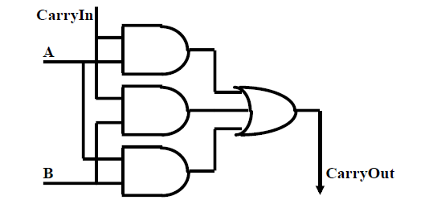
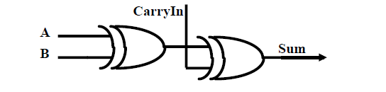
Logic of CarryOut and Sum
5.1
CarryOut = B & CarryIn | A & CarryIn | A & B
Sum = A XOR B XOR CarryIn

Slide 25
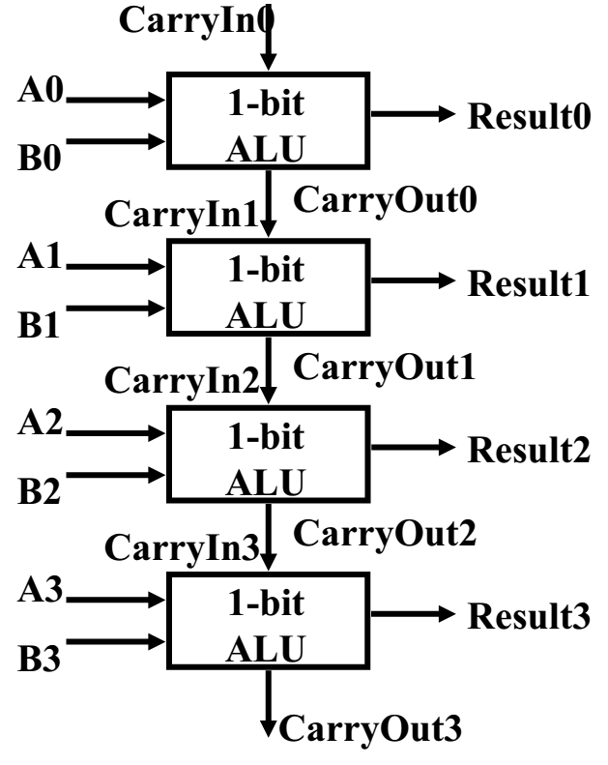
From 1-bit ALU to 4-bit ALU
5.2
1-bit ALU 4-bit ALU

Slide 26
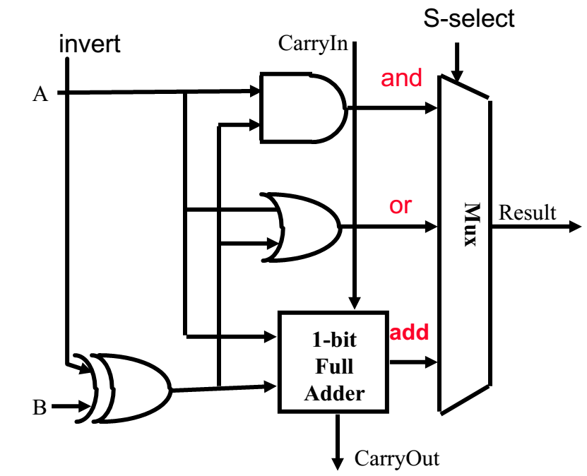
How to do subtraction?
5.3
[A+B]C=[A]C+[B]C
[A-B]C=[A]C+[-B]C
input：[A]C，[B]C
n
for subtraction：How to generate [-B]C from [B]C ?
Notes:
Here by, an all-complement-inputs adder implements addition and subtraction with the Sub =1 selection in this slide.
[A]_{T}+[B]_{T} If A and B both positive, this equation will be the same with [A]_{C}+[B]_{C}, if any negative number exists, it should be considered as subtraction.
[A]_{T}-[B]_{T} = [A]_{T}+[-B]_{T} =[A]_{C}+[B]_{C}. Whatever the positive or negative inputs will works find with this equation.
In the second equation, if [B]_{T} is positive, [-B]_{C}=~[B]_{T}+1. If [B]_{T} is negative, as the input is [B]_{C} and [-B]_{T} is positive, [-B]_{T} = [[-B]_{T}]_{C} = ![B]_{C}+1.
e.g. 0100-1001=0100+0001=0101 all-complement-inputs: 0100+!(1111)+1=0100+0001=0101
The key in all-complement-inputs is to invert a complement should follow the procedure that turn it into true form, invert it, and then turn it back to complement. That means, for both positive or negative value, invert sign + complement is the equivalent with inverting bitwise plus 1.

Slide 27
generate [-B]C from [B]C ?
5.3
[B]C=b0.b1b2…bn
If B>=0, [B]C=0.b1b2…bn=B
-B=-0.b1b2…bn
[-B]C=2+（-B）
=2-0.b1b2…bn
=1+1-0.b1b2…bn
=1+0.11…1+0.00…1-0.b1b2…bn
=1+(0.11…1-0.b1b2…bn)+0.00…1
=1+0.b1b2…bn +0.00…1
=1. b1b2…bn +0.00…1
=b0.b1b2…bn+0.00…1

Slide 28
generate [-B]C from [B]C ?
5.3
[B]C=b0.b1b2…bn
If B<0, [B]C=1.b1b2…bn=2+B
-B=2-1.b1b2…bn
=1-0.b1b2…bn
=0.b1b2…bn+0.00…1
-B>0
[-B]C=-B
=0.b1b2…bn+0.00…1
=b0.b1b2…bn+0.00…1

Slide 29
How to do subtraction?
5.3
[A+B]C=[A]C+[B]C
[A-B]C=[A]C+[-B]C
n
Invert with Sign
Notes:
Here by, an all-complement-inputs adder implements addition and subtraction with the Sub =1 selection in this slide.
[A]_{T}+[B]_{T} If A and B both positive, this equation will be the same with [A]_{C}+[B]_{C}, if any negative number exists, it should be considered as subtraction.
[A]_{T}-[B]_{T} = [A]_{T}+[-B]_{T} =[A]_{C}+[B]_{C}. Whatever the positive or negative inputs will works find with this equation.
In the second equation, if [B]_{T} is positive, [-B]_{C}=~[B]_{T}+1. If [B]_{T} is negative, as the input is [B]_{C} and [-B]_{T} is positive, [-B]_{T} = [[-B]_{T}]_{C} = ![B]_{C}+1.
e.g. 0100-1001=0100+0001=0101 all-complement-inputs: 0100+!(1111)+1=0100+0001=0101
The key in all-complement-inputs is to invert a complement should follow the procedure that turn it into true form, invert it, and then turn it back to complement. That means, for both positive or negative value, invert sign + complement is the equivalent with inverting bitwise plus 1.

Slide 30
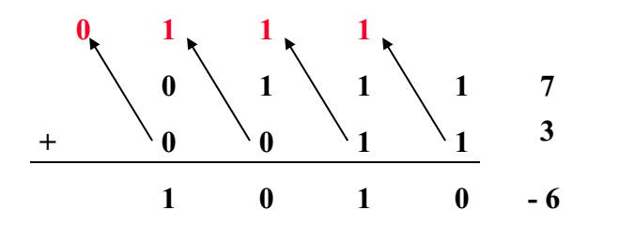
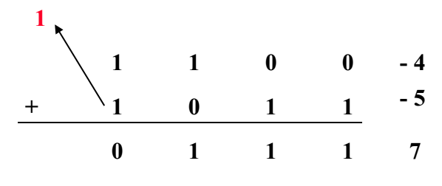
Are they error?
5
7+3=10, but…
Why?
-4-5=-9, but…
Why?
Notes:
In signed data type, if all bits is proceeded in arithmetic units, the overflow will effect the sign bit. That the answer of the question.

Slide 31
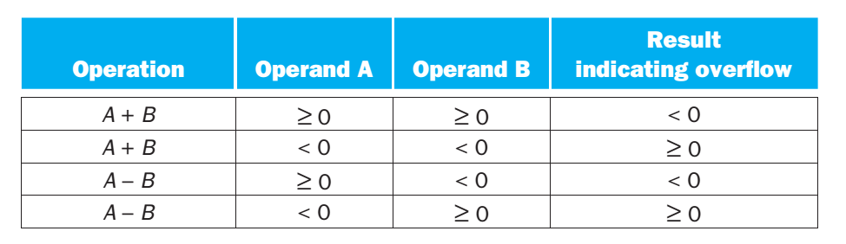
Overflow
5
Overflow occurs when the result from an operation can not be represented with the available hardware.
A 4-bit binary can represent integer from -8 to +7

Slide 32
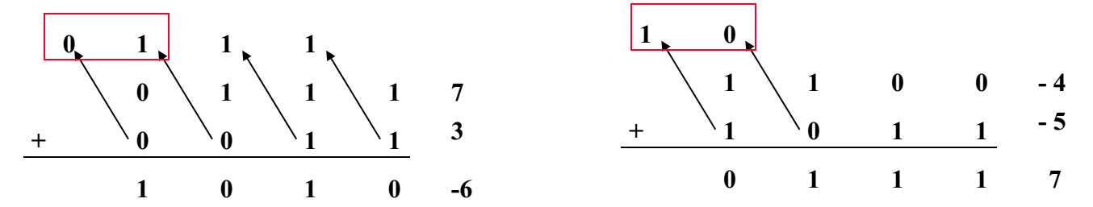
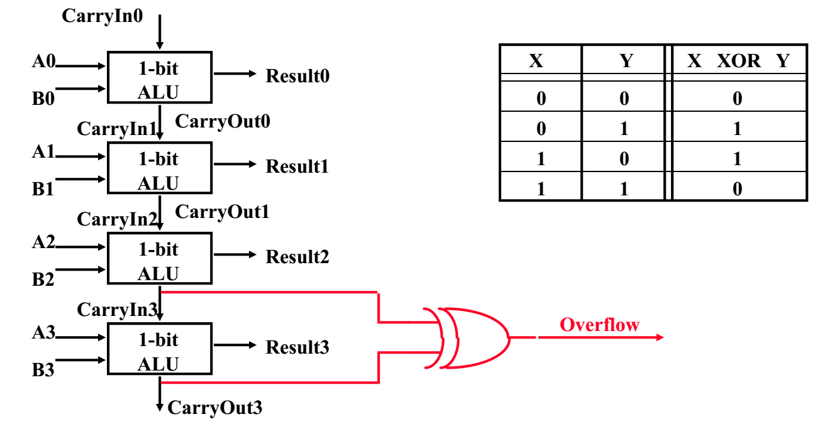
Overflow detection
5
Notes:
1100+1111= 11011

Slide 33
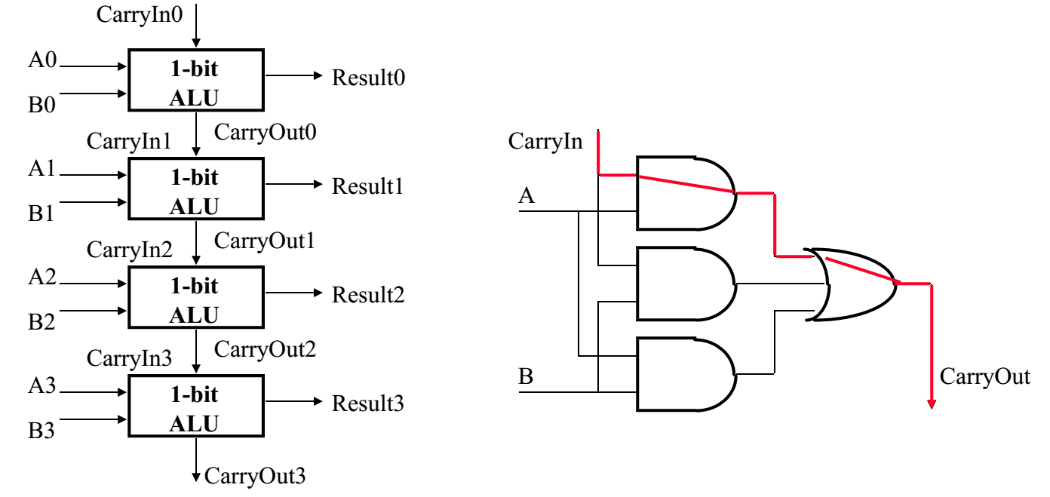
Disadvantage of Ripple Carry Adder
5.5
The critical path is from CarryIn to CarryOut.
How can we optimize this?

Slide 34
Fast Adder
5.5
We can reduce the delays to the carry bits by calculating them directly from the inputs, not from the outputs from the previous stage.
The trade-off is an increase in complexity for a decrease in delay.
There are two ways to produce a carry output from each stage.
Carry Generation
Carry Propagate

Slide 35
Fast Adder
5.5
Carry Generation: in a given stage, a carry is generated if both a and b are 1.
⇒ c_{n+1} = 1 if a_{n} = b_{n} = 1
 | 1 | 1
 | 1 | 0 | 1 | 1
+ | 0 | 1 | 1 | 0
1 | 0 | 0 | 0 | 1
No carry at stage 0
Carry generated at stage 1
⇒ g_{n} = a_{n} b_{n}

Slide 36
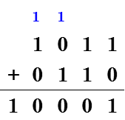
Fast Adder
5.5
Carry Propagate: if a carry comes in to a given stage, the carry will be propagated to the next stage if either a or b is 1.
⇒ c_{n+1} = 1 if c_{n} = 1 and (a_{n} = 1 or b_{n} = 1)
Note: if a_{n} = b_{n} = c_{n} = 1, it is
customary to count this as a
generate, but not a propagate.
No carry
Generate
⇒ p_{n} = a_{n} ⊕ b_{n}
Propagate
Notes:
For a full adder, define what happens to carries
Generate: C_{out} = 1 independent of C
G = A • B
Propagate: C_{out} = C
P = A ⊕ B
Kill: C_{out} = 0 independent of C
K = ~A • ~B
We call this logic as PGK logic

Slide 37
Fast Adder
5.5
Note: g_{n} and p_{n} are already produced by the full adder circuit!!!
Adder outputs
s_{n} = a_{n} ⊕ b_{n} ⊕ c_{n} = p_{n} ⊕ c_{n}
c_{n+1} = a_{n} b_{n} + (a_{n} ⊕ b_{n}) c_{n} = g_{n} + p_{n} c_{n}

Slide 38
Recursion Relation with P/G Logic
5.5
To reduce delays to carry outputs, rewrite c_{n+1} in terms of c₀, g, and p signals
Bit 0: c₁ = g₀ + p₀c₀
Bit 1: c₂ = g₁ + p₁c₁
= g₁ + p₁g₀ + p₁p₀c₀
Bit 2: c₃ = g₂ + p₂c₂
= g₂ + p₂g₁ + p₂p₁g₀ + p₂p₁p₀c₀
Bit 3: c₄ = g₃ + p₃c₃
= g₃ + p₃g₂ + p₃p₂g₁ + p₃p₂p₁g₀ + p₃p₂p₁p₀c₀
Result: Carry-lookahead adder

Slide 39
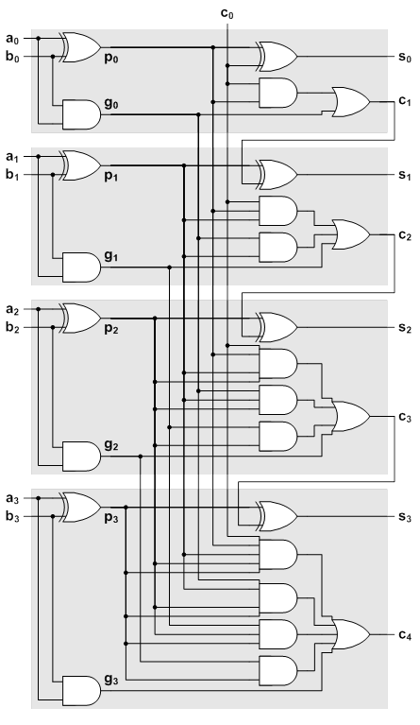
Fast Adder
5.5
4-Bit Carry-Look-Ahead Adder
Critical paths:
inputs to s₁, s₂, s₃
Critical path delay = 4 gates
Drawbacks:
Complexity, fan-ins
Comprise:
Block CLA structure

Slide 40
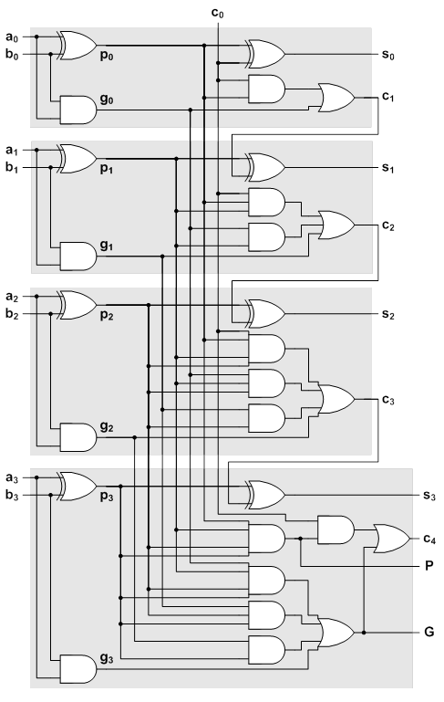
Fast Adder
5.5
4-Bit Carry-Look-Ahead Adder
w/ Block Generate and Propagate
When will a 4-bit adder propagate a carry from c₀ to c₄?
A: When it is propagated at every stage
P = p₃p₂p₁p₀
When will a 4-bit adder generate a carry output c₄?
A: (1) if a carry is generated at the last stage
− OR −
(2) If it is generated at any stage and propagated through all following stages
G = g₃ + p₃g₂ + p₃p₂g₁ + p₃p₂p₁g₀

Slide 41
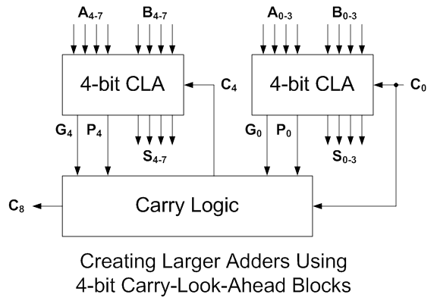
Fast Adder
5.5
~G7
~G7
~G3
~P3

Slide 42
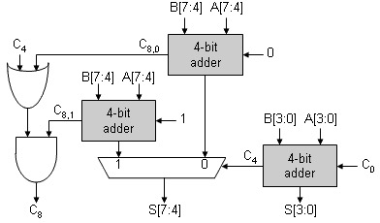
Carry Selected Adder
5.5
8-bit Adder
Faster
More Cost
3 4-bit Adders

Slide 43
Carry Selected Adder
5.5
8-bit ALU
Faster
More Cost
3 4-bit ALUs

