Slide 1
Lecture8 Arithmetic-Multiply/Division
Computer Organization and Architecture

Slide 2
Outline
Multiplication
Division
Put them altogether: An ALU with Multiplication and Division
Notes:
ALU设计目标：兼顾速度与面积！

Slide 3
Multiplication-Steps
1.1
multiplicand
1000
× 1001
1000
0000
0000
1000
1001000
multiplier
product
Notes:
牢记这几个英文：
Multiplicand：被乘数
Multiplier：乘数
Product：乘积

Slide 4
Multiplication-Steps
1.1
multiplicand
The length of the product is considerable larger than either the multiplicand or the multiplier.
1000
× 1001
1000
0000
0000
1000
1001000
multiplier
product

Slide 5
Multiplication-Steps
1.1
multiplicand
The length of the product is considerable larger than either the multiplicand or the multiplier.
It is much easier to implement binary multiplication
0=>0 ( 0 X multiplicand)
1=> multiplicand
1000
× 1001
1000
0000
0000
1000
1001000
multiplier
product

Slide 6
A Combinational Multiplier
1.2
0
0
0
0
A₃
A₂
A₁
A₀
B₀
A₃
A₂
A₁
A₀
B₁
A₃
A₂
A₁
A₀
B₂
A₃
A₂
A₁
A₀
B₃
P₇
P₆
P₅
P₄
P₃
P₂
P₁
P₀
For a 32-bit multiplier, how much hardware should be used? How about the critical path?

Slide 7
How does the multiplier work?
1.2
0
0
0
A₃
A₂
A₁
A₀
B₀
A₃
A₂
A₁
A₀
B₁
A₃
A₂
A₁
A₀
B₂
A₃
A₂
A₁
A₀
B₃
P₇
P₆
P₅
P₄
P₃
P₂
P₁
P₀
At each level, shifts A to the left (X 2)
use next bit of B to determine whether to add in shifted multiplicand
Calculates a 2n-bit partial product at each level

Slide 8
First version of the multiplication
1.3
Shift Left
Multiplicand
64 bits
Multiplier
Shift Right
64-bit ALU
32 bits
Product
Write
Control
64 bits
Initially 0
Multiplier = datapath + control
A 64-bit register for multiplicand
A 64-bit ALU
A 64-bit register for product
A 32-bit register for multiplier
Notes:
被乘数左移：以实现错位相加
乘数右移：以方便判断

Slide 9
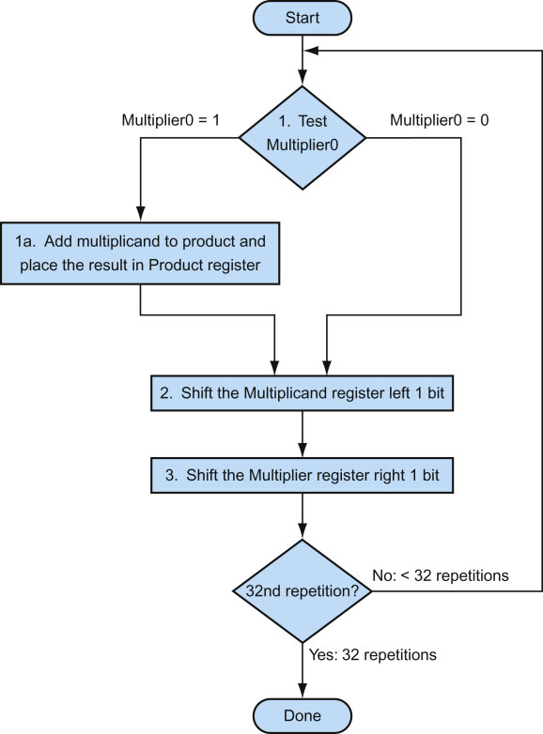
The First Multiplication Algorithm
1.3
0000 0010 x 0011
Product Multiplier Multiplicand
0000 0000 0011 0000 0010
0000 0010
0001
0000 0100
0000 0110
0000
0000 1000
0000 0110

Slide 10
Inspiration of the First Multiplication
1.3
1 clock per step=> ~ 100 clocks per multiply (3x32)
If multiply comes as a COMMON CASE
1/2 bits in multiplicand always 0 => 64-bit adder is wasted
The multiplicand is shifted left 1 bit each iteration=> least significant bits of product never changed once formed
Instead of shifting multiplicand to left, shift product right?
Notes:
Typically, ratio of multiply to add is 5:1 to 100:1. However if multiply comes as a common case, according to Amdahl’s law, the performance will be degraded by the increased number of multiplies.
时钟数按照2*32更加合理，因为两个移位可以并行完成。

Slide 11
How to think of this?
1.4
Remember original combinational multiplier:
0
0
0
0
A₃
A₂
A₁
A₀
B₀
A₃
A₂
A₁
A₀
B₁
A₃
A₂
A₁
A₀
B₂
A₃
A₂
A₁
A₀
B₃
P₇
P₆
P₅
P₄
P₃
P₂
P₁
P₀
Notes:
被乘数每次左移；
乘积位置不变。

Slide 12
Simply warp to let product move right...
1.4
0
0
0
0
A₃
A₂
A₁
A₀
B₀
A₃
A₂
A₁
A₀
B₁
A₃
A₂
A₁
A₀
B₂
A₃
A₂
A₁
A₀
B₃
P₇
P₆
P₅
P₄
P₃
P₂
P₁
P₀
Multiplicand stays still and product moves right
Notes:
与上图对比（相对运动）：
被乘数不变；
乘积每次右移；

Slide 13
MULTIPLY HARDWARE Version 2
1.4
32-bit Multiplicand reg
32 -bit ALU
64-bit Product reg
32-bit Multiplier reg
Multiplicand
32 bits
Multiplier
Shift Right
32-bit ALU
32 bits
Shift Right
Product
Control
64 bits
Write
Notes:
The product should be 65-bit register, in which MSB is for carry out, however, in this slide, it is noted as 64-bit just for comparing with the original structure.

Slide 14
MULTIPLY HARDWARE Version 2
Start
1.4
Multiplier0 = 1
1.
Multiplier0 = 0
Test
Multiplier0
1a. Add multiplicand to the left half of product &
place the result in the left half of Product register
S: Product Multiplier Multiplicand
0000 0000 0011 0010
1: 0010 0000 0011 0010
2: 0001 0000 0011 0010
3: 0001 0000 0001 0010
1: 0011 0000 0001 0010
2: 0001 1000 0001 0010
3: 0001 1000 0000 0010
1: 0001 1000 0000 0010
2: 0000 1100 0000 0010
3: 0000 1100 0000 0010
1: 0000 1100 0000 0010
2: 0000 0110 0000 0010
3: 0000 0110 0000 0010
0000 0110 0000 0010
2. Shift the Product register right 1 bit.
3. Shift the Multiplier register right 1 bit.
32nd
repetition?
No: < 32 repetitions
Yes: 32 repetitions
Done

Slide 15
Still more wasted space!
Start
1.4
Multiplier0 = 1
1.
Multiplier0 = 0
Test
Multiplier0
1a. Add multiplicand to the left half of product &
place the result in the left half of Product register
Product Multiplier Multiplicand
0000 0000 0011 0010
1: 0010 0000 0011 0010
2: 0001 0000 0011 0010
3: 0001 0000 0001 0010
1: 0011 0000 0001 0010
2: 0001 1000 0001 0010
3: 0001 1000 0000 0010
1: 0001 1000 0000 0010
2: 0000 1100 0000 0010
3: 0000 1100 0000 0010
1: 0000 1100 0000 0010
2: 0000 0110 0000 0010
3: 0000 0110 0000 0010
0000 0110 0000 0010
2. Shift the Product register right 1 bit.
3. Shift the Multiplier register right 1 bit.
32nd
repetition?
No: < 32 repetitions
Yes: 32 repetitions
Done
Notes:
The inserted 0s waste register space. And the wasted space is just the same size with multiplier
注意蓝色部分的零都浪费了寄存器的空间。

Slide 16
Inspiration of the Second Multiplication
1.4
Product register wastes space that exactly matches size of multiplier => combine Multiplier register and Product register
Notes:
乘积寄存器右移位数与被乘数右移位数刚好相同=>可以合并两者

Slide 17
MULTIPLY HARDWARE Version 3
1.5
Multiplicand
32 bits
32-bit ALU
Shift Right
Product
(Multiplier)
Control
64 bits
Write
A 32-bit multiplicand reg
A 32-bit ALU
A 64-bit product reg
No specific multiplier reg (0-bit Multiplier reg)

Slide 18
Multiply Algorithm Ver. 3
1.5
Start
Multiplicand Product 0010 0000 0011
Product0 = 1
1.
Product0 = 0
Test
Product0
.
.
.
1a. Add multiplicand to the left half of product &
place the result in the left half of Product register
0000 0110
2. Shift the Product register right 1 bit.
0010
32nd
repetition?
No: < 32 repetitions
Yes: 32 repetitions
Done
Notes:
Step: Multiplicand Product
0010 0000 0011
1: 0010 0010 0011
2: 0010 0001 0001
1: 0010 0011 0001
2: 0010 0001 1000
1: 0010 0001 1000
2: 0010 0000 1100
1: 0010 0000 1100
2: 0010 0000 0110

Slide 19
Observations on Multiply Version 3
1.5
2 steps per bit because Multiplier & Product combined
MIPS registers Hi and Lo are left and right half of Product
Gives us MIPS instruction MultU

Slide 20
Signed Multiply
1.6
Easiest solution is to make both positive & remember whether to complement product when done (leave out the sign bit, run for 31 steps)
Calculate the sign of the result (xor signs)
Disadvantage
Complement is used in most machines
Data should be converted between true value and complement multiple times
Signed multiply is implemented in complement.
Notes:
In 1951，A.D Booth presented a fast multiply Algorithm in his paper “A Signed binary multiplication technique”, which is called as Booth’s Algorithm. This algorithm is aimed at the signed multiply by modifying the sign affection. If the multiplier is singed，the sign will be calculated, and if it is unsigned, a 0 extension at MSB.
早期使用原码->Booth简化了补码乘法。
安德鲁·唐纳德·布思（Andrew Donald Booth，1918年2月11日－2009年11月29日）是一位英国的工程师、物理学家与计算机科学家。他曾领导了用于计算机的磁鼓存储器的研发；此外，他还发明了布斯乘法算法。
在1943年到1945年间，布思是英国橡胶生产者研究协会（BRPRA）下辖X射线团队的一名数学物理学家。1945年后，他转职到了伦敦大学的柏贝克学院。
安德鲁·唐纳德·布思（Andrew Donald Booth，1918年2月11日－2009年11月29日）是一位英国的工程师、物理学家与计算机科学家。他曾领导了用于计算机的磁鼓存储器的研发；此外，他还发明了布斯乘法算法。
在1943年到1945年间，布思是英国橡胶生产者研究协会（BRPRA）下辖X射线团队的一名数学物理学家。1945年后，他转职到了伦敦大学的柏贝克学院。
布斯简介：布斯乘法算法是计算机中一种利用数的2的补码形式来计算乘法的算法。该算法由安德鲁·唐纳德·布斯于1950 年发明，当时他在伦敦大学伯克贝克学院做晶体学研究。布斯曾使用过台式计算器，由于用这种计算器来做移位计算比加法快，他发明了该算法来加快计算速度。布斯算法在计算机体系结构学科中备受关注。

Slide 21
Signed Multiply-Algorithm Analysis
1.6
Multiplicand: [x]_{C}=x₀.x₁x₂...x_{n}
Multiplier: [y]_{C}=y₀.y₁y₂...y_{n}
[x ·y]_{C}=？

Slide 22

Signed Multiply-Algorithm Analysis
1.6
1）If y is positive：
[x]_{C}=x₀.x₁x₂...x_{n}=2+x=2^{n+1}+x (mod 2)
[y]_{C}=0.y₁y₂...y_{n}=y
[x]_{C} ·[y]_{C}=[x]_{C}·y=（2^{n+1}+x）·y=2^{n+1}·y+xy
$$\sum_{i=1}^{n}{y_{i}}⋅2^{−i}$$
y=0.y₁y₂...y_{n}=
2^{n+1}·y=2 ， is an positive integer. (>=1)
Due to modular computation，2^{n+1}·y=2 （mod 2）
[x]_{C} ·[y]_{C}=2^{n+1}·y+xy=2+xy=[x·y]_{C} (mod 2）
[x·y]_{C}=[x]_{C} ·[y]_{C}=[x]_{C} ·y
Notes:
在模 2 运算中，任何整数 k 乘以 2 的结果在模 2 下都是 0，即 2k≡0(mod2)

Slide 23
Signed Multiply-Algorithm Analysis
1.6
2
2）if y is negative:
[x]_{C}=x₀.x₁x₂...x_{n}
[y]_{C}=1.y₁y₂...y_{n}=2+y (mod 2)
y= [y]_{C}-2=1.y₁y₂...y_{n}-2=0.y₁y₂...y_{n}-1
x·y=x(0.y₁y₂...y_{n}-1)
=x(0.y₁y₂...y_{n})-x
[x·y]_{C}=[ x(0.y₁y₂...y_{n})]_{C}+[-x]_{C}
0.y₁y₂...y_{n} can be looked as a positive，which is similar to 1)
[ x(0.y₁y₂...y_{n})]_{C}=[x]_{C}(0.y₁y₂...y_{n})
[x·y]_{C}=[x]_{C}(0.y₁y₂...y_{n})+[-x]_{C}

Slide 24
Signed Multiply-Algorithm Analysis
1.6
y is positive，[x·y]_{C}=[x]_{C} (0.y₁y₂...y_{n})
y is negative， [x·y]_{C}=[x]_{C}(0.y₁y₂...y_{n})+[-x]_{C}
y₀=0 when y is positive, otherwise y₀=1
So we have：
y is positive， [x·y]_{C}=[x]_{C} (0.y₁y₂...y_{n})+[-x]_{C} ·y₀
y is negative， [x·y]_{C}=[x]_{C} (0.y₁y₂...y_{n})+[-x]_{C} ·y₀
In summary：[x·y]_{C}=[x]_{C} (0.y₁y₂...y_{n})+[-x]_{C} ·y₀
We can prove ：[-x]_{C} =-[x]_{C}
Conclusion ：[x·y]_{C}=[x]_{C}(0.y₁y₂...y_{n})-[x]_{C} ·y₀

Slide 25
Booth’s Multiplication Algorithm
1.7
Take 2’s complement fraction for example
[x]_{C} = x₀. x₁x₂ x_{n}
…
…
[y]_{C} = y₀. y₁y₂ y_{n}
If y is positive, y₀=0. Can be calculated in the same way of unsigned multiplication. The sign can be generated naturally
If y is negative, y₀=1. Can be calculated in the same way of unsigned multiplication while not consider y₀ . Finally adjust the product by adding [–x]_{C.}
Notes:
For a negative integer multiplier:
[y]C= 2n+1+[y]T→[y]C-[y}T=

Slide 26
Booth’s Multiplication Algorithm
1.7
…
…
[x]_{C} = x₀.x₁x₂ x_{n} [y]_{C} = y₀.y₁y₂ y_{n}
[x · y]_{C}
–[x]_{C}= +[–x]_{C}
…
= [x]_{C}( 0.y₁ y_{n} ) – [x]_{C} · y₀
…
2⁻¹ = 2⁰ – 2⁻¹
= [x]_{C}(y₁ 2⁻¹+y₂2⁻²+ +y_{n}2^{-n}) – [x]_{C} · y₀
…
= [x]_{C}(–y₀+y₁ 2⁻¹+y₂2⁻²+ +y_{n}2^{-n})
2⁻² = 2⁻¹ – 2⁻²
…
= [x]_{C}[–y₀+(y₁ – y₁2⁻¹)+(y₂2⁻¹–y₂2⁻²)+ +(y_{n}2^{-(n-1)}–y_{n}2^{-n})]
…
= [x]_{C}[(y₁–y₀)+(y₂–y₁)2⁻¹+ +(y_{n}–y_{n-1})2^{-(n-1)}+(0 –y_{n})2^{-n})]
…
= [x]_{C}[(y₁–y₀)+(y₂–y₁)2⁻¹+ +(y_{n+1}–y_{n})2^{-n}]
additional bit y_{n+1}
Notes:
It is noted that, as the complement has change the value of number by modulo 2, it is not describe the value directly, and can not be modified the sign directly to present a negative number.
Also this slide is for negative multiply.
[0010]T*[1011]T=[1110]T
[0010]C*[1101]C=[0010]C*[0101]-[0010]C*1=

Slide 27
Booth’s Multiplication Algorithm
1.7
[z₀]_{C}= 0
[z₁]_{C}= 2⁻¹{(y_{n+1}–y_{n})[x]_{C}+[z₀]_{C}} y_{n+1} = 0
…
[z_{n}]_{C}= 2⁻¹{(y₂–y₁)[x]_{C}+[z_{n-1}]_{C}}
[x · y]_{C}= [z_{n}]_{C}+(y₁–y₀)[x]_{C}
It does not shift at the last step!
y_{i} y_{i+1}
y_{i+1}–y_{i}
OP
How to implement
y_{i+1}–y_{i} ?
0 0
0
1
0 1
1
+[x]_{C} 1
1 0
-1
+[–x]_{C} 1
1 1
0
1

Slide 28
Booth’s Algorithm
middle of run
end of run
beginning of run
0 1 1 1 1 0
Current Bit Bit to the Right Explanation Example Op
1 0 Begins run of 1s 0001111000 sub & shr
1 1 Middle of run of 1s 0001111000 shr
0 1 End of run of 1s 0001111000 add & shr
0 0 Middle of run of 0s 0001111000 shr
Originally for Speed (when shift was faster than add)
Replace a string of 1s in multiplier with an initial subtract when we first see a one and then later add for the bit after the last one
–1
+ 10000
01111
Notes:
这里可以看到一个booth乘法的直观解释，也便于booth乘法步骤的记忆。
类似×00001，肯定是要加被乘数；
类似*01111等价于 *（10000-1），因此要减去被乘数再移位。
参考资料：https://baike.baidu.com/item/%E5%B8%83%E6%96%AF%E4%B9%98%E6%B3%95%E7%AE%97%E6%B3%95

Slide 29
Examples for Booth’s Algorithm
1.7
2 X 7
Operation Multiplicand Product next?
0. initial value 0010 0000 0111 0 10 -> sub
1a. P = P - m 1110 + 1110 1110 0111 0 shift P (sign ext)
1b. 0010 1111 0011 1 11 -> nop, shift
2. 0010 1111 1001 1 11 -> nop, shift
3. 0010 1111 1100 1 01 -> add
4a. 0010 + 0010
0001 1100 1 shift
4b. 0010 0000 1110 0 done
Notes:
注意乘积右移时最高位要补符号位：算术右移！

Slide 30
Examples for Booth’s Algorithm
1.7
2 X (-3)
Operation Multiplicand Product next?
0. initial value 0010 0000 1101 0 10 -> sub
1a. P = P - m 1110 +1110 1110 1101 0 shift P (sign ext)
1b. 0010 1111 0110 1 01 -> add + 0010
2a. 0001 0110 1 shift P
2b. 0010 0000 1011 0 10 -> sub +1110
3a. 0010 1110 1011 0 shift
3b. 0010 1111 0101 1 11 -> nop
4a 1111 0101 1 shift
4b. 0010 1111 1010 1 done
Notes:
在线计算器：
http://www.ecs.umass.edu/ece/koren/arith/simulator/Booth/

Slide 31
Implementation of Booth’s Multiplication
1.7
Some details are missed

Slide 32
Implementation of Booth’s Multiplication
1.7

Slide 33
Calculate Division Manually
2.1
quotient
Check for 0 divisor
Long division approach
If divisor ≤ dividend bits
1 bit in quotient, subtract
Otherwise
0 bit in quotient, bring down next dividend bit
dividend
1001
1000 1001010
-1000
10
101
1010
-1000
10
divisor
remainder
n-bit operands yield n-bit quotient and remainder

Slide 34
How to calculate division automatically?
2.2
Do the subtract first
If remainder >=0, the corresponding quotient bit is 1
if remainder goes < 0, the corresponding quotient shift left, add divisor back

Slide 35
First version of division hardware
2.3
Shift Right
Divisor
64 bits
Quotient
Shift Left
64-bit ALU
32 bits
Remainder
Write
Control
64 bits
A 64-bit register for divisor
A 64-bit ALU
A 64-bit register for remainder
A 32-bit register for quotient

Slide 36
An example-7/2
2.3

Slide 37
Division Algorithm
2.3
Start: Place Dividend in Remainder
1. Subtract the Divisor register from the
Remainder register, and place the result
in the Remainder register.
Takes n+1 steps for n-bit Quotient & Rem.
Remainder Quotient Divisor 0000 0111 0000 0010 0000
Remainder ≥ 0
Test Remainder
Remainder < 0
2a. Shift the
Quotient register
to the left setting
the new rightmost
bit to 1.
2b. Restore the original value by adding the
Divisor register to the Remainder register, &
place the sum in the Remainder register. Also
shift the Quotient register to the left, setting
the new least significant bit to 0.
3. Shift the Divisor register right1 bit.
n+1
repetition?
No: < n+1 repetitions
Yes: n+1 repetitions (n = 4 here)
Done

Slide 38
Inspiration of the First Division
2.3
Half of the 64-bit divisor is always 0.
Half of 64-bit adder is wasted.
Half of the divisor is wasted.
Can the right shifting of the divisor be substituted by the left shifting of the reminder?

Slide 39
The second Division
2.4
Divisor
32 bits
Quotient
Shift Left
32-bit ALU
32 bits
Shift Left
Remainder
Control
64 bits
Write
A 32-bit register for divisor
A 32-bit ALU
A 64-bit register for remainder
A 32-bit register for quotient

Slide 40
Divide Algorithm V2
2.4
Start: Place Dividend in Remainder
1. Shift the Remainder register left 1 bit.
Remainder Quotient Divisor 0000 0111 0000 0010
2. Subtract the Divisor register from the left half of the Remainder register, & place the
result in the left half of the Remainder register.
Remainder ≥ 0
Test Remainder
Remainder < 0
3a. Shift the
Quotient register
to the left setting
the new rightmost
bit to 1.
3b. Restore the original value by adding the Divisor
register to the left half of the Remainderregister,
&place the sum in the left half of the Remainder
register. Also shift the Quotient register to the left,
setting the new least significant bit to 0.
nth
repetition?
No: < n repetitions
Yes: n repetitions (n = 4 here)
Done

Slide 41
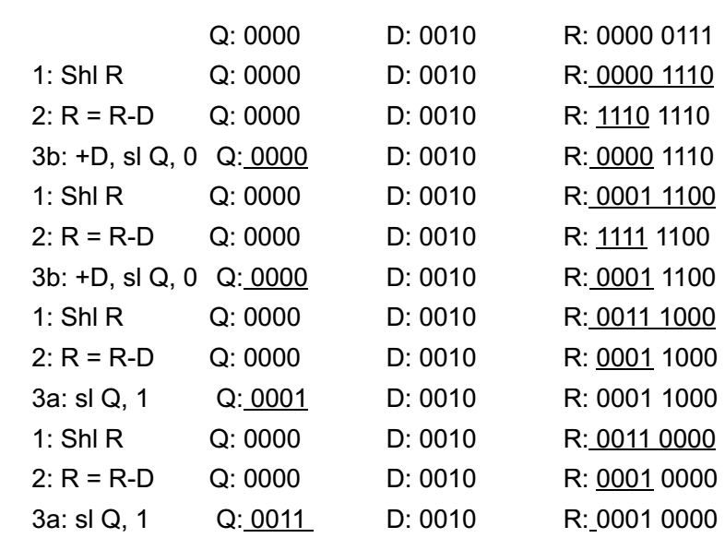
An example 7/2
2.4

Slide 42
Inspiration of the Second Division
2.4
Quotient register wastes space that exactly matches size of remainder => combine Remainder register and Quotient register by shifting quotient reg left
Beginning with shifting remainder
However a redundant shift happens as in a loop
Left half should be shift back at the end

Slide 43
The third division
2.5
Divisor
32 bits
32-bit ALU
“HI”
“LO”
Shift Left
Remainder
(Quotient)
Control
64 bits
Write
A 32-bit register for divisor
A 32-bit ALU
A 64-bit register for remainder
No specific register for quotient (0-bit)

Slide 44
Divide Algorithm V3
2.5
Start: Place Dividend in Remainder
1. Shift the Remainder register left 1 bit.
Remainder Divisor 0000 0111 0010
2. Subtract the Divisor register from the left half of the Remainder register, & place the
result in the left half of the Remainder register.
Remainder ≥ 0
Test Remainder
Remainder < 0
3a. Shift the
Remainder register
to the left setting
the new rightmost
bit to 1.
3b. Restore the original value by adding the Divisor
register to the left half of the Remainder register,
&place the sum in the left half of the Remainder
register. Also shift the Remainder register to the
left, setting the new least significant bit to 0.
nth
repetition?
No: < n repetitions
Yes: n repetitions (n = 4 here)
Done. Shift left half of Remainder right 1 bit.

Slide 45
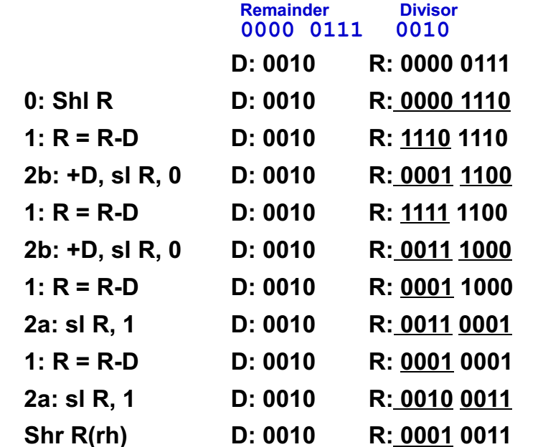
An example
2.5

Slide 46
Inspiration of the third division
2.5
The hardware of multiplication and division are identical.
A ALU to perform addition or subtraction
A 64-bit register which can be shifted to left or right.
Hi and Lo registers in MIPS can be merged together as 64-bit register for multiplication and division.
Signed division
The sign is calculated separately.
Perform unsigned division
Adjust the quotient and the remainder
The remainder must has the same sign with the dividend
Also has fast algorithm in complement form

Slide 47
An ALU with Multiplication and Division
3

Slide 48
Adder

Slide 49
MULTIPLY HARDWARE Version 3
1.5
Multiplicand
32 bits
32-bit ALU
Shift Right
Product
(Multiplier)
Control
64 bits
Write
A 32-bit multiplicand reg
A 32-bit ALU
A 64-bit product reg
No specific multiplier reg (0-bit Multiplier reg)

Slide 50
The third division
2.5
Divisor
32 bits
32-bit ALU
“HI”
“LO”
Shift Left
Remainder
(Quotient)
Control
64 bits
Write
A 32-bit register for divisor
A 32-bit ALU
A 64-bit register for remainder
No specific register for quotient (0-bit)

