Slide 1
Lecture8 Floating Point
Computer Organization and Architecture

Slide 2
Outline
Floating Point Representation
Addition
Multiply and Division
FP Instructions in MIPS
Accurate Arithmetic

Slide 3
Real Numbers in mathmetics
1.1
3.14159265…(pi)
2.71828…(e)
0.000000001 or 1.0 X 10 ⁻⁹ (seconds in a nanosecond)
3,155,760,000 0r 3.15576 X 10 ⁹ (Seconds in a typical century)
Real numbers should be support by programming language.
Scientific Notation: A notation that renders numbers with a single digit to the left of the decimal point
Normalized: A number in floating-point notation that has no leading 0s.
1.0 X 10⁻⁹ VS 0.1 X 10⁻⁸ VS 10.0 X 10⁻¹⁰
Notes:
有时，这种方式也叫做隐含的以1开头的表示 ，因为我们可以把尾数 M 看成是一个二进制表达式为：" " 的数字。为什么要用这种表示方式，既然我们总能够调整阶码 E ，使得尾数 M 在范围 之中，那么这种表示方法是一种轻松获得一个额外精度位的技巧——既然第一位总是等于1，那我们就不需要显式地表示它。
————————————————
版权声明：本文为CSDN博主「HelloAaric」的原创文章，遵循 CC 4.0 BY-SA 版权协议，转载请附上原文出处链接及本声明。
原文链接：https://blog.csdn.net/aaricyang/java/article/details/91358149

Slide 4
Floating Point
1.2
Floating point : Computer arithmetic that represents numbers in which the binary point is not fixed.

Slide 5

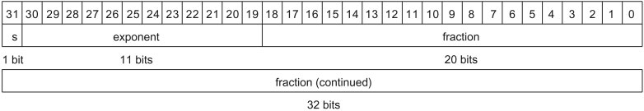
Floating Point Representation
1.2
Single Precision
Double Precision
Notes:
符号位：sign
阶码：exponent
尾数：significand/fraction
对于双精度double，组成形式是：1位符号，11位阶码，52位尾数。
对于单精度float，组成形式是：1位符号，8位阶码，23位尾数。
https://blog.csdn.net/aaricyang/article/details/91358149
此网站详细讲述了浮点格式。

Slide 6
IEEE-754 Standard
1.3
Virtually, found in every computer since 1980.
Makes the leading 1-bit of normalized binary numbers implicit.
The number is actually 24 bits long in single precision, and 53 bits long in double precision.
Biased Component (Biased Notation)
component=actual value +127(Single Precision)/ 1023(Double precision)
Notes:
Biased Notation is aimed to represent negative exponent, in which it is too complicate for complement method in floating point.
移码相对补码的优势：更加容易比较指数大小

Slide 7
Overflow and Underflow
1.3
Overflow: A situation in which a positive exponent becomes too large to fit in the exponent field. x>127 for single
Underflow: A situation in which a negative exponent becomes too large to fit the exponent field x<-126 for single
X denotes the real exponent without bias
Overflow
Underflow
Overflow
Negative
Positive
0
The minimum
negative
The minimum
Positive
The maximum
negative
The maximum
positive
Notes:
注意：上溢和下溢是根据绝对值大小，而不是正负数。

Slide 8
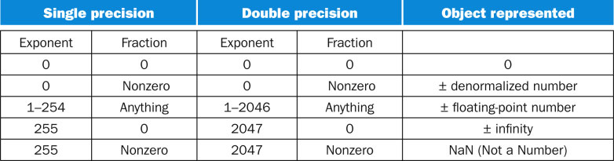

IEEE-754 Encoding
1.3
Infinity
NaN
Not 0
F(NaN)=NaN!
Notes:
举例：非规格化数？

Slide 9
Floating Point Addition- decimal example
2.1
Step1: Align the decimal point of the number that has the smaller exponent.
Step2: Perform the addition of the significands.
Step3: Adjust the result to normalized scientific notation.
Step4: Round the significand of the result to fixed digits bits (include the sign)

Slide 10
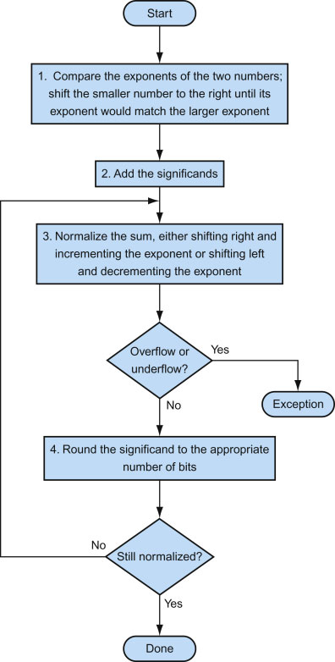
Floating Point Addition
2.2

Slide 11
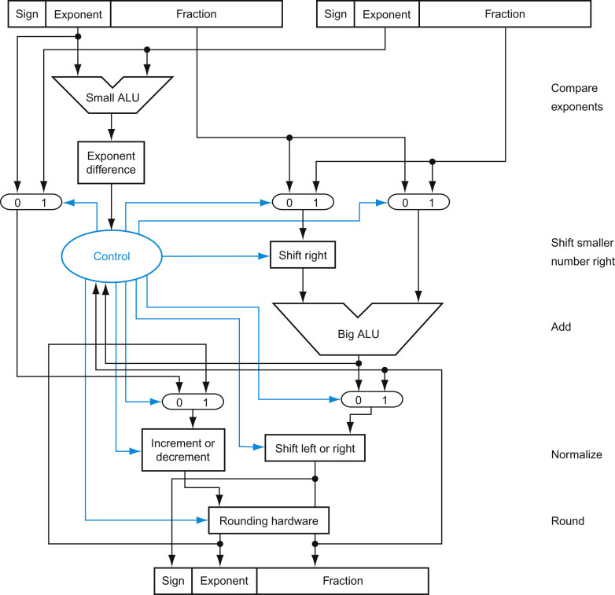
Block diagram of an arithmetic unit dedicated to floating-point addition
x = 1011000
2.3

Slide 12
Floating Point Multiplication-Example1
3.1
Consider a 4-digit decimal example
1.110 × 10¹⁰ × 9.200 × 10^{–5}
1. Add exponents
For biased exponents, subtract bias from sum
New exponent = 10 + –5 = 5
2. Multiply significands
1.110 × 9.200 = 10.212 ⇒ 10.212 × 10⁵
3. Normalize result & check for over/underflow
1.0212 × 10⁶
4. Round and renormalize if necessary
1.021 × 10⁶
5. Determine sign of result from signs of operands
+1.021 × 10⁶

Slide 13
Floating Point Multiplication-Example2
3.2
Now consider a 4-digit binary example
1.000₂ × 2^{–1} × –1.110₂ × 2^{–2} (0.5 × –0.4375)
1. Add exponents
Unbiased: –1 + –2 = –3
Biased: (–1 + 127) + (–2 + 127) -127= –3 + 254 – 127 = –3 + 127=124
2. Multiply significands
1.000₂ × 1.110₂ = 1.1102 ⇒ 1.110₂ × 2^{–3}
3. Normalize result & check for over/underflow
1.110₂ × 2^{–3} (no change) with no over/underflow
4. Round and renormalize if necessary
1.110₂ × 2^{–3} (no change)
5. Determine sign: +ve × –ve ⇒ –ve
–1.110₂ × 2^{–3} = –0.21875

Slide 14
FP Arithmetic Hardware
3.3
FP multiplier is of similar complexity to FP adder
But uses a multiplier for significands instead of an adder
FP arithmetic hardware usually does
Addition, subtraction, multiplication, division, reciprocal, square-root
FP ↔ integer conversion
Operations usually takes several cycles
Can be pipelined

Slide 15
FP Instructions in MIPS
4.1
Single-precision arithmetic
add.s, sub.s, mul.s, div.s
e.g., add.s $f0, $f1, $f6
Double-precision arithmetic
add.d, sub.d, mul.d, div.d
e.g., mul.d $f4, $f4, $f6
Single- and double-precision comparison
c.xx.s, c.xx.d (xx is eq, lt, le, …)
Sets or clears FP condition-code bit
e.g. c.lt.s $f3, $f4
Branch on FP condition code true or false
bc1t, bc1f
e.g., bc1t TargetLabel
Notes:
For double precision data, two float registers(32-bit) are combined for 1 b4-bit double precision data, such as $f2, $f3, in which it always consists of 1 even and 1 odd single precision register and labeled with the # of even, such as $f2.
Only 16 of the 32 MIPS foating-point registers could originally be used for double precision operations: $f0, $f2, $f4, ..., $f30. Double precision is computed using pairs of these single precision registers. The odd-numbered foating-point registers were used only to load and store the right half of 64-bit foating-point numbers. MIPS-32 added l.d and s.d to the instruction set. MIPS-32 also added “paired single” versions of all foating-point instructions, where a single instruction results in two parallel oating-point operations on two 32-bit operands inside 64-bit registers (see Section 3.6). For example, add.ps $f0, $f2, $f4 is equivalent to add.s $f0, $f2, $f4 followed by add.s $f1, $f3, $f5.

Slide 16
FP Example: °F to °C
4.2
C code:
float f2c (float fahr) { return ((5.0/9.0)*(fahr - 32.0)); }
fahr in $f12, result in $f0, literals in global memory space
Compiled MIPS code:
f2c: lwc1 $f16, const5($gp) lwc1 $f18, const9($gp) div.s $f16, $f16, $f18 lwc1 $f18, const32($gp) sub.s $f18, $f12, $f18 mul.s $f0, $f16, $f18 jr $ra
Notes:
Another reason for separate integers and foating-point registers is that microprocessors in the 1980s didn’t have enough transistors to put the oating-point unit on the same chip as the integer unit. Hence, the foating-point unit, including the foating-point registers, was optionally available as a second chip. Such optional accelerator chips are called coprocessors, and explain the acronym for foating-point loads in MIPS: lwc1 means load word to coprocessor 1, the foating-point unit. (Coprocessor 0 deals with virtual memory, described in Chapter 5.) Since the early 1990s, microprocessors have integrated foating point (and just about everything else) on chip, and hence the term coprocessor joins accumulator and core memory as quaint terms that date the speaker.

Slide 17
FP Example: Array Multiplication
4.2
X = X + Y × Z
All 32 × 32 matrices, 64-bit double-precision elements
C code:
void mm (double x[][], double y[][], double z[][]) { int i, j, k; for (i = 0; i! = 32; i = i + 1) for (j = 0; j! = 32; j = j + 1) for (k = 0; k! = 32; k = k + 1) x[i][j] = x[i][j] + y[i][k] * z[k][j]; }
Addresses of x, y, z in $a0, $a1, $a2, and i, j, k in $s0, $s1, $s2

Slide 18
FP Example: Array Multiplication
4.2
MIPS code (only shows partial data loading):
li $t1, 32 # $t1 = 32 (row size/loop end) li $s0, 0 # i = 0; initialize 1st for loop L1: li $s1, 0 # j = 0; restart 2nd for loop L2: li $s2, 0 # k = 0; restart 3rd for loop sll $t2, $s0, 5 # $t2 = i * 2⁵ (size of row of x) addu $t2, $t2, $s1 # $t2 = i * size(row) + j sll $t2, $t2, 3 # $t2 = byte offset of [i][j] addu $t2, $a0, $t2 # $t2 = byte address of x[i][j] l.d $f4, 0($t2) # $f4 = 8 bytes of x[i][j] L3: sll $t0, $s2, 5 # $t0 = k * 32 (size of row of z) addu $t0, $t0, $s1 # $t0 = k * size(row) + j sll $t0, $t0, 3 # $t0 = byte offset of [k][j] addu $t0, $a2, $t0 # $t0 = byte address of z[k][j] l.d $f16, 0($t0) # $f16 = 8 bytes of z[k][j] …
Notes:
Memory is organized with linear address in one dimension although array can be index with more than 1 or 2 dimensions.
The array layout discussed in the example, called row-major order, is used by C and many other programming languages. Fortran instead uses column-major order, whereby the array is stored column by column.
Somehow, in this slide, l.d is ldc1 just as the table shown in pre-page.

Slide 19
FP Example: Array Multiplication
4.2
MIPS code (also parts):
sll $t0, $s0, 5 # $t0 = i * 32 (size of row of z) addu $t0, $t0, $s2 # $t0 = i * size(row) + k sll $t0, $t0, 3 # $t0 = byte offset of [i][k] addu $t0, $a1, $t0 # $t0 = byte address of [i][k] l.d $f18, 0($t0) # $f18 = 8 bytes of y[i][k]
mul.d $16, $f18, $f16 #$f16=y[i][k]*z[k][j]
add.d $f4, $f4, $f16 #$f4=x[i][j]+y[i][k]*z[k][j]
addiu $s2, $s2, 1 #$k = k + 1
bne $s2, $t1, L3 #if (k != 32) go to L3
s.d $f4, 0($t2) #store x[i][j]=$f4
addiu $s1, $s1, 1 #$j = j + 1
bne $s1, $t1, L2 #if (j != 32) go to L2
addiu $s0, $s0, 1 #$i = i + 1
bne $s0, $t1, L1 #if (i != 32) go to L1
Notes:
Memory is organized with linear address in one dimension although array can be index with more than 1 or 2 dimensions.

Slide 20
Accurate Arithmetic
5
IEEE Std 754 specifies additional rounding control
Extra bits of precision (guard, round, sticky)
Choice of rounding modes
Allows programmer to fine-tune numerical behavior of a computation
Not all FP units implement all options
Most programming languages and FP libraries just use defaults
Trade-off between hardware complexity, performance, and market requirements

Slide 21
The revised IEEE 754-2008 standard added a 16-bit foating-point format with 5 exponent bits. What do you think is the likely range of numbers it could represent?
1.0000 00x2⁰ to 1.1111 1111 11x2³¹, 0
1.0000 0000 0x2⁻¹⁴ to 1.1111 1111 1x2¹⁵, 0, +∞, - ∞ , NaN
1.0000 0000 00x2⁻¹⁴ to 1.1111 1111 11x2¹⁵, 0, +∞, - ∞ ,NaN
1.0000 0000 00x2⁻¹⁵ to 1.1111 1111 11x2¹⁴, 0, +∞, - ∞ , NaN
Notes:
Answer 3
Bias

Slide 22
Shifters

Slide 23
Shifters
Two kinds:
logical-- value shifted in is always "0"
arithmetic-- on right shifts, sign extend
"0"
msb
lsb
"0"
msb
lsb
"0"
Note: these are single bit shifts. A given instruction might request 0 to 32 bits to be shifted!

Slide 24
Combinational Shifter from MUXes
Basic Building Block
A
B
sel
1
0
D
8-bit right shifter
A₇
A₆
A₅
A₄
A₃
A₂
A₁
A₀
S₂ S₁ S₀
1
0
1
0
1
0
1
0
1
0
1
0
1
0
1
0
1
0
1
0
1
0
1
0
1
0
1
0
1
0
1
0
1
0
1
0
1
0
1
0
1
0
1
0
1
0
1
0
R₇
R₆
R₅
R₄
R₃
R₂
R₁
R₀
What comes in the MSBs?
How many levels for 32-bit shifter?
What if we use 4-1 Muxes ?
Notes:
1) 0, MSB of muxes should be grounded.
2) 6 levels
3)

Slide 25
General Shift Right Scheme using 16 bit example
S 0
(0,1)
S 1
(0, 2)
S 2
(0, 4)
S 3
(0, 8)
If added Right-to-left connections could
support Rotate (not in MIPS but found in ISAs)

Slide 26
Funnel Shifter
Instead Extract 32 bits of 64.
Y
X
Shift Right
R
Shift A by i bits (sa= shift right amount)
Logical: Y = 0, X=A, sa=i
Arithmetic? Y = _, X=_, sa=_
Rotate? Y = _, X=_, sa=_
Left shifts? Y = _, X=_, sa=_
Y
X
32
32
Shift Right
32
R
Notes:
Logical: Y = 0
Arithmetic: Y = sign(X)
Rotate: Y = X
What about left shifts?
Load Value into Y, 0 into X
Just do 32 - i with right shift

Slide 27
Barrel Shifter
Technology-dependent solutions: transistor per switch
SR3
SR2
SR1
SR0
D3
D2
A6
D1
A5
D0
A4
A3
A2
A1
A0
Notes:
Ai are data input
Di are output
SRi are control lines that make connection
Can do N x N shifter in N**2 transistors: 32x32 = 1024 transistors
Simplicity lead to inclusion even if large shifts are rare

