Slide 1
Lecture11 Single Cycle CPU – Control Path
Computer Organization and Architecture

Slide 2
Outline
Recap design steps (5 steps)
Recap Single Cycle Data Path and analyze Control Signals
Implementations
Evaluation and Analyzing
Summary

Slide 3
Where are we now?
1.1
The Five Classic Components of a Computer
Processor
Input
Control
Memory
Datapath
Output
Today's Topic: Design a Single Cycle Processor

Slide 4
Recap: Summary from last time
1.2
5 steps to design a processor
  1. Analyze instruction set => datapath requirements
  2. Select set of datapath components & establish clock methodology
  3. Assemble datapath meeting the requirements
  4. Analyze implementation of each instruction to determine setting of control points that effects the register transfer.
  5. Assemble the control logic
MIPS makes it easier
  Instructions same size
  Source registers always in same place
  Immediates same size, location
  Operations always on registers/immediates
Single cycle datapath ⇒ CPI=1, Cycle Time = long!

Slide 5
Recap: The MIPS Instruction Formats
2.1
All MIPS instructions are 32 bits long. The three instruction formats:
  R-type
  I-type
  J-type
The different fields are:
  op: operation of the instruction
  rs, rt, rd: the source and destination register specifiers
  shamt: shift amount
  funct: selects the variant of the operation in the “op” field
  address / immediate: address offset or immediate value
  target address: target address of the jump instruction
31
26
21
16
11
6
0
op
rs
rt
rd
shamt
funct
6 bits
5 bits
5 bits
5 bits
5 bits
6 bits
31
26
21
16
0
op
rs
rt
immediate
6 bits
5 bits
5 bits
16 bits
31
26
0
op
target address
6 bits
26 bits

Slide 6
Recap: The MIPS Instruction Formats
2.1
All MIPS instructions are 32 bits long. The three instruction formats:
  R-type
  I-type
  J-type
31
26
21
16
11
6
0
op
rs
rt
rd
shamt
funct
6 bits
5 bits
5 bits
5 bits
5 bits
6 bits
31
26
21
16
0
op
rs
rt
immediate
6 bits
5 bits
5 bits
16 bits
31
26
0
op
target address
6 bits
26 bits

Slide 7
An Abstract View of the Implementation
2.2
Control
Ideal
Instruction
Memory
Instruction
Control Signals
Conditions
Rd
Rs
Rt
5
5
5
Instruction
Address
A
Data
Address
Rw
Ra
Rb
32
Data
Out
32
32
Ideal
Data
Memory
32 32-bit
Registers
ALU
PC
Next Address
Data In
B
Clk
32
Clk
Clk
Datapath

Slide 8
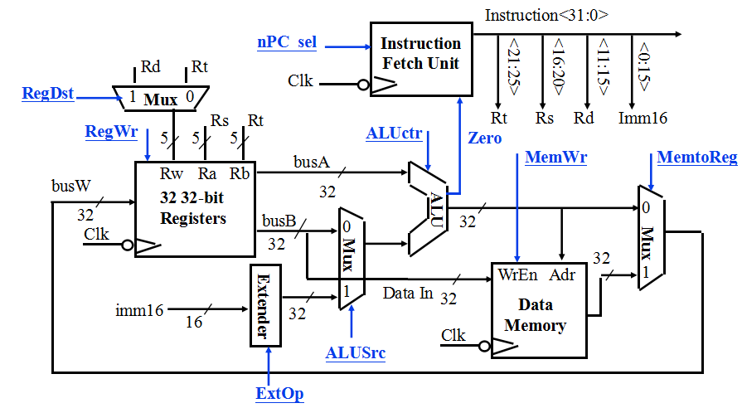
Recap: A Single Cycle Datapath
2.3
Rs, Rt, Rd and Imed16 hardwired into datapath from Fetch Unit
We have everything except control signals (underline)
  Today’s lecture will show you how to generate the control signals

Slide 9
Recap: Meaning of the Control Signals
2.4
nPC_MUX_sel: 0 ⇒ PC <– PC + 4
1 ⇒ PC <– PC + 4 + SignExt(Im16) || 00
Later in lecture: higher-level connection between mux and branch cond
nPC_MUX_sel
Inst
Memory
4
Adr
Adder
00
Mux
PC
Adder
Clk
imm16
PC Ext

Slide 10
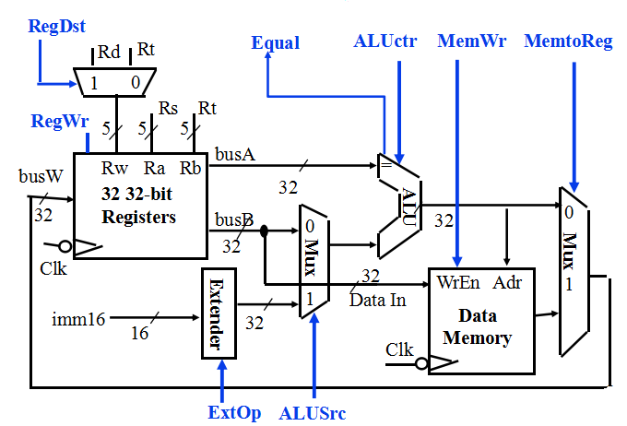
Recap: Meaning of the Control Signals
2.5
ExtOp: “zero”, “sign”
ALUsrc: 0 ⇒ regB; 1 ⇒ immed
ALUctr: “add”, “sub”, “or”
MemWr: 1 ⇒ write memory
MemtoReg: 0 ⇒ ALU; 1 ⇒ Mem
RegDst: 0 ⇒ “rt”; 1 ⇒ “rd”
RegWr: 1 ⇒ write register

Slide 11
RTL: The Add Instruction
x = 1011000
2.6
31
26
21
16
11
6
0
op
rs
rt
rd
shamt
funct
6 bits
5 bits
5 bits
5 bits
5 bits
6 bits
add rd, rs, rt
  mem[PC] Fetch the instruction from memory
  R[rd] <- R[rs] + R[rt] The actual operation
  PC <- PC + 4 Calculate the next instruction’s address

Slide 12
Instruction Fetch Unit at the Beginning of Add
2.7
Fetch the instruction from Instruction memory: Instruction <- mem[PC]
  This is the same for all instructions
Inst
Memory
Instruction<31:0>
Adr
nPC_MUX_sel
4
Adder
00
Mux
PC
Adder
Clk
imm16
PC Ext

Slide 13
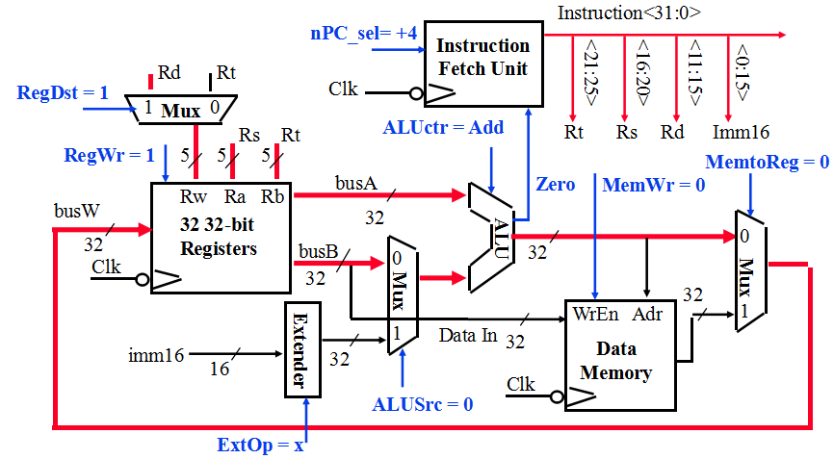
The Single Cycle Datapath during Add
2.8
31
26
21
16
11
6
0
op
rs
rt
rd
shamt
funct
R[rd] <- R[rs] + R[rt]

Slide 14
Instruction Fetch Unit at the End of Add
2.9
Instruction Fetch Unit at the End of Add
PC <- PC + 4
  This is the same for all instructions except: Branch and Jump
Inst
Memory
Instruction<31:0>
Adr
nPC_MUX_sel
4
Adder
0
00
Mux
PC
1
Adder
Clk
imm16

Slide 15
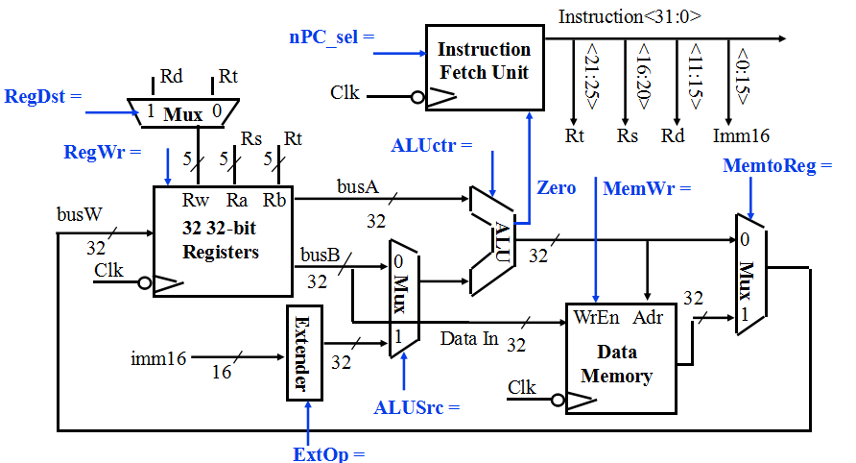
The Single Cycle Datapath during Or Immediate
2.10
31
26
21
16
0
op
rs
rt
immediate
R[rt] <- R[rs] or ZeroExt[Imm16]

Slide 16
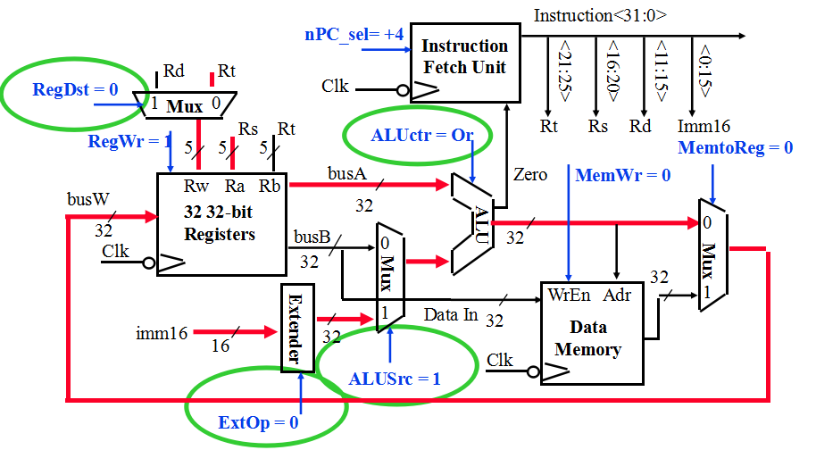
The Single Cycle Datapath during Or Immediate
3
31
26
21
16
0
op
rs
rt
immediate
R[rt] <- R[rs] or ZeroExt[Imm16]

Slide 17
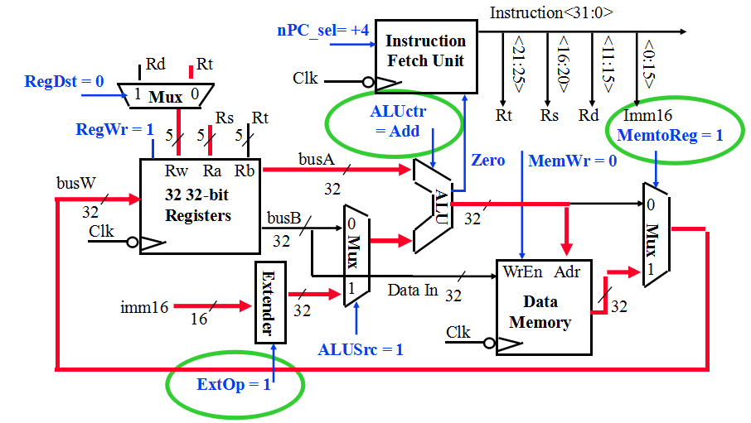
The Single Cycle Datapath during Load
3.1
31
26
21
16
0
op
rs
rt
immediate
R[rt] <- Data Memory {R[rs] + SignExt[imm16]}

Slide 18
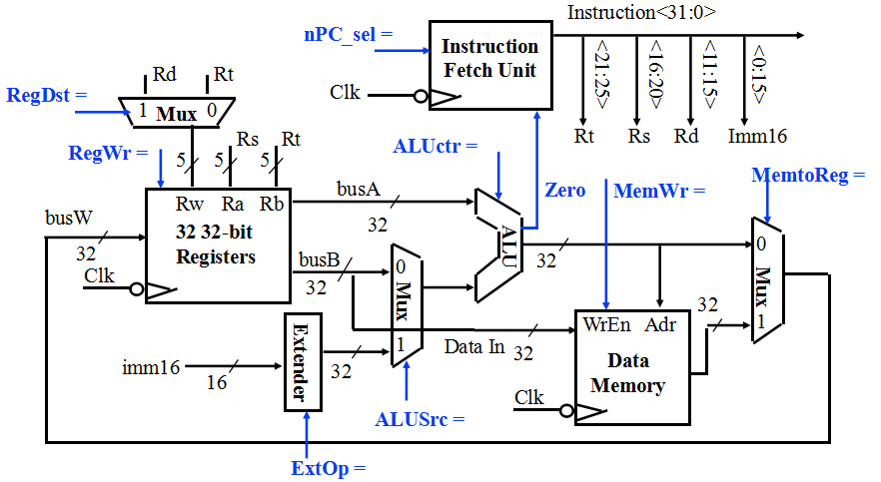
The Single Cycle Datapath during Store
3.2
31
26
21
16
0
op
rs
rt
immediate
Data Memory {R[rs] + SignExt[imm16]} <- R[rt]

Slide 19
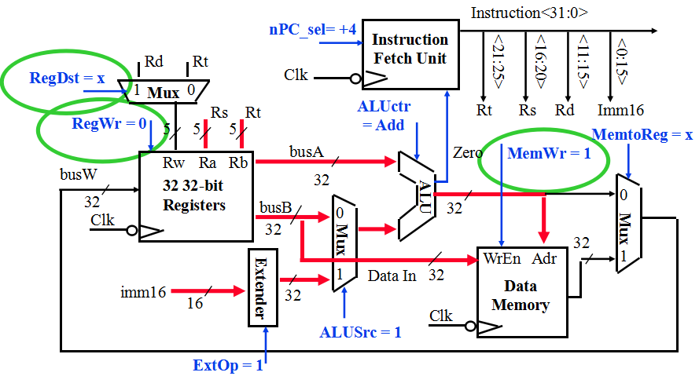
The Single Cycle Datapath during Store
3.2
31
26
21
16
0
op
rs
rt
immediate
Data Memory {R[rs] + SignExt[imm16]} <- R[rt]

Slide 20
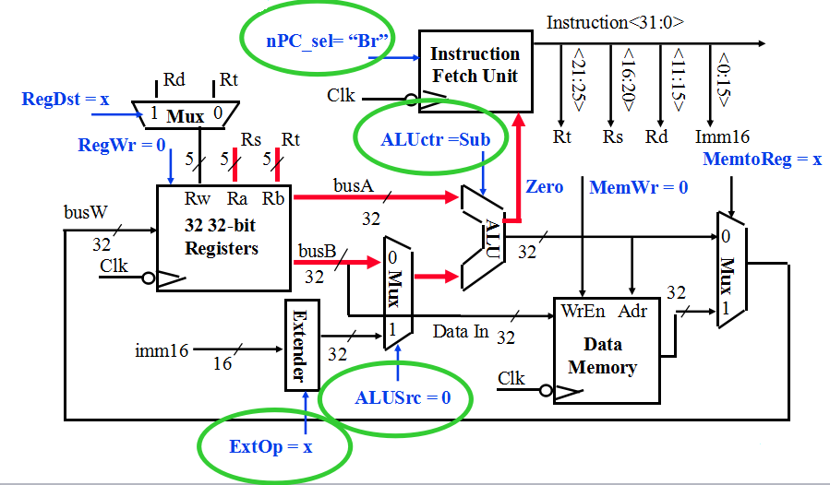
The Single Cycle Datapath during Branch
4
31
26
21
16
0
op
rs
rt
immediate
if (R[rs] - R[rt] == 0) then Zero <- 1 ; else Zero <- 0

Slide 21
Instruction Fetch Unit at the End of Branch
5.1
31
26
21
16
0
op
rs
rt
immediate
if (Zero == 1) then PC = PC + 4 + SignExt[imm16]*4 ; else PC = PC + 4
Inst
Memory
Instruction<31:0>
nPC_sel
Adr
Zero
What is encoding of nPC_sel?
  Direct MUX select?
  Branch / not branch
Let’s choose second option
nPC_MUX_sel
4
Adder
0
00
Mux
PC
1
Adder
Clk
imm16

Slide 22
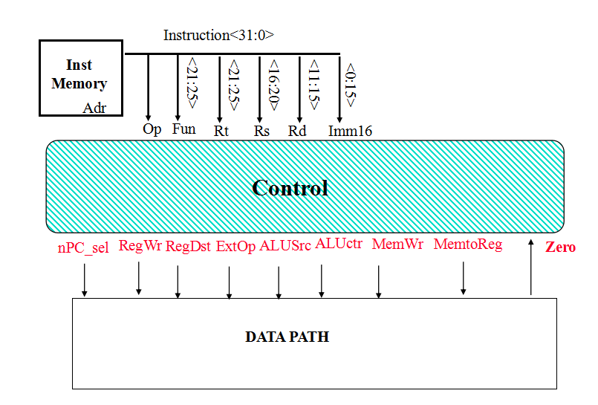
Step 4: Given Datapath: RTL -> Control
5.2

Slide 23
A Summary of Control Signals
6.1
inst Register Transfer
ADD R[rd] <– R[rs] + R[rt]; PC <– PC + 4
ALUsrc = RegB, ALUctr = “add”, RegDst = rd, RegWr, nPC_sel = “+4”
SUB R[rd] <– R[rs] – R[rt]; PC <– PC + 4
ALUsrc = RegB, ALUctr = “sub”, RegDst = rd, RegWr, nPC_sel = “+4”
ORi R[rt] <– R[rs] + zero_ext(Imm16); PC <– PC + 4
ALUsrc = Im, Extop = “Z”, ALUctr = “or”, RegDst = rt, RegWr, nPC_sel = “+4”
LOAD R[rt] <– MEM[ R[rs] + sign_ext(Imm16)]; PC <– PC + 4
ALUsrc = Im, Extop = “Sn”, ALUctr = “add”, MemtoReg, RegDst = rt, RegWr, nPC_sel = “+4”
STORE MEM[ R[rs] + sign_ext(Imm16)] <– R[rs]; PC <– PC + 4
ALUsrc = Im, Extop = “Sn”, ALUctr = “add”, MemWr, nPC_sel = “+4”
BEQ if ( R[rs] == R[rt] ) then PC <– PC + sign_ext(Imm16)] || 00 else PC <– PC + 4
nPC_sel = “Br”, ALUctr = “sub”
SLT if R[rs]< R[rt] then R[rd] = 1 PC <– PC + 4 else R[rd] = [0] PC <– PC + 4
ALUsrc=RegB, ALUctr=“slt”, RegDst=rd, RegWr, nPC_sel=“+4”

Slide 24
A Summary of the Control Signals
6.1
See
func
10 0000
10 0010
We Don’t Care :-)
10 1010
Appendix A
op
00 0000
00 0000
00 1101
10 0011
10 1011
00 0100
00 0010
00 0000
add
sub
ori
lw
sw
beq
jump
slt
RegDst
1
1
0
0
x
x
x
ALUSrc
0
0
1
1
1
0
x
Same to sub
MemtoReg
0
0
0
1
x
x
x
RegWrite
1
1
1
1
0
0
0
MemWrite
0
0
0
0
1
0
0
nPCsel
0
0
0
0
0
1
0
Jump
0
0
0
0
0
0
1
ExtOp
x
x
0
1
1
x
x
ALUop<N:0>
Add
Subtract
Or
Add
Add
Subtract
xxx
31
26
21
16
11
6
0
R-type
op
rs
rt
rd
shamt
funct
add, sub
I-type
op
rs
rt
immediate
ori, lw, sw, beq
J-type
op
target address
jump

Slide 25
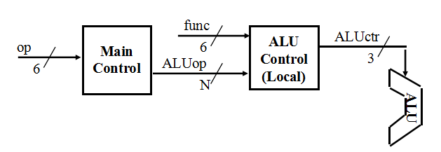
The Concept of Local Decoding
6.2
op
00 0000
00 1101
10 0011
10 1011
00 0100
00 0010
R-type
ori
lw
sw
beq
jump
RegDst
1
0
0
x
x
x
ALUSrc
0
1
1
1
0
x
MemtoReg
0
0
1
x
x
x
RegWrite
1
1
1
0
0
0
MemWrite
0
0
0
1
0
0
Branch
0
0
0
0
1
0
Jump
0
0
0
0
0
1
ExtOp
x
0
1
1
x
x
ALUop<N:0>
“R-type”
Or
Add
Add
Subtract
xxx

Slide 26
The Encoding of ALUop
6.3
func
op
Main
Control
6
ALU
Control
(Local)
ALUctr
6
ALUop
3
N
In this exercise, ALUop has to be 2 bits wide to represent:
  (1) “R-type” instructions
  “I-type” instructions that require the ALU to perform:
    (2) Or, (3) Add, and (4) Subtract
To implement the full MIPS ISA, ALUop has to be 3 bits to represent:
  (1) “R-type” instructions
  “I-type” instructions that require the ALU to perform:
    (2) Or, (3) Add, (4) Subtract, and (5) And (Example: andi)
R-type
ori
lw
sw
beq
jump
ALUop (Symbolic)
“R-type”
Or
Add
Add
Subtract
xxx
ALUop<2:0>
1 00
0 10
0 00
0 00
0 01
xxx

Slide 27
The Decoding of the “func” Field
6.3
func
op
Main
Control
6
ALU
Control
(Local)
ALUctr
6
ALUop
3
N
R-type
ori
lw
sw
beq
jump
ALUop (Symbolic)
“R-type”
Or
Add
Add
Subtract
xxx
ALUop<2:0>
1 00
0 10
0 00
0 00
0 01
xxx
31
26
21
16
11
6
0
R-type
op
rs
rt
rd
shamt
funct
P. 286 text:
funct<5:0>
Instruction Operation
ALUctr
ALUctr<2:0>
ALU Operation
10 0000
add
000
And
10 0010
subtract
001
Or
10 0100
and
ALU
010
Add
10 0101
or
110
Subtract
10 1010
set-on-less-than
111
Set-on-less-than

Slide 28
The Truth Table for ALUctr
6.4
funct<3:0>
Instruction Op.
0000
add
ALUop
(Symbolic)
R-type
ori
lw
sw
beq
0010
subtract
“R-type”
Or
Add
Add
Subtract
0100
and
ALUop<2:0>
1 00
0 10
0 00
0 00
0 01
0101
or
1010
set-on-less-than
ALUop
func
ALU
Operation
ALUctr
bit<2>
bit<1>
bit<0>
bit<3>
bit<2>
bit<1>
bit<0>
bit<2>
bit<1>
bit<0>
0
0
0
x
x
x
x
Add
0
1
0
0
x
1
x
x
x
x
Subtract
1
1
0
0
1
x
x
x
x
x
Or
0
0
1
1
x
x
0
0
0
0
Add
0
1
0
1
x
x
0
0
1
0
Subtract
1
1
0
1
x
x
0
1
0
0
And
0
0
0
1
x
x
0
1
0
1
Or
0
0
1
1
x
x
1
0
1
0
Set on <
1
1
1

Slide 29
The Logic Equation for ALUctr<2>
6.5
ALUop
func
bit<2>
bit<1>
bit<0>
bit<3>
bit<2>
bit<1>
bit<0>
ALUctr<2>
0
x
1
x
x
x
x
1
1
x
x
0
0
1
0
1
1
x
x
1
0
1
0
1
This makes func<3> a don’t care
ALUctr<2> = !ALUop<2> & ALUop<0> +
  ALUop<2> & !func<2> & func<1> & !func<0>

Slide 30
The Logic Equation for ALUctr<1>
6.5
ALUop
func
bit<2>
bit<1>
bit<0>
bit<3>
bit<2>
bit<1>
bit<0>
ALUctr<1>
0
0
0
x
x
x
x
1
0
x
1
x
x
x
x
1
1
x
x
0
0
0
0
1
1
x
x
0
0
1
0
1
1
x
x
1
0
1
0
1
ALUctr<1> = !ALUop<2> & !ALUop<1> +
  ALUop<2> & !func<2> & !func<0>

Slide 31
The Logic Equation for ALUctr<0>
7
ALUop
func
bit<2>
bit<1>
bit<0>
bit<3>
bit<2>
bit<1>
bit<0>
ALUctr<0>
0
1
x
x
x
x
x
1
1
x
x
0
1
0
1
1
1
x
x
1
0
1
0
1
ALUctr<0> = !ALUop<2> & ALUop<1>
  + ALUop<2> & !func<3> & func<2> & !func<1> & func<0>
  + ALUop<2> & func<3> & !func<2> & func<1> & !func<0>

Slide 32
The ALU Control Block
7.1
func
6
ALU
Control
(Local)
ALUctr
ALUop
3
3
ALUctr<2> = !ALUop<2> & ALUop<0> +
  ALUop<2> & !func<2> & func<1> & !func<0>
ALUctr<1> = !ALUop<2> & !ALUop<1> + !ALUop<2> +
  ALUop<2> & !func<2> & !func<0>
ALUctr<0> = !ALUop<2> & ALUop<1>
  + ALUop<2> & !func<3> & func<2> & !func<1> & func<0>
  + ALUop<2> & func<3> & !func<2> & func<1> & !func<0>

Slide 33
Step 5: Logic for each control signal
7.2
nPC_sel <= if (OP == BEQ) then “Br” else “+4”
ALUsrc <= if (OP == “Rtype”) then “regB” else “immed”
ALUctr <= if (OP == “Rtype”) then funct elseif (OP == ORi) then “OR” elseif (OP == BEQ) then “sub” else “add”
ExtOp <= _____________
MemWr <= _____________
MemtoReg <= _____________
RegWr: <=_____________
RegDst: <= _____________

Slide 34
Step 5: Logic for each control signal
nPC_sel <= if (OP == BEQ) then “Br” else “+4”
ALUsrc <= if (OP == “Rtype”) then “regB” else “immed”
ALUctr <= if (OP == “Rtype”) then funct elseif (OP == ORi) then “OR” elseif (OP == BEQ) then “sub” else “add”
ExtOp <= if (OP == ORi) then “zero” else “sign”
MemWr <= (OP == Store)
MemtoReg <= (OP == Load)
RegWr: <= if ((OP == Store) || (OP == BEQ)) then 0 else 1
RegDst: <= if ((OP == Load) || (OP == ORi)) then 0 else 1

Slide 35
The “Truth Table” for the Main Control
RegDst
func
ALUSrc
ALU
Control
(Local)
ALUctr
op
Main
Control
:
6
3
6
ALUop
3
op
00 0000
00 1101
10 0011
10 1011
00 0100
00 0010
R-type
ori
lw
sw
beq
jump
RegDst
1
0
0
x
x
x
ALUSrc
0
1
1
1
0
x
MemtoReg
0
0
1
x
x
x
RegWrite
1
1
1
0
0
0
MemWrite
0
0
0
1
0
0
nPC_sel
0
0
0
0
1
0
Jump
0
0
0
0
0
1
ExtOp
x
0
1
1
x
x
ALUop (Symbolic)
“R-type”
Or
Add
Add
Subtract
xxx
ALUop <2>
1
0
0
0
0
x
ALUop <1>
0
1
0
0
0
x
ALUop <0>
0
0
0
0
1
x

Slide 36
The “Truth Table” for RegWrite
op
00 0000
00 1101
10 0011
10 1011
00 0100
00 0010
R-type
ori
lw
sw
beq
jump
RegWrite
1
1
1
0
0
0
RegWrite = R-type + ori + lw
  = !op<5> & !op<4> & !op<3> & !op<2> & !op<1> & !op<0> (R-type)
  + !op<5> & !op<4> & op<3> & op<2> & !op<1> & op<0> (ori)
  + op<5> & !op<4> & !op<3> & !op<2> & op<1> & op<0> (lw)
.
.
.
.
.
.
op<5>
.
op<5>
.
op<5>
.
op<5>
.
op<5>
.
op<5>
.
<0>
<0>
<0>
<0>
<0>
op<0>
R-type
ori
lw
sw
beq
jump
RegWrite

Slide 37
PLA Implementation of the Main Control
.
.
.
.
.
.
op<5>
.
op<5>
.
op<5>
.
op<5>
.
op<5>
.
op<5>
.
<0>
<0>
<0>
<0>
<0>
op<0>
R-type
ori
lw
sw
beq
jump
RegWrite
ALUSrc
RegDst
MemtoReg
MemWrite
Branch
Jump
ExtOp
ALUop<2>
ALUop<1>
ALUop<0>

Slide 38
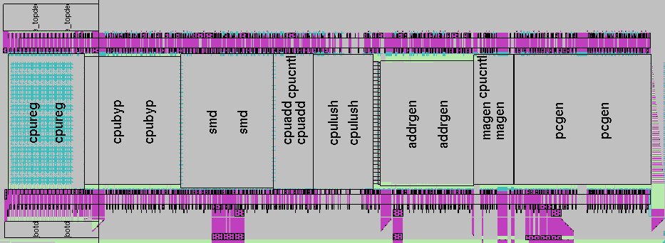
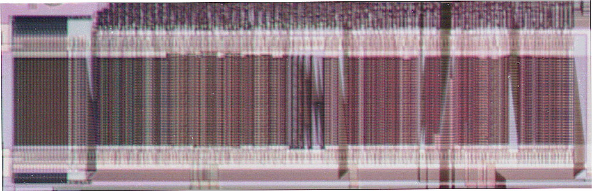
A Real MIPS Datapath (CNS T0)

Slide 39
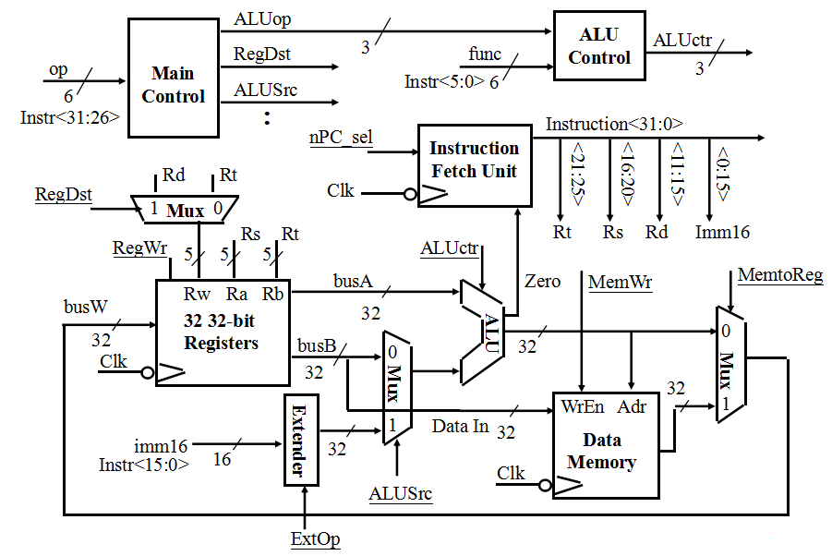
Putting it All Together: A Single Cycle Processor

Slide 40
Recap: An Abstract View of the Critical Path (Load)
Register file and ideal memory:
  The CLK input is a factor ONLY during write operation
  During read operation, behave as combinational logic:
    Address valid => Output valid after “access time.”
Critical Path (Load Operation) =
PC’s Clk-to-Q +
Instruction Memory’s Access Time +
Register File’s Access Time +
ALU to Perform a 32-bit Add +
Data Memory Access Time +
Setup Time for Register File Write +
Clock Skew
Ideal
Instruction
Memory
Instruction
Rd
Rs
Rt
Imm
5
5
5
16
Instruction
Address
A
Data
Address
Rw
Ra
Rb
32
32
32
Ideal
Data
Memory
32 32-bit
Registers
ALU
PC
Next Address
Data In
B
Clk
Clk
Clk
32

Slide 41
Worst Case Timing (Load)
Clk
Clk-to-Q
PC
Old Value
New Value
Instruction Memory Access Time
Rs, Rt, Rd,
Op, Func
Old Value
New Value
Delay through Control Logic
ALUctr
Old Value
New Value
ExtOp
Old Value
New Value
ALUSrc
Old Value
New Value
MemtoReg
Old Value
New Value
Register
Write Occurs
RegWr
Old Value
New Value
Register File Access Time
busA
Old Value
New Value
Delay through Extender & Mux
busB
Old Value
New Value
ALU Delay
Address
Old Value
New Value
Data Memory Access Time
busW
Old Value
New

Slide 42
Drawback of this Single Cycle Processor
Long cycle time:
  Cycle time must be long enough for the load instruction:
    PC’s Clock -to-Q +
    Instruction Memory Access Time +
    Register File Access Time +
    ALU Delay (address calculation) +
    Data Memory Access Time +
    Register File Setup Time +
    Clock Skew
Cycle time for load is much longer than needed for all other instructions

Slide 43
Preview
Next Time: MultiCycle Data Path
  CPI ≥ 1, CycleTime much shorter (~1/5 of time)

Slide 44
Summary
Single cycle datapath => CPI=1, CCT => long
5 steps to design a processor
  1. Analyze instruction set => datapath requirements
  2. Select set of datapath components & establish clock methodology
  3. Assemble datapath meeting the requirements
  4. Analyze implementation of each instruction to determine setting of control points that effects the register transfer.
  5. Assemble the control logic
Control is the hard part
MIPS makes control easier
  Instructions same size
  Source registers always in same place
  Immediates same size, location
  Operations always on registers/immediates
Processor
Input
Control
Memory
Datapath
Output

