Slide 1
Lecture 19 Input/Output
Computer Organization and Architecture

Slide 2
Recap: What is virtual memory?
Virtual
Address Space
Physical
Address Space
Virtual Address
10
V page no.
offset
Page Table
Page Table
Base Reg
V
Access
Rights
PA
index
into
page
table
table located
in physical
memory
P page no.
offset
10
Physical Address
Virtual memory => treat memory as a cache for the disk
Terminology: blocks in this cache are called “Pages”
Typical size of a page: 1K — 8K
Page table maps virtual page numbers to physical frames
“PTE” = Page Table Entry

Slide 3
Recap: Implementing Large Page Tables
Two-level Page Tables
1K
PTEs
32-bit address:
4KB
10
10
12
P1 index
P2 index
page offest
4 bytes
° 4 GB virtual address space
° 4 MB of PTE2
– paged, holes
° 4 KB of PTE1
4 bytes
What about a 48-64 bit address space?

Slide 4
Recap: Making address translation practical: TLB
Virtual memory => memory acts like a cache for the disk
Page table maps virtual page numbers to physical frames
Translation Look-aside Buffer (TLB) is a cache translations
virtual address
Virtual
Address Space
Physical
Memory Space
page
off
Page Table
2
0
1
3
physical address
TLB
page
off
frame
page
2
2
0
5

Slide 5
TLB organization: include protection
Virtual Address Physical Address Dirty Ref Valid Access ASID
0xFA00 0x0003 Y N Y R/W 34
0xFA00 0x0003 Y N Y R/W 34 0x0040 0x0010 N Y Y R 0 0x0041 0x0011 N Y Y R 0
TLB usually organized as fully-associative cache
Lookup is by Virtual Address
Returns Physical Address + other info
Dirty => Page modified (Y/N)? Ref => Page touched (Y/N)? Valid => TLB entry valid (Y/N)? Access => Read? Write? ASID => Which User?

Slide 6
Example: R3000 pipeline includes TLB stages
MIPS R3000 Pipeline
Inst Fetch
Dcd/ Reg
ALU / E.A
Memory
Write Reg
TLB I-Cache RF Operation WB
E.A. TLB D-Cache
TLB
64 entry, on-chip, fully associative, software TLB fault handler
Virtual Address Space
ASID
V. Page Number
Offset
6
20
12
0xx User segment (caching based on PT/TLB entry)
100 Kernel physical space, cached
101 Kernel physical space, uncached
11x Kernel virtual space
Allows context switching among
64 user processes without TLB flush

Slide 7
What is the replacement policy for TLBs?
On a TLB miss, we check the page table for an entry. Two architectural possibilities:
Hardware “table-walk” (Sparc, among others)
Structure of page table must be known to hardware
Software “table-walk” (MIPS was one of the first)
Lots of flexibility
Can be expensive with modern operating systems.
What if missing Entry is not in page table?
This is called a “Page Fault” ⇒ requested virtual page is not in memory
Operating system must take over
pick a page to discard (possibly writing it to disk)
start loading the page in from disk
schedule some other process to run
Note: possible that parts of page table are not even in memory (I.e. paged out!)
The root of the page table always “pegged” in memory

Slide 8
Page Replacement: Not Recently Used (1-bit LRU, Clock)
Tail pointer:
Mark pages as “not used recently
Set of all pages
in Memory
Freelist
Head pointer: Place pages on free list if they are still marked as “not used”. Schedule dirty pages for writing to disk
Free Pages

Slide 9
Page Replacement: Not Recently Used (1-bit LRU, Clock)
Associated with each page is a “used” flag such that
used flag = 1 if the page has been referenced in recent past
= 0 otherwise
-- if replacement is necessary, choose any page frame such that its
reference bit is 0. This is a page that has not been referenced in the
recent past
dirty
used
page fault handler:
1 0
page table entry
last replaced pointer (lrp)
if replacement is to take place,
advance lrp to next entry (mod
table size) until one with a 0 bit
is found; this is the target for
replacement; As a side effect,
all examined PTE's have their
used bits set to zero.
1 0
page
table
entry
0 1
1 1
0 0
Or search for the a page that is both
not recently referenced AND not dirty.
Architecture part: support dirty and used bits in the page table
=> may need to update PTE on any instruction fetch, load, store
How does TLB affect this design problem? Software TLB miss?

Slide 10
Reducing translation time further
As described, TLB lookup is in serial with cache lookup:
Machines with TLBs go one step further: they overlap TLB lookup with cache access.
Works because lower bits of result (offset) available early
Virtual Address
10
V page no.
offset
TLB Lookup
V
Access
Rights
PA
P page no.
offset
10
Physical Address

Slide 11
Overlapped TLB & Cache Access
If we do this in parallel, we have to be careful, however:
TLB
assoc
lookup
4K Cache
index
1 K
32
20
10
2
4 bytes
page #
disp
00
Hit/
Miss
FN
=
FN
Data
Hit/
Miss
What if cache size is increased to 8KB?

Slide 12
Problems With Overlapped TLB Access
Overlapped access only works as long as the address bits used to
index into the cache do not change as the result of VA translation
This usually limits things to small caches, large page sizes, or high
n-way set associative caches if you want a large cache
Example: suppose everything the same except that the cache is
increased to 8 K bytes instead of 4 K:
11
2
cache
index
00
This bit is changed
by VA translation, but
is needed for cache
lookup
20
12
virt page #
disp
Solutions:
go to 8K byte page sizes;
go to 2 way set associative cache; or
SW guarantee VA[13]=PA[13]
1K
2 way set assoc cache
10
4
4

Slide 13
Another option: Virtually Addressed Cache
VA
Trans-
lation
PA
Main
Memory
CPU
Cache
hit
data
Only require address translation on cache miss!
synonym problem: two different virtual addresses map to same
physical address => two different cache entries holding data for
the same physical address!
nightmare for update: must update all cache entries with same
physical address or memory becomes inconsistent

Slide 14
Cache Optimization: Alpha 21064
TLBs fully associative
TLB updates in SW (“Priv Arch Libr”)
Separate Instr & Data TLB & Caches
Caches 8KB direct mapped, write thru
Critical 8 bytes first
Prefetch instr. stream buffer
4 entry write buffer between D$ & L2$
2 MB L2 cache, direct mapped, (off-chip)
256 bit path to main memory, 4 x 64-bit modules
Victim Buffer: to give read priority over write
Instr
Data
Write
Buffer
Stream
Buffer
Victim Buffer

Slide 15
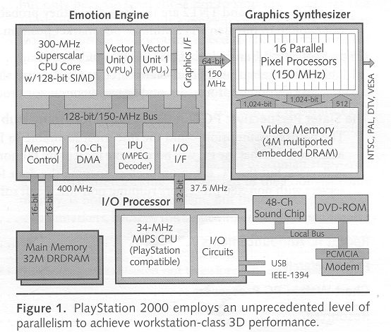
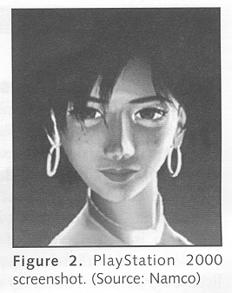
Computers in the News: Sony Playstation 2000
(as reported in Microprocessor Report, Vol 13, No. 5)
Emotion Engine: 6.2 GFLOPS, 75 million polygons per second
Graphics Synthesizer: 2.4 Billion pixels per second
Claim: Toy Story realism brought to games!

Slide 16
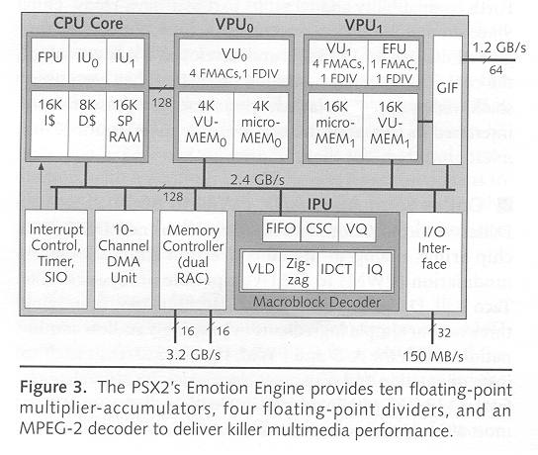
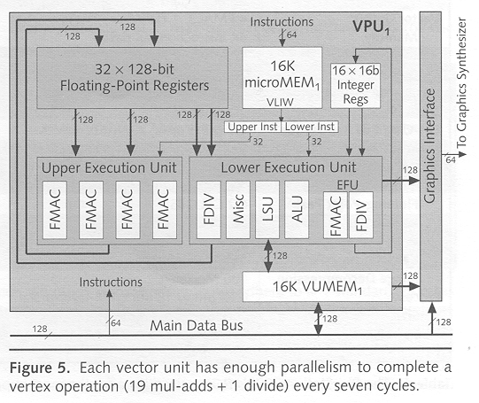
Playstation 2000 Continued
Emotion Engine:
Superscalar MIPS core
Vector Coprocessor Pipelines
RAMBUS DRAM interface
Sample Vector Unit
2-wide VLIW
Includes Microcode Memory
High-level instructions like matrix-multiply

Slide 17
What is a bus?
A Bus Is:
shared communication link
single set of wires used to connect multiple subsystems
A Bus is also a fundamental tool for composing large, complex systems
systematic means of abstraction
Processor
Input
Control
Memory
Datapath
Output

Slide 18
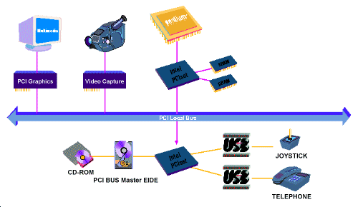
Buses

Slide 19
Advantages of Buses
I/O Device
I/O Device
I/O Device
Processer
Memory
Versatility:
New devices can be added easily
Peripherals can be moved between computer systems that use the same bus standard
Low Cost:
A single set of wires is shared in multiple ways
Notes:
The two major advantages of the bus organization are versatility and low cost.
By versatility, we mean new devices can easily be added.
Furthermore, if a device is designed according to a industry bus standard, it can be move between computer systems that use the same bus standard.
The bus organization is a low cost solution because a single set of wires is shared in multiple ways.
+1 = 7 min. (X:47)

Slide 20
Disadvantage of Buses
I/O Device
I/O Device
I/O Device
Processer
Memory
It creates a communication bottleneck
The bandwidth of that bus can limit the maximum I/O throughput
The maximum bus speed is largely limited by:
The length of the bus
The number of devices on the bus
The need to support a range of devices with:
Widely varying latencies
Widely varying data transfer rates
Notes:
The major disadvantage of the bus organization is that it creates a communication bottleneck. When I/O must pass through a single bus, the bandwidth of that bus can limit the maximum I/O throughput.
The maximum bus speed is also largely limited by:
(a) The length of the bus.
(b) The number of I/O devices on the bus.
(C) And the need to support a wide range of devices with a widely varying latencies and data transfer rates.
+2 = 9 min. (Y:49)

Slide 21
The General Organization of a Bus
Control Lines
Data Lines
Control lines:
Signal requests and acknowledgments
Indicate what type of information is on the data lines
Data lines carry information between the source and the destination:
Data and Addresses
Complex commands
Notes:
A bus generally contains a set of control lines and a set of data lines.
The control lines are used to signal requests and acknowledgments and to indicate what type of information is on the data lines.
The data lines carry information between the source and the destination.
This information may consists of data, addresses, or complex commands.
A bus transaction includes tow parts: (a) sending the address and (b) then receiving or sending the data.
+1 = 10 min (X:50)

Slide 22
Master versus Slave
Master issues command
Bus
Master
Bus
Slave
Data can go either way
A bus transaction includes two parts:
Issuing the command (and address) – request
Transferring the data – action
Master is the one who starts the bus transaction by:
issuing the command (and address)
Slave is the one who responds to the address by:
Sending data to the master if the master ask for data
Receiving data from the master if the master wants to send data
Notes:
The bus master is the one who starts the bus transaction by sending out the address.
The slave is the one who responds to the master by either sending data to the master if the master asks for data.
Or the slave may end up receiving data from the master if the master wants to send data.
In most simple I/O operations, the processor will be the bus master but as I will show you later in today’s lecture, this is not always be the case.
+1 = 11 min. (X:51)

Slide 23
Types of Buses
Processor-Memory Bus (design specific)
Short and high speed
Only need to match the memory system
Maximize memory-to-processor bandwidth
Connects directly to the processor
Optimized for cache block transfers
I/O Bus (industry standard)
Usually is lengthy and slower
Need to match a wide range of I/O devices
Connects to the processor-memory bus or backplane bus
Backplane Bus (standard or proprietary)
Backplane: an interconnection structure within the chassis
Allow processors, memory, and I/O devices to coexist
Cost advantage: one bus for all components
Notes:
Buses are traditionally classified as one of 3 types: processor memory buses, I/O buses, or backplane buses. The processor memory bus is usually design specific while the I/O and backplane buses are often standard buses.
In general processor bus are short and high speed. It tries to match the memory system in order to maximize the memory-to-processor BW and is connected directly to the processor.
I/O bus usually is lengthy and slow because it has to match a wide range of I/O devices and it usually connects to the processor-memory bus or backplane bus.
Backplane bus receives its name because it was often built into the backplane of the computer--it is an interconnection structure within the chassis.
It is designed to allow processors, memory, and I/O devices to coexist on a single bus so it has the cost advantage of having only one single bus for all components.
+2 = 16 min. (X:56)

Slide 24
A Computer System with One Bus: Backplane Bus
Backplane Bus
Processor
Memory
I/O Devices
A single bus (the backplane bus) is used for:
Processor to memory communication
Communication between I/O devices and memory
Advantages: Simple and low cost
Disadvantages: slow and the bus can become a major bottleneck
Example: IBM PC - AT
Notes:
Here is an example showing a single bus, the backplane bus is used to provide communication between the processor and memory.
As well as communication between I/O devices and memory.
The advantage here is of course low cost.
One disadvantage of this approach is that the bus with so many things attached to it will be lengthy and slow.
Furthermore, the bus can become a major communication bottleneck if everybody wants to use the bus at the same time.
The IBM PC is an example that uses only a backplane bus for all communication.
+2 = 18 min. (X:58)

Slide 25
A Two-Bus System
Processor Memory Bus
Processor
Memory
Bus
Adaptor
Bus
Adaptor
Bus
Adaptor
I/O
Bus
I/O
Bus
I/O
Bus
I/O buses tap into the processor-memory bus via bus adaptors:
Processor-memory bus: mainly for processor-memory traffic
I/O buses: provide expansion slots for I/O devices
Apple Macintosh-II
NuBus: Processor, memory, and a few selected I/O devices
SCCI Bus: the rest of the I/O devices
Notes:
Right before the break, I showed you a system with one bus only.
Here is an example using two buses where multiple I/O buses tap into the processor-memory bus via bus adaptors.
The Processor-memory bus is used mainly for processor-memory traffic while the I/O buses are used to provide expansion slots for the I/O devices.
The Apple Macintosh-II adopts this organization where the NuBus is used to connect processor, memory, and a few selected I/O devices together.
The rest of the I/O devices reside on an industry standard bus, the SCCI Bus, which is connected to the NuBus via a bus adaptor.
+2 = 25 min. (Y:05)

Slide 26
A Three-Bus System (+ backside cache)
Processor Memory Bus
Processor
Memory
Bus
Adaptor
Backside
Cache bus
Bus
Adaptor
I/O Bus
L2 Cache
Bus
Adaptor
I/O Bus
A small number of backplane buses tap into the processor-memory bus
Processor-memory bus is only used for processor-memory traffic
I/O buses are connected to the backplane bus
Advantage: loading on the processor bus is greatly reduced
Notes:
Finally, in a 3-bus system, a small number of backplane buses (in our example here, just 1) tap into the processor-memory bus.
The processor-memory bus is used mainly for processor memory traffic while the I/O buses are connected to the backplane bus via bus adaptors.
An advantage of this organization is that the loading on the processor-memory bus is greatly reduced because of the small number of taps into the high-speed processor-memory bus.
+1 = 26 min. (Y:06)

Slide 27
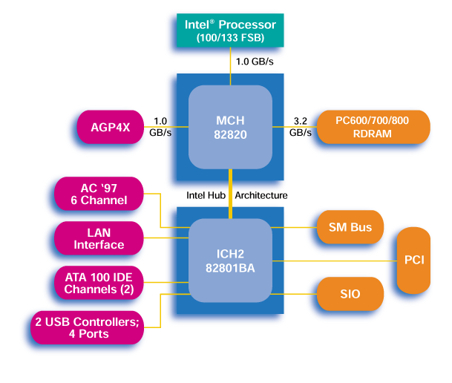
Main components of Intel Chipset: Pentium II/III
Northbridge:
Handles memory
Graphics
Southbridge: I/O
PCI bus
Disk controllers
USB controlers
Audio
Serial I/O
Interrupt controller
Timers

Slide 28
What is DMA (Direct Memory Access)?
Typical I/O devices must transfer large amounts of data to memory of processor:
Disk must transfer complete block
Large packets from network
Regions of frame buffer
DMA gives external device ability to access memory directly:
much lower overhead than having processor request one word at a time.
Issue: Cache coherence:
What if I/O devices write data that is currently in processor Cache?
The processor may never see new data!
Solutions:
Flush cache on every I/O operation (expensive)
Have hardware invalidate cache lines (remember “Coherence” cache misses?)

Slide 29
What defines a bus?
Transaction Protocol
Timing and Signaling Specification
Bunch of Wires
Electrical Specification
Physical / Mechanical Characterisics
– the connectors

Slide 30
Synchronous and Asynchronous Bus
Synchronous Bus:
Includes a clock in the control lines
A fixed protocol relative to the clock
Advantage: little logic and very fast
Disadvantages:
Every device on the bus must run at the same clock rate
To avoid clock skew, they cannot be long if they are fast
Asynchronous Bus:
It is not clocked
It can accommodate a wide range of devices
It can be lengthened without worrying about clock skew
It requires a handshaking protocol
Notes:
There are substantial differences between the design requirements for the I/O buses and processor-memory buses and the backplane buses.
Consequently, there are two different schemes for communication on the bus: synchronous and asynchronous.
Synchronous bus includes a clock in the control lines and a fixed protocol for communication that is relative to the clock.
Since the protocol is fixed and everything happens with respect to the clock, it involves very logic and can run very fast. Most processor-memory buses fall into this category.
Synchronous buses have two major disadvantages: (1) every device on the bus must run at the same clock rate. (2) And if they are fast, they must be short to avoid clock skew problem.
By definition, an asynchronous bus is not clocked so it can accommodate a wide range of devices at different clock rates and can be lengthened without worrying about clock skew.
The draw back is that it can be slow and more complex because a handshaking protocol is needed to coordinate the transmission of data between the sender and receiver.
+2 = 28 min. (Y:08)

Slide 31
Simple Synchronous Protocol
BReq
BG
R/W
Address
Cmd+Addr
Data
Data1
Data2
Even memory busses are more complex than this
memory (slave) may take time to respond
it may need to control data rate

Slide 32
Typical Synchronous Protocol
BReq
BG
R/W
Address
Cmd+Addr
Wait
Data
Data1
Data1
Data2
Slave indicates when it is prepared for data xfer
Actual transfer goes at bus rate

Slide 33
Asynchronous Write Transaction
Write Transaction
Address
Data
Read
Req
Ack
Master Asserts Address
Next Address
Master Asserts Data
t0 t1 t2 t3 t4 t5
t0 : Master has obtained control and asserts address, direction, data
Waits a specified amount of time for slaves to decode target.
t1: Master asserts request line
t2: Slave asserts ack, indicating data received
t3: Master releases req
t4: Slave releases ack

Slide 34
Asynchronous Read Transaction
Address
Data
Read
Req
Ack
Master Asserts Address
Next Address
Slave Data
t0 t1 t2 t3 t4 t5
t0 : Master has obtained control and asserts address, direction, data
Waits a specified amount of time for slaves to decode target.
t1: Master asserts request line
t2: Slave asserts ack, indicating ready to transmit data
t3: Master releases req, data received
t4: Slave releases ack

Slide 35
Multiple Potential Bus Masters: the Need for Arbitration
Bus arbitration scheme:
A bus master wanting to use the bus asserts the bus request
A bus master cannot use the bus until its request is granted
A bus master must signal to the arbiter after finish using the bus
Bus arbitration schemes usually try to balance two factors:
Bus priority: the highest priority device should be serviced first
Fairness: Even the lowest priority device should never be completely locked out from the bus
Bus arbitration schemes can be divided into four broad classes:
Daisy chain arbitration
Centralized, parallel arbitration
Distributed arbitration by self-selection: each device wanting the bus places a code indicating its identity on the bus.
Distributed arbitration by collision detection: Each device just “goes for it”. Problems found after the fact.
Notes:
A more aggressive approach is to allow multiple potential bus masters in the system.
With multiple potential bus masters, a mechanism is needed to decide which master gets to use the bus next. This decision process is called bus arbitration and this is how it works.
A potential bus master (which can be a device or the processor) wanting to use the bus first asserts the bus request line and it cannot start using the bus until the request is granted.
Once it finishes using the bus, it must tell the arbiter that it is done so the arbiter can allow other potential bus master to get onto the bus.
All bus arbitration schemes try to balance two factors: bus priority and fairness. Priority is self explanatory. Fairness means even the device with the lowest priority should never be completely locked out from the bus.
Bus arbitration schemes can be divided into four broad classes. In the fist one:
(a) Each device wanting the bus places a code indicating its identity on the bus.
(b) By examining the bus, the device can determine the highest priority device that has made a request and decide whether it can get on.
In the second scheme, each device independently requests the bus and collision will result in garbage on the bus if multiple request occurs simultaneously.
Each device will detect whether its request result in a collision and if it does, it will back off for an random period of time before trying again.
The Ethernet you use for your workstation uses this scheme.
We will talk about the 3rd and 4th schemes in the next two slides.
+3 = 38 min. (Y:18)

Slide 36
Arbitration: Obtaining Access to the Bus
Control: Master initiates requests
Bus
Master
Bus
Slave
Data can go either way
One of the most important issues in bus design:
How is the bus reserved by a device that wishes to use it?
Chaos is avoided by a master-slave arrangement:
Only the bus master can control access to the bus:
It initiates and controls all bus requests
A slave responds to read and write requests
The simplest system:
Processor is the only bus master
All bus requests must be controlled by the processor
Major drawback: the processor is involved in every transaction
Notes:
Taking about trying to get onto the bus: how does a device get onto the bus anyway? If everybody tries to use the bus at the same time, chaos will result.
Chaos is avoided by a maser-slave arrangement where only the bus master is allow to initiate and control bus requests.
The slave has no control over the bus. It just responds to the master’s response. Pretty sad.
In the simplest system, the processor is the one and ONLY one bus master and all bus requests must be controlled by the processor.
The major drawback of this simple approach is that the processor needs to be involved in every bus transaction and can use up too many processor cycles.
+2 = 35 min. (Y:15)

Slide 37
The Daisy Chain Bus Arbitrations Scheme
Device 1
Highest
Priority
Device N
Lowest
Priority
Device 2
Grant
Grant
Grant
Bus
Arbiter
Release
Request
wired-OR
Advantage: simple
Disadvantages:
Cannot assure fairness: A low-priority device may be locked out indefinitely
The use of the daisy chain grant signal also limits the bus speed
Notes:
The daisy chain arbitration scheme got its name from the structure for the grant line which chains through each device from the highest priority to the lowest priority.
The higher priority device will pass the grant line to the lower priority device ONLY if it does not want it so priority is built into the scheme.
The advantage of this scheme is simple. The disadvantages are:
(a) It cannot assure fairness. A low priority device may be locked out indefinitely.
(b) Also, the daisy chain grant line will limit the bus speed.
+1 = 39 min. (Y:19)

Slide 38
Centralized Parallel Arbitration
Device 1
Device N
Device 2
Grant
Req
Bus
Arbiter
Used in essentially all processor-memory busses and in high-speed I/O busses

Slide 39
Increasing the Bus Bandwidth
Separate versus multiplexed address and data lines:
Address and data can be transmitted in one bus cycle if separate address and data lines are available
Cost: (a) more bus lines, (b) increased complexity
Data bus width:
By increasing the width of the data bus, transfers of multiple words require fewer bus cycles
Example: SPARCstation 20’s memory bus is 128 bit wide
Cost: more bus lines
Block transfers:
Allow the bus to transfer multiple words in back-to-back bus cycles
Only one address needs to be sent at the beginning
The bus is not released until the last word is transferred
Cost: (a) increased complexity (b) decreased response time for request
Notes:
Our handshaking example in the previous slide used the same wires to transmit the address as well as data. The advantage is saving in signal wires.
The disadvantage is that it will take multiple cycles to transmit address and data. By having separate lines for addresses and data, we can increase the bus bandwidth by transmitting address and data in the same cycle at the cost of more bus lines and increased complexity.
This (1st bullet) is one way to increase bus bandwidth. Another way is to increase the width of the data bus so multiple words can be transferred in a single cycle.
For example, the SPARCstation memory bus is 128 bits of 16 bytes wide. The cost of this approach is more bus lines.
Finally, we can also increase the bus bandwidth by allowing the bus to transfer multiple words in back-to-back bus cycles without sending an address or releasing the bus.
The cost of this last approach is an increase of complexity in the bus controller as well as a decease in response time for other parties who want to get onto the bus.
+2 = 33 min. (Y:13)

Slide 40
Increasing Transaction Rate on Multimaster Bus
Overlapped arbitration
perform arbitration for next transaction during current transaction
Bus parking
master can holds onto bus and performs multiple transactions as long as no other master makes request
Overlapped address / data phases (prev. slide)
requires one of the above techniques
Split-phase (or packet switched) bus
completely separate address and data phases
arbitrate separately for each
address phase yield a tag which is matched with data phase
“All of the above” in most modern buses

Slide 41
PCI Read/Write Transactions
All signals sampled on rising edge
Centralized Parallel Arbitration
overlapped with previous transaction
All transfers are (unlimited) bursts
Address phase starts by asserting FRAME#
Next cycle “initiator” asserts cmd and address
Data transfers happen when
IRDY# asserted by master when ready to transfer data
TRDY# asserted by target when ready to transfer data
transfer when both asserted on rising edge
FRAME# deasserted when master intends to complete only one more data transfer

Slide 42
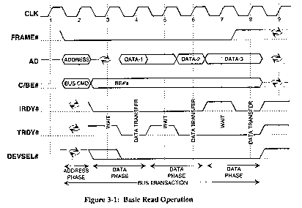
PCI Read Transaction
– Turn-around cycle on any signal driven by more than one agent

Slide 43
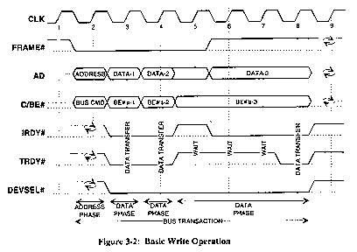
PCI Write Transaction

Slide 44
PCI Optimizations
Push bus efficiency toward 100% under common usage
Bus Parking
retain bus grant for previous master until another makes request
granted master can start next transfer without arbitration
Arbitrary Burst length
initiator and target can exert flow control with xRDY
target can disconnect request with STOP (abort or retry)
master can disconnect by deasserting FRAME
arbiter can disconnect by deasserting GNT
Delayed (pended, split-phase) transactions
free the bus after request to slow device

Slide 45
Bus Summary
Buses are an important technique for building large-scale systems
Their speed is critically dependent on factors such as length, number of devices, etc.
Critically limited by capacitance
Tricks: esoteric drive technology such as GTL
Important terminology:
Master: The device that can initiate new transactions
Slaves: Devices that respond to the master
Two types of bus timing:
Synchronous: bus includes clock
Asynchronous: no clock, just REQ/ACK strobing
Direct Memory Access (DMA) allows fast, burst transfer into processor’s memory:
Processor’s memory acts like a slave
Probably requires some form of cache-coherence so that DMA’ed memory can be invalidated from cache.

Slide 46
I/O Summary:
I/O performance limited by weakest link in chain between OS and device
Three Components of Disk Access Time:
Seek Time: advertised to be 8 to 12 ms. May be lower in real life.
Rotational Latency: 4.1 ms at 7200 RPM and 8.3 ms at 3600 RPM
Transfer Time: 2 to 12 MB per second
I/O device notifying the operating system:
Polling: it can waste a lot of processor time
I/O interrupt: similar to exception except it is asynchronous
Delegating I/O responsibility from the CPU:
DMA, or even IOP
Notes:
First we showed you the diversity of I/O requirements by talking about three categories of disk I/O benchmarks. Supercomputer application’s main concern is data rate. The main concern of transaction processing is I/O rate and file system’s main concern is file access.
Then we talk about magnetic disk. One thing to remember is that disk access time has 3 components. The first 2 components, seek time and rotational latency involves mechanical moving parts and are therefore very slow compare to the 3rd component, the transfer time.
One good thing about the seek time is that this is probably one of the few times in life that you can actually get better than the “advertised” result due to the locality of disk access.
As far as graphic display is concerned, resolution is the basic measurement of how much information is on the screen and is usually described as “some number” by “some number.”
The first “some number” is the horizontal resolution in number of pixels while the second “some number” is the vertical resolution in number of scan lines.
Then I showed you how the size as well as bandwidth requirement of a Color Frame Buffer can be reduced if a Color Map is placed between the Frame Buffer and the graphic display.
Finally, we talked about a spacial memory, the VRAM, that can be used to construct the Frame Buffer. It is nothing but a DRAM core with a high speed shift register attach to it.
That’s all I have for today and we will continue our discussion on I/O Friday.
+3 = 80 min. (Z:00)

