Slide 1


Ethiopia: Culture and Traditions for First-Time Visitors
by Maria Kosogova, Fedorov Dmitry

Slide 2



Introduction
Ethiopia has very beautiful nature, and it looks really amazing.
However, cultural values can feel quite different, and people may act differently and unexpectedly, so it can feel a bit strange at first.

Slide 3

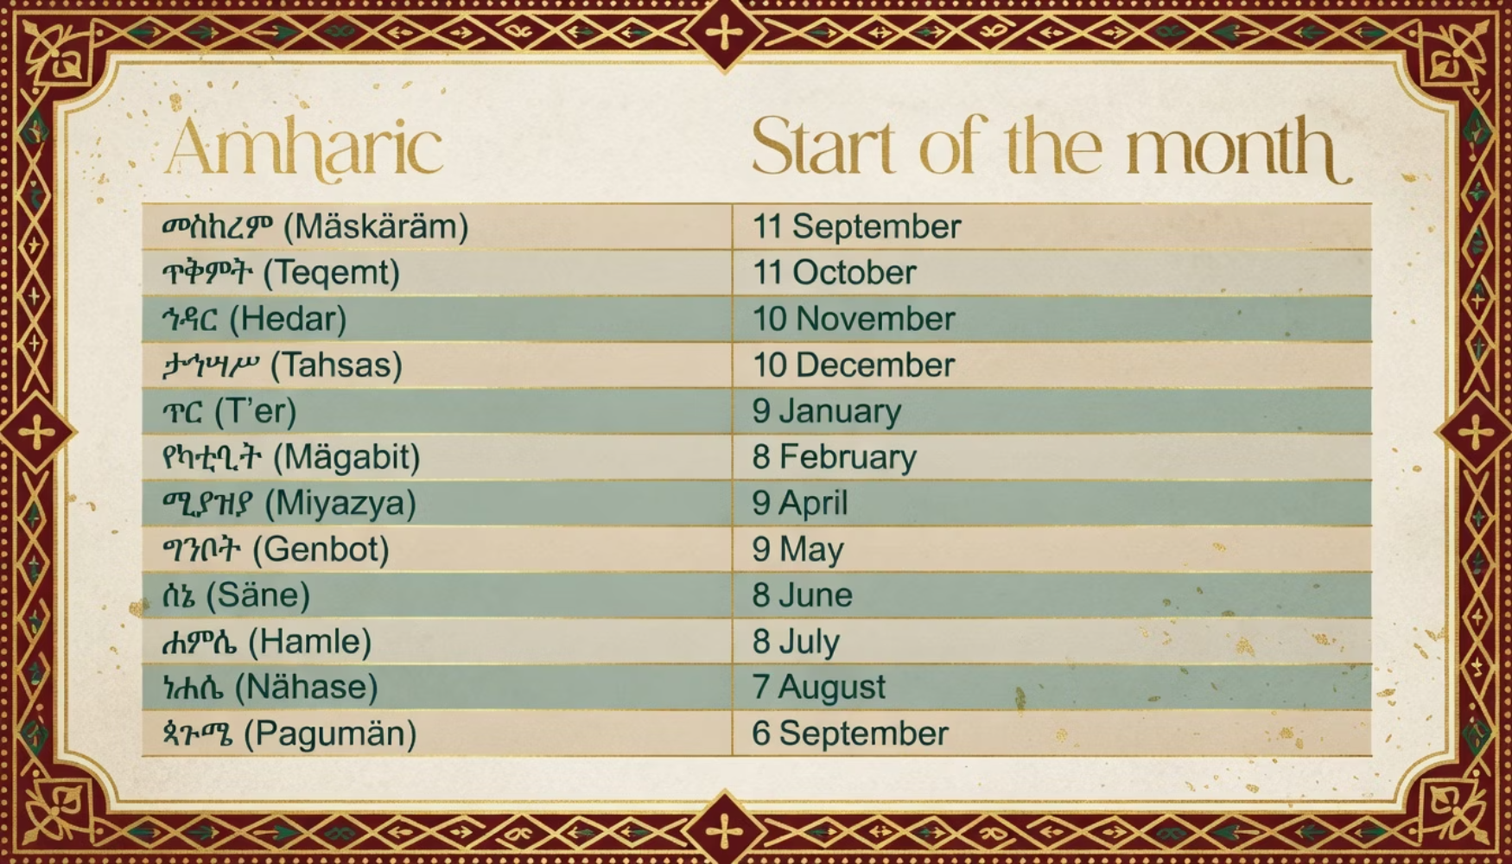
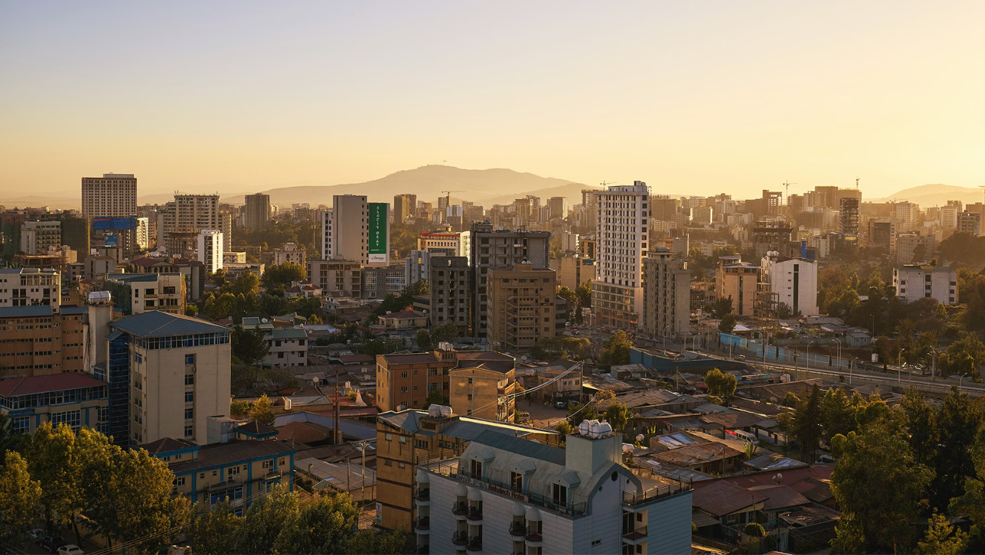
Time Works Differently Here
Time works very differently in Ethiopia. The year is different, and people count time from sunrise. Life moves quite slowly, and people are not very strict about time.

Slide 4
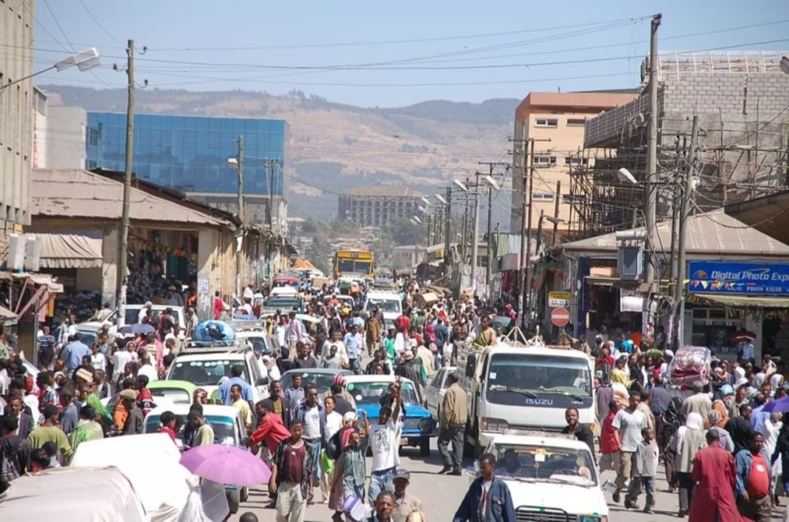

Driving and Road Culture
The traffic is quite dynamic and very unpredictable.
Cars, people, and animals move together and freely on the roads.
Drivers often drive fast and sometimes dangerously.
Rules are followed less strictly than in Europe.
Driving can feel really risky, but local people drive well and carefully.

Slide 5

Behavior and Social Etiquette
People communicate quite differently from Europe
The culture can seem very unusual
They often speak directly and openly
Communication is not formal
This can feel really strange

Slide 6

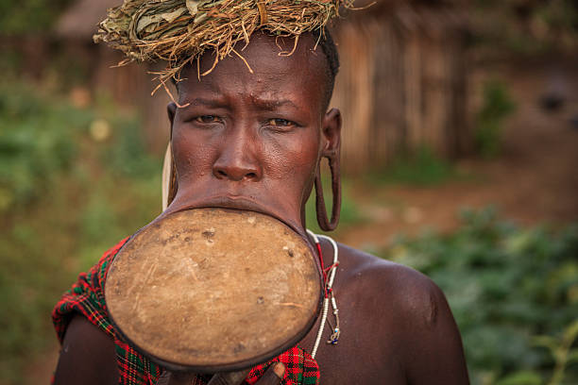
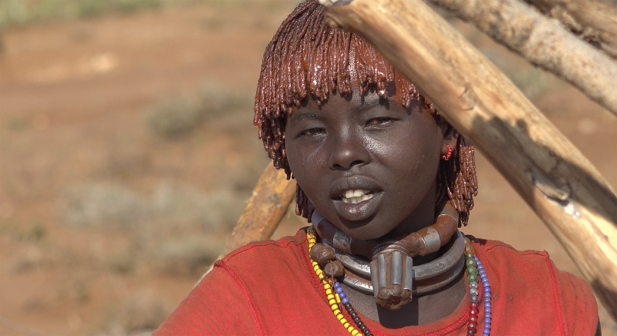
Traditional Tribal Life
Some tribes live very traditionally
They use ancient customs and rituals
People live very close to nature
Clothing and body decoration can be quite unusual
Life is completely different from modern cities

Slide 7
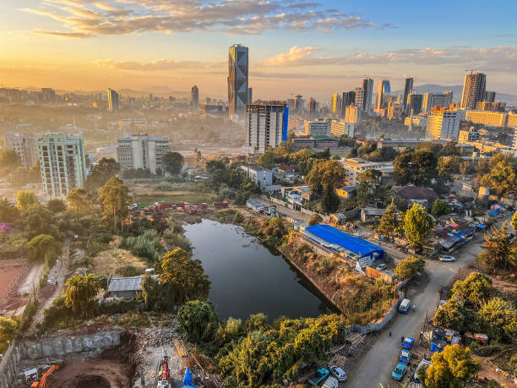

Conclusion
Ethiopia is not what you expect
It offers a completely different way of life
The culture is very rich and unique
It is an incredible cultural experience

