Slide 1

World of Wine Craft Wine Types and Global Differentiation Group: Piotr Kulak, Joseph Barratt, Yiting Chen, Zijian Deng

Slide 2
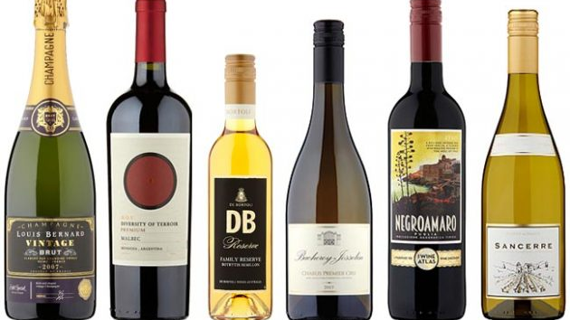
Aim
The aim of the project is to visualise and compare the types of wines produced over the World in countries being famous for its wines.
We will aim to do this with an interactive map, that will spatially visualise the top wineries of the world by country and region.

Slide 3
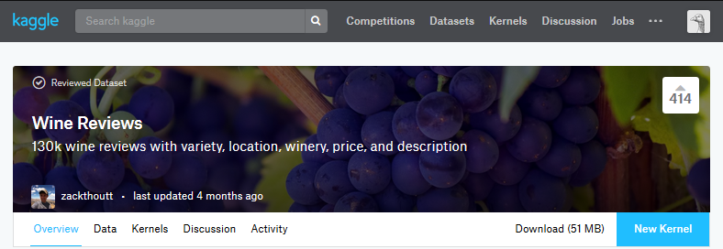
Dataset
Dataset used for this project is acquired from https://www.kaggle.com/zynicide/wine-reviews and was created upon wine reviews coming from Wine Enthusiast.
This dataset contains 130,000 reviews from across the world, based on various aspects around a country’s wine production and quality of said wines. Within these reviews we have access to the categories shown on the right which offer important insight into a country or regions’ capability to produce wine and the quality at which it stands.
The dataset does however exclude anything below 80 points so this project will only refer to wines that are considered a high quality already.
Features of this dataset
1) Name of the wine
2) Country of origin
3) Description (reviev)
4) Variety
5) Winery
5) Designation
6) Points (80-100)
7) Price (in $)
8) Province of origin
9) Taster name and twitter ID

Slide 4
Data Set Potential Analysis
Within the dataset we have several indicators of winery quality or a countries capability of producing wine
Review (Description/Content)
It is possible to produce a sentiment analysis based on the feelings of the reviewer to gain some insight into the emotion/qualitative value surrounding the wine produced in a country.
Adding to this we can also potentially find common flavours in the wine a country is producing based on sentiment analysis - For Example – a review for a wine produced in England “Russet and Red Delicious apples set the aromatic tone, edged by rhubarb and pink grapefruit zest…dryness and the earthy, resonant notes of autolysis....”
This could potentially lead to us to be able to categorise countries based on the most prevalent flavours – “apple” “rhubarb” “grapefruit” “dryness” “earthy”.

Slide 5
Data Analysis Cont.
Variety – Countries can be ranked according to the amount of differentiation in their production
Points & Price
Points – Countries/Regions can be ranked according to the points they’ve scored
Price - Countries/Regions can be ranked according to the cost of the wines
Points & Price (Value) – An index showing value for money can be achieved by combining cost with points scored. A wine with 90 points at a lower cost to a wine that was awarded the same points will score significantly better on the value for many index.

Slide 6
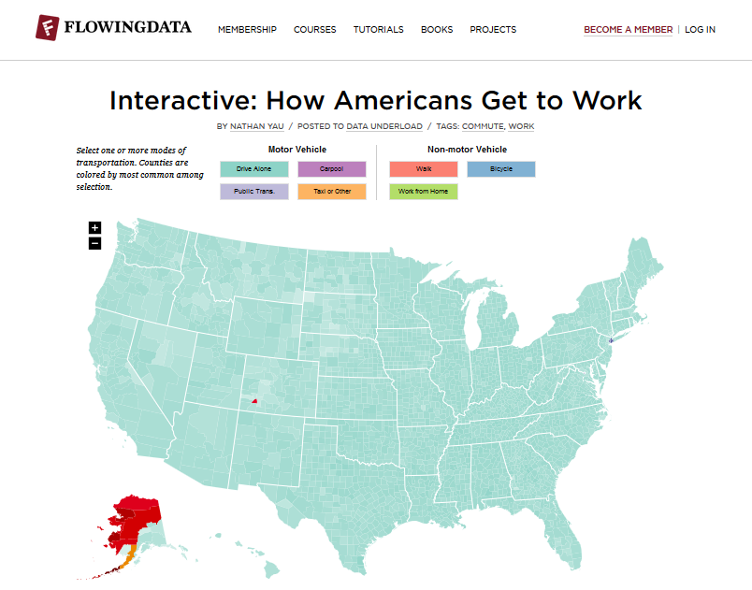
Expected shape of the data
We would like to eventually create interactive map where the user can change input and then be able to visualize proper comparison between countries, provinces, wineries.
We are also going to add some separate analysis for the topic and emphasize trends that can be found in the data or stress the outliers.

