Slide 1
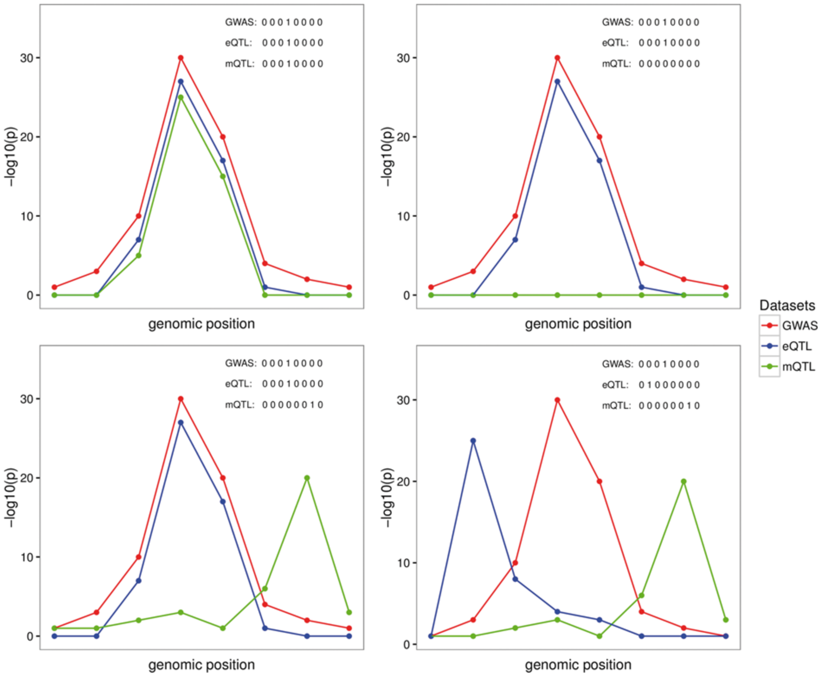
From: A Bayesian framework for multiple trait colocalization from summary association statistics
Bioinformatics. Published online March 19, 2018. doi:10.1093/bioinformatics/bty147
Bioinformatics | © The Author(s) 2018. Published by Oxford University Press. All rights reserved. For permissions, please e-mail: journals.permissions@oup.comThis article is published and distributed under the terms of the Oxford University Press, Standard Journals Publication Model (https://academic.oup.com/journals/pages/about_us/legal/notices)
Notes:
Fig. 1. Graphical representation of four possible configurations at a locus with eight SNPs in common across three traits. The traits are labeled as G, E, M representing GWAS (G), eQTL (E) and mQTL (M) datasets, respectively. Each plot represents one possible configuration, which is a possible combination of three sets of binary vectors indicating whether the variant is associated with the selected trait. Left plot top panel (GEM scenario): points to one causal variant behind all of the associations; Right plot top panel (GE scenario): represent the scenario with the same causal variant behind the GE and no association or lack of power for the M association; Left plot bottom panel (GE.M scenario): represents the case with two causal variants, one shared by the G and E and a different causal variant for M; Right plot bottom panel (G.E.M. scenario): represents the case of three distinct causal variants behind each of the datasets considered

