Slide 1

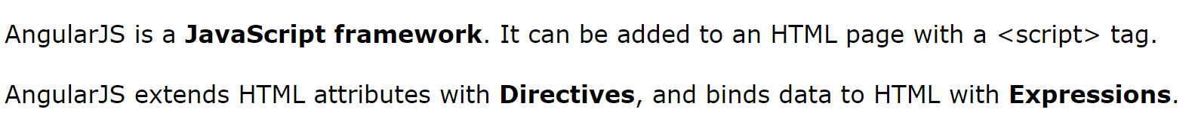
AngularJS

Slide 2
AngularJS extends HTML with ng-directives.
The ng-app directive defines an AngularJS application.
The ng-model directive binds the value of HTML controls (input, select, text area) to application data.
The ng-bind directive binds application data to the HTML view.

Slide 3
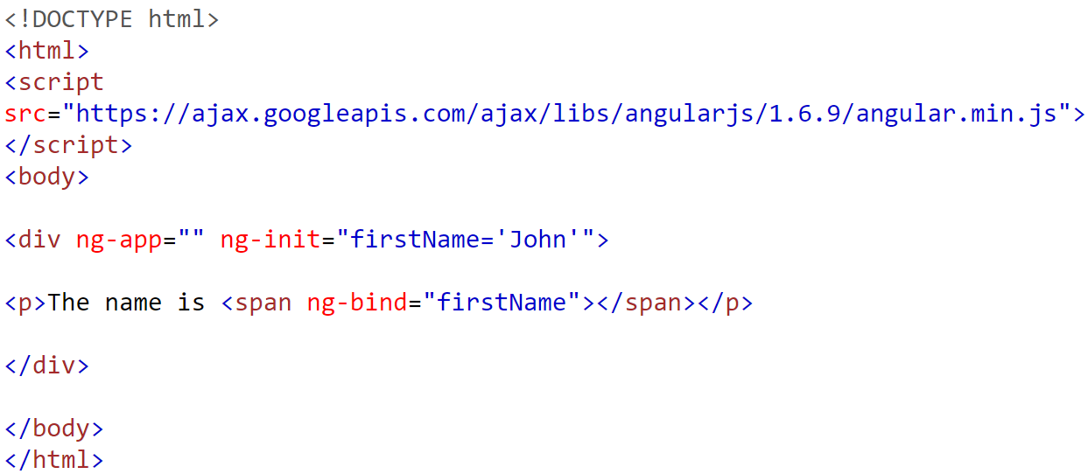
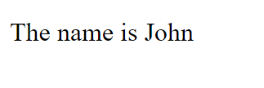
ng-init

Slide 4
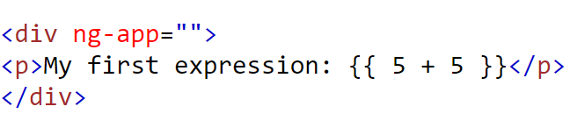

AngularJS Expressions
AngularJS expressions are written inside double braces: {{ expression }}.
AngularJS will "output" data exactly where the expression is written:

Slide 5
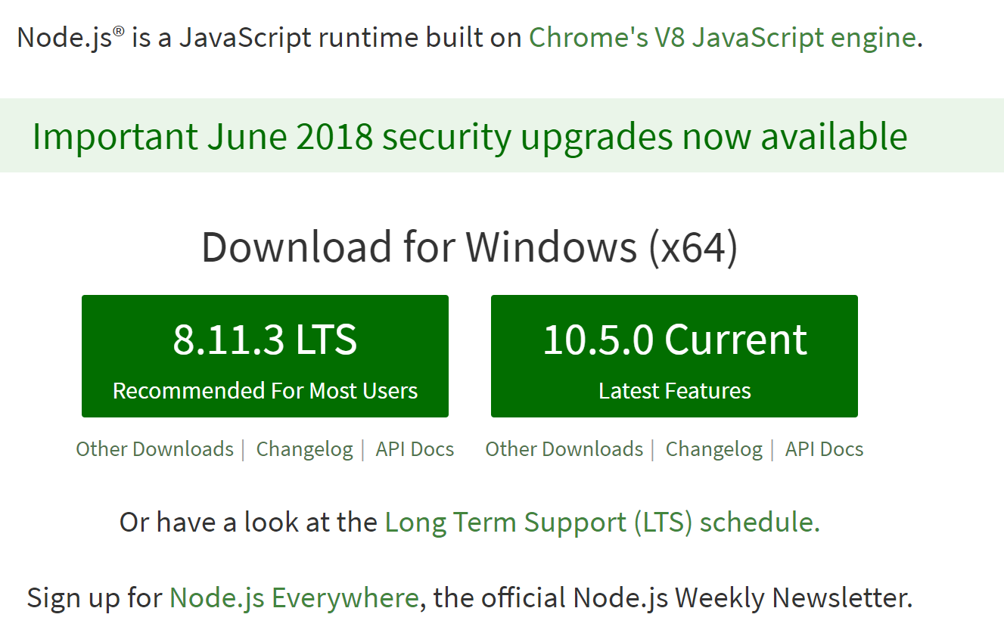
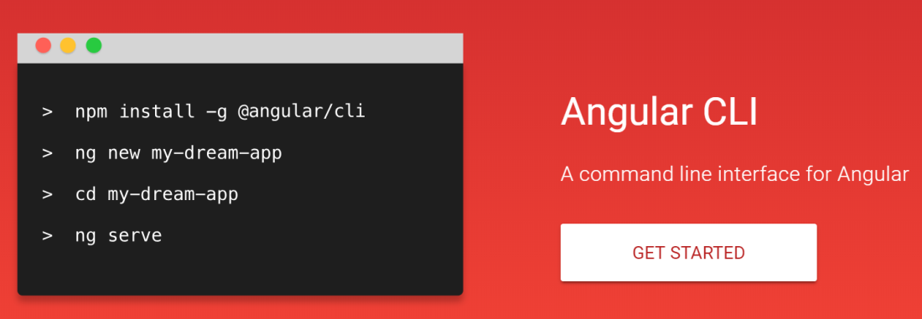
Install Angular JS

