Slide 1

THE JOURNEY

Slide 2


Depend
on a minigame

Slide 3
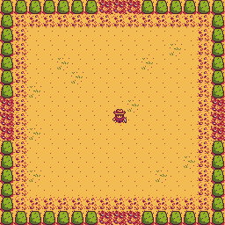

BACKGROUND OF THE
GAME
GAMEPLAY

Slide 4
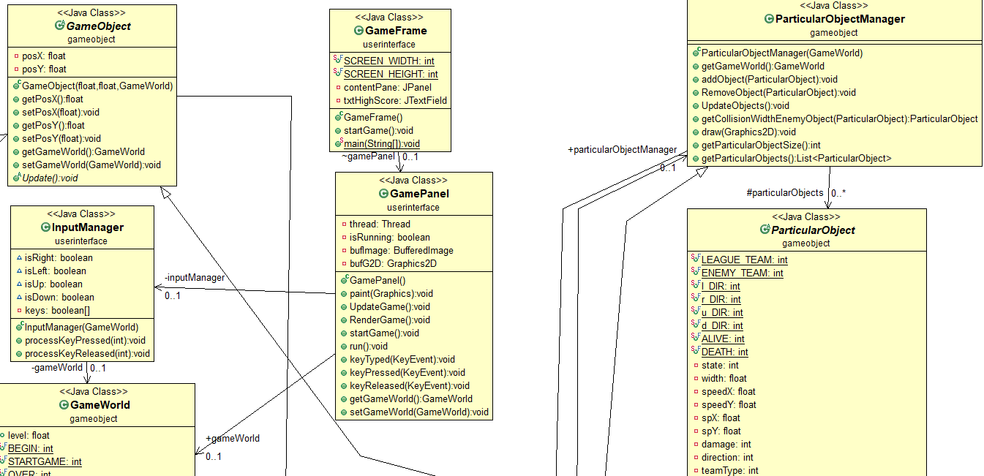
CLASS
DIAGRAM

