Slide 1
Recitation 9

Slide 2
How do I make 5 variables in CPP?
#include<iostream>
using namespace std;
int main() {
int number1 = 10;
int number2 = 20;
int number3 = 30;
int number4 = 40;
int number5 = 50;
cout << number1 << endl;
cout << number2 << endl;
cout << number3 << endl;
cout << number4 << endl;
cout << number5 << endl;
}

Slide 3
Anatomy of an array
int myfirstarray[5] = {10, 20, 30, 40, 50};
WHO AM I???
WHAT IS MY NAME???
HOW MANY VALUES DO I HOLD???
WHOM DO I HOLD???
ARRAY TYPE
ARRAY NAME
ARRAY SIZE
ARRAY VALUES

Slide 4
WHAT YOU SEE -
WHAT HAPPENS INSIDE MEMORY -
int
myfirstarray
[5]
= {10, 20, 30, 40, 50};
idx
10
ADRESSES 100-103
0
20
WHAT CPU SEES -
ADRESSES 104-107
1
30
2
THIS IS AN INTEGER, SIZE OF INTEGERS IS 4 BYTES.
THE NAME OF THIS ENTITY IS myfirstarray.
THIS IS INFACT AN ARRAY! I SHOULD RESERVE 5*4 BYTES FOR THIS! myfirstarray WILL STAY AT ADDRESS 100!
THIS ARRAY IS INITIALIZED, I SHOULD PUT VALUES INSIDE THE ARRAY!
ADRESSES 108-111
40
ADRESSES 112-115
3
50
ADRESSES 116-119
4
* This is a simplistic view for illustrative purposes.

Slide 5
Ways to create an Array
int myfirstarray[5] = {10, 20, 30, 40, 50};
int myfirstarray[] = {10, 20, 30, 40, 50};
int myfirstarray[5] = {};
myfirstarray[0] = 10;
myfirstarray[1] = 20;
myfirstarray[2] = 30;
myfirstarray[3] = 40;
myfirstarray[4] = 50;
DECLARE
DECLARE AND INITIALIZE
INITIALIZE

Slide 6
Take user input to fill the array.
#include<iostream>
using namespace std;
int main() {
int i=0;
int myfirstarray[5] = {};
for(i=0; i<5; i++)
{
cin >> myfirstarray[i];
cout << myfirstarray[i] << endl;
}
}

Slide 7
Who are you and where do you live?
#include<iostream> using namespace std;
int main() {
int myvar = 5;
cout << myvar << endl;
cout << &myvar << endl;
}
5
0x7ffff9d23644
&
ADDRESS OF OPERATOR

Slide 8

Function which returns 2 values.
#include<iostream> using namespace std;
int opfun(int a)
{
return a+1, a-1;
}
int main()
{
int k = 10;
cout << opfun(k) << endl;
}
9
CANNOT RETURN MORE THAN ONE VALUE FROM THE FUNCTION IN THIS SETUP

Slide 9
#include<iostream> using namespace std;
void val(int a){
a = 20;
cout << &a << endl;
}
void ref(int &a){
a = 30;
cout << &a << endl;
}
int main()
{
int num = 100;
cout << &num << endl;
val(num);
cout << num << endl;
ref(num); return 0;
}
0x7fffc1efe0b4
0x7fffc1efe09c
100
0x7fffc1efe0b4
100
100
30
20
0x7fffc1efe0b4
0x7fffc1efe09c

Slide 10
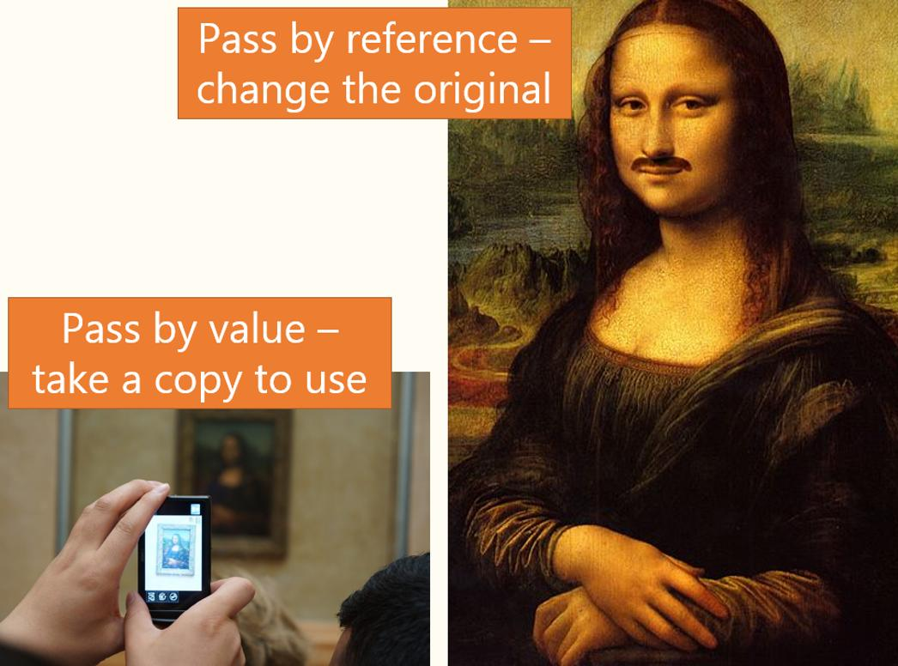
Pass by reference to the rescue!
Credit – Stuart Davidson, StackExchange

Slide 11
Pass arrays into functions
#include<iostream>
#include<stdlib.h>
using namespace std;
void randArrays(int intarr[], int length)
{
for(int i=0; i<length; i++)
intarr[i] = rand() % 1000 + 1;
}
void printArr(int intarr[], int length)
{
for(int i=0; i<length; i++)
cout << intarr[i] << endl;
}
int main()
{
int arrayA[10] = {};
randArrays(arrayA,10);
printArr(arrayA,10);
}
// Notes-
// Line 1 -> declares an array
// Line 2 -> calls randArrays to // fill arrayA with random
// values
// Line 3 -> print values inside // the array

