Slide 1
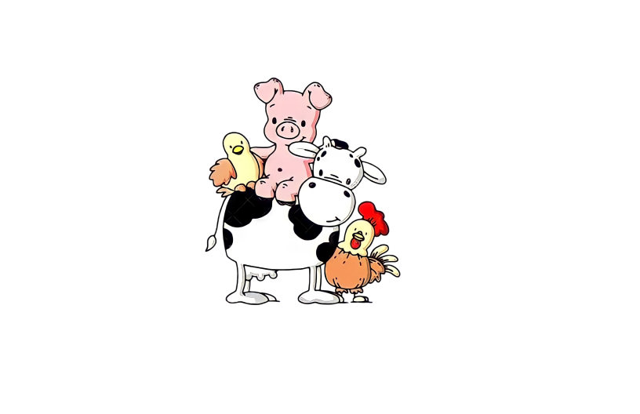
FIRST

Slide 2
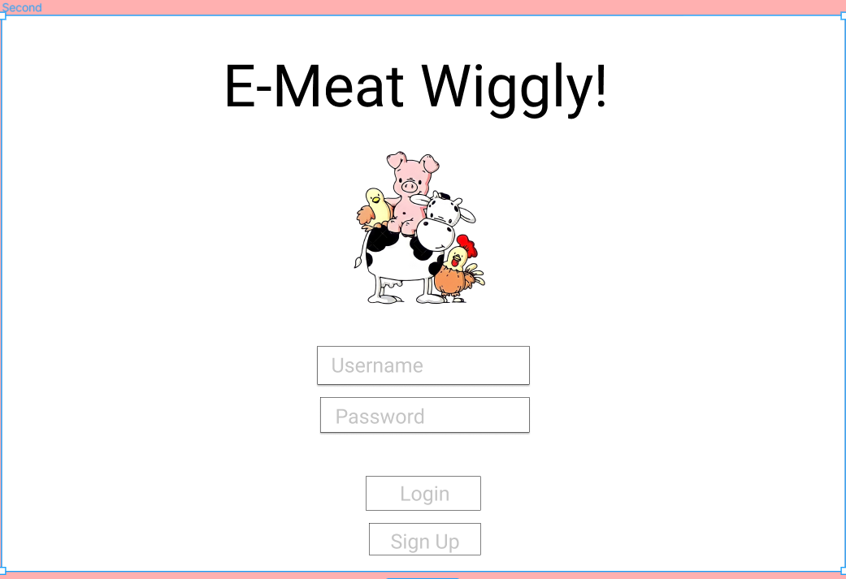
LOGIN PAGE

Slide 3
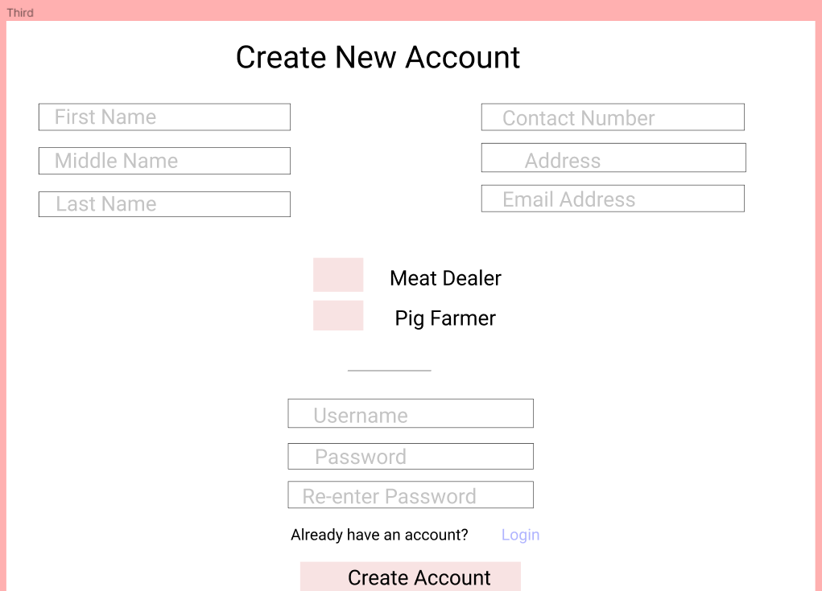
REGISTRATION FOR DEALERS

Slide 4
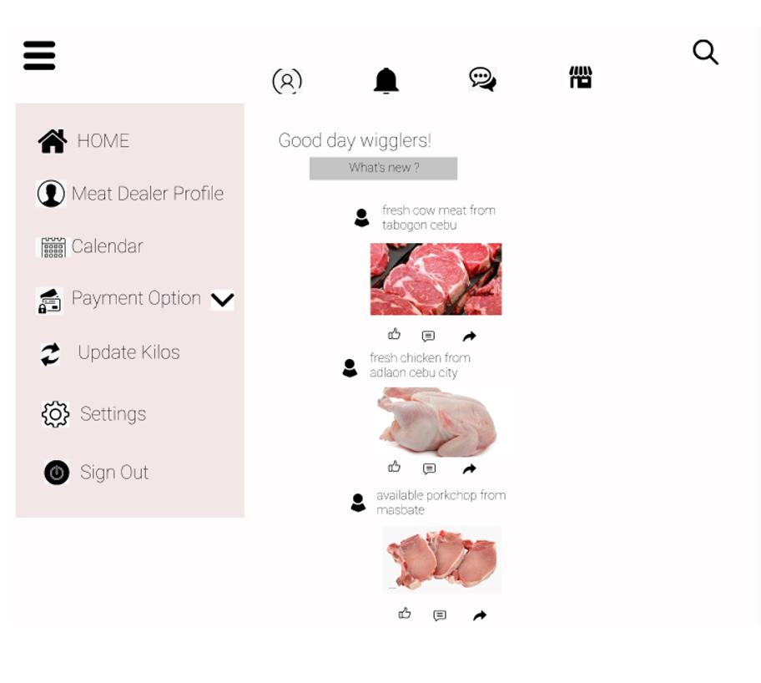
HOME

Slide 5
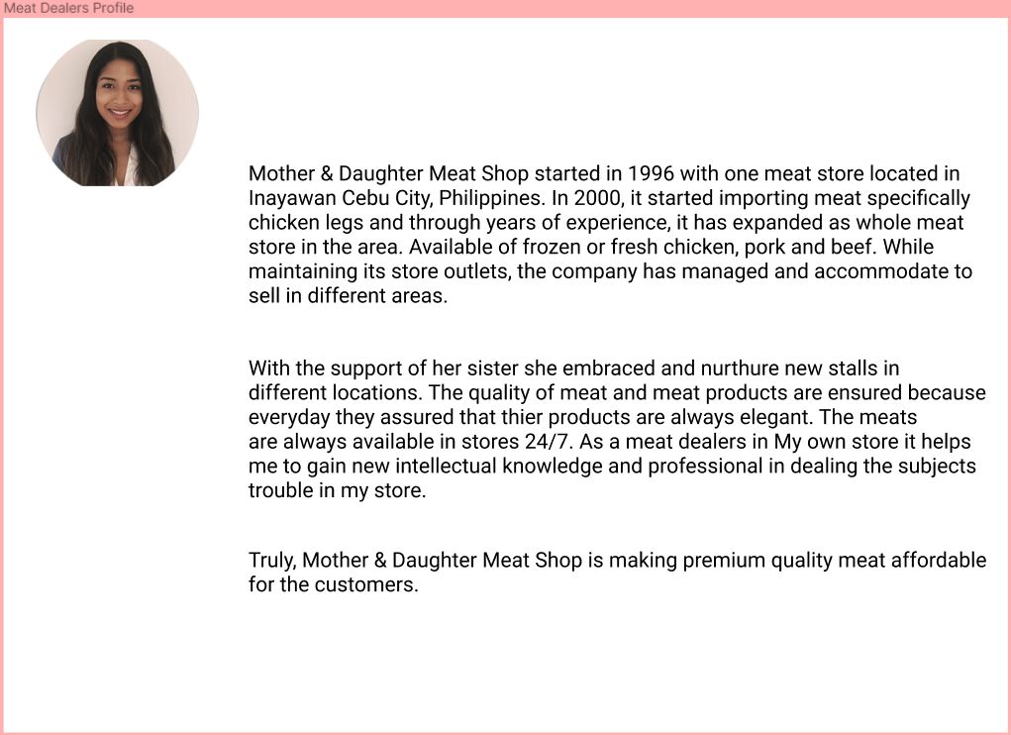
MEAT DEALERS PROFILE

Slide 6
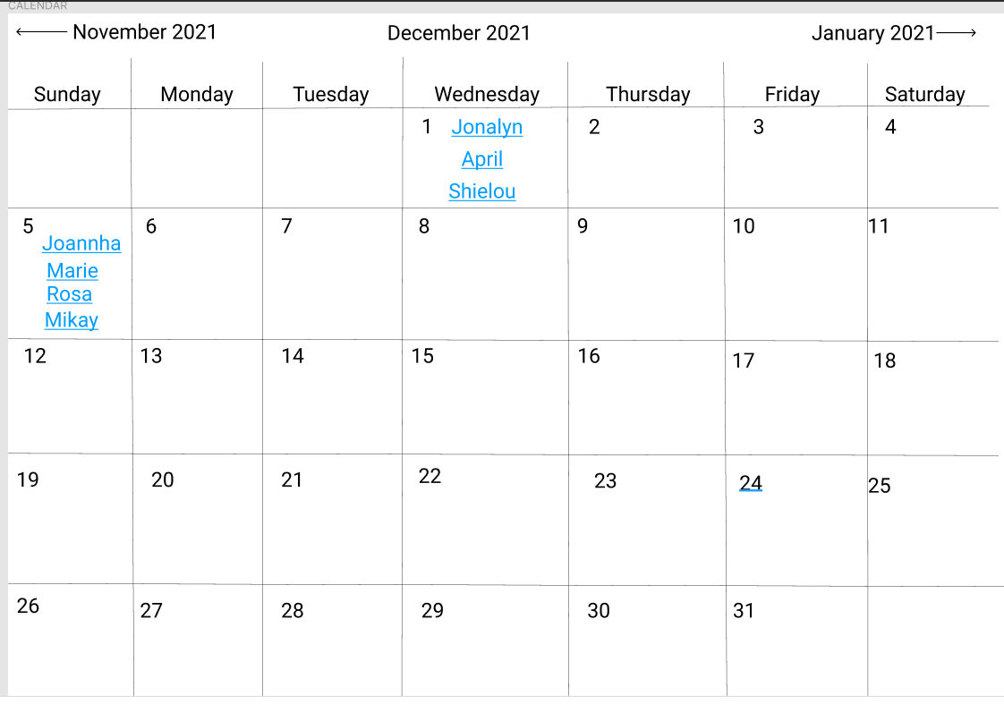
CALENDAR

Slide 7
Kanus a kuhaon ang animal sa certain farmer

Slide 8
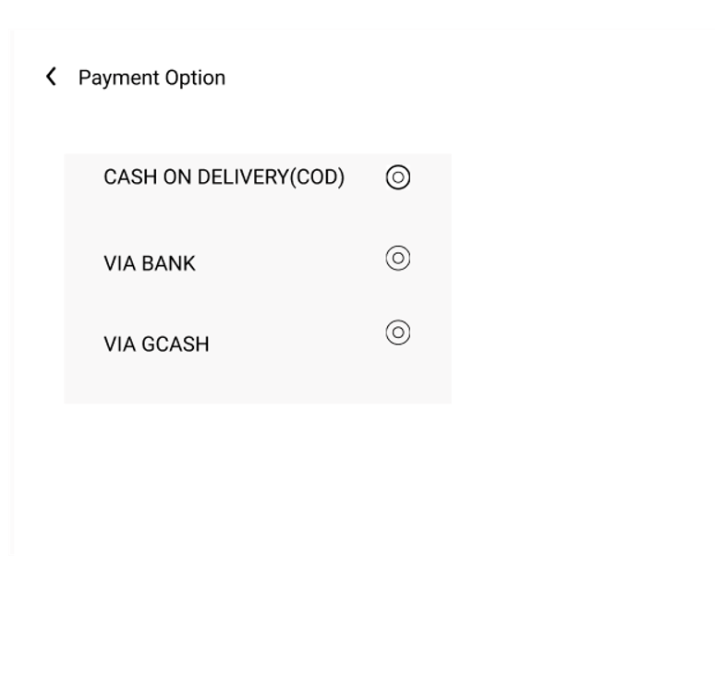
PAYMENT

Slide 9
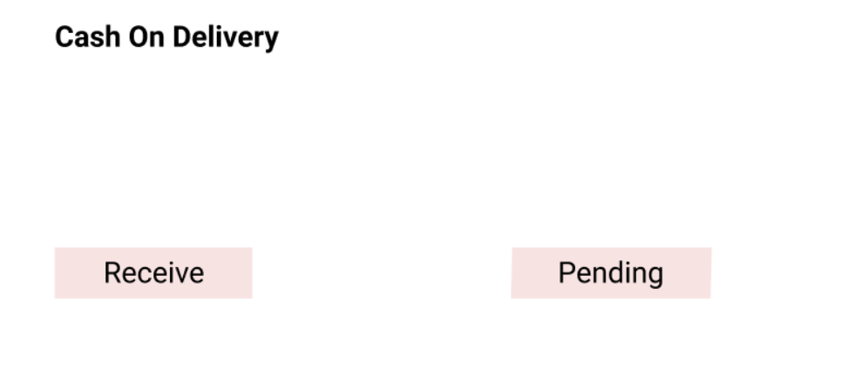

Slide 10
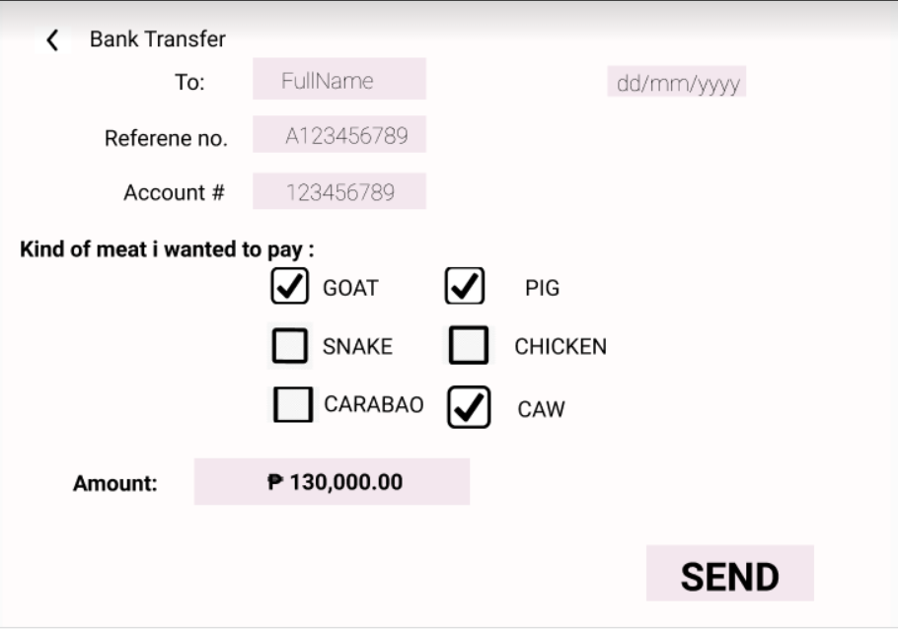

Slide 11
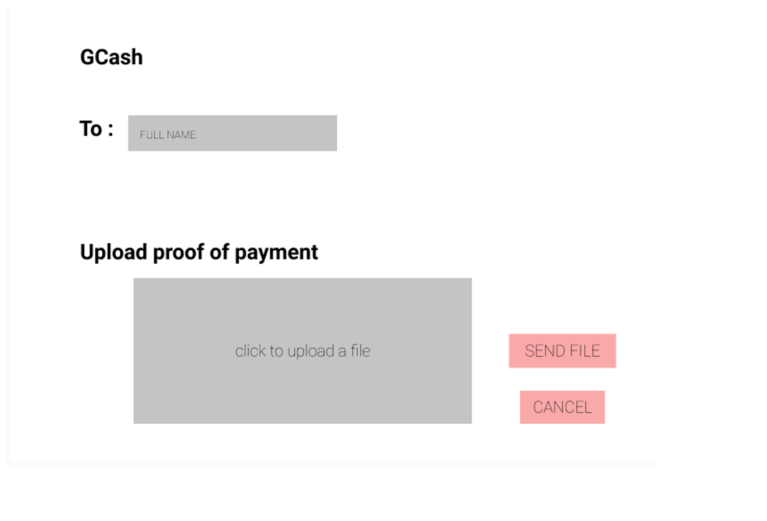

Slide 12
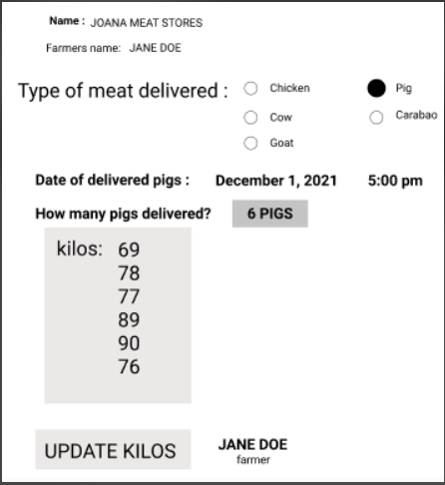
UPDATE KILOS

Slide 13
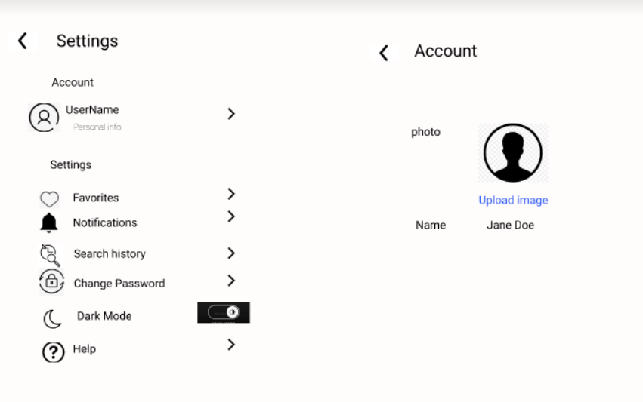
SETTINGS

Slide 14
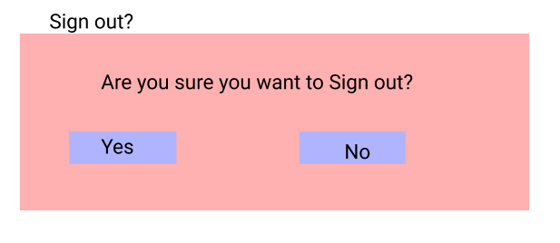
SIGNOUT

