Slide 1

FIRST

Slide 2
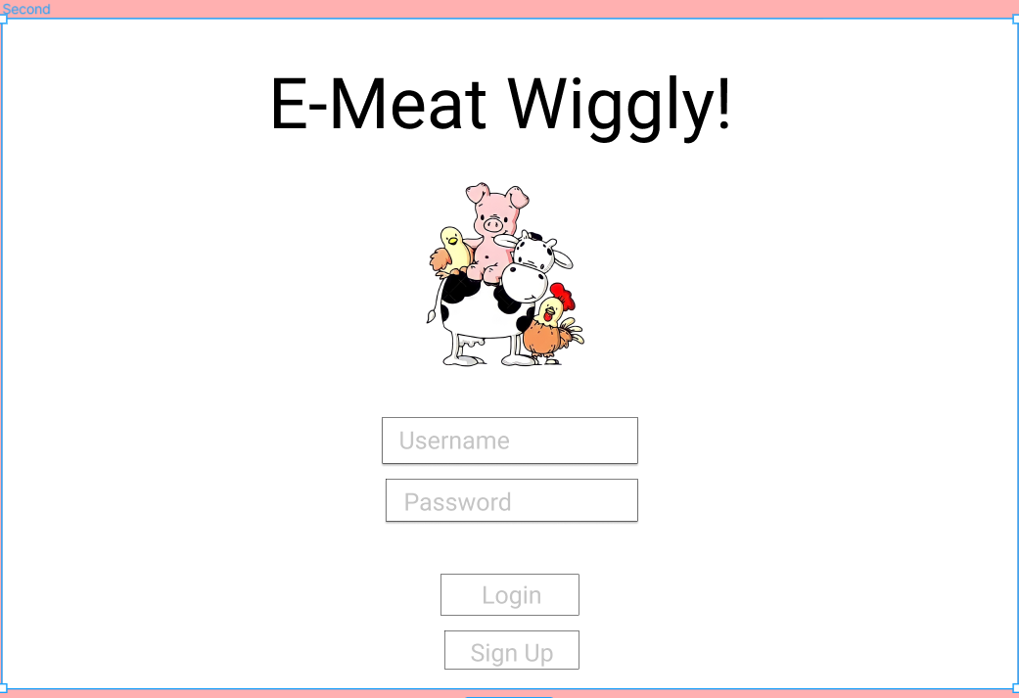
LOGIN PAGE FOR FARMERS

Slide 3
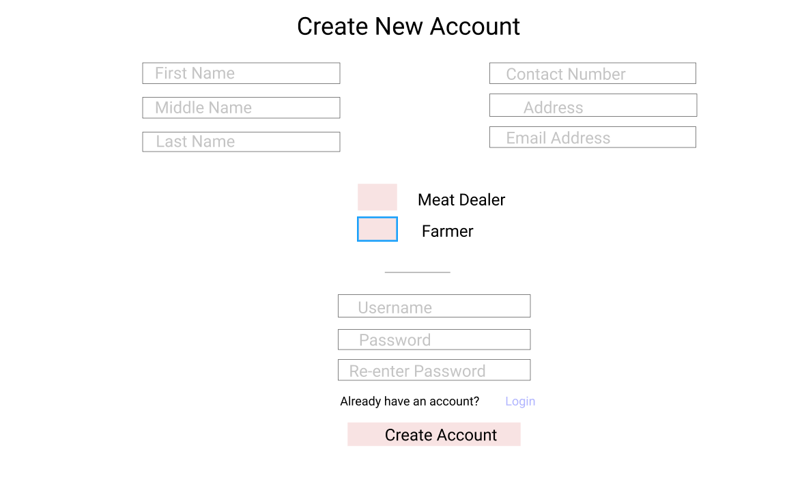
REGISTRATION FOR FARMERS

Slide 4
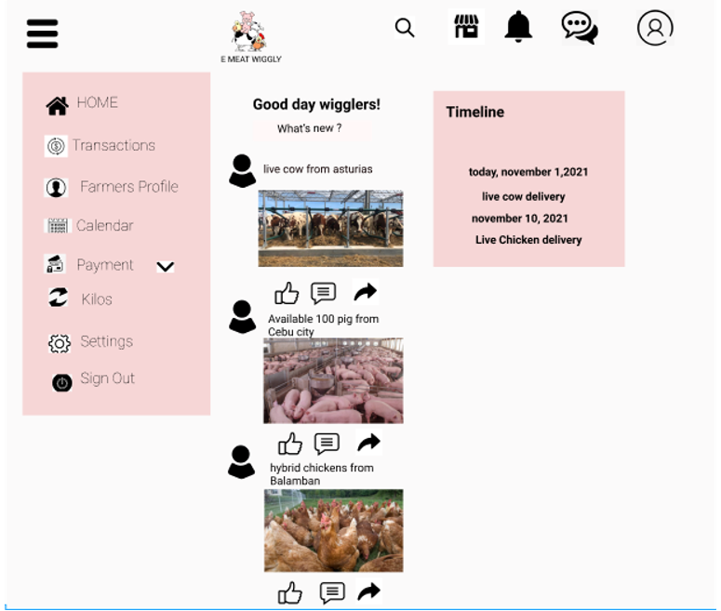
HOME

Slide 5
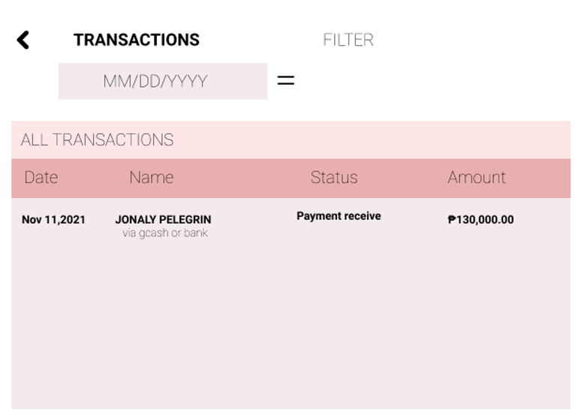
TRANSACTION

Slide 6
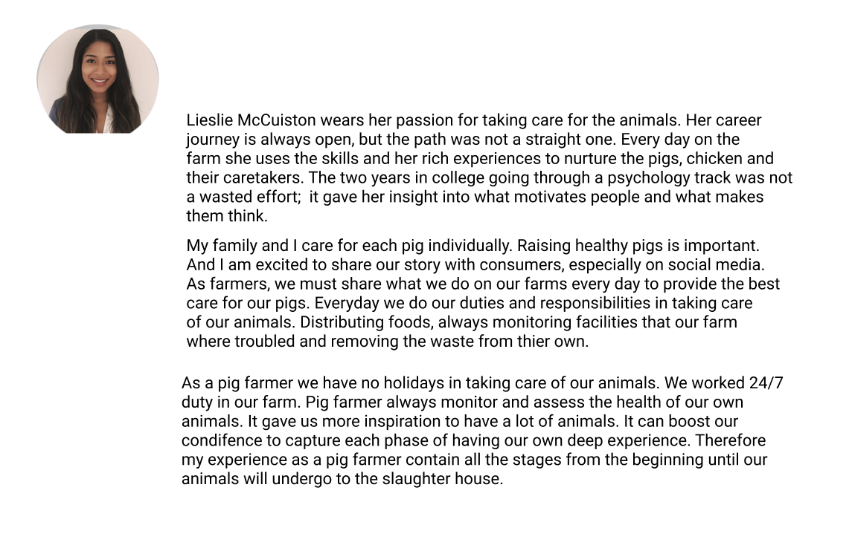
FARMERS PROFILE

Slide 7
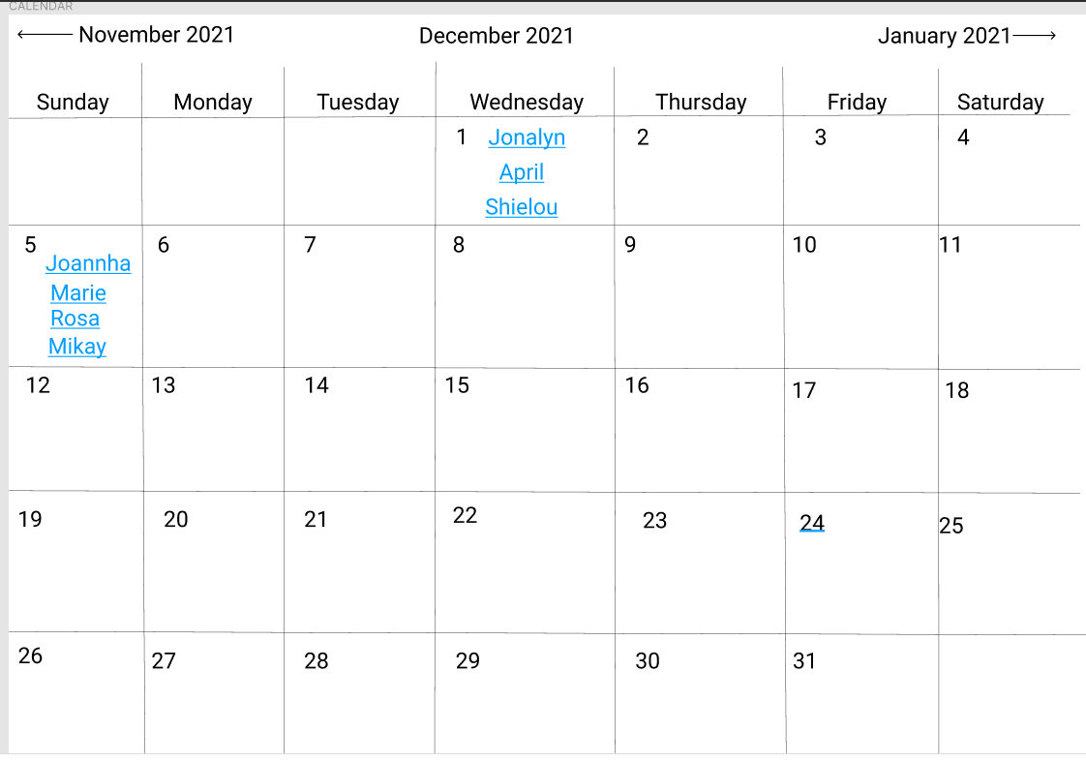
CALENDAR

Slide 8
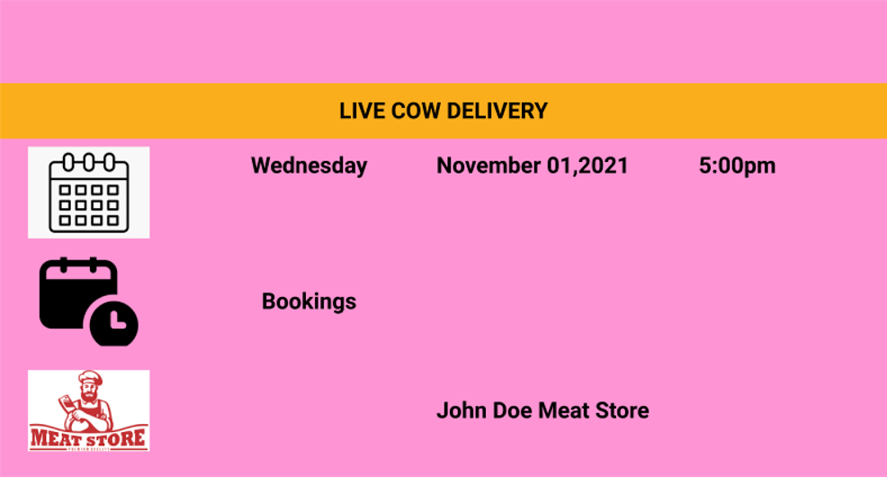

Slide 9
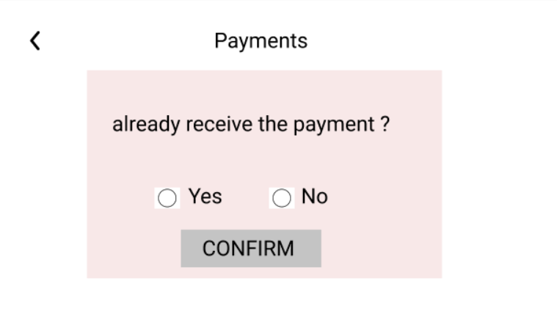
PAYMENT

Slide 10
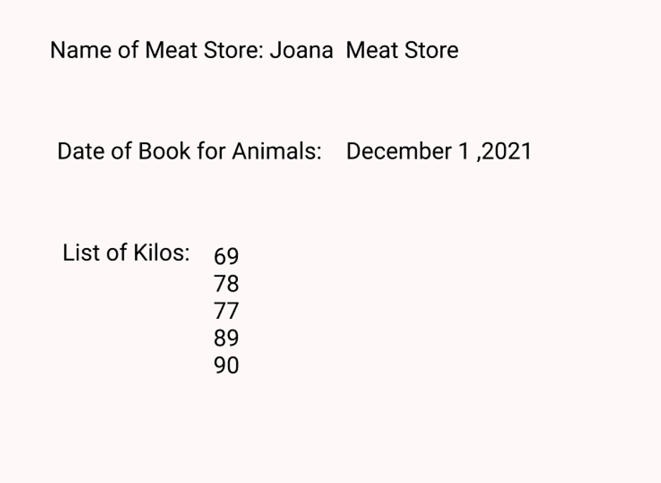
KILOS

Slide 11
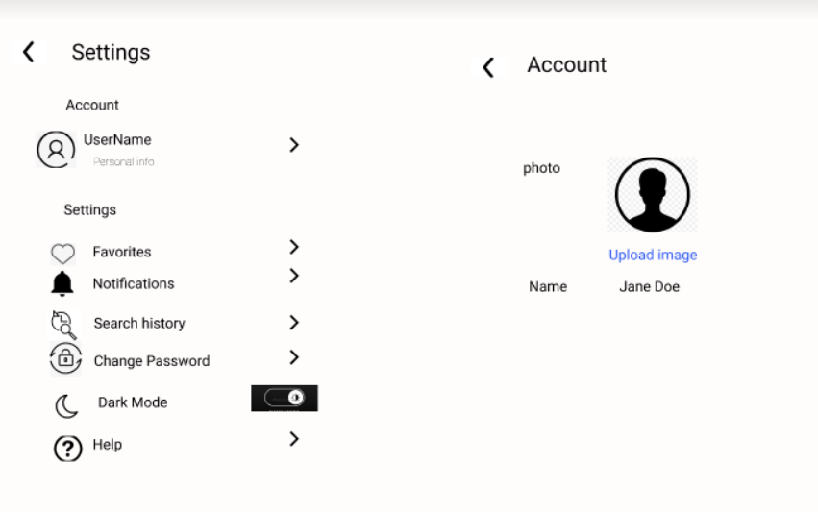
SETTING

Slide 12
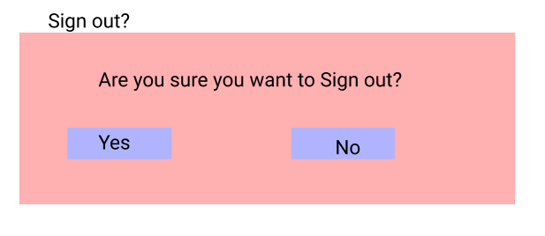
SIGNOUT

