Slide 1
Introduction to Scratch!
Michelle Venable-Foster
Barb Ericson
Dec 2007
Adventures in Animation

Slide 2
What is Scratch?
Scratch is a free programmable toolkit that enables kids to create their own games, animated stories, and interactive art
and share their creations with one another over the Internet.
Adventures in Animation

Slide 3
What is Scratch?
Scratch builds on the long tradition of Logo and LEGO/Logo, but takes advantage of new computational ideas and capabilities to make it easier for kids to get started with programming (lowering the floor) and to extend the range of what kids can create and learn (raising the ceiling).
Adventures in Animation

Slide 4
What is Scratch?
The ultimate goal is to help kids become fluent with digital media, empowering them to express themselves creatively and make connections to powerful ideas.
Adventures in Animation

Slide 5
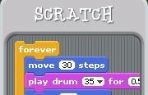
What is Scratch?
Scratch is built on top of the Squeak environment developed by Alan Kay and colleagues.
Adventures in Animation

Slide 6
What is Scratch?
Scratch is being developed by the Lifelong Kindergarten research group at the MIT Media Lab, in collaboration with KIDS research group at the UCLA Graduate School of Education & Information Studies.
Adventures in Animation

Slide 7

Let’s Get Started!
To Open Scratch, double-click on the Scratch (cat) icon or click on Scratch.exe
Adventures in Animation

Slide 8
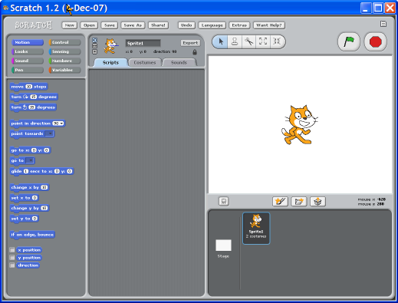
Getting Started With Scratch
Once you’ve opened Scratch, you should see this default screen:
Adventures in Animation

Slide 9
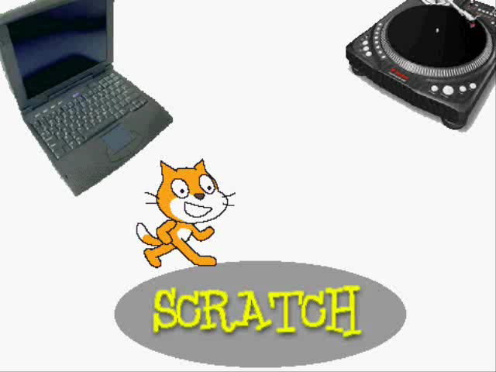
Watch a Quick Introduction to Scratch!
Adventures in Animation

Slide 10
Let’s Look At Some Scratch Examples
Go to Open > Projects and choose the category Animation
Look through them and see what you will be able to do in Scratch!
(Some of these have sound. Please be considerate of your neighbors and turn the sound down on your computers! Ask your teacher to help you if you don’t know how.)
Adventures in Animation
Notes:
Show those students who don’t know, how to turn the volume down on their computers.

Slide 11
Choose Your Sprite!
You will notice that the default sprite is an orange cat.
(A sprite is a small graphic that can be moved independently around the screen, producing animated effects.)
You can choose a different sprite to program from a library in Scratch, or you can draw your own! You will create your own sprite later.
Adventures in Animation
Notes:
You can save time if you make a collection of sprites and put them in a folder beforehand. Choose sprites of characters or people who are currently popular. The students in my camp enjoyed using cartoon characters and their own pictures.

Slide 12
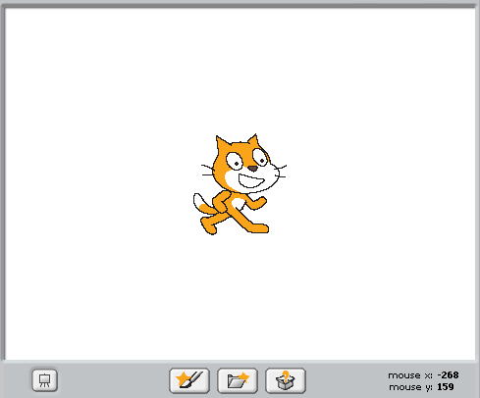
Choose Your Sprite!
To choose a sprite from the Scratch library, click on the Folder with a Star icon. When you hover your mouse over it, it will say “Choose new sprite from file”.
Adventures in Animation

Slide 13
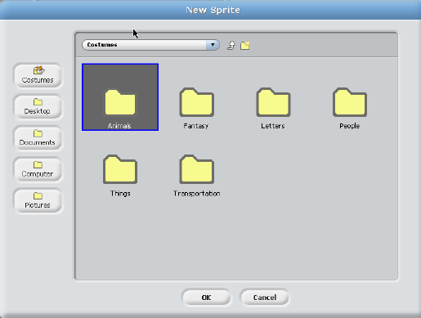
Choose Your Sprite!
Open the folders of the different categories of sprites. Choose one that you’d like to experiment with by double clicking on it. You can have more than one sprite in your animation!
Adventures in Animation

Slide 14
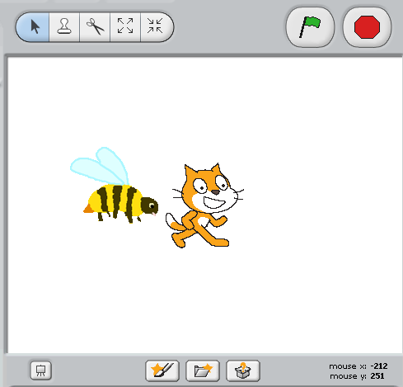
Choose Your Sprite!
Once you have a sprite that you’d like to program, you can delete the orange cat sprite by clicking the scissor icon and clicking on the cat!
Make sure that you click on the arrow icon before you do anything else – otherwise, you’ll delete something that you really wanted!
You can also right click on the icon to delete that sprite
Adventures in Animation

Slide 15

Resize Your Sprite!
You can make your sprite larger or smaller by using the “grow sprite” or “shrink sprite” icons.
You click on one of these icons, then click on your sprite until it is the size you’d like.
Adventures in Animation

Slide 16
Choose Your Background!
Right now, you have a plain, white background – boring!
You can also change your background by choosing one from the Scratch library or creating your own!
Adventures in Animation

Slide 17
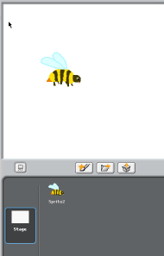
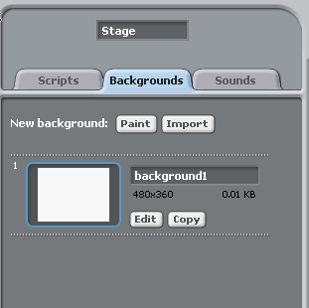
Choose Your Background!
Click on the Stage:
Now, select the “Backgrounds” tab!
Adventures in Animation

Slide 18
Change Your Background!
You can experiment with creating or importing your own background later, but, for right now – choose one from the library by selecting Import.
Adventures in Animation

Slide 19
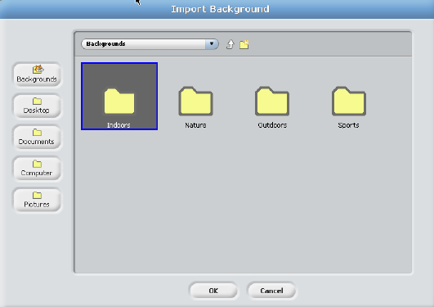
Change The Background!
From this screen, you can choose one of the category folders, and select a background that you like by double clicking on it!
Adventures in Animation

Slide 20
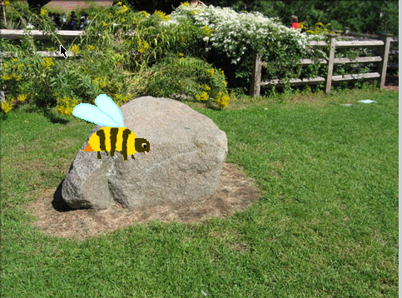
Now, We’re Ready to Program!
Now, you should have a sprite and a
background that you’d like to work
with!
Adventures in Animation

Slide 21
Programming In Scratch!
The first thing you need to do is to click on the sprite you want to program, and select the “Scripts” tab.
Since your sprite is the only thing that can be animated, make sure you have it selected.
The Scripts area is where you “build” your program by using the programming blocks.
Adventures in Animation

Slide 22
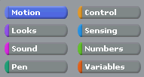
Programming In Scratch!
In the upper, left-hand corner of your Scratch window, you will see 8 buttons .
Each of these buttons have programming blocks in those particular areas.
We will first experiment with the Motion blocks.
Adventures in Animation

Slide 23
Motion!
When you click on the motion button, you will see the programming blocks that can be used with your sprite.
Let’s all program our sprites with the same code first, and then you’ll be allowed to experiment on your own!
Adventures in Animation

Slide 24

Motion!
Drag out the “move 10 steps” block.
Change the “10” to “50” by clicking in the block and typing in 50.
To see your sprite move 50 pixels to the right, double click on the block in the Script area. Cool, isn’t it?!
Adventures in Animation
Notes:
You can execute any block by double clicking on it. This is a good way to try out blocks and see what they do. You can also get help on any block by right clicking on it and selecting help.

Slide 25
Motion
You can also set the motion block to move a negative number of pixels by typing a negative number in the block.
This will move your sprite that number of pixels in the opposite direction.
Adventures in Animation

Slide 26
What Is A Pixel?
We’ve been talking about pixels – what is a pixel?
A pixel is one of the small units that make up an image on a computer or television screen.
It is derived from the words picture and element to make pixel!
Adventures in Animation

Slide 27
The Scratch Stage
The Scratch stage is 480 pixels wide and 360 pixels high.
180
-240
240
-180
Adventures in Animation

Slide 28

More Motion!
Now, add the “turn 15 degrees” block to the other block of code.
When you see the white bar between the 2 blocks of code, you can release your mouse. That white bar means that the 2 blocks will “snap” onto the other block.
Adventures in Animation

Slide 29
More Motion!
Again, you can change the number of degrees by double clicking in that area and typing in the number of degrees you’d like your sprite to rotate.
Double click on the blocks to see your sprite move and rotate!
Adventures in Animation

Slide 30
Experiment With Motion!
We’ve only used 2 of the blocks in the Motion category.
For the next few minutes, I want you to experiment with all of the other blocks in the Motion category.
If you’d like to see what a block does, right click on the block and then click on help.
You can delete code easily by just dragging it from the Script area!
Have fun!
Adventures in Animation
Notes:
Depending on the level of the group you’re working with, this can be a 5 minute or a 15 minute activity. Make sure that they are only working within the Motion category for now, so you will limit the number of questions they have at one time!

Slide 31
Control!
The next category of programming buttons we will experiment with is the Control category.
This is a very important category because it controls how many times an event happens, how long an event happens, or when an event happens.
Adventures in Animation

Slide 32

Control!
The first block I’d like us to use is the “when flag clicked” block:
Drag this block out, and snap it on top of the blocks you already have in your script.
Adventures in Animation

Slide 33
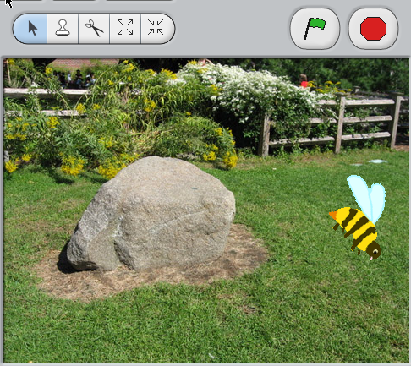
Control!
Click here to start
Now, instead of having to double click on your block of code, you can just click on the flag icon to play your animation!
Adventures in Animation

Slide 34
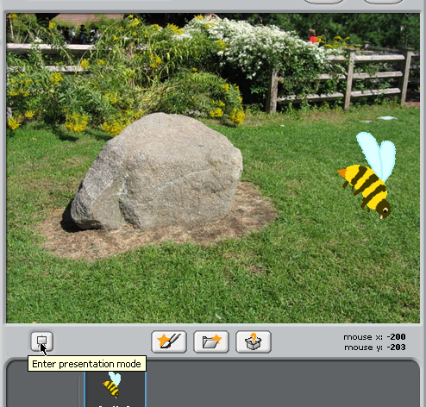
Presentation Mode
When you click on the presentation mode button, your animation will fill the whole screen!
To exit presentation mode, click the arrow in the top left of the screen, or just press the Esc key.
Adventures in Animation

Slide 35
Back to Control!
Other powerful blocks in the Control category are the blocks that handle conditional statements.
Conditional statements are commonly called “if statements” or “if-else statements”.
Adventures in Animation

Slide 36

Conditional Statements
This code means that if the user presses the Space key on the keyboard, the sprite will move 10 steps.
Adventures in Animation
Notes:
You can lead a discussion of “if statements” or “if-else statements” in the real world.
Examples: 1) If you eat all of your dinner, you may have dessert.
2) If you study for your exam, you will do well, or else, you will do badly!

Slide 37
Sensing!
The conditional statements must be used along with the sensing blocks. (Notice the shape of some of the sensing blocks. They are the ones that will fit inside the “condition” since they have 6 sides)
Adventures in Animation

Slide 38
Back to Control!
For the next few minutes, experiment with the blocks in Motion, Control, and Sensing.
Right click on a block and select help to get information about a block.
When you get something cool, I’d like to see it!
Adventures in Animation
Notes:
Again, depending on the number of students you have, and the length of their attention spans, this could be a 5 minute or a 20 minute activity.
If you have a student who needs a direct “assignment”, have him/her try to program a sprite to move in a complete circle! (Hint – there are 360 degrees in a circle.)

Slide 39
Sound!
Now, let’s add some sound to our animation!
There are many different ways to get sound in your animation.
The first way we’re going to experiment with is by importing a sound from the Scratch sound library.
Adventures in Animation

Slide 40

Importing Sound From The Scratch Sound Library
Click on the sprite you want to have sound.
Click on the Sounds tab and select Import.
Adventures in Animation

Slide 41
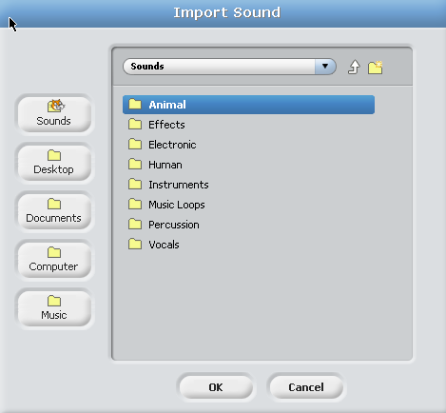
Scratch Sound Library
You will see different categories of sounds that you can use in your animation that are available for you in the Scratch library.
Adventures in Animation

Slide 42
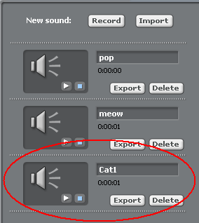
Inserting Sound
Once you find a sound that you like, select it and click on OK.
You will see the sound you just selected show up under “New Sound”.
Adventures in Animation
Notes:
You can import any wav and mp3 sound files.

Slide 43
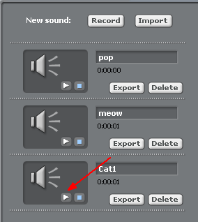
Play Your Sound
If you click on the “Play” button, you can preview your sound.
Adventures in Animation

Slide 44
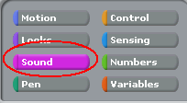
Adding The Sound To Your Animation
Now, you’re ready to add the sound to your animation!
Click on the Script tab.
Select the sprite you want to have sound.
Now select the Sound button.
Adventures in Animation

Slide 45

Adding Sound
Now, select one of the blocks that says, “play sound…”
Select your sound from the drop-down menu by clicking on the triangle next to “pop”.
Adventures in Animation

Slide 46
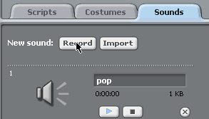
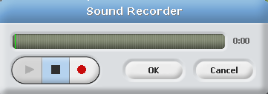

Recording a Sound
Click on the record button to record a sound
Click on the red button to start recording
Click on the square to stop
You can rename the sound by typing over the name
Adventures in Animation

Slide 47
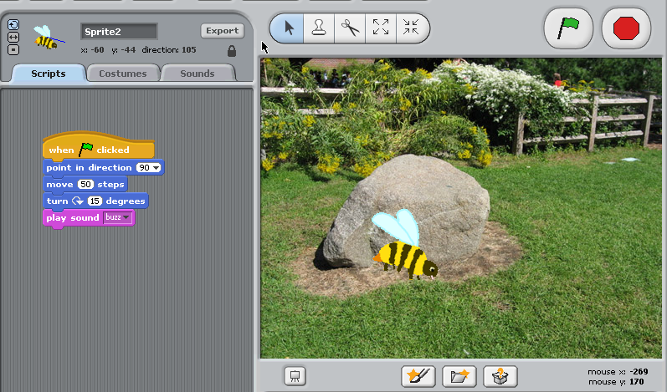
Incorporate Sound Into Your Animation!
When I click the flag, my bee will move and buzz.
Adventures in Animation

Slide 48
Time To Play!
For the next few minutes, experiment with Motion, Control, Sensing, and Sound!
When you get something cool, let me see it!
Adventures in Animation

Slide 49
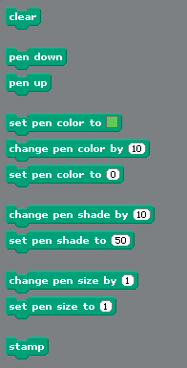
Using The Pen!
When using the Pen tools, your sprite actually becomes your writing instrument!
You can change the Pen’s color, its shade, and its size.
Adventures in Animation

Slide 50
Using the Pen!
Your first Pen challenge is to write your initials using the Pen tools.
It may sound easy, but, you have to remember to lift your pen when necessary and also to put it back down!
Adventures in Animation
Notes:
You might want to offer a little prize or reward to the first person to complete this challenge correctly.
This activity may take them about 15 minutes.

Slide 51
Pen Challenge #2
Great job with Pen Challenge #1!
Your second Pen Challenge is to use the tools to create an interesting design.
Remember that you can change Pen color and shade!
Adventures in Animation
Notes:
You might want to have the students vote on the most creative design, and offer the winner a small reward.

Slide 52
Numbers!
There are many animation effects you can create using Numbers in Scratch.
One effect is random movement of a sprite!
Adventures in Animation

Slide 53
Random Movement
Remember that the Scratch animation area is 480 pixels wide and 360 pixels high.
That means that the range on the horizontal axis is from -240 to 240.
The range on the vertical axis is
-180 to 180.
Adventures in Animation
Notes:
You can ask who remembers which two words were combined to create the word pixel.
To help them remember “horizontal” is the x-axis, tell them to think about the horizon.

Slide 54
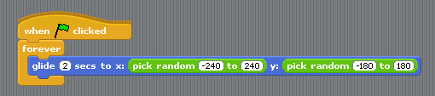
Random Movement
This is the block of code I would use if I wanted my sprite to randomly glide the entire horizontal and vertical distance of my Scratch animation area:
Adventures in Animation
Notes:
You can change the amount of time it takes the sprite to glide to the new location.

Slide 55
Numbers!
For the next few minutes, experiment with the tools in Motion, Control, Sensing, Sound, and Numbers.
Click right on a block and select help to see what it does.
When you get something cool, let me see it!
Adventures in Animation

Slide 56
Variables!
Variables are used mainly in the development of games.
Open some of the examples in Projects > Games to see how variables are used to keep score in a game.
Adventures in Animation

Slide 57
Time To Have Fun!
Now it’s time for you to create your own original animations or games!
Each table has a set of 12 laminated cards with different projects that you can try, to give you ideas for your own animation.
Adventures in Animation

Slide 58
Learn How To:
While you’re creating your own Scratch animation, I want you to discover how to:
  Create your own sprite;
  Create your own background;
Adventures in Animation
Notes:
You may want to find some appropriate websites for the students to use to import their own sounds. This will alleviate off-task behavior of the students surfing the internet.

Slide 59
Last Slide!
Remember to:
  Be appropriate;
  Be creative;
  Have fun!
You will also be given a Scratch Help Guide, complete with screenshots to help you get started.
Adventures in Animation
Notes:
No unnecessary violence, no profanity, no profane lyrics, no references to drugs or alcohol.

