Slide 1

Secure and Scalable File Server Migration
With Ethical Oversight and Automation
J Nuttall – Lead Engineer| Internship Final Presentation

Slide 2

Project Overview
Original Goal:
Consolidate user and public drive data into a centralized server for better performance and scalability.
Enhanced Scope:
Addressed complex technical challenges and embedded ethical standards to ensure secure, transparent, and efficient migration.

Slide 3
Key Accomplishments
Migrated 7,000+ user data profiles from DC-3 and DC-4 to fs-01
Consolidated 40 public drives from apps-01 and apps-02
Automated migration using PowerShell and Python
Updated GPOs across 40 OUs
Validated data integrity with automated checks
Minimized downtime and improved compliance

Slide 4
Complex Challenges Addressed
Data Integrity: Ensured through validation checkpoints in scripts
Privilege Management: Used Just-in-Time access controls
Policy Drift: Solved with GPO automation and logging
Downtime Risk: Mitigated via staged rollouts and scheduling

Slide 5
Ethical Considerations
Data Privacy: Migration tools respected locked files and user sessions
Authorization: Only approved admins had access; activity logged
Transparency: Users notified of changes; process documented
Accountability: Followed Acceptable Use Policy and conducted ethical reviews

Slide 6

Enhanced Tools & Techniques
PowerShell + Python scripting for automation
GPO templating and auditing
Real-time server monitoring (Grafana + WMI)
Documented processes, SOPs, and post-training sessions

Slide 7
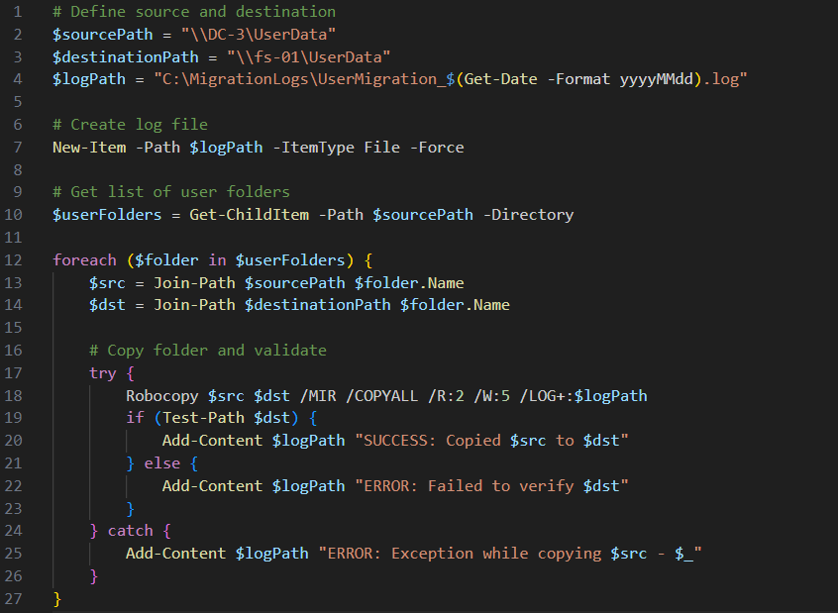
Enhanced Tools & Techniques
PowerShell Script Example:

Slide 8
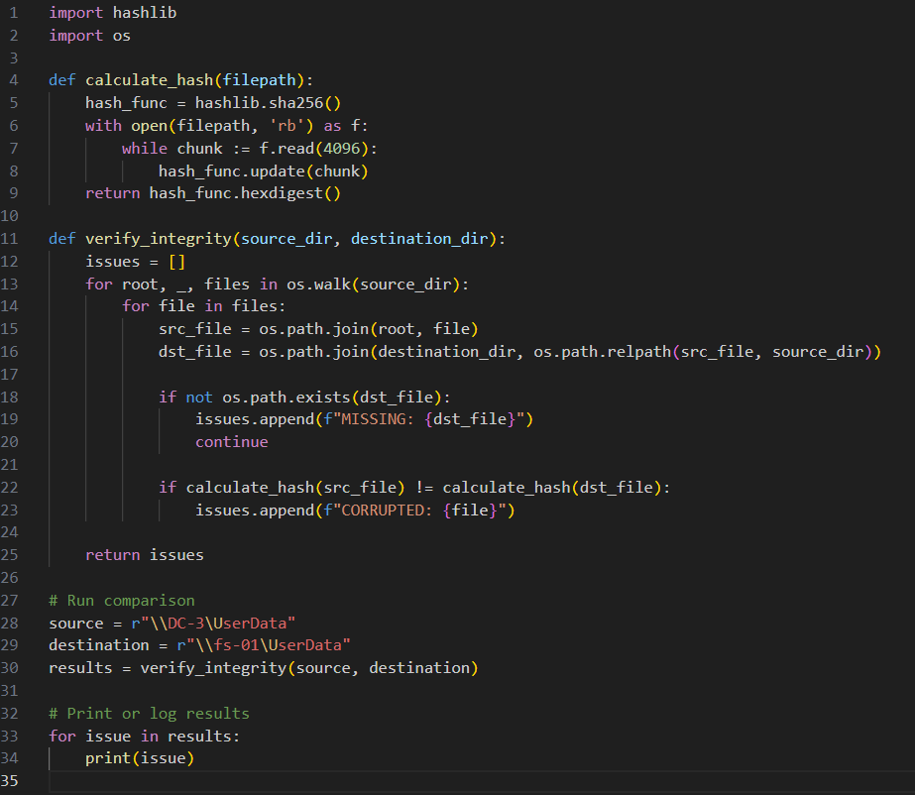
Enhanced Tools & Techniques
Python Script Example:

Slide 9

Reflection on Coursework Integration
Scripting Modules: Strengthened logic and structure
Systems Admin Labs: Applied best practices from lab scenarios
IT Ethics Lessons: Shaped the handling of user data and permissions
Project Planning Skills: Used Gantt charts and tracked milestones

Slide 10
Final Recommendations
1. Implement ongoing access auditing tools
01
2. Review admin privileges quarterly
02
3. Continue training staff on new procedures
03
4. Simulate disaster recovery annually
04

Slide 11

Professional Growth & Next Steps
Growth:
Mastered scripting and server automation
Led a complex infrastructure migration
Next Goals:
Earn Bachelor’s and Systems Admin Certifications
Continue leading secure infrastructure projects

Slide 12
Thank You
Questions or Comments?
“Efficiency without ethics is a liability.”

