Slide 1
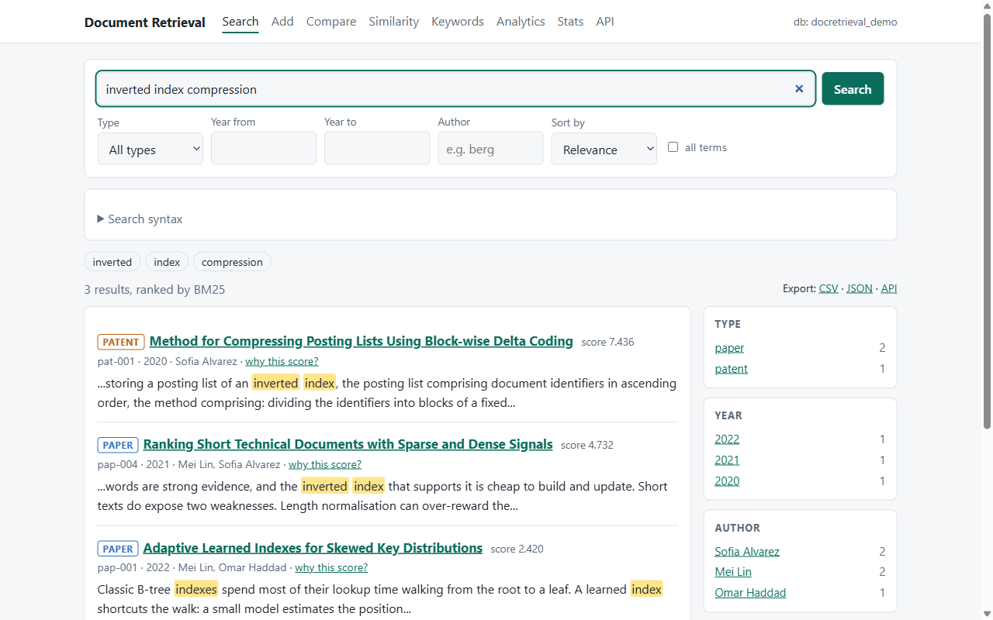
Large-scale Document Retrieval System
Experiment 5 · MongoDB and GridFS
Papers, patents, technical reports and engineering drawings
4
6
127
document types
functions
automatic tests
Database Systems · 2026
Notes:
Good day everyone. My topic is Experiment 5: a large-scale document retrieval system.
It stores four kinds of documents - papers, patents, technical reports and engineering drawings - in MongoDB, and it lets you search them, read them, compare them, find related ones, and download the originals.
Everything you will see is running for real on a MongoDB database. I will show the design first, then each function, and then the code behind it.
(About half a minute here. The three numbers on the right are the whole story in short: four document types, six functions, 127 automatic tests.)

Slide 2
What the system has to do
Six functions
Paper
Patent
1
Storage add documents with their original files
text and metadata
claims and description
2
Retrieval ranked search with filters
3
Reading one page at a time
Technical report
Engineering drawing
4
Comparison how alike are two documents
text and metadata
a binary file (PNG, DXF...)
5
Association related documents, graph, keyword pairs
6
Download get the original file back
One system for all four types: even a drawing is found through its title, keywords and description.
NoSQL product: MongoDB (pymongo) + GridFS
Notes:
The assignment asks for a system that collects and stores four kinds of documents, and offers six functions: storage, retrieval, reading, comparison, association analysis and download. It has to be built on a NoSQL product.
I chose MongoDB, with the pymongo driver, and GridFS for the files.
One design point I want you to notice: the text documents and the engineering drawings go through the same system. A drawing is a real binary file - in my samples a PNG image - kept in GridFS. It can still be found, because it has a title, keywords and a description that are indexed like any other text.

Slide 3
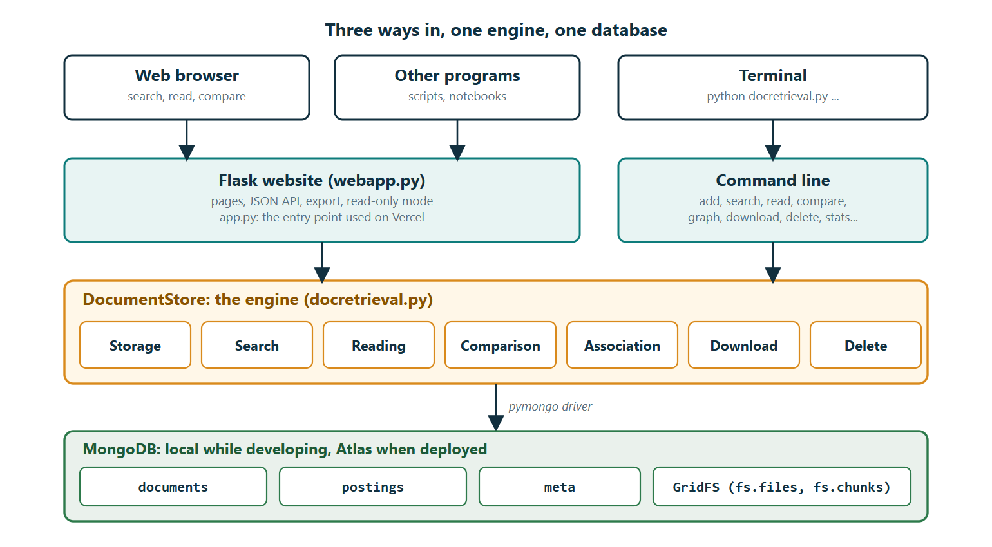
Three ways in, one engine, one database
Notes:
This is the architecture. There are three ways in: the website in a browser, a JSON API for other programs, and a command line in the terminal.
All three call the same engine - a Python class called DocumentStore, in the file docretrieval.py. The engine is the only part that talks to MongoDB, through the pymongo driver.
That has a practical benefit: a feature is written once and works on the website, in the API and on the command line, and my automatic tests can test the engine directly.
At the bottom is the database: the collections documents, postings and meta, plus GridFS for the original files. While developing I used a local MongoDB; the deployed website uses MongoDB Atlas, which is the same database in the cloud.

Slide 4
Why MongoDB and GridFS
1
2
3
Flexible records
GridFS for the files
Index in MongoDB
Papers, patents, reports and drawings share one collection. Authors and keywords are arrays inside the record, so one read returns a whole document and no join tables are needed.
A file is cut into 255 KB chunks (fs.chunks) and described in fs.files. Drawings and PDFs of any size live in the same database, and are backed up and deleted with it.
The inverted index is a collection with a unique index on (term, doc_id). A search is an ordinary indexed query: nothing extra to install or keep in step.
Considered and rejected: files on disk with only paths in the database. A delete could leave orphan files, and the database and the files would not be backed up together.
Notes:
Three reasons for this choice.
One, flexible records. The four document types share one collection. A drawing has no body text and a patent has claims, but that does not need different tables. Authors and keywords are arrays inside the record, so reading one document is one read, with no join tables.
Two, GridFS. A normal MongoDB record is limited to 16 megabytes and is not meant for big files. GridFS cuts a file into 255-kilobyte chunks stored in fs.chunks and describes the file in fs.files. So drawings and PDFs of any size live in the same database, are backed up with it, and are deleted with it.
Three, the search index lives in the database too. The inverted index is just a collection with a unique index, so a search is an ordinary indexed query and there is nothing extra to install.
I considered keeping files on disk and storing only their paths in the database. I rejected it: deleting a document could leave an orphan file behind, and the database and the files could be backed up at different moments.

Slide 5
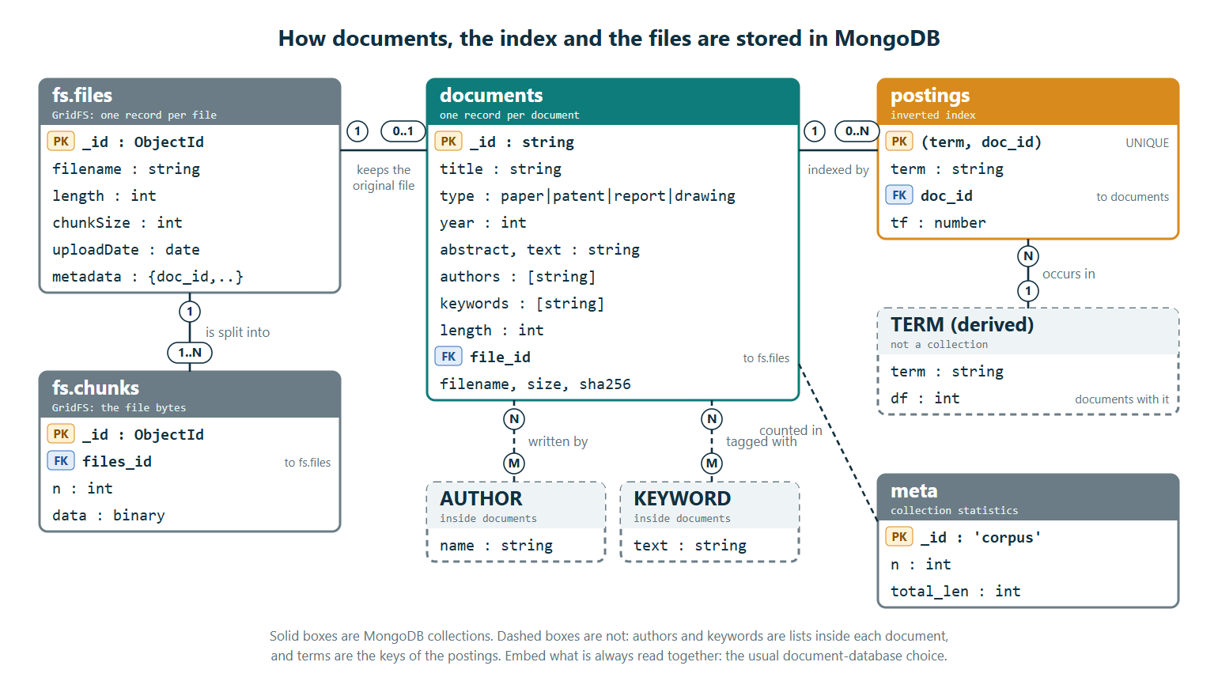
The data model (ER diagram)
Notes:
This is the data model, as an entity-relationship diagram. There are five collections.
In the middle, documents: one record per document, of any of the four types. It holds the title, type, year, abstract and text, and the authors and keywords as lists inside the record. Authors and keywords are drawn as dashed boxes because I embedded them instead of making separate collections: they are always read together with the document, which is the normal choice in a document database.
On the right, postings is the inverted index. One record for each pair of a term and a document, with the weighted count of that term. The pair (term, doc_id) is the primary key, and I enforce it with a unique index. One document has many postings; a term is the key of many postings. The term box is dashed: there is no terms collection, the vocabulary is simply the set of values in postings.
On the left is GridFS. fs.files has one record per stored file, and fs.chunks holds the bytes in pieces: one file has one or more chunks. A document has zero or one file, linked by file_id.
Bottom right, meta holds two counters - the number of documents and their total length - which the ranking formula needs.
Point at the cardinalities as you go: one document, zero-or-one file, zero-or-many postings.

Slide 6
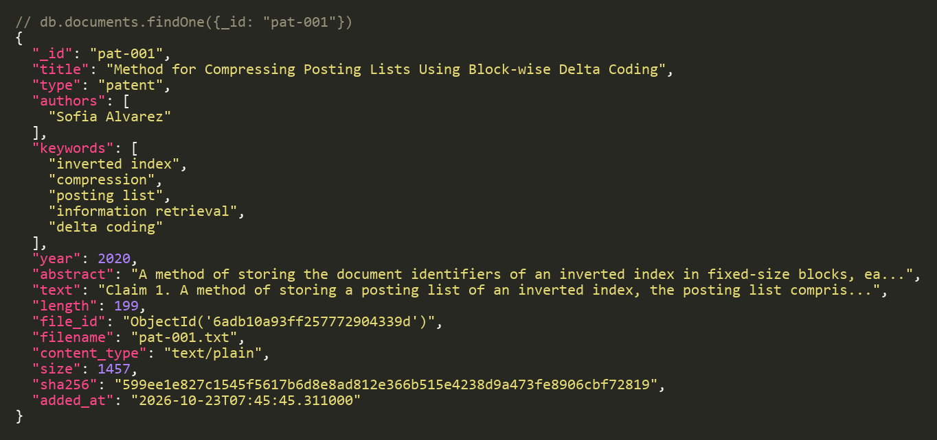
What one stored document looks like
_id readable id; the first letters show the type
authors, keywords arrays inside the record
length weighted number of terms, used by BM25
file_id points to the original file in GridFS
sha256 fingerprint that proves a download is intact
A real record from the demo database (text shortened for the slide)
A drawing uses the same record: its text is the description, and file_id points to a binary PNG.
Notes:
Here is a real record from my database, a patent with the id pat-001. The text is shortened for the slide.
The _id is a readable id: the first letters show the type, here "pat" for patent. The type field is one of paper, patent, report or drawing.
Authors and keywords are arrays inside the record.
The field length is the number of weighted terms in the document - I will use it when I explain ranking.
file_id points to the original file in GridFS, and next to it I keep the file name, type and size, plus a SHA-256 fingerprint. When someone downloads the file, I recompute the fingerprint and compare, so I can prove the file came back intact.
A drawing uses exactly the same record. Its text is the description, and its file_id points to a binary PNG.

Slide 7
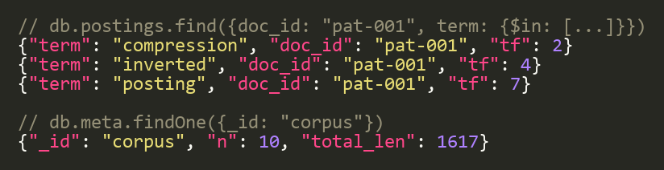
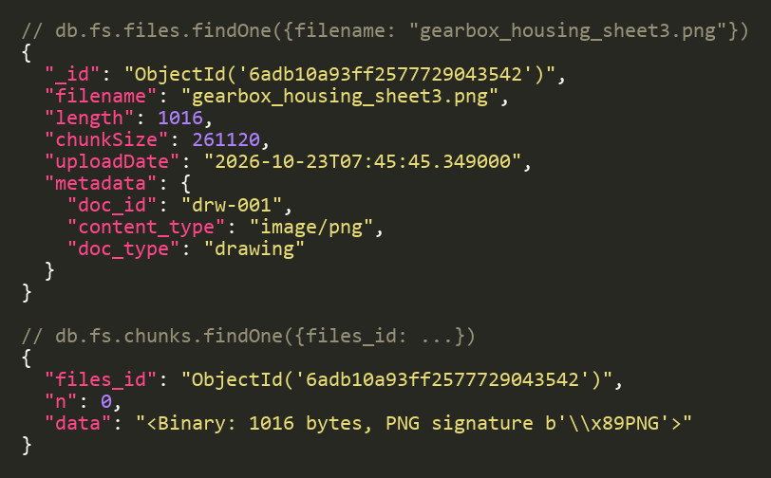
The inverted index and the original file
postings: one record per term and document
GridFS: the original file in pieces
tf is a weighted count: a word in the title counts 3, in a keyword 2, in the text 1. The demo has 945 postings for 701 distinct terms in 10 documents.
The 1,016-byte PNG fits in one 255 KB chunk (n: 0). Bigger files simply get more chunks.
Notes:
On the left, the inverted index. A posting says: this term occurs this many times in this document. For the patent pat-001, the word "posting" has a count of 7, "inverted" 4 and "compression" 2. The count is weighted: a word in the title counts three, in a keyword two, in the text one.
My demo has ten documents, 945 postings and 701 distinct terms. The meta record shows the two counters: 10 documents and a total length of 1,617, which gives an average length of 161.7 terms.
On the right, GridFS. fs.files describes the drawing: its name, its length of 1,016 bytes, the chunk size of 261,120 bytes - that is 255 kilobytes - and metadata that points back to the document. fs.chunks holds the bytes. The file is small, so it fits in one chunk, number 0, and you can see the PNG signature at the start of the data. A bigger file would simply have more chunks.

Slide 8
Storing a document, step by step
1
Input
2
Validate
3
Get text
4
Analyse
5
Weight
6
Write
metadata
title and type
given text,
lower-case
title word: x3
file to GridFS
text (if any)
year is sensible
or .txt / .pdf,
drop stop words
keyword: x2
record, postings
original file
id is free
or description
strip plurals
text: x1
counters
error: undo all
All or nothing
No duplicates
Counters stay right
If any write fails, the file, record and postings already written are removed again.
A unique index on (term, doc_id) makes MongoDB itself refuse a second posting for the same pair.
meta keeps the document count and total length with $inc, so ranking never scans everything.
Notes:
This is what happens when I add a document. There are six steps.
One, the input: the metadata, the text if I have it, and the original file.
Two, validation: the title must not be empty, the type must be one of the four, the year must be plausible, and the id must not exist already. If this fails, nothing at all is written.
Three, get the text: use the text I was given; otherwise read it from a .txt or .pdf file; for a drawing, the description is the text.
Four, analyse the text: lower-case, split into words, drop stop words like "the" and "of", and strip plural endings, so "gearboxes" becomes "gearbox".
Five, weight the terms: title words count three, keyword words two, everything else one.
Six, write: first the file to GridFS, then the record to documents, then one posting per term, then update the counters.
Three guarantees at the bottom. If any write fails, everything already written is removed again - all or nothing. A unique index makes MongoDB itself refuse a second posting for the same term and document. And the counters are updated with an atomic $inc, so ranking never has to scan the whole collection.

Slide 9
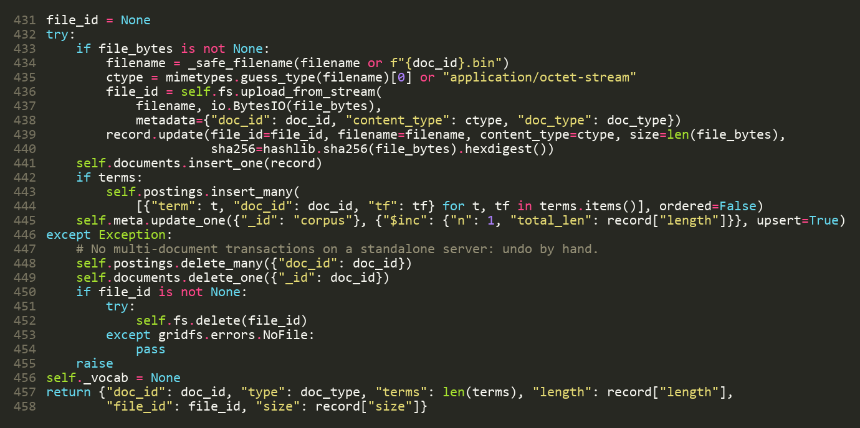
Code: writing the file, the record and the index
1
The original file goes to GridFS; its name, type, size and SHA-256 join the record (lines 433-440)
2
The record goes into documents (441)
3
One posting per term, in one insert_many (442-444)
4
Counters updated with $inc (445)
5
Any error: undo everything by hand (446-455)
docretrieval.py, add_document()
Notes:
This is the heart of add_document, lines 431 to 458 of docretrieval.py.
Inside the try block: first, if there is a file, it is uploaded to GridFS with upload_from_stream, and its name, type, size and SHA-256 are added to the record. Then the record goes into the documents collection with insert_one. Then all the postings go in with a single insert_many - one posting per term. Then the counters are updated with $inc.
The except block is the safety net. MongoDB on a single server has no multi-document transactions, so I undo by hand: delete the postings, delete the record, and delete the GridFS file, then re-raise the error. That is how I get all-or-nothing storage.
If asked: I tested this too - a test adds a document with a duplicate id and checks that nothing, no file and no posting, is left behind.

Slide 10
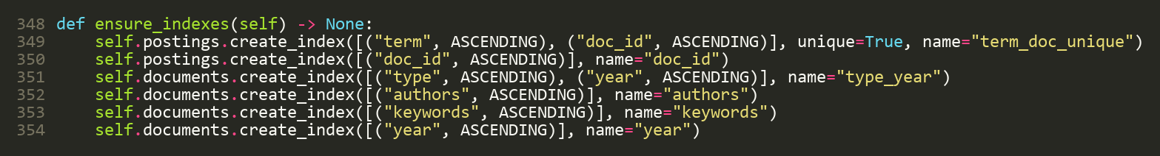
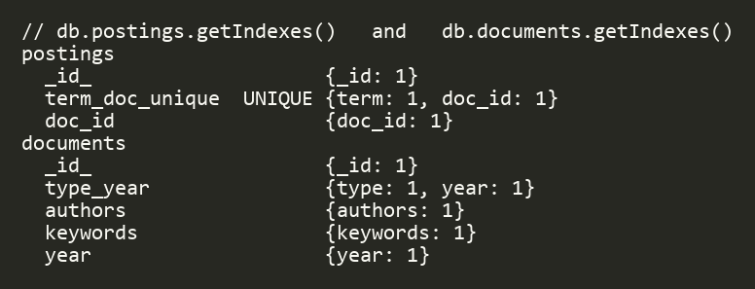
Indexes keep every lookup fast
(term, doc_id), unique: finds every document of a term, and refuses duplicates
doc_id: rebuilds one document's term vector and deletes its postings
(type, year), authors, keywords: serve the filters and the keyword counts
What MongoDB reports for these two collections
Notes:
Indexes are what make this scale. At the top is the code that creates them, run automatically when the program connects.
The most important one is on postings: term and doc_id together, marked unique. It does two jobs. First, it finds all documents that contain a term very quickly, because term is the first part of the index. Second, it guarantees one record per term and document.
There is a second index on doc_id alone, to rebuild a single document's term vector for comparison, and to find every posting of a document when I delete it.
On documents, indexes on type and year, authors and keywords serve the filters and the keyword counts.
The bottom left is the real output of MongoDB's getIndexes, which proves the unique index exists.

Slide 11
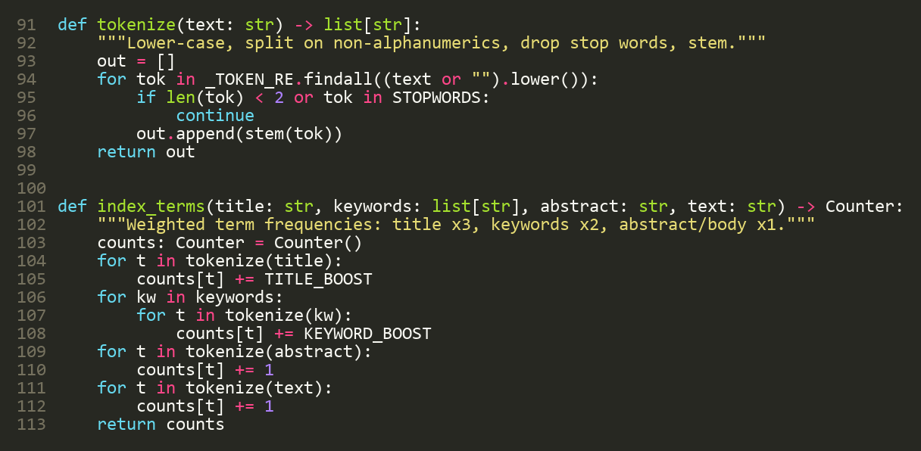
From words to index terms
Example
Title: “Gearboxes of wind turbines”
lower-case, split
gearboxes · of · wind · turbines
drop stop words
gearboxes · wind · turbines
strip plurals
gearbox · wind · turbine
Stop words and one-letter words are dropped
Only plural endings are stripped (not a full stemmer)
The same function analyses the query, so words match
weight (title x3)
gearbox 3 · wind 3 · turbine 3
Notes:
Before anything is indexed, text goes through a small analysis step. The function tokenize lower-cases the text, splits it on anything that is not a letter or digit, drops stop words and one-letter words, and strips plural endings. index_terms then counts the terms with weights: title three, keywords two, abstract and text one.
The example on the right: the title "Gearboxes of wind turbines" becomes gearboxes, of, wind, turbines. The stop word "of" is dropped. Plurals are stripped, giving gearbox, wind, turbine. And because they come from the title, each gets weight three.
The same function is applied to the search query, which is why a search for "turbine" finds a document that says "turbines".
I should be honest about the limit: I only strip plurals, not a full stemmer, so "optimize" and "optimization" are different terms. That is on my list of next steps.

Slide 12
Searching: the pipeline
1
Query
2
Parse
3
Look up
4
Score
5
Filter
6
Present
"posting list"
terms
postings of each
BM25 per term
type, year,
rank by score
-sensor
phrases
term: one query,
rare = heavier
author, keyword
snippets
type:patent
exclusions
uses the index
long = penalised
excluded words
facet counts
filters
exact phrase
10 per page
The query language
"posting list"
the words must appear next to each other
vibration -sensor
leave out documents that contain the word sensor
type:report year:>=2023 author:berg
filters, with words or on their own
Notes:
Now the first function, retrieval. This is what happens when you type a query.
One, the query text. Two, it is parsed: words become terms, a phrase in quotes is remembered, a minus sign marks an excluded word, and words like type:patent or year:>2019 become filters. Three, one query on the postings collection fetches the records of all the query terms - this uses the unique index. Four, each candidate document is scored with BM25. Five, the filters are applied: type, year, author, keyword, title words, excluded words, and the exact phrase is checked in the stored text. Six, the results are ranked, with a snippet showing the matches, counts for the facets, and ten results per page. If nothing matches, I look for a spelling suggestion.
At the bottom are three example queries. A phrase in quotes. A minus to exclude a word. And filters, which can be combined with words or used alone.
It is all one function, search_ex, shared by the website, the API and the command line.

Slide 13
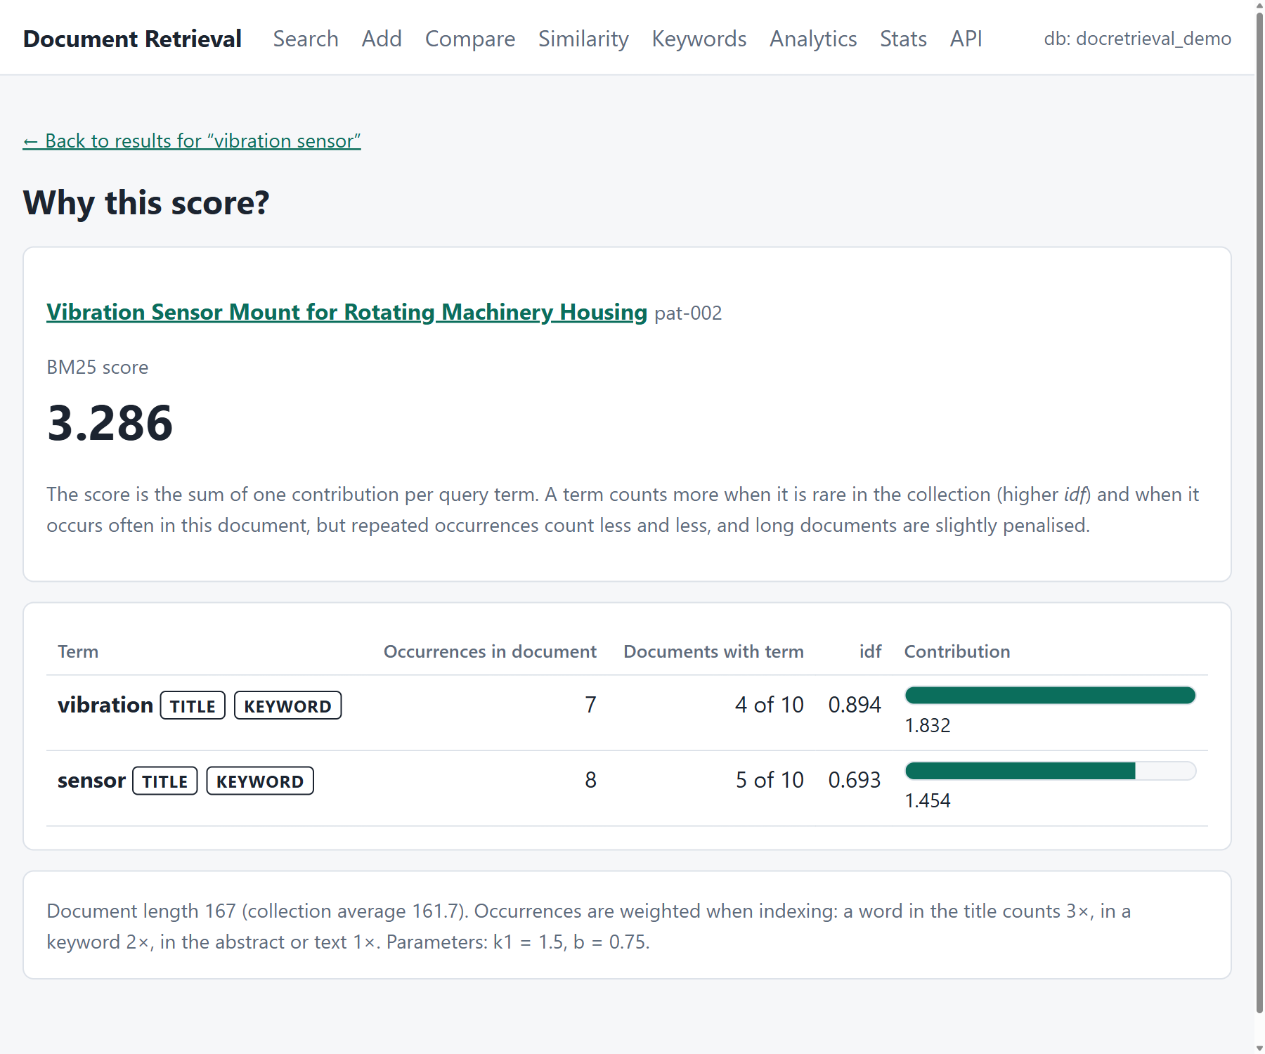
Ranking with BM25
score = Σ idf × tf × (k1 + 1) / (tf + k1 × norm)
norm = 1 − b + b × len / avglen
idf = ln(1 + (N − df + 0.5) / (df + 0.5))
k1 = 1.5, b = 0.75
Rare words weigh more (idf)
Repeats help, with diminishing returns
Long documents are slightly penalised
pat-002, “vibration sensor”: 1.832 + 1.454 = 3.286
Notes:
Results are ranked with BM25, the standard ranking formula in search engines. The score of a document is the sum, over the query terms, of one contribution per term.
Each contribution has three ideas. First, rare words weigh more: that is idf, the inverse document frequency. A word in only one document is strong evidence; a word in every document tells you nothing. Second, repeating a word helps, but with diminishing returns: the fifth occurrence adds much less than the first. Third, long documents are slightly penalised, so a long document does not win just by being long. The constants are k1 equals 1.5 and b equals 0.75, the usual values.
A real example from my data: the patent pat-002 for the query "vibration sensor". "Vibration" appears 7 times in it and in 4 of the 10 documents, so its contribution is 1.832. "Sensor" appears 8 times and in 5 documents, so 1.454. The total is 3.286.
On the right is the page I built to explain this: "why this score?". It shows each term, how often it occurs, how rare it is, and a bar for its contribution, and the numbers add up to exactly the score in the results list - I have a test that checks that.

Slide 14
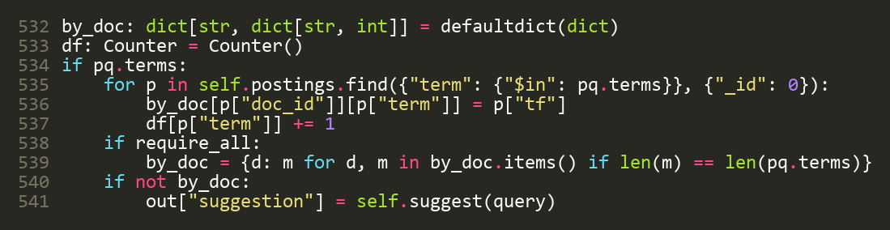
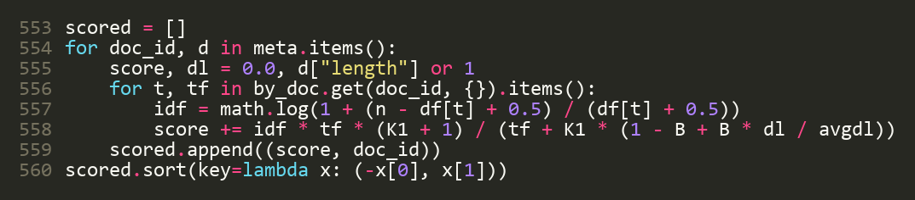
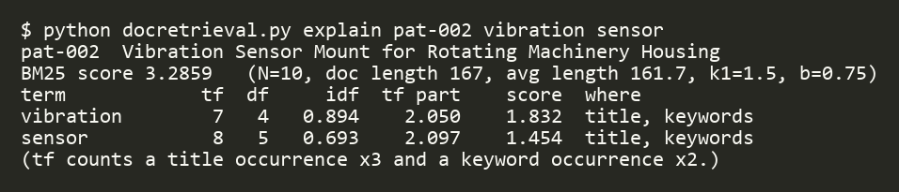
Code: fetching postings and scoring
1
One query fetches the postings of all query terms and counts document frequency (lines 532-541)
2
The BM25 formula, as on the previous slide (lines 553-560)
3
The same numbers from the command line: the explain command
Notes:
Here is the code. The top part, lines 532 to 541: one query on the postings collection with $in over all the query terms. For each posting I record the term count for that document, and I count how many documents have each term - that is df.
The middle part, lines 553 to 560, is the BM25 formula exactly as on the previous slide: for each candidate document and each of its matching terms, idf times the saturated term frequency with length normalisation, added up. Then the list is sorted by score, and ties are broken by id so the order is stable.
At the bottom is the same computation on the command line, with the explain command: the same two numbers, 1.832 and 1.454, adding up to 3.286.

Slide 15
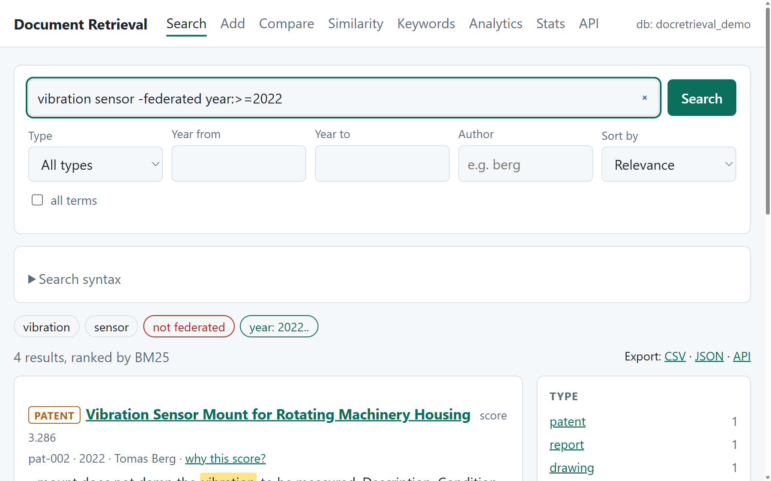
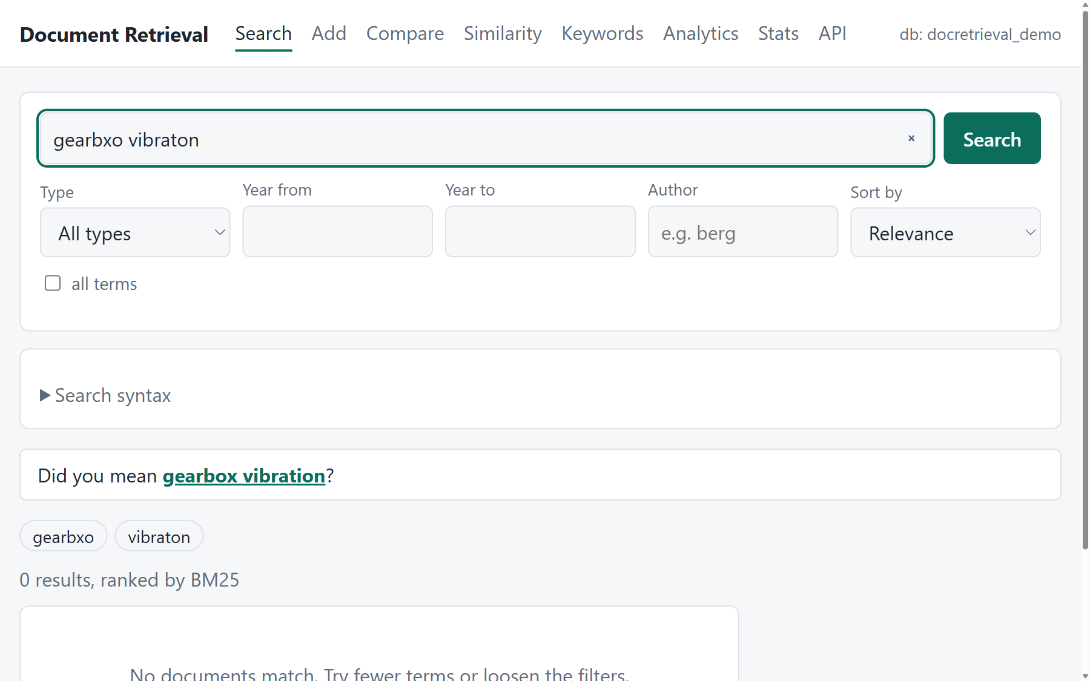
Query language, facets and spelling help
Phrases, exclusions and filters; the facet sidebar counts all matches and adds a filter when clicked
An unknown word gets a suggestion: gearbxo vibraton becomes gearbox vibration
10 results per page
Sort: relevance or newest
Export: CSV or JSON
Notes:
Let me show this on the website. On the left, the query "vibration sensor", minus "federated", with year greater than or equal to 2022. Under the search box the page shows how it understood the query: two terms, one excluded word, one year filter. Every result has a snippet with the matching words highlighted, and a "why this score" link.
The sidebar on the right shows facets: how many results there are of each type, year, author and keyword. These count all the matches, not just this page, and clicking one adds that filter to the query.
On the right-hand screenshot, I misspelled two words: "gearbxo vibraton". There are no results, but the page suggests "gearbox vibration". The suggestion uses the vocabulary of the index: for an unknown word it picks the closest indexed word, within one or two edits.
Results come ten to a page, can be sorted by relevance or by newest first, and can be exported as CSV or JSON.

Slide 16
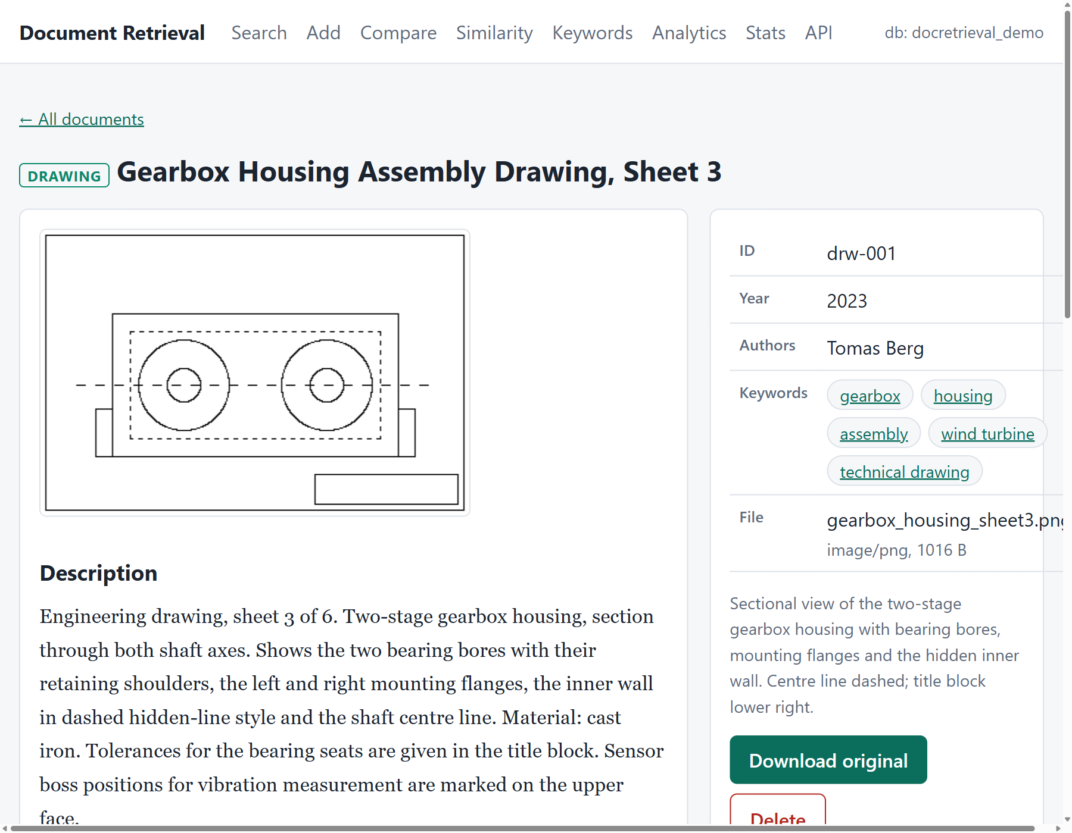
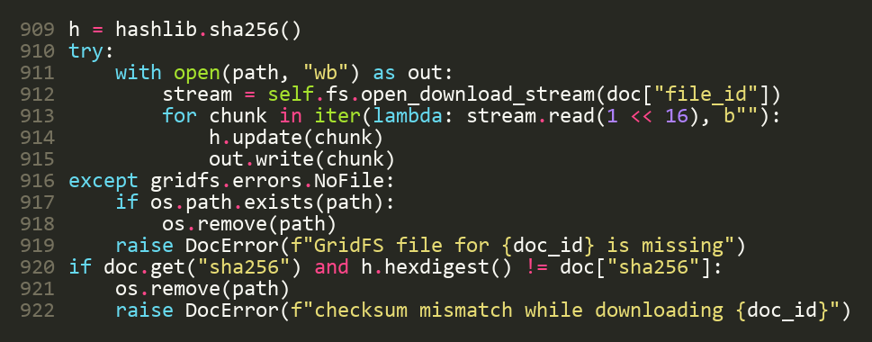
Reading and downloading
Reading: pages of about 1,000 characters, cut at paragraph or word breaks; the pages join back into the exact original
Download: streamed out of GridFS, SHA-256 checked, never overwrites
Safety: images and PDFs open in the browser; any other file is forced to download
A drawing: the binary PNG comes from GridFS
Notes:
Reading and downloading. This is the page of a drawing. The picture is a real binary PNG, fetched from GridFS. The text under it is the description that is indexed.
Reading is paginated. The text is cut into pages of about a thousand characters, preferably at a paragraph break and otherwise at a word break, so no word is split. The pages join back to exactly the original text - I test that.
Downloading is the code on the right. It opens a stream from GridFS and copies the file out 64 kilobytes at a time, computing a SHA-256 on the way. If the fingerprint does not match the one stored when the file was added, the download is rejected and the partial file removed. It never overwrites an existing file; it adds a number to the name instead.
On the website there is a security detail: images and PDFs may open in the browser, but any other file type, for example an uploaded HTML file, is forced to download, so an uploaded file can never run a script on my site.

Slide 17
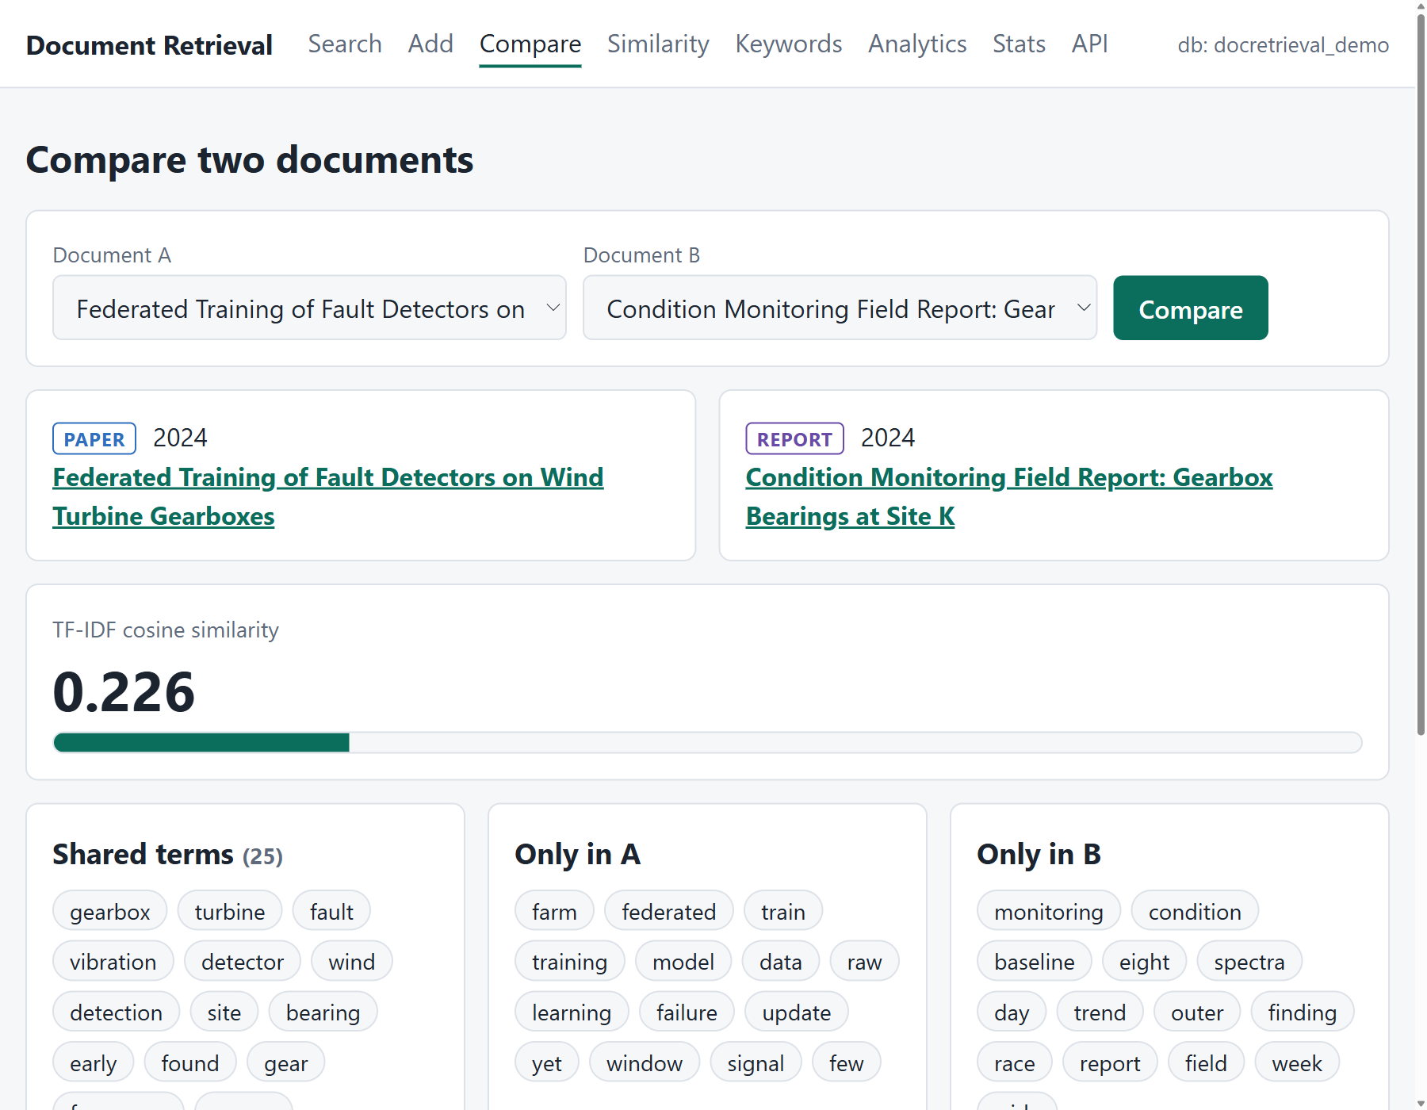
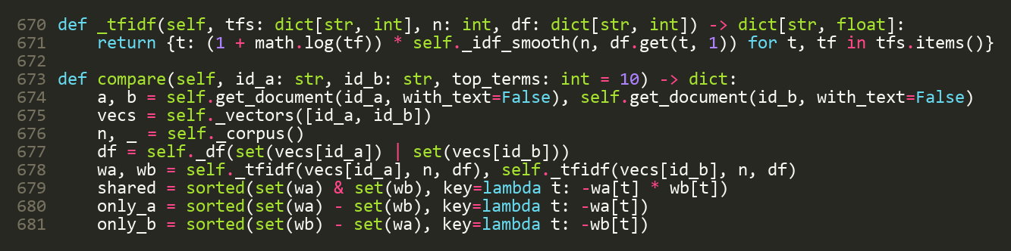
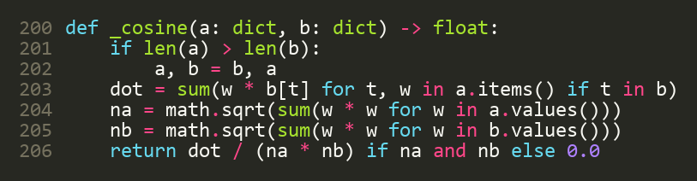
Comparing two documents
weight = (1 + ln tf) × idf
cosine = dot ÷ (|a| × |b|): 0 nothing shared, 1 identical
pap-003 vs rep-002: 0.226; vs the unrelated pat-001: 0.031
Notes:
Comparison. The page shows two documents: a similarity bar, the terms they share, the terms only one of them has, and how much their authors and keywords overlap.
The similarity is TF-IDF cosine similarity. Each document becomes a vector: for each term, a weight equal to one plus the log of the count, times the idf. Cosine similarity is the dot product of the two vectors divided by the product of their lengths. Zero means nothing in common, one means identical.
The code on the right: the first block builds the two weighted vectors from their postings and finds the shared and distinctive terms; the second block is the cosine itself, four lines.
Real numbers: the federated-learning paper and the condition-monitoring report, which are both about wind-turbine gearboxes, score 0.226. The same paper against the compression patent, an unrelated topic, scores 0.031. The page also shows the shared author and the shared keywords - fault detection, wind turbine, vibration - with a Jaccard overlap.

Slide 18
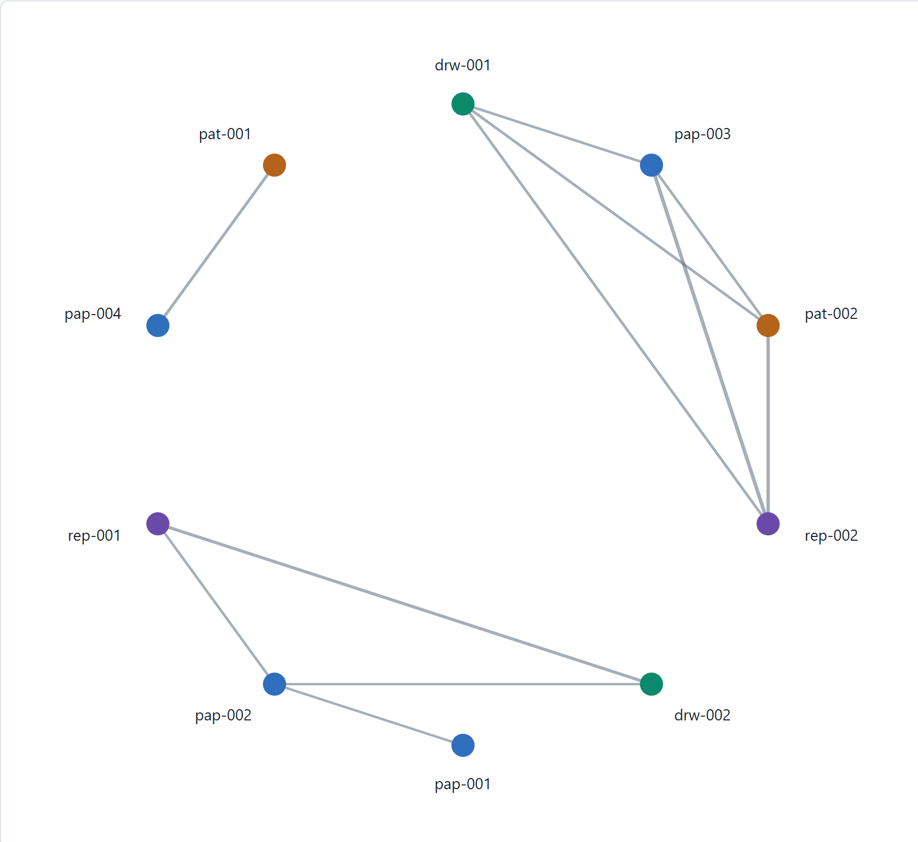
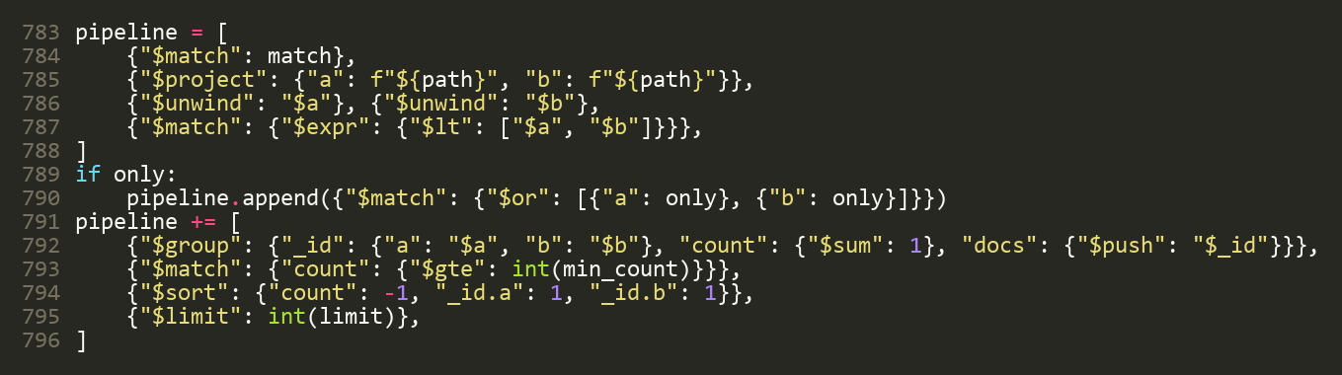
Association analysis
Keyword pairs, counted inside MongoDB with an aggregation pipeline
Related documents: the 25 heaviest terms give candidates, which are then scored exactly
Similarity graph: all pairs above a threshold; connected groups are the topics
Co-occurrence: $unwind, $group and $sort count keyword pairs in the database
Similarity graph at cosine 0.10: 11 links, 3 topic groups
Notes:
Association analysis has three parts.
First, related documents: for one document, find the most similar ones. I take its 25 heaviest terms, collect candidate documents from the postings of those terms, and then score the candidates exactly with cosine similarity. That avoids comparing against every document.
Second, the similarity graph, on the left. Every pair of documents with a cosine above a threshold is joined by a line. At a threshold of 0.10 on my ten documents there are 11 links and three clear topic groups: wind-turbine monitoring, document databases, and inverted-index retrieval. The groups are the connected components of the graph. Colours show the document type, so you can see a drawing, a report and a patent in the same group.
Third, keyword co-occurrence, counting which keywords appear together in the same document. This one I let MongoDB do itself with an aggregation pipeline - the code on the right. It takes the keywords array twice, unwinds both copies, keeps each pair once, groups by pair and counts. For example "gearbox" with "wind turbine" appears together in three documents.

Slide 19
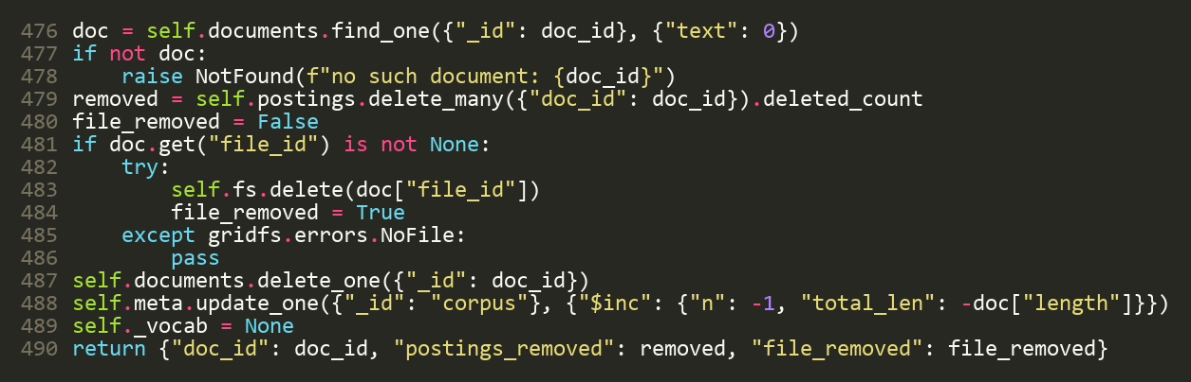
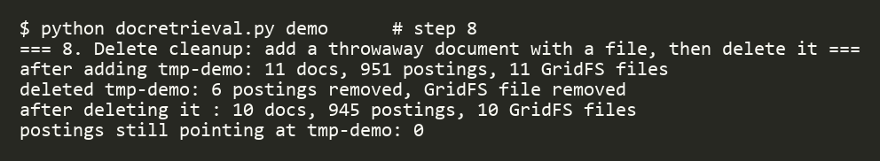
Deleting without leaving traces
Real output: add a throwaway document, delete it; the counts return to 10 / 945 / 10
Order matters
Safe to repeat
Tested
Postings first, then the file, then the record, then the counters: a half-finished delete never leaves a searchable ghost.
Running delete again finishes the job: it ignores what is already gone.
No leftovers in documents, postings, fs.files or fs.chunks; search, graph and related no longer see it.
Notes:
Delete. The requirement was that deleting a document must also remove its index entries and its file. That is what this code does, in this order: first the postings, then the GridFS file, then the record, then the counters.
The order is deliberate. If something fails half way, the document is already gone from search, because its postings were removed first, so there is never a ghost that can be found but cannot be opened. And running the delete again finishes the job.
The output on the right is real. The demo adds a temporary document with a file, so the numbers go to 11 documents, 951 postings and 11 stored files. Then it deletes it: 6 postings and the file are removed, and the counts return to 10, 945 and 10. Zero postings still point at the deleted document.
In the tests I check that nothing is left in documents, postings, fs.files or fs.chunks, and that search, the graph and related documents no longer see it.

Slide 20
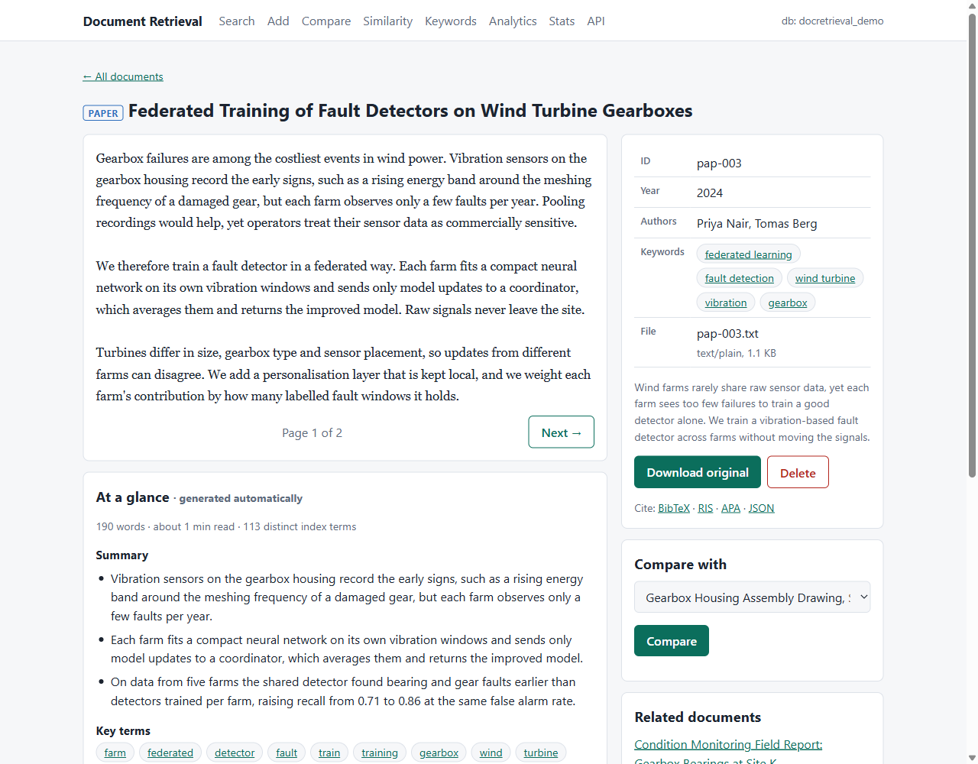
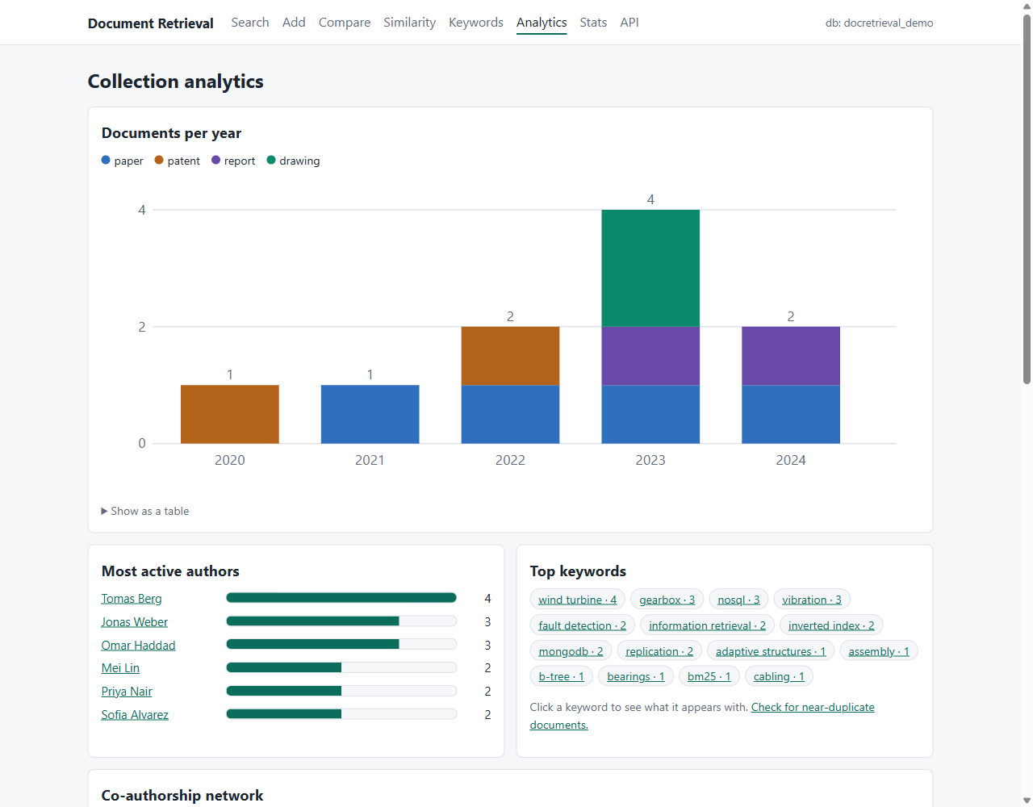
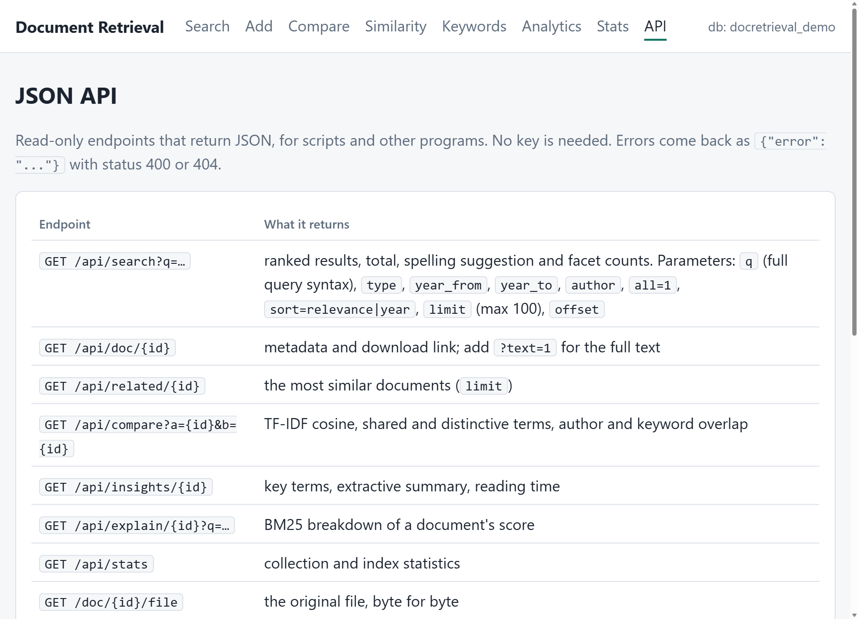
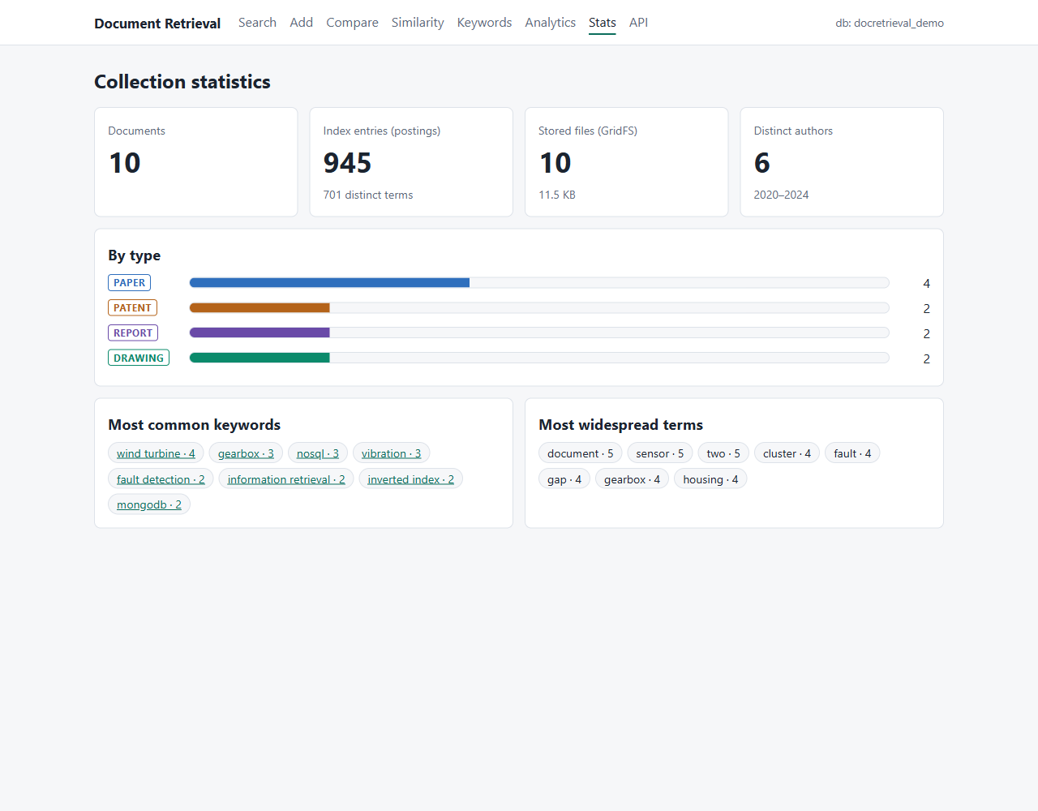
Beyond the requirements
Insights
Analytics
JSON API
Statistics
A 3-sentence summary, key terms and reading time on every document
Documents per year by type, top authors and a co-authorship network
Search, documents, compare and stats as JSON for other programs
Counts by type, index size, GridFS use, common terms and keywords
Notes:
Beyond the six required functions I added a few things that make it feel like a real product.
Document insights: on every document page, an automatic summary of three sentences chosen from the text, the key terms, and the reading time. The sentences are scored by the weight of their terms, so it uses the same index and needs no external AI service.
Analytics: documents per year by type, the most active authors, and a co-authorship network: authors who share a document are joined by a line.
A JSON API, so other programs can search and fetch documents, with the full query language.
And a statistics page: counts by type, the size of the index, GridFS use, and the most common keywords.
There are also citations in BibTeX, RIS and APA, CSV and JSON export, and a near-duplicate finder that warns you when you add a document that is almost the same as an existing one.

Slide 21
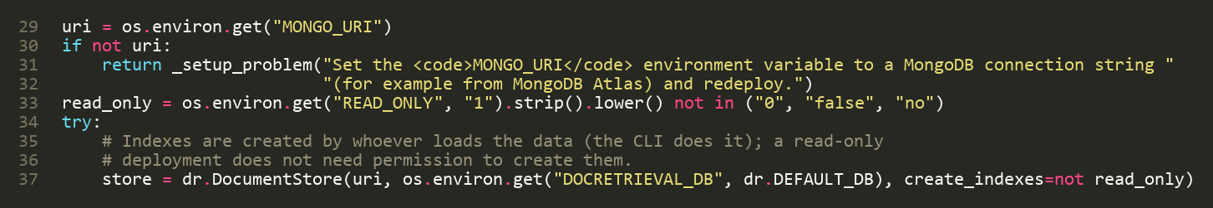
The website and the cloud deployment
GitHub repository
→
Vercel
→
MongoDB Atlas
the code
builds and runs the Flask app
the cloud database
app.py, lines 29-37: the entry point Vercel looks for
Read-only by default
Secrets in settings
Clear failures
No login on a public site, so add and delete are blocked (HTTP 403).
The connection string is a Vercel environment variable, never in the code.
A “Setup needed” page says what is missing.
Notes:
The website is a small Flask application, and it is deployed. The code is on GitHub; Vercel builds the Flask app from it; and the data lives in MongoDB Atlas, the cloud version of the same database.
app.py, shown here, is the entry point Vercel looks for. It reads the connection string from an environment variable. That variable is set in Vercel's settings, never written in the code, so the password is not on GitHub.
Because a public site with no login is risky, it is read-only by default: the add and delete pages are removed and any write request is refused with a 403 error. Searching, reading, comparing and downloading all still work. Writes are enabled only with a setting, for a private deployment.
If the database cannot be reached, or the setting is missing, the site shows a "Setup needed" page that says what is wrong instead of a blank error.

Slide 22
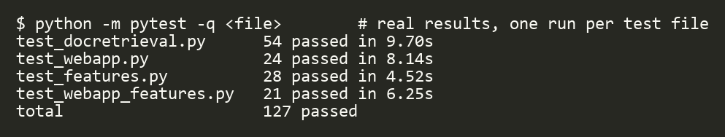
Testing
127
tests, all passing
Real MongoDB
Broken on purpose
No mocks: each test run creates a throw-away database and drops it afterwards.
I broke the code (delete, BM25, phrases, exclusion, spelling) and the matching tests failed.
What is tested:
• ranking
• filters
• comparison
• association
• download round trip
• delete cleanup
• query language
• web pages
• JSON API
Notes:
Testing. I wrote 127 automatic tests and they all pass, in about 40 seconds. This is the real output.
They run against a real MongoDB, not mocks: each test run creates a throw-away database and drops it afterwards.
They cover each required function: ranking, including a hand-computed BM25 score; the filters; comparison; association analysis, checked against manual counts; a download that must be byte-for-byte identical; and delete cleanup. They also cover the query language, every web page, and the JSON API.
One more check I am proud of: I broke the code on purpose - I removed the posting deletion, removed the length normalisation in BM25, disabled the phrase check, the exclusion and the spelling distance - and each time the matching test failed. That shows the tests really can fail.

Slide 23
Limits and next steps
Known limits
Next steps
Only plural endings are stripped: no full stemming
The similarity graph compares all pairs: fine for thousands of documents, not millions
No multi-document transactions on a plain server: failed writes are undone by hand
Text comes only from .txt and .pdf files; no OCR
No login, so the public site is read-only
A real stemmer and a synonym list
Atlas Search or vector search for matching by meaning
Login with an admin role, so writes can be allowed safely
Transactions on a replica set
OCR for scanned documents and drawings
Notes:
Honest limits. I only strip plural endings, so word forms like "optimize" and "optimization" are different terms. The similarity graph compares all pairs, so it suits thousands of documents, not millions; for a very large collection you would use the related-documents search instead. A plain MongoDB server has no multi-document transactions, so I undo failed writes by hand. Text is extracted only from text files and PDFs: scanned PDFs and drawings are searched through their title, keywords and description. And the public website has no login, which is why it is read-only.
Next steps: a proper stemmer and a synonym list; MongoDB Atlas Search or vector search for meaning-based matching; a login with an admin role so writes can be allowed safely; transactions on a replica set; and OCR to read scanned documents.

Slide 24
Thank you: questions?
Live demo plan
1
Search the phrase "posting list"
2
Misspell a word: see the suggestion
3
Open a drawing and download it
Four document types, six functions, built on MongoDB and GridFS.
4
Compare two documents
5
Show the similarity graph
6
Open “why this score?”
Notes:
That is the system: four document types, six functions, built on MongoDB and GridFS, with the data model, the index and the code that I showed.
If there is time, I can do a short live demo. The plan is on the right: search for a phrase, show the spelling suggestion, open a drawing and download it, compare two documents, show the similarity graph, and explain a score.
Thank you. I am happy to take questions.
(Before the demo: start MongoDB, run "python webapp.py --db docretrieval_demo", open http://127.0.0.1:5000 . Keep a browser tab on each of the pages in advance.)

