Slide 1
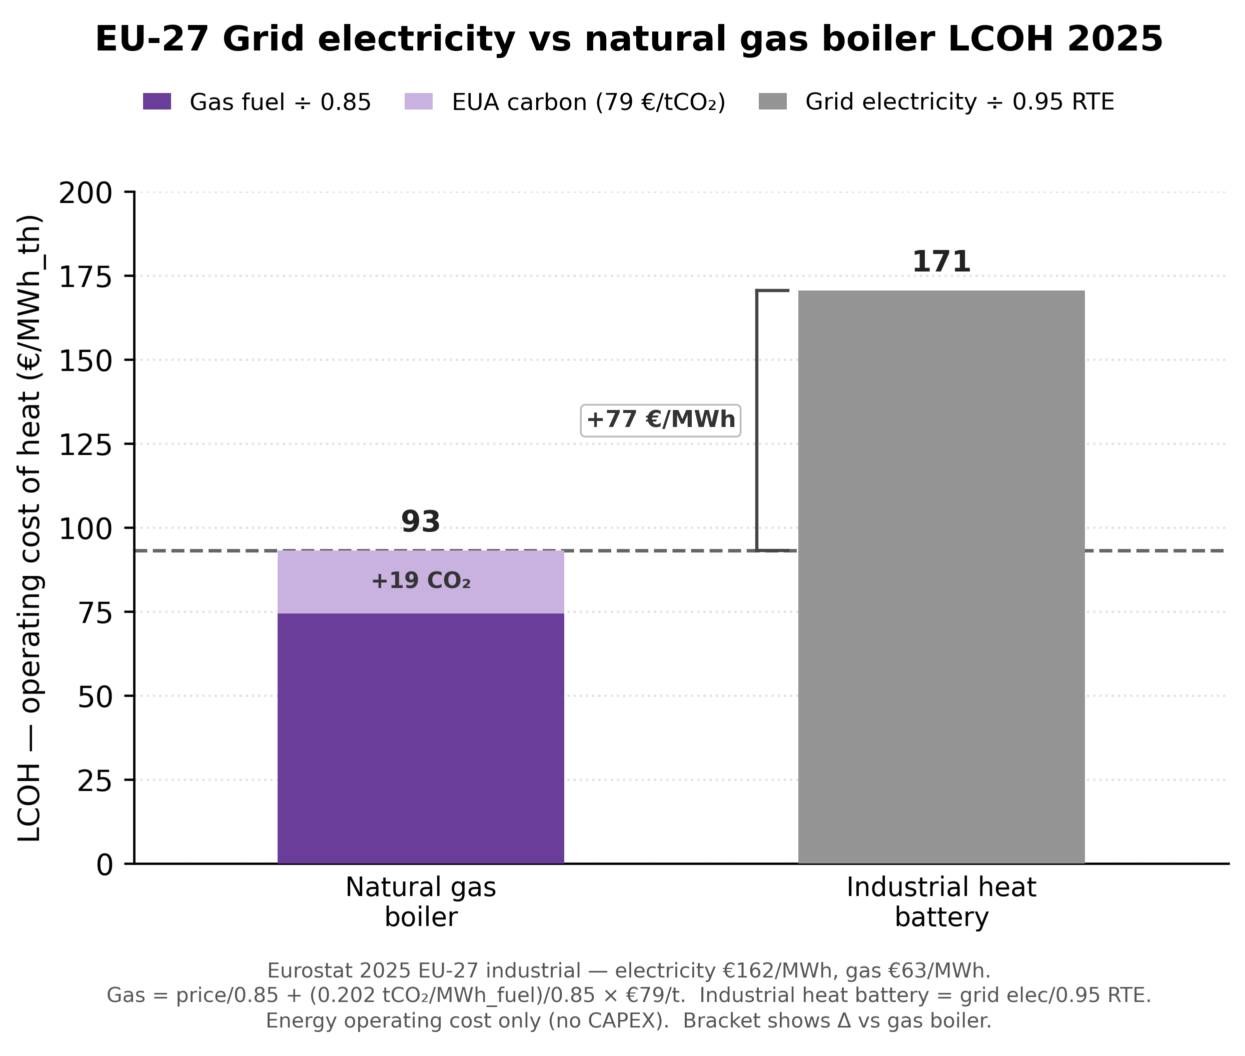
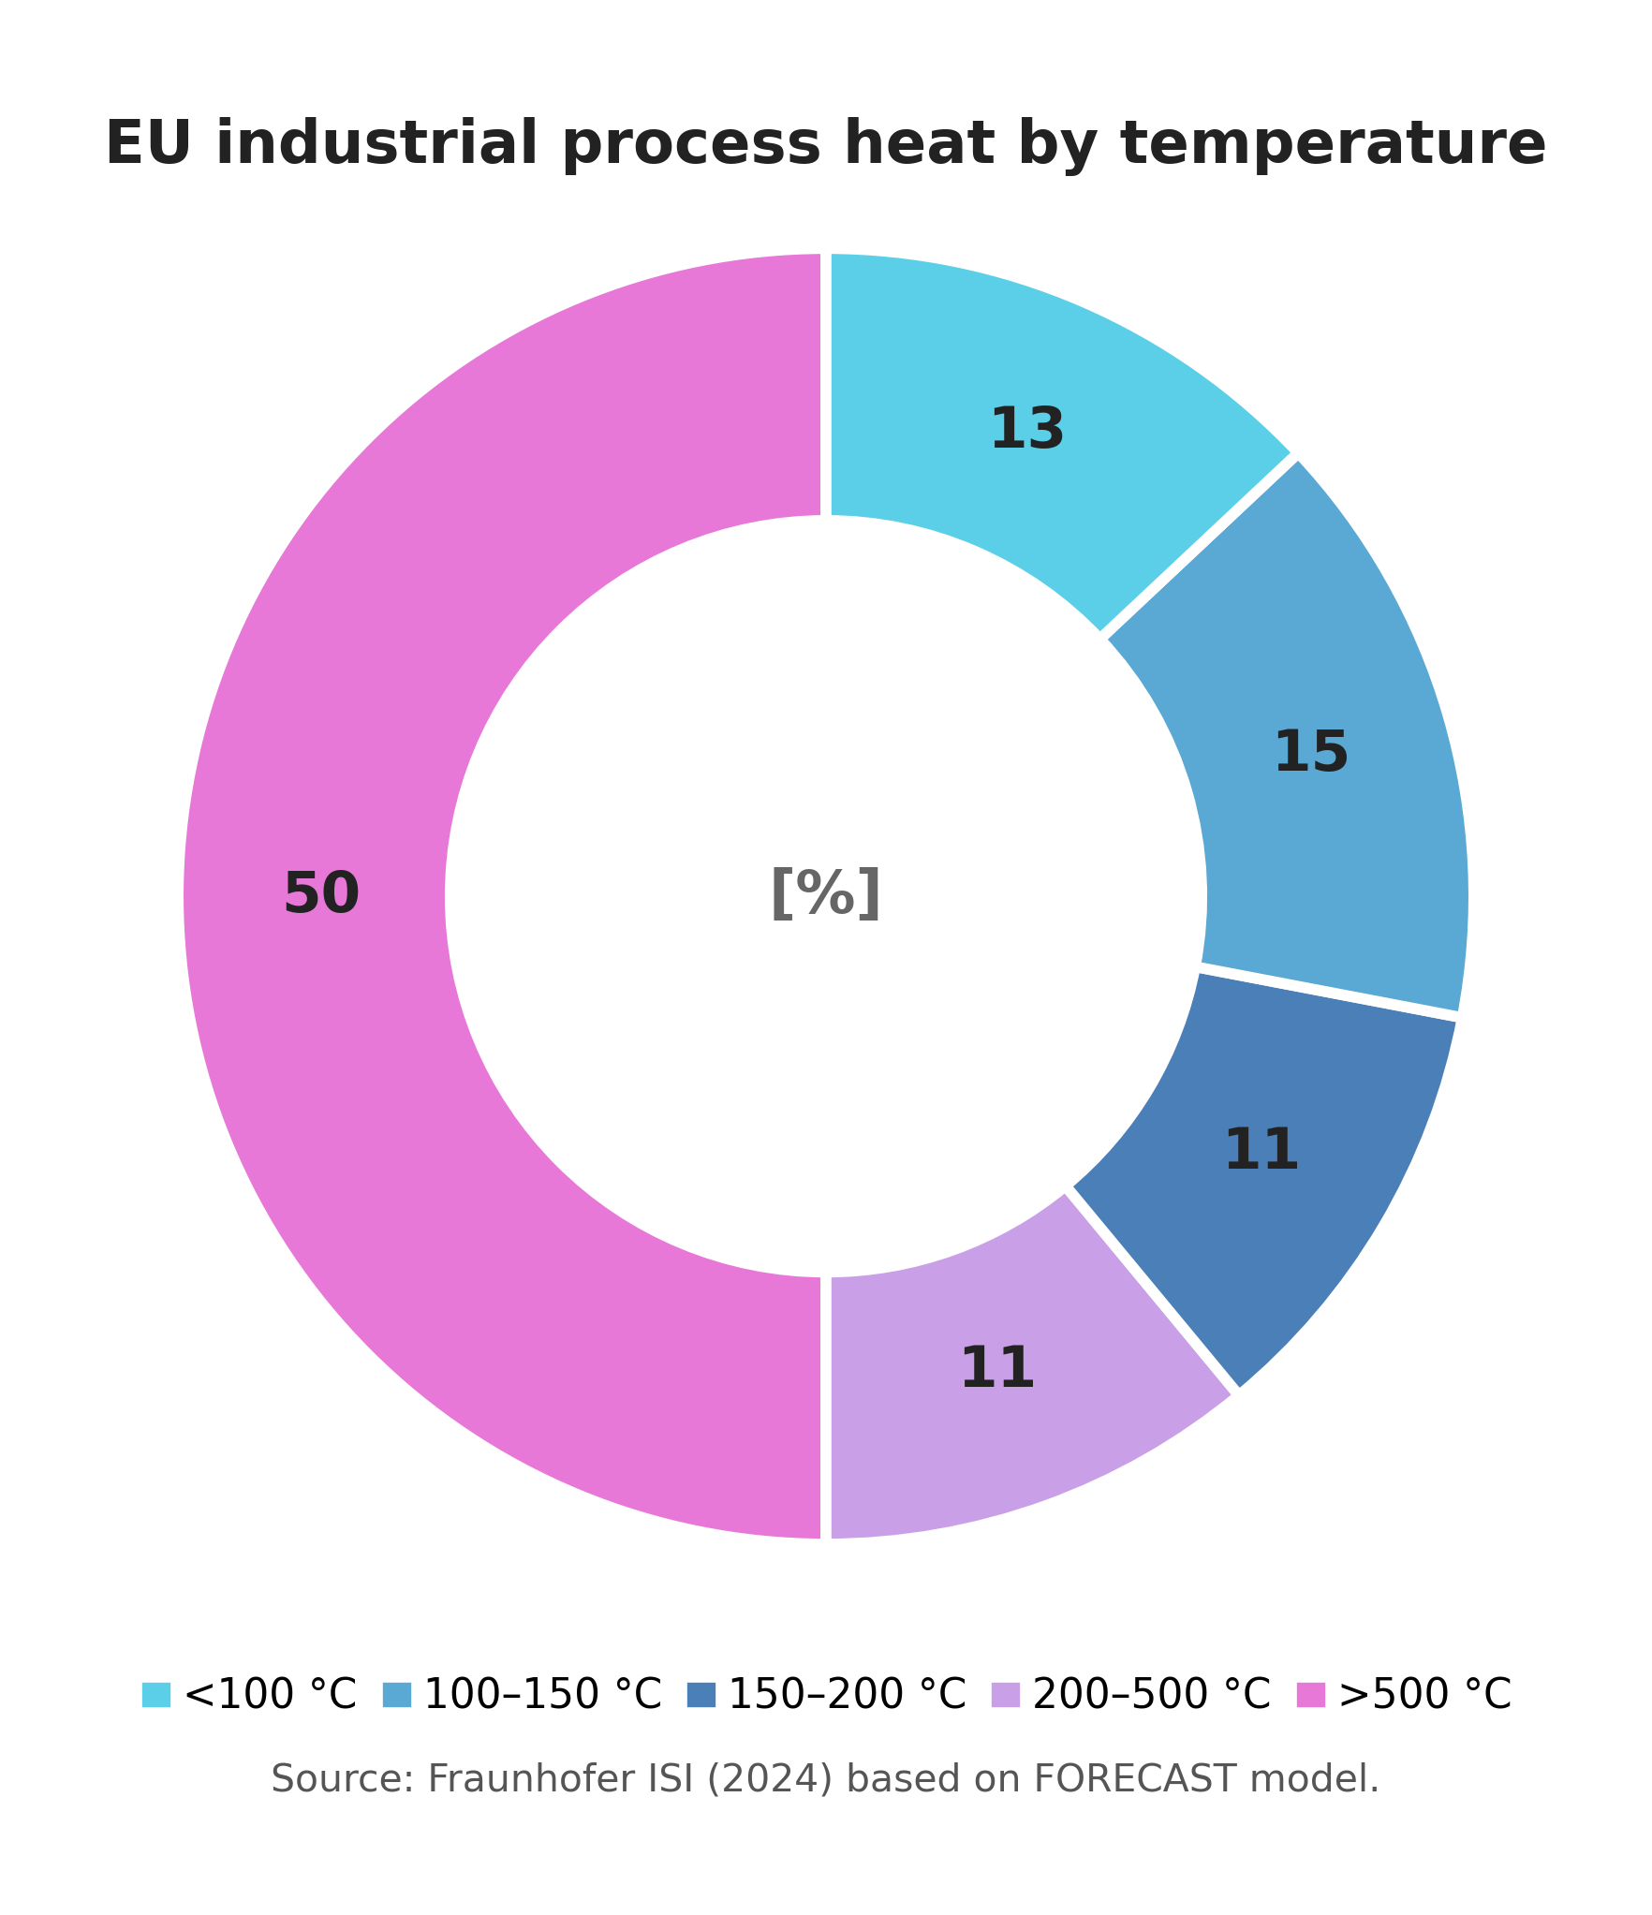



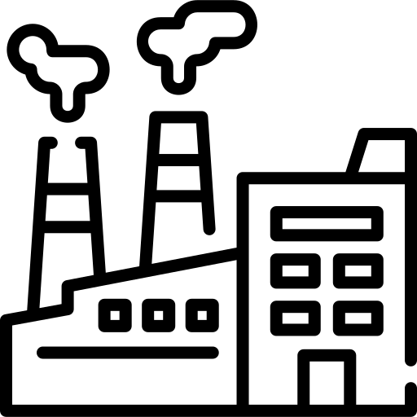

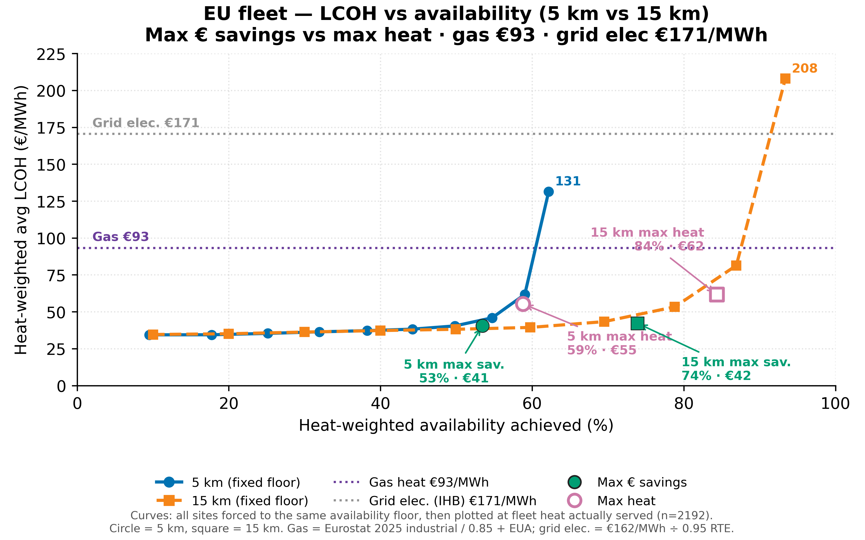
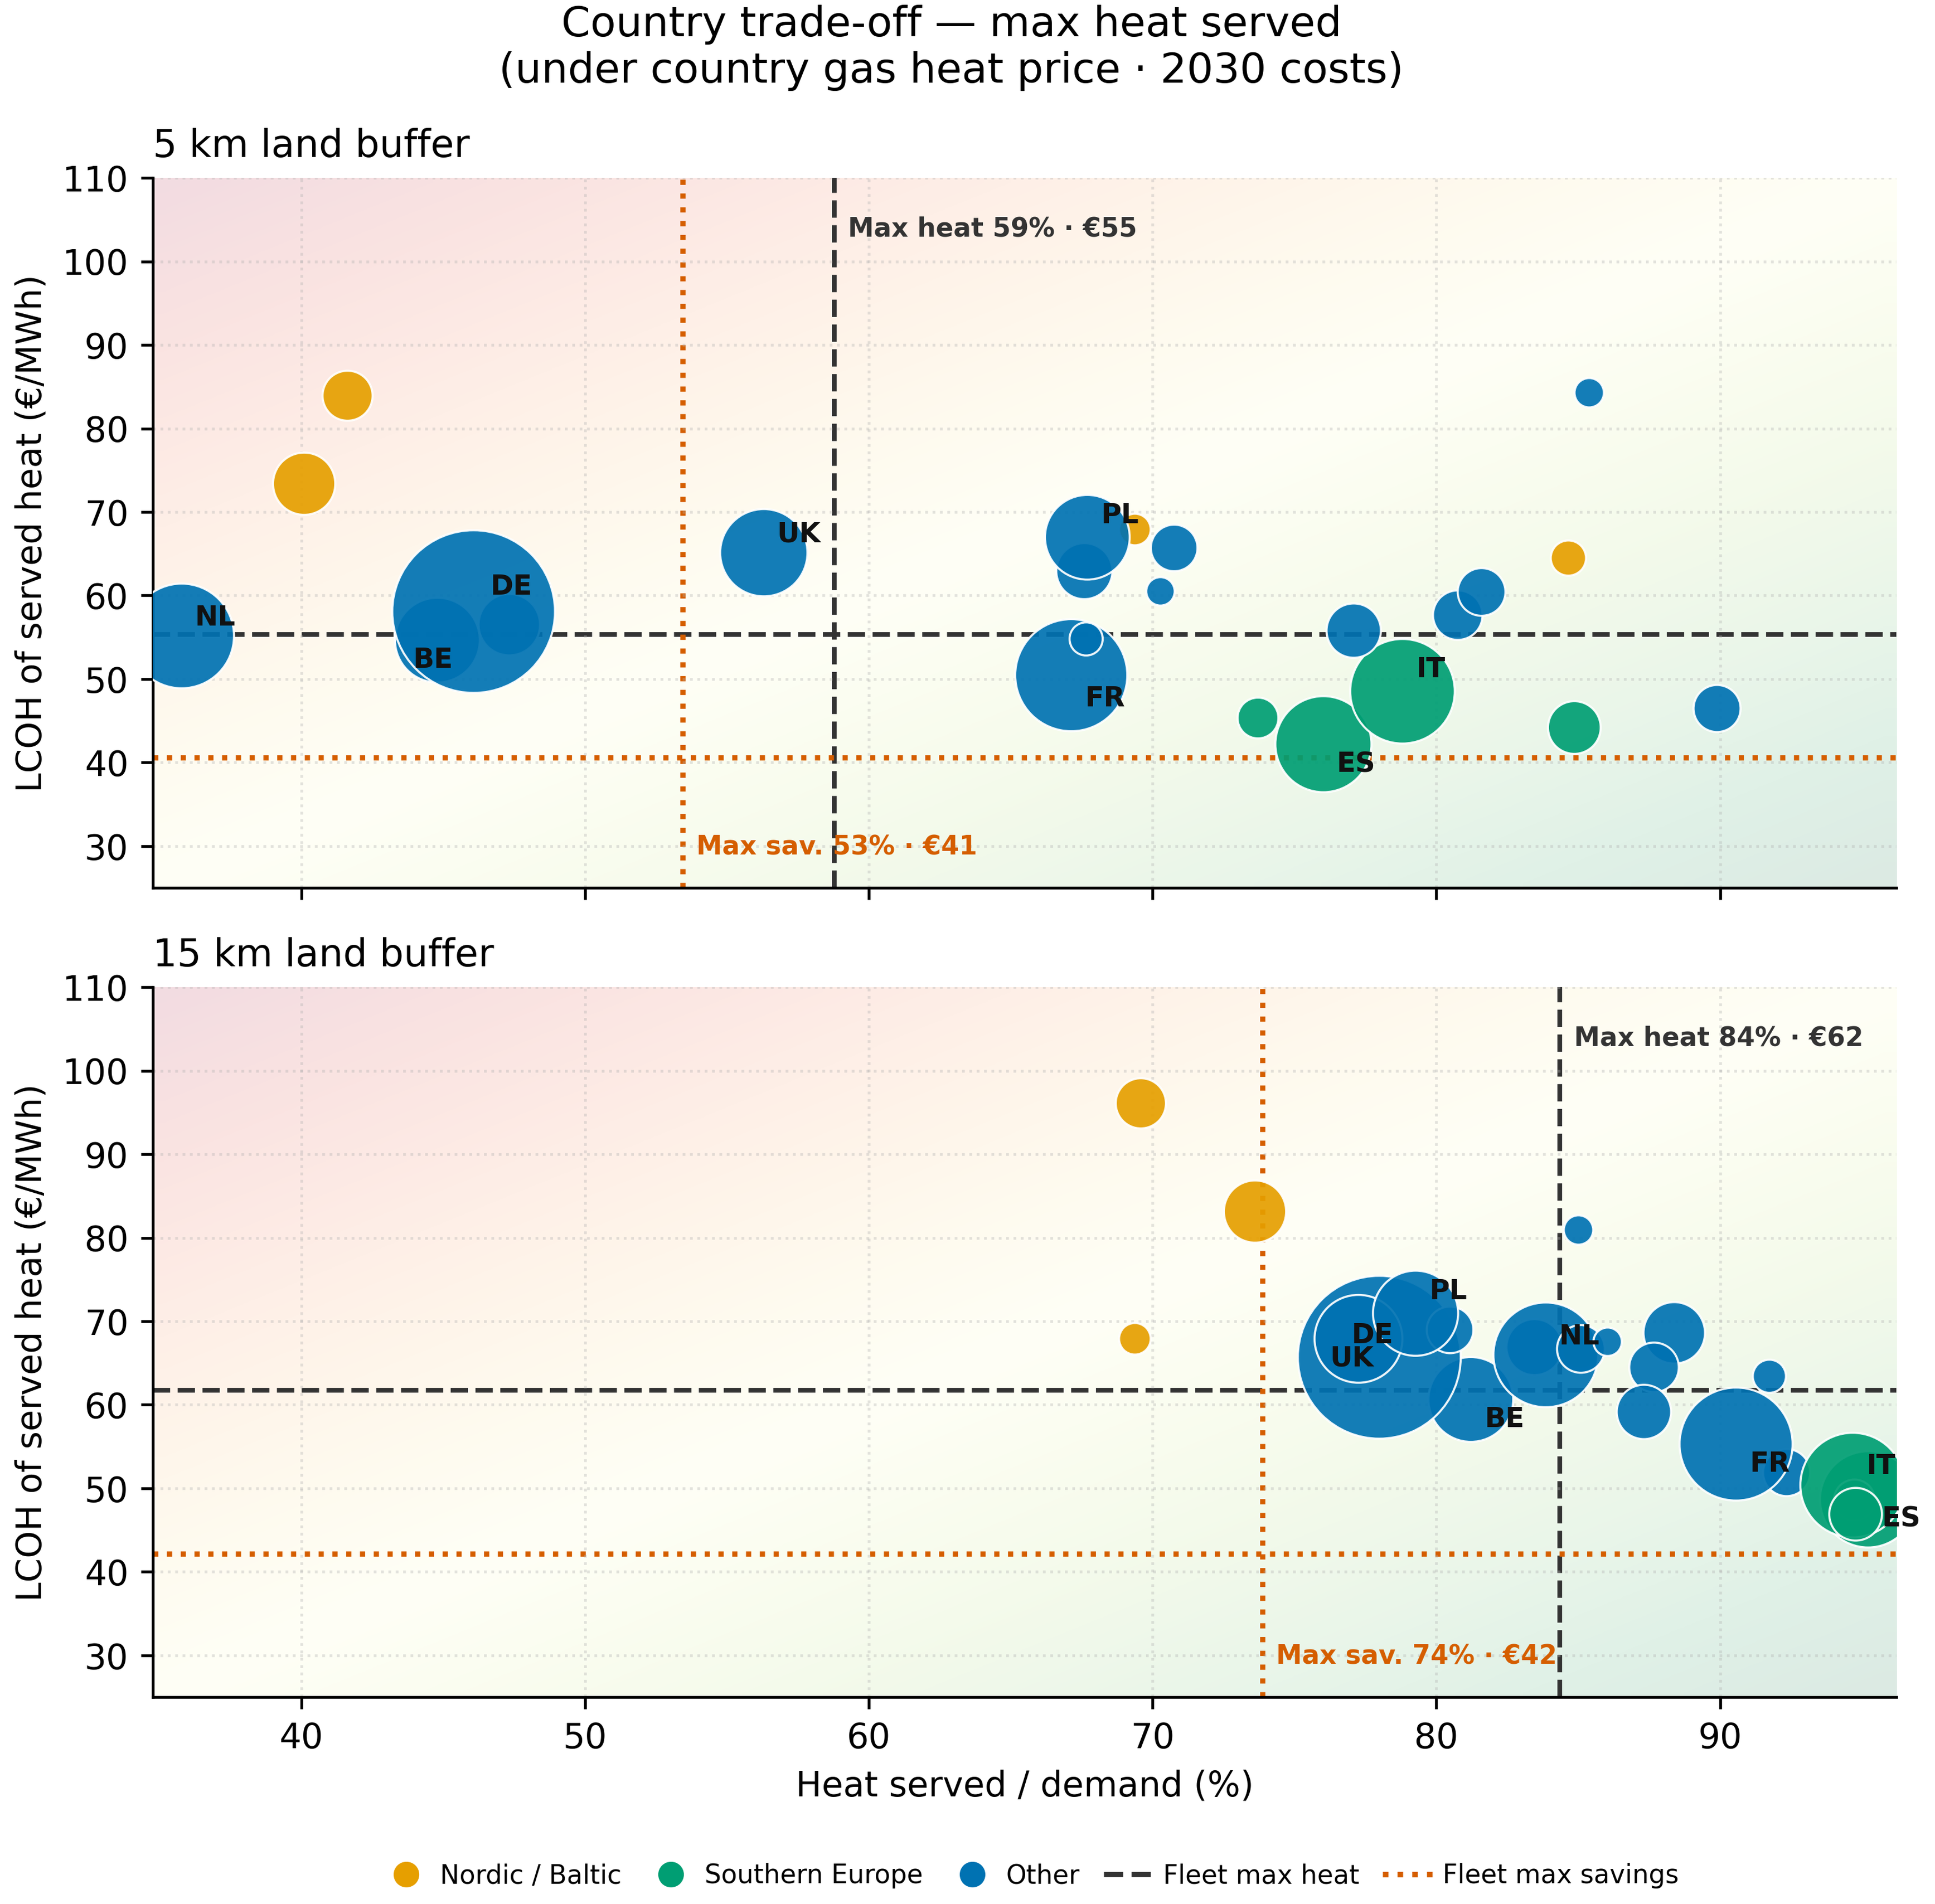
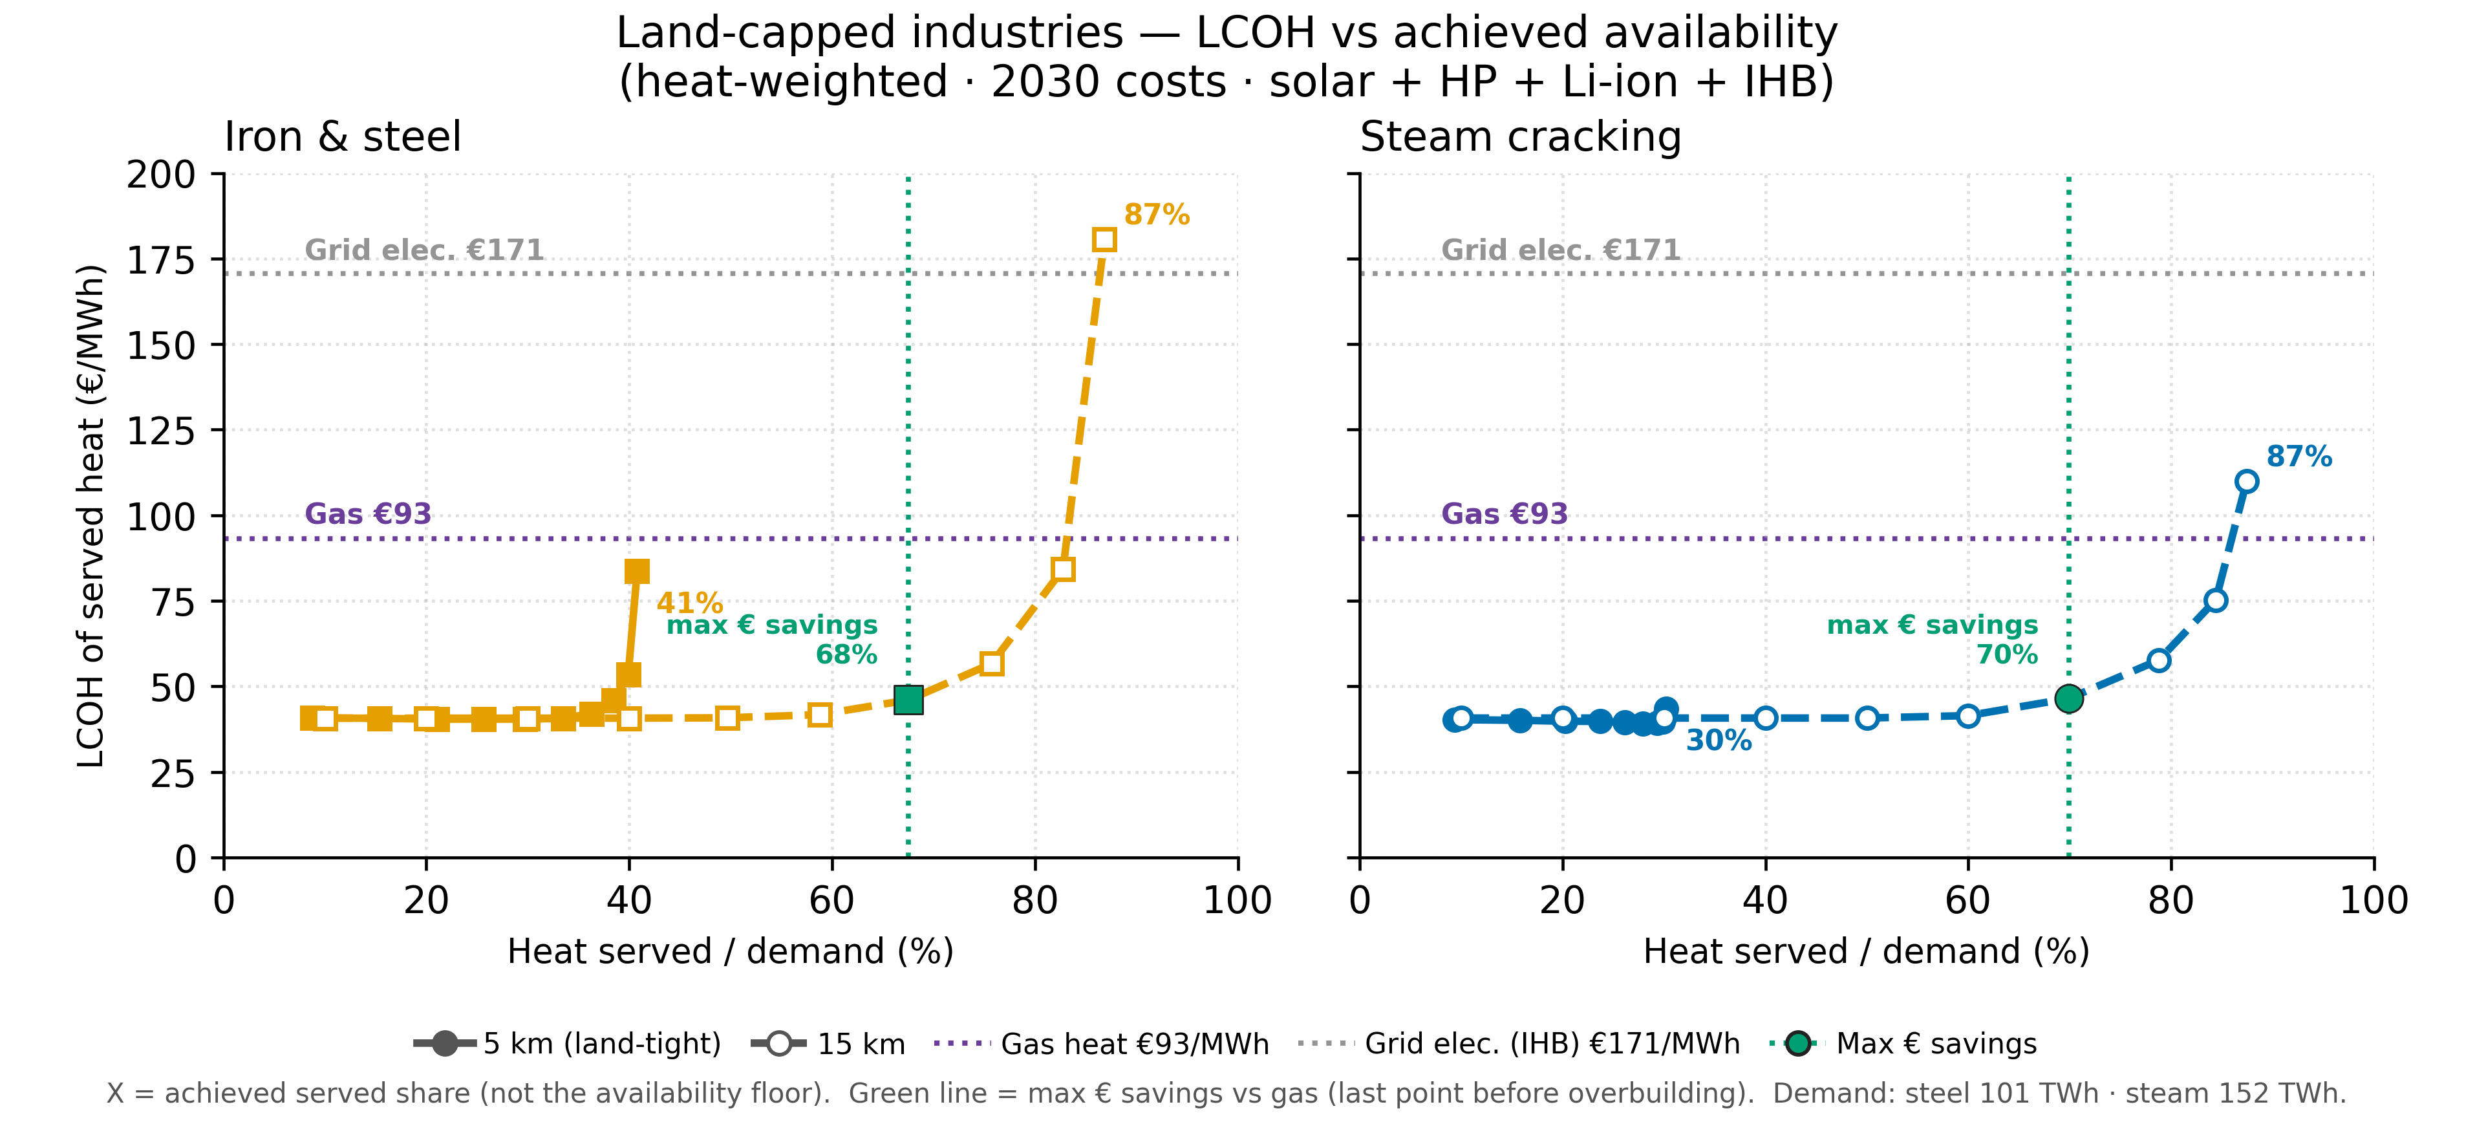
Techno-economic Potential of Electrified Industrial Process Heat in European Manufacturing
Anna Yuen^{1, 2, *}, Amol Phadke²
¹Energy and Resources Group, University of California, Berkeley
²Goldman School of Public Policy, University of California, Berkeley
Introduction
Methods
Processes < 200°C
Heat pump
Heat (Steam)
Off-grid solar panels
Processes >= 200°C
Facility
Heat Battery
We model an off-grid solar with heat pump and li-ion battery for <200°C and with industrial heat battery for >=200°C processes. Both can be drop-in technology for steam generation in manufacturing facilities.
  50% of EU industrial process heat demand is above 500°C.
  Industrial heat batteries are the leading option to electrify it, yet grid power costs €77/MWh more than gas.
Facility-level Production Data
Solar Radiation
Land Availability
Results
Optimization
Minimize LCOH subject to energy balance, solar capacity and land availability
 | 5 km | 15 km
Served (max heat) | 58.8% (307 TWh) | 84.4% (441 TWh)
LCOH (max heat) | €55 | €62
Served (max savings) | 53.4% (278 TWh) | 73.9% (377 TWh)
LCOH (max savings) | €41 | €42
% of total heat decarbonized and savings
Max heat: for each site, raise availability as high as possible while keeping LCOH below that country’s gas heat cost. Goal: serve the most heat that still beats gas.
Max savings: for each site, pick the availability that maximizes total € savings vs gas:
served heat × (gas cost − LCOH). Goal: largest bill savings, even if that means serving less heat.
With the total heat level decarbonized at 10-100% availability, we analyzed the costs and benefit of implementing solutions at different availability served for different sectors and countries.
Discussion
  To maximize savings, a facility should aim for availability up to the maximum savings points. The remaining can be met with grid electricity or gas.
  To maximize heat demand served, a facility could overbuild solar panels while still being under gas prices resulting in a lower marginal benefit but is still gas competitive.
Conclusion
  Germany, the Netherlands, and France have very large process-heat demand. With a ~15 km land buffer, a large majority can be served below country gas. At 5 km, Germany and the Netherlands remain more land-constrained.
  Southern Europe (Greece, Spain, Italy, Portugal) is the strongest fit: ~95% of demand served at LCOH roughly 70–75% of country gas (closer to ~half gas under a max-savings framing). Sites tend to be smaller, with better solar yield.
  For high-temperature processes, this solution can decarbonize a high share of replaceable heat (~80% for steel and steam cracking at 15 km), even if not 100% everywhere.
  By meeting heat on-site with solar + storage, this package can reduce reliance on gas boilers and incremental electric load on the local grid, potentially easing upgrades and gas exposure, and offers a deployable path to cheaper cleaner heat.
  Steam cracking, iron & steel sector have very large sites and have more heat intense processes ( > 500°C) resulting in much higher heat loads.
  These sectors require more hybrid solutions: increased land availability, utilizing grid electricity, co-firing with gas plants.
  Even building up to the max savings point, solar plus storage can meet over 50% of the heat served.
Notes:
Germany, Netherlands, France are countries with large amount of heat demands and is moderately suitable for off-grid solar plus storage with below gas prices majority heat demand.
Southern European countries, Greece, Spain, Italy and Portugal, are the most suited for this solution with around half of the gas cost and greater than 90% heat demand covered. They have industrial facilities that have lower heat demand.
For high temperature processes, even though it cannot be fully decarbonized, this package provides a solution that can decarbonize a high percentage of heat demand.
implementing on-site decarbonized solutions can help alleviate local grid electricity constraints and be less dependent on gas power plants. This can minimize expensive grid updates and volatile natural gas prices. It is a high potential solution to allow faster decarbonization and cheaper heat.
Land availability, not cost, is the main factor in achieving decarbonized heat generation solutions for EU’s industrial manufacturing.
The highest temperature processes (petroleum steam cracking, iron & steel and aluminium) have the highest increase in share of sector process heat below gas prices from 5km to 15km.
Countries with high demand with high temperature manufacturing such as Germany, France and Netherlands (industrial belt) saw a high increase in decarbonized heat shares. The industrial belt contains many heat intense manufacturing such as steam cracking and iron & steel manufacturing with relatively built-up land and river constraint. With low land availability and high heat demand, this region is only able to achieve substantial heat generation availability with 15km.
The Country trade-off scatterplots show the increase in countries that can meet 90% availability at under gas costs increases dramatically from 5km to 15km.
With 5km, the southern European countries could meet high percentage of availability (>70%) but countries with larger shares of heat demand like Germany or France can only meet around 50% and 70% respectively. With 15km, Germany, France and Netherlands are all above 70%.
Gas prices here are the boiler-delivered heat costs (gas_heat_cost_eur_mwh = gas price / 0.85 + EUA), not raw commodity €/MWh.
Industrial process heat accounts for three quarters of industrial greenhouse-gas emissions in the European Union (EU) and has been recognized as a requirement to achieve net zero emissions[1].
Different technologies are already available to electrify process heat in different temperature heat bands such as heat pumps, industrial heat batteries.
Utilizing renewable generation for electrification allows for EU to use its own resources and tackle its high exposed vulnerability in fuel import dependence [2].
Critical barriers to electrifying industrial heat include high electricity grid prices relative to gas [3] and long lead times to connect to the electricity grid[4].
Using off-grid solar to power heat pumps and industrial heat batteries can be a potential solution to bring electricity price down and increase speed to power.
Gas boiler delivered heat cost assuming 0.85 efficiency
Limitations:
Heat demand estimates are benchmarked at the country and sector-level but they are not from the facility sources themselves. There is a +- 50% in the estimates for process heat depending on the types of technologies that each facility uses. Sensitivity analysis is conducted to show that the increase and decrease in heat demand based on the changes in coefficients in the equations do not change the results meaningfully.
Land availability has only been modeled based on land classified. The regional regulations and land permitting process are out of the scope of this research.
Flatblock load profiles are used due to the nature of constant and continuous process heat demand profiles across different sectors.
Images
Introduction charts: Eurostat data graphed
https://thegigaton.substack.com/p/industrial-heat-pumps-hot-or-not-b81
Heat pump icon: <a href="https://www.flaticon.com/free-icons/pump" title="pump icons">Pump icons created by juicy_fish - Flaticon</a>
Battery icon: <a href="https://www.flaticon.com/free-icons/car-battery" title="car battery icons">Car battery icons created by DinosoftLabs - Flaticon</a>
Heat battery: <a href="https://www.flaticon.com/free-icons/heating-element" title="heating element icons">Heating element icons created by IconBaandar - Flaticon</a>
Industrial factory: <a href="https://www.flaticon.com/free-icons/industry" title="industry icons">Industry icons created by Magnific - Flaticon</a>

