Slide 1


Team Pizza:
Victor Lee, Wing, Zoyi
Olist Business Analysis

Slide 2


Background
Analysis of Olist Store, the largest department store in Brazilian marketplaces
connects small businesses from all over Brazil to channels without hassle and with a single contract
The Brazilian ecommerce public dataset of orders (from 2016 to 2018)
Overview on below parts:
-Sales
-Demand & Supply
-Seller
-Customer (by location, by purchase frequency)
-Order
-Delivery
-Review
-Product
-Recommendations
Purpose: to understand the current situation on different aspects, and to improve the business performance

Slide 3
Business Overview

Slide 4
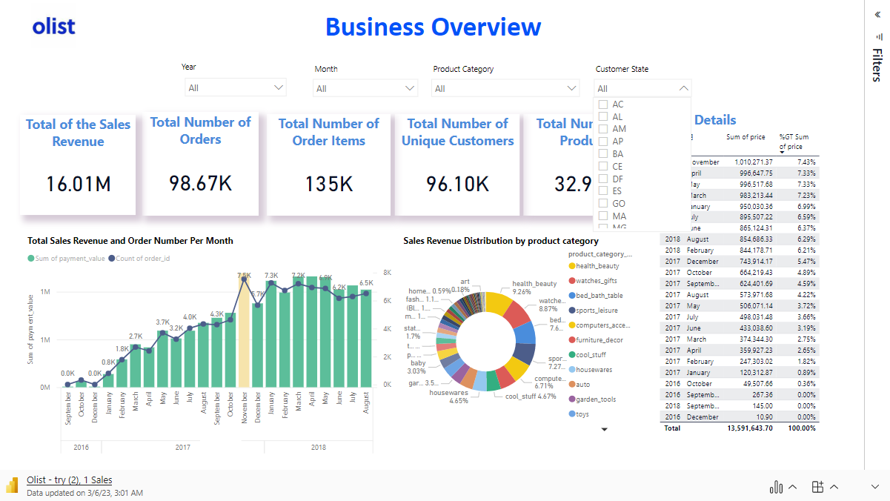
Steadily increase of customers
YoY/ MoM comparison
Revenue Driven Product
Importance of seasonality/ Promotion (Nov - Black Friday Promotion)

Slide 5
Demand & Supply Overview

Slide 6
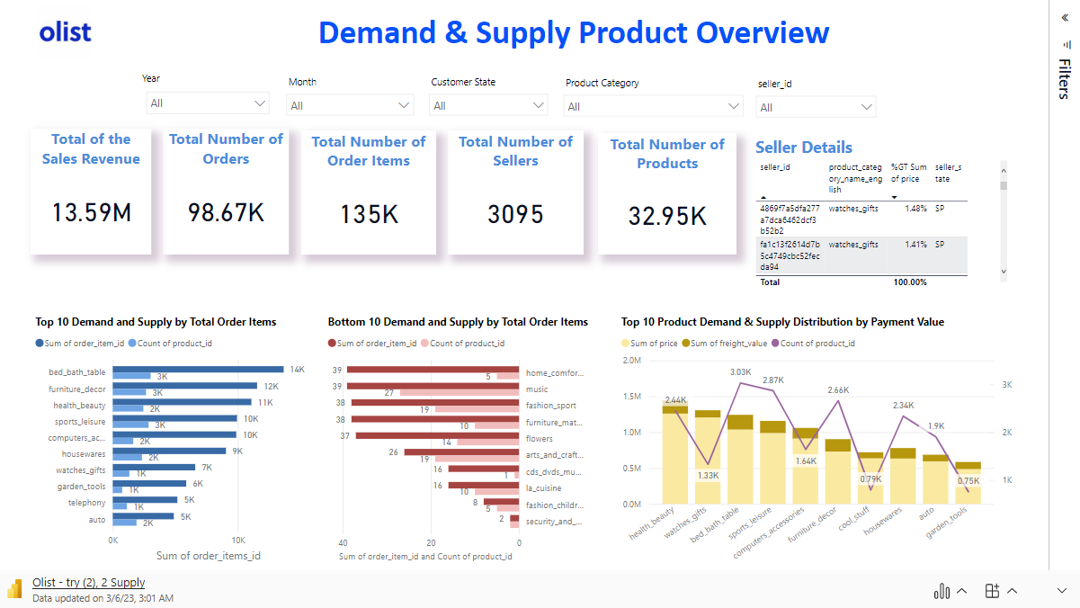

Slide 7
Seller Overview

Slide 8
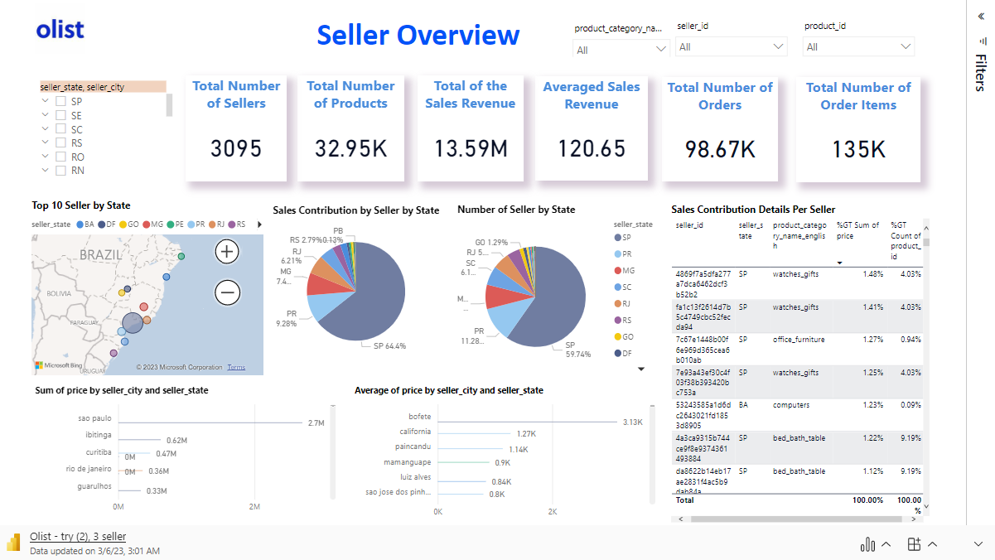

Slide 9
Customer Overview

Slide 10
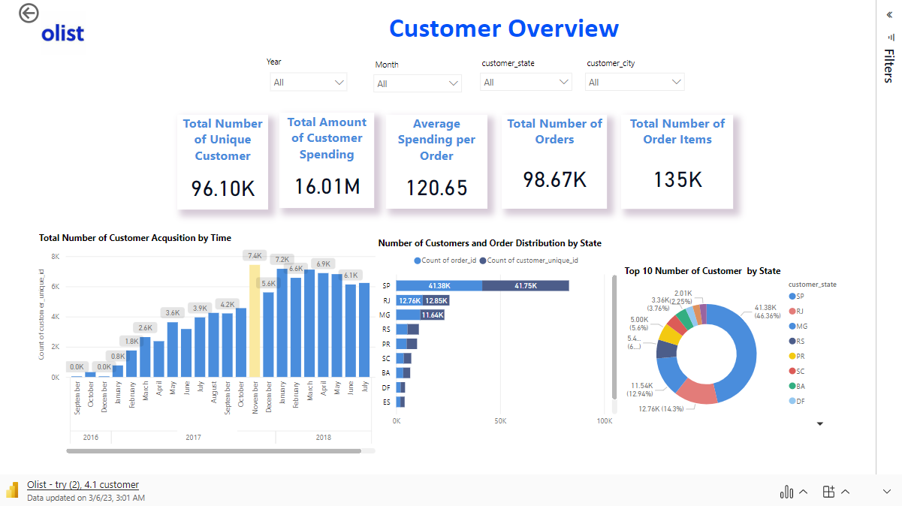
Steadily increase of customers
YoY/ MoM comparison
Revenue Driven Product
Importance of seasonality/ Promotion (Nov - Black Friday Promotion)

Slide 11
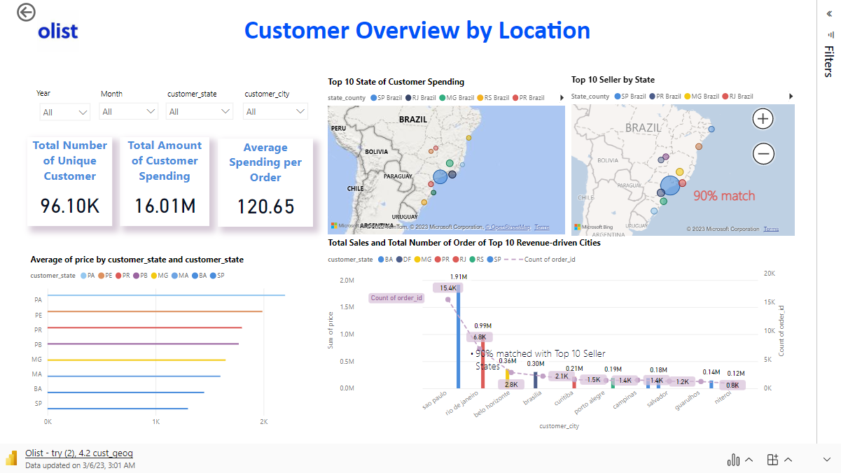

Slide 12
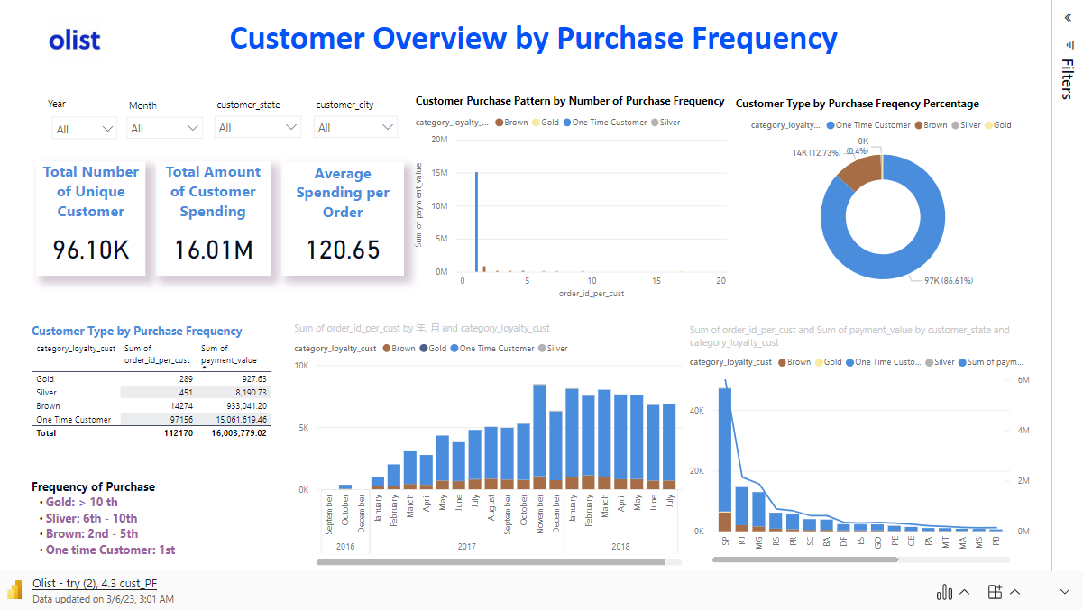

Slide 13


Slide 14
Order Overview

Slide 15
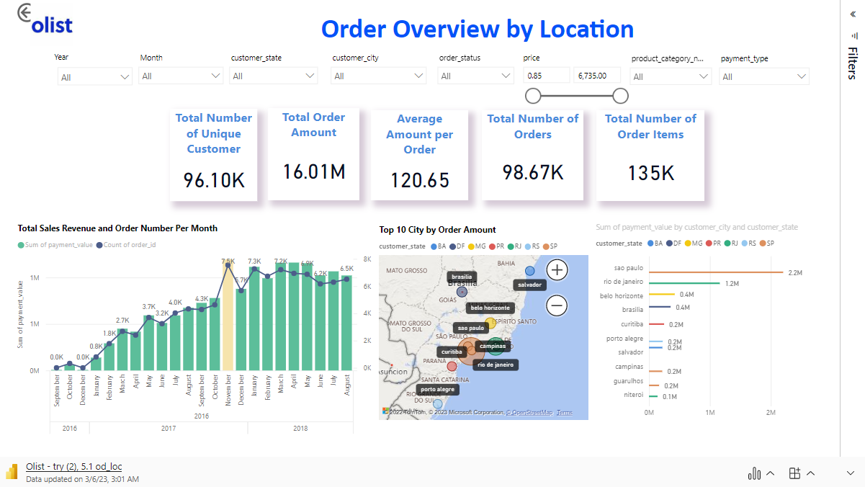

Slide 16
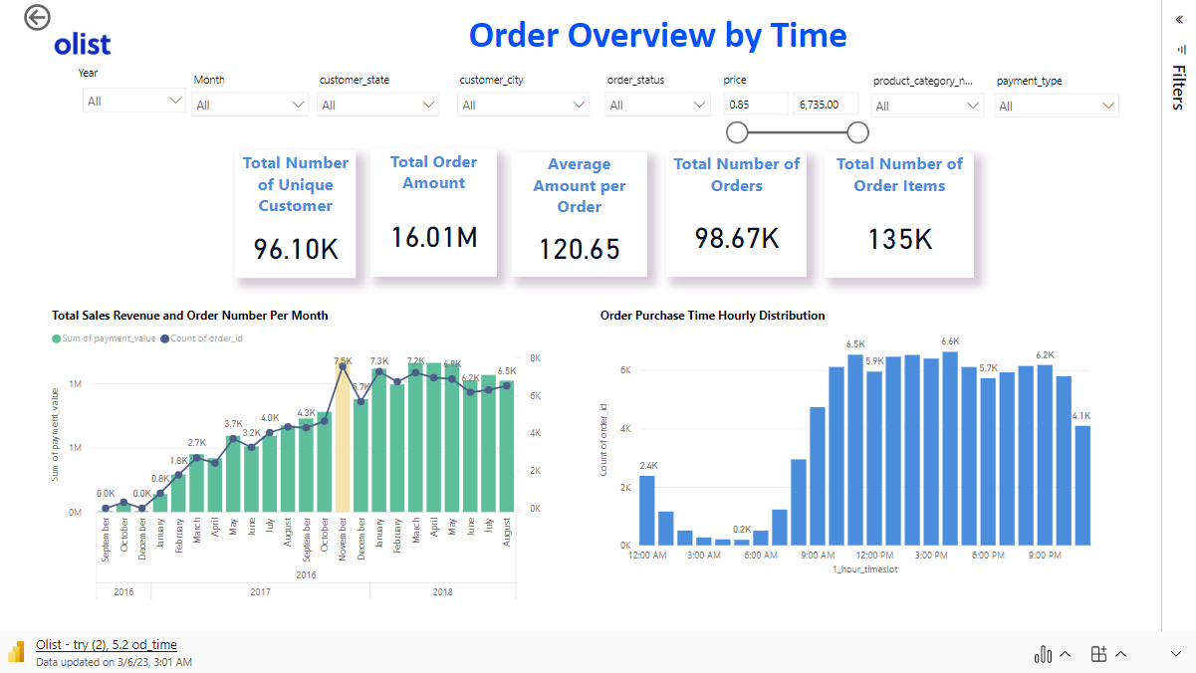

Slide 17
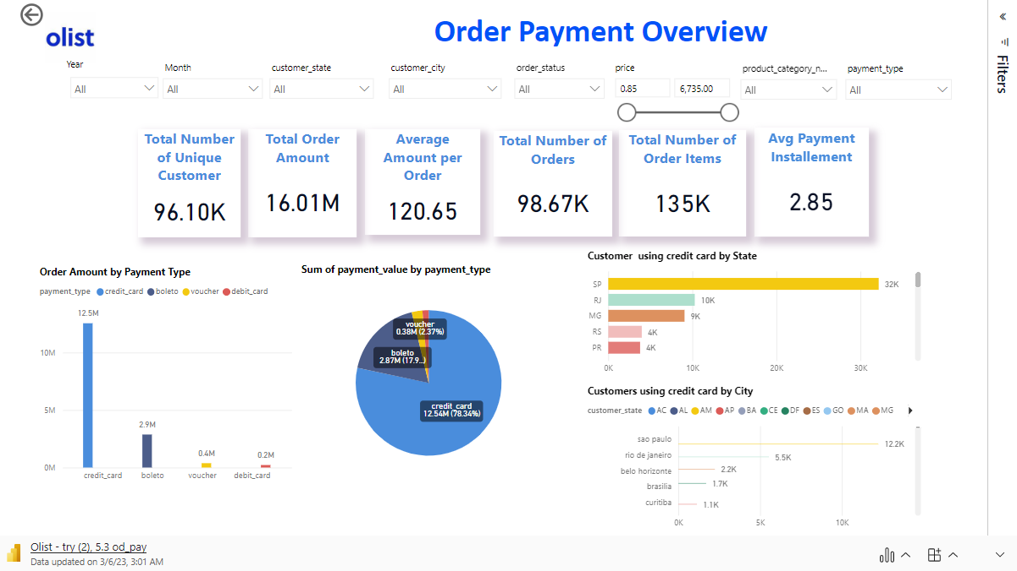

Slide 18
Order Delivery Overview

Slide 19
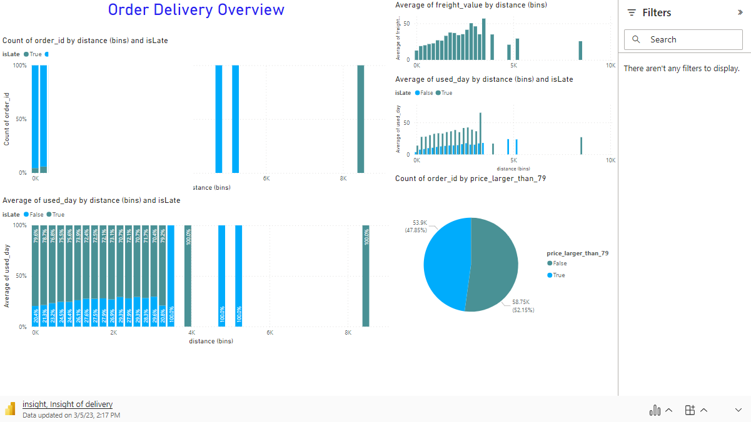

Slide 20
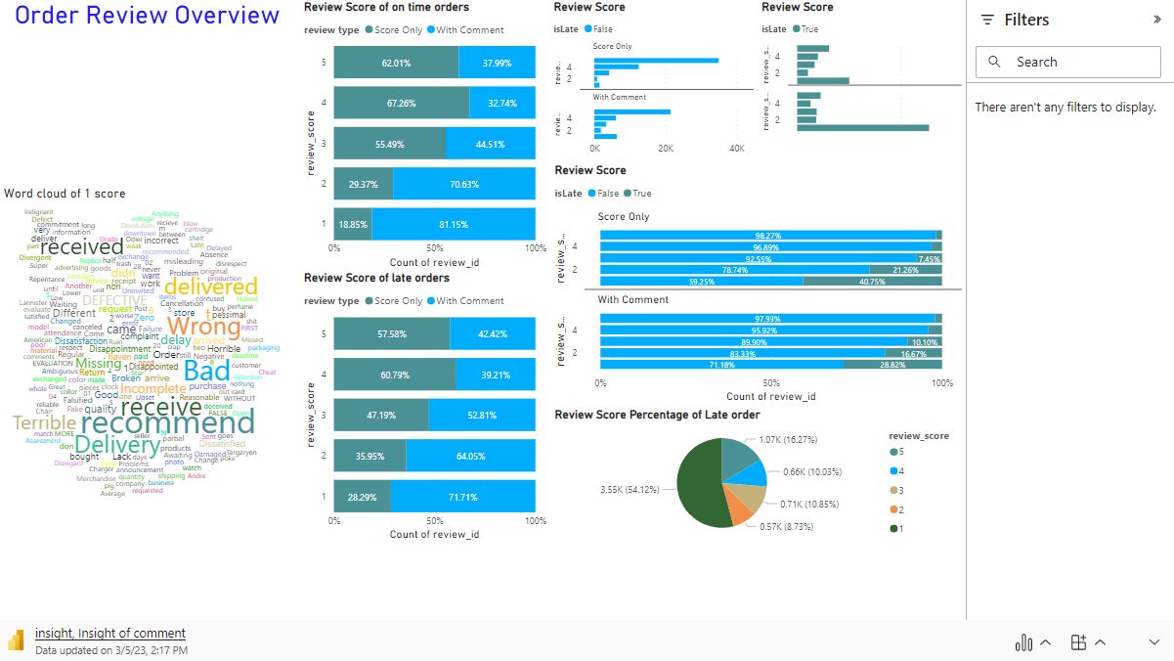

Slide 21
Product Overview

Slide 22
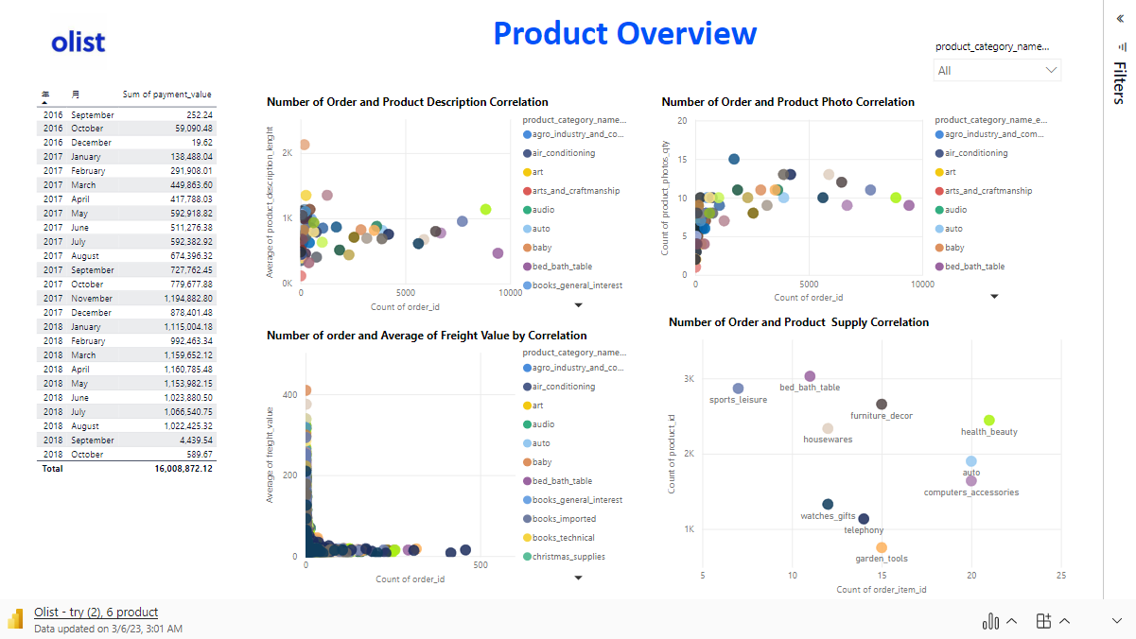

Slide 23
Forecast Overview

Slide 24
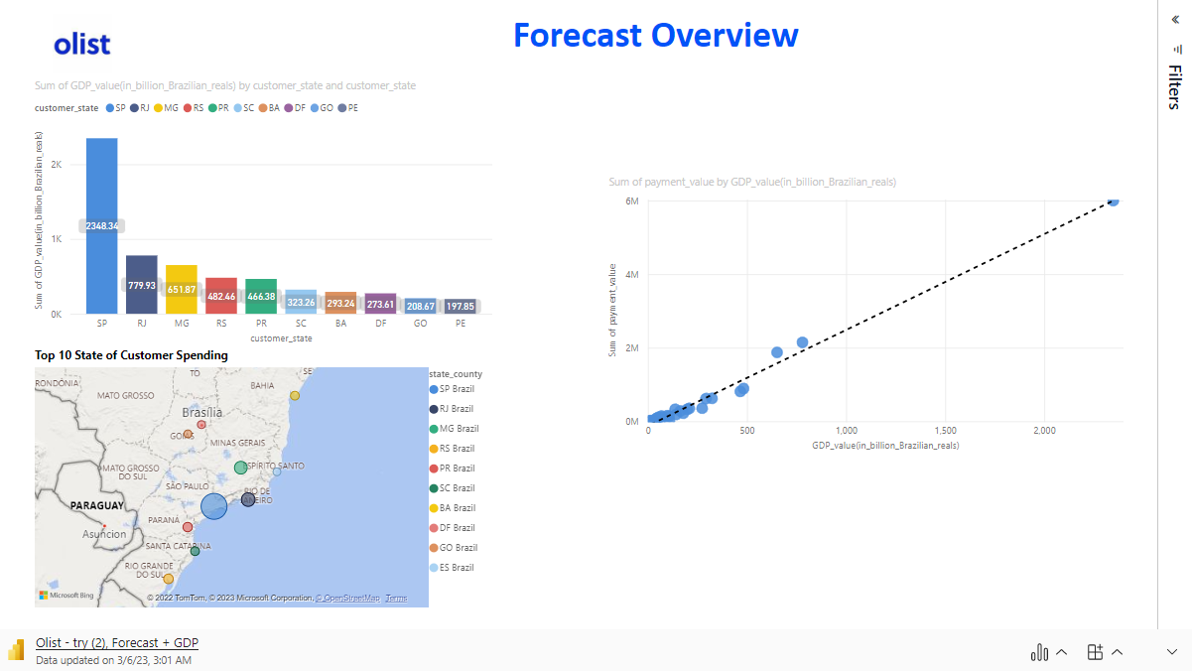

Slide 25
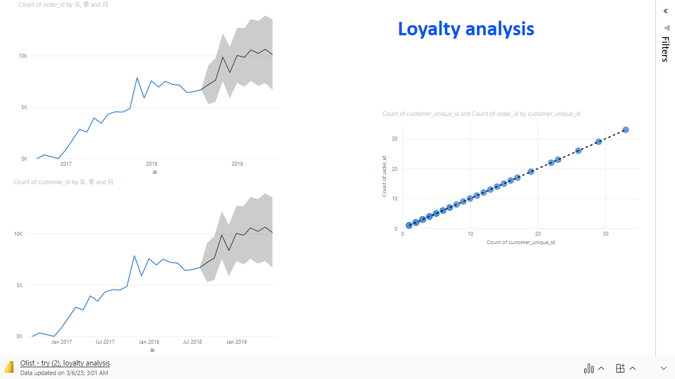

Slide 26
Summary Recommendations
Business Strategic Planning
Demand
Supply
Marketing (CRM)
Product
Order

Slide 27
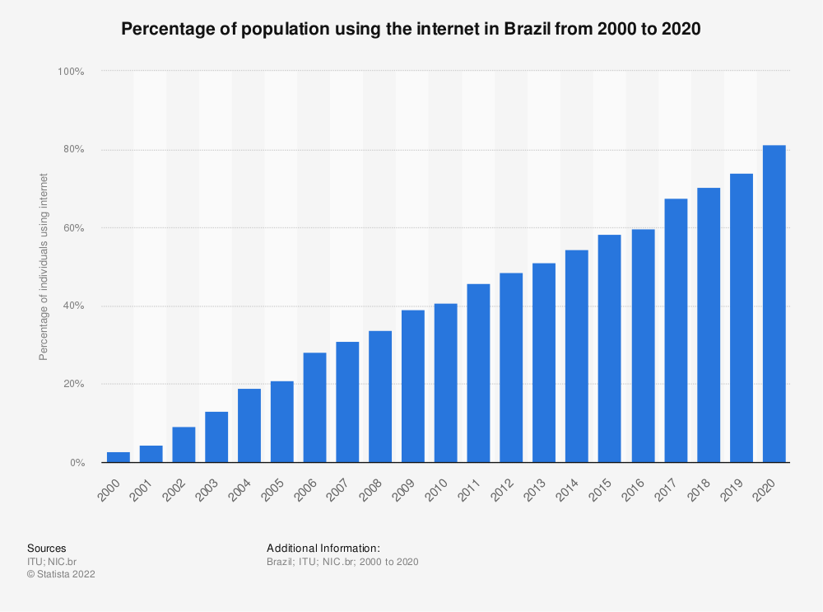
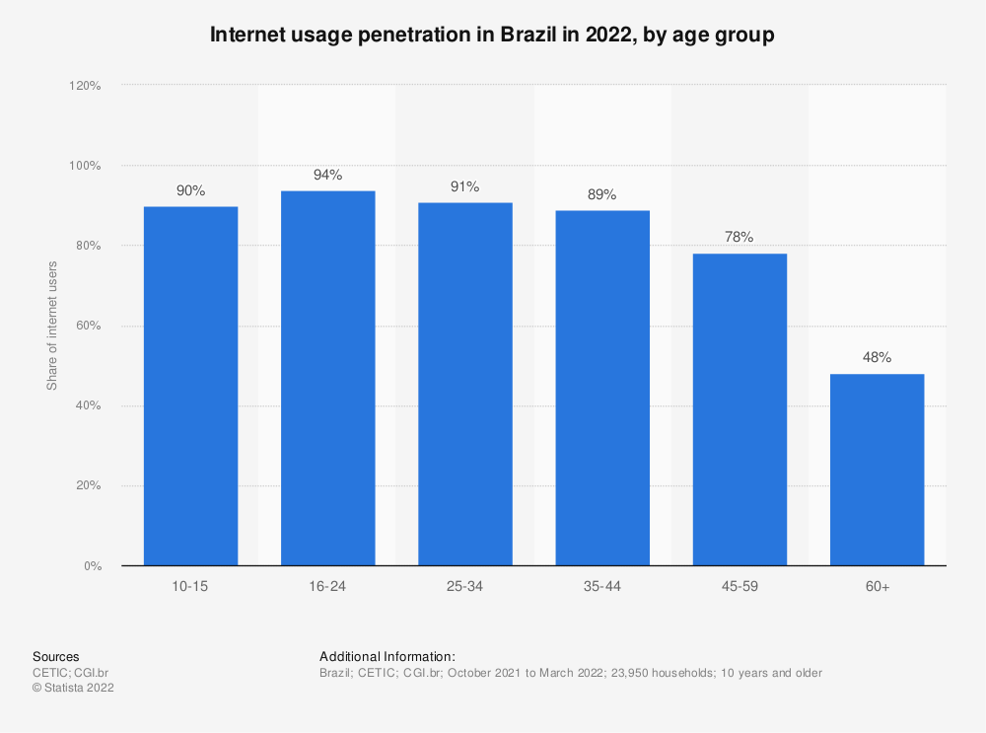
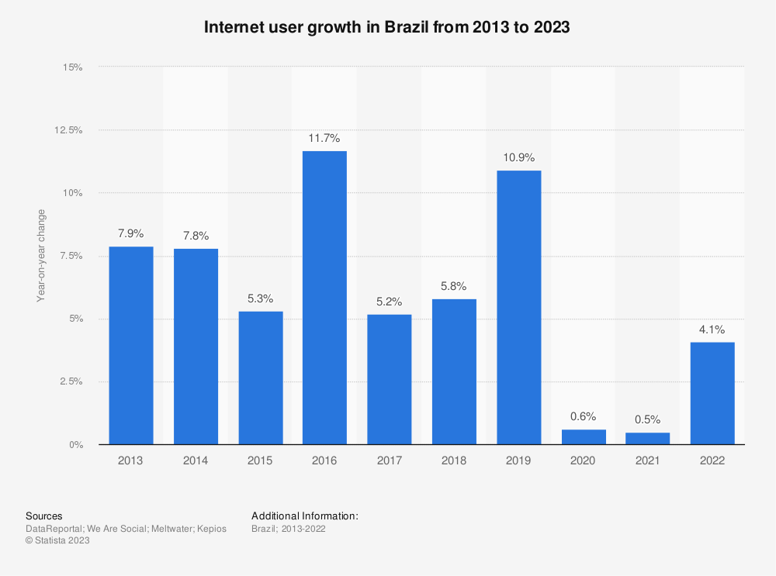
Recommendations - Business Strategic Planning
Situation | Recommendations
Customer > 40% customer focus in SP states One-time purchase No significant customer demographic info collected Online marketplace in Brazil only | Local acquisition, to enrich acquisition on other states Membership reward phase by phase, on credit, giveaway Registration system with more customer details on age, gender, preference, and target young adult and adult Develop nearby international market
Internet usage penetration in Brazil in 2015, by age group

Slide 28
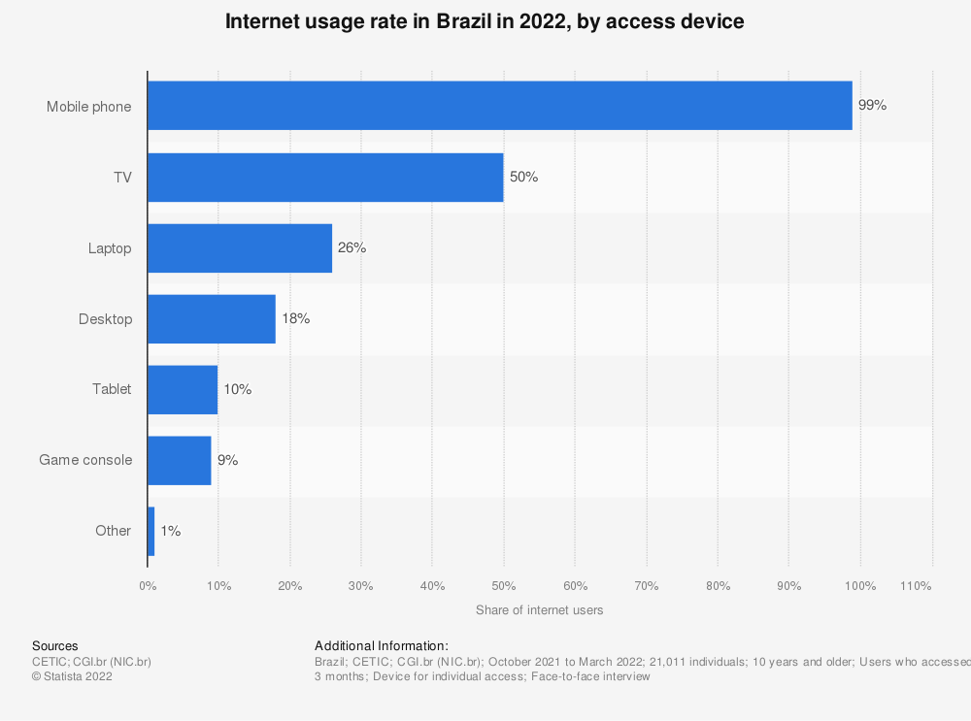
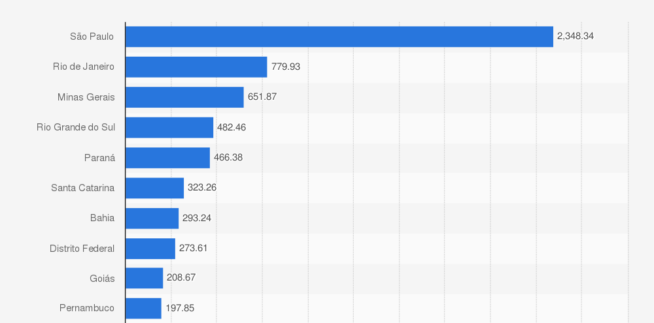
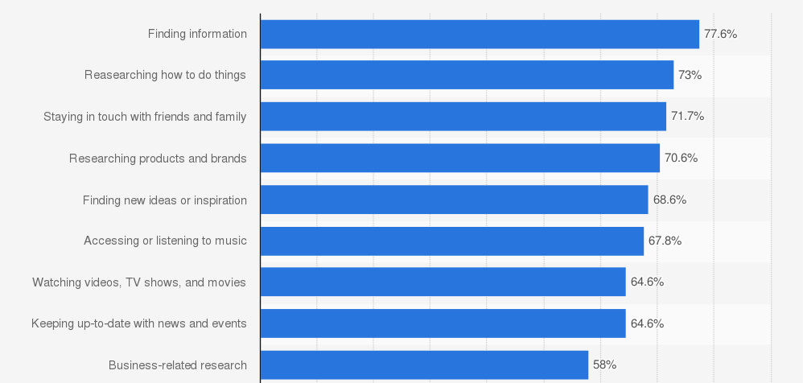
Recommendations - Business Strategic Planning
Situation | Recommendations
Seller 60% seller revenue & number of sellers in SP states Slow growth on number of sellers | Enrich the SP States number of sellers to other cities Enlarge acquisition scales to other nearest states and related cities, e.g. RG & MG (3.2 times difference)
Marketing No enough with “WoW” products and market noise | Social Media promotion on platforms Partnership for credit card and electronic payment/ bank partners & logistic company Referral credits as incentives for customer Active SEO, SEM EDM for subscription / SMS Seasonal product sales campaign Blog feature
Value of Gross Domestic Product (GDP) in Brazil in 2018,
by federative unit (in billion Brazilian reals)
Most Popular Reason Online Users in Brazil Using Internet as of 2015 Q3

Slide 29
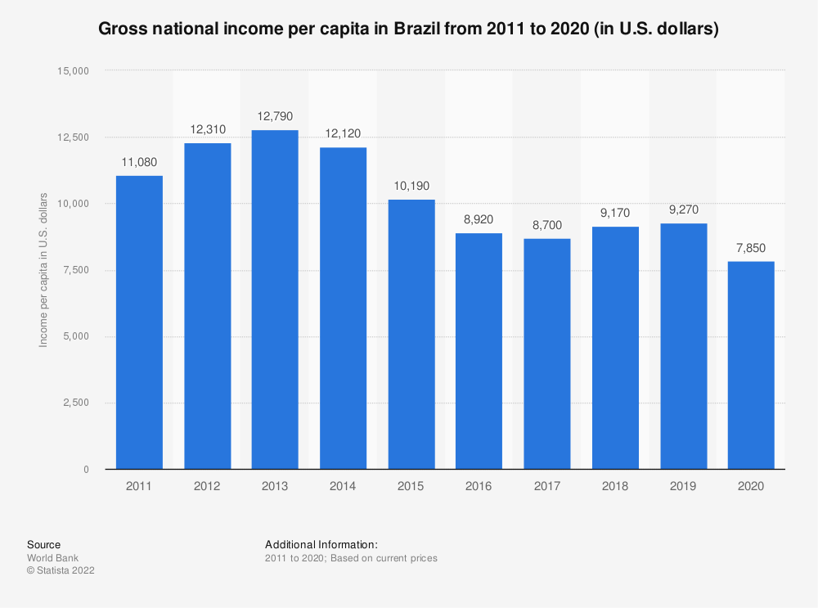
Recommendations - Product
Situation | Recommendations
Product NO attractive product category to keep customer Routine product rankings Lacking interesting / gimmick product | Optimize current product coverage and mix on website and app Increase number of products supply based on sales revenue e.g. beauty, watch & gifts, sports Product with more description and photos Launch more seasonal product offerings with theme Black Friday Sales, Happy Easter/ Post Xmas/ Valentine’s Day Launch gimmick products, e.g. for first trial beauty products/ free sample

Slide 30
Recommendations - Order
Situation | Recommendations
Order Low activeness to score and comment, no photo sharing Many customer with one time purchase Delivery on late problem Olist afford much on delivery fee | Reminder notification for customer Optimize the frontend part Credit rebate for score and comment for the community Recommendation on related choices of products, 5% discount voucher for repurchase Punishment and reward scheme internally for seller on delivery on-time and delay, e.g. higher ranking, prime position/ EDM Adjust the free-delivery minimum spending , develop membership of delivery scheme

Slide 31
Task Arrangement
Tasks | Victor Lee | Wing | Zoyi
Research | 🗸 | 🗸 | 🗸
External Data | 🗸 | - | 🗸
Power BI | -Forecast Overview -Payment Overview | -Order Delivery Overview -Review Overview -Customer Clustering | -Sales Overview -Supply Overview -Seller Overview -Order Overview -Customer Overview
PowerPoint | 🗸 | 🗸 | 🗸
Presentation | 🗸 | 🗸 | 🗸

Slide 32
Q&A

Slide 33
Thank You

