Slide 1
Interaction Diagram / AUML-2 Tool
Michael Winikoff
August 2003
http://www.cs.rmit.edu.au/~winikoff/auml

Slide 2
AUML2 Tool
Rough prototype tool!
Takes text and generates .eps generating layout automatically
  .eps can be converted to other formats (jpg,png,…)
  Does both AUML-2 subset and interaction diagrams
Requires perl and tcl/tk (probably easiest on unix, but should also work under windows)
  Requires available $DISPLAY (unix)
start FIPA query protocol
agent I Initiator
agent P Participant
box alt
message I P query-if
…
auml.pl
Tcl/tk program
wish
.eps file

Slide 3
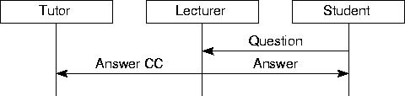
Input Format
agent T Tutor
agent L Lecturer
agent S Student
message S L Question
message L S Answer
backup
message L T Answer CC
One command per line.
Commands:
  agent shortname longname
  (also invis and role)
  start protocol name
  finish
  message from to message description
  box type
  next
  end type
  backup
Leave these out for interaction diagrams

Slide 4
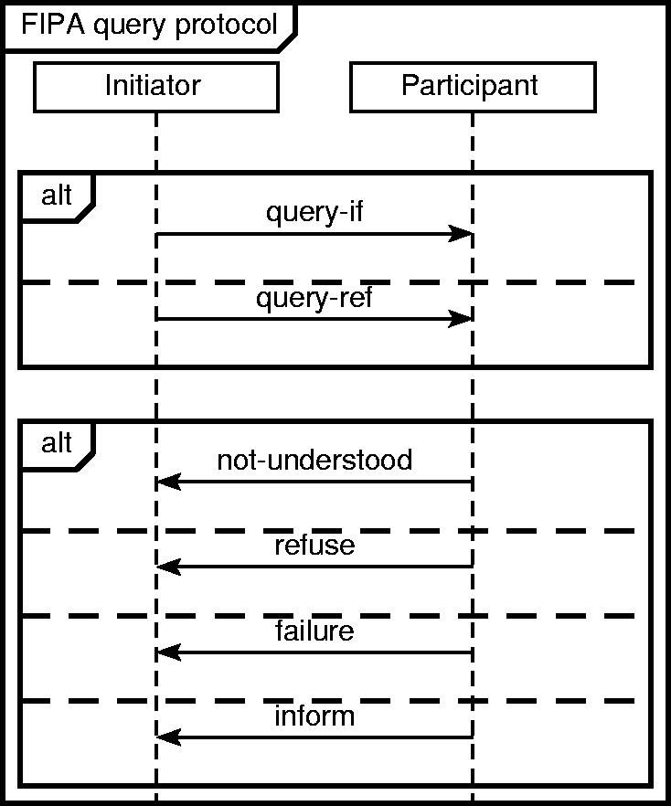

Example
start FIPA query protocol
agent I Initiator
agent P Participant
box alt
message I P query-if
next
message I P query-ref
end alt
box alt
message P I not-understood
next
message P I refuse
next
message P I failure
next
message P I inform
end alt
finish

Slide 5
Book Store Example
start Book Order
agent c Customer
agent s Sales ass.
agent w Warehouse man.
agent d Delivery manager
agent b Bank
message c s Request Book
message s w Price+availability
message w s response
message s c response
box alt
message c s Cancel
next
message c s Buy Book
message s w Delivery Options?
message w s Delivery info
message s c Delivery info
message c s Delivery Choice
message s c Payment details?
box alt
message c s Cancel
next
message c s Credit card info
message s b Credit Check Request
box alt
message b s Not understood
next
message b s Not approved
next
message b s Approval
message s w Order
backup
message s c Thanks
end alt
end alt
end alt
finish

Slide 6
