Slide 1
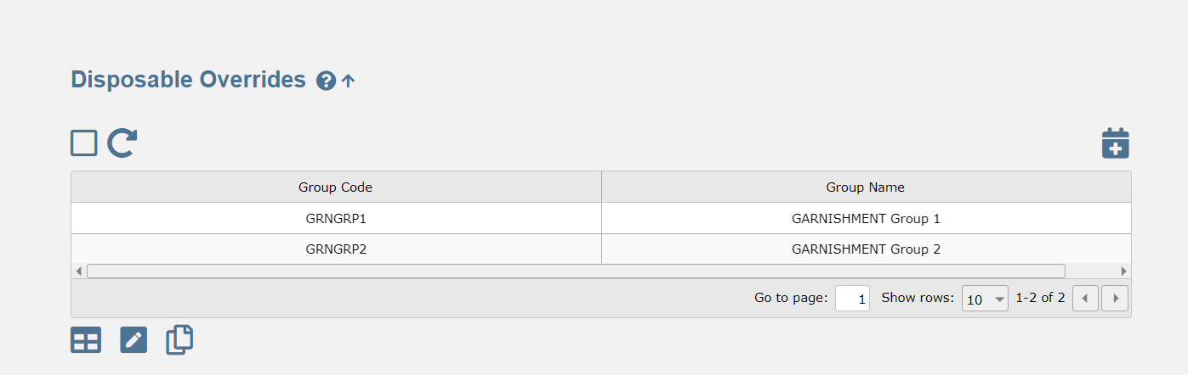
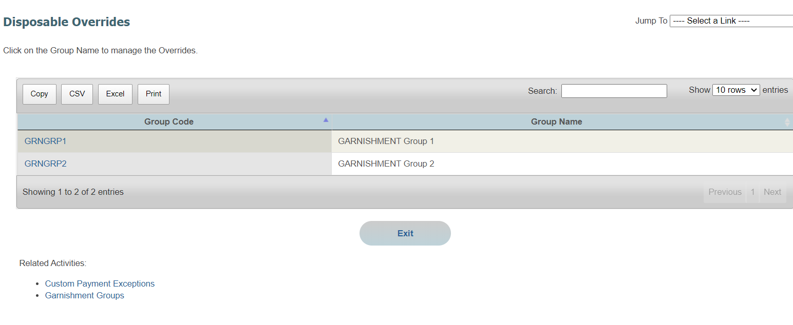
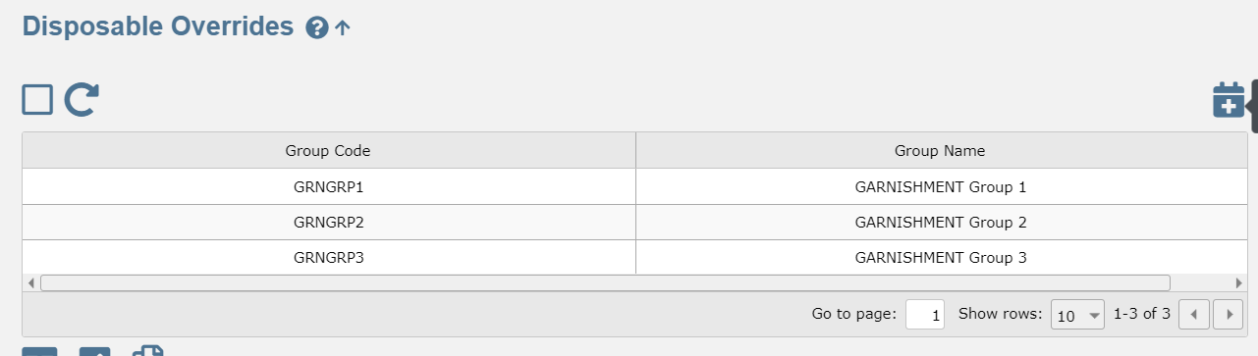
DISPOSABLE OVERRIDES (PARENT)
In TF 11 UI, one cannot add a Garnishment Group from Disposable Override screen parent screen
In TF new UI, one can add a Garnishment Group from Disposable Override screen parent screen

Slide 2
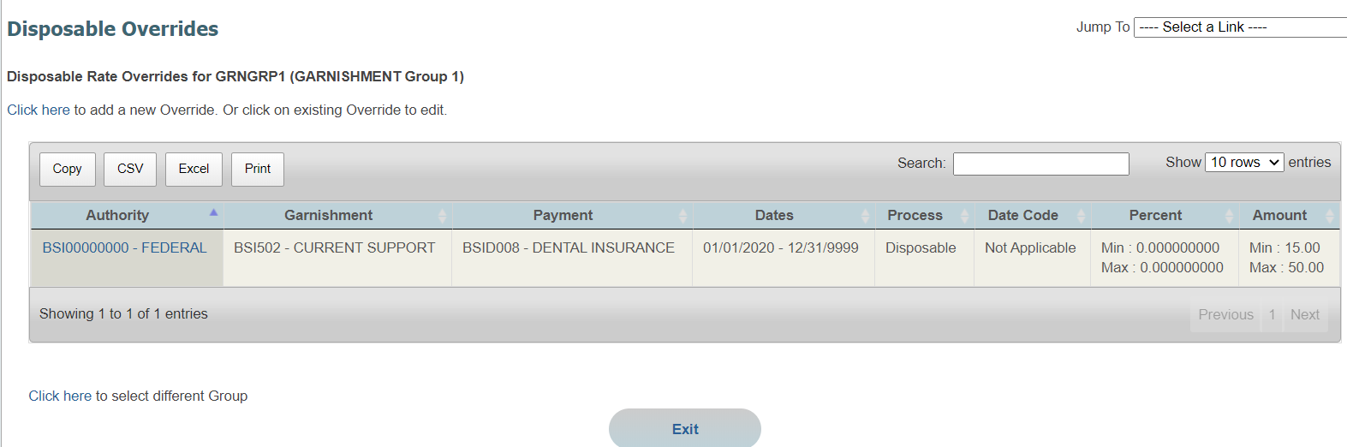
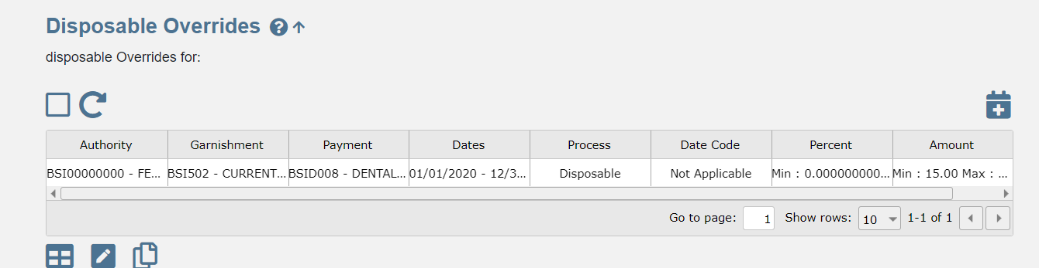
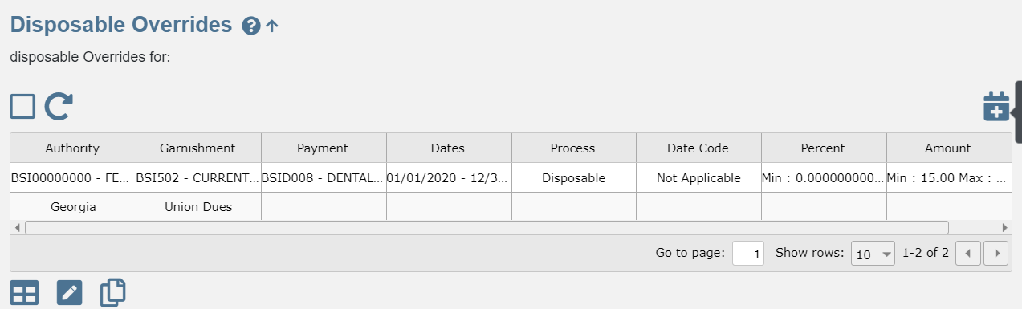
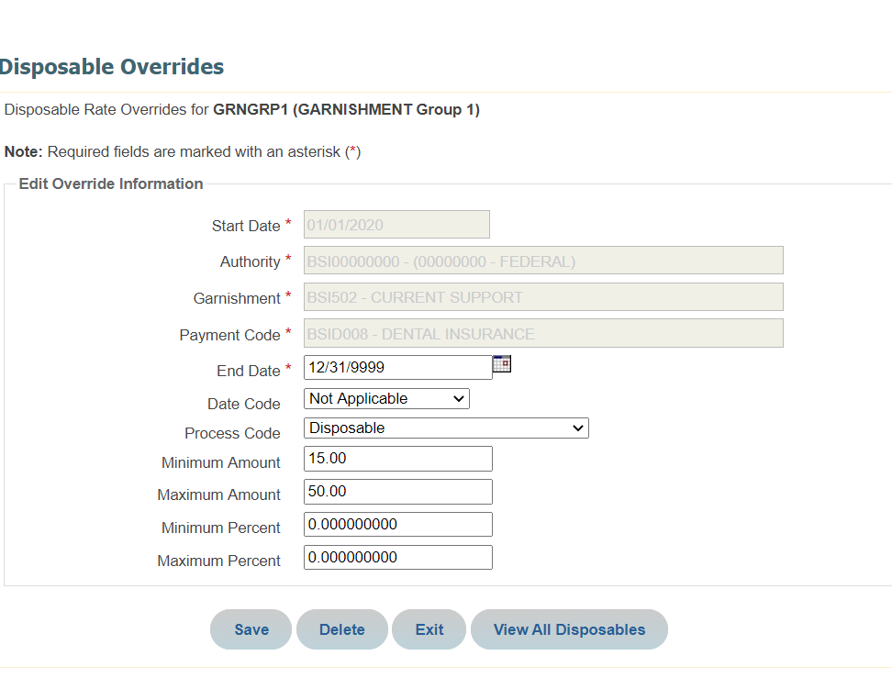
DISPOSABLE OVERRIDES (CHILD)
In TF 11 UI, one can add a Disposable Override from the child screen
In TF new UI, one can add a disposable Override from the child screen- but all columns do not populate

Slide 3
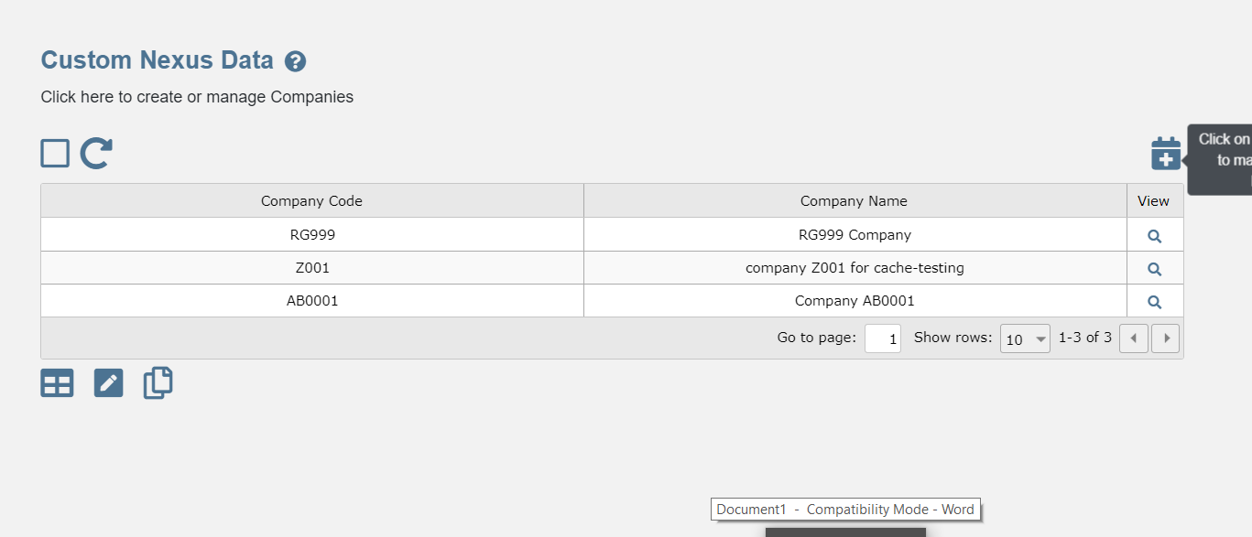
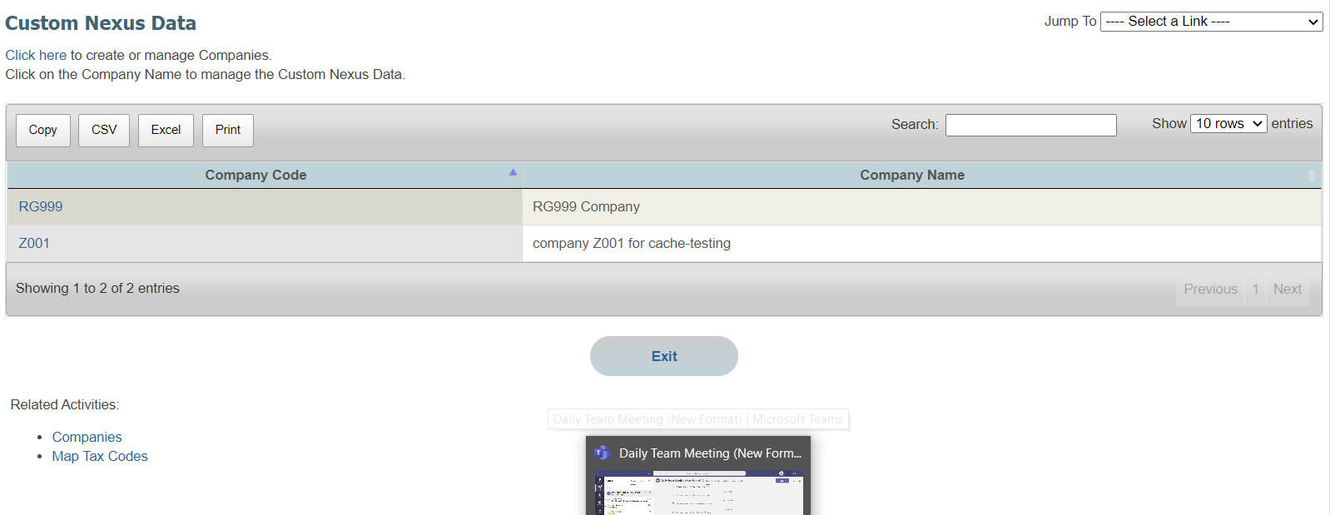
CUSTOM NEXUS DATA (PARENT)
In TF 11 UI, one can add a Company (navigated to a Companies Screen –one has to click on add New Company ) Custom nexus Data Child parent screen
In TF 11 UI, one can add a Company from
Custom nexus Data Child parent screen

Slide 4
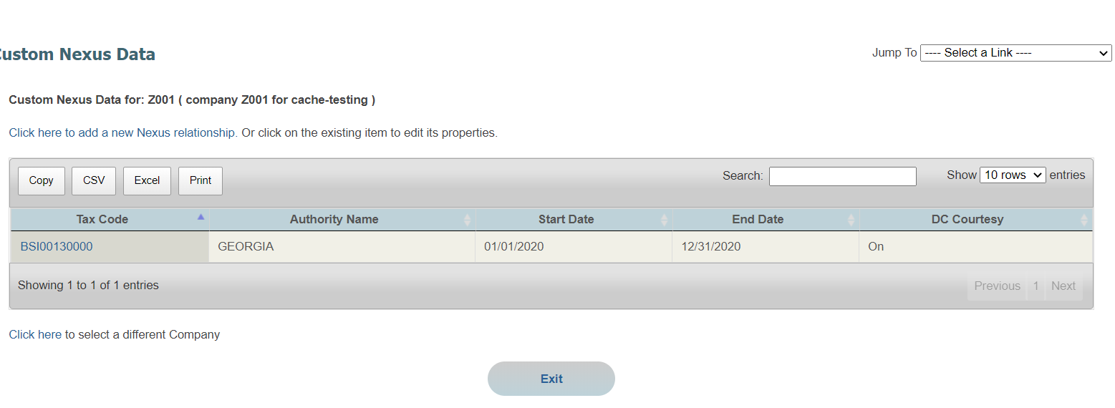
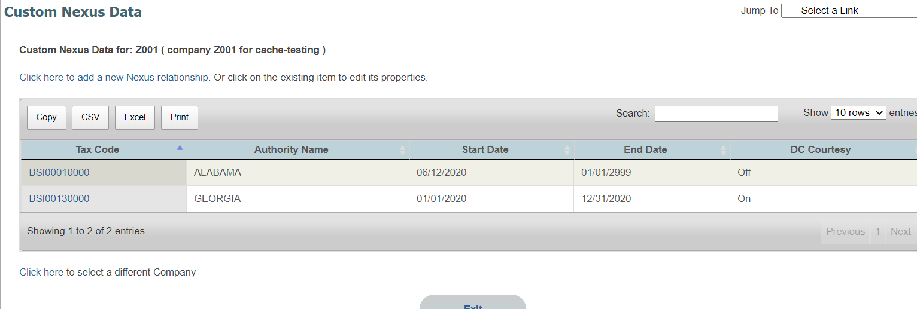
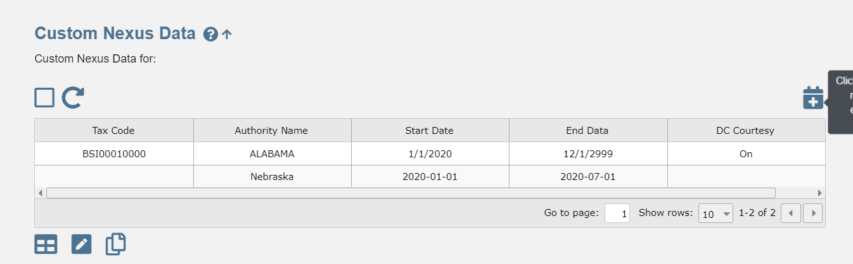
CUSTOM NEXUS DATA (CHILD)
In TF 11 UI, one can add a custom nexus from Custom nexus Data Child screen
In TF 11 UI, one can add a custom nexus from Custom nexus Data Child screen

Slide 5
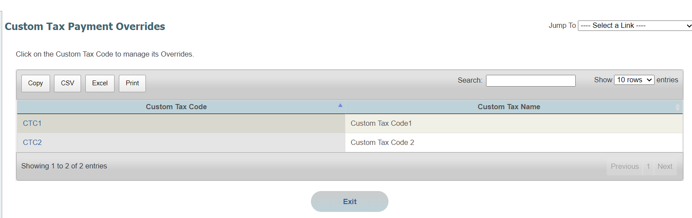
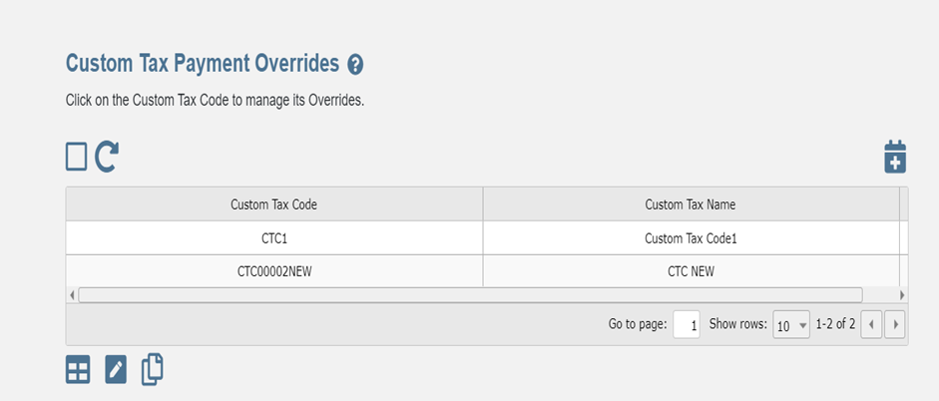
CUSTOM TAX PAYMENT OVERRIDES(PARENT)
In TF 11 UI, one cannot add a Custom Tax Code from Custom Tax Payment Overrides parent screen
In TF new UI, one can add a Custom Tax Code from Custom Tax Payment Overrides parent screen

Slide 6
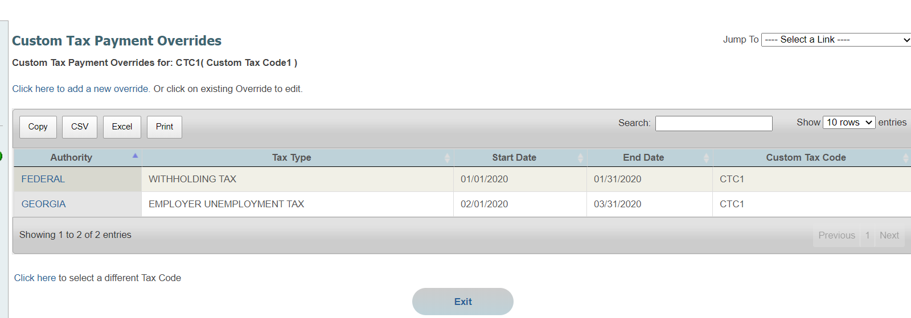
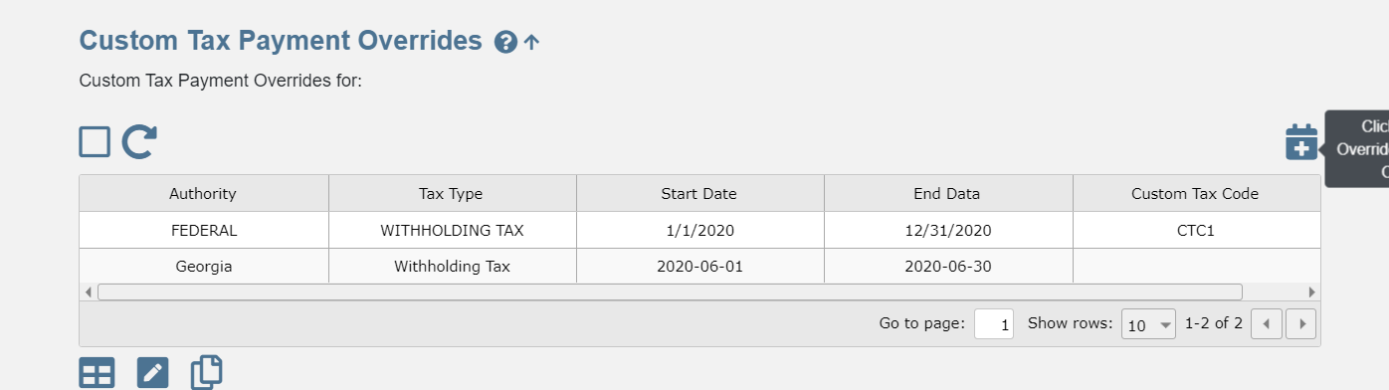
CUSTOM TAX PAYMENT OVERRIDES (CHILD)
In TF 11 UI, one can add a Custom Tax Payment Override from Custom Tax Payment Overrides child screen
In TF new UI, one can add a Custom Tax Payment Override from Custom Tax Payment Overrides child screen

Slide 7
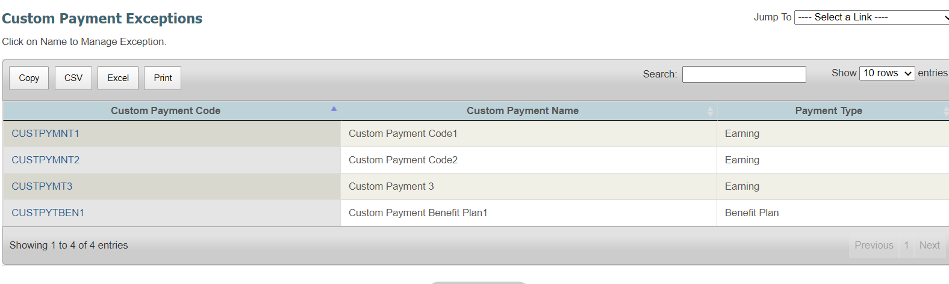
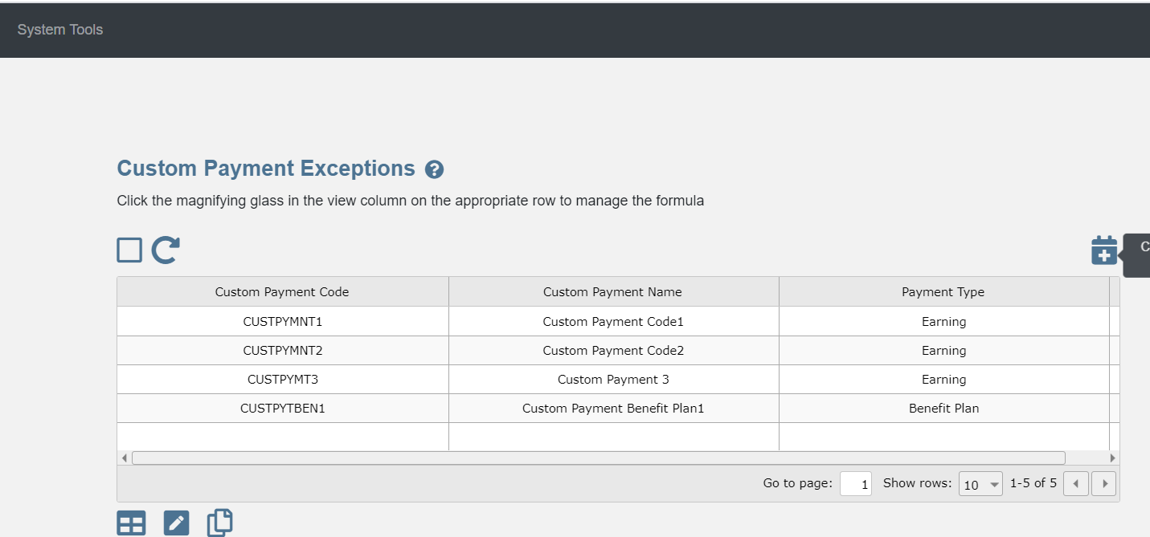
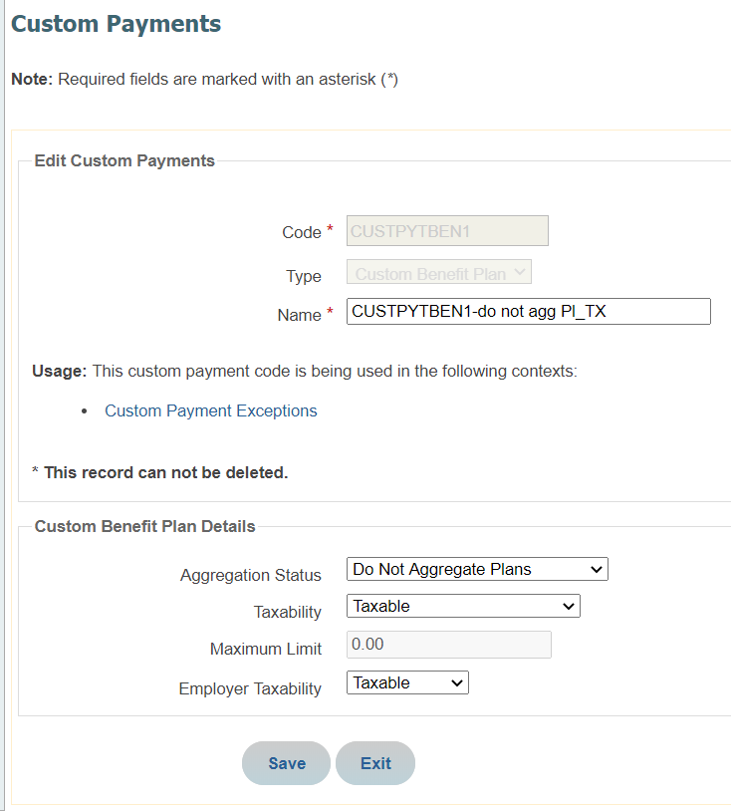
CUSTOM PAYMENT EXCEPTIONS (PARENT)
In TF 11 UI, one cannot add a Custom Payment from Custom Payment Exceptions screen parent screen
In TF new UI, one can add a Custom Payment from Custom Payment Exceptions screen parent screen but grid does not populate

Slide 8
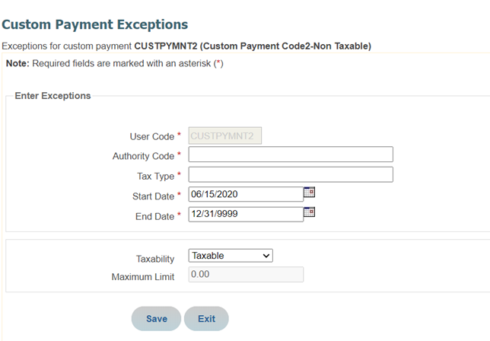
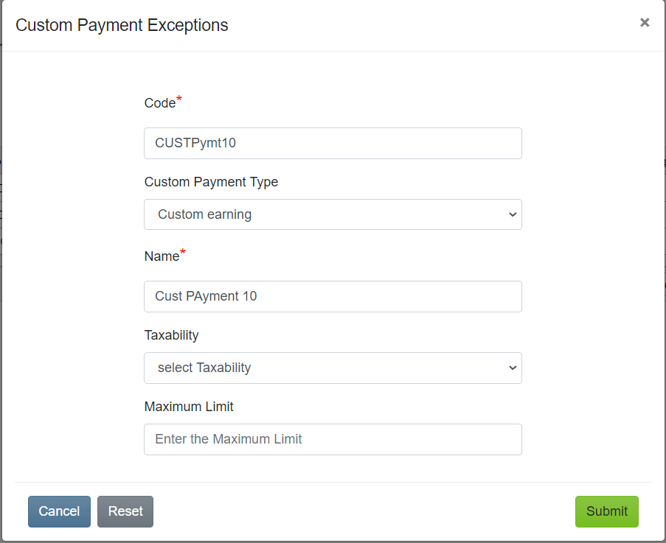
CUSTOM PAYMENT EXCEPTIONS (PARENT)
In TF 11 UI, one cannot add a Custom Payment from Custom Payment Exceptions screen parent screen
When Earnings are added from Custom Payment screen the fields Taxability and Maximum Limit display
In TF new UI, one can add a Custom Payment from Custom Payment Exceptions screen parent screen but grid does not populate

Slide 9
CUSTOM PAYMENT EXCEPTIONS (PARENT)
In TF 11 UI, one cannot add a Custom Payment from Custom Payment Exceptions screen parent screen
When Earnings are added from Custom Payment screen the fields Taxability and Maximum Limit display
In TF new UI, one can add a Custom Payment from Custom Payment Exceptions screen parent screen but grid does not populate

Slide 10
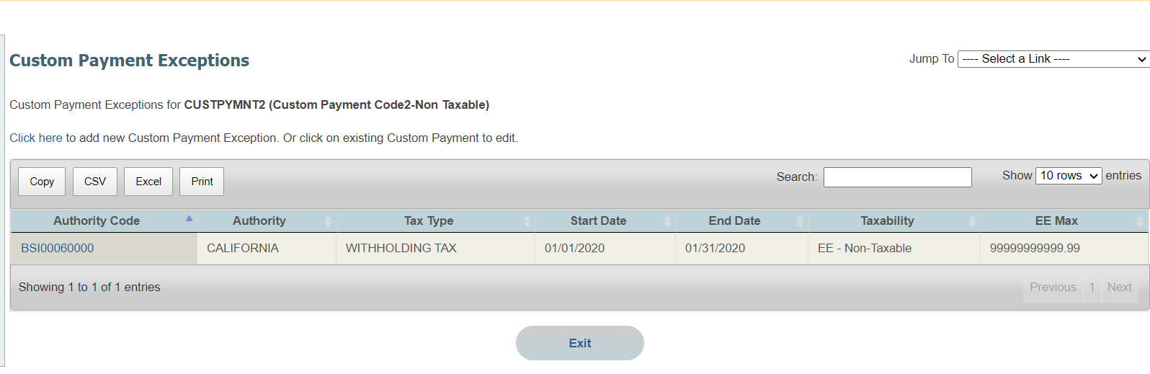

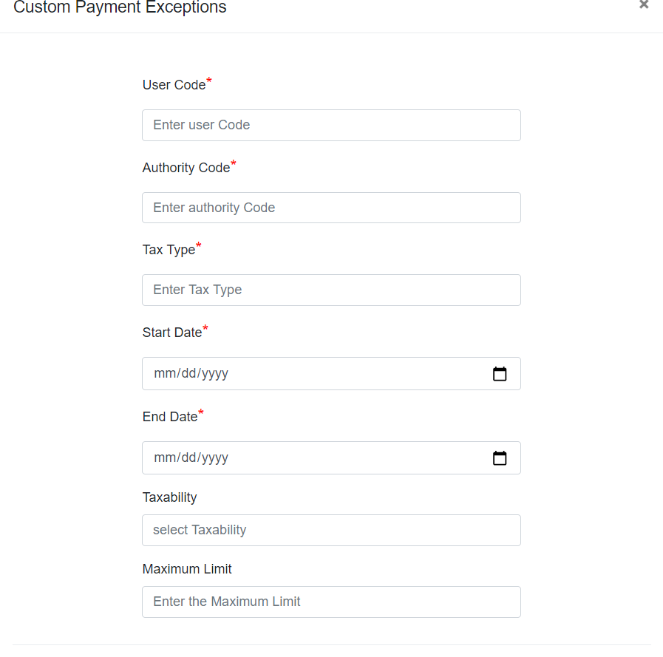
CUSTOM PAYMENT EXCEPTIONS _Earnings-(CHILD)
In TF 11 UI, one can add a Custom Payment Exception from the child screen
In TF new UI, one can add a Custom Payment Exception from the child screen Page Data, Field data and Mock Data configured for Earnings

Slide 11
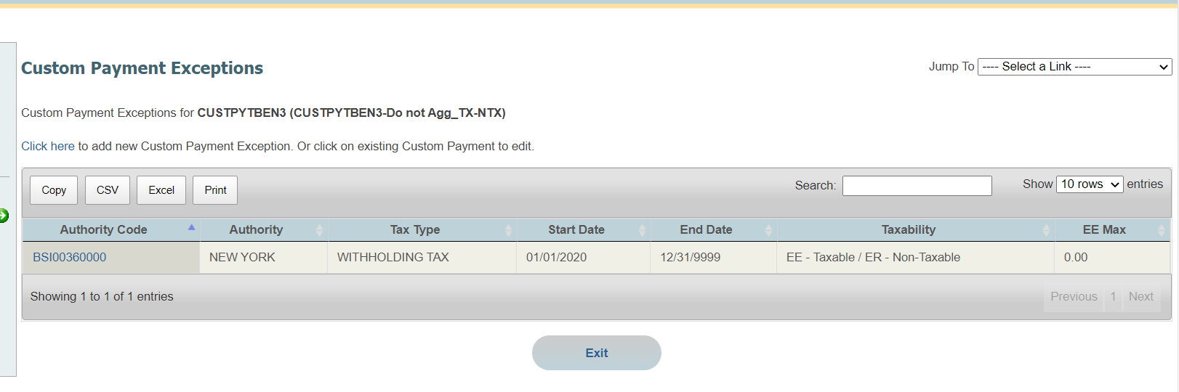
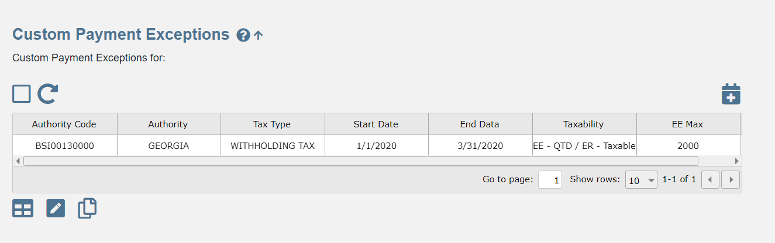
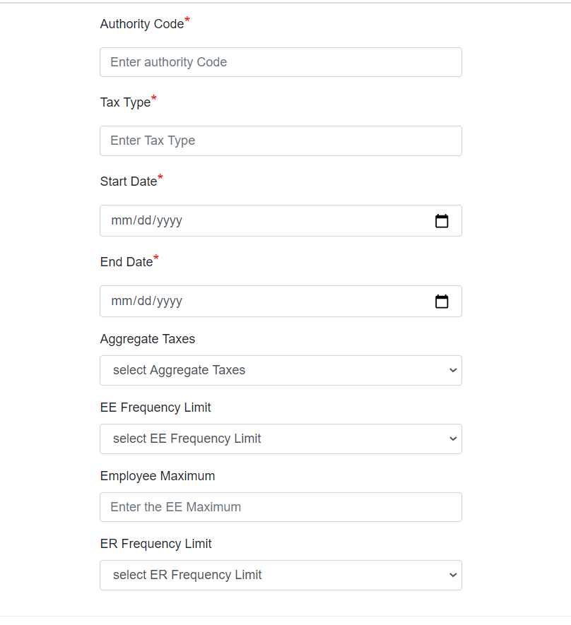
CUSTOM PAYMENT EXCEPTIONS _Earnings-(BENEFITS)
USED FIELD DATA FOR BENEFITS
In TF 11 UI, one can add a Custom Payment Exception from the child screen- the fields display based on Type
In TF new UI, one can add a Custom Payment Exception from the child screen. Page Data, Field data and Mock Data configured for Benefits

Slide 12
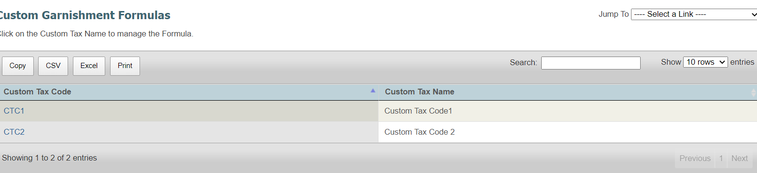
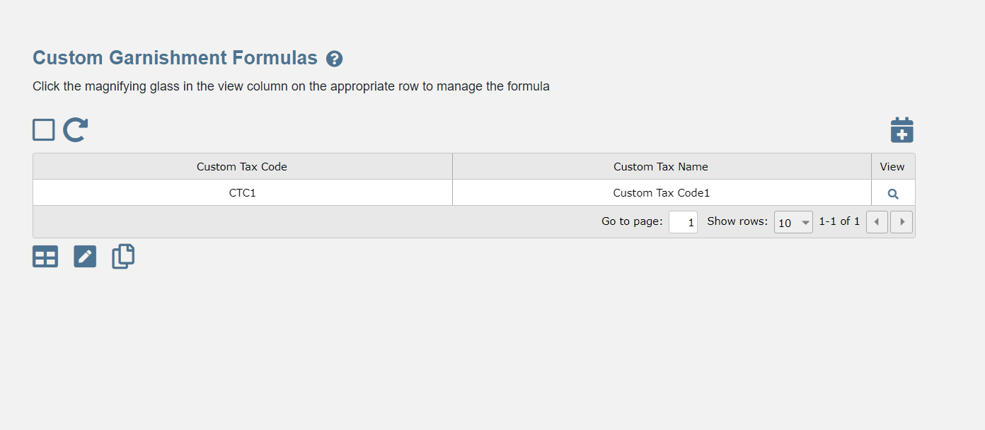
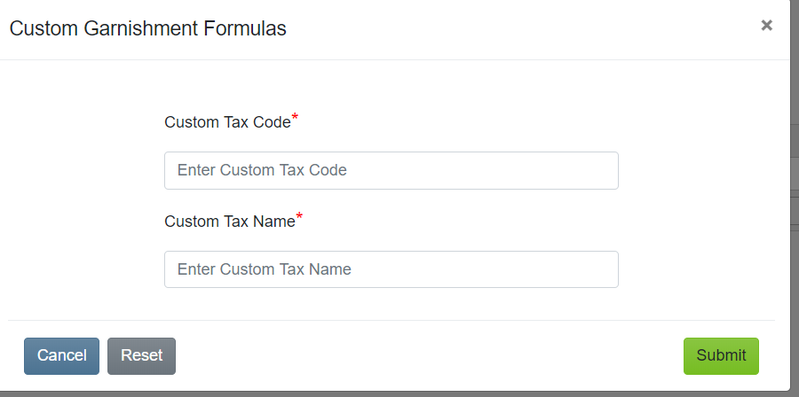
CUSTOM GARNISHMENT FORMULAS (PARENT)
In TF 11 UI, one cannot add a Custom Garnishments from Custom Garnishment Formulas parent screen.
In TF new UI, one can add a Custom Garnishments from Custom Garnishment Formulas parent screen.

Slide 13
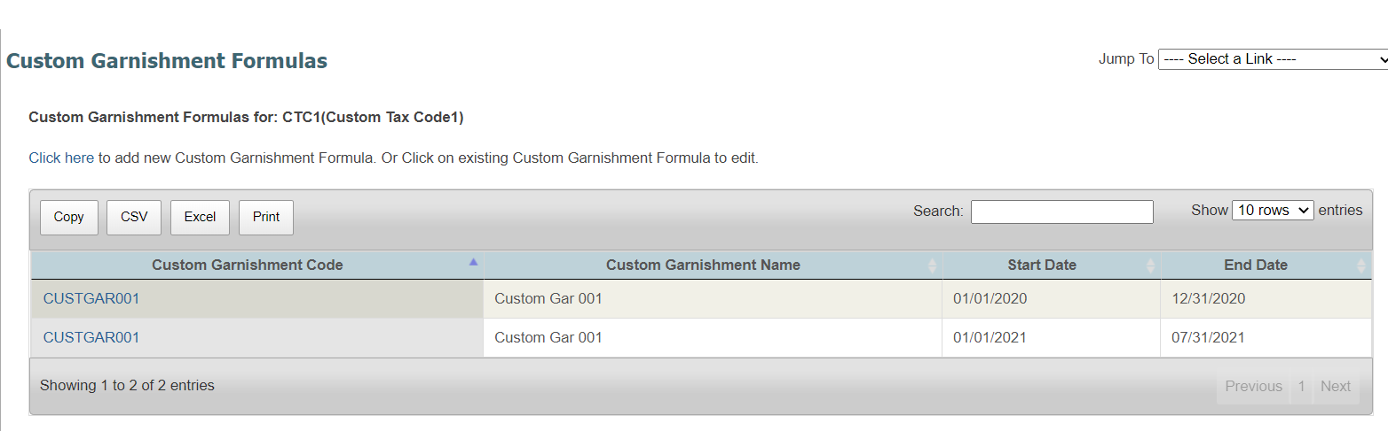
CUSTOM GARNISHMENT FORMULAS (CHILD)
In TF 11 UI, one can add a Custom Garnishments from Custom Garnishment Formulas Child screen.
In TF New UI, one can add a Custom Garnishments from Custom Garnishment Formulas Child screen.
.

Slide 14
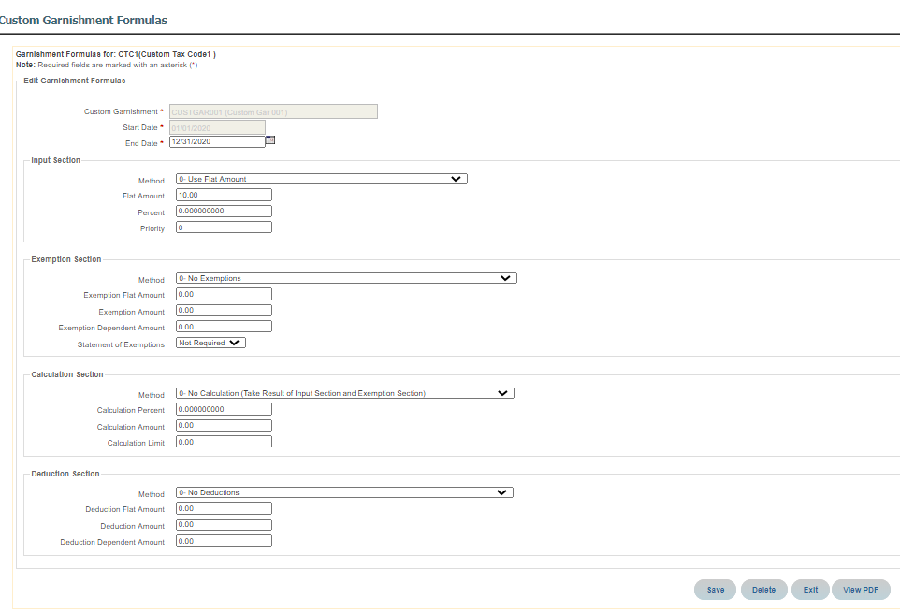
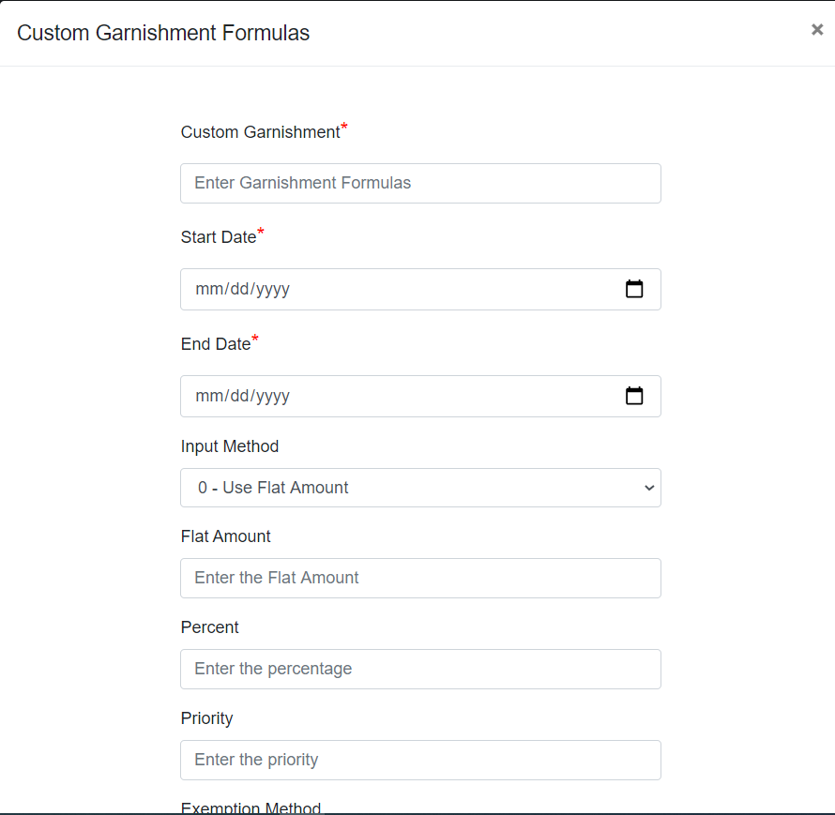
CUSTOM GARNISHMENT FORMULAS (CHILD)
In TF 11 UI, one can add a Custom Garnishments from Custom Garnishment Formulas Child screen.
In TF New UI, one can add a Custom Garnishments from Custom Garnishment Formulas Child screen.
.

