Slide 1
Tax Factory New Web Application Architecture
Modularization
&
UI Design Proposal

Slide 2
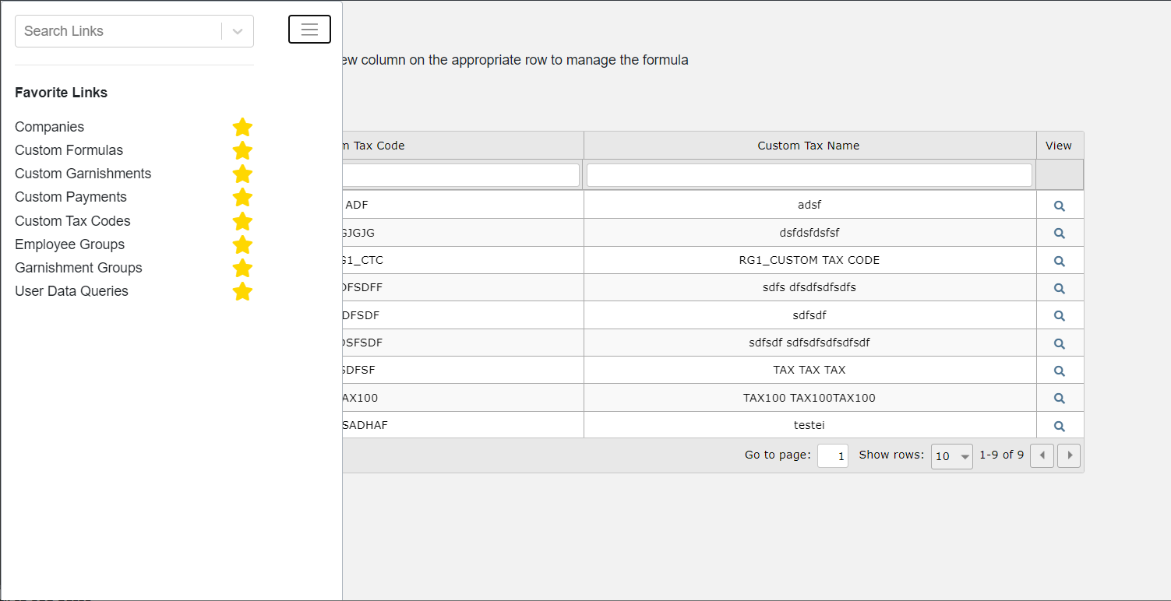
Modularization
An application module can contain many sub-areas/pages.
Intra-module Navigation

Slide 3
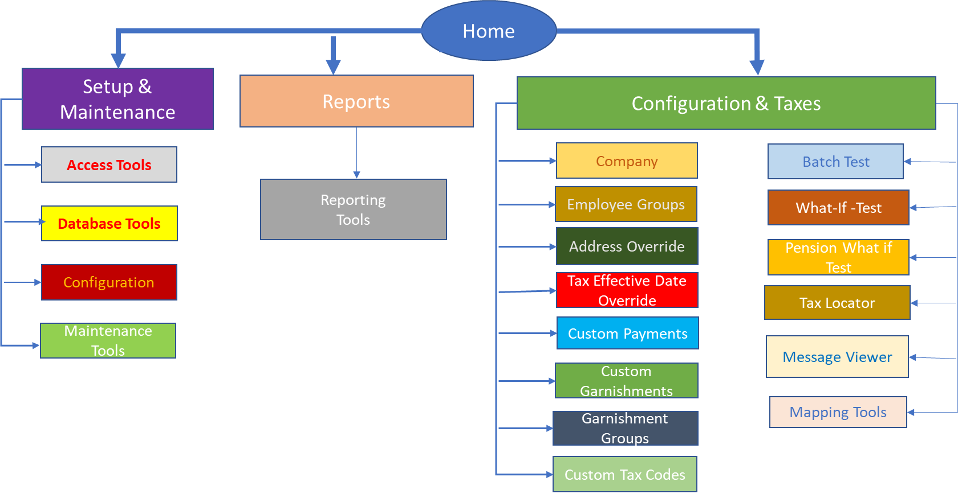
Modularization
Setup & Maintenance, Reports, Configuration & Taxes are 3 UI modules that together compose all Tax Factory functionality.
Message Viewer
Message Viewer

Slide 4
Modularization – Pros/Cons
Cons
Multiple UI module projects.
Adds additional time to project timelines (few days)
Pros
Phased release to production possible for alpha/beta testing and early preview for customers.
Phased delivery to product team.
Phased certification/testing – reduce overall cycle time to prod.
Product team can start supporting new version in phases reducing ramp-up time.
Partial/Module production deployments possible.

Slide 5
UI Navigation/Flow
Tax Locator - Current Flow
Employees
Actoins
Legend
Edit Employee
Grid
Form
Grid & Actions
Manage Locations/Run Locator

Slide 6
UI Navigation/Flow
Tax Locator - Proposed Flow
Employees
Edit Employee
Actoins
Legend
Grid
Form
Manage Locations
Grid & Actions

Slide 7
UI Navigation/Flow
Wire Frames

Slide 8
UI Flow – What If Test (Current)
Employees
Edit Employee
Actoins
Legend
Grid
Manage Employee Tax
Form
Grid & Actions
Manage Taxes
Manage Wages

Slide 9
UI Flow – What If Test (Current)
Employees
Actoins
Legend
Edit Employee
Grid
Form
Grid & Actions
Manage Garnishments
Employee Garnishment
Garnishment Deduction/Benefit Plan
Manage Ben/Ded Plans

Slide 10
UI Flow – What If Test (Current)
Employees
Tax Locator - Employees
Edit Employee
Actoins
Legend
Grid
Manage Locations
Form
Grid & Actions
Manage Employee Tax Locator Info
Manage Taxes

Slide 11
UI Flow – What If Test (Proposed)
Employees
Add/Edit Employee
Manage Garnishments
Manage Locations
Manage Taxes
Add/Edit Tax
Add/Edit Garnish…
Add/Edit
Location
Actoins
Manage Wages
Manage Ben/Ded Plans
Legend
Grid
Add/Edit Wage
Add/Edit Ben/Ded Plan
Form
Grid & Actions

Slide 12
UI Flow – What If Test (Proposed)
Wire Frames

Slide 13
UI Flow Re-Design Pros & Cons
Cons
Common Library Enhancement Required
Metadata definition additions to support multi-child, multi-level navigation.
Pros
All metadata driven UI generation.
Reduces UI implementation/coding effort
Less error prone/reduces defects
Increases maintainability

Slide 14
Conclusion
Q&A
Comments

