Slide 1
The Purpose of the Corporation

Slide 2
Shareholder Theory

Slide 3
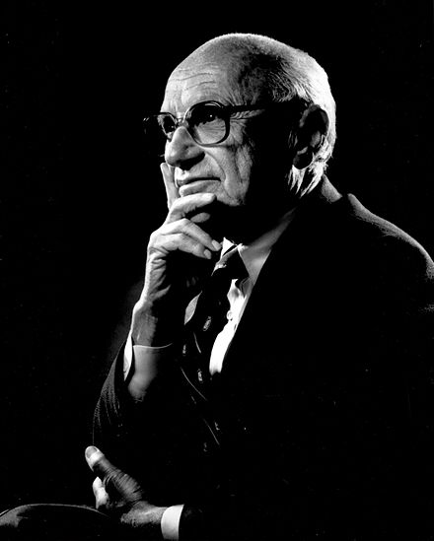
Shareholder Theory
Milton Friedman 1912-2006
Notes:
Shareholder theory is attributed to Milton Friedman, an economist.

Slide 4
Shareholder Theory
Milton Friedman 1912-2006
The purpose of the corporation is to maximize shareholder value

Slide 5
Shareholder Theory
A shareholder is someone who owns stock in the corporation

Slide 6
Shareholder Theory
A shareholder is someone who owns stock in the corporation
A business maximizes the value of stock by maximizing profits

Slide 7
Shareholder Theory
“there is one and only one social responsibility of business–to use its resources and engage in activities designed to increase its profits so long as it stays within the rules of the game, which is to say, engages in open and free competition without deception or fraud.”
-Milton Friedman

Slide 8
Opposing Argument to Shareholder Theory
Market Failures

Slide 9
Opposing Argument to Shareholder Theory
Phillip Arrow has 2 effects of maximizing profits that are undesirable to society
Notes:
Pollution and traffic congestion. Putting more cars on the road may be the best way to maximize profits. The cost imposed on others by putting more cars on the road is not imposed on the business that chooses to put more cars on the road.

Slide 10
Opposing Argument to Shareholder Theory
Phillip Arrow has 2 effects of maximizing profits that are undesirable to society
When an action poses a greater cost to society than to the imposer of the cost.
Notes:
Pollution and traffic congestion. Putting more cars on the road may be the best way to maximize profits. The cost imposed on others by putting more cars on the road is not imposed on the business that chooses to put more cars on the road.

Slide 11
Opposing Argument to Shareholder Theory
Phillip Arrow has 2 effects of maximizing profits that are undesirable to society
When an action poses a greater cost to society than to the imposer of the cost.
Examples:
Pollution
Traffic congestion
Notes:
Pollution and traffic congestion. Putting more cars on the road may be the best way to maximize profits. The cost imposed on others by putting more cars on the road is not imposed on the business that chooses to put more cars on the road.

Slide 12
Opposing Argument to Shareholder Theory
Phillip Arrow has 2 effects of maximizing profits that are undesirable to society
2. Asymmetric information
Notes:
Asymmetric information. Since the seller generally knows more than the buyer, the seller

Slide 13
Opposing Argument to Shareholder Theory
Phillip Arrow has 2 effects of maximizing profits that are undesirable to society
2. Asymmetric information
Examples:
The car salesperson knows more about the defects of the car than the buyer
Notes:
Asymmetric information. Since the seller generally knows more than the buyer, the seller

