Slide 1
Charity

Slide 2
Review of Utilitarianism
When multiple actions are available, utilitarianism obligates the individual to take the action that
maximizes net aggregate happiness

Slide 3
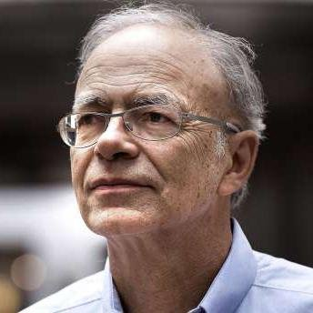
Peter Singer
Famous utilitarian philosopher

Slide 4
Peter Singer
Famous utilitarian philosopher
Animal liberation activist

Slide 5
Peter Singer
Famous utilitarian philosopher
Animal liberation activist
1971 author of
“Famine, Affluence, and Morality”

Slide 6
“Famine, Affluence, and Morality”
“Constant poverty, a cyclone, and a civil war have turned at least nine million people into destitute refugees”
“Australia is another country which, on a per capita basis, is well up in the "aid to Bengal" table. Australia's aid, however, amounts to less than one-twelfth of the cost of Sydney's new opera house.”

