Slide 1
Dungeons & Dragons Character Creator Database
Foster Clinton & Dan Kercher

Slide 2
Enterprise Statement – Solution Requirements
Our group tasked itself with creating a solution to create and store Dungeons and Dragons characters
A player has a unique username and passphrase
A player may have many characters
A character has one race, class, and background
A character may have more than one spell or item at their disposal
Races, classes, backgrounds, spells, and items may belong to more than one character

Slide 3
Goals from Enterprise Statement
UI application to facilitate usability and keep the database hidden from users
Characters should be collected in player accounts, requiring account creation and authentication
During character creation, minimal data should be saved to the character table with most entries consisting of foreign keys to other tables
Character creation options should be pulled from the database to maintain consistency and minimize app updates and local storage
After character creation, data should be viewable and updatable from a centralized database to provide a portable character collection solution

Slide 4
Part 1: Database

Slide 5
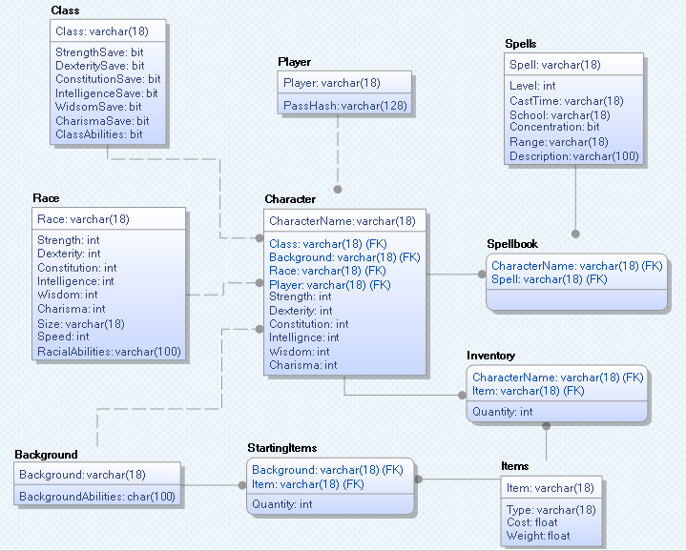
Database Physical Design - ER Diagram
Physical view of ER Diagram for the database
Most domains consist of int, bit, or varchar
Users only save data directly into player, character, spellbook, and inventory
Other tables are only updated by admins

Slide 6
Player Table and Authentication
 | Player | PassHash
1 | Foster | ***********************
2 | Dan | ***********************
3 | GaryGygax | ***********************
A player table stores player usernames and passphrase hashes
Passphrases are salted and hashed with MD5
Passphrases can be updated from within the application if the currently passphrase is known
If a passphrase is forgotten, admins can send a temp passphrase to players to update

Slide 7
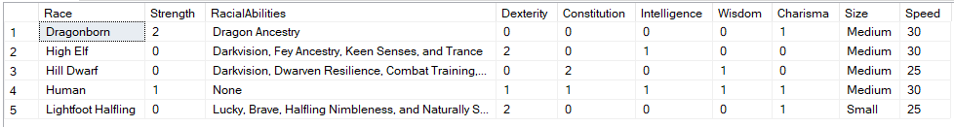
Character Data Tables – Example: Race Table
Character class, race, and background tables contain data relevant to each selection
When a character is created, its race is stored in the character table as a foreign key
Since racial data is static, the table can be used consistently to construct character stat totals. This is also convenient in the rare case that a character’s race changes
The race table is given below as an example. Class and background tables are similar

Slide 8
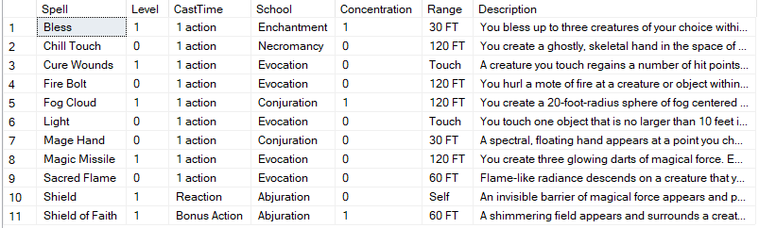

Spell and Item Tables
Tables for spells and items are connected to characters though intermediate spellbook and inventory tables to facilitate many-to-many relationships
Spells and items are not stored in the character table, making frequent updates only necessary in the smaller tables with less risk of breaking characters.
Spells Table (top) and Spellbook Table (bottom)

Slide 9
Part 2: Application

Slide 10
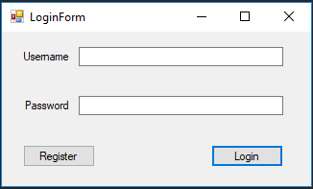
Account Creation and Authentication
New users begin by registering, saving their information to the player table
Returning players authenticate with username and passphrase checked against the player table
Incorrect passphrases and duplicate usernames return error messages from DBMS (PK Violations) or stored procedure

Slide 11
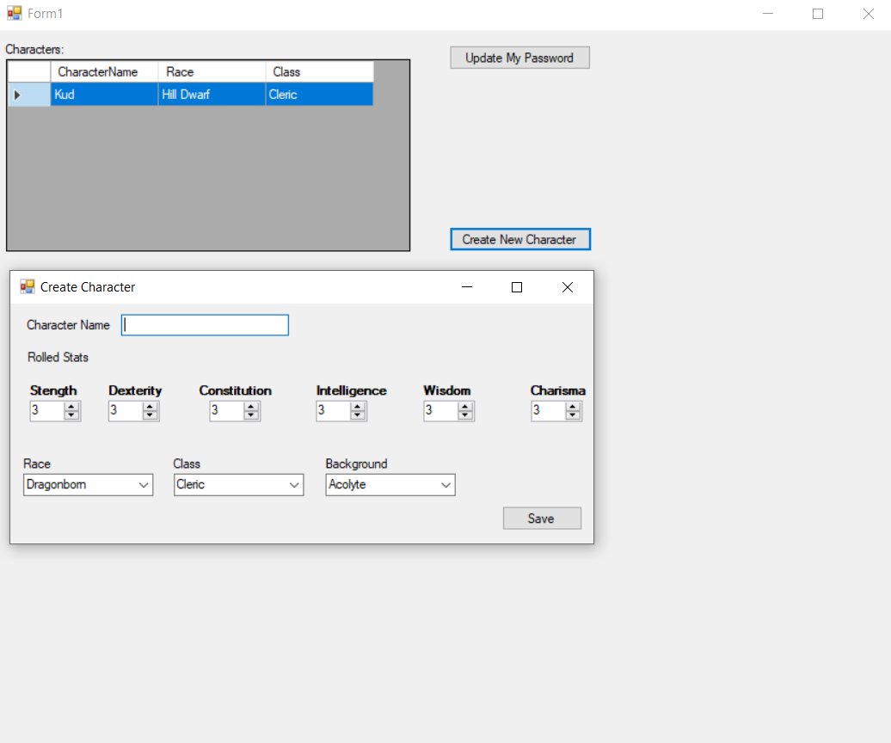
Character Creation and List
Characters with the logged in player’s username assigned in the character table are displayed in a table format in the top left
Buttons allow passphrase updating and new character creation
Newly created characters are saved to the character table and are immediately viewable in the character list

Slide 12
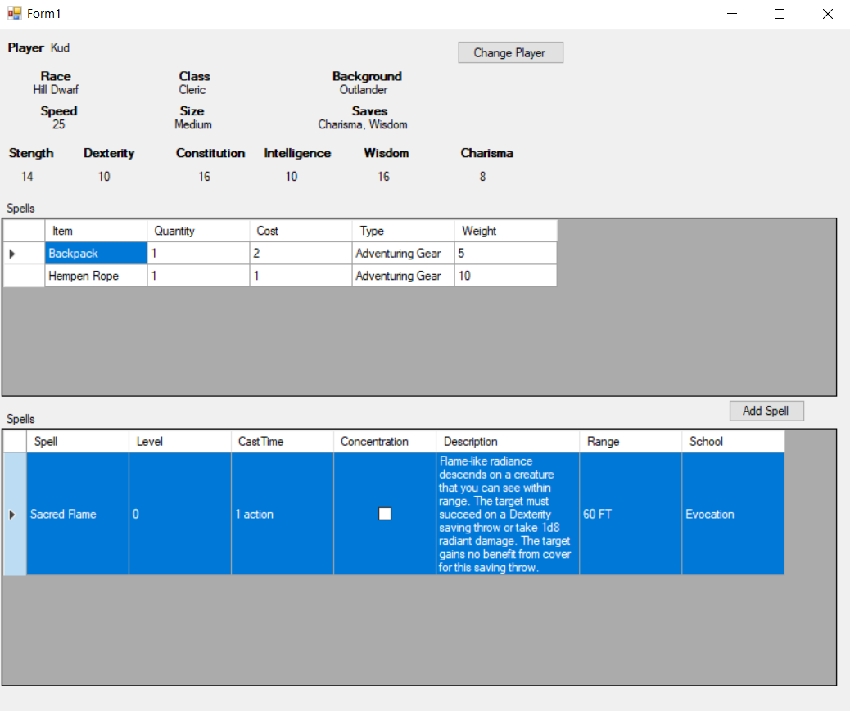
Character Information
Double clicking a character in the character list brings up a form with detailed character information
Values such as player, race, class, and background are pulled directly from the character table
Other values such as speed, size, and saves are pulled from other tables (e.g. race table) using foreign keys saved in the character table
Item and spell lists are pulled from inventory and spellbook tables with entries matching the character’s name

Slide 13
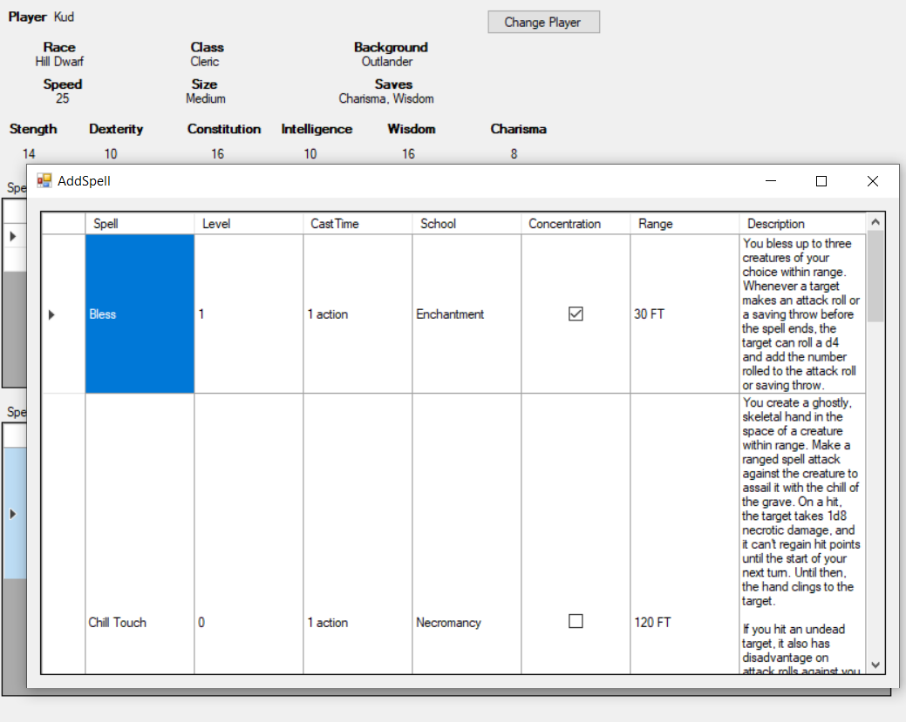
Add Spells
As characters gain new spells, updates to the spellbook table can be made with Add Spell
Selectable spells are pulled from the spell table based on the character’s class
Adding spells saves additional entries to the spellbook table
Adding items, while not currently implemented, works the same way as spells

Slide 14
Part 3: Procedures, Queries, and Security

Slide 15
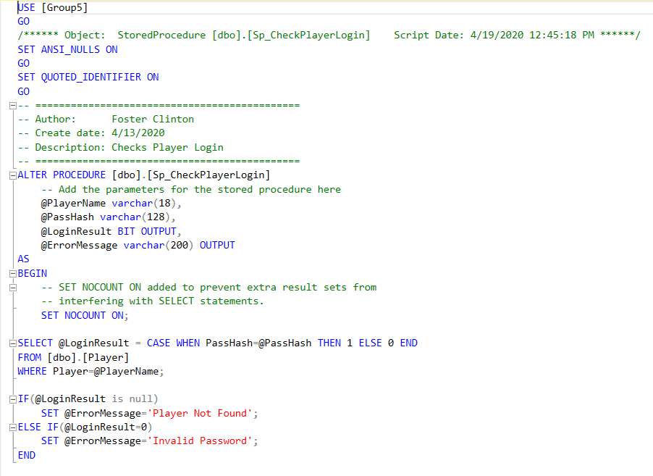
Stored Procedures
Stored procedures were created to implement player authentication and new character creation
Part of the CheckPlayerLogin procedure is presented to the right as an example
This implementation reduces exposure to Password Hashes and SQL Injection

Slide 16
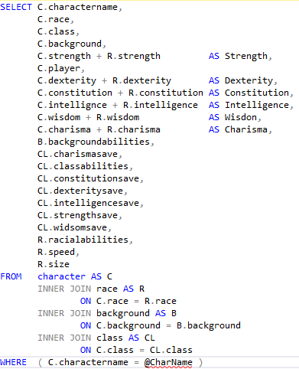
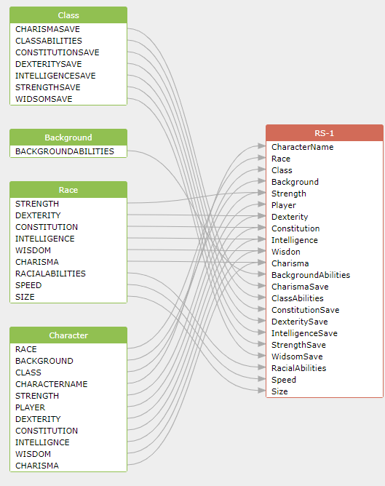
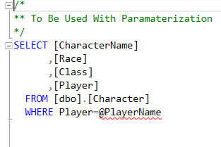
Application Stored Queries
UPDATE & INSERT queries saves information into player, character, spellbook, and inventory
SELECT queries get information from all of the tables
Many queries, such as GetCharacterDetails pull data from multiple tables.
Example: GetCharacterDetails combines character table stats (player input) with racial stats (static) to calculate total character stats
GetCharacterDetails (above) GetCharactersByPlayer (left)

Slide 17
Security Considerations
Player accounts check for duplicate usernames, salt and hash passphrases, and require authentication to use the app
All queries are parameterized to protect again SQL injection attacks
Whenever possible, the database structure is hidden from users
Users are not allowed to modify many tables such as race, class, spells, etc. to help prevent corruption or creating impossible characters

Slide 18
Part 4: Demo
Create a new player
Create a new character
Add a new spell

