Slide 1
您最近使用过哪些前端框架和类库：
@Thoughtworks
1、React.js 2、Angular 3、Vue 4、Rx.js
5、Underscore
6、jQuery/jQueryUI 7、Angular.js 8、纯原生 9、其他

Slide 2
Svelte 动手玩
@Thoughtworks
Zhang Wenqing

Slide 3

简介
是否还沉浸在流行的ARV之花式炫技（选择困难），或jQuery之流式调用（事件黑洞）？
那么你需要换一个思路，让我们来一起动手玩玩大神Rich Harris的Svelte吧！

Slide 4
目标
1
2
3
什么是Svelte？
Svelte是如何工作的？
启示和应用

Slide 5
SVELTE - Cybernetically enhanced web apps
Svelte is a radical new approach to building user interfaces. Whereas traditional frameworks like React and Vue do the bulk of their work in the browser, Svelte shifts that work into a compile step that happens when you build your app.
Instead of using techniques like virtual DOM diffing, Svelte writes code that surgically updates the DOM when the state of your app changes.

Slide 6
什么是Svelte？

Slide 7


高效的web应用工具
和其他的JavaScript框架相似，如React，Vue和Angular，共同的目标都是创建易于交互的界面
重要区别：
- Svelte在编译时转换代码成纯JavaScript
优势： - 不用担心框架的抽象带来的性能损耗，从而提高首次加载性能 - 不用担心依赖引入的语法和相关限制

Slide 8

More than hello world demo!
// app.svelte <script>
let a = 1;
let b = 2;
</script> <style> p { color: purple; font-size: 2em; } </style>
<input type="number" bind:value={a}>
<input type="number" bind:value={b}>
<p>{a} + {b} = {a + b}</p>

Slide 9
揭秘 1
Svelte应用通常保存.svelte文件
可以在<script>块中写JavaScript代码，其中的变量默认作用域是当前组件
可以在<style>块中写CSS代码，作用在当前组件
可以使用 { } 引用JavaScript变量
可以在 { } 中执行JavaScript语句
可以使用 bind:value={ } 来双向绑定HTML标签的属性和JavaScript变量
Demo可以学到什么？

Slide 10
揭秘 2
Svelte编译器分析代码块
生成instance/create_fragment函数
生成组件类 class App extends SvelteComponent
在App的构造函数调用init并传入instance/create_fragment函数
Demo是如何工作的？

Slide 11
Svelte组件剖析

Slide 12

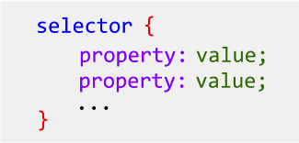
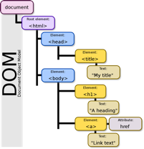
组件构成
Template
Script
Style
- Tag - Attributes and props - Text expressions - Directives
- .svelte - <script> - <script context=“module”>
- <style> - :global(…) - -global-

Slide 13
Script
export creates a component prop
<script>
export let bar = 'optional initial value';
export let baz = undefined;
// these are readonly
export const thisIs = 'readonly’;
export function greet(name) {
alert(`hello ${name}!`);
}
// this is a prop
export let format = n => n.toFixed(2);
</script>

Slide 14
Script
Assignments are 'reactive'
<script>
let count = 0;
function handleClick () {
// calling this function will trigger an
// update if the markup references `count`
count = count + 1;
}
</script>

Slide 15
Script
$: marks a statement as reactive
<script>
export let title;
// this will update `document.title` whenever
// the `title` prop changes
$: document.title = title;
export let num;
// we don't need to declare `squared` and `cubed`
// — Svelte does it for us
$: squared = num * num;
$: cubed = squared * num;
</script>

Slide 16
Script
Prefix stores with $ to access their values
Store contract
store = {
subscribe: (subscription: (value: any) => void) => (() => void),
set?: (value: any) => void
}
<script>
import { writable } from 'svelte/store’;
const count = writable(0);
count.set(1);
$count = 2;
</script>

Slide 17
Script
<script context="module">
<script context="module">
let totalComponents = 0;
// this allows an importer to do e.g.
// `import Example, { myfun } from './Example.svelte’`
export function myfun() {
alert(totalComponents);
}
</script>
<script>
totalComponents += 1;
console.log(`total number: ${totalComponents}`);
</script>

Slide 18
Template
Tag
Attributes and props
Text expressions
Comments
<script>
import Widget from './Widget.svelte';
</script>
<div>
<Widget foo={bar} answer={42} text="hello"/>
</div>
<div>
<button disabled>can't touch this</button>
<button disabled={!clickable}>...</button>
</div>
<h1>Hello {name}!</h1>
<p>{a} + {b} = {a + b}.</p>

Slide 19
Template
{#if expression} ... {:else if expression} ... {:else} ... {/if}
{#if porridge.temperature > 100}
<p>too hot!</p>
{:else if 80 > porridge.temperature}
<p>too cold!</p>
{:else}
<p>just right!</p>
{/if}

Slide 20
Template
{#each expression as name, index (key)} ... {/each}
{#each items as { id, name, qty }, i (id)}
<li>{i + 1}: {name} x {qty}</li>
{/each}
{#each objects as { id, ...rest }}
<li><span>{id}</span><MyComponent {...rest}/></li>
{/each}
{#each items as [id, ...rest]}
<li><span>{id}</span><MyComponent values={rest}/></li>
{/each}

Slide 21
Template
{#await expression} ... {:then name} ... {:catch name} ... {/await}
{#await promise}
<!-- promise is pending -->
<p>waiting for the promise to resolve...</p>
{:then value}
<!-- promise was fulfilled -->
<p>The value is {value}</p>
{:catch error}
<!-- promise was rejected -->
<p>Something went wrong: {error.message}</p>
{/await}

Slide 22
Template
{@html ...}
{@debug ...}
<div class="blog-post">
<h1>{post.title}</h1>
{@html post.content}
</div>
<!-- Compiles -->
{@debug user}
{@debug user1, user2, user3}

Slide 23
Template
Element directives
on:eventName
bind:property
bind:group
bind:this
class:name
use:action
transaction:fn
in:fn/out:fn
animate:fn
<script>
let count = 0;
function handleClick(event) {
count += 1;
}
</script>
<button on:click={handleClick}>
count: {count}
</button>
<input bind:value={name}>
<textarea bind:value={text}></textarea>

Slide 24
Template
slot
<!-- App.svelte -->
<Widget>
<h1 slot="header">Hello</h1>
<p slot="footer">Copyright (c) 2019 Svelte</p>
</Widget>
<!-- Widget.svelte -->
<div>
<slot name="header">No header was provided</slot>
<p>Some content between header and footer</p>
<slot name="footer"></slot>
</div>

Slide 25
Template
<svelte:self>
<svelte:component>
<svelte:window>
<svelte:body>
<svelte:head>
<svelte:options>
<script>
function handleKeydown(event) {
alert(`pressed the ${event.key} key`);
}
</script>
<svelte:window on:keydown={handleKeydown}/>
<svelte:window bind:scrollY={y}/>
<svelte:head>
<link rel="stylesheet" href="tutorial/dark-theme.css">
</svelte:head>

Slide 26
Style
<style>, component scoped style
:global(…)
-global-
<style>
p {
/* only affect <p> elements in this component */
color: burlywood;
}
:global(body) {
/* this will apply to <body> */
margin: 0;
}
@keyframes -global-my-animation-name {...}
</style>

Slide 27
Svelte组件生命周期

Slide 28
onMount/onDestroy
挂载到DOM的时候
Server side环境不运行
返回的函数会在DOM卸载时运行
onDestroy在DOM卸载时运行
<script>
import { onMount } from 'svelte‘;
onMount(() => {
const interval = setInterval(() => {
console.log('beep‘);
}, 1000);
return () => clearInterval(interval);
});
</script>

Slide 29
beforUpdate/afterUpdate
状态变化时触发
<script>
import { beforeUpdate, afterUpdate } from ‘svelte’;
beforeUpdate(() => {
console.log(‘the component is about to update’);
});
afterUpdate(() => {
console.log('the component just updated‘);
});
</script>

Slide 30
setContext/getContext
获取上下文数据
会从当前组件传递到子组件
键值对集合
getContext只能在初始化时调用
import { setContext, getContext } from 'svelte’;
setContext('answer', 42);
const answer = getContext('answer');

Slide 31
createEventDispatcher
创建事件触发器
<script>
import { createEventDispatcher } from 'svelte‘;
const dispatch = createEventDispatcher();
</script>
<button on:click="{() => dispatch('notify', 'detail value')}">Fire Event</button>

Slide 32
Svelte工具包
svelte/store
svelte/motion
svelte/transition
svelte/animate
svelte/easing
svelte/register
import { writable } from 'svelte/store';
const count = writable(0, () => {
console.log('got a subscriber‘);
return () => console.log('no more subscribers');
});
count.set(1); // does nothing
const unsubscribe = count.subscribe(value => {
console.log(value);
}); // logs 'got a subscriber', then '1'
unsubscribe(); // logs 'no more subscribers'

Slide 33
Svelte工程化

Slide 34
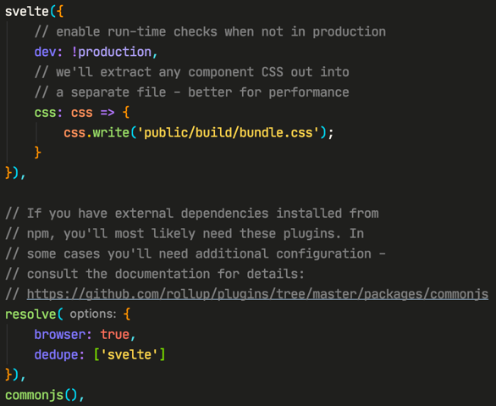
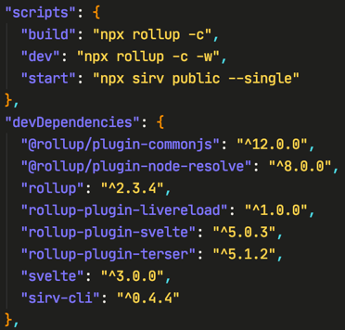

工程化方案

Slide 35
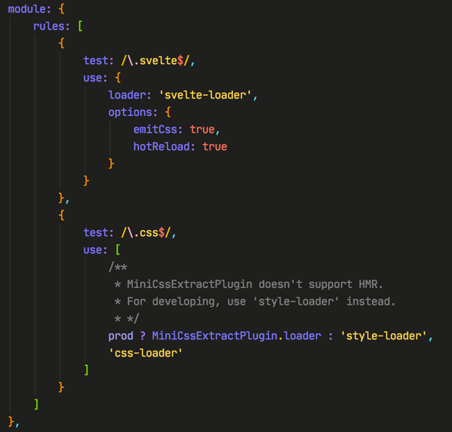
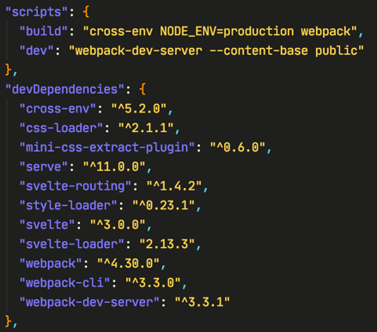

工程化方案

Slide 36
启示和应用

Slide 37
总结
响应式UI/组件开发
编译器生成运行代码，无运行时框架依赖
直接操作DOM，浏览器优化
成熟的工程化系统

Slide 38
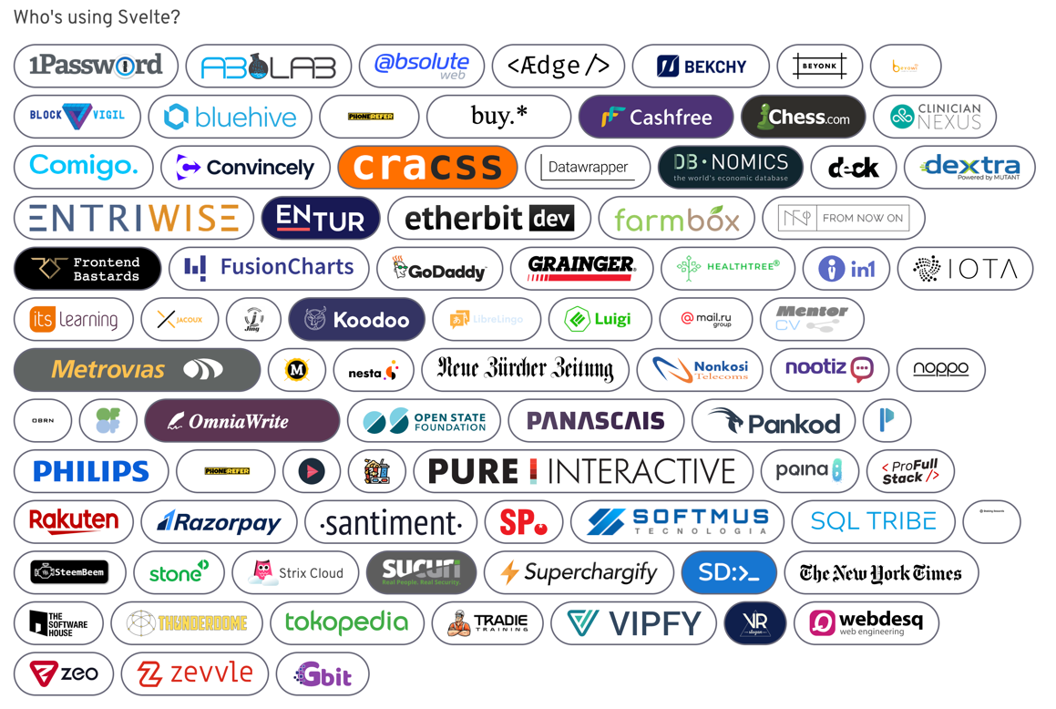

Slide 39
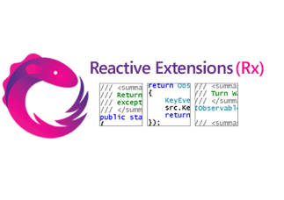

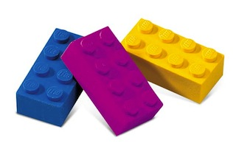
应用场景
01 | 担心框架锁定
02 | 重交互行为UI
03 | 快速原型项目
04 | 统一的SSR

Slide 40

下一步
Sapper
服务器端框架
基于Svelte，组件设计
类似Next.js
Sapper
https://sapper.svelte.dev/
React/Angular/Vue

Slide 41

资料
Svelte官方站点
https://svelte.dev/
https://github.com/sveltejs/svelte
Svelte社区
https://svelte-community.netlify.app/

Slide 42
Thank you.

