Slide 1
Title
Title
Biology internship in M.Sc. Appl. Bioinformatics,
under the supervision of Dr. Tom Keaney,
by Benni Winkler

Slide 2
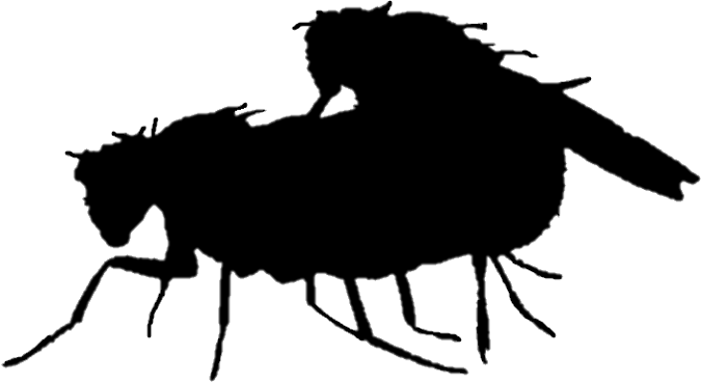
header
Types of sexual conflict
1
Sexual conflict is split into:
text
Interlocus conflict ^{[1]}:
Conflict on an individual level
Sexes exhibit behaviour which harms the other sex
Intralocus conflict ^{[2]}:
Conflict on a populational level
Selection favouring genotypes in one sex but not the other
(Antagonistic structures on ‚omics‘ levels)
placeholder
^{[3]}
[1] Schenkel, M. A., Pen, I., Beukeboom, L. W., & Billeter, J.-C. (2018). Making sense of intralocus and interlocus sexual conflict. Ecology and Evolution, 8(24), 13035–13050. https://doi.org/10.1002/ece3.4629
[2] Bonduriansky, R., & Chenoweth, S. F. (2009). Intralocus sexual conflict. TRENDS IN ECOLOGY & EVOLUTION, 24(5), 280–288. https://doi.org/10.1016/j.tree.2008.12.005
[3] Hollis, B., Koppik, M., Wensing, K. U., Ruhmann, H., Genzoni, E., Erkosar, B., Kawecki, T. J., Fricke, C., & Keller, L. (2019). Sexual conflict drives male manipulation of female postmating responses in Drosophila melanogaster. Proceedings of the National Academy of Sciences of the United States of America, 116(17), 8437–8444. https://doi.org/10.1073/pnas.1821386116

Slide 3
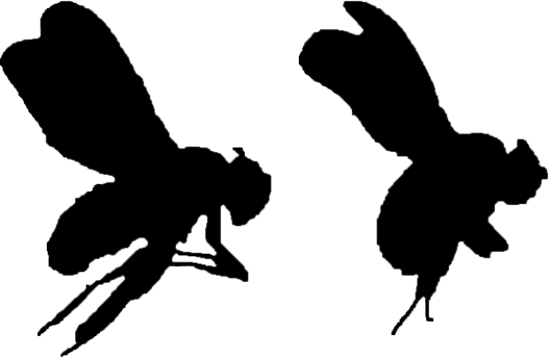
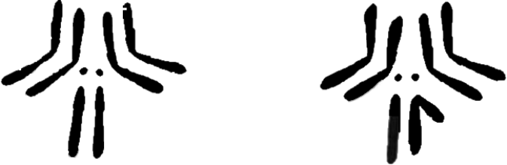
header
Factors influencing intralocus conflict
2
1) Effect of the alleles in each sex
text
2) Recessiveness of alleles
Aa AA
Intralocus conflict is shaped by:
3) Chromosome location of the
genotype
Theory by:
Charlesworth et al, 1987 ^{[3]}
Rice, 1984 ^{[4]}
XX XY
^{[5]}
[4] Charlesworth, B., Coyne, J. A., & Barton, N. H. (1987). The Relative Rates of Evolution of Sex Chromosomes and Autosomes. The American Naturalist, 130(1), 113–146.
[5] Rice, W. R. (1984). Sex Chromosomes and the Evolution of Sexual Dimorphism. Evolution, 38(4), 735–742. https://doi.org/10.1111/j.1558-5646.1984.tb00346.x
[6] Kaufman, T. C. (2017). A Short History and Description of Drosophila melanogaster Classical Genetics: Chromosome Aberrations, Forward Genetic Screens, and the Nature of Mutations. Genetics, 206(2), 665–689. https://doi.org/10.1534/genetics.117.199950

Slide 4


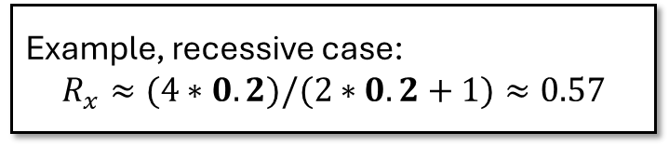
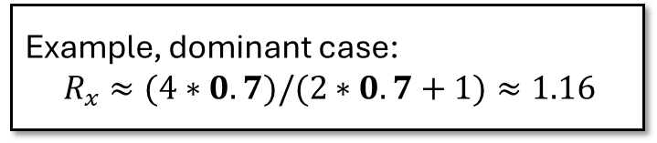
header
Charlesworth et al, 1987 – Beneficial mutations ^{[4]}
3
text
Example, dominant case:
${ R}_{x} ≈(4∗0.7)/(2∗0.7+1)≈1.16$
Example, recessive case:
$$R_{x}≈(4∗0.2)/(2∗0.2+1)≈0.57$$
In both sexes, recessiveness supports the fixation of new
beneficial alleles on the X chromosome (faster-X theory)
[4] Charlesworth, B., Coyne, J. A., & Barton, N. H. (1987). The Relative Rates of Evolution of Sex Chromosomes and Autosomes. The American Naturalist, 130(1), 113–146.

Slide 5




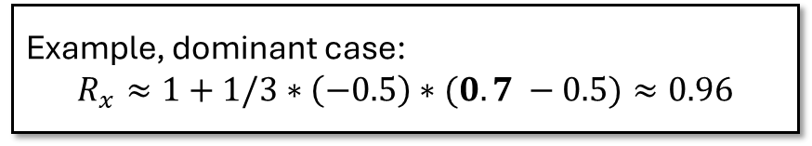

header
Charlesworth et al, 1987 – Deleterious mutations ^{[4]}
4
text
Example, dominant case:
$$R_{x}≈1+1/3∗\left(−0.5\right)∗(0.7 −0.5)≈0.96$$
Example, recessive case:
$$R_{x}≈1+1/3∗\left(−0.5\right)∗(0.2 −0.5)≈1.05$$
When selection acts on both sexes or males only, recessiveness
impedes the fixation of new deleterious alleles on the X chromosome
[4] Charlesworth, B., Coyne, J. A., & Barton, N. H. (1987). The Relative Rates of Evolution of Sex Chromosomes and Autosomes. The American Naturalist, 130(1), 113–146.

Slide 6
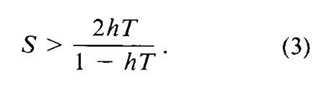
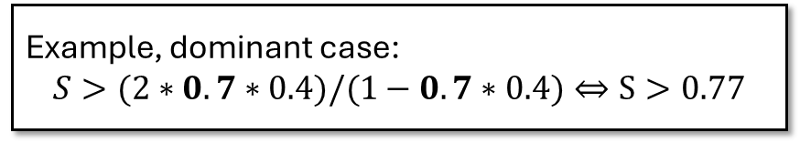
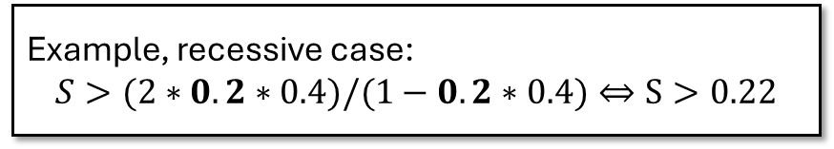
header
Rice, 1984 – Antagonistic mutations ^{[5]}
5
text
Example, dominant case:
$$S>(2∗0.7∗0.4)/(1−0.7∗0.4)⇔S>0.77$$
Example, recessive case:
$$S>(2∗0.2∗0.4)/(1−0.2∗0.4)⇔S>0.22$$
As long as a X-linked allele is recessive enough, the fitness increase in males
outweighs the fitness decrease in females
[5] Rice, W. R. (1984). Sex Chromosomes and the Evolution of Sexual Dimorphism. Evolution, 38(4), 735–742. https://doi.org/10.1111/j.1558-5646.1984.tb00346.x

Slide 7
header
Summary on theory and research question
6
Recessive beneficial alleles fix faster on the X chromosome,
but if male-deleterious fix slower
text
Antagonistic and recessive X-linked alleles favour the heterogametic sex
Recessive X-linked alleles are constantly exposed to selection
in males but may stay masked in females
„Does the number of X-linked deleterious variants impact
female fitness more severely than male fitness?“

Slide 8
header
Methods
7
text
Drosophila genetic reference panel (DGRP) genotypes ^{[7]}
Identification of putatively deleterious variants
Match with fitness essays ^{[10]}
Calculate genetic load
Via SnpEff ^{[8]}
Via GERP ^{[9]}
Statistical evaluation ^{[11]}
Fitness ~
Genetic load * Sex * Chromosome type + DGRP line
[7] Mackay, T. F. C., Richards, S., Stone, E. A., Barbadilla, A., Ayroles, J. F., Zhu, D., Casillas, S., Han, Y., Magwire, M. M., Cridland, J. M., Richardson, M. F., Anholt, R. R. H., Barrón, M., Bess, C., Blankenburg, K. P., Carbone, M. A., Castellano, D., Chaboub, L., Duncan, L., … Gibbs, R. A. (2012). The Drosophila melanogaster Genetic Reference Panel. Nature, 482(7384), 173–178. https://doi.org/10.1038/nature10811
[8] Cingolani, P., Platts, A., Wang, L. L., Coon, M., Nguyen, T., Wang, L., Land, S. J., Lu, X., & Ruden, D. M. (2012). A program for annotating and predicting the effects of single nucleotide polymorphisms, SnpEff. Fly, 6(2), 80–92. https://doi.org/10.4161/fly.19695
[9] Davydov, E. V., Goode, D. L., Sirota, M., Cooper, G. M., Sidow, A., & Batzoglou, S. (2010). Identifying a high fraction of the human genome to be under selective constraint using GERP++. PLoS Computational Biology, 6(12), e1001025. https://doi.org/10.1371/journal.pcbi.1001025
[10] Wong, H. W. S., & Holman, L. (2023). Pleiotropic fitness effects across sexes and ages in the Drosophila genome and transcriptome. Evolution, 77(12), 2642–2655. https://doi.org/10.1093/evolut/qpad163
[11] Bürkner, P.-C. (2017). brms: An R Package for Bayesian Multilevel Models Using Stan. Journal of Statistical Software, 80, 1–28. https://doi.org/10.18637/jss.v080.i01

Slide 9
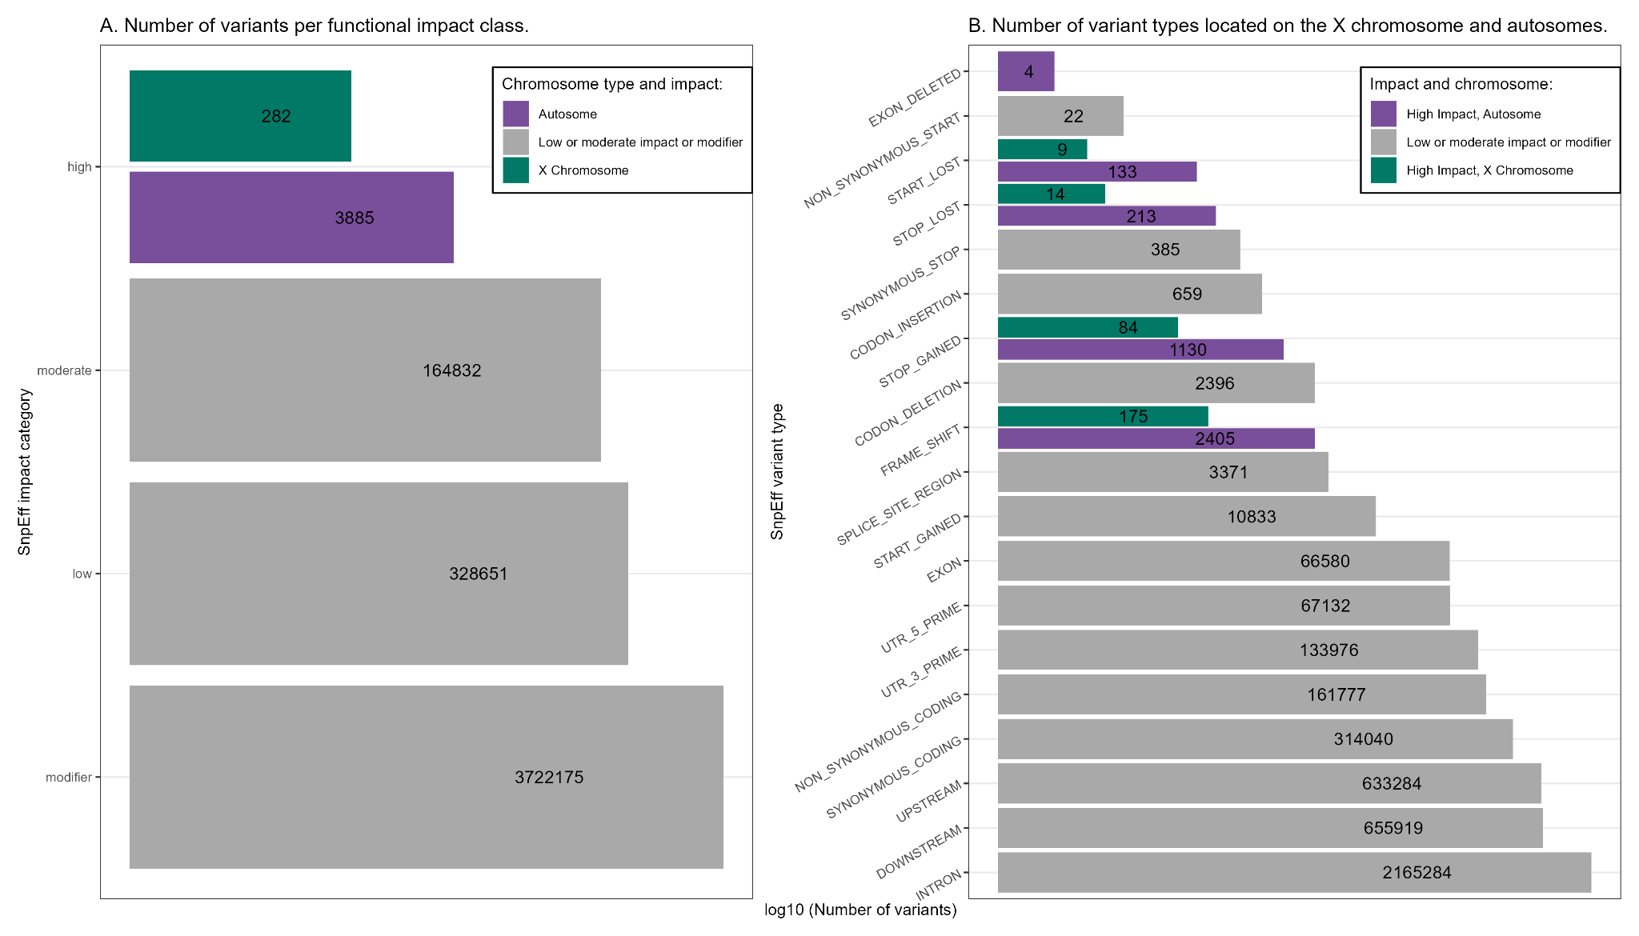
header
Putatively deleterious variants with high impact
8
text

Slide 10
header
Putatively deleterious variants with high impact
9
text
Across 4.219.825 variants:
282 X-linked putatively deleterious variants
3.885 autosomal putatively deleterious variants

Slide 11
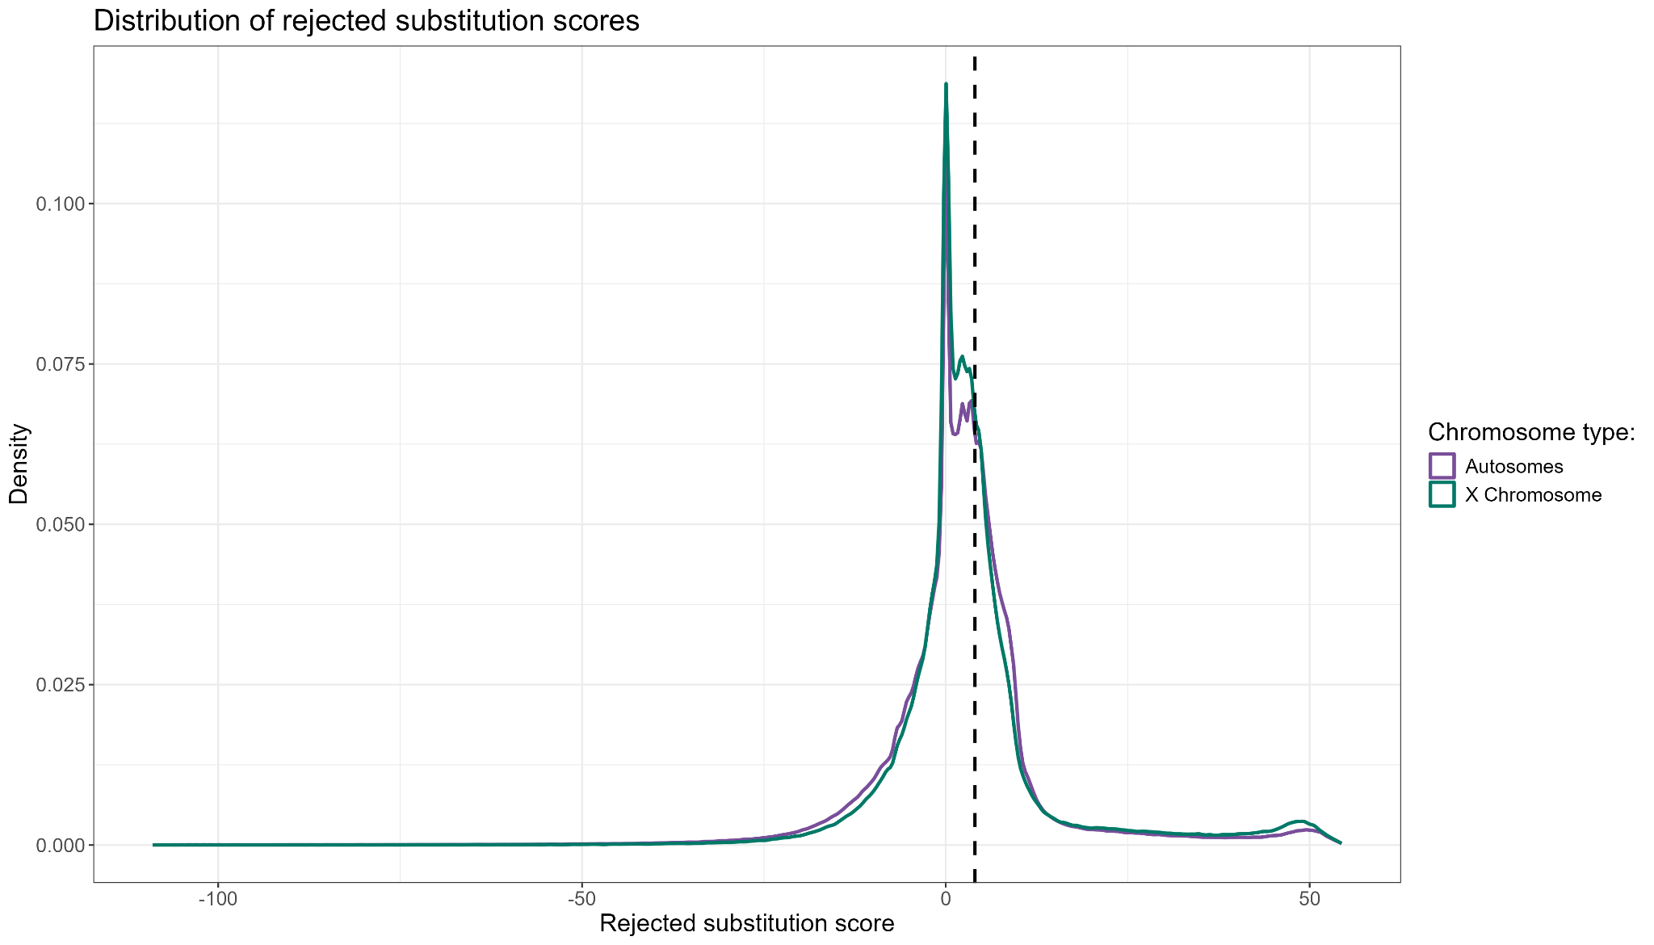
header
Evolutionary constraint across the genome
10
text

Slide 12

header
Evolutionary constraint across the genome
11
text
RS $≥$ 4 : putatively deleterious variant ^{[12, 13]}
196.374 X-linked putatively deleterious variants
1.302.241 autosomal putatively deleterious variants
[12] Chen, R. S., Soulsbury, C. D., Hench, K., van Oers, K., & Hoffman, J. I. (2025). Predicted deleterious mutations reveal the genetic architecture of male reproductive success in a lekking bird. Nature Ecology & Evolution, 9(10), 1924–1937. https://doi.org/10.1038/s41559-025-02802-8
[13] Smeds, L., & Ellegren, H. (2023). From high masked to high realized genetic load in inbred Scandinavian wolves. Molecular Ecology, 32(7), 1567–1580. https://doi.org/10.1111/mec.16802

Slide 13
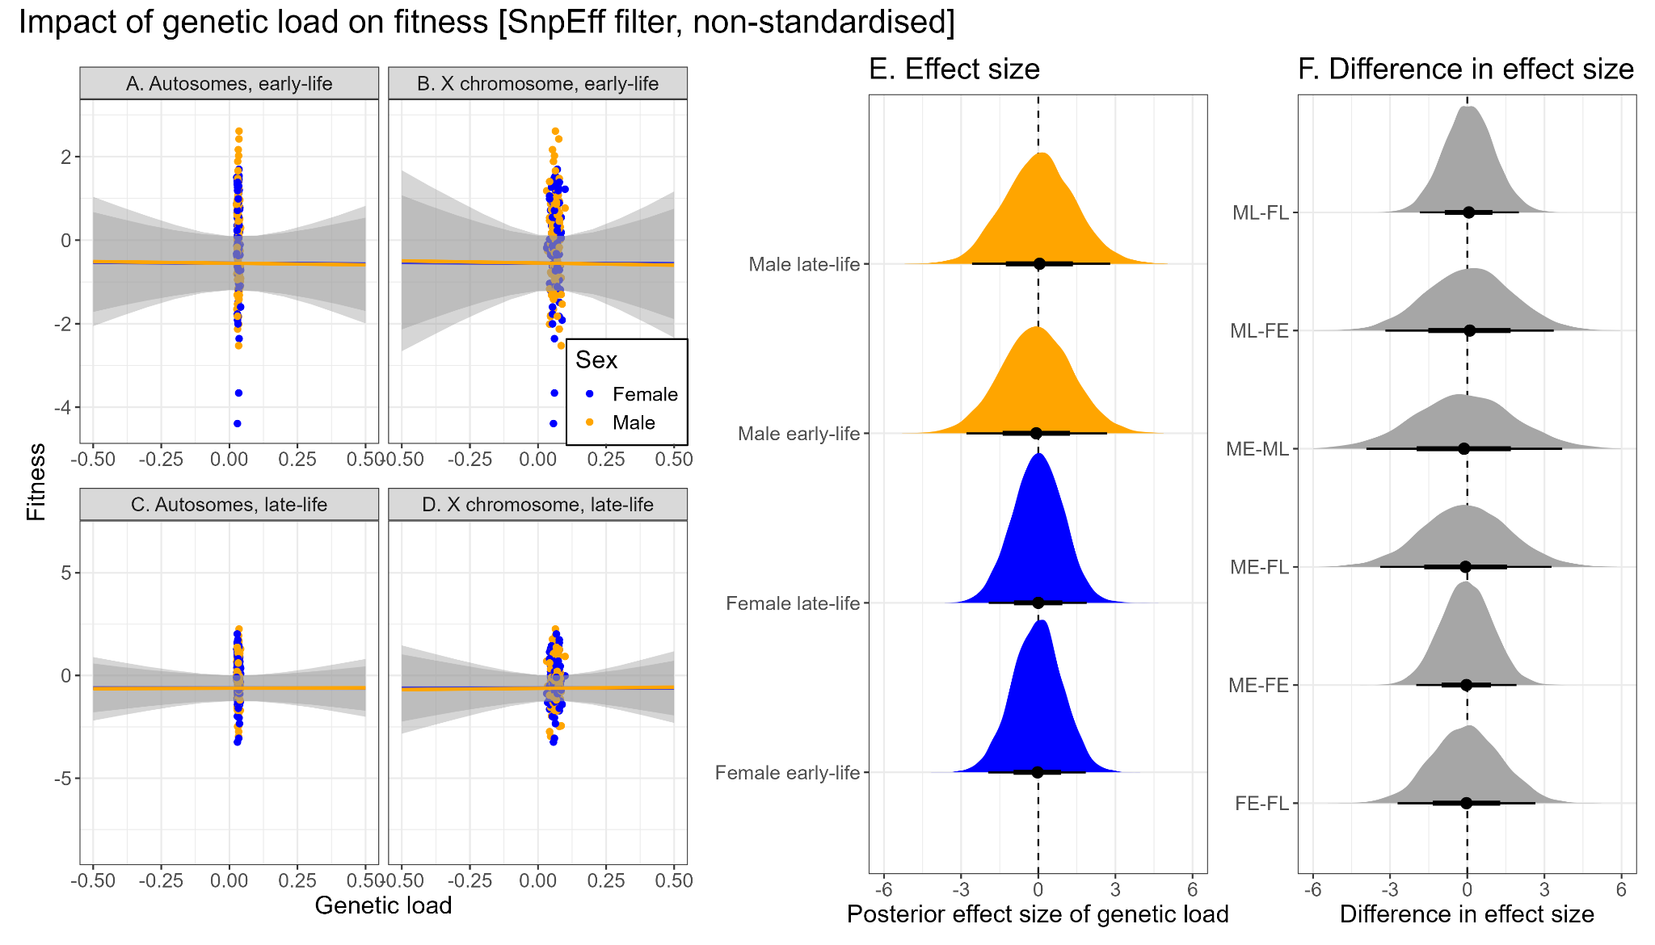
header
Putatively deleterious variants with high impact
12
text

Slide 14
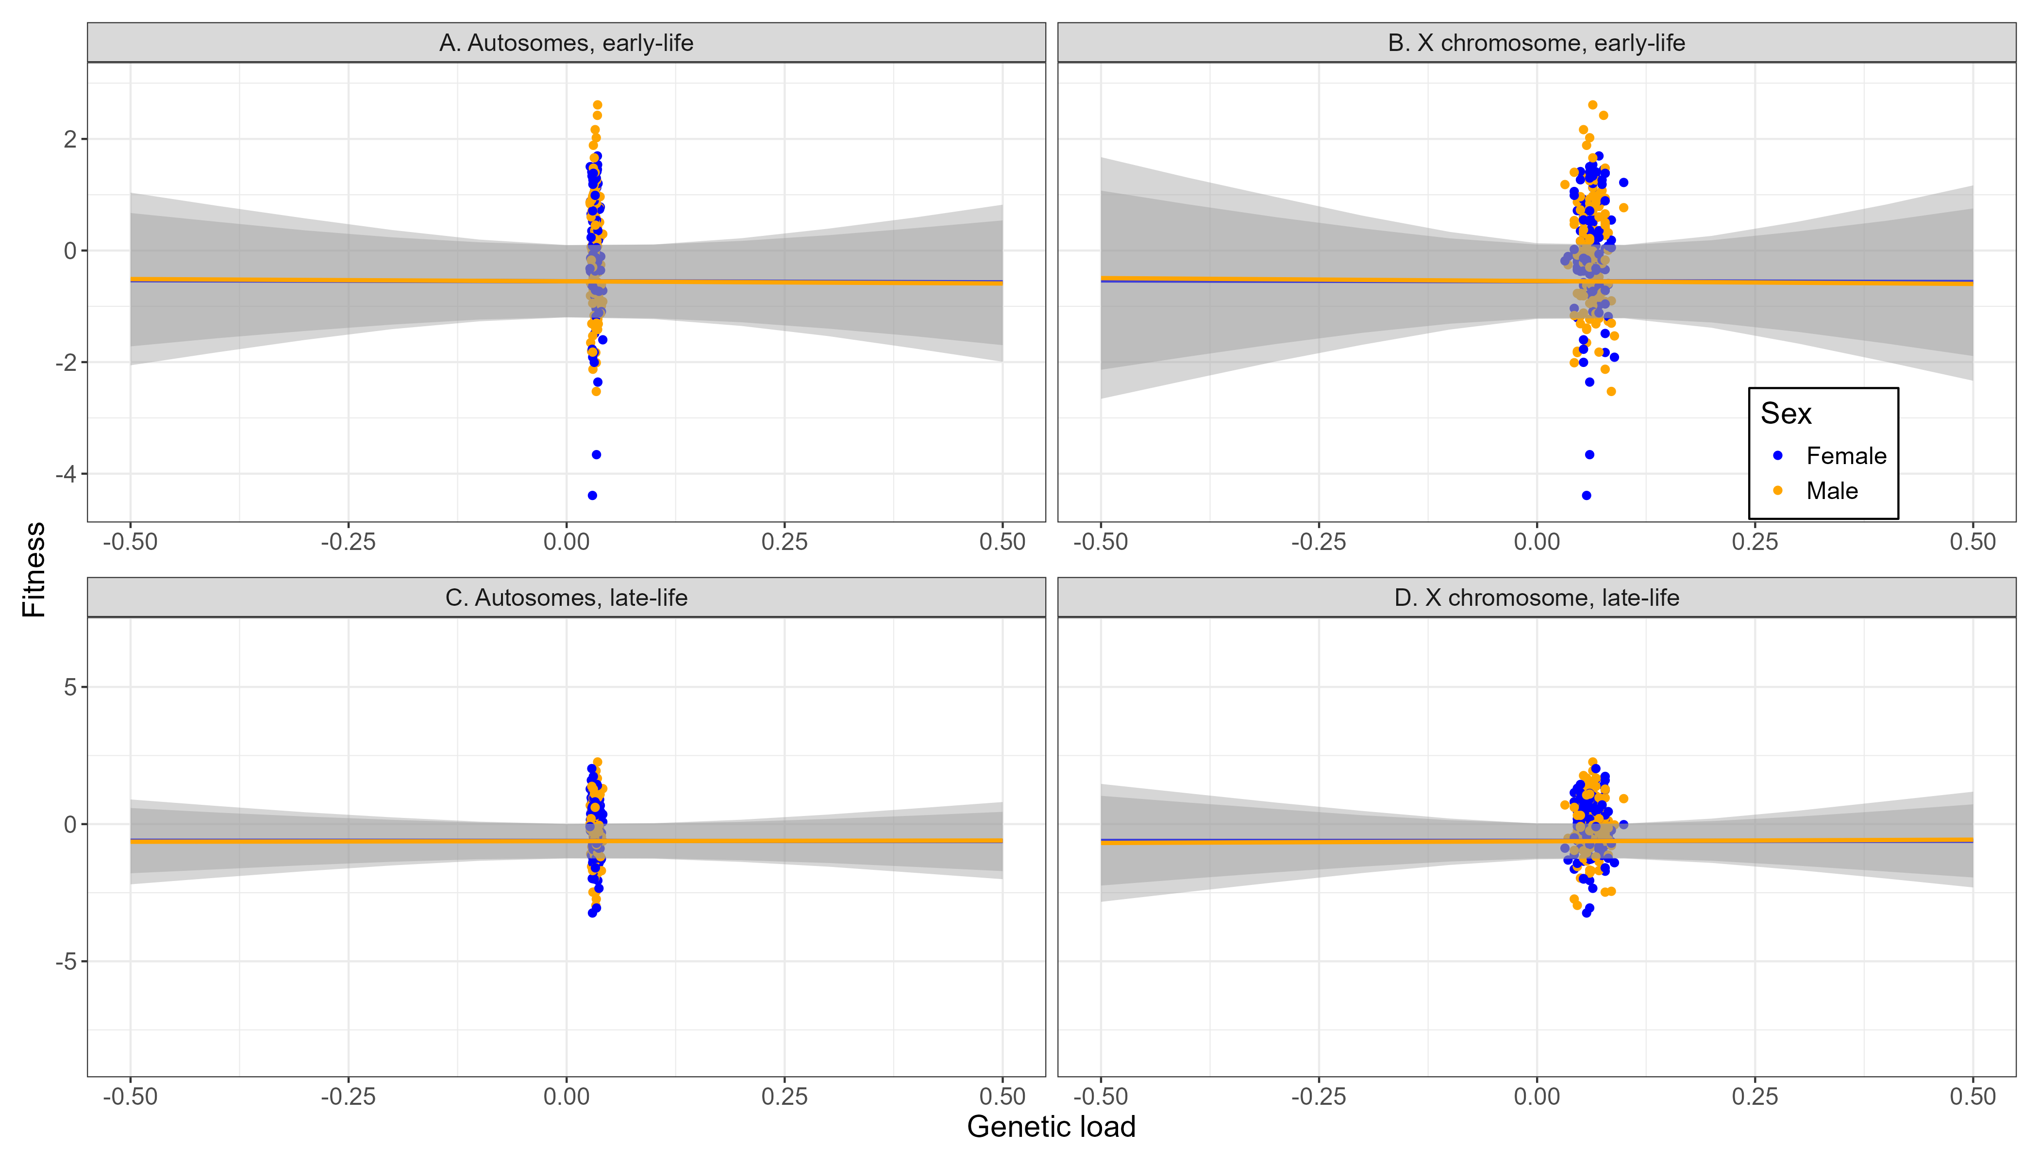
header
Putatively deleterious variants with high impact
13
text
Range of values similar to previous studies ^{[10]}
[10] Wong, H. W. S., & Holman, L. (2023). Pleiotropic fitness effects across sexes and ages in the Drosophila genome and transcriptome. Evolution, 77(12), 2642–2655. https://doi.org/10.1093/evolut/qpad163

Slide 15
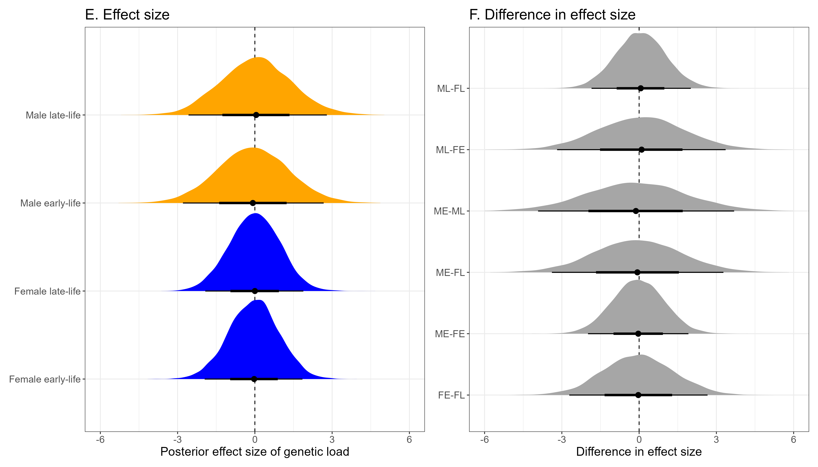
header
Putatively deleterious variants with high impact
14
text
Investigating antagonistic pleiotropy in aging ^{[14, 15]}
[14] Williams, G. C. (1957). Pleiotropy, Natural Selection, and the Evolution of Senescence. Evolution, 11(4), 398–411. https://doi.org/10.1111/j.1558-5646.1957.tb02911.x
[15] Austad, S. N., & Hoffman, J. M. (2018). Is antagonistic pleiotropy ubiquitous in aging biology? Evolution, Medicine, and Public Health, 2018(1), 287–294. https://doi.org/10.1093/emph/eoy033

Slide 16
header
Discussion – Genetic purging
15
text
The findings did not match the expectations based on theory – but we can try to explain them

Slide 17
header
Discussion – Genetic purging
16
1) Genetic purging
text
Inbreeding depression because of the exposure of deleterious recessives and loss of genetic variability
Trade-off
Removal of deleterious sites from population after exposure to selection (genetic purging) ^{[16, 17, 18, 19]}
[16] Crnokrak, P., & Barrett, S. C. H. (2002). PERSPECTIVE: PURGING THE GENETIC LOAD: A REVIEW OF THE EXPERIMENTAL EVIDENCE. Evolution, 56(12), 2347–2358. https://doi.org/10.1111/j.0014-3820.2002.tb00160.x
[17] García-Dorado, A. (2012). Understanding and Predicting the Fitness Decline of Shrunk Populations: Inbreeding, Purging, Mutation, and Standard Selection. Genetics, 190(4), 1461–1476. https://doi.org/10.1534/genetics.111.135541
[18] Khan, A., Patel, K., Shukla, H., Viswanathan, A., van der Valk, T., Borthakur, U., Nigam, P., Zachariah, A., Jhala, Y. V., Kardos, M., & Ramakrishnan, U. (2021). Genomic evidence for inbreeding depression and purging of deleterious genetic variation in Indian tigers. Proceedings of the National Academy of Sciences, 118(49), e2023018118. https://doi.org/10.1073/pnas.2023018118
[19] Kleinman-Ruiz, D., Lucena-Perez, M., Villanueva, B., Fernández, J., Saveljev, A. P., Ratkiewicz, M., Schmidt, K., Galtier, N., García-Dorado, A., & Godoy, J. A. (2022). Purging of deleterious burden in the endangered Iberian lynx. Proceedings of the National Academy of Sciences, 119(11), e2110614119. https://doi.org/10.1073/pnas.2110614119

Slide 18
header
Discussion – Genetic purging
17
1) Genetic purging
text
Inbreeding depression because of the exposure of deleterious recessives and loss of genetic variability
Trade-off
Removal of deleterious sites from population after exposure to selection (genetic purging) ^{[16, 17, 18, 19]}
Purging effects are stronger the more
lethal the mutations are ^{[20]}
Half of the inbreeding depression for
viability in Drosophila is caused by
recessive lethals ^{[21, 22]}
20 generations of inbreeding may have cleansed the DGRP
lines from (highly) deleterious variants
[20] Hedrick, P. W. (1994). Purging inbreeding depression and the probability of extinction: Full-sib mating. Heredity, 73(4), 363–372. https://doi.org/10.1038/hdy.1994.183
[21] Hedrick, P. W., & Garcia-Dorado, A. (2016). Understanding Inbreeding Depression, Purging, and Genetic Rescue. Trends in Ecology & Evolution, 31(12), 940–952. https://doi.org/10.1016/j.tree.2016.09.005
[22] Simmons, M. J., & Crow, J. F. (1977). MUTATIONS AFFECTING FITNESS IN DROSOPHILA POPULATIONS. Annual Review of Genetics, 11(Volume 11, 1977), 49–78. https://doi.org/10.1146/annurev.ge.11.120177.000405

Slide 19
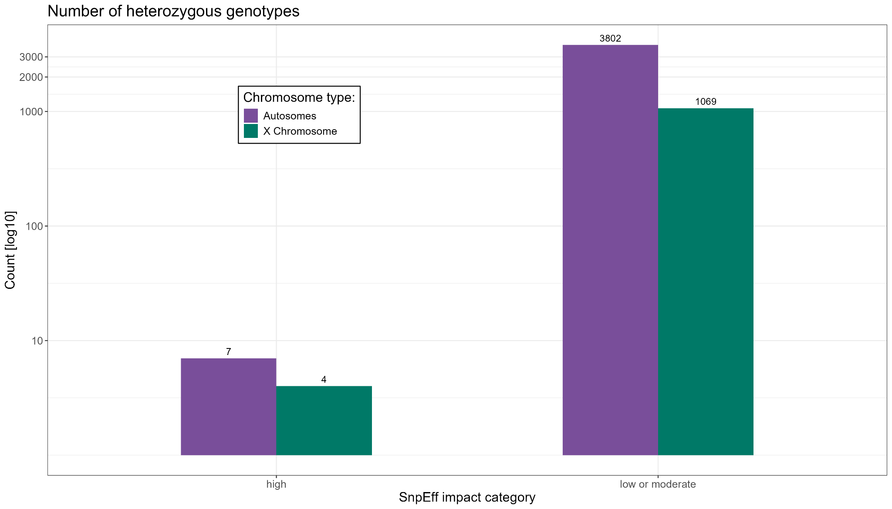
header
Discussion – Genetic purging
18
text
Across > four million sites roughly 5.000 heterozygous sites
Only 11 heterozygous sites located on the X chromosome

Slide 20
header
Discussion – Genetic purging
19
1) Genetic purging
text
2) Conservative approach
Besides genetic purging the estimation of deleterious variants is very conservative:
Fitness can be only measured in living flies – lethal mutations are not represented
Fitness was measured in flies which survived both early and late life ^{[10]} – the most deleterious mutations are not represented either
[10] Wong, H. W. S., & Holman, L. (2023). Pleiotropic fitness effects across sexes and ages in the Drosophila genome and transcriptome. Evolution, 77(12), 2642–2655. https://doi.org/10.1093/evolut/qpad163

Slide 21
header
Discussion – Genetic purging
20
1) Genetic purging
The Drosphila X chromosome lacks
male-beneficial genes ^{[23, 24, 25]}
text
2) Conservative approach
3) Demasculinised X chromosome
X chromosome 2/3 of the time in
females and only 1/3 of the time in
males
Sex-biased gene expression effects,
e.g., silencing of the X chromosome
during spermatogenesis
The Drosophila X chromosome is an unhospitable location
for male-beneficial loci
[23] Gurbich, T. A., & Bachtrog, D. (2008). Gene content evolution on the X chromosome. Current Opinion in Genetics & Development, Genomes and evolution, 18(6), 493–498. https://doi.org/10.1016/j.gde.2008.09.006
[24] Parisi, M., Nuttall, R., Naiman, D., Bouffard, G., Malley, J., Andrews, J., Eastman, S., & Oliver, B. (2003). Paucity of Genes on the Drosophila X Chromosome Showing Male-Biased Expression. Science (New York, N.Y.), 299(5607), 697–700. https://doi.org/10.1126/science.1079190
[25] Sturgill, D., Zhang, Y., Parisi, M., & Oliver, B. (2007). Demasculinization of X chromosomes in the Drosophila genus. Nature, 450(7167), 238–241. https://doi.org/10.1038/nature06330

Slide 22
header
Discussion – Genetic purging
21
1) Genetic purging
Obtaining and filtering genotypes with both filtering criteria (impact and constraint)
text
2) Conservative approach
3) Demasculinised X chromosome
Calculating genetic loads for the X chromosome and autosomes
4) Technical limitations
Only possible to match genetic load with DGRP line, not with each sex, chromosome type and life stage
Apart from biological reasons, the results can be traced back
to technical limitations in data structure

Slide 23
header
Outlook
22
text
We did not create the expected results, possibly due to biological and technical limitations, however:

Slide 24
header
Outlook
23
Provide basis for future research:
Freely accessible and reproducible methods (especially on ‚cryptic‘ methods like GERP++)
text
Clear recommendations on what needs to be paid attention to in future studies
Recently these methods have raised interest in wild and controlled populations ^{[10, 11, 12, 21]}: methods can be applied broadly as long as certain data criteria are fulfilled
Personal interest: Evolution through whole genome duplication - substution scores between gene duplicates to find evidence of conservational divergence
[10] Wong, H. W. S., & Holman, L. (2023). Pleiotropic fitness effects across sexes and ages in the Drosophila genome and transcriptome. Evolution, 77(12), 2642–2655. https://doi.org/10.1093/evolut/qpad163
[12] Chen, R. S., Soulsbury, C. D., Hench, K., van Oers, K., & Hoffman, J. I. (2025). Predicted deleterious mutations reveal the genetic architecture of male reproductive success in a lekking bird. Nature Ecology & Evolution, 9(10), 1924–1937. https://doi.org/10.1038/s41559-025-02802-8
[13] Smeds, L., & Ellegren, H. (2023). From high masked to high realized genetic load in inbred Scandinavian wolves. Molecular Ecology, 32(7), 1567–1580. https://doi.org/10.1111/mec.16802
[26] Singh, A., Hasan, A., & Agrawal, A. F. (2023). An investigation of the sex-specific genetic architecture of fitness in Drosophila melanogaster. Evolution, 77(9), 2015–2028. https://doi.org/10.1093/evolut/qpad107

Slide 25
header
text
Some closing remarks

