Slide 1
Title
Genetic load in
Drosophila melanogaster
Biology internship in M.Sc. Appl. Bioinformatics,
under the supervision of Dr. Tom Keaney,
by Benni Winkler
28.08.2026

Slide 2
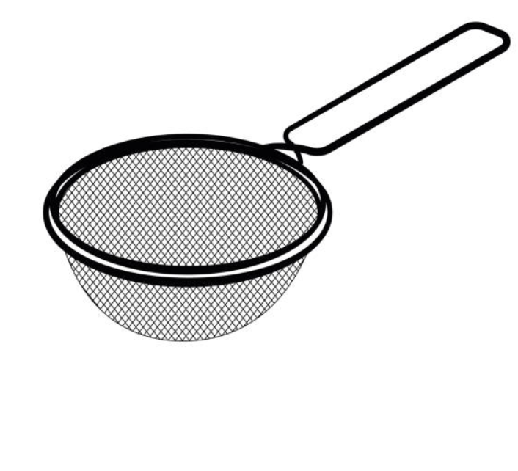
header
Metaphorical selective sieve^{[1]}
1
text
Selective sieve
Mutations:
Beneficial
Deleterious
(Nearly)
neutral ^{[2, 3]}
[1] Frank, S. A. (2012). Evolution: Mitochondrial Burden on Male Health. Current Biology, 22(18), R797–R799. https://doi.org/10.1016/j.cub.2012.07.066
[2] Kimura, M. (1968). Evolutionary Rate at the Molecular Level. Nature, 217(5129), 624–626. https://doi.org/10.1038/217624a0
[3] Ohta, T. (1992). The Nearly Neutral Theory of Molecular Evolution. Annual Review of Ecology and Systematics, 23, 263–286.

Slide 3
header
Impact of deleterious mutations
2
Deleterious mutations occur but how big is their impact? ^{[4]}
text
L = 1 - e^{-U}
If as much as one deleterious mutation enters a
population per generation and individual, the mean
fitness is ~ 37 % lower compared to a mutation-free
equivalent system ^{[5]}
[4] Agrawal, A. F., & Whitlock, M. C. (2012). Mutation Load: The Fitness of Individuals in Populations Where Deleterious Alleles Are Abundant. Annual Review of Ecology, Evolution, and Systematics, 43, 115–135. https://doi.org/10.1146/annurev-ecolsys-110411-160257
[5] Haldane, J. B. S. (1937). The Effect of Variation on Fitness. The American Naturalist, 71(735), 337–349.

Slide 4
header
Caveats
3
L = 1 - e^{-U}
text
Relies only on mutation rate
Ignores ecological context like density dependence ^{[6]}
Haldane considered bi-allelic loci present in each
genome in each individual
[6] Mylius, S. D., & Diekmann, O. (1995). On Evolutionarily Stable Life Histories, Optimization and the Need to Be Specific about Density Dependence. Oikos, 74(2), 218–224. https://doi.org/10.2307/3545651

Slide 5

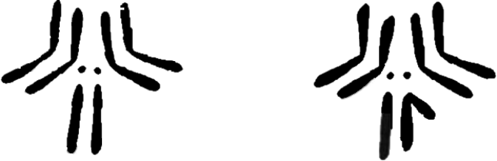
header
Factors influencing the establishment of (deleterious) alleles
4
Dominance of alleles
text
Aa AA
The chromosome and sex the allele is expressed in
Theory by:
Charlesworth et al, 1987 ^{[7]}
XX XY
^{[8]}
[7] Charlesworth, B., Coyne, J. A., & Barton, N. H. (1987). The Relative Rates of Evolution of Sex Chromosomes and Autosomes. The American Naturalist, 130(1), 113–146.
[8] Kaufman, T. C. (2017). A Short History and Description of Drosophila melanogaster Classical Genetics: Chromosome Aberrations, Forward Genetic Screens, and the Nature of Mutations. Genetics, 206(2), 665–689. https://doi.org/10.1534/genetics.117.199950

Slide 6


header
Charlesworth et al, 1987 – Beneficial mutations ^{[4]}
5
text
In both sexes, recessiveness supports the fixation of new
beneficial alleles on the X chromosome (faster-X theory)
[8] Charlesworth, B., Coyne, J. A., & Barton, N. H. (1987). The Relative Rates of Evolution of Sex Chromosomes and Autosomes. The American Naturalist, 130(1), 113–146.

Slide 7




header
Charlesworth et al, 1987 – Deleterious mutations ^{[4]}
6
text
When selection acts on both sexes or males only, recessiveness
impedes the fixation of new deleterious alleles on the X chromosome
[8] Charlesworth, B., Coyne, J. A., & Barton, N. H. (1987). The Relative Rates of Evolution of Sex Chromosomes and Autosomes. The American Naturalist, 130(1), 113–146.

Slide 8
header
Summary on theory and research question
7
text
Female-deleterious variants may stay hidden on the X
chromosome but if male-deleterious are exposed to selection
The effect of X-linked and autosomal deleterious mutations should be
more similar in females than in males
„Do X-linked deleterious variants impact female fitness
more severely than male fitness?“

Slide 9
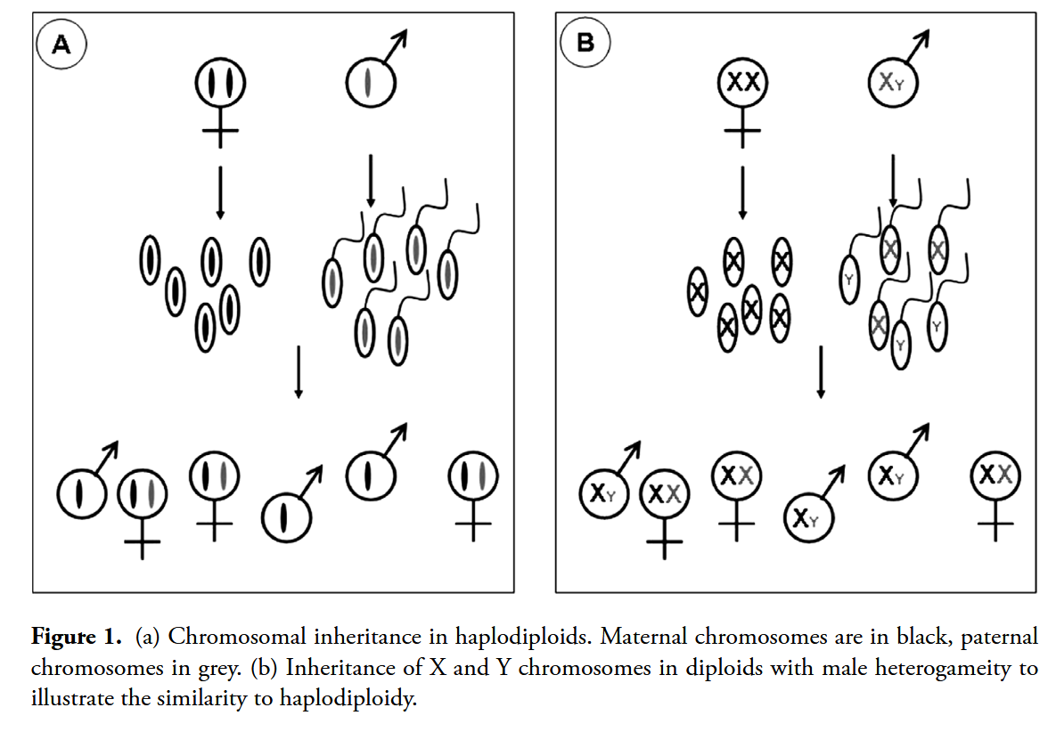
header
X chromosome and male eusocial insects
8
text
[9]
[9] Kraaijeveld, K. (2009). Male genes with nowhere to hide; sexual conflict in haplodiploids. Animal Biology, 59(4), 403–415. https://doi.org/10.1163/157075509X12499949744225

Slide 10
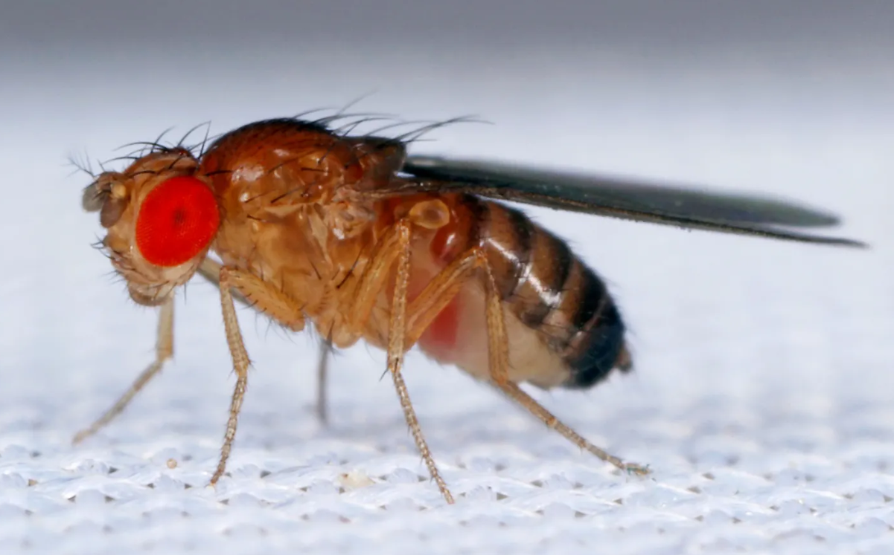
header
Methods
9
Drosophila Genetic Reference Panel (DGRP) genotypes ^{[10]}
text
Genotypes of 205 heavily inbred
(20 generations of sib matings) Drosophila melanogaster flies
Increased homozygosity may
expose masked deleterious
variants
[10] Mackay, T. F. C., Richards, S., Stone, E. A., Barbadilla, A., Ayroles, J. F., Zhu, D., Casillas, S., Han, Y., Magwire, M. M., Cridland, J. M., Richardson, M. F., Anholt, R. R. H., Barrón, M., Bess, C., Blankenburg, K. P., Carbone, M. A., Castellano, D., Chaboub, L., Duncan, L., … Gibbs, R. A. (2012). The Drosophila melanogaster Genetic Reference Panel. Nature, 482(7384), 173–178. https://doi.org/10.1038/nature10811

Slide 11
header
Methods
10
text
Drosophila genetic reference panel (DGRP) genotypes ^{[10]}
Identification of putatively deleterious variants
Via SnpEff ^{[11]}
Via GERP ^{[12]}
[10] Mackay, T. F. C., Richards, S., Stone, E. A., Barbadilla, A., Ayroles, J. F., Zhu, D., Casillas, S., Han, Y., Magwire, M. M., Cridland, J. M., Richardson, M. F., Anholt, R. R. H., Barrón, M., Bess, C., Blankenburg, K. P., Carbone, M. A., Castellano, D., Chaboub, L., Duncan, L., … Gibbs, R. A. (2012). The Drosophila melanogaster Genetic Reference Panel. Nature, 482(7384), 173–178. https://doi.org/10.1038/nature10811
[11] Cingolani, P., Platts, A., Wang, L. L., Coon, M., Nguyen, T., Wang, L., Land, S. J., Lu, X., & Ruden, D. M. (2012). A program for annotating and predicting the effects of single nucleotide polymorphisms, SnpEff. Fly, 6(2), 80–92. https://doi.org/10.4161/fly.19695
[12] Davydov, E. V., Goode, D. L., Sirota, M., Cooper, G. M., Sidow, A., & Batzoglou, S. (2010). Identifying a high fraction of the human genome to be under selective constraint using GERP++. PLoS Computational Biology, 6(12), e1001025. https://doi.org/10.1371/journal.pcbi.1001025
[10] Wong, H. W. S., & Holman, L. (2023). Pleiotropic fitness effects across sexes and ages in the Drosophila genome and transcriptome. Evolution, 77(12), 2642–2655. https://doi.org/10.1093/evolut/qpad163
[11] Bürkner, P.-C. (2017). brms: An R Package for Bayesian Multilevel Models Using Stan. Journal of Statistical Software, 80, 1–28. https://doi.org/10.18637/jss.v080.i01

Slide 12
header
Methods
10
text
Drosophila genetic reference panel (DGRP) genotypes ^{[10]}
Identification of putatively deleterious variants
Match with fitness essays ^{[13]}
Calculate genetic load
Via SnpEff ^{[11]}
Via GERP ^{[12]}
[10] Mackay, T. F. C., Richards, S., Stone, E. A., Barbadilla, A., Ayroles, J. F., Zhu, D., Casillas, S., Han, Y., Magwire, M. M., Cridland, J. M., Richardson, M. F., Anholt, R. R. H., Barrón, M., Bess, C., Blankenburg, K. P., Carbone, M. A., Castellano, D., Chaboub, L., Duncan, L., … Gibbs, R. A. (2012). The Drosophila melanogaster Genetic Reference Panel. Nature, 482(7384), 173–178. https://doi.org/10.1038/nature10811
[11] Cingolani, P., Platts, A., Wang, L. L., Coon, M., Nguyen, T., Wang, L., Land, S. J., Lu, X., & Ruden, D. M. (2012). A program for annotating and predicting the effects of single nucleotide polymorphisms, SnpEff. Fly, 6(2), 80–92. https://doi.org/10.4161/fly.19695
[12] Davydov, E. V., Goode, D. L., Sirota, M., Cooper, G. M., Sidow, A., & Batzoglou, S. (2010). Identifying a high fraction of the human genome to be under selective constraint using GERP++. PLoS Computational Biology, 6(12), e1001025. https://doi.org/10.1371/journal.pcbi.1001025
[13] Wong, H. W. S., & Holman, L. (2023). Pleiotropic fitness effects across sexes and ages in the Drosophila genome and transcriptome. Evolution, 77(12), 2642–2655. https://doi.org/10.1093/evolut/qpad163
[16] Bürkner, P.-C. (2017). brms: An R Package for Bayesian Multilevel Models Using Stan. Journal of Statistical Software, 80, 1–28. https://doi.org/10.18637/jss.v080.i01

Slide 13
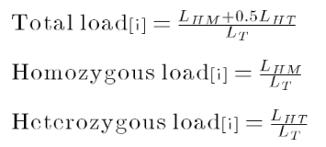
header
Calculation of genetic load ^{[14, 15]}
11
text
[14] Chen, R. S., Soulsbury, C. D., Hench, K., van Oers, K., & Hoffman, J. I. (2025). Predicted deleterious mutations reveal the genetic architecture of male reproductive success in a lekking bird. Nature Ecology & Evolution, 9(10), 1924–1937. https://doi.org/10.1038/s41559-025-02802-8
[15] Bertorelle, G., Raffini, F., Bosse, M., Bortoluzzi, C., Iannucci, A., Trucchi, E., Morales, H. E., & van Oosterhout, C. (2022). Genetic load: Genomic estimates and applications in non-model animals. Nature Reviews Genetics, 23(8), 492–503. https://doi.org/10.1038/s41576-022-00448-x

Slide 14
header
Methods
12
text
Drosophila genetic reference panel (DGRP) genotypes ^{[10]}
Identification of putatively deleterious variants
Match with fitness essays ^{[13]}
Calculate genetic load
Via SnpEff ^{[11]}
Via GERP ^{[12]}
Statistical evaluation ^{[16]}
Fitness ~
Genetic load * Sex * Chromosome type + DGRP line
[10] Mackay, T. F. C., Richards, S., Stone, E. A., Barbadilla, A., Ayroles, J. F., Zhu, D., Casillas, S., Han, Y., Magwire, M. M., Cridland, J. M., Richardson, M. F., Anholt, R. R. H., Barrón, M., Bess, C., Blankenburg, K. P., Carbone, M. A., Castellano, D., Chaboub, L., Duncan, L., … Gibbs, R. A. (2012). The Drosophila melanogaster Genetic Reference Panel. Nature, 482(7384), 173–178. https://doi.org/10.1038/nature10811
[11] Cingolani, P., Platts, A., Wang, L. L., Coon, M., Nguyen, T., Wang, L., Land, S. J., Lu, X., & Ruden, D. M. (2012). A program for annotating and predicting the effects of single nucleotide polymorphisms, SnpEff. Fly, 6(2), 80–92. https://doi.org/10.4161/fly.19695
[12] Davydov, E. V., Goode, D. L., Sirota, M., Cooper, G. M., Sidow, A., & Batzoglou, S. (2010). Identifying a high fraction of the human genome to be under selective constraint using GERP++. PLoS Computational Biology, 6(12), e1001025. https://doi.org/10.1371/journal.pcbi.1001025
[13] Wong, H. W. S., & Holman, L. (2023). Pleiotropic fitness effects across sexes and ages in the Drosophila genome and transcriptome. Evolution, 77(12), 2642–2655. https://doi.org/10.1093/evolut/qpad163
[16] Bürkner, P.-C. (2017). brms: An R Package for Bayesian Multilevel Models Using Stan. Journal of Statistical Software, 80, 1–28. https://doi.org/10.18637/jss.v080.i01

Slide 15
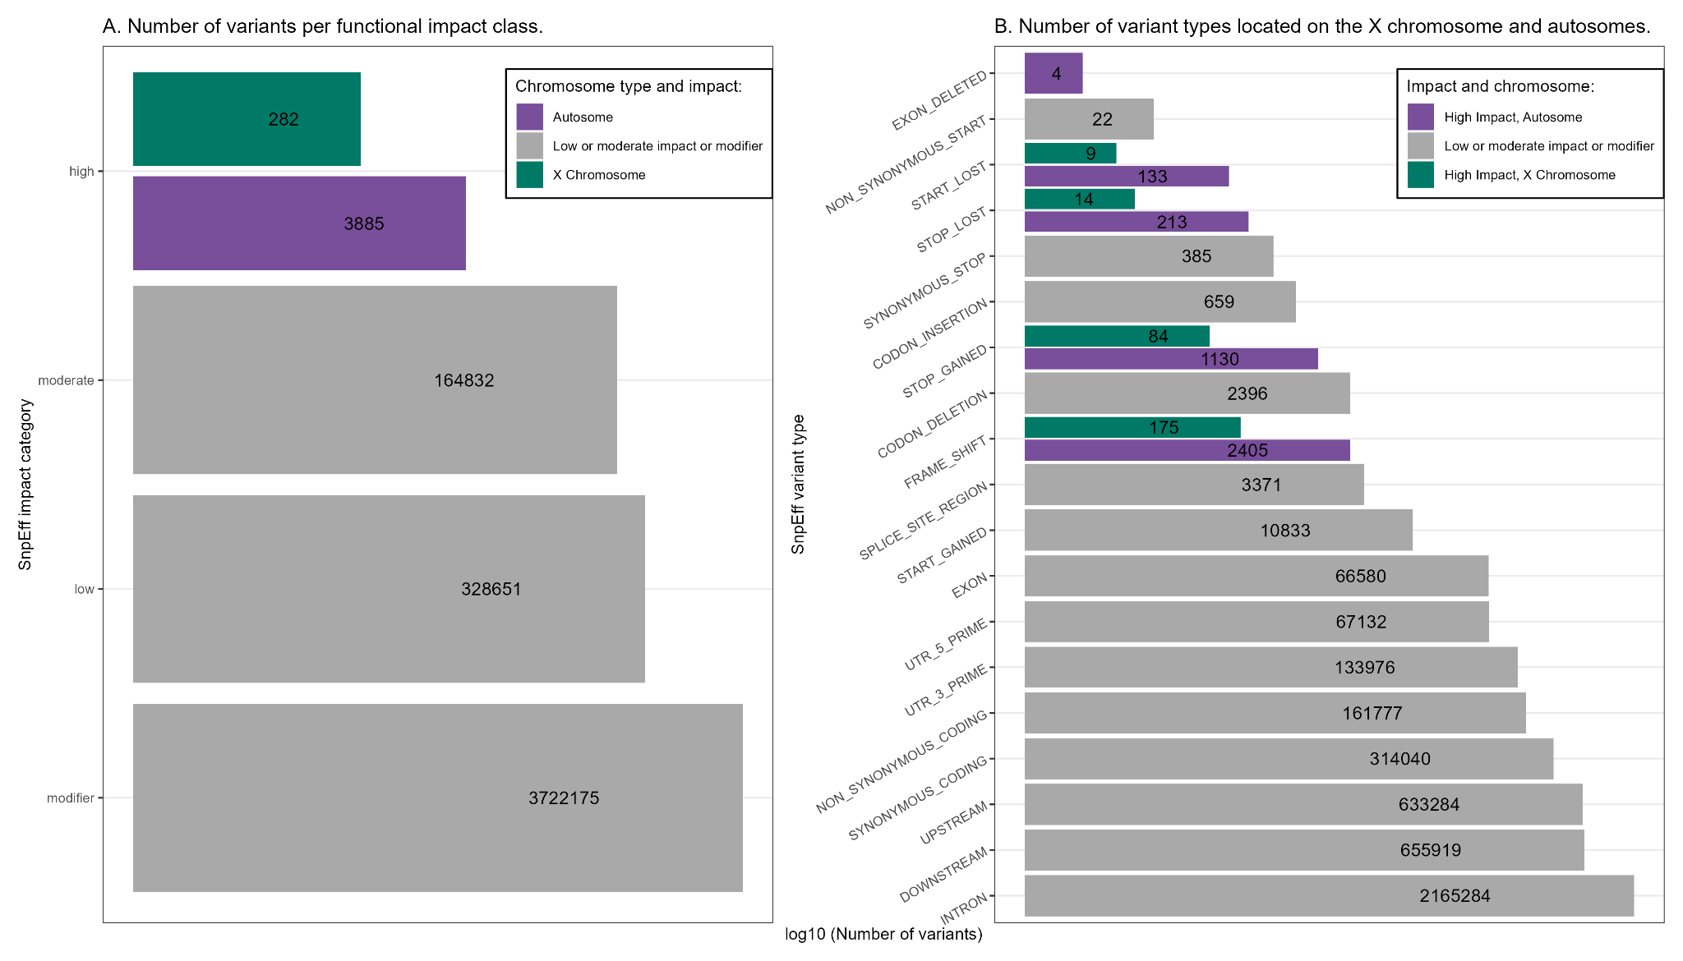
header
13
Putatively deleterious variants with high impact
13
text

Slide 16
header
Putatively deleterious variants with high impact
14
text
Across 4.219.825 variants:
282 X-linked putatively deleterious variants
3.885 autosomal
putatively deleterious
variants

Slide 17
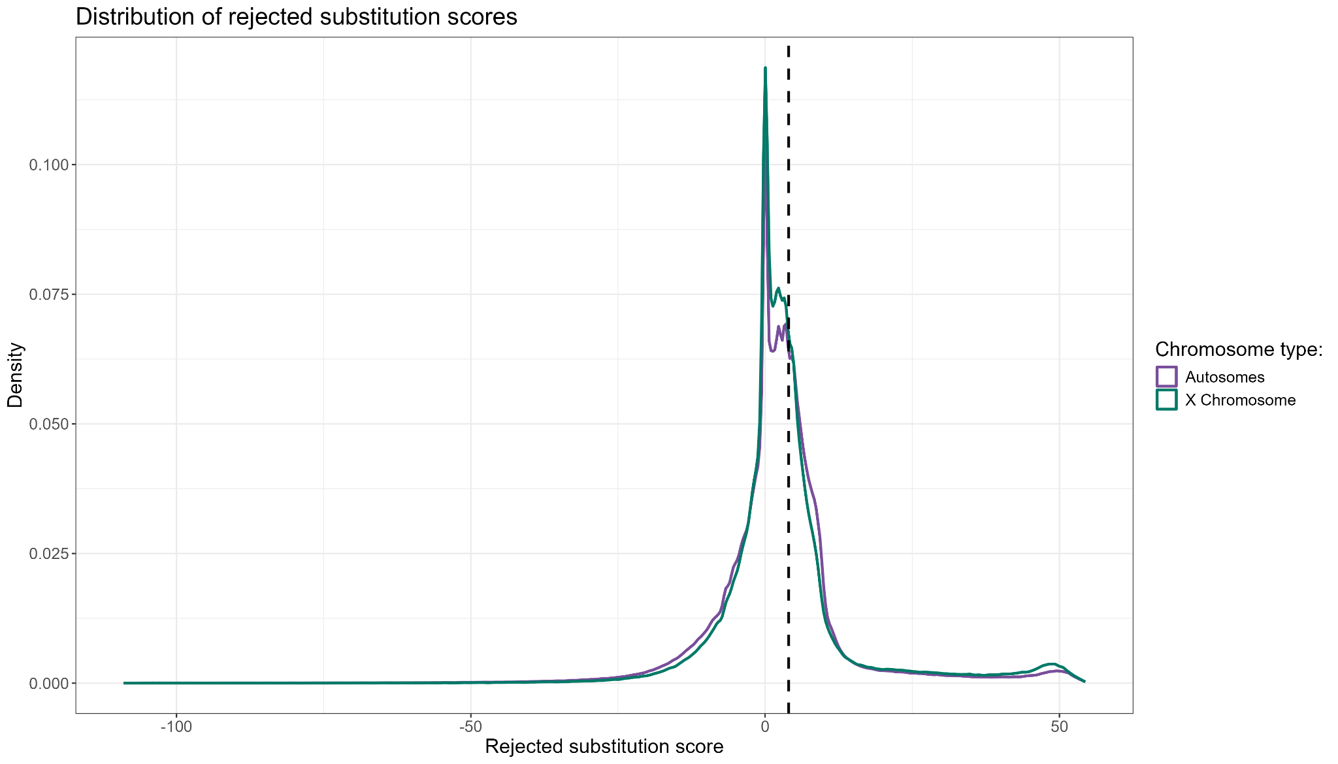
header
Evolutionary constraint across the genome
15
text

Slide 18

header
Evolutionary constraint across the genome
15
text
RS $≥$ 4 : putatively
deleterious variant ^{[14, 17]}
196.374 X-linked
putatively deleterious
variants
1.302.241 autosomal
putatively deleterious
variants
[14] Chen, R. S., Soulsbury, C. D., Hench, K., van Oers, K., & Hoffman, J. I. (2025). Predicted deleterious mutations reveal the genetic architecture of male reproductive success in a lekking bird. Nature Ecology & Evolution, 9(10), 1924–1937. https://doi.org/10.1038/s41559-025-02802-8
[17] Smeds, L., & Ellegren, H. (2023). From high masked to high realized genetic load in inbred Scandinavian wolves. Molecular Ecology, 32(7), 1567–1580. https://doi.org/10.1111/mec.16802

Slide 19
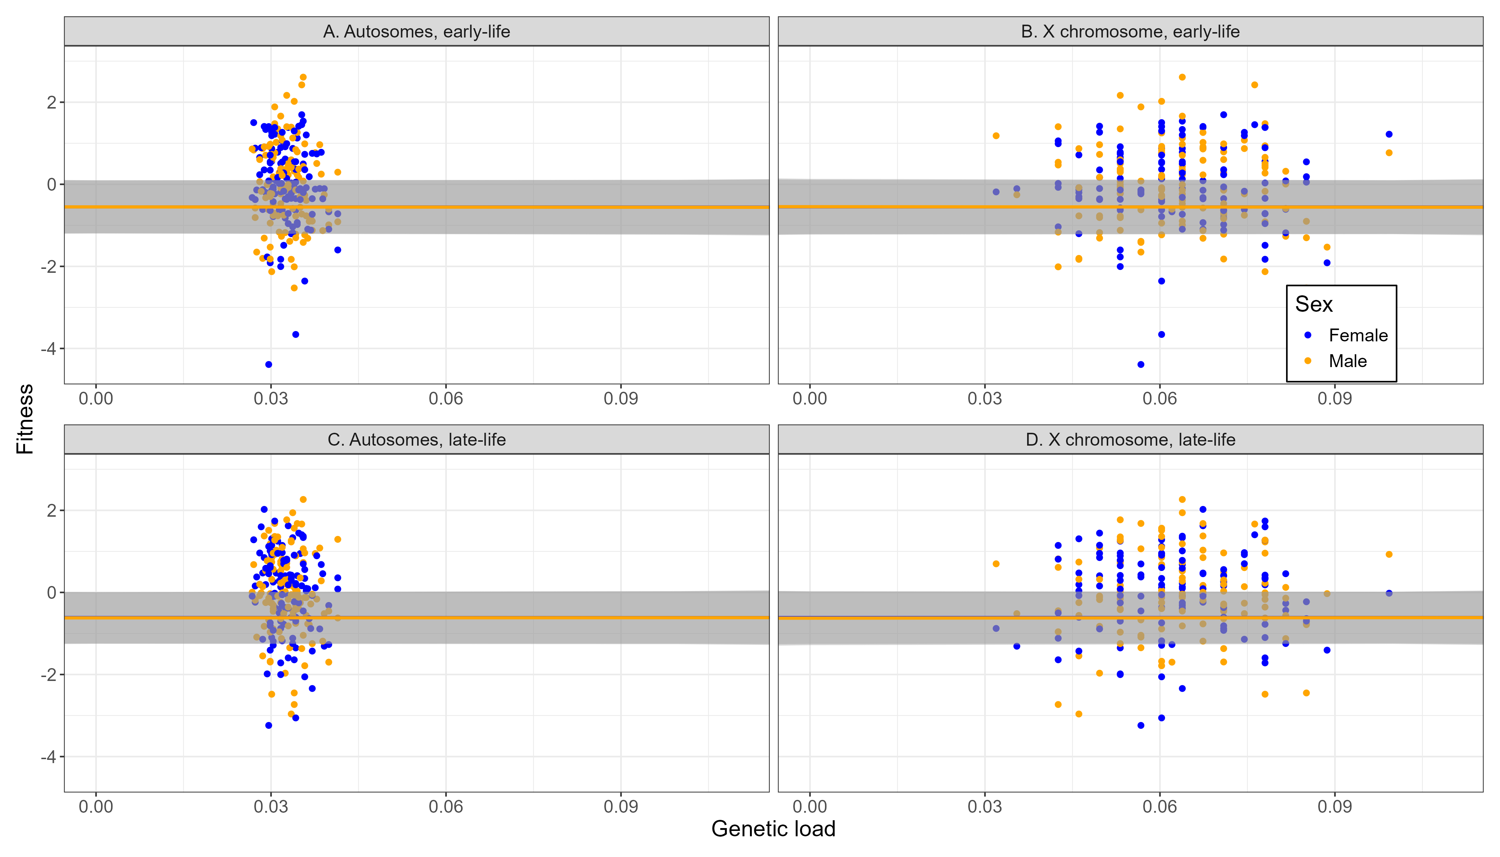
header
Relationship between genetic load and fitness
16
text
Range of values similar to previous studies ^{[13]}
No relationship between
genetic load and fitness
[10] Wong, H. W. S., & Holman, L. (2023). Pleiotropic fitness effects across sexes and ages in the Drosophila genome and transcriptome. Evolution, 77(12), 2642–2655. https://doi.org/10.1093/evolut/qpad163

Slide 20
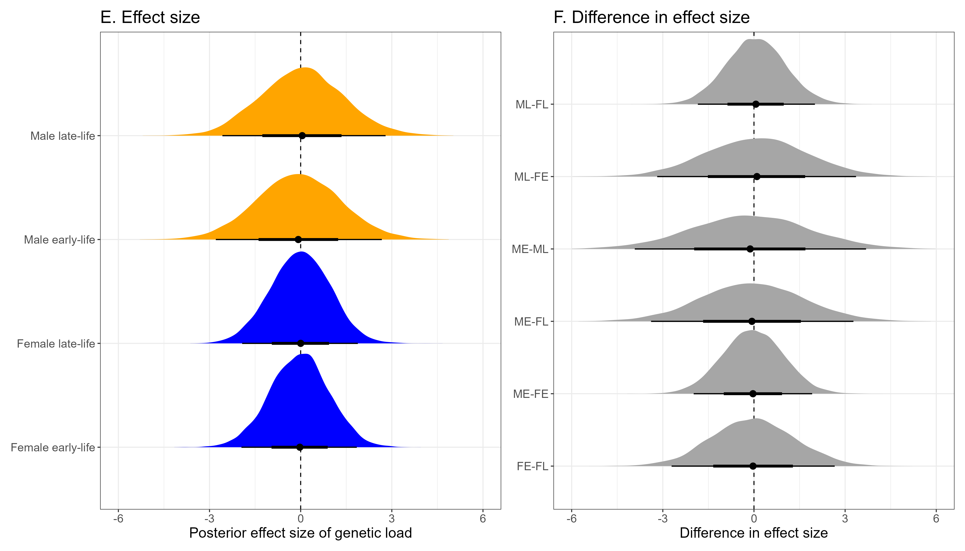
header
Differences in effect size between sexes and life-stages
17
text
No effect of antagonistic pleiotropy in aging ^{[18, 19]}
[18] Williams, G. C. (1957). Pleiotropy, Natural Selection, and the Evolution of Senescence. Evolution, 11(4), 398–411. https://doi.org/10.1111/j.1558-5646.1957.tb02911.x
[19] Austad, S. N., & Hoffman, J. M. (2018). Is antagonistic pleiotropy ubiquitous in aging biology? Evolution, Medicine, and Public Health, 2018(1), 287–294. https://doi.org/10.1093/emph/eoy033

Slide 21
header
Discussion – Genetic purging
18
text
The findings did not match the expectations based on theory – but we can try to explain them

Slide 22
header
Discussion – Genetic purging
19
1) Genetic purging
text
Inbreeding depression because of the exposure of deleterious recessives and loss of genetic variability
Trade-off
Removal of deleterious sites from population after exposure to selection (genetic purging) ^{[20, 21, 22, 23]}
[20] Crnokrak, P., & Barrett, S. C. H. (2002). PERSPECTIVE: PURGING THE GENETIC LOAD: A REVIEW OF THE EXPERIMENTAL EVIDENCE. Evolution, 56(12), 2347–2358. https://doi.org/10.1111/j.0014-3820.2002.tb00160.x
[21] García-Dorado, A. (2012). Understanding and Predicting the Fitness Decline of Shrunk Populations: Inbreeding, Purging, Mutation, and Standard Selection. Genetics, 190(4), 1461–1476. https://doi.org/10.1534/genetics.111.135541
[22] Khan, A., Patel, K., Shukla, H., Viswanathan, A., van der Valk, T., Borthakur, U., Nigam, P., Zachariah, A., Jhala, Y. V., Kardos, M., & Ramakrishnan, U. (2021). Genomic evidence for inbreeding depression and purging of deleterious genetic variation in Indian tigers. Proceedings of the National Academy of Sciences, 118(49), e2023018118. https://doi.org/10.1073/pnas.2023018118
[23] Kleinman-Ruiz, D., Lucena-Perez, M., Villanueva, B., Fernández, J., Saveljev, A. P., Ratkiewicz, M., Schmidt, K., Galtier, N., García-Dorado, A., & Godoy, J. A. (2022). Purging of deleterious burden in the endangered Iberian lynx. Proceedings of the National Academy of Sciences, 119(11), e2110614119. https://doi.org/10.1073/pnas.2110614119

Slide 23
header
Discussion – Genetic purging
20
1) Genetic purging
text
Inbreeding depression because of the exposure of deleterious recessives and loss of genetic variability
Trade-off
Removal of deleterious sites from population after exposure to selection (genetic purging) ^{[20, 21, 22, 23]}
Purging effects are stronger the more
lethal the mutations are ^{[24]}
Half of the inbreeding depression for
viability in Drosophila is caused by
recessive lethals ^{[25, 26]}
20 generations of inbreeding may have cleansed the DGRP
lines from (highly) deleterious variants
[24] Hedrick, P. W., & Garcia-Dorado, A. (2016). Understanding Inbreeding Depression, Purging, and Genetic Rescue. Trends in Ecology & Evolution, 31(12), 940–952. https://doi.org/10.1016/j.tree.2016.09.005
[25] Hedrick, P. W. (1994). Purging inbreeding depression and the probability of extinction: Full-sib mating. Heredity, 73(4), 363–372. https://doi.org/10.1038/hdy.1994.183
[26] Simmons, M. J., & Crow, J. F. (1977). MUTATIONS AFFECTING FITNESS IN DROSOPHILA POPULATIONS. Annual Review of Genetics, 11(Volume 11, 1977), 49–78. https://doi.org/10.1146/annurev.ge.11.120177.000405

Slide 24
header
Discussion – Conservative estimates
21
1) Genetic purging
text
2) Conservative approach
Fitness and genotypes can be only measured in living flies – lethal mutations are not represented ^{[10]}
Fitness was measured in flies which survived both early and late life ^{[13]} – the most deleterious mutations are not represented either
[13] Wong, H. W. S., & Holman, L. (2023). Pleiotropic fitness effects across sexes and ages in the Drosophila genome and transcriptome. Evolution, 77(12), 2642–2655. https://doi.org/10.1093/evolut/qpad163

Slide 25
header
Discussion – Demasculinised X
22
1) Genetic purging
The Drosphila X chromosome lacks
male-beneficial genes ^{[23, 24, 25]}
text
2) Conservative approach
3) Demasculinised X chromosome
Effective population size,
dominant alleles
Sex-biased gene expression effects,
e.g., silencing of the X chromosome
during spermatogenesis
The Drosophila X chromosome seems to be an unhospitable
location for male-beneficial loci
[27] Gurbich, T. A., & Bachtrog, D. (2008). Gene content evolution on the X chromosome. Current Opinion in Genetics & Development, Genomes and evolution, 18(6), 493–498. https://doi.org/10.1016/j.gde.2008.09.006
[28] Parisi, M., Nuttall, R., Naiman, D., Bouffard, G., Malley, J., Andrews, J., Eastman, S., & Oliver, B. (2003). Paucity of Genes on the Drosophila X Chromosome Showing Male-Biased Expression. Science (New York, N.Y.), 299(5607), 697–700. https://doi.org/10.1126/science.1079190
[29] Sturgill, D., Zhang, Y., Parisi, M., & Oliver, B. (2007). Demasculinization of X chromosomes in the Drosophila genus. Nature, 450(7167), 238–241. https://doi.org/10.1038/nature06330

Slide 26
header
Discussion – Techninal limitations
23
1) Genetic purging
Obtaining and filtering genotypes with both filtering criteria (impact and constraint)
text
2) Conservative approach
3) Demasculinised X chromosome
Calculating genetic loads for the X chromosome and autosomes
4) Technical limitations
Only possible to match genetic load with DGRP line, not with each sex, chromosome type and life stage
Apart from biological reasons, the results can be traced back
to technical limitations in data structure

Slide 27
header
Outlook
24
text
We did not create the expected results, possibly due to biological and technical limitations, however:

Slide 28
header
Outlook
25
Provide basis for future research:
text
Freely accessible and reproducible methods
Encouragement to re-visit this question in the future
Applicable to lab populations but also necessary to assess the fitness of wild populations ^{[13, 14, 15, 17, 30]}
[13] Wong, H. W. S., & Holman, L. (2023). Pleiotropic fitness effects across sexes and ages in the Drosophila genome and transcriptome. Evolution, 77(12), 2642–2655. https://doi.org/10.1093/evolut/qpad163
[14] Chen, R. S., Soulsbury, C. D., Hench, K., van Oers, K., & Hoffman, J. I. (2025). Predicted deleterious mutations reveal the genetic architecture of male reproductive success in a lekking bird. Nature Ecology & Evolution, 9(10), 1924–1937. https://doi.org/10.1038/s41559-025-02802-8
[15] Bertorelle, G., Raffini, F., Bosse, M., Bortoluzzi, C., Iannucci, A., Trucchi, E., Morales, H. E., & van Oosterhout, C. (2022). Genetic load: Genomic estimates and applications in non-model animals. Nature Reviews Genetics, 23(8), 492–503. https://doi.org/10.1038/s41576-022-00448-x
[17] Smeds, L., & Ellegren, H. (2023). From high masked to high realized genetic load in inbred Scandinavian wolves. Molecular Ecology, 32(7), 1567–1580. https://doi.org/10.1111/mec.16802
[30] Singh, A., Hasan, A., & Agrawal, A. F. (2023). An investigation of the sex-specific genetic architecture of fitness in Drosophila melanogaster. Evolution, 77(9), 2015–2028. https://doi.org/10.1093/evolut/qpad107

Slide 29
header
text
Some closing remarks

Slide 31
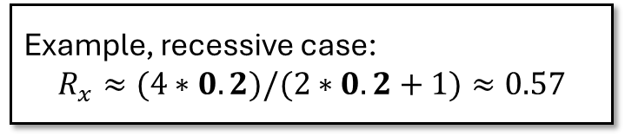
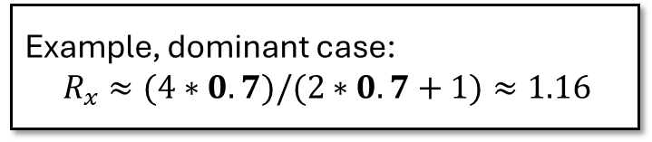
header
Charlesworth et al, 1987 – Beneficial mutations ^{[4]}
3
text
Example, dominant case:
${ R}_{x} ≈(4∗0.7)/(2∗0.7+1)≈1.16$
Example, recessive case:
$$R_{x}≈(4∗0.2)/(2∗0.2+1)≈0.57$$
In both sexes, recessiveness supports the fixation of new
beneficial alleles on the X chromosome (faster-X theory)
[4] Charlesworth, B., Coyne, J. A., & Barton, N. H. (1987). The Relative Rates of Evolution of Sex Chromosomes and Autosomes. The American Naturalist, 130(1), 113–146.

Slide 32
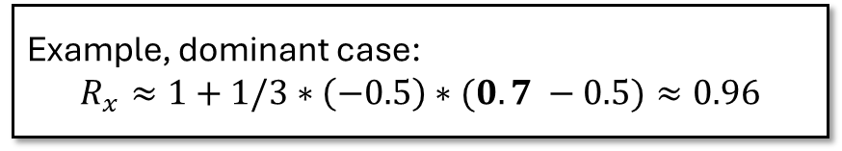

header
Charlesworth et al, 1987 – Deleterious mutations ^{[4]}
4
text
Example, dominant case:
$$R_{x}≈1+1/3∗\left(−0.5\right)∗(0.7 −0.5)≈0.96$$
Example, recessive case:
$$R_{x}≈1+1/3∗\left(−0.5\right)∗(0.2 −0.5)≈1.05$$
When selection acts on both sexes or males only, recessiveness
impedes the fixation of new deleterious alleles on the X chromosome
[4] Charlesworth, B., Coyne, J. A., & Barton, N. H. (1987). The Relative Rates of Evolution of Sex Chromosomes and Autosomes. The American Naturalist, 130(1), 113–146.

Slide 33
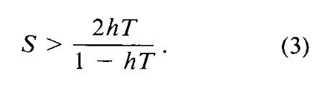
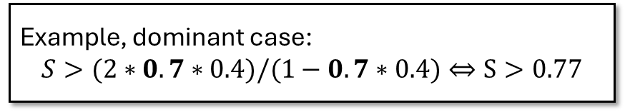
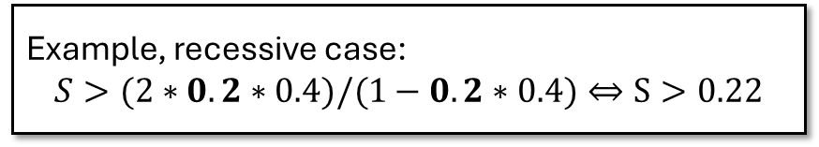
header
Rice, 1984 – Antagonistic mutations ^{[5]}
5
text
Example, dominant case:
$$S>(2∗0.7∗0.4)/(1−0.7∗0.4)⇔S>0.77$$
Example, recessive case:
$$S>(2∗0.2∗0.4)/(1−0.2∗0.4)⇔S>0.22$$
As long as an invading X-linked allele is recessive enough, the fitness
increase in males outweighs the fitness decrease in females
[5] Rice, W. R. (1984). Sex Chromosomes and the Evolution of Sexual Dimorphism. Evolution, 38(4), 735–742. https://doi.org/10.1111/j.1558-5646.1984.tb00346.x

Slide 34
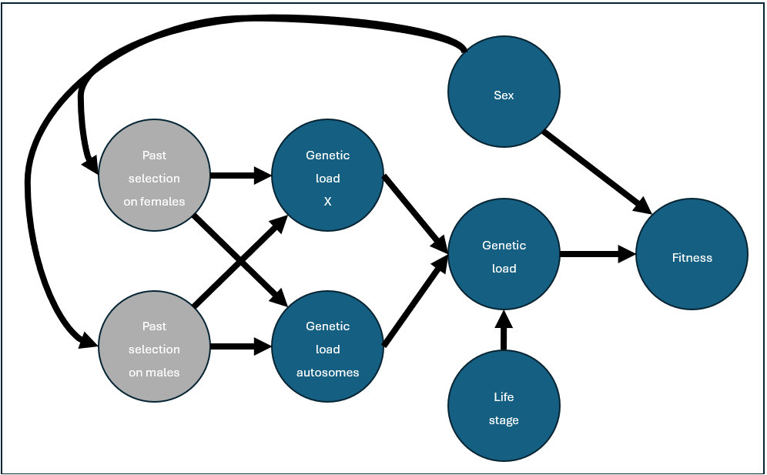
header
Model visualisation
13
text

Slide 35
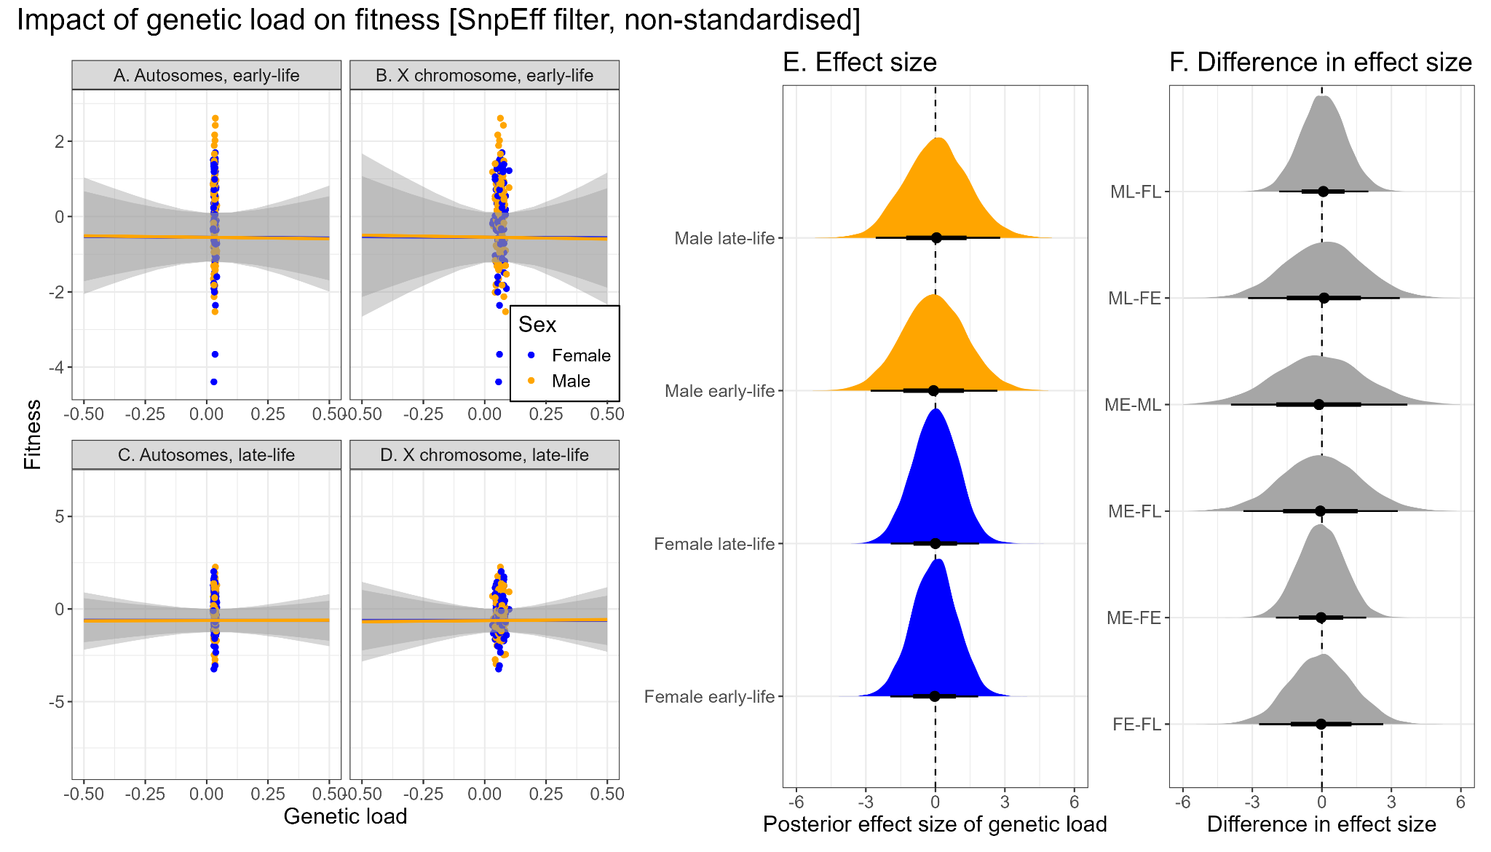
header
Putatively deleterious variants with high impact
12
text

Slide 36
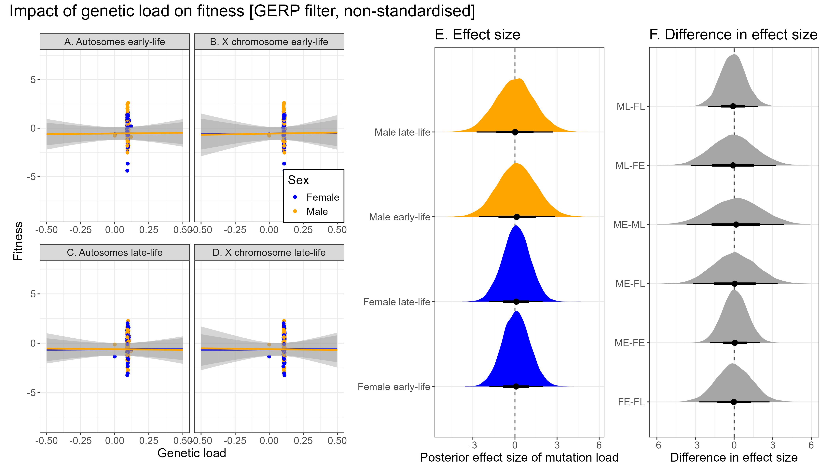

Slide 37
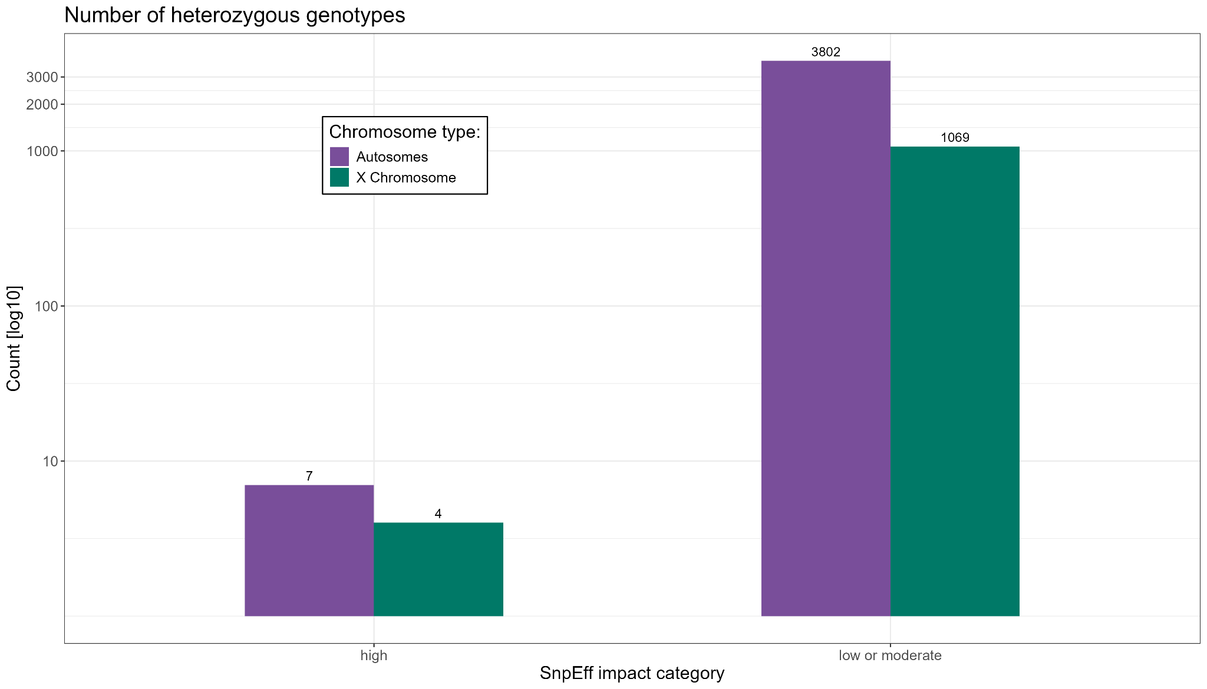
header
Discussion – Genetic purging
18
text
Across > four million sites roughly 5.000 heterozygous sites
Only 11 heterozygous sites located on the X chromosome

Slide 38
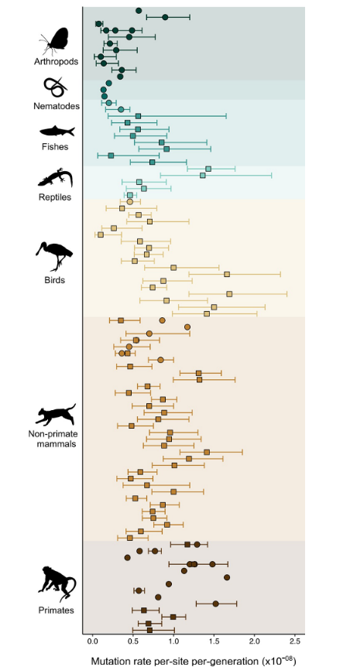
header
Mutation rates ^{[1]}
1
text
[1] Popovic, I., Bergeron, L. A., Bozec, Y.-M., Waldvogel, A.-M., Howitt, S. M., Damjanovic, K., Patel, F., Cabrera, M. G., Wörheide, G., Uthicke, S., & Riginos, C. (2024). High germline mutation rates, but not extreme population outbreaks, influence genetic diversity in a keystone coral predator. PLoS Genetics, 20(2), e1011129. https://doi.org/10.1371/journal.pgen.1011129

