Slide 1
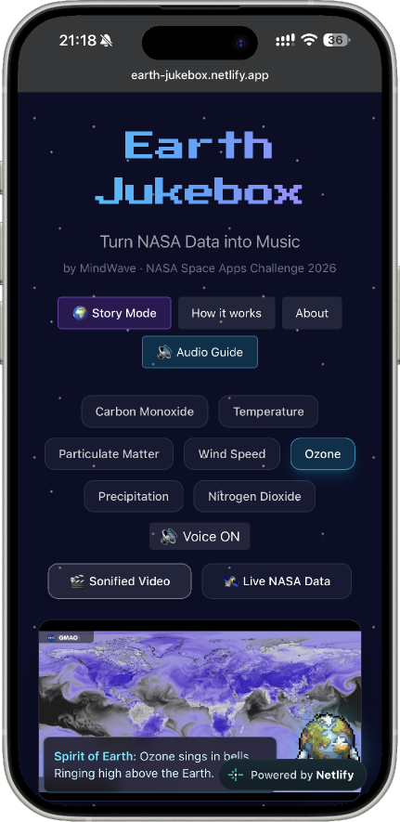
Earth Jukebox / MindWave
EARTH JUKEBOX
TURNING NASA EARTH OBSERVATION DATA INTO MUSIC
MINDWAVE · NASA SPACE APPS CHALLENGE
→ GITHUB ←
→ MVP ←

Slide 2
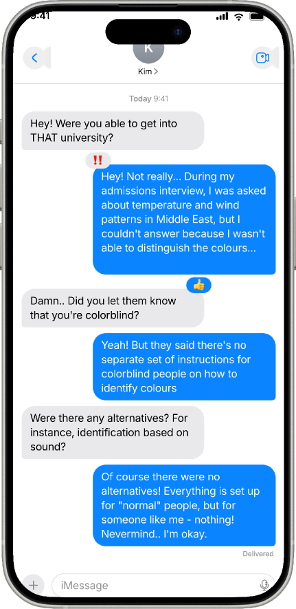
Earth Jukebox / MindWave
PROBLEM & SOLUTION
Problem: Climate Data Beyond Sight
More than 300 million blind or visually impaired people worldwide are unable to see complex heat maps and graphs from NASA
People with dyslexia, colorblind people, auditory learners, and children also struggle to process dense visual content
Solution: Transform the colours in satellite imagery into musical instruments.
Keywords: Word 01, Word 02, Word 03

Slide 3







Earth Jukebox / MindWave
HOW IT WORKS (CORE IDEA)
Each colour is the Visual Tool
The user hears “heavy bass” - which means that in the atmosphere there is a high concentration of carbon monoxide
Blue → Cello
Purple → Synth
White → Bells
Red → Bass
Orange → Piano
Yellow → Strings
Green → Flute

Slide 4




Earth Jukebox / MindWave
ACCESSIBLE BY DESIGN. USEFUL FOR EVERYONE
Blind and visually impaired individuals: sound serves as their primary channel for perception
People with dyslexia: sound bypasses the challenges associated with reading text
Auditory learners: they retain information better when they hear it
Children: music makes abstract scientific concepts concrete and engaging

Slide 5
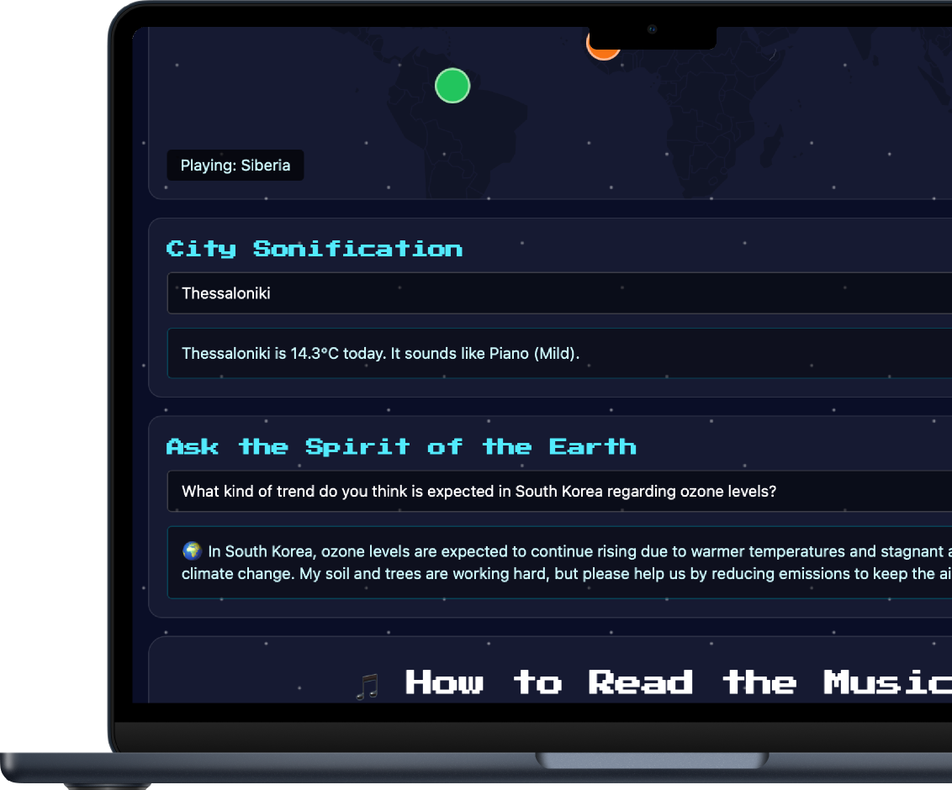
Earth Jukebox / MindWave
MORE THAN JUST A VIDEO — AN INTERACTIVE PLATFORM
Features:
Sonified Videos (seven NASA datasets) 🎵
Instrument Mixer: isolate the sound of a specific colour 🎛️
Audio Guide: voice-guided navigation and descriptions 🗣️
Ask the Earth (AI Chatbot): get answers to your questions from the perspective of the "Spirit of the Earth" (powered by the Gemini API) 🤖
Guess the Instrument: an educational mini-game 🎮

Slide 6








Earth Jukebox / MindWave
TECHNOLOGY STACK
FRONTEND
BACKEND
AI & PIPELINE
React 18 Vite Tailwind CSS 4 Framer Motion Recharts React-Leaflet
Google Gemini API (Fallback on 3 models) Python (OpenCV for colour analysis, music21, FluidSynth, FFmpeg) - offline
Node.js
Netlify Functions (serverless)

Slide 7
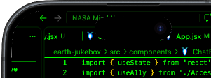
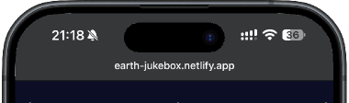

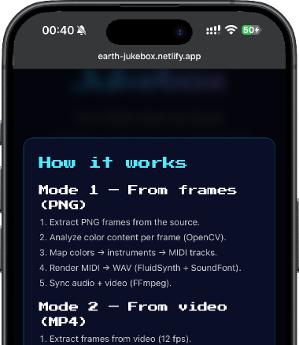
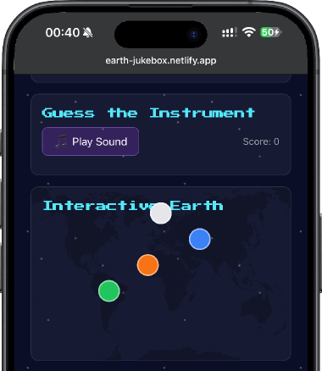

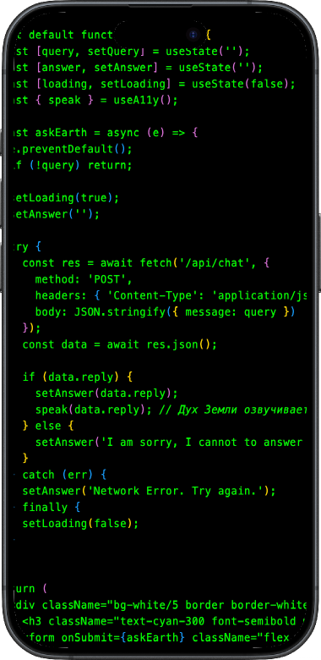
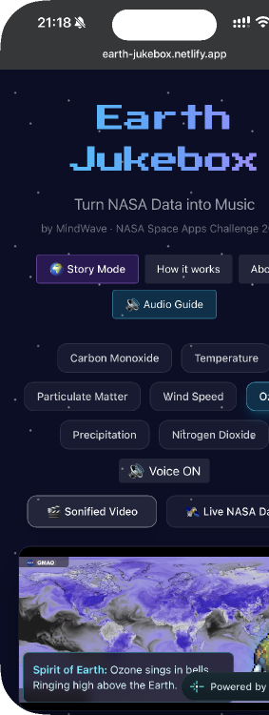
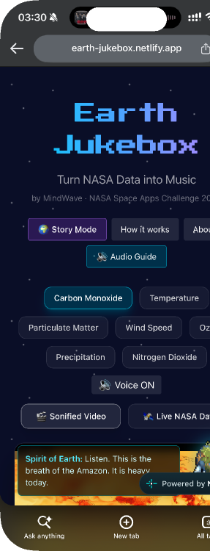


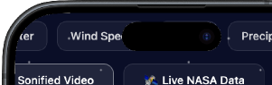



Slide 8
Earth Jukebox / MindWave
Data Pipeline (How the music is born)
Take a video or image from gmao.gsfc.nasa.gov - either as a downloaded file or via a source link (API/JSON)
Perform an offline analysis of the video to precisely determine the proportion of each colour
A script analyses every pixel in each frame and calculate the percentage breakdown of colours
Next, a Python script generates a MIDI file, with each colour assigned to its own separate track
FluidSynth converts the MIDI data into audio
FFmpeg then merges the audio with the video
VIDEO
OPENCV (HSV-ANALYS)
% COLOURS
MUSIC21
FLUIDSYNTH
FFMPEG
Notes:
What's on the radar?

Slide 9
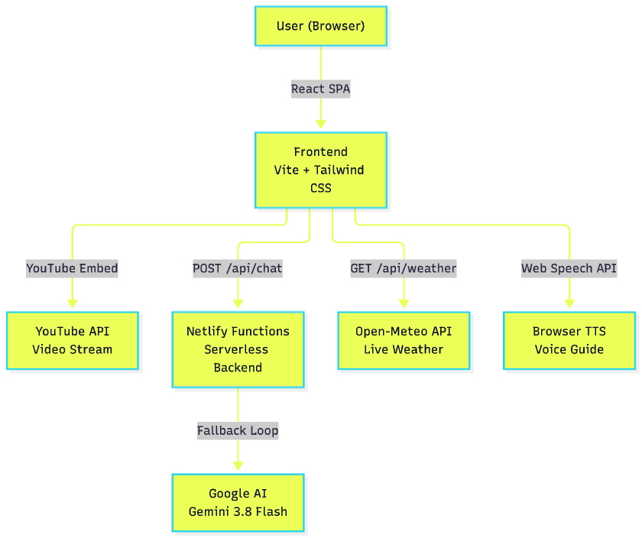
Earth Jukebox / MindWave
SOLUTION ARCHITECTURE. MVP TRANSPARENCY
•
Also includes integration with Open-Meteo and the Web Speech API.
•
Real-time color analysis is not possible for YouTube (due to CORS) — this design choice was made to efficiently handle large volumes of data.
•
We use static percentages calculated offline (these are accurate, verified data points).
•
The instrument mixer currently only works for local video files.
•
The NASA GIBS WMS service is occasionally blocked in certain regions.
Note: We are transparent about these limitations in the README

Slide 10





Earth Jukebox / MindWave
SCALING. 5-YEAR PLAN
Year 1: Integration of all NASA GMAO data; support for tactile (Braille) displays.
Year 5: Open standard for scientific sonification.
Year 3: AI-adaptive soundscapes (using ML models).
Year 2: Real-time synthesis via the Web Audio API.
Year 4: Educational portal and API for schools.

Slide 11

Earth Jukebox / MindWave
EARTH JUKEBOX
VERSION: 1.0.0
SITE →
TEAM:
MINDWAVE
WINTER SOFIA-LUNA (FULLSTACK)
→ GITHUB ←

